Slide 1
An Adaptive Communication Architecture for
Wireless Sensor Networks
Adam Dunkels, Fredrik Österlind, Zhitao He
ACM SenSys 2007

Slide 2
Executive Summary
Increasing diversity: applications, protocols, low-level mechanisms
Systems need to be redeveloped for every platform
  No socket layer, no IP
Chameleon/Rime: an “IP and sockets” for sensornets
  Set of communication primitives
  Separates protocol logic from protocol headers
Results: good expressiveness, low overhead

Slide 3
Increasing heterogeneity
Network/transport/application/…
Network
reprogramming
Reliable
multi-hop
bulk transfer
End-to-end
reliable
unicast
routing
Hop-by-hop
reliable
data
collection
Single-packet
reliable data
dissemination
Best-effort
unicast
multi-hop
routing
Best-effort
network
flooding
Scoped
flooding
Link
quality
estimation
Neighbor
discovery
ZigBee
MAC
Z-MAC
Crankshaft
X-MAC
B-MAC
SCP
S-MAC
6lowpan
802.15.4
Link
TR1001
nRFxx
CC2420
CC1100

Slide 4
What are good base abstractions?
Is single-hop best-effort broadcast enough?
  Should applications do all the hard work themselves?
  Do we provide a complete set of communication modules?
    For every possible situation?
Can we find a set of communication primitives?
How do we map onto the low-level mechanisms?
  … that are increasingly diverse
Where is the narrow waist?

Slide 5
Prior work
[HotOS 2005] Towards a Sensor Network Architecture: Lowering the Waistline. Culler, Dutta, Cheng, Fonseca, Hui, Levis, Zhao.
[SenSys 2005] A unifying link abstraction for wireless sensor networks. Polastre, Hui, Levis, Zhao, Culler, Shenker, Stoica.
[OSDI 2006] A modular network layer for sensornets. Cheng, Fonseca, Kim, Moon, Tavakoli, Culler, Shenker, Stoica.

Slide 6
SP [SenSys 2005]
Application 1
Application 2
Base abstraction: single-hop best-effort broadcast
Do not define any protocol headers
  Applications control headers
Packet parameters and link feedback as meta-data
  Transmission time, link quality, time of arrival, …
SP
B-MAC
802.15.4

Slide 7
Modular Network Layer [OSDI 2006]
Application 1
Application 2
Decomposition of multi-hop routing protocols
Each module defines its own protocol header
  Strictly layered sub-headers
Sits on top of SP
MNL
FE
RE
RT
SP
B-MAC
802.15.4

Slide 8
Remaining challenges
Finding a common header format
  SP: leave to the applications
  MNL: sub-headers make it difficult
Making use of low-level mechanisms
  Unicast and broadcasts treated differently
  Link-level retransmission

Slide 9
Chameleon / Rime
Rime: a set of communication primitives
  Lightweight layering: primitives built in terms of each other
  More complex abstractions easy to build
Chameleon: separate communication logic from protocol headers
  Header construction/parsing done separate from communication stack

Slide 10
Chameleon / Rime
Application 1
Application data
All packet attributes
Application 2
Application 3
Data dissemination
protocol
Deal with communication here
Application data
Unicast routing protocol
Data collection protocol
Application data
All packet attributes
Rime
Application data
Packet attributes
Application data
All packet attributes
Application data
More packet attributes
Chameleon
Packets (header + data)
Some packet attributes
Confine bit-level headaches here
Packets (header + data)
802.15.4
IP
Bit-packet header
…

Slide 11
Packet attributes
Abstract representation of packet header information and low-level meta-data
  Sender, receiver, packet ID, time to live, number of hops, number of retransmissions, reliable flag, …
  Link quality estimate, time of arrival, …
MAC protocol decisions based on attributes
  Broadcast and unicast different
  Make use of link-layer ACKs, retransmissions

Slide 12
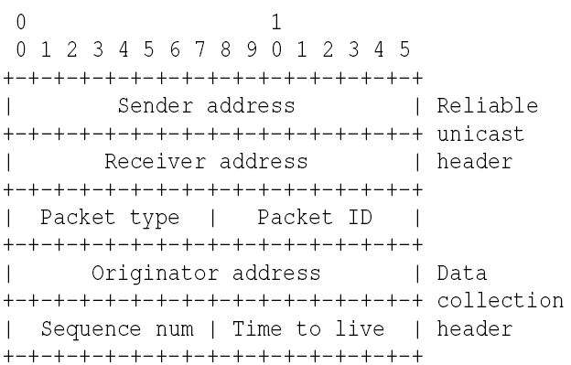
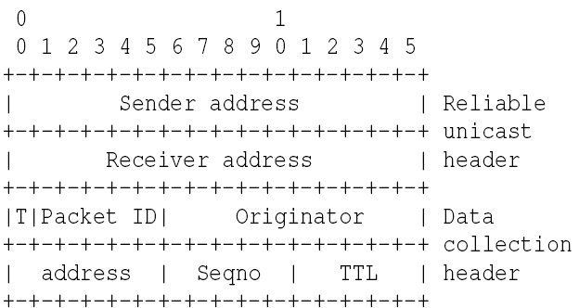
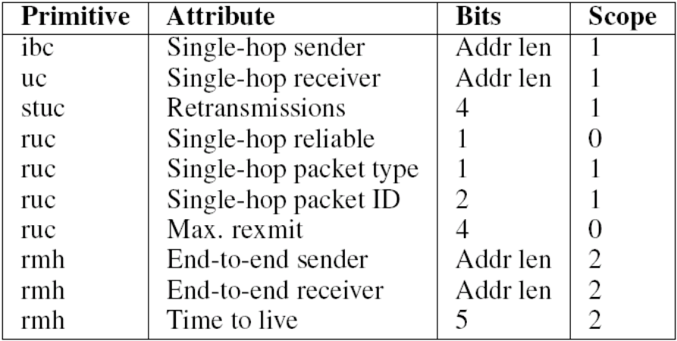
Turning packet attributes into generic headers
Network byte ordering
Cross-layer bit-packing

Slide 13
Turning packet attributes into specific headers
Extract packet attributes that match header fields
Use generic header construction for remaining packet attributes
May need to implement protocol logic
  E.g. ARP for IP header module

Slide 14
Rime primitives
Anonymous best-effort local broadcast (abc)
Identified best-effort local broadcast (ibc)
Best-effort local unicast (uc)
Stubborn local unicast (stuc)
Reliable local unicast (ruc)
Polite anonymous local broadcast (polite)
Polite identified local broadcast (ipolite)
Best-effort multi-hop unicast (mh)
Hop-by-hop reliable multi-hop unicast (rmh)
Best-effort multi-hop broadcast (nf)

Slide 15
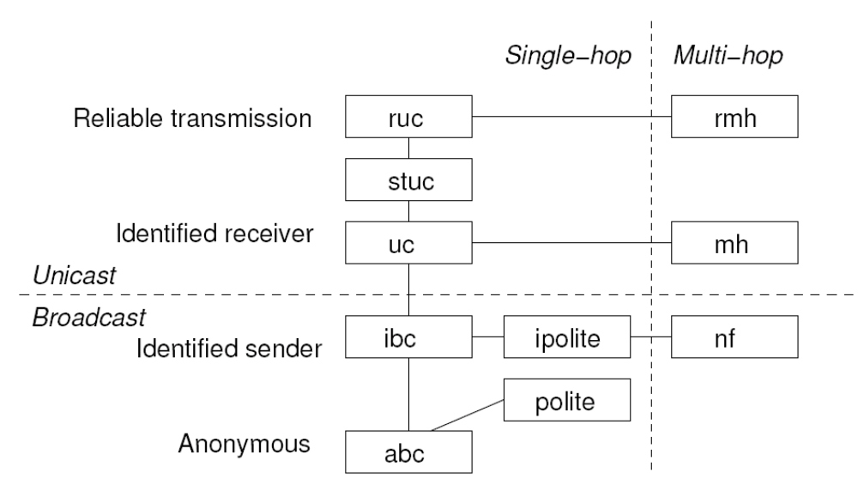
Rime stack

Slide 16
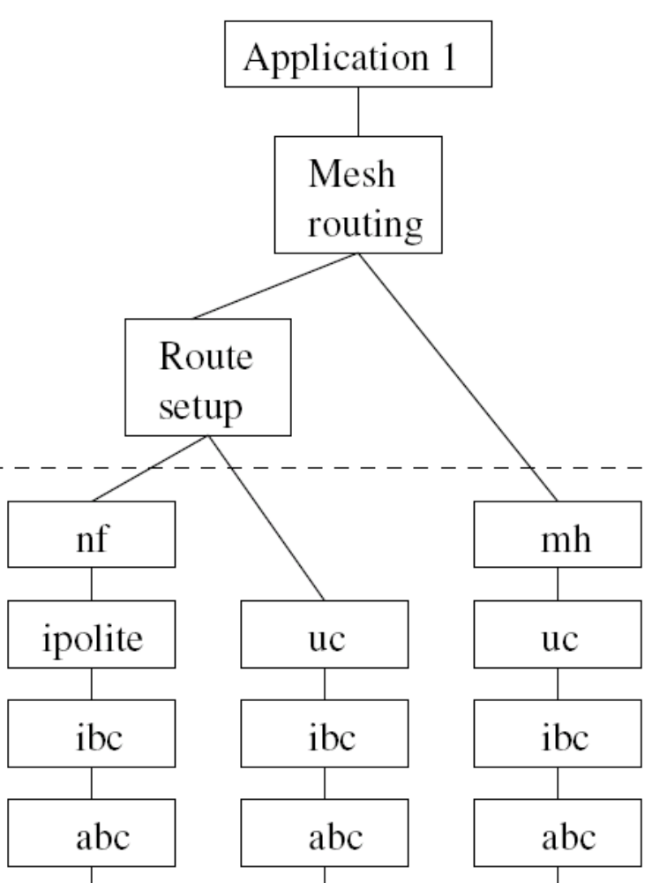
Implementing protocols on top of Rime
Data collection
  Neighbor advisement (stuc)
  Hop-by-hop reliable multihop (rmh)
Data dissemination
  Network flooding (nf)
  Identified polite broadcasts (ipolite)
Unicast routing
  Network flooding (nf)
  Best-effort singlehop unicast (uc)
  Best-effort multihop (mh)

Slide 17
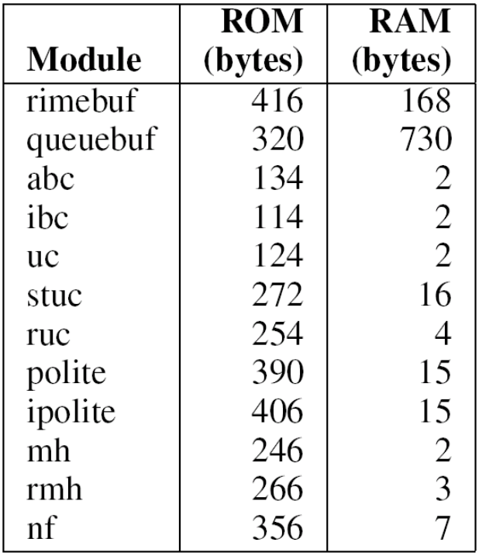
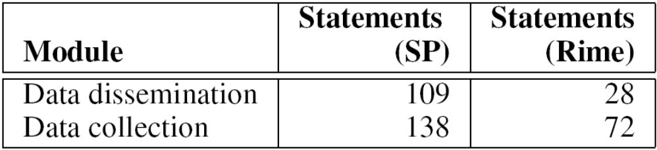
Complexity of protocol implementations
Rime primitives simple
  uc 57 lines of code
  ruc 128 lines of code
  rmh 91 lines of code
Protocols shorter than comparative code in TinyOS (with SP)
  Rough indication

Slide 18
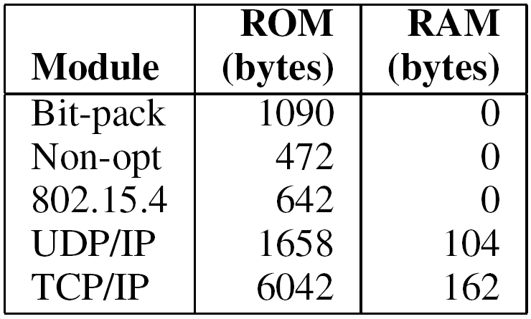
Complexity of header transformation modules low
UDP/IP includes ARP
TCP/IP includes uIP

Slide 19
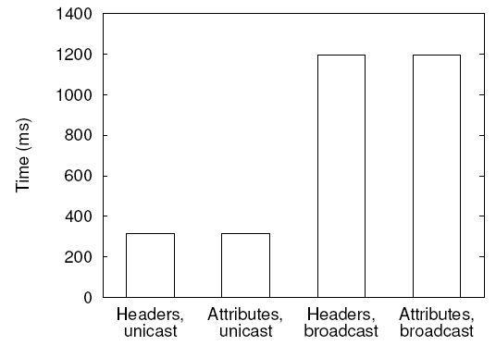
No visible increase in rtt

Slide 20
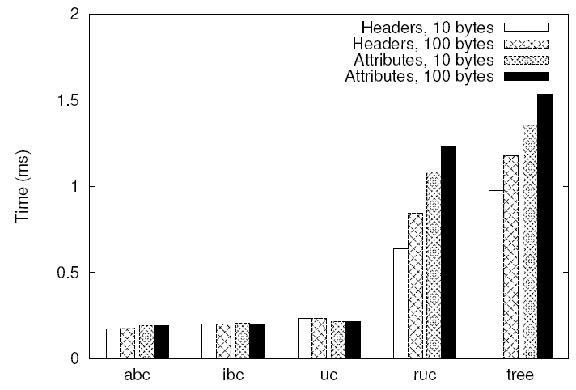
No or low execution time overhead
Need to copy attributes when queuing
Attributes slightly faster

Slide 21
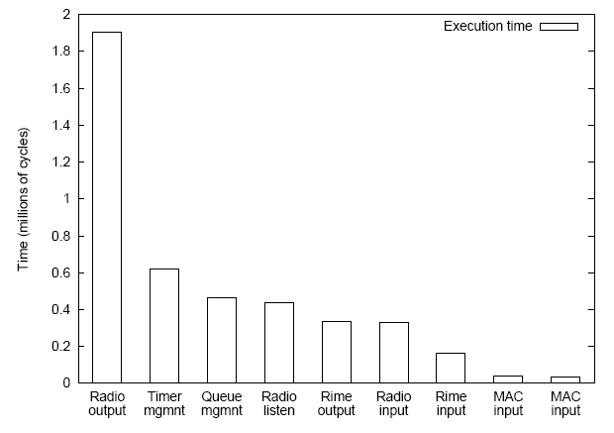
Execution time of the stack is comparatively small anyway
Transferring packets to CC2420

Slide 22
Conclusions
Lightweight set of communication primitives
  Layering reduces complexity
  Narrow waist around single-hop broadcast
Decoupling of protocol logic and protocol headers
  Enable cross-layer bit-packed headers, headers conforming to specific formats
Availability
  Rime: part of Contiki 2.0
  Chameleon: to be part of Contiki 2.1

Slide 23
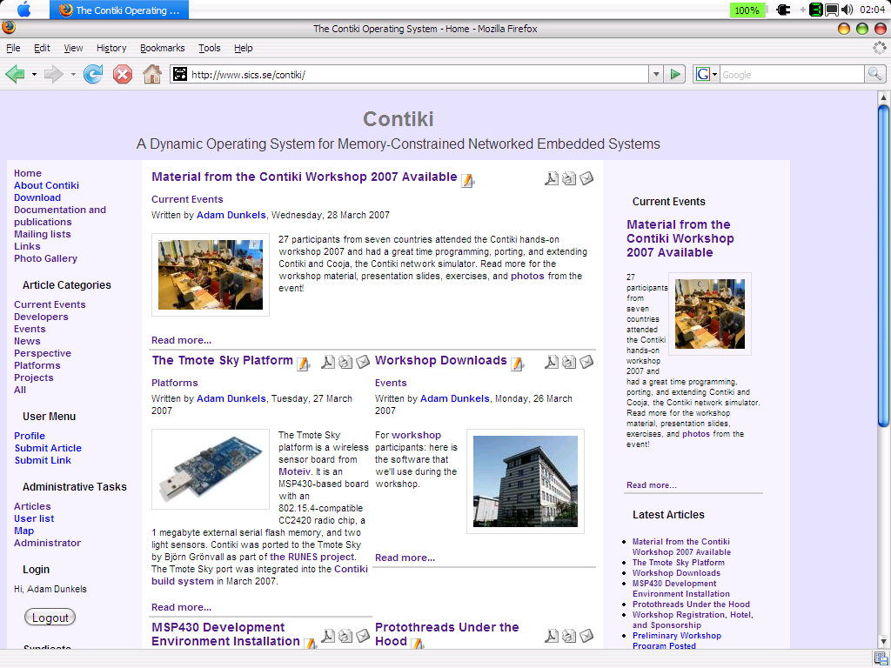
Thank you
  http://www.sics.se/contiki/

Slide 24
One protocol over different radios
Application protocol header
Simple data-collection
  Local (single-hop) source address
  Final (multi-hop) destimation address
  Original (multi-hop) sender address
Local source
Final destination
Original sender

Slide 25
One protocol over a raw byte-level radio
Byte-level radio (cc1100)
No extra headers added
Local source
Final destination
Original sender

Slide 26
One protocol over two mechanisms
Byte-level radio (cc1100)
802.15.4 radio (cc2420)
Local source
Length
FC0
Final destination
FC1
Seqno
Original sender
PAN ID
Destination address
Sender address
Local source
Final destination
Original sender

Slide 27
One protocol over three mechanisms
Byte-level radio (cc1100)
802.15.4 radio (cc2420)
IP over 802.15.4
Local source
Length
FC0
802.15.4 header
Final destination
FC1
Seqno
802.15.4 src address
Original sender
PAN ID
IP hdr (compressed)
Destination address
IP src address
Sender address
IP dest address
Local source
Local source
Final destination
Final destination
Original sender
Original sender

