Slide 1
You-t-360
Your youtube eye

Slide 2


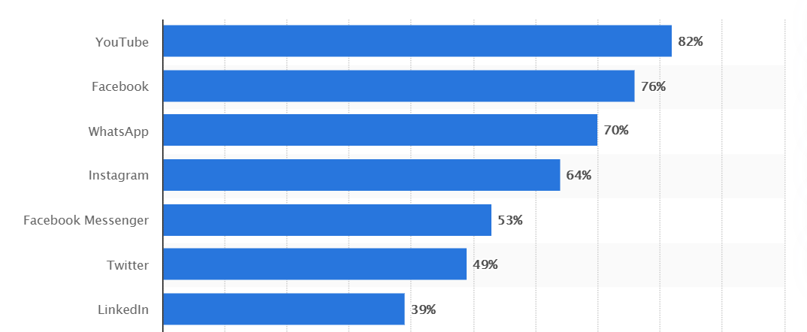
54.58%
Social network penetration in india in 2021
YouTube
265000000+ YouTube Users in INDIA
1700+ YouTube Channels with 1M+ Subscription in INDIA
70% of viewership coming from the age group 18-34
Most interactive Commenting Platform

Slide 3
Optimizing your political penetration
It’s insanely easy to improve your content ROI
Experience Humanized data platform for your political video.
Let’s know if this actually reached to the target audience.
The Only dedicated youtube end-to-end platform able to segment users by sentiment analysis from individual atomic level what matter for you.
Turns a red-flag emotional loss for you through the platform.
Easy to pin point, how and what audience is thinking about your opposition.
Find out the sentiment for the entire channel for you and for your opposition in a minute.
360 degree sentiment analysis on comments made in any language from millions of videos.

Slide 4
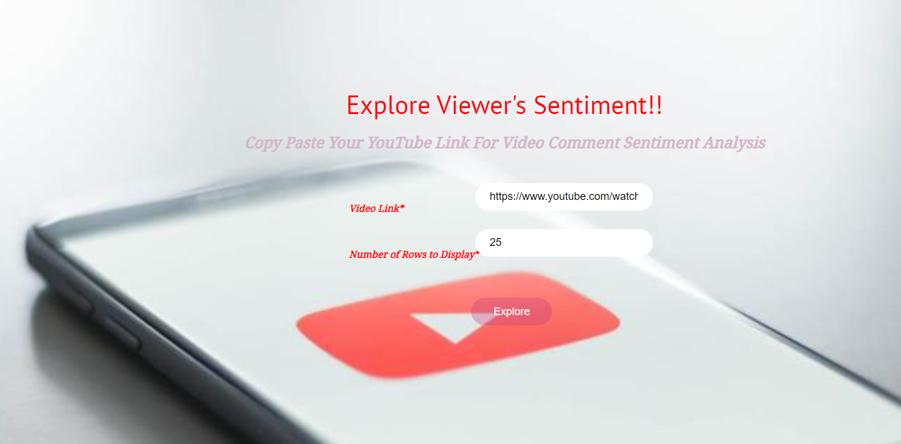
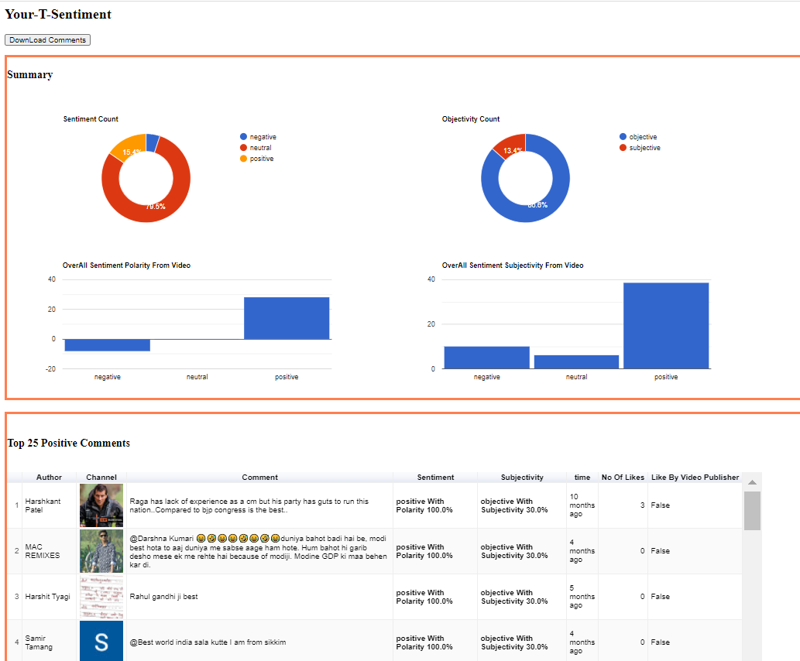
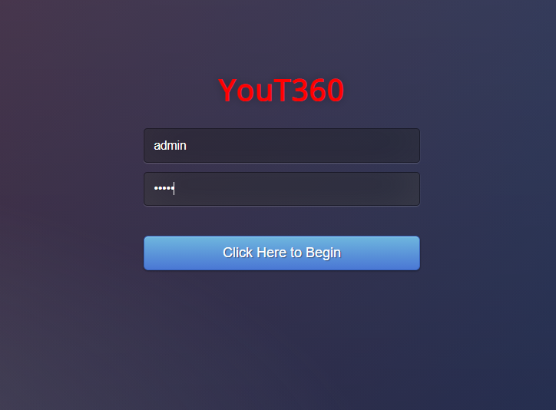
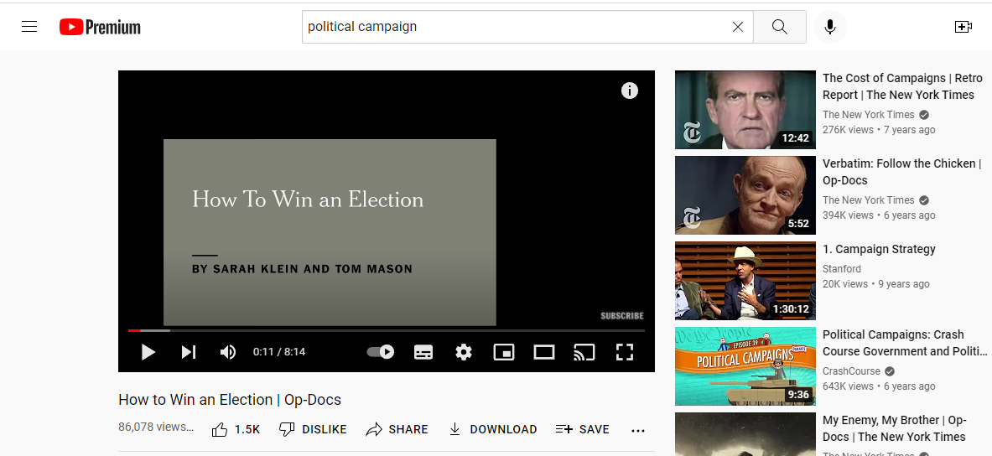
See what is not seen in your political campaign
One Click And See all the Insights

Slide 5
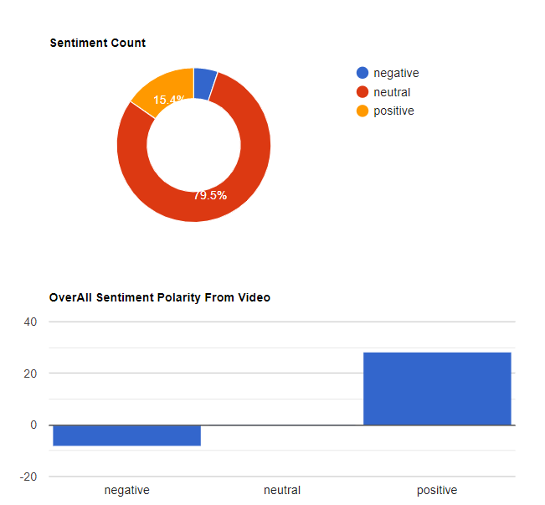
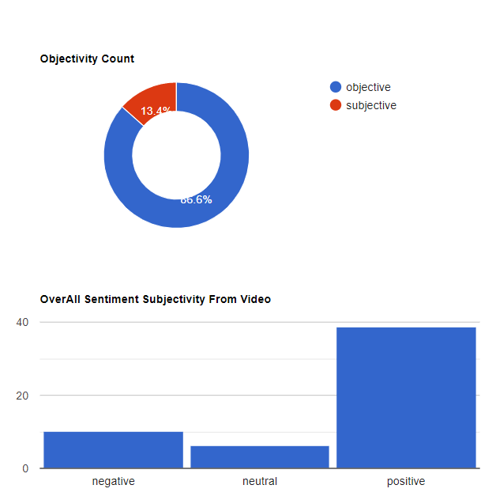
Deep insight…… <https://www.youtube.com/watch?v=JHqKKuUXX8s>
Comment Sentiment Summary:
Overall sentiment on the video on total comments
Overall Objectivity analysis on the video comments

Slide 6
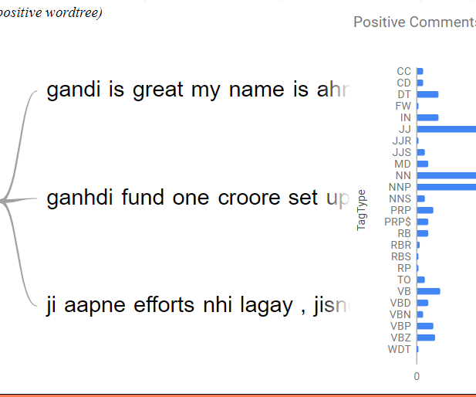
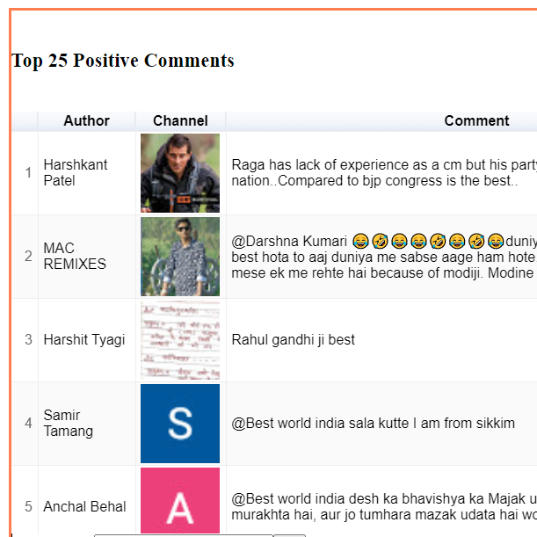
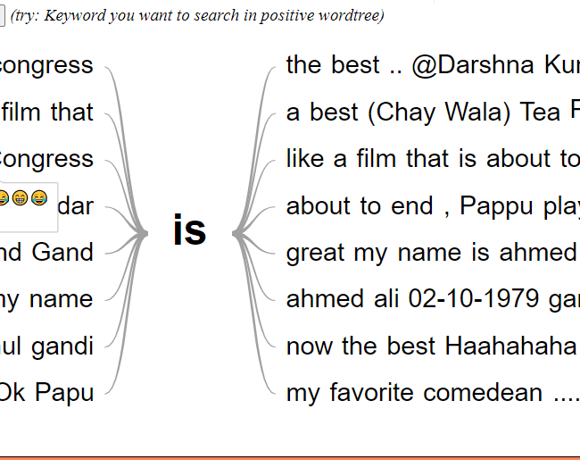
Deep insight positive sentiments
Check the positive comments analyzed by AI and NLP on comments made on any local languages and its impact , based on the number which you provide.
Click on the Channel to explore more on the users, who commented on you and decide real time impacts.
Positive interactive word tree to explore the wording in comments to understand Human sentiment on the video. Sentiment Vector Count on each section using Natural Language Processing.

Slide 7
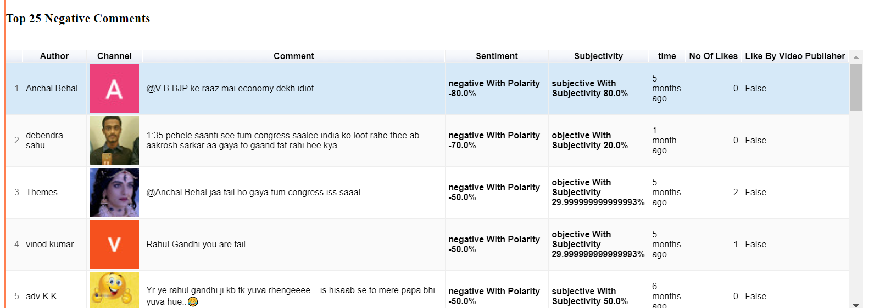
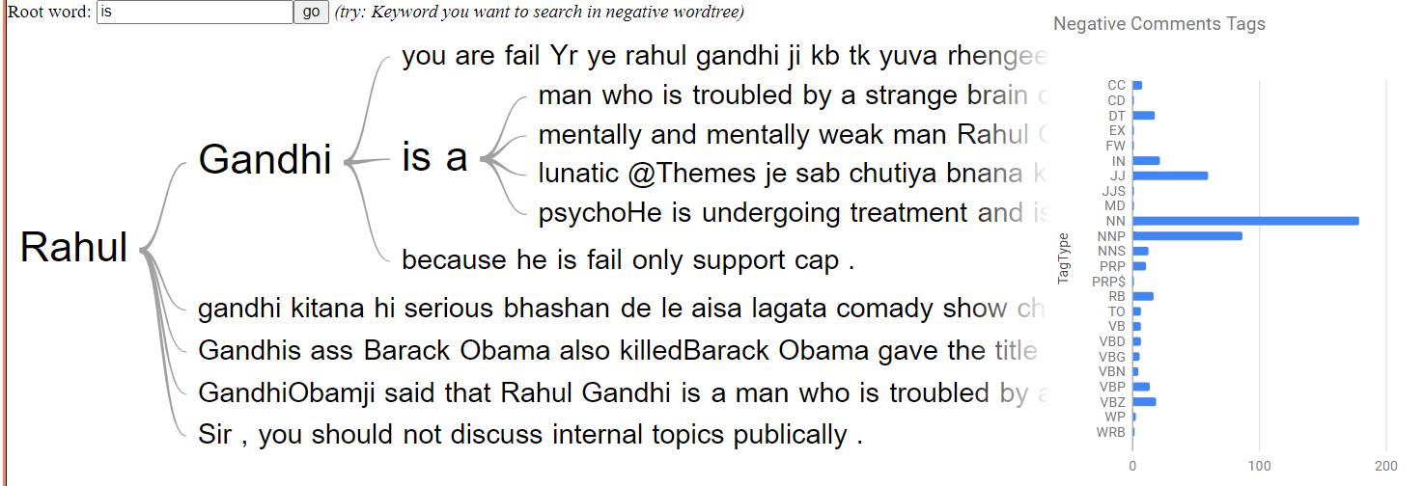
Negative in any language….
You can see and explore any negative comments.
What are the comments impact and polarity.
How many more people liked those comments.
Capable of detecting sentiment on the comments made on any language.
Explore the Haters my one click.
Interactive Word Tree to explore the Negativity on the comment section on video views.
Analysis on the sentiment by means of tagging in the comments.

Slide 8

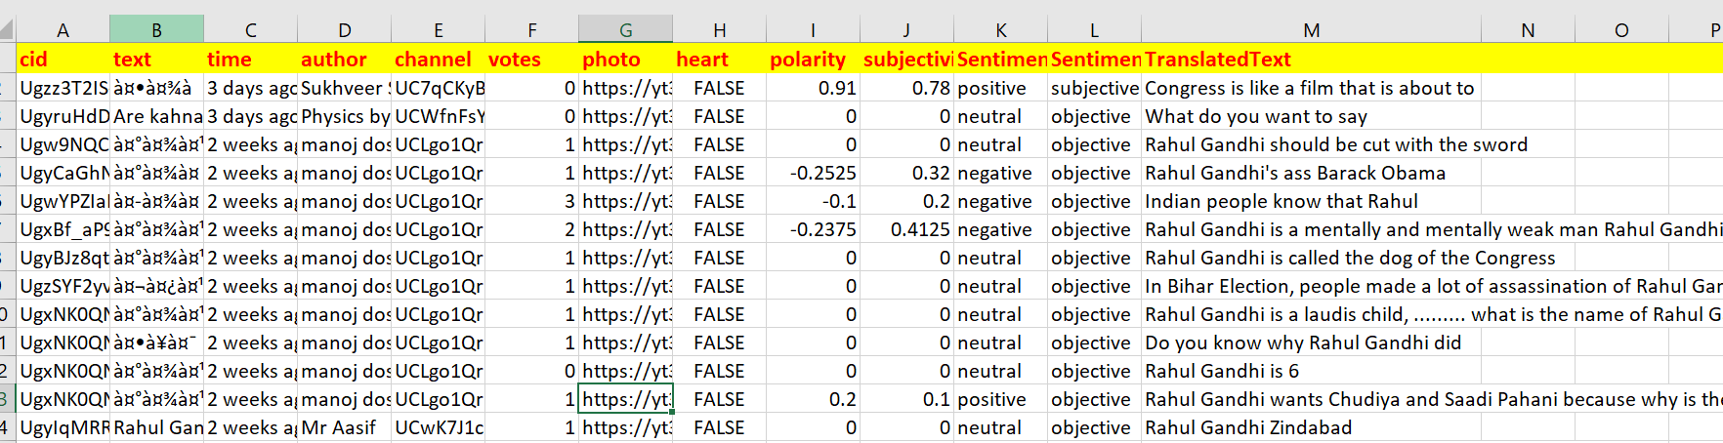
You can see it all…
When you download the report from dashboard… you can see the details from your comfortable worksheet……
Data Never leaves your browser.
Easy and plugin and play, with security being highest priority.
You can analyse for the entire channel comment you want, in few moments.

Slide 9
Last but not least .. You-t-360
One single step to know what your viewers think on your video over the platform in minutes.
Detail analysis on who said what , are you been targeted by someone ?
How authentic your audience is
How your Haters are organized to demine you
Instantly analyse for the comment user details over the platform, from which channel they came from , what is there intension
Let you know if you are being target my any paid and fake or spammer.
Help you to improve your content, brand and image
Get ready to experience modern AI technology to enhance your horizon in moments

Slide 10
About …..
We are team of young people who are data enthlasis and AI application builder from non political background working in IT MNC, Our Vision is to improve and bride the gap between common people and technology and using technology build a superior Nation.
We are always there and ready to help you … Hope you will give us a chance to serve the nation through you.
HOPE SEE YOU SOON ………………

