Slide 1

ECE 521: Embedded ML
Edge AI lab & TinyML
Running AI models at the edge — from MPUs to microelectronics
Prepared by: Kirolos Mina Supervised by: Dr. Rami Zewail

Slide 2
Overview
Edge AI refers to running AI and ML models directly on local hardware devices (like smartphones, smart cameras, or appliances) rather than in a remote cloud data center.
TinyML is a specialized subset of Edge AI. It focuses on shrinking these AI models so they can run on ultra-small, low power microelectronics.
This offers three major benefits:
✦ zero latency
✦ enhanced privacy
✦ offline functionality

Slide 3
Edge AI Software Tools for Different Devices
Texas instrument is a pioneering company in EdgeAI field, and has its own software tools within its ecosystem, the tools are as follows:
1- CCStudio Edge AI Studio
✦ Uses: it unifies data collection, model training, performance analysis and deployment. It handles everything from simple visual steps to complex command-line processes.
✦ Key components: model composer and model analyzer
✦ Model composer: script-based tool used to collect and annotate data, train neural networks and compile models directly for target devices.
✦ Model analyzer: cloud-based service that allows developers to benchmark deep learning models on remote development boards in minutes, displaying metrics like FPS and memory usage

Slide 4
Edge AI Software Tools — TIDL & Model Zoo
2- TI deep learning (TIDL) tools
✦ Uses: It allows developers to run machine learning models directly on specialized on-chip accelerators (such as digital signal processor or a deep learning matrix accelerator)
✦ Run-time-support: provides off-the-shelf support for industry-standard frameworks like ONNX and TensorFlow lite.
3- Edge AI Model Zoo
✦ Vast, built-in repository containing pre-trained models optimized for TI's hardware
✦ Uses: Instead of building a model from scratch, developers can choose from dozens of pre-trained architectures for tasks like image classification, semantic segmentation and object detection.

Slide 5
Edge AI Software Tools — Processor SDK Linux for Edge AI
4- Processor SDK linux for Edge AI
✦ A scalable software development kit (SDK) providing pre-tuned inference engines and foundational AI applications.
✦ Uses: it acts as the software foundation to connect camera streams or sensor data to live display outputs. It features plug-and-play integration with tools like Gstreamer, OpenCV and OpenVX
These tools are compatible with MCUs and MPUs
Getting started with Edge AI MPUs
✦ Overview: to use AM6xA and TDA4X processors for your Edge AI system, follow these steps:
1- Select a processor and acquire evaluation hardware

Slide 6
Getting started with Edge AI MPUs
2- Setup the SDK for your device, install to an SD card and boot the Edge AI SDK on the evaluation hardware
3- Use TIDL to compile neural network models for the C7 AI accelerator and run on the target device.
4- Run models with open-source runtimes and integrate into an end-to-end application with Gstreamer or TI's OpenVX implementation.
✦ TI Edge AI model development flow
At a high-level, the Edge AI development flows features two stages.
1. On x86 host machine (PC or server), import and compile a trained model for the C7 NPU
○ Compiled models can be run on PC with a bit-accurate emulator of the C7 NPU to evaluate and optimize accuracy
2. Transfer your compiled model to the embedded processor and accelerate with standard runtimes.

Slide 7
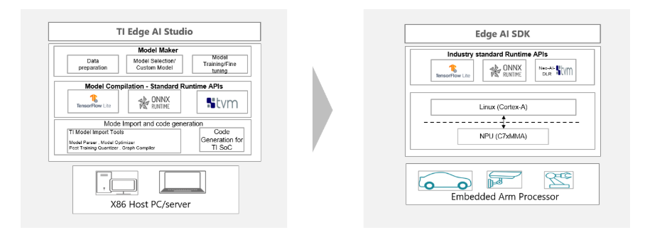
TI Edge AI Model Development Flow — Diagram
TI provides tools for various points in the process.
For each GUI-based tool, there is a corresponding open source, programmatic / command-line tool
After initial evaluation of a model architecture, developers will often iterate on their model to achieve optimal performance and accuracy.

Slide 8
Performance & Accuracy Optimization
The first stage of performance optimization is by ensuring all layers within a model have acceleration support.
Accuracy optimization can be approached during or after model training by post-training quantization and quantization aware-training

Slide 9
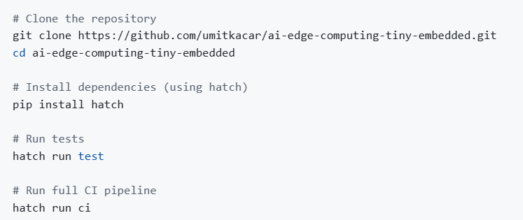
Getting started with TinyML
✦ Installation
the project uses modern python tooling with hatch for dependency management and development workflows

Slide 10
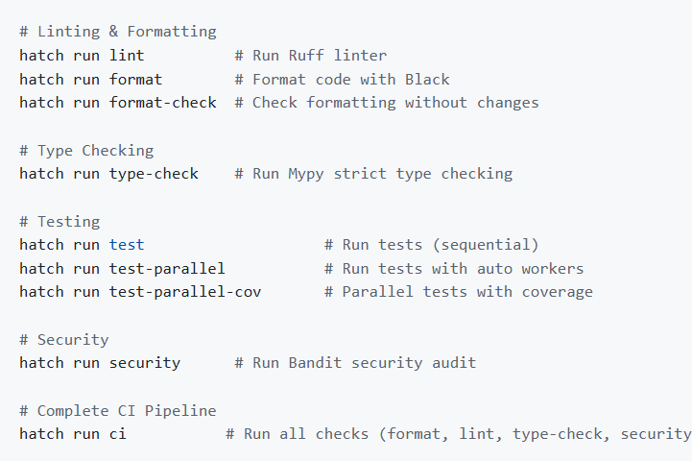
Getting started with TinyML — Development Setup
✦ Development setup

Slide 11
Getting started with TinyML — Features
✦ Features
✓ INT8 Quantization
✓ INT4 Quantization
✓ FP16 Quantization
✓ Dynamic Quantization
✓ Symmetric and asymmetric modes
✓ Per-tensor & per-channel quantization
✓ Weight quantization with 6 different modes
✓ Compression ratio analysis
✓ Model size calculation
✓ Type-safe APIs with full annotations
✓ Comprehensive error handling

Slide 12
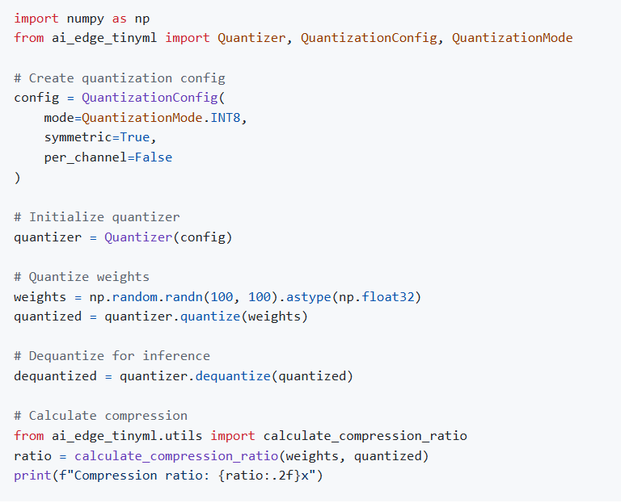
Getting started with TinyML — Example Usage
✦ Example usage

Slide 13
References
[1]
Awesome TinyML
https://github.com/umitkacar/awesome-tinyml
[2]
TI Edge AI TensorLab
https://github.com/TexasInstruments/edgeai-tensorlab

Slide 14
Thank You

