Slide 1

CSE 521: Embedded ML
Introduction to JAX
JAX is a library for array-oriented numerical computation with automatic differentiation and JIT compilation to enable high-performance machine learning research.
Prepared by: Kirolos Mina Supervised by: Dr. Rami Zewail

Slide 2
Overview
JAX provides a unified Numpy-like interface to computations that run on CPU, GPU or TPU in local or distributed settings.
JAX features built-in Just-In-Time compilation via Open XLA, an open-source machine learning compiler ecosystem.
JAX functions support efficient evaluation of gradients via its automatic differentiation transformations.
JAX functions can be automatically vectorized to efficiently map them over arrays representing batches of inputs.

Slide 3
Installation
JAX can be installed for CPU on linux, windows and macOS directly from the python package index.
Using JAX requires installing two packages: jax, which is pure Python and cross-platform, and jaxlib which contains compiled binaries, and requires different builds for different operating systems and accelerators.
• For CPU-only
pip install jax
• For Nvidia GPU
pip install -U "jax[cuda13]"
• For GPU (AMD, ROCm)
pip install -U "jax[rocm7-local]"
• For TPU (Google cloud TPU VM)
pip install -U "jax[tpu]"

Slide 4
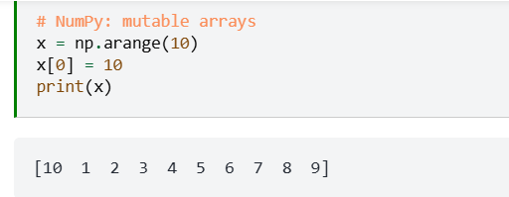
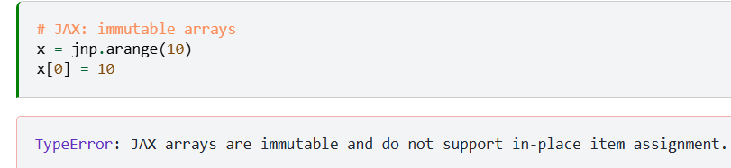
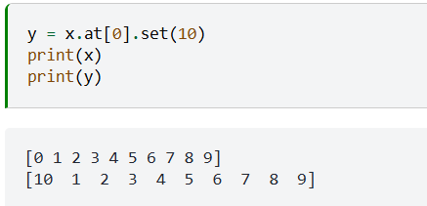
JAX vs. NumPy
JAX provides a NumPy-inspired interface for convenience, and unlike NumPy arrays, JAX arrays are always immutable.
• JAX provides jax.numpy which closely mirrors the NumPy API and provides easy entry into JAX, almost anything that can be done with numpy can be done with jax.numpy which is typically imported under the jnp alias:
import jax.numpy as jnp
• Python's duck-typing allows JAX arrays and NumPy arrays to be used interchangeably in many places. However, there is one important difference: JAX arrays are immutable, meaning that once created their contents cannot be changed.
For updating individual elements, JAX provides an indexed update syntax that returns an updated copy

Slide 5
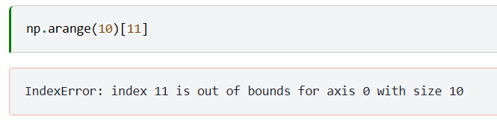
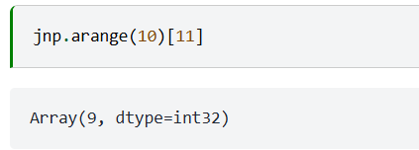
JAX vs. NumPy — Out-of-Bounds Indexing
• Out-of-bounds indexing:
NumPy:
JAX:
Unlike NumPy, JAX does not raise an IndexError for out-of-bounds access — instead it clips the index to the last valid value.

Slide 6
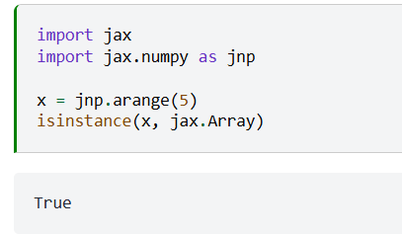
JAX Common Functions
1- Jax.array function
Create arrays using JAX API functions
JAX array objects have a devices attribute that indicate where the array is stored
JAX arrays can be sharded across multiple devices for parallel computation
We typically don't call the jax.array constructor directly, but rather create arrays via JAX API functions. For example, jax.numpy provides familiar NumPy-style array construction functionality such as jax.numpy.zeros, jax.numpy.linspace, jax.numpy.arange
• JAX array objects have a devices method that lets you inspect where the contents of the array are stored. In general, an array may be sharded across multiple devices, in a manner that can be inspected via the sharding attribute

Slide 7
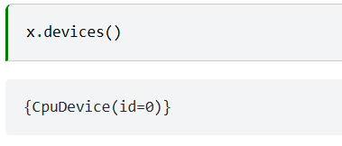
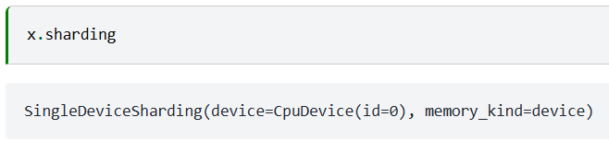
JAX Common Functions — jax.array: devices & sharding
2- Jax.jit function
By default, JAX executes operations one at a time, in sequence
Using a just-in-time (JIT) compilation decorator, sequences of operations can be optimized together and run at once.
Not all JAX code can be JIT compiled, as it requires array shapes to be static and known at compile time

Slide 8
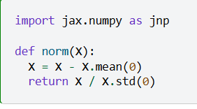
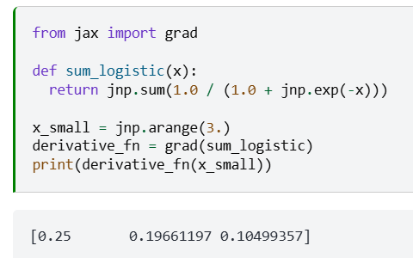
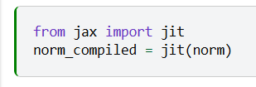
JAX Common Functions — jax.jit examples
3- jax.grad function
JAX provides automatic differentiation via the jax.grad transformation
Jax.grad and jax.jit transformations compose and can be mixed arbitrarily

Slide 9
JAX Common Functions — Additional Utilities
Some another useful functions can be used such as:
vmap
for vectorization — automatically vectorize functions over batches of inputs
random
for pseudo-random numbers — JAX has its own functional PRNG system
debug
for debugging — inspect values and trace execution in JIT-compiled code

Slide 10
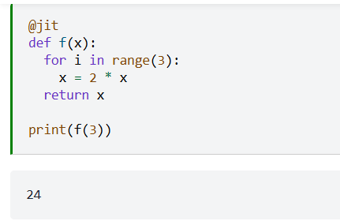
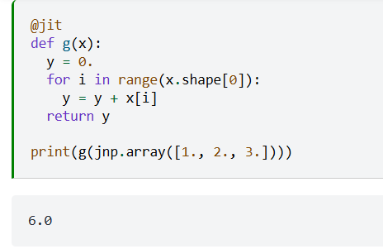
Examples — Control Flow and Logical Operators with JIT
When executing eagerly (outside of jit), JAX code works with python control flow and logical operators just like NumPy code.
Using control flow and logical operators with jit is more complicated.
In a nutshell, python control flow and logical operators are evaluated at JIT compile time, such that the compiled function represents a single path through the control flow graph.
• If the path depends on the values of the inputs, the function by default cannot be JIT compiled. The path may depend on the shape or data type of inputs, and the function is re-compiled every time it is called on an input with a new shape or data type.

Slide 11
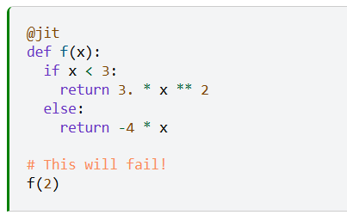
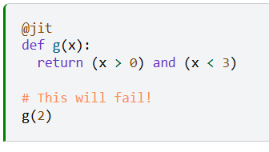
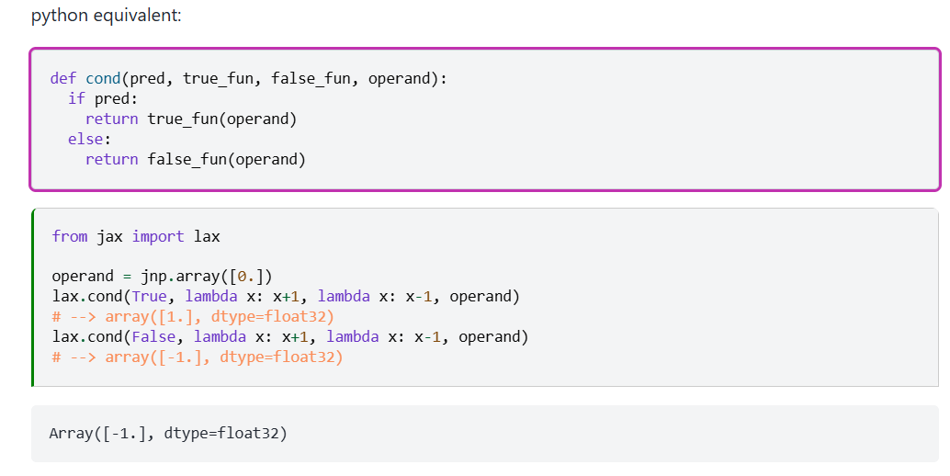
Examples — JIT Failures with Python Control Flow
✦ Structured control flow primitives:
1- lax.cond

Slide 12
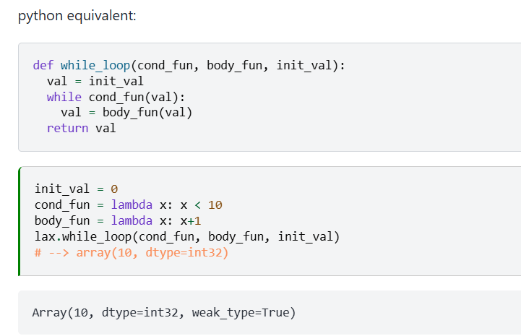
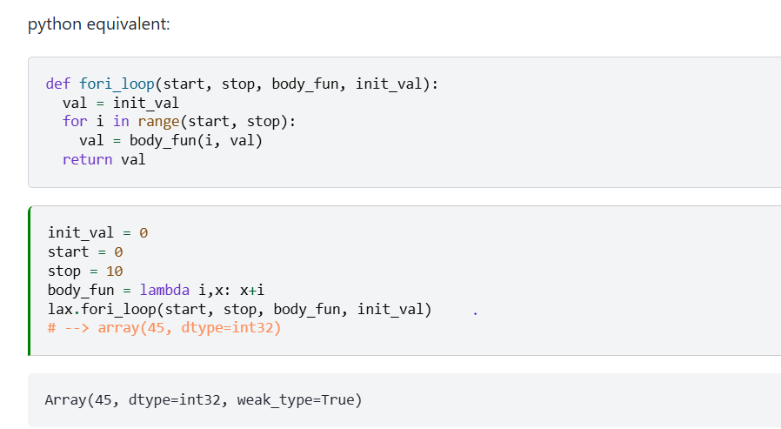
Structured Control Flow Primitives
2- While_loop
3- Fori_loop

Slide 13
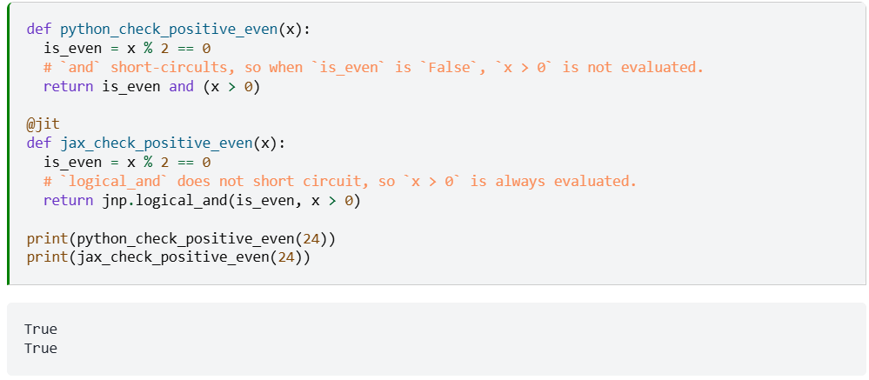
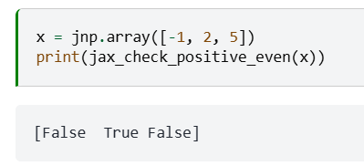
Logical Operators
✦ Logical operators

Slide 14
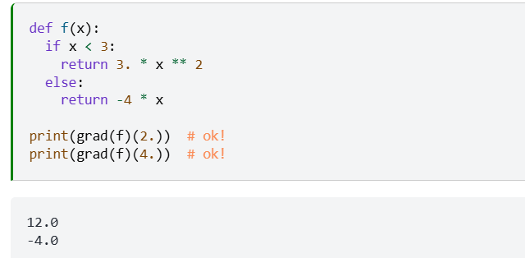
Logical Operators — grad without JIT (Works!)
Key takeaway: When using grad without jit, Python control flow (if/else, and/or) works just fine — only jit compilation imposes the constraint that control flow must be statically determined.
If you just want to apply grad to your python functions, without jit, you can use regular Python control-flow constructs with no problems.
✓ Outside jit: use regular Python control flow freely
✓ Inside jit: use lax.cond, lax.while_loop, lax.fori_loop
✓ grad composes with both jit and regular Python flow

Slide 15
References
https://github.com/agwr/learn-jax
https://docs.jax.dev/en/latest/notebooks/thinking_in_jax.html

Slide 16
Thank you

