Slide 1

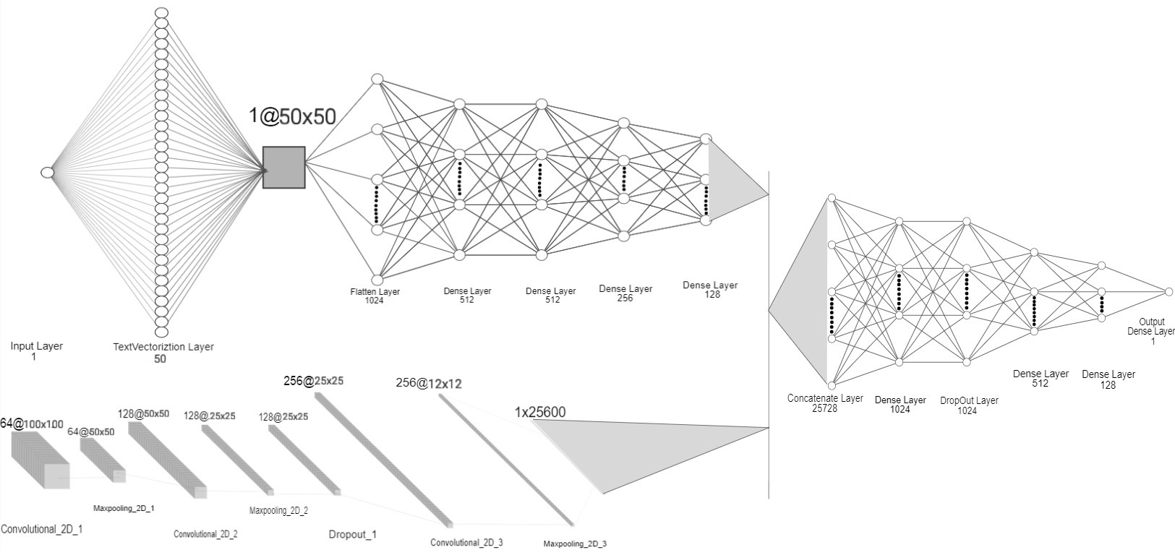
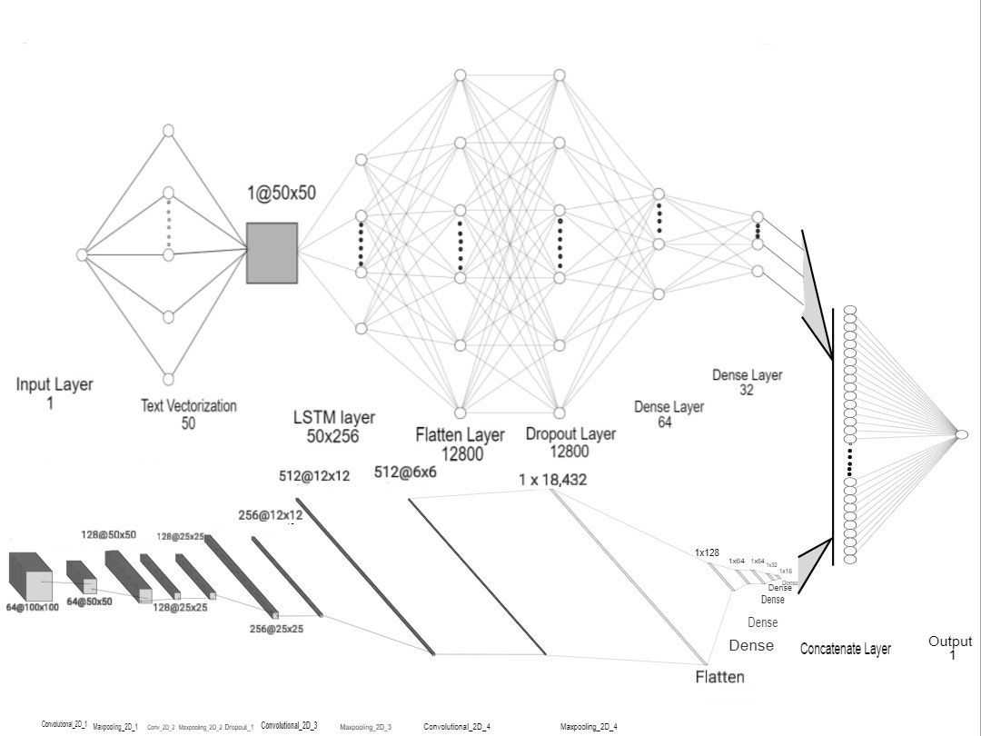
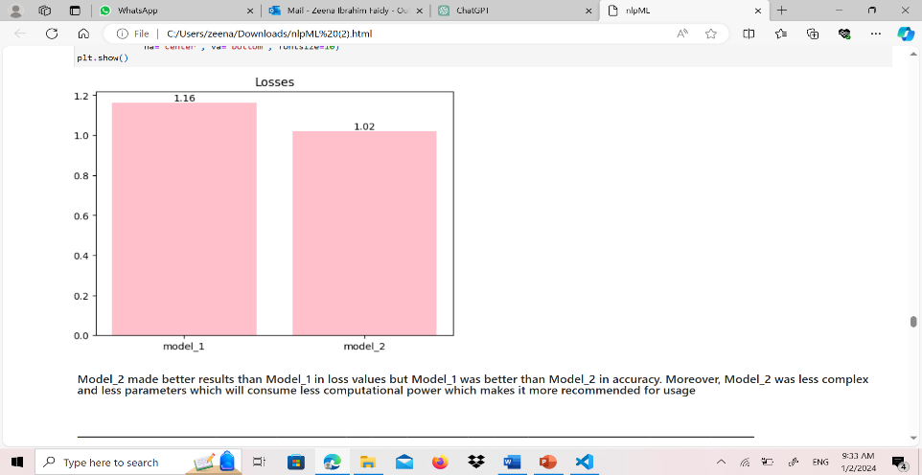
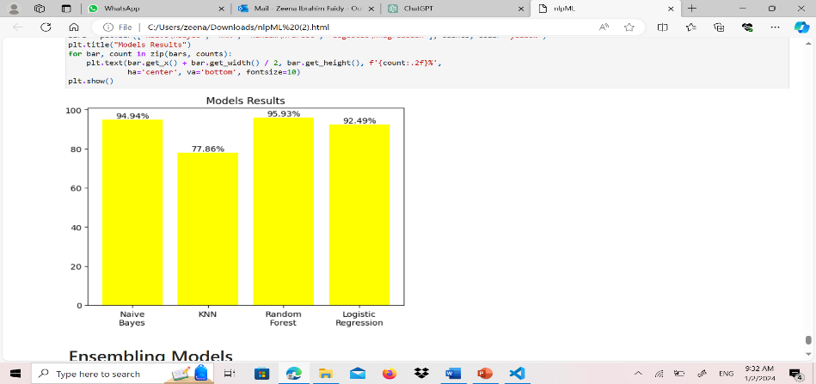

CSCI417-02
Dr. Ghada Khoriba
FAKE NEWS DETECTION
Abstract
Methodology
The project's goal was twofold:
to detect fake news using a multi-modal neural network and to classify news articles as fake or real using diverse machine learning and deep learning techniques. It encompassed processing textual data and images to construct a classifier capable of distinguishing between fake and real news. This involved data preprocessing, text feature extraction, image data handling, and the creation of two multi-modal neural network architectures. The primary aim was to assess and compare these models in terms of accuracy and computational efficiency. Additionally, it entailed concatenating multiple datasets, preprocessing textual data, and implementing four distinct models—Multinomial Naive Bayes, KNN, Random Forest, and Logistic Regression. Each model utilized unique approaches for feature extraction and classification, all geared towards the primary goal of accurately differentiating between fake and real news articles.
Data Preparation: Reading a large dataset and concatenating it with scrapped data, extracting relevant columns, handling null values, merging text data with corresponding image filenames, and concatenating various news article datasets into a unified dataset.
Preprocessing: Lowercasing text, removing stop words, lemmatizing words for textual data, and preprocessing textual content. It also included rescaling images and preparing them for input into the models.
Model Development: Constructing two multi-modal neural networks combining image and text branches, utilizing Convolutional Neural Networks (CNNs) and Dense layers for the multi-modal neural network. The classification methodology involved implementing four distinct models: Multinomial Naive Bayes, KNN, Random Forest, and Logistic Regression, each with its specific architecture or algorithm.
Training and Evaluation:
Splitting data into train/test sets.
Training models & optimizing hyperparameters via GridSearchCV.
Constructing an ensemble with diverse models: Multinomial NB, RF, LogReg, and KNN
Training the ensemble on the train set.
Evaluating ensemble performance on the test set using accuracy metrics.
Conclusion
Model_2 in the multi-modal neural network, achieved 74.81% accuracy while being simpler than Model_1, proving its efficiency in detecting fake news with fewer computational resources. In news article classification, the Random Forest model excelled with 95.93% accuracy in discerning fake and real news articles, though optimal model choice might vary.
Results
References
Team Photo
Lai, C.-M.; Chen, M.-H.; Kristiani, E.; Verma, V.K.; Yang, C.-T. Fake News Classification Based on Content Level Features. Appl. Sci. 2022, 12, 1116. https://doi.org/10.3390/app12031116 Nakamura, K., Levy, S., & Wang, W. Y. (2020). Fakeddit: A New Multimodal Benchmark Dataset for Fine-grained Fake News Detection. In Proceedings of the Twelfth Language Resources and Evaluation Conference (pp. 6149-6157). Marseille, France: European Language Resources Association.
Zeena Faidy – Saif Elattar – Kerolos Salama – Ahmed Atia

