Slide 1
Application E-learning management system

Slide 2
Introduction
Problem Definition
Motivation
Objectives
Description of the program

Slide 3
Introduction
Abstract
Evaluation is a key element in students’ self-regulation of learning as it enables students to monitor their progress towards their learning goals and to adjust their strategies to attain these goals. Therefore, the present project aims to develop a mobile application for “Tracking, Evaluating and Improving Students’ Performance” through a web application. The proposed model aims to improve the online educational systems for both instructors and students. It includes the more accurate estimation and a more effective evaluation of the learning process. It provides the instructors with customizable dashboards, precise analysis of their course data and the students’ results future results.

Slide 4
The evaluation of the students’ performance is focusing on tracking the behavior of the students and their results, evaluating them according to previously recorded results of other students, and predicting their future results. This technique shows visual statistics for the course and its submodules to both instructors and students, so students can know where they’re lacking to be able to improve their performance to attain their goals. The Data Mining technique is used in this project to analyses students’ performance, identify their risk and predict their future results.

Slide 5
1.1ProblemDefinition
We have found the old ways in which the student was evaluated, and there were many defects, as it was that the student could only be evaluated through final exams, even though it must be evaluated through his presence throughout the study phase, so an application was built that communicates with students and the teacher to deliver Homework and research.

Slide 6
1.2 Motivation
One of the ways that assessment can be presented regularly to students is in the form of an application through which multiple sources of data can be visualized in the same presentation, which shows each student a complete and detailed analysis of his performance
1.3 Objectives
Our system aims to improve and facilitate the online learning process for instructors and students, and to provide all the suitable tools and features to make it approachable and understandable by its users for a variety of purposes. The main objectives for our system are:

Slide 7
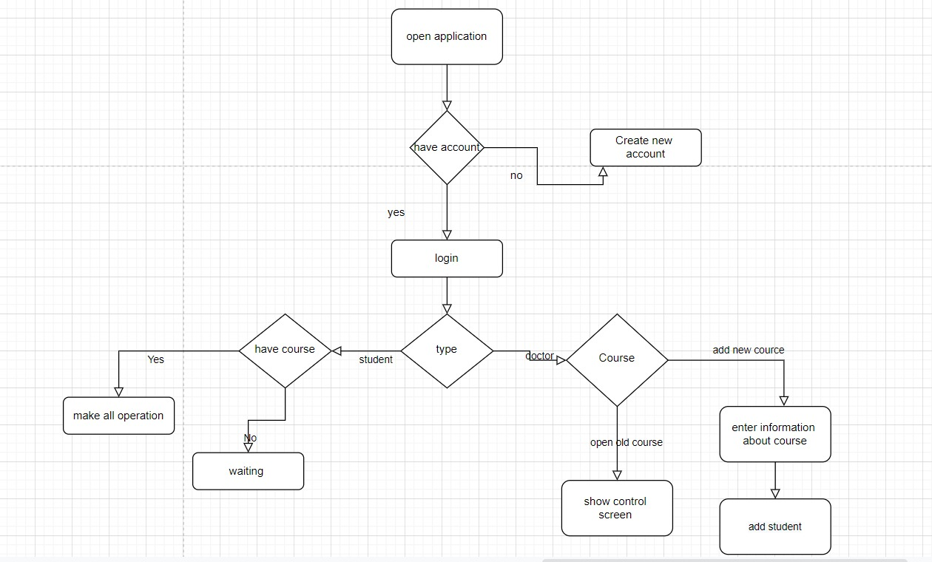

Slide 8
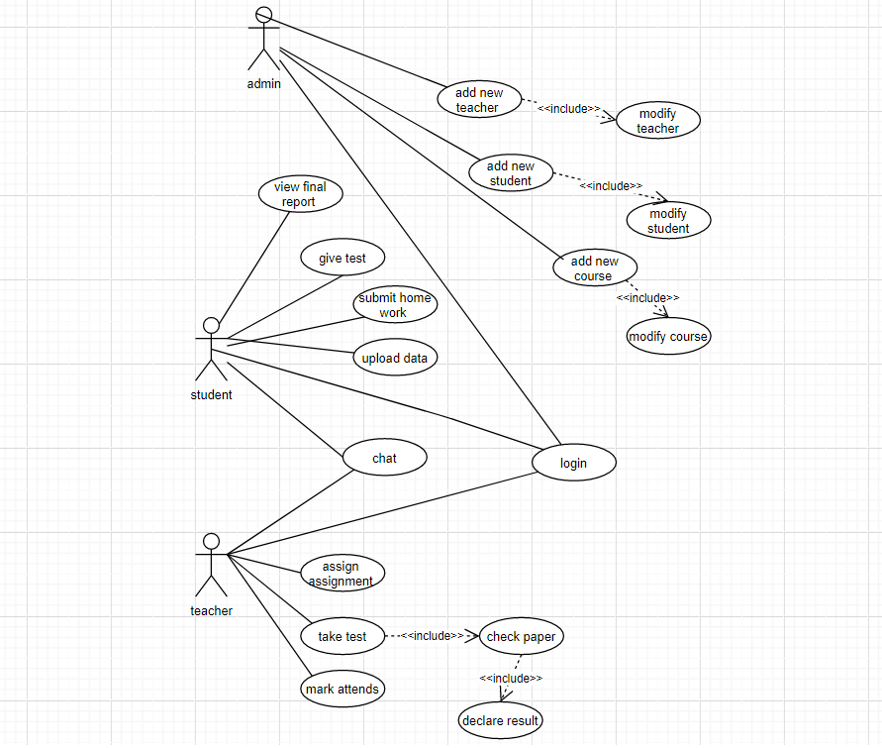
Class Diagram

Slide 9
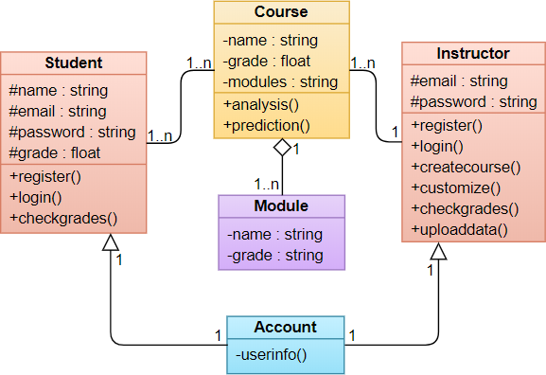

Slide 10
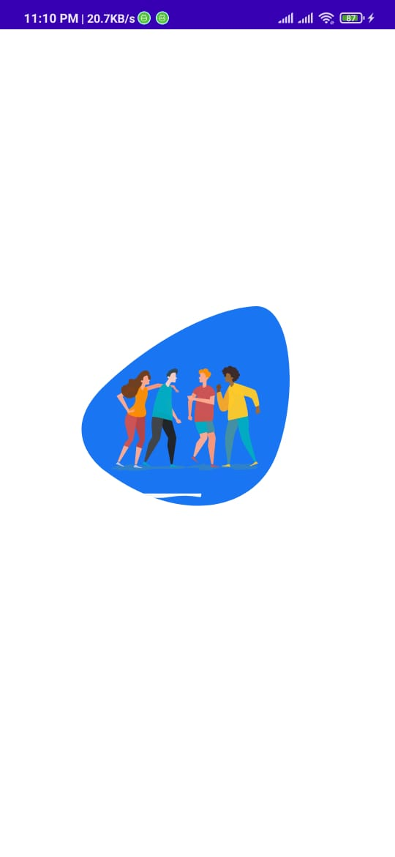
1-Open Application
Figer 15

Slide 11
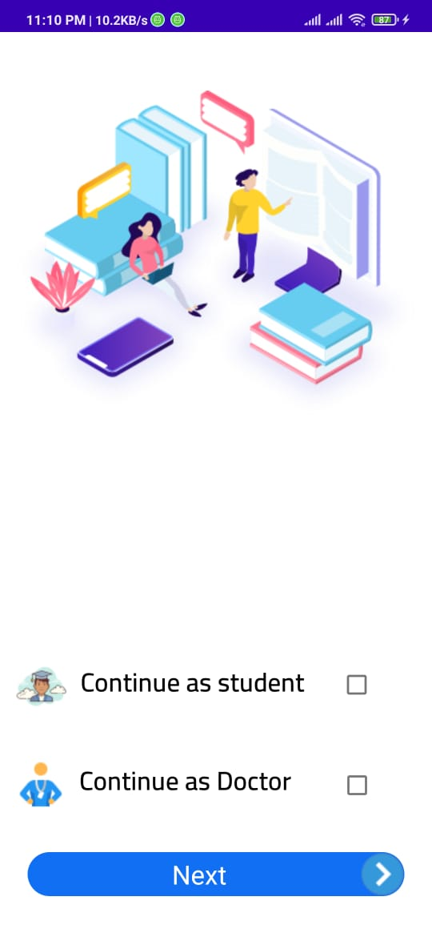
2-Choose between doctor and student
Figer 16

Slide 12
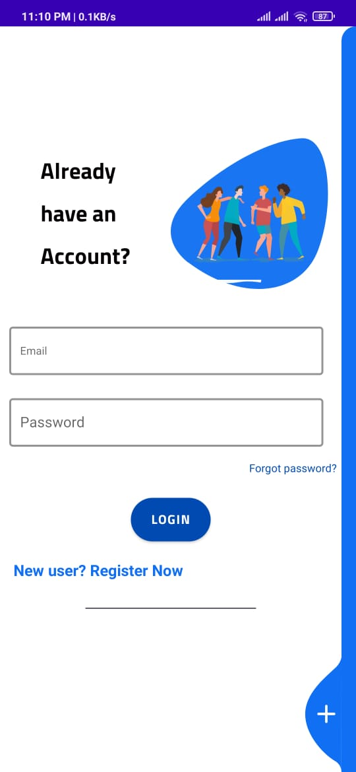
3-Login screen
Figer 17

Slide 13
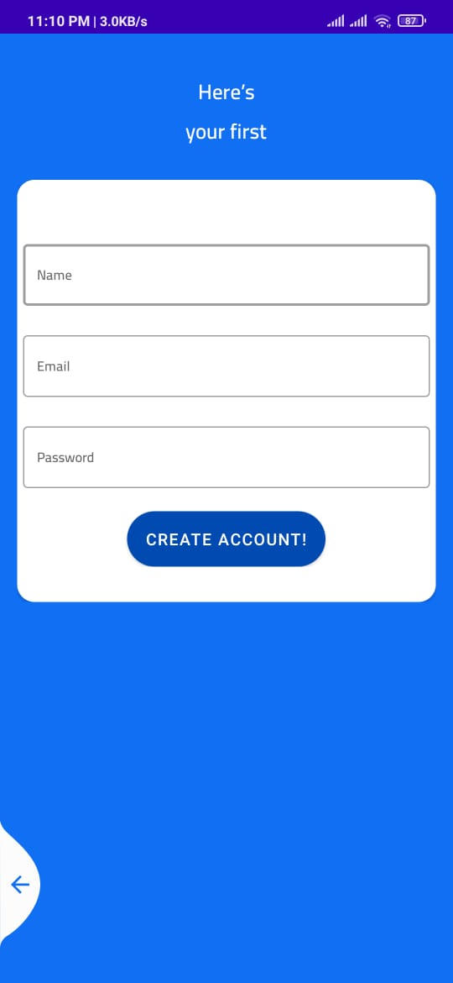
4-Registration Screen
Figer 18

Slide 14
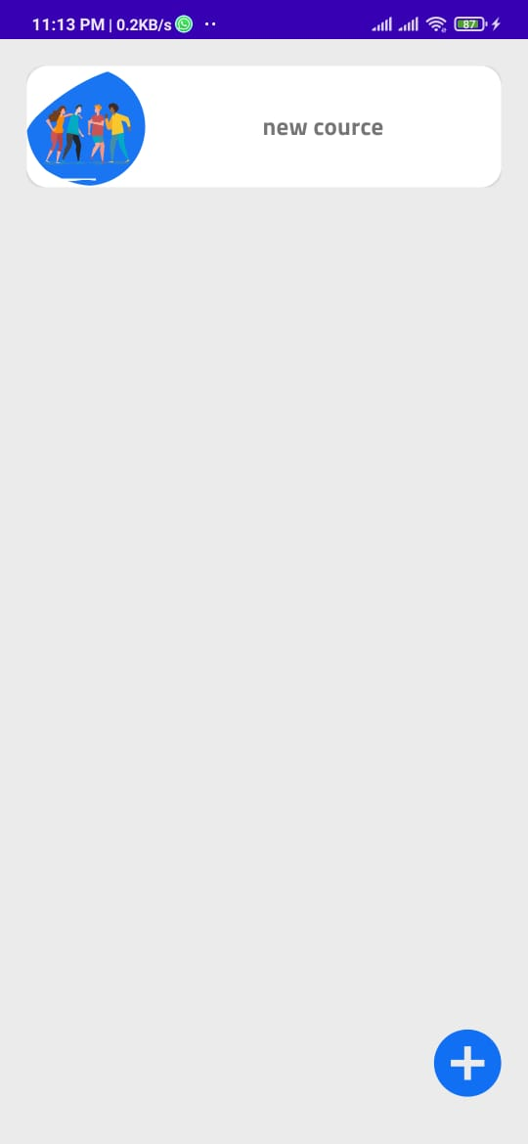
5-Show all courses for student
Figer 19

Slide 15
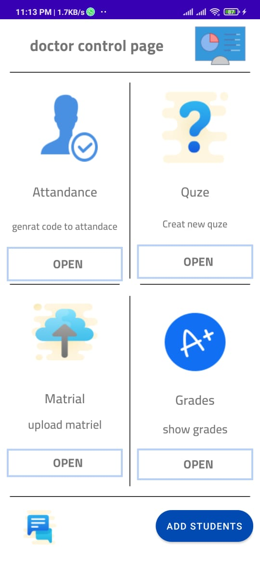
6-Show control for doctor
Figer 20

Slide 16
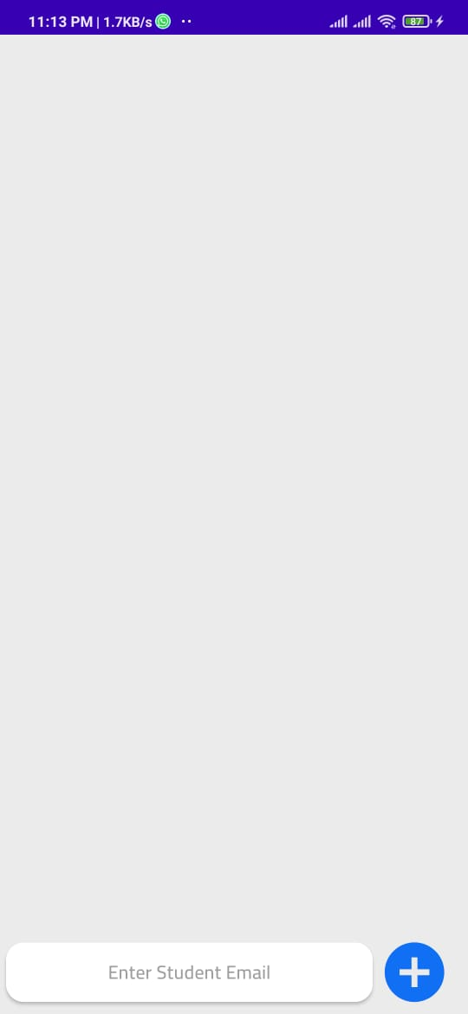
7-Add new student
Figer 21

Slide 17
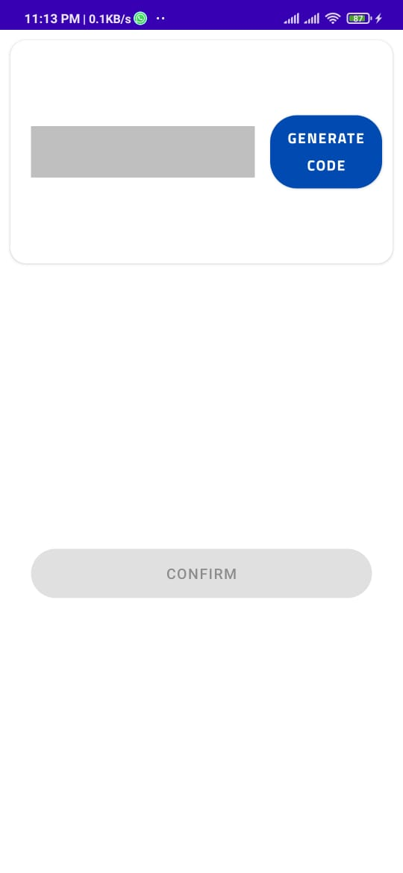
8-Create new code
Figer 22

Slide 18
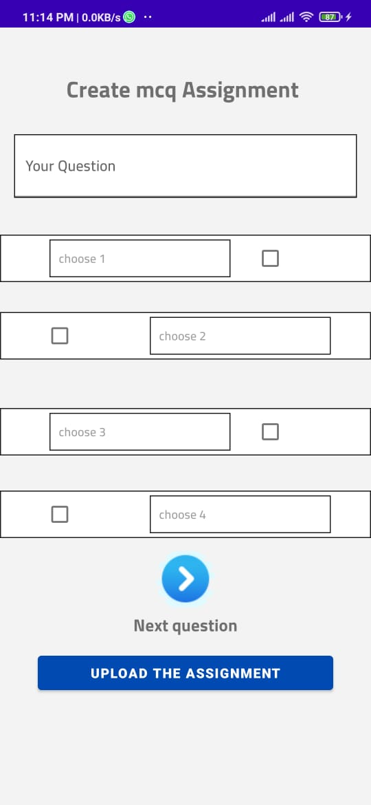
9- Make new Quze
Figer 23

Slide 19
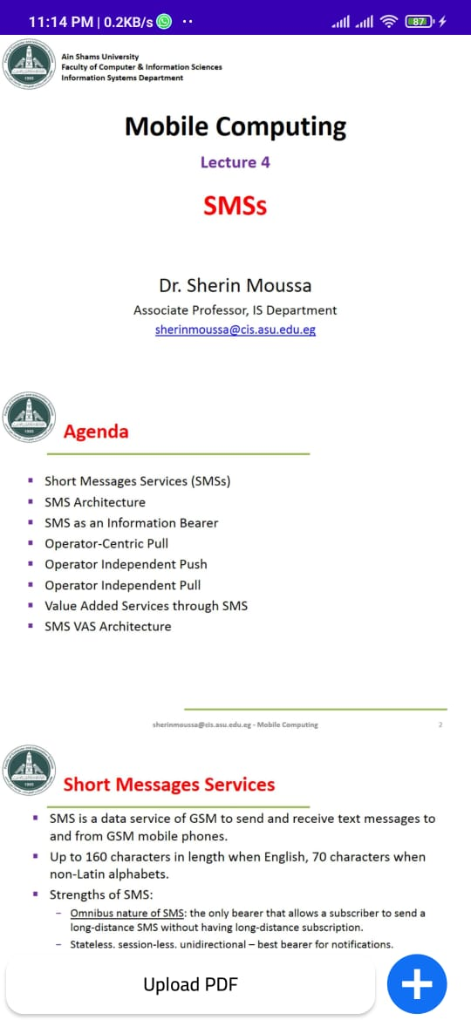
10- Upload Material
Figer 24

Slide 20
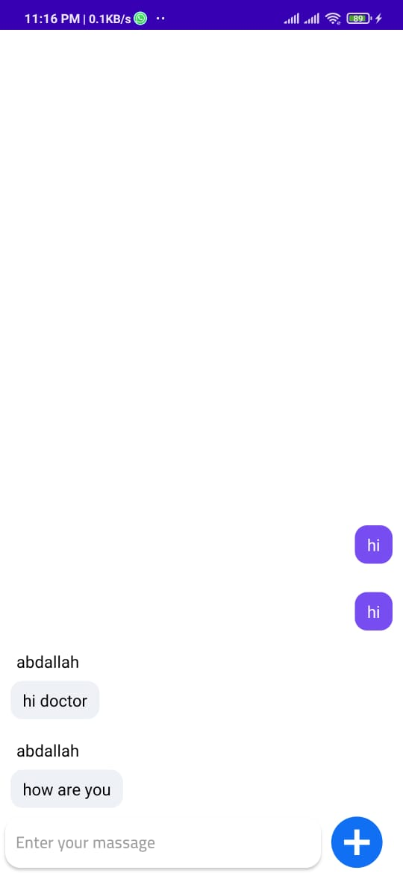
11-Chat
Figer 25

Slide 21
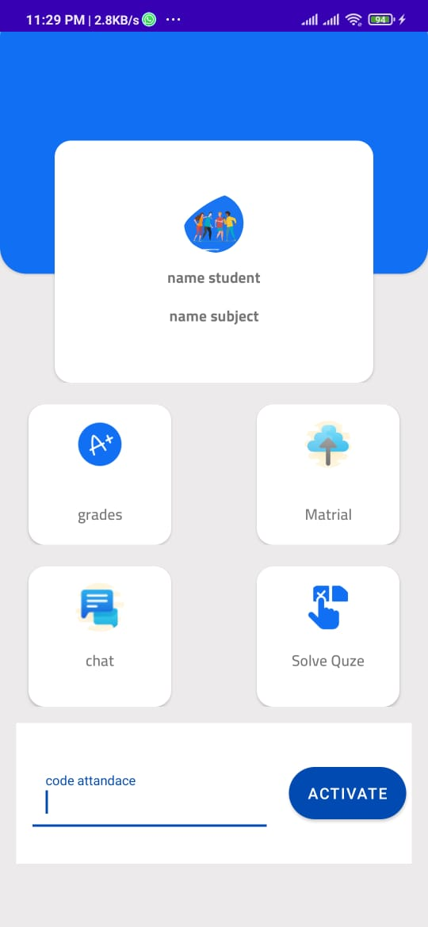
12-Show control student
Figer 26

Slide 22
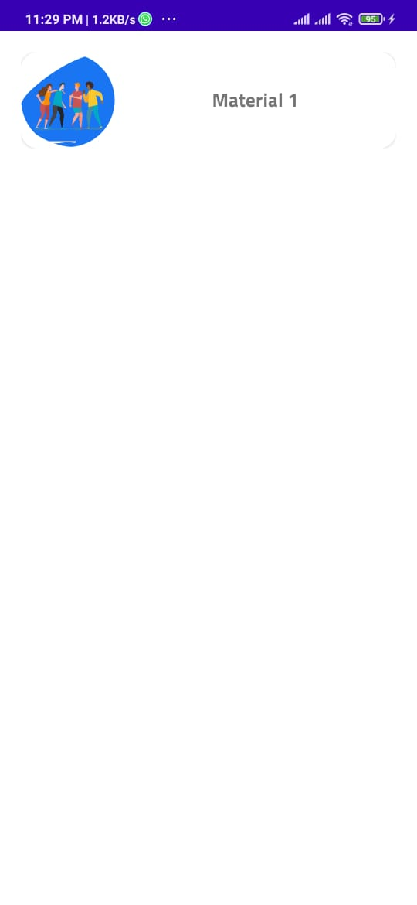
13-Show material
Figer 27

Slide 23
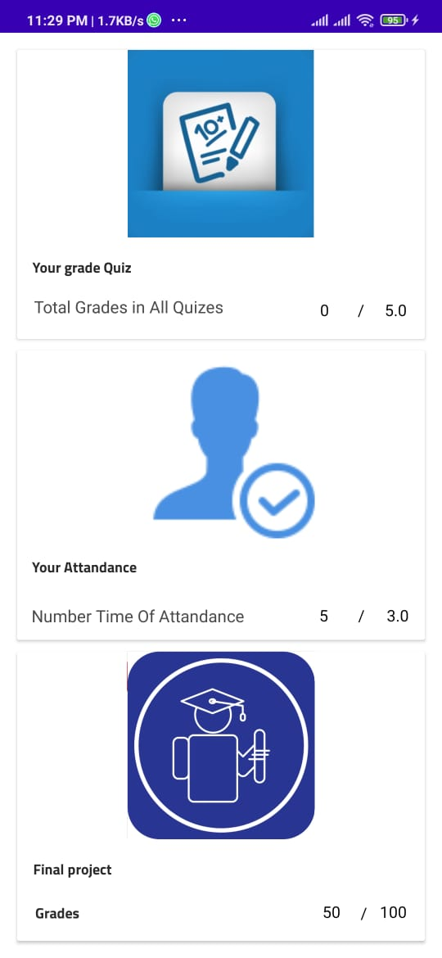
14-Show grades
Figer 28

Slide 24
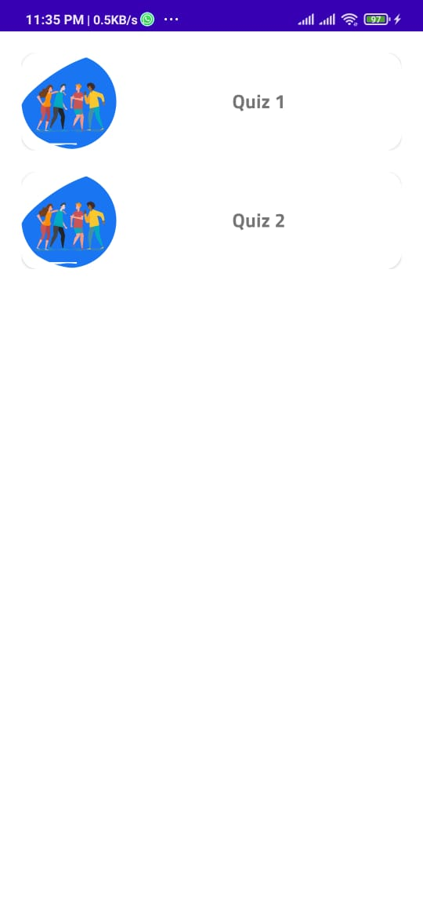
15-Show all Quizzes
Figer 29

