Slide 1



Social Media Database & Analysis Presentation
An In-Depth Look at Database Design and Data Insights
by kerolos hani

Slide 2
Presentation Agenda: What We'll Cover
1
Introduction
2
Database Design & ERD
3
SQL Queries & Data Analysis
4
Key Findings & Insights
5
Conclusion

Slide 3
Introduction: Social Media Data Landscape
Overview:
Objectives:
This presentation focuses on a social media platform where users connect, share content, and engage with each other.
To efficiently store and manage a vast amount of social media data.
To extract valuable insights for optimizing user experience and platform growth.
The database stores crucial information about users, posts, comments, likes, follows, hashtags, and more.

Slide 4
Database Design: Overview and Structure
Key Tables & Their Relationships
Relationships:
Users: Stores user details (ID, username, email, profile photo, bio, created_at).
One-to-Many: Users to Posts, Posts to Comments.
Posts: Contains post content (ID, caption, location, created_at) and optional references to photos/videos.
Many-to-Many: Posts to Hashtags via Post_Tags.
Comments & Likes: Capture user interactions on posts.
Self-referencing: Users following other users via Follows.
Follows & Hashtags: Support social connections and content categorization.

Slide 5
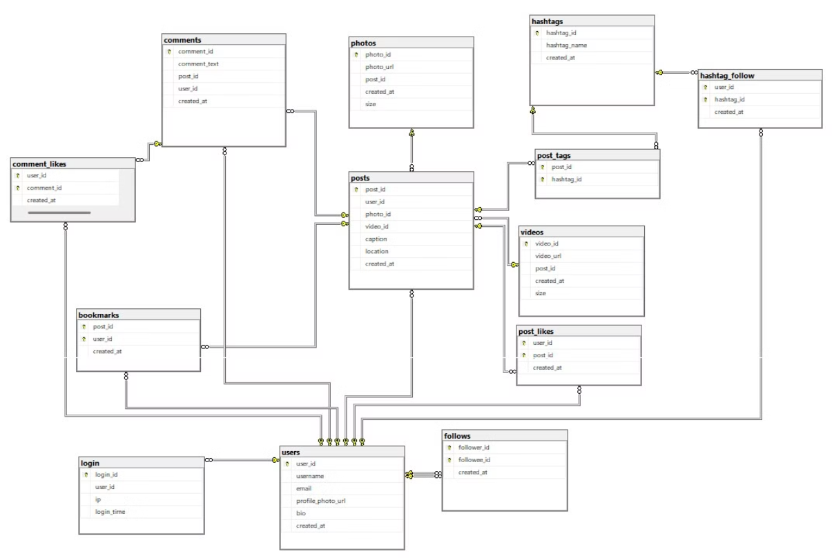
ERD :

Slide 6

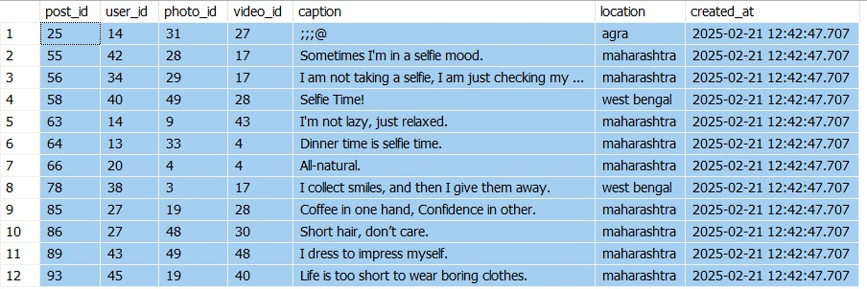

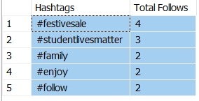
Some analysis
Retrieve all posts with location in 'agra', 'maharashtra', or 'west bengal'
2. Retrieve the top 5 hashtags by the number of follows (i.e., most followed hashtags)

Slide 7
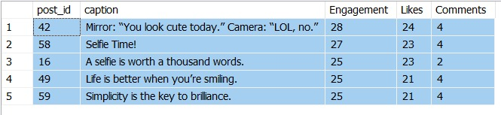
Some analysis
3. Retrieve the top 5 posts with the highest engagement rate,
where engagement is defined as the sum of likes and comments.
This query calculates total likes and total comments for each post,
then orders posts by the combined engagement in descending order.

Slide 8
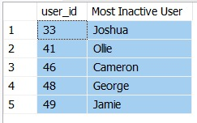
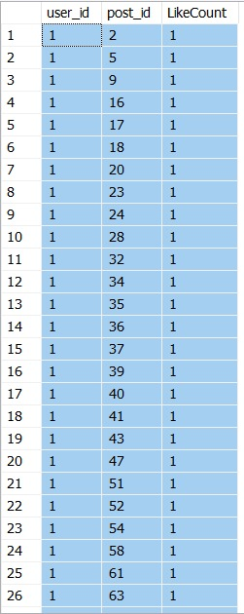
Some analysis
4. Retrieve users who have never made a post (i.e., most inactive users)
5. Retrieve posts with the highest number of likes,
ordered in descending order by like count

Slide 9

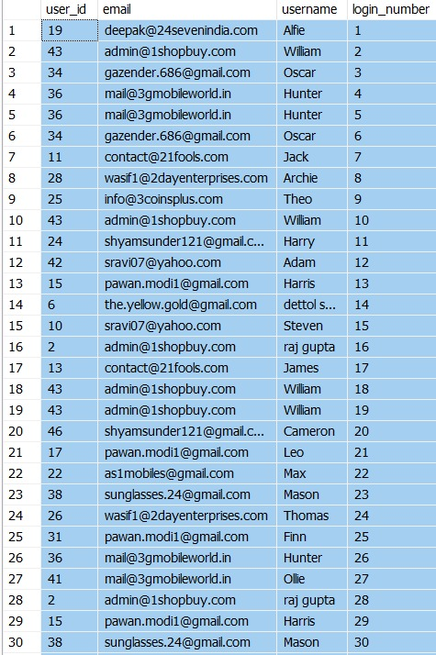
Some analysis
6. Calculate the average number of posts per user (rounded to 2 decimal places)
7. Retrieve login details by joining users and login tables
(SQL Server does not support NATURAL
JOIN, so we use an explicit JOIN)

Slide 10
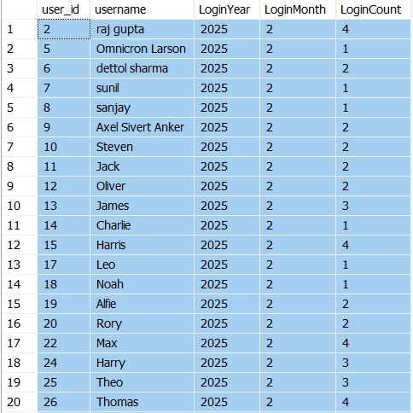
Some analysis
8. Analyze user login activity: Retrieve the number of logins per user per month.
This query extracts the month and year from each login_time,
then counts the number of logins per user for that period.

Slide 11

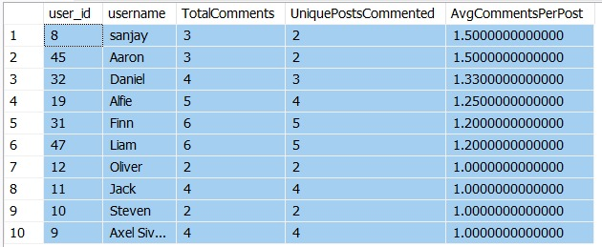
Some analysis
9. Retrieve users who have never commented on any post
10. Identify the most active commenters:
Retrieve the top 10 users with the highest average comments per post they've engaged in.
The query calculates total comments per user and divides by the number of posts they commented on.

Slide 12
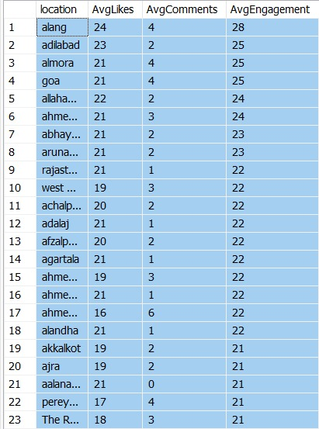
Some analysis
11. Analyze location-based engagement:
Retrieve the average number of likes and
comments per post for each location.
This helps identify which locations have
posts with higher engagement.

Slide 13
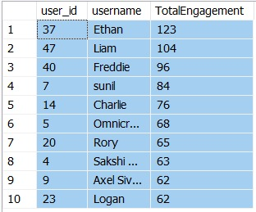

Some analysis
12. Identify Influential Users:
Retrieve users who have the highest total engagement on their posts.
Total engagement is the sum of likes and comments on all posts by the user.
13. Retrieve users who have posted more than 5 times,
ordered by the number of posts descending

Slide 14
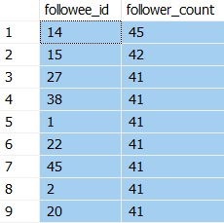
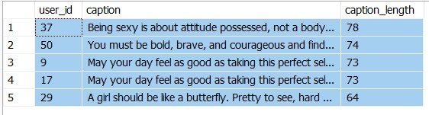
Some analysis
14. Retrieve entities (users) who have more than 40 followers, ordered by follower count descending
15. Retrieve the top 5 posts with the longest captions, ordered by caption length in descending order

Slide 15
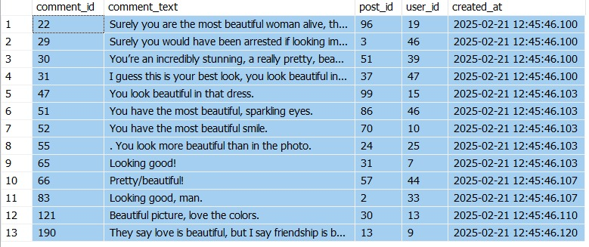
Some analysis
16. Retrieve comments that contain either the word "good" or "beautiful"
Note: SQL Server does not support REGEXP, so we use LIKE instead

Slide 16
Thanks

