Slide 1
NYCU 2025 Summer DL Lab6
Generative Models
TA 楊賀弼
August 7, 2025
Notes:
1

Slide 2
Outline
Rule
Lab description
Model design guide
Scoring criteria
Notes:
2

Slide 3
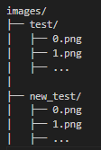
Rule
Report submission deadline: August 22, 2025, 11:59 p.m.
No need to demo this lab
Zip all files in one file (Please do not upload dataset)
Report (.pdf)
Source code
images Folders -|-- test
|-- new_test
Name it "DL_LAB6_YourStudentID_YourName.zip”
Example: “DL_LAB6_313553051_楊賀弼.zip”
-5% to your score if you do not follow the format

Slide 4
Lab description

Slide 5
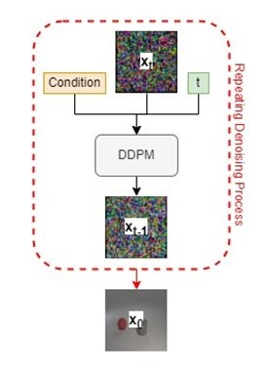
Lab objective
You need to implement a DDPM to generate synthetic images according to multi-label conditions

Slide 6
File Descriptions
You can download file.zip from e3 or ntu cool, except iclevr.zip, from the open-source Google Drive (link).
There are 7 files in the file.zip: readme.txt, train.json, test.json, new_test.json, object.json, evaluator.py, and checkpoint.pth. All the details of the dataset are in the readme.txt.

Slide 7
Requirements
Design and train your models
Implement a conditional DDPM
You can use any architecture you like
(Feel free to use any library that helps your work, but you need to mention the implementation details and include the reference in your report)
Synthesis image and evaluate the results
Show the synthetic images in grids (for test.json, new_test.json)
Show the denoising process in a grid for sampling from your DDPM
(with the label set ["red sphere", "cyan cylinder", "cyan cube"])
Evaluate your model with the classification accuracies from the provided evaluator (for test.json, new_test.json)

Slide 8
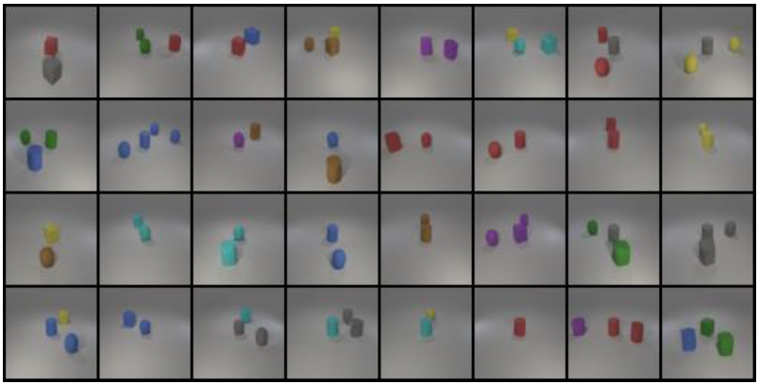
Requirements
Synthetic images in grids
Denoising process

Slide 9
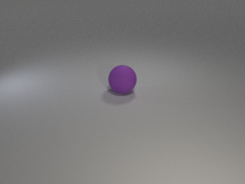
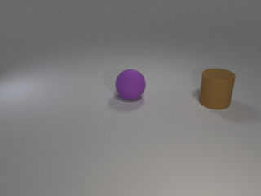
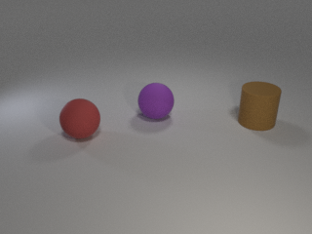
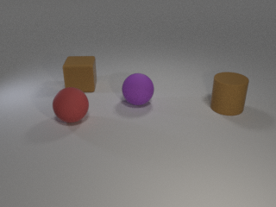
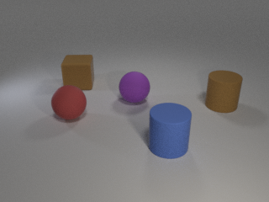
Dataset
Provided files
readme.txt, train.json, test.json, new_test.json, object.json, iclevr.zip
object.json
Dictionary of objects
24 classes
Example of labels:
[“cyan cylinder”, “red cube”], [“green sphere”], …
The same object will not appear twice in an image

Slide 10
Pretrained evaluator
Provided files: evaluator.py, checkpoint.pth
DO NOT modify any of them
Use eval(images, labels) to compute accuracy of your synthetic images
Labels should be one-hot vector. E.g. [[1,1,0,0,…],[0,1,0,0,…],…]
Images should be all generated images. E.g. (batch size, 3, 64, 64)
Images should be normalized with transforms.Normalize((0.5, 0.5, 0.5), (0.5, 0.5, 0.5))
You can involve this evaluator in training or sampling for better result
E.g. classifier guidance for DDPM
Inherit the class if you need extra functionalities
Again, DO NOT modify the weight and class script

Slide 11
Implement a conditional DDPM

Slide 12
Design of DDPM
Denoising diffusion model
Latent diffusion model
encoder/decoder design
Condition embedding
label embedding
Time embedding
Noise schedule
linear
cosine
other

Slide 13
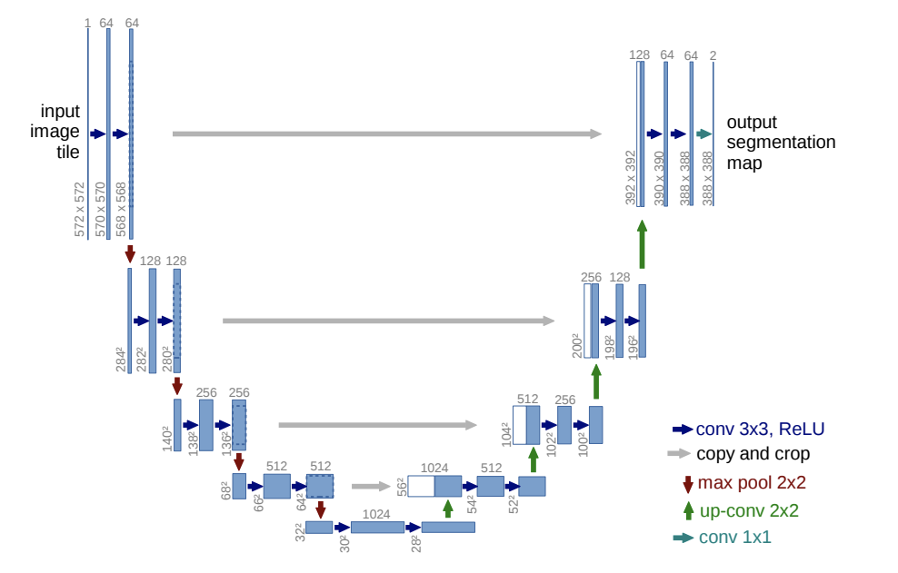
Design of UNet
Number of blocks
Number of layers, channels in each blocks
Down/upsampling blocks design
Architecture for the blocks. e.g. Resnet block
Self/cross attention
Where to add condition
other

Slide 14
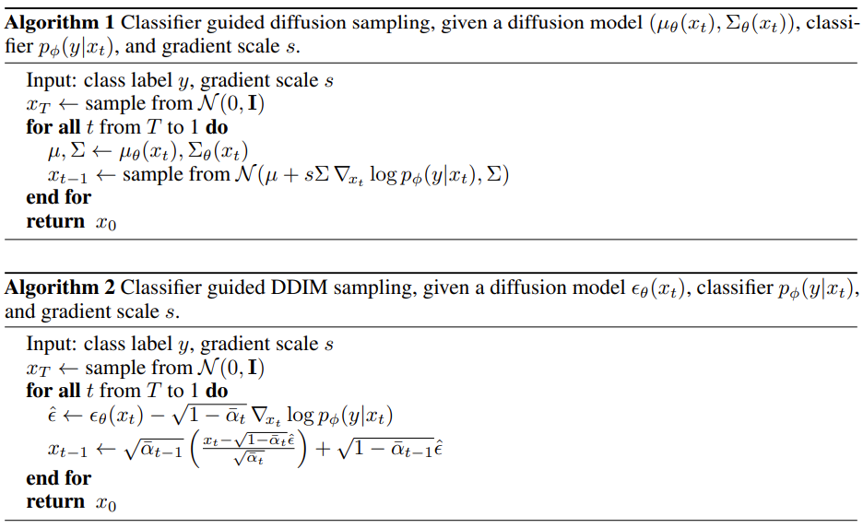
Choice of sampling method
DDPM, DDIM, etc.
With classifier guidance (Diffusion models beat gans on image synthesis)
You can include the pretrained evaluator (classifier) here
You can include the pretrained evaluator (classifier) here

Slide 15
Simple suggestions (in the other PDF)
● Denoising Diffusion Probabilistic Models
● Hugging Face Diffusion Models Course
The Hugging Face Diffuser library offers comprehensive functionality to help you implement various diffusion model architectures, scheduling methods, sampling types, reparameterizations, etc. You can refer to the tutorial linked above to design your diffusion model for this lab.

Slide 16
Scoring criteria

Slide 17
Scoring criteria
Report (60%)
Introduction (5%)
Implementation details (30%)
Describe how you implement your model, what is this step, including your choice of DDPM, noise schedule.
(Please write in detail.)
Results and discussion (25%)
Show your synthetic image grids and save images (6%: 3% * 2 testing data) and a denoising process image (4%)
Discussion of your extra implementations or experiments (15%)

Slide 18
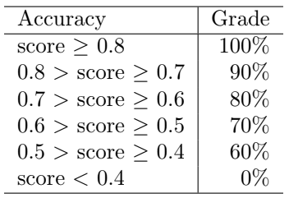
Scoring criteria
Result (40%) (based on results shown in your report)
Classification accuracy on test.json and new_test.json.
Show your accuracy screenshots.
20% * 2 testing data

Slide 19
Save Images
Save your synthetic images for the 2 testing data (test.json , new_test.json) Save in png files !!!
The data structure will be organised as follows:
The image name should follow the order in the test.json and new_test.json.

Slide 20
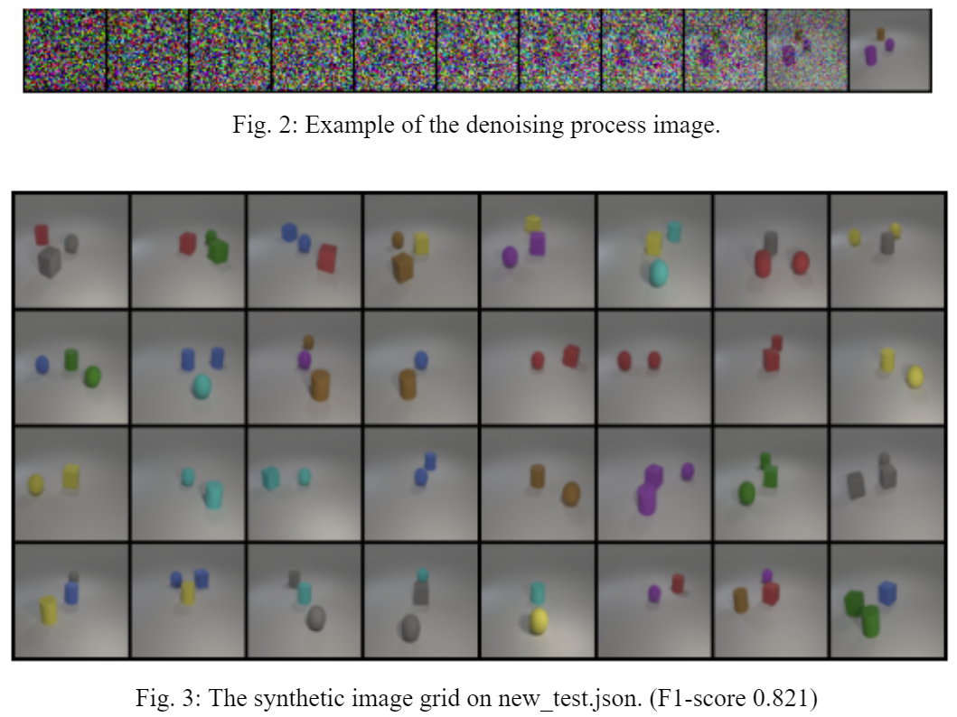
Output
examples

