Slide 1

Evil Genius Tips, Tricks and Best Practices -
Programming Arm MCU’s.
“C/C++ developers will hate you…”
By David Gelkin
Github: kerosene98
27th September 2018

Slide 2




What is Embedded
“a programmed controlling and
operating system with a
dedicated function”
Image source : getty

Slide 3
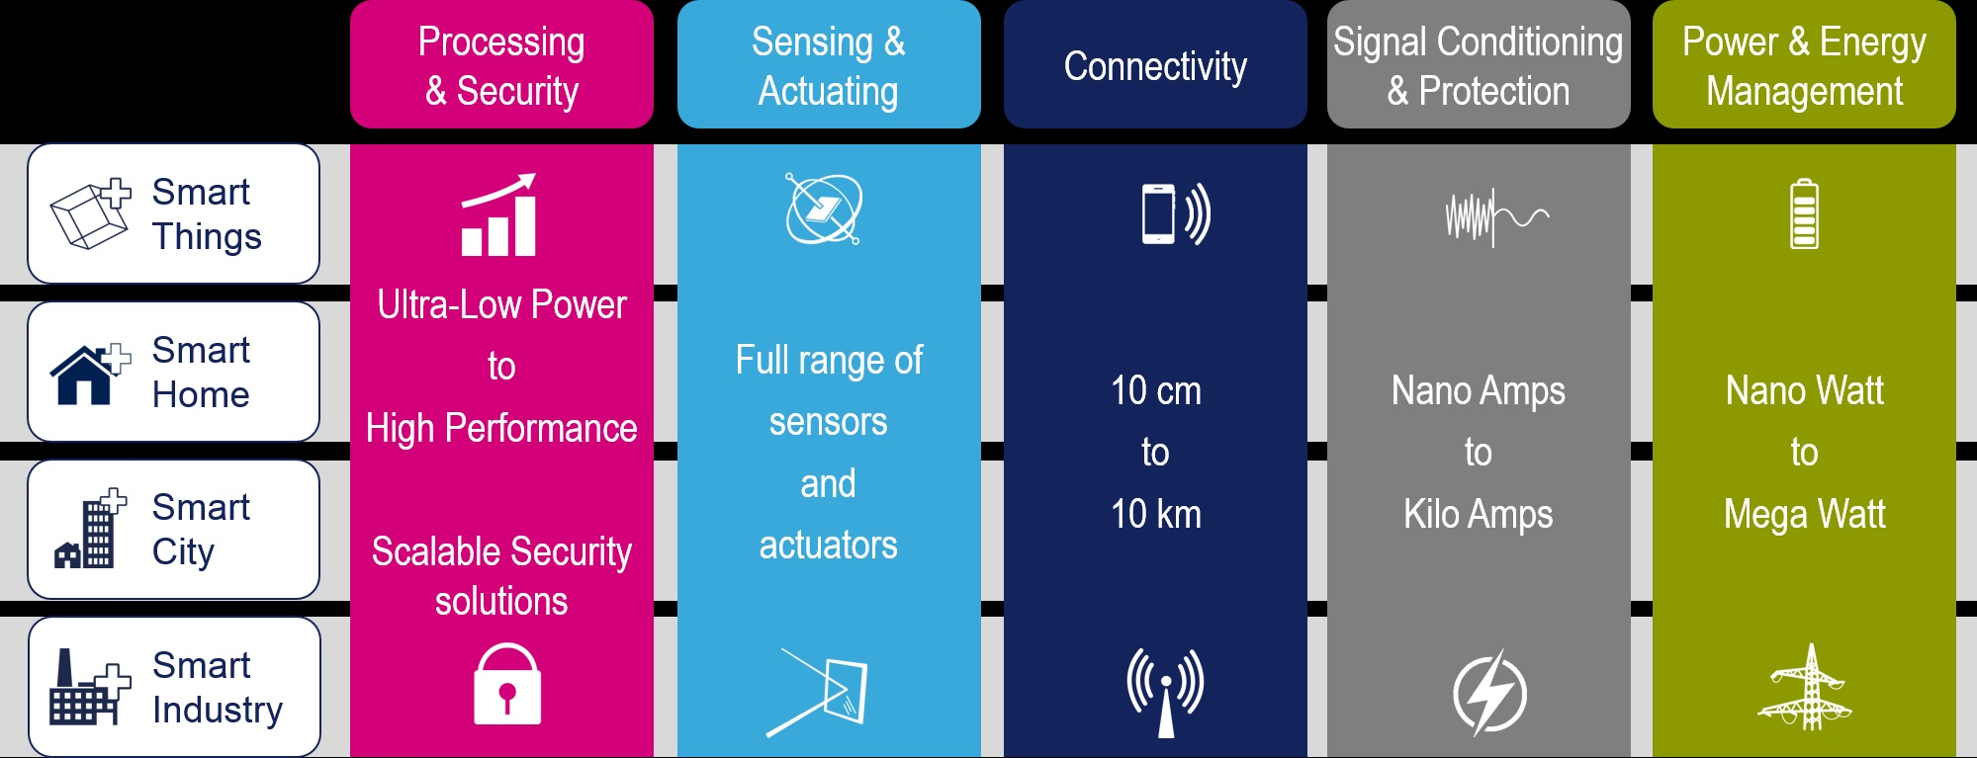
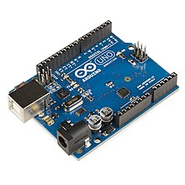

ARM
Cortex-Mx
** Concurrent
Activities
** Debugging
** RTOS
Real-Time Operating System support
Image source : getty, ST.com

Slide 4
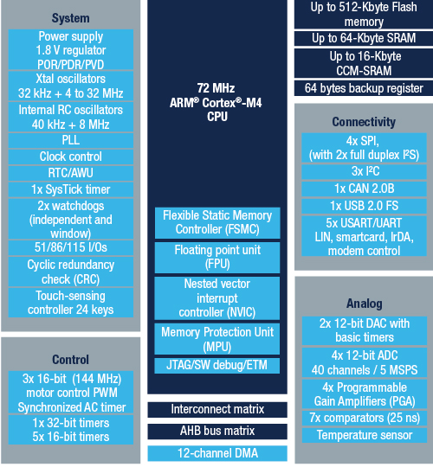
Memory.x
DataSheet
Reference Manual
User Manual
Application Notes
Image source : ST.com

Slide 5
Structure??
- Bare Metal
- Vendors HAL or Middleware
- CMSIS - Cortex Micro controller Software Interface Standard
- Full Me(n)tal – Code in Assembly

Slide 6
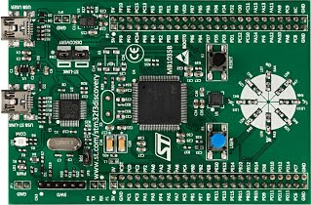
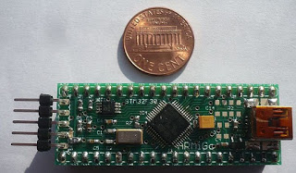
ST-LINK v2
STM32F303VC
STM32F3Discovery
Cortex-M4
STM32F303VCT6 microcontroller featuring 256-Kbyte Flash memory, 48-Kbyte RAM in an LQFP100.
On-board ST-LINK/V2 for PCB version A or B or ST-LINK/V2-B for PCB version C and newer.
> External application power supply: 3 V and 5 V
> L3GD20, ST MEMS motion sensor, 3-axis digital output gyroscope
> LSM303DLHC, ST MEMS system-in-package featuring a 3D digital linear acceleration sensor and a
3D digital magnetic sensor
> Ten LEDs:
Eight user LEDs: LD3/10 (red), LD4/9 (blue), LD5/8 (orange) and LD6/7 (green)
> Two push-buttons (user and reset)
Image source : ST.com, rssing.com

Slide 7
Required understanding
TIPs and Tricks Section!!
> RCC – Reset and Clock Control
https://bluetechs.wordpress.com/zothers/x/rcc/
AHB, APB1, APB2
RCC_AHB1Periph_GPIOE: GPIOE clock
> Watchdogs – Timebomb
Notes:
Rustc - “Cargo”
Cross compiling
Cargo build –target thumbv7em-none-eabihf
Eclipse (RUSTDT , Photon)
OpenOCD

Slide 8
setup
- Dev Environment
- Debug and Uploading !!
- led_roulette.rs
- Peripherals !!!!!!!!!!!!!!!!!!!!!!!!!!!!!!!!! ADC, DAC, GPIO, I2C, SPI, TIM, USART...
Notes:
Rustc - “Cargo”
Cross compiling
Cargo build –target thumbv7em-none-eabihf
Eclipse (RUSTDT , Photon)
OpenOCD

Slide 9
Debug & UPLOADING
openocd
-f interface/stlink-v2.cfg
-f target/stm32f3x.cfg
arm-none-eabi-gdb -q <TARGET>
rust-gdb ???
Notes:
Rustc - “Cargo”
Cross compiling
Cargo build –target thumbv7em-none-eabihf
Eclipse (RUSTDT , Photon)
OpenOCD

Slide 10
What means UnSAFE in RUST
- Deadlocks
- Leaks of memory or other resources
- Exiting without calling destructors
- Integer overflow
#![deny(unsafe_code)] | allow
#![no_main]
#![no_std]
#[entry]
fn main() -> ! { // return ! i.e. never terminates
Notes:
Rustc - “Cargo”
Cross compiling
Cargo build –target thumbv7em-none-eabihf
Eclipse (RUSTDT , Photon)
OpenOCD

Slide 11
Fundamental initialization steps required to use any of the STM32 peripherals:-
1. Enable clocks to the peripheral
2. Configure pins required by the peripheral
3. Configure peripheral hardware
Relevant firmware libraries are from crates:-
- cortex-m-rt
- cortex-m
- f3
// Enable Clocks
…
// Configure Pins
…
// Configure SysTick Timer
…
Notes:
Rustc - “Cargo”
Cross compiling
Cargo build –target thumbv7em-none-eabihf
Eclipse (RUSTDT , Photon)
OpenOCD

Slide 12
Tips and Tricks Section
>> IDE not so important. VIM is fine, lite and fast. **** BUT!!!!
>> Get comfortable using Cargo (clean/build --target) and RUSTUP / Nightly
Rather than editting .cargo/config….
The repetitive nature of daily usage helps memory retention and learning.
>> Scale DOWN project dreams initially.
RUST is RUST and works fine. Figuring out how embedded works is the struggle.
C/C++ embedded guys are interested in RUST. Their experience is VALID!
Making RUST AN EVEN MORE VALID BUSINESS CASE OPTION
BREAK
Notes:
Rustc - “Cargo”
Cross compiling
Cargo build –target thumbv7em-none-eabihf
Eclipse (RUSTDT , Photon)
OpenOCD

