Slide 1
Git & GitHub
How You Learn to Stop Worrying and Love Developing and Sharing Code

Slide 2
Welcome
Girl Develop It is here to provide affordable and accessible programs to learn software through mentorship and hands-on instruction.
Some "rules"
We are here for you!
Every question is important
Help each other
Have fun

Slide 3
Introductions
Notes:
This slide is just to remind me to introduce myself, and Sharon. I would also like to go around the room and have you say your name, and a few things you are hoping to get out of the class. Please don’t hesitate to ask questions at any time during the class. If you are confused, then someone else probably is too. That goes double if I use a term that you don’t understand. I will be using a lot of jargon, forking, cloning, and repo. It’s important understand these terms, but it can be hard to keep them all straight. I am always going to try to define terms that are specific to GitHub, but I might miss some. So again, please don’t hesitate to ask questions.

Slide 4
What this Class Will Go Over
Brief overview of git and github
Manage documents using git bash
configure your git user credentials
initializing a git repository
track, stage, and commit files
modify and remove files
branch and merge
Use GitHub to store and share
link git to github
push and pull
Notes:
So this is an outline of what this class will go over. I will talk, ever so briefly, about what git and github is. We will then learn how to manage documents using git bash, which is the command line for git. And we also learn how to store and share those git documents using GitHub.

Slide 5
Git and GitHub
Version Control Software
Track and Revert Changes
Collaborate
Git
Local (everything happens on your computer and ONLY your computer)
Controlled using command line (Git Bash)
GitHub
Internet based service developed by the good people of Linx
Free (for all public documents)
Can be used with Git to share and collaborate on projects
Notes:
Git is a version control software that can track your project, and can be used to recover documents. GitHub is a great way to collaborate and share projects, and we will talk a lot more on how all this is done, and go through some specific examples.

Slide 6
Before we get started
Create a new folder/directory
Make two new files and put them in your new folder
*you can use html-ipsum.com for psudo code
** when we get to the practice part of the class, you will use your real working directory, but for these examples use the one we created here
Notes:
Before we get started I would like to make a new folder (for people using windows), or a new directory for everyone else. Then I would like you to make two new files, you can use what ever text editor you are comfortable with. If you don’t have a text editor, you can create a text file with Notepad. Then save those files in your new directory. You can pull some psudo code from the site html-ipsum.com and use that in the file, or just make a comment.
This is for some examples we are going to work through as a class, when we get to the practice part of the class, that is when you are going to set-up your real directory.

Slide 7
Setting-up Git
Open Git Bash ( the command box )
Set user name and email
Use the same name and email address you used for you GitHub account
To check your settings use
** Change your editor
Vim is usually the default
Emacs
Others: https://help.github.com/articles/associating-text-editors-with-git/
$ git config --global user.name “Your name here”
$ git config --global user.email your.email@here
$ git config --list
$ git config --global core.editor emacs
Notes:
You only need to set you user credentials once. So you won’t need to go through this set-up again.
Once you check your settings, you should see your name and email near the bottom of the list.
Since most of us are using different editors, I’m not going to include them for this class. I just wanted to make you aware, you can and should set git to use one.

Slide 8
Getting Started with Git
Basic commands for Command Line
pwd => print working directory
cd <path to directory> => change directory
mkdir => make directory (makes a new folder in your current folder)
Go to the directory(folder) you just made
windows path: C:\Users\Regel\Documents\GDI
change it to: C:\\Users\\Regel\\Documents\\GDI or C:/Users/Regel/Documents/GDI
$ cd ~ Documents/Test
Notes:
First I want to go over some common commands. Now we are going to navigate to our test directory.

Slide 9
Getting Started with Git
Create a Git repository (in our working directory)
Look into our new repository
Shows you: untracked files
tracked files
changes to tracked files
$ git init
$ git status
Notes:
In this test directory, we are going to create a git repository. Now what does this do? It tells git to pay attention to all the files in this directory, or folder. It does this by creating some meta date, or a system so that it can keep track of everything.
You should see your two files under the Untracked heading. Now before we go any further, I want to talk about the life cycle of files using git.

Slide 10
The Life of a File in Git
Untracked
Tracked
Staged
Committed
Modified
$ git add <filename>
$ git commit –m “message”
Starts over
Notes:
We are going to pause here and talk about how git works, and what the workflow looks like. Every file starts as an Untracked file. In order for git to start tracking a file, we use the <git add> command. This tells git to both track the file and add it to the staging area.
Once it is in the staging area, it can then be committed. I’ll talk more about commit, but the quick version is, once a file has been committed, there is almost always a way to get back to that version of the file.
Once the file is committed, it then becomes a tracked file. Notice it doesn’t go all the way back to the untracked state. That is because git assumes once you commit a file, you are going to want to keep track of it.
Once the file is tracked, any time you change that file (from the last commit), git will mark it as modified. So you can see the files you need to stage and commit.

Slide 11
Going Through the Lifecycle
Start tracking files
This will add that file to the staging area
Run again, to see the change
Commit file
This will commit the files
$ git add <filename>
$ git status
$ git commit -m “initial commit”
Notes:
We can then use the git add command for the two untracked files, which both adds the files to the staging area, and tells git to start tracking it.
If you run git status, you should see two files in the staged area.
Then you can run the commit command, make sure you use the –m. If you don’t do that, git will open your editor and you have to make the commit message there. How that works depends on your editor, so for now we are going to add the message in the git command line. Once your files are commited, they go back to being tracked files. You can see that if you do the git status command again.
The next thing I want to go over, is how git handles commits.

Slide 12
How does git track files?
Initial Commit
2nd Commit
3nd Commit
add file
modify file
File a1
File a1
File a2
File b1
File b1
File b1
File a2
File c
File c
File c
Notes:
Git stores commits as “snapshots” of the entire git directory, not just tracking the differences.
Lets say you have two files in your initial commit. This is your first snapshot.
Then you add a third file. The next time you commit, the snapshot won’t just contain the new file, but all the files your are tracking in that directory.
Now lets say you make some changes to file A, when you commit those changes. Git will not only remember the changes in commit 3, but it will also remember where the previous version of file A is. That way, if something happens you can always revert to the previous versions. Because git uses this “snapshot” system, once a commit is made, you can most likely get back to previous snapshots. The in-between states, when files are staged or modified, those files are not in any snapshot. so you need to be careful. Those are the places you might lose information.

Slide 13
Modified files
Modify both files
Files should be labeled as modified
Add both files
Commit file
This will commit both of the modified files
$ git status
$ git add <filename1>
$ git add <filename2>
$ git commit -m “modified both”
Notes:
Open the files you just committed, and change something in both of them. Save. and close them.
Run git status again, and you should see both files as modified.
Run git add on both files, which will stage them.
Run git commit again.
So now we have a new snapshot, of both changed files

Slide 14
Looking back
This shows you all of the commit messages (and how git labeled it)
shows you the difference made in each commit
limits the output to last two entries (or any other number)
To get out of the log mode (if you haven’t limited it) , type <q>
$ git log
$ git log -p
$ git log -2
Notes:
The git log command will show you information about all of the commits you have made in this directory. But by the end of a project, that could be too much. So you can use these add-ons to limit what you are looking at. The –p , shows you the differences between the commits, and the -2 (or 3 or…) limits the output to the last two entries. You can even use them together.
When you just use the log command, they have some search features, to get out of log, you need to just type q.

Slide 15
Going Back
Un-staging files
Un-modifying a file
If you have modified a file, but haven’t committed it yet. You can undo all of the modifications by using
BE CAREFUL: Once done, you can not get that modified file back.
$ git reset HEAD <filename>
$ git checkout -- <filename>
Notes:
Remember, you can almost always get back to committed changes. But removing the changes before committing means, that those changes are gone.

Slide 16
Going Back
Undo Commit
This will undo your LAST commit.
BE CAREFUL: This is a way you can end up losing something.
Branching and merging is usually a better strategy when developing new code
$ git commit --amend
Notes:
This way you can add a forgotten file, or change the commit message, and it will show up as only one commit. It kind of adds it to the previous commit.
Remember, you can almost always get back to committed changes. But you will have to go through a data recovery process, that we don’t have time to get into today.

Slide 17
Other helpful commands
Get a log report in a format you want.
See the differences in log report in a format you want
$ git log --pretty=format :"%h - %an, %ar : %s"
$ git diff
Notes:
There are a lot of different format options, this is just an example

Slide 18
How git development is different
Start project
Start project
Milestone 1
Milestone 1
Milestone 2
Milestone 2
Milestone 3
Milestone 3
Finish
Finish
Notes:
Before I get into how branching works, I just want to talk about how using branching is a little different. The first figure is how a lot of projects go, with important advances in the project being saved, “somewhere safe”, but there are a lot of different version between those milestones. In git, if you have a working version or an important advance and you don’t want to mess it up, you can make a branch to start working on a different problem. This branch is basically a copy. However, I want to be clear git is not making an entire new copy of your directory. It’s more like knows what the last commit snapshot looks like, and will get that information as needed. I’m not going to go into the particulars, because we don’t have time. But you can get this information from GitPro, and free book online.
So once you make a branch, you can do whatever you want with it, and it won’t change any previous commits. You can also go back and forth from a branch to branch. The master is actually just the default branch. Once you like whatever you were working on for your branch, you can merge it back into the master branch. Or if you never like it, or it doesn’t work for the main project you can just keep it as a branch.

Slide 19
Branching
Create a branch
Switching to that branch
$ git branch <name>
$ git checkout <name>
Notes:
First we create a branch, then we have to switch to that branch
.

Slide 20
Test out Branching
Create a branch and switch to that branch
Use git status to see what branch you are on
Make a change in one of your documents, save, and close the file
use again to see your modified file
commit that document
Switch back to the main branch
Open your document back up: your change will be gone
Switch back to branch_one: your change will be there
$ git branch branch_one
$ git checkout branch_one
$ git status
$ git status
$ git commit –a –m “branch change”
$ git checkout master
Notes:
First we create a branch, then we have to switch to that branch
The –a (is add) –m(is message) . These are used as a shortcut when committing, it skips the add step.
So now you like what you did in your branch. We are now going to merge it into the master branch.

Slide 21
Merging
Go to the branch you want to merge into
Merge with branch
It is that easy
If there is a problem, git will tell you there is a merge conflict
$ git checkout master
$ git merge branch_one
Notes:
Go to the branch you want to merge into, then use the merge command with the branch you want merged in.
That’s all there is to it. Some times there are merge conflicts. When this happens, git will normally open your editor and point out which area’s need to be changed in order to merge. So you just need to change those areas and merge again.
Sometimes merge conflicts happen when you are working with other people, and I will talk about that when we talk about GitHub

Slide 22
Cleaning up
Removing Branches
This removes any branches you don’t need anymore
Warning: Make sure you commit your merged file before you get rid of anything!
$ git branch –d <branch you want to delete>
Notes:
Go to the branch you want to merge into, the use the merge command with the branch you want merged in.
That’s all there is to it. Some times there are merge conflicts. When this happens, git will normally open your editor and point out which area’s need to be changed in order to merge. So you just need to change those areas and merge again.
Sometimes merge conflicts happen when you are working with other people, and I will talk about that in the next few slides.

Slide 23
Next some practice. But first any questions so far?

Slide 24
Practice
Initialize a git repository
Add and Commit files you want to track
Try creating a branch and merging back to the master branch
Ask for help if you get stuck, that is what we are here for!

Slide 25
Next up is GitHub
(and a break if we have time)

Slide 26
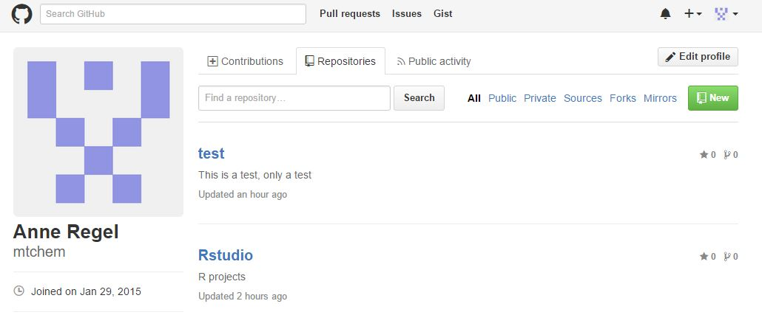
Creating a New Repository (repo)
Log into your GitHub account, and click on New (the green button)
Notes:
Go to the repository tab, and click on the green button.

Slide 27
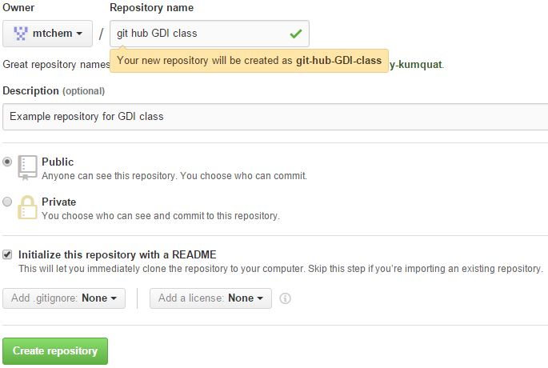
Creating a New Repository (repo)
Notes:
Call your new repo anything. I would suggest Test.
Type in a description
And make sure you initialize with a README
Then Create repository

Slide 28
Fork Someone Else’s Repo
Find some interesting project
Use the search feature to find something
by topic
by name
Go to my GitHub account and fork the repo for this class
https://github.com/mtchem/git-hub-GDI-class
Fork the repo into your account
This creates a copy in your GitHub account
Notes:
That is the actually terminology, I swear. Instead of making your own, you can find one in GitHub. You can use the search function (that works like pretty much any other search function) or you can go to my account and fork the repo I made for this class

Slide 29
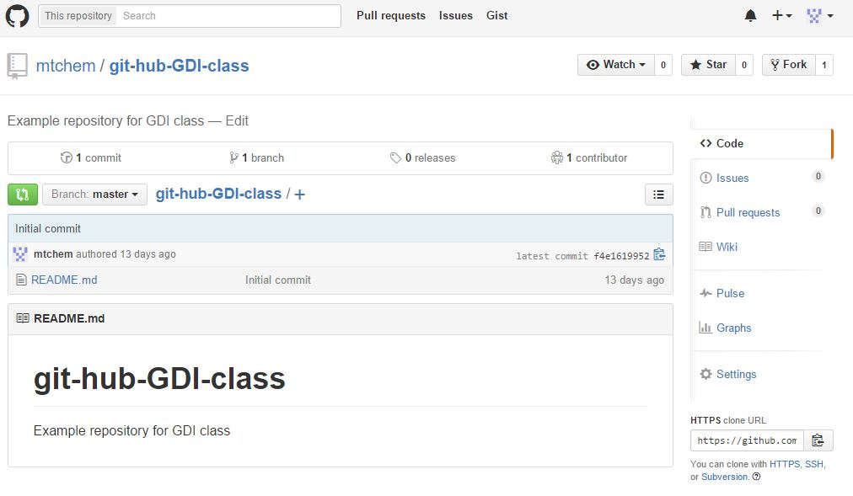
Fork a Repo

Slide 30
Create a Local Copy
Clone a copy of a GitHub repo
This creates a copy in your local working directory
$ git clone https://github.com/mtchem/test.git
Notes:
This is how you clone a local copy of any repo on GitHub into your hard drive. This includes your own repos.

Slide 31
Work flow when Collaborating with GitHub
1. Create a branch from master.
2. Make some commits to improve the project.
3. Push this branch to your GitHub project.
4. Open a Pull Request on GitHub.
5. Discuss, and optionally continue committing.
6. The project owner merges or closes the Pull Request.
* This was taken from ProGit, an open source book at https://progit.org/
Notes:
Before we get to far into GitHub, I wanted to show you what the workflow when collaborating with GitHub looks like.

Slide 32
Work Through and Example
Clone a copy of the repo you just created (with the README) in your GitHub account
This creates a copy of the repo on your local working directory
Change your working directory to your new repo
Create a new branch
$ git clone <https://new repo>
$ cd <path to new repo>
$ git branch <branch name>
Notes:
Make sure you are in the right directory. You might need to use the cd command.

Slide 33
Work Through an Example
Switch to the new branch
Modify the README file (it should be the only thing in there)
Commit the changes
$ git checkout <branch name>
$ git commit –a –m “message”
Notes:
We are now going to push our changes up to the remote repository. We are using GitHub, but git can be used with private servers too.
When you do the push you are going to have to put your git hub name and password in.

Slide 34
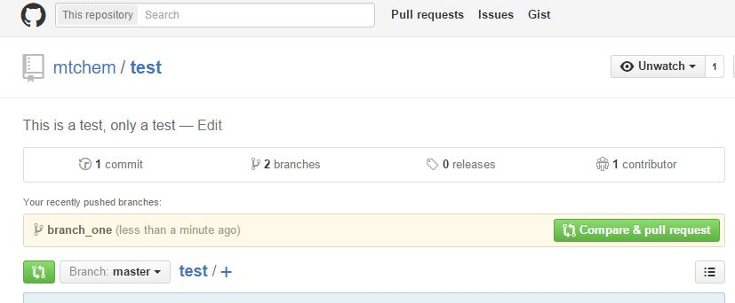
Work Through an Example
Push our new branch back up to our GitHub
Go to your GitHub account and a new pull request should be there
$ git push origin <name of branch>
Notes:
We are now going to push our changes up to the remote repository. We are using GitHub, but git can be used with private servers too. At this point you will need to enter in you user name and password.
The go to you github account and a pull request should be there.
When we click on the green button, a pull request opens. This is where we describe the changes we made. When we are working with other people, the better this is filled out, the more likely the request will be accepted.

Slide 35
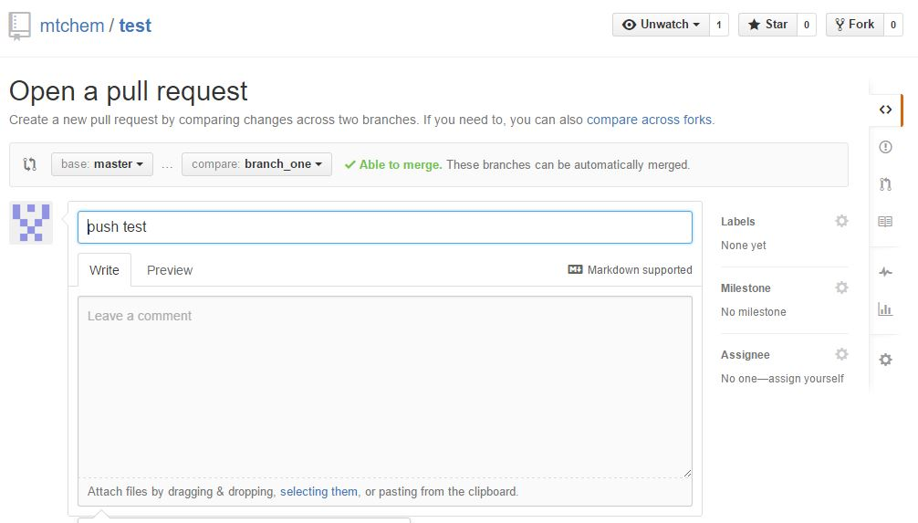
Work Through an Example
Fill out the pull request
Press the “Create Pull Request” button
This will take you to a screen with different tabs about the pull request
Conversation
Commits
Files changed
Notice the link “command line instructions”
If you can’t automatically merge, this link will give you options on how to deals with any merge conflicts
Last thing is to Merge pull request (and the confirm)
Notes:
I want you to kinda look around this screen before we merge the files. This is where the discussion part of the workflow happens
So look at the different tabs. You made the request so it isn’t giving you much information, but when you start working with other people you will want this information. Notice in the Conversation tab there are two green buttons a Merge pull request and a comment button.
This is where you can either accept the changes, or ask questions, or close the pull request (reject the request).

Slide 36
Now time for Practice!
Notes:
I would like you to pair off and try working through that last example, but instead of using your own repo, clone your partners.
Sharon and I will be here to answer any questions. I also encourage you to go back to the start and set up a git directory in one of your real directories.

Slide 37
Practice
Make a new repo, or find a repo on GitHub
Clone that repo using git
3. Create a branch from master (of your new repo).
4. Make some commits to improve the project.
5. Push this branch to your GitHub .
6. Open a Pull Request on GitHub.
7. Discuss, and optionally continue committing.
8. The project owner merges or closes the Pull Request.

Slide 38
Last Thing!
Thank you Galavanize for this space
Thank you Sharon, for being a TA
I used a LOT of information from the open source book ProGit (https://progit.org/) I highly recommend it.
And Thank YOU!

