Slide 1
HACK FOR HUMANITY · POWERED BY QWEN
Generative
Turn any prompt, PDF, or doc into a narrated Manim educational video.
No sign-in needed
Realtime updates
AI self-healing renders
Team Generative · AI Hack for Humanity
Notes:
Timing: 15s. Hook: 'What if any teacher could get a 3Blue1Brown-style video for any lesson, in minutes, for free?' Introduce Generative in one sentence. Everything you'll see was generated by the pipeline — no human animation.

Slide 2
Great teaching videos are locked behind studios
?
Animated lessons take weeks
3Blue1Brown-style math videos need expert animators. A single 10-minute lesson can take tens to hundreds of hours of skilled work.
250M+
children and youth are out of school worldwide
UNESCO estimate — millions more learn without adequate materials
$
Schools can't afford them
Under-resourced classrooms and NGOs spend budgets on basics. Quality visual teaching stays a luxury reserved for well-funded platforms.
10–100 hrs
!
Text answers don't teach
Chatbots return words, not understanding. Learners — especially in math and science — need to see ideas move.
of expert work per finished animated lesson — the cost Generative drives to near zero
02
Notes:
Timing: 45s. The gap: demand for visual education is exploding, supply is capped by human animators. Anchor with the UNESCO number. Punchline: 'The bottleneck is production, not knowledge.'

Slide 3
One prompt in. A narrated lesson out.
Generative plans, writes, animates, narrates and renders a complete Manim video — in minutes, for free, with no account required.
1
2
3
Any input
Narrated animation
Zero friction
A prompt, a PDF, or a DOCX. Drop in a textbook chapter and get back a visual lesson with narration and citations.
Qwen directs a production script, then writes real Manim scene code. A render microservice animates it with voiceover.
No sign-in to generate. Live realtime status — no polling. Videos attach to a guest id and are auto-claimed when you sign up.
Prompt → Director script → Manim code → Rendered, narrated video
03
Notes:
Timing: 30s. Walk the three pillars fast — the demo carries the weight. Emphasize 'no account needed': judges can try it themselves in seconds.

Slide 4
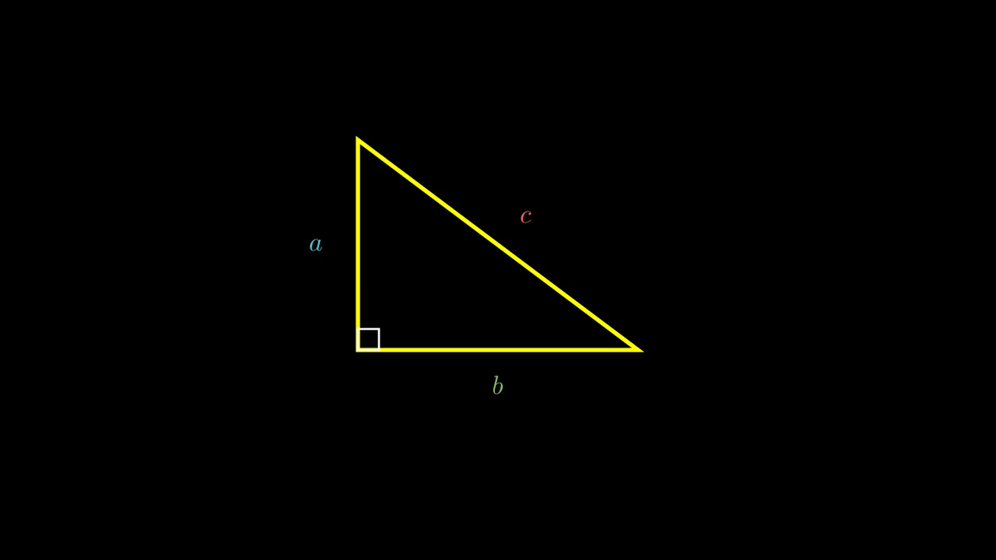
Live demo: from prompt to narrated proof
1
Open the app — paste a prompt or attach a PDF/DOCX
2
Hit generate; the card shows live status via Convex realtime
3
Qwen researches, directs, codes — and repairs its own render errors
4
The finished video appears with narration, thumbnail and sources
“Explain the Pythagorean theorem with a visual proof”
Real output from our local test run — prompt to finished narrated video, zero human editing.
5
Play it, share it, like it — or sign up to claim it to your library
04
Notes:
Timing: 90s. THE moment of the pitch. Start generation early (it takes minutes) or show the pre-rendered Pythagorean video while a fresh one generates. Point at the live status flipping in realtime. If asked about render time: ~20 min worst case including retries; faster on clean code.

Slide 5
A self-healing pipeline, end to end
1
Upload
2
Schedule
3
Trigger
4
Research
Next.js API takes the prompt + file; unpdf/mammoth extract text as context
Convex inserts the video doc and schedules a durable action
The action fires the generate-video task on Trigger.dev
Qwen Plus builds a search query; Google CSE adds sources (optional)
5
Direct
6
Code
7
Render + heal
Qwen Max writes a structured production script for the lesson
Qwen Plus picks Manim skills; Qwen Max writes the scene code
Manim service renders with narration. Errors go back to Qwen for repair — up to 4 attempts. Result lands on R2 and Convex flips to ready.
The browser subscribes to Convex — every status change appears instantly, no polling, no refresh.
05
Notes:
Timing: 45s. Don't read all seven cards — trace one path with your hand: upload → Convex → Trigger.dev → Qwen (twice) → render → back to Convex. Land on the self-heal loop in card 7: 'the AI debugs its own animation until it renders.'

Slide 6
Qwen runs the whole production
Qwen3.8-Max
Qwen3.7-Plus
The Director & Engineer
The Scout & Editor
Writes the production script, the full Manim scene code, and every repair when a render fails. The heavy reasoning that makes the video correct.
Fast model for quick decisions: extracts web-search queries for research and selects the right Manim skills from our curated pattern library.
Robust structured output
Streamed generations
Skill library
Some endpoints reject tool-calling — so we request plain JSON, validate with zod, and retry with the error as feedback.
Long code-writing calls are streamed end to end, so gateway idle timeouts (504s) never kill a 3-minute generation.
Curated Manim patterns (skills/*.md) get injected into prompts — layout rules, overflow guards, animation idioms that prevent whole bug classes.
06
Notes:
Timing: 30s. Key message: this isn't one API call — it's a two-model crew. Max thinks, Plus scouts. The engineering notes below are your answers if judges probe reliability.

Slide 7
Battle-tested, serverless-scale stack
Next.js 16
Convex
Trigger.dev
App Router frontend: landing, watch page, public vault, auth dialog.
Database + realtime queries + scheduled actions + Better Auth component. Zero polling anywhere.
Durable task engine — renders can run 20+ minutes with retries without holding a request open.
Qwen · ModelScope
Manim microservice
Cloudflare R2
All intelligence via the OpenAI-compatible endpoint. Two models, five calls per video.
Python render API with text-to-speech narration; the same engine behind 3Blue1Brown-style math videos.
Finished videos and thumbnails served from a custom domain — no egress fees as the library grows.
07
Notes:
Timing: 15s (glanceable — don't read it). If asked: everything is managed/serverless; a single laptop runs the whole demo. Auth is email+password via Better Auth on Convex.

Slide 8
Hard problems we actually solved
LLMs write broken animation code
Structured output that endpoints refuse
Self-healing loop: the renderer's error output is fed back to Qwen Max, which repairs the scene — up to 4 attempts, fully automatic.
The ModelScope endpoint rejects tool-calling modes. We ask for plain JSON, validate with zod, and retry with the validation error as feedback.
Long generations vs gateway timeouts
Instant access vs user accounts
Every model call streams. State lives in Convex + Trigger.dev, so a 20-minute render survives disconnects and deploys.
Guests generate freely with a local guest id; the moment they sign up, every guest video is claimed into their account automatically.
08
Notes:
Timing: 30s. This is your engineering-credibility slide. Pick the self-heal loop if you only discuss one — it's the most impressive and most human: we let the AI debug itself.

Slide 9
Why this is for humanity
Free by design
No paywall, no sign-in wall. Any student with a browser gets a personal animation studio — the same tooling that once required a production team.
FREE
Teachers multiply
A syllabus PDF becomes a shelf of visual lessons in an afternoon. Prep time collapses from weeks to minutes.
TEACH
Accessible learning
Narrated animation serves diverse learners — visual, auditory, self-paced. Qwen's multilingual reach opens the door to lessons in the learner's own language.
ACCESS
Open knowledge
Every lesson can be published to the community vault — a growing, free library of explained ideas for anyone, anywhere.
OPEN
09
Notes:
Timing: 30s. Tie back to the 250M number from slide 2. The thesis: knowledge isn't the scarce resource — explanation is. Generative makes explanation free.

Slide 10
Where we take it next
1
Multilingual narration
Generate the same lesson in the learner's language — Qwen already speaks dozens.
2
Teacher studio
Review and tweak the director script before rendering; bundle curriculum packs.
3
Community vault
Search, remix and rate published lessons; credit original prompts.
4
Faster renders
Warm render pools and scene caching to push 20 minutes toward 5.
5
Low-bandwidth mode
Audio-first and offline bundles for schools with limited connectivity.
10
Notes:
Timing: 15s. One line: 'The pipeline is proven — next is reach: languages, teachers, and low-bandwidth classrooms.'

Slide 11
Generative
Any prompt. A narrated lesson. Powered by Qwen.
Live demo: localhost:3000
Sample video: videos.foldex.space
Thank you · Questions welcome
Built for Hack for Humanity with Qwen
Notes:
Timing: 15s. Close the loop: 'We turned a prompt into a lesson in front of you. Imagine what a million teachers do with that.' Invite judges to try it on their phones/laptops right now.

