Slide 1

MGMT 638
Session 9: Asset Pricing and Machine Learning
Kerry Back
Fall 2025

Slide 2

Session Agenda: A Deep Dive into Predictive Modeling
1
Data and Code Pipeline: data4 files, scripts, and outputs
2
Foundational Research: Gu-Kelly-Xiu, 2020
3
Data Creation: create_data4.py
4
Model Training and Prediction: train_predict_data4.py (Rolling Windows)
5
Current Model Output: data4_current.xlsx, data4_model.pkl
6
Performance Analysis: analyze_portfolios.ipynb (Historical Returns)
7
Model Interpretation: analyze_model_features.ipynb (Feature Analysis)

Slide 3

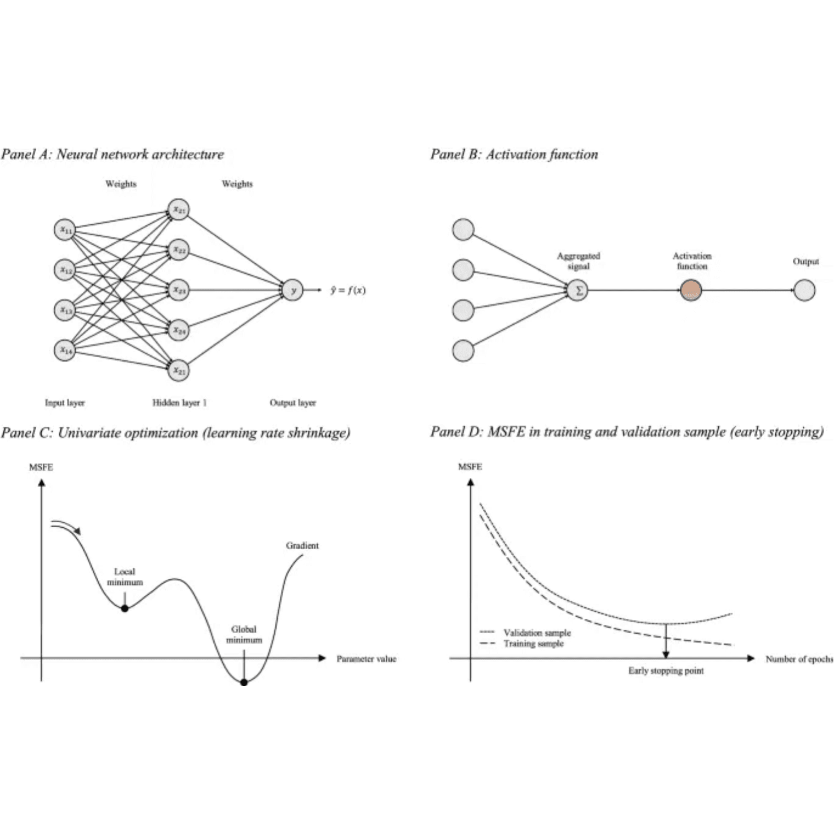
Foundational Research: Asset Pricing and Machine Learning
Asset Pricing and Machine Learning
Authors: Gu, Kelly, and Xiu
Year: 2020
Source: Review of Financial Studies (RFS)
Resources:
📄 PDF: Gu_Kelly_Xiu_RFS_2020.pdf
🎥 Video: Gu_Kelly_Xiu_RFS_2020.pdf.mp4
📚 NotebookLM Reference

Slide 4

Data Overview: data4.parquet - A Comprehensive Panel Dataset
Purpose: Monthly panel dataset for predicting stock returns with comprehensive coverage of price data, fundamental accounting metrics, and stock classifications.
591,892
4,851
Stock-Month Observations
Unique Tickers (incl. delisted)
Feb 2011 – Nov 2025
15 Years
Time Period
Historical Coverage
Dataset Components:
✓ Price Data: Closing prices, market capitalization, price-to-book ratios
✓ Fundamentals: Asset growth, ROE, gross margins, leverage ratios from 10-K filings
✓ Classifications: Sector, industry, and market cap-based size categories
✓ Created by: create_data4.py (template for similar datasets)

Slide 5

Data Variables (Part 1): Returns and Price Data
Identifiers and Returns
ticker, month
Stock identifier and time period
return
Monthly return (decimal)
momentum
12-month return, skipping the most recent month
lagged_return
Prior month's return
Price Data (End-of-Prior-Month)
close
Closing price
marketcap
Market capitalization (millions USD)
pb
Price-to-book ratio

Slide 6
Data Variables (Part 2): Fundamentals and Classifications
Fundamentals (from 10-K Filings)
Classifications
asset_growth
1-year percent change in total assets
sector
Industry sector classification
roe
Return on equity
industry
Specific industry classification
gp_to_assets
Gross profit / total assets
size
Market cap category: Mega / Large / Mid / Small / Micro / Nano-Cap
grossmargin
Gross profit margin ratio
assetturnover
Asset turnover efficiency
leverage
Financial leverage ratio

Slide 7
Key Methodology: Avoiding Bias and Defining Size
Avoiding Look-Ahead Bias
Filters Applied
Price data (close, marketcap, pb) lagged by 1 month
▸
All tickers included (including delisted) to avoid survivorship bias
▸
Fundamentals available in first full month after filing date
▸
Penny stock filter: close ≥ $5.00
▸
Forward-filled until next filing
▸
Size Categories
Based on percentile cutoffs within each month
▸
Mega: 1.5%
▸
Large: 20%
▸
Mid: 27%
▸
Small: 33%
▸
Micro: 15%
▸
Nano: 3%
▸

Slide 8
Data Creation Script: create_data4.py
Function
Data Sources
Python script that generates data4.parquet from the Rice Data Portal
Queries SEP, DAILY, SF1, and TICKERS tables via API
Methodology
Purpose
Implements proper time-series methodology to ensure no look-ahead bias
Designed as a template for creating similar ML-ready datasets
Documentation & Output
Well-documented with 580 lines including extensive comments. Outputs raw data only (percentile ranking done in training script)

Slide 9
Data Creation Configuration: Key Parameters in create_data4.py
Date Range
Penny Stock Filter
START_YEAR
2010
MINIMUM_PRICE
$5.00
API Efficiency
Size Percentile Cutoffs
BATCH_SIZE
500
tickers per query
NANO_CUTOFF
3.34%
MICRO_CUTOFF
18.83%
SMALL_CUTOFF
51.46%
MID_CUTOFF
78.60%
LARGE_CUTOFF
98.53%

Slide 10
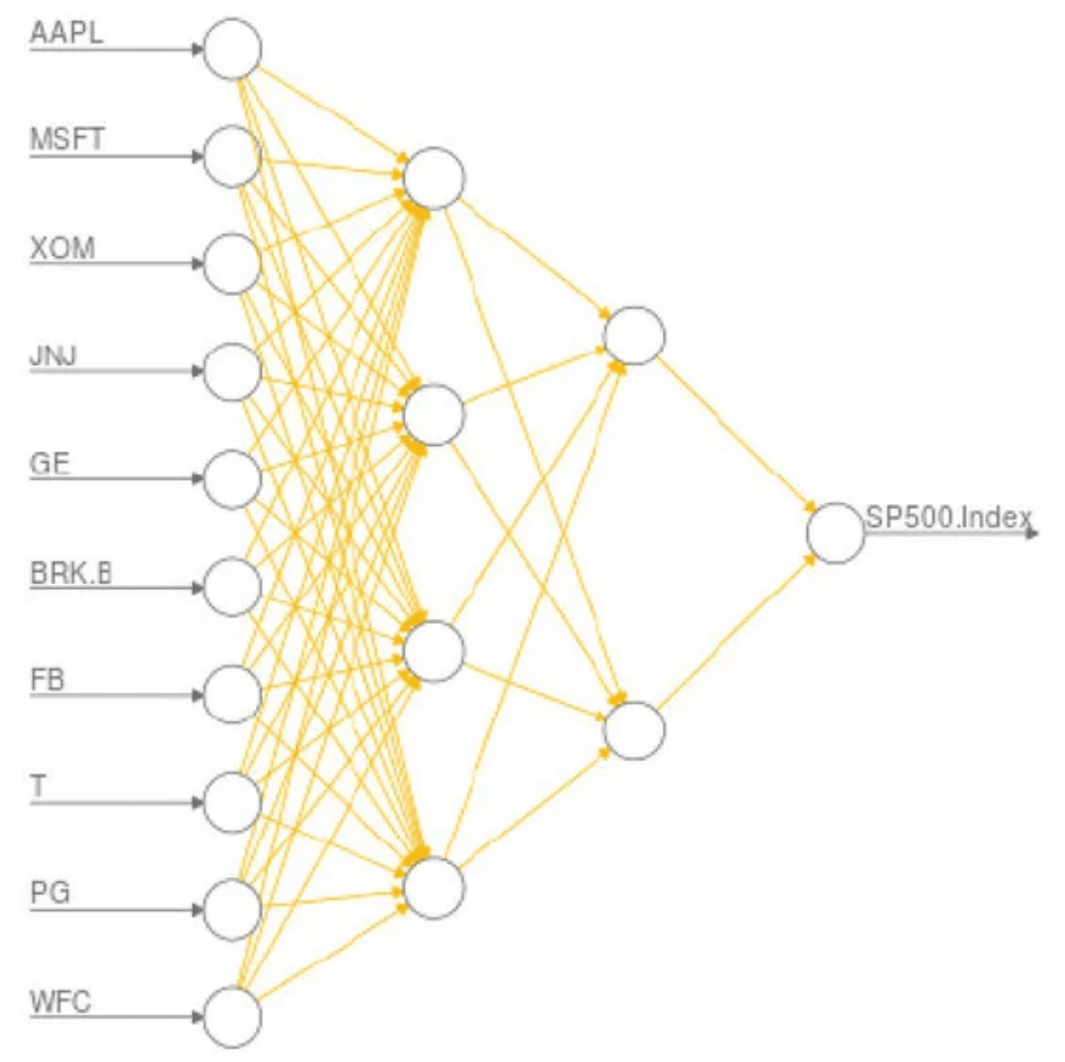
Training and Prediction Pipeline: train_predict_data4.py
Complete pipeline from raw data to portfolio analysis. Consolidates training, prediction, and portfolio formation with comprehensive outputs.
Four Main Steps:
1
Create percentile-ranked features from raw data
2
Train LightGBM with 12-month rolling windows (data4_predict.parquet)
3
Form decile portfolios and analyze (data4_portfolios.csv)
4
Predict current month and save model (data4_current.xlsx, data4_model.pkl)

Slide 11

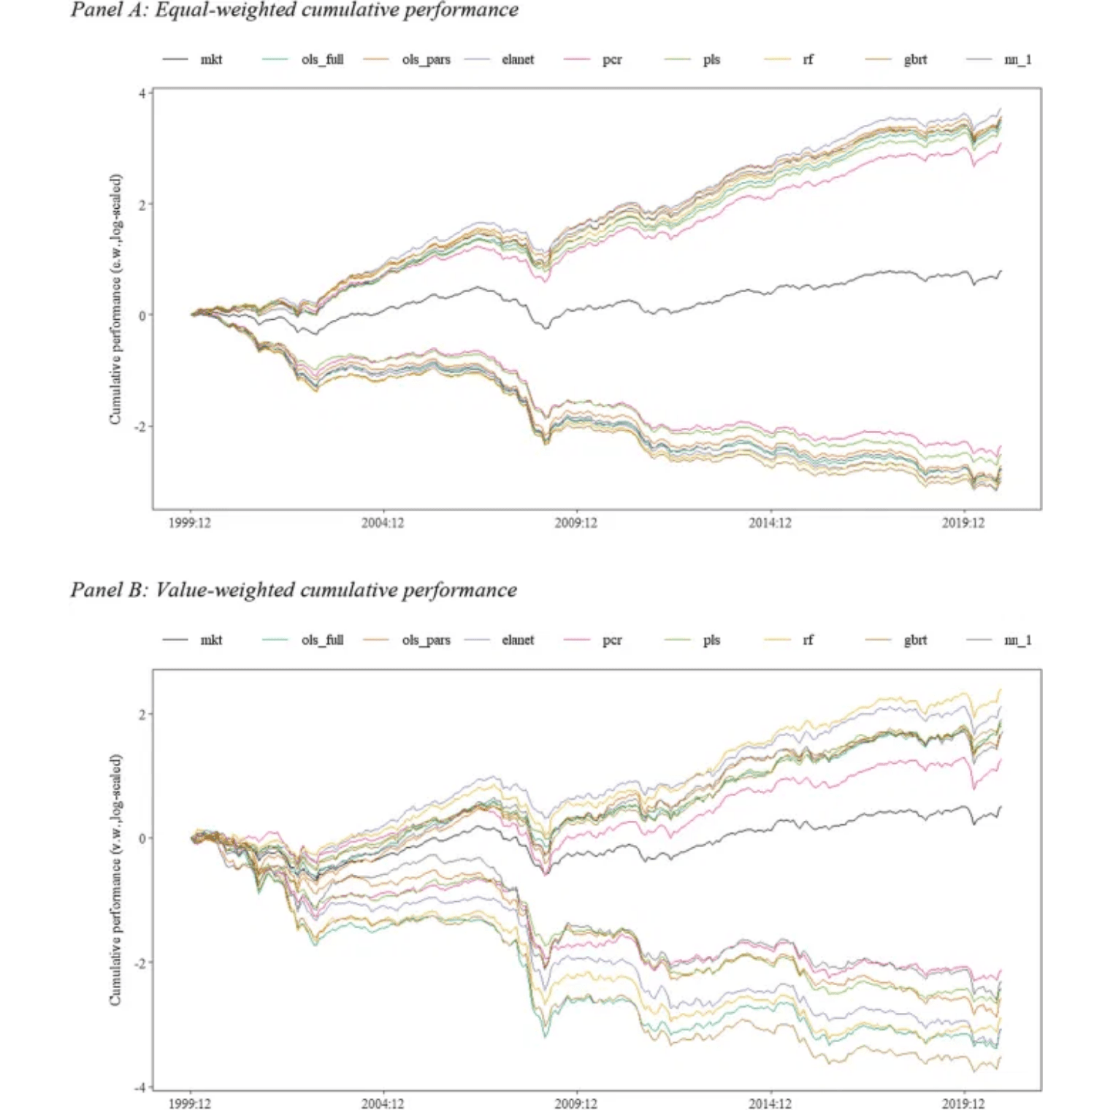
Portfolio Performance: data4_portfolios.csv
Content: Portfolio returns generated by sorting on LightGBM predictions
Scale: 1,650 rows (165 months × 10 deciles)
Timeframe: February 2012 to October 2025
Columns:
month – Prediction month
decile – Portfolio rank (1 = lowest predicted, 10 = highest)
return – Average realized return in decile
predict – Average predicted return rank in decile
Key Performance Result:
2.50%
Average monthly spread (Decile 10 − Decile 1)
▸
▸
▸
▸

Slide 12
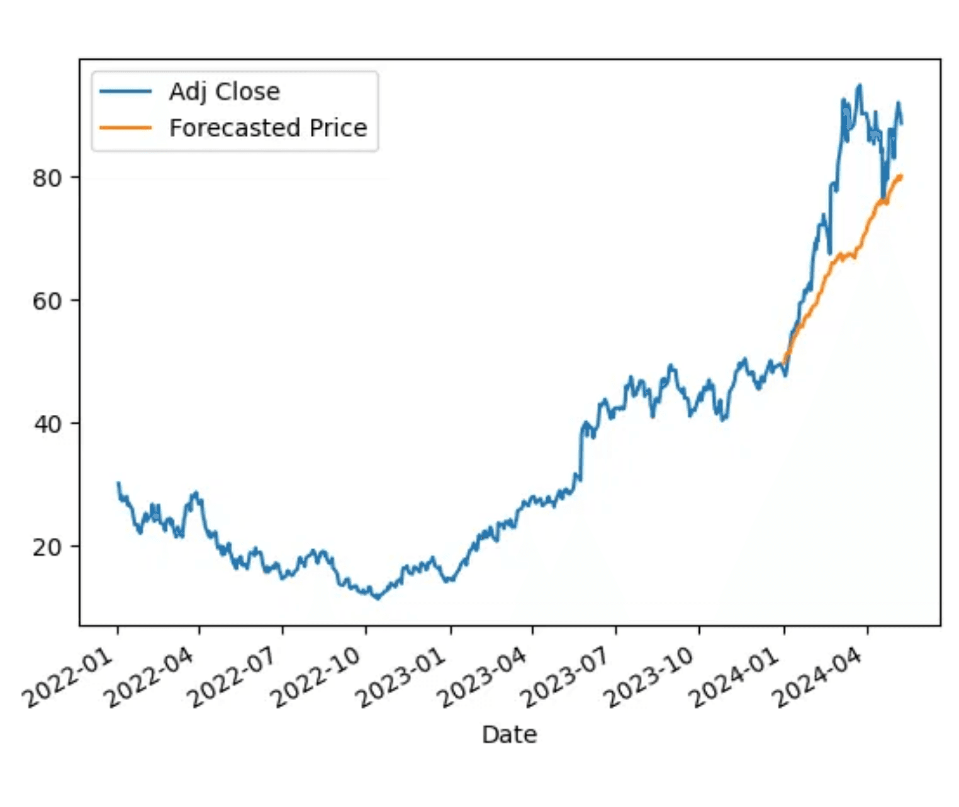
Current Month Predictions: data4_current.xlsx
Purpose
Provides current month predictions for live trading or analysis
Creation
Created by Step 4 of train_predict_data4.py
Training Window
Trains on the last 12 complete months
Key Columns
ticker – Stock ticker symbol
predict – Predicted return rank (sorted highest to lowest)
All features from data4.parquet for current month
Use Cases
Identify top/bottom predicted stocks
✓
Analyze stock characteristics
✓
Construct portfolios based on predictions
✓

Slide 13
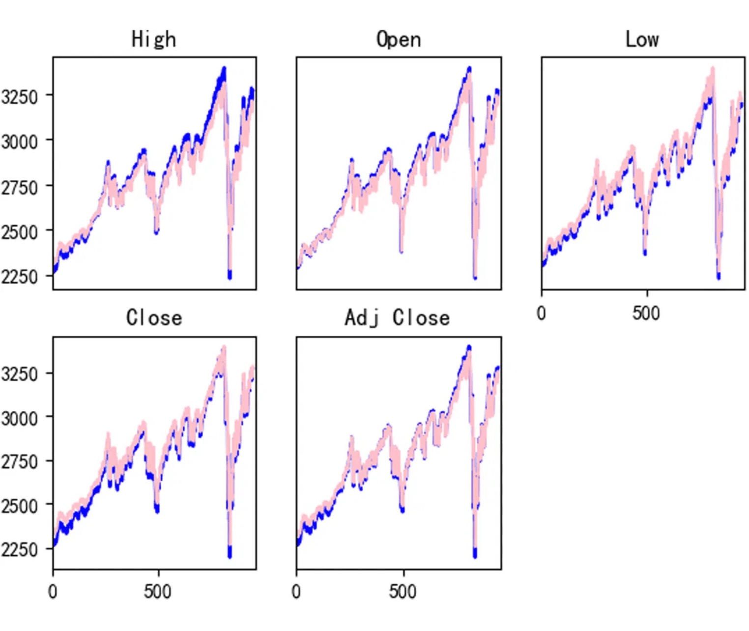
Analyzing Performance: analyze_portfolios.ipynb
Purpose
Jupyter notebook for in-depth analysis of decile portfolio performance
Input & Output
Reads: data4_portfolios.csv (165 months × 10 deciles)
Creates publication-quality visualizations and statistics, saving three PNG figures
Analysis Components
Mean returns bar chart by decile
▸
Sharpe ratios bar chart by decile
▸
Cumulative returns (linear and log scale subplots)
▸
Summary statistics (mean, volatility, Sharpe, min, max)
▸
Long-short portfolio (D10 − D1 spread performance)
▸

Slide 14
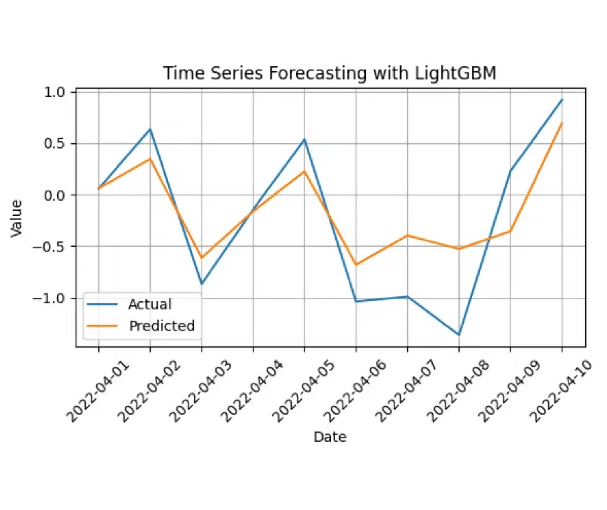
Interpreting the Model: analyze_model_features.ipynb
Jupyter notebook for analyzing how the trained LightGBM model uses features to make predictions. Reads data4_model.pkl and data4_current.xlsx.
Analysis Components:
1
Feature importances pie chart from LightGBM split gain
2
Linear regression of predictions on percentile-ranked features
3
Coefficient bar chart (positive = green, negative = red)
4
Comparison table of feature importance ranks vs. coefficient ranks
Key Insight:
Large rank differences between importance and coefficients reveal non-linear feature effects in the model

Slide 15

LightGBM Hyperparameters for Return Prediction
Tree Structure
Learning Parameters
num_leaves
learning_rate
31
0.05
Max leaves per tree (up to 30 splits/tree)
Moderate learning rate
max_depth
n_estimators
6
100
Shallow trees prevent overfitting to noise
Fixed 100 boosting iterations (trees)
Regularization
Training Methodology
min_child_samples
subsample
12-month rolling window
50
0.8
No validation set
Minimum samples per leaf
Row sampling for variance reduction
No early stopping
colsample_bytree
reg_alpha
0.8
0.1
Column sampling for variance reduction
L1 regularization (Lasso)
reg_lambda
1.0
L2 regularization (Ridge)

Slide 16
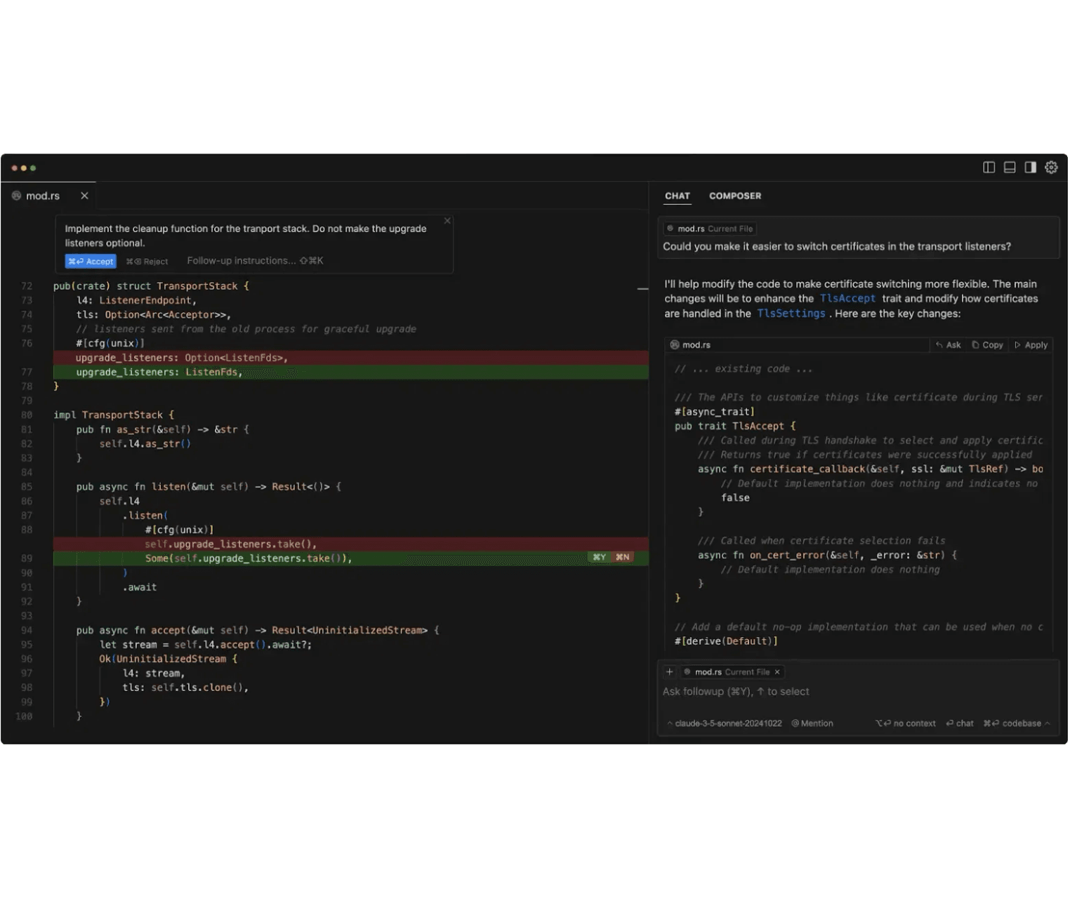
AI Code Editors: The Rise of VS Code Forks
Cursor
Fork of VS Code by Anysphere Inc. (San Francisco)
Launched:March 2023
First Stable Release (v1.0):June 2025
🔗 cursor.com
Windsurf
Fork of VS Code by Codeium
Launched:November 13, 2024
Branded as "agentic IDE" with AI Flows for autonomous code generation
🔗 windsurf.com

Slide 17

Google's Strategic Acqui-Hire of Windsurf
Timeline
Why OpenAI's Deal Collapsed
Initial Offer
Microsoft's IP Rights: Microsoft (OpenAI's largest investor) has rights to OpenAI's acquired intellectual property
▸
OpenAI offered $3 billion to acquire Windsurf
Privacy Concerns: OpenAI wanted to keep Windsurf technology private from Microsoft
July 11, 2025
▸
Exclusivity period expired
Microsoft's Refusal: Microsoft refused to allow the acquisition without sharing the technology
Post-Expiration
▸
Google executed $2.4B "reverse acqui-hire" + licensing deal
Deal Collapse: When exclusivity period expired on July 11, 2025, the deal collapsed entirely
Key Appointments
▸
CEO Varun Mohan and co-founder Douglas Chen joined Google DeepMind
Cognition Acquisition: Cognition later acquired the remaining Windsurf assets for $250M
▸
Remaining Assets
Google received non-exclusive license to Windsurf's AI technology

Slide 18
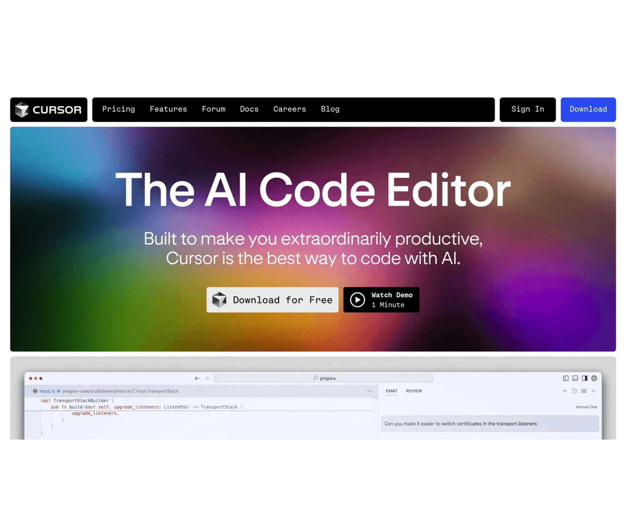
Introducing Google Antigravity: The Agent-First IDE
Release
Announced: November 18, 2025 (alongside Gemini 3)
Availability: Free public preview available immediately
Platforms: Windows, macOS, and Linux
Features
Fork of VS Code with agent-first interface
▸
Powered by Gemini 3 (also supports Claude Sonnet 4.5)
▸
Autonomous agents for planning, executing, and verifying tasks
▸
Integrates editor, terminal, and browser into unified experience
▸
Download
antigravity.google/download

