Slide 1
Cost of Equity Analysis for WMT

Slide 2
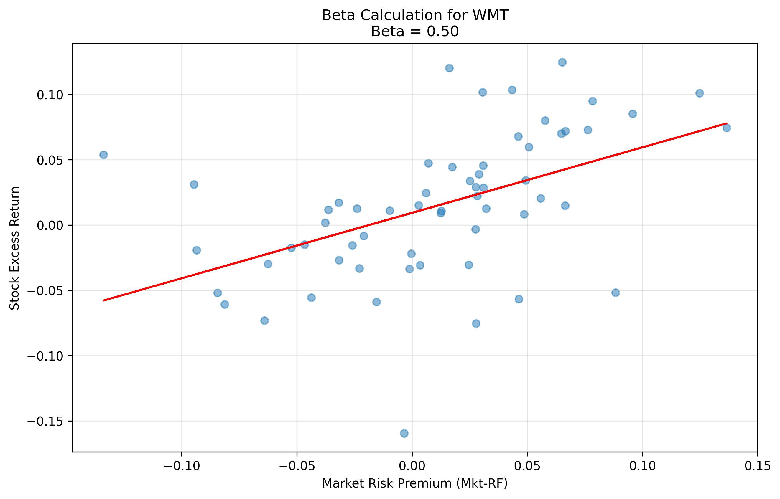
Beta Calculation for WMT

Slide 3
Cost of Equity Components
Component | Value | Source
Risk-free Rate | 4.20% | 3-month T-bill (FRED)
Beta | 0.50 | Regression using monthly returns
Market Risk Premium | 8.24% | Fama-French factors (1926-present)
Cost of Equity | 8.33% | rf + β × MRP

