Slide 1
Cost of Equity Analysis for AAPL

Slide 2
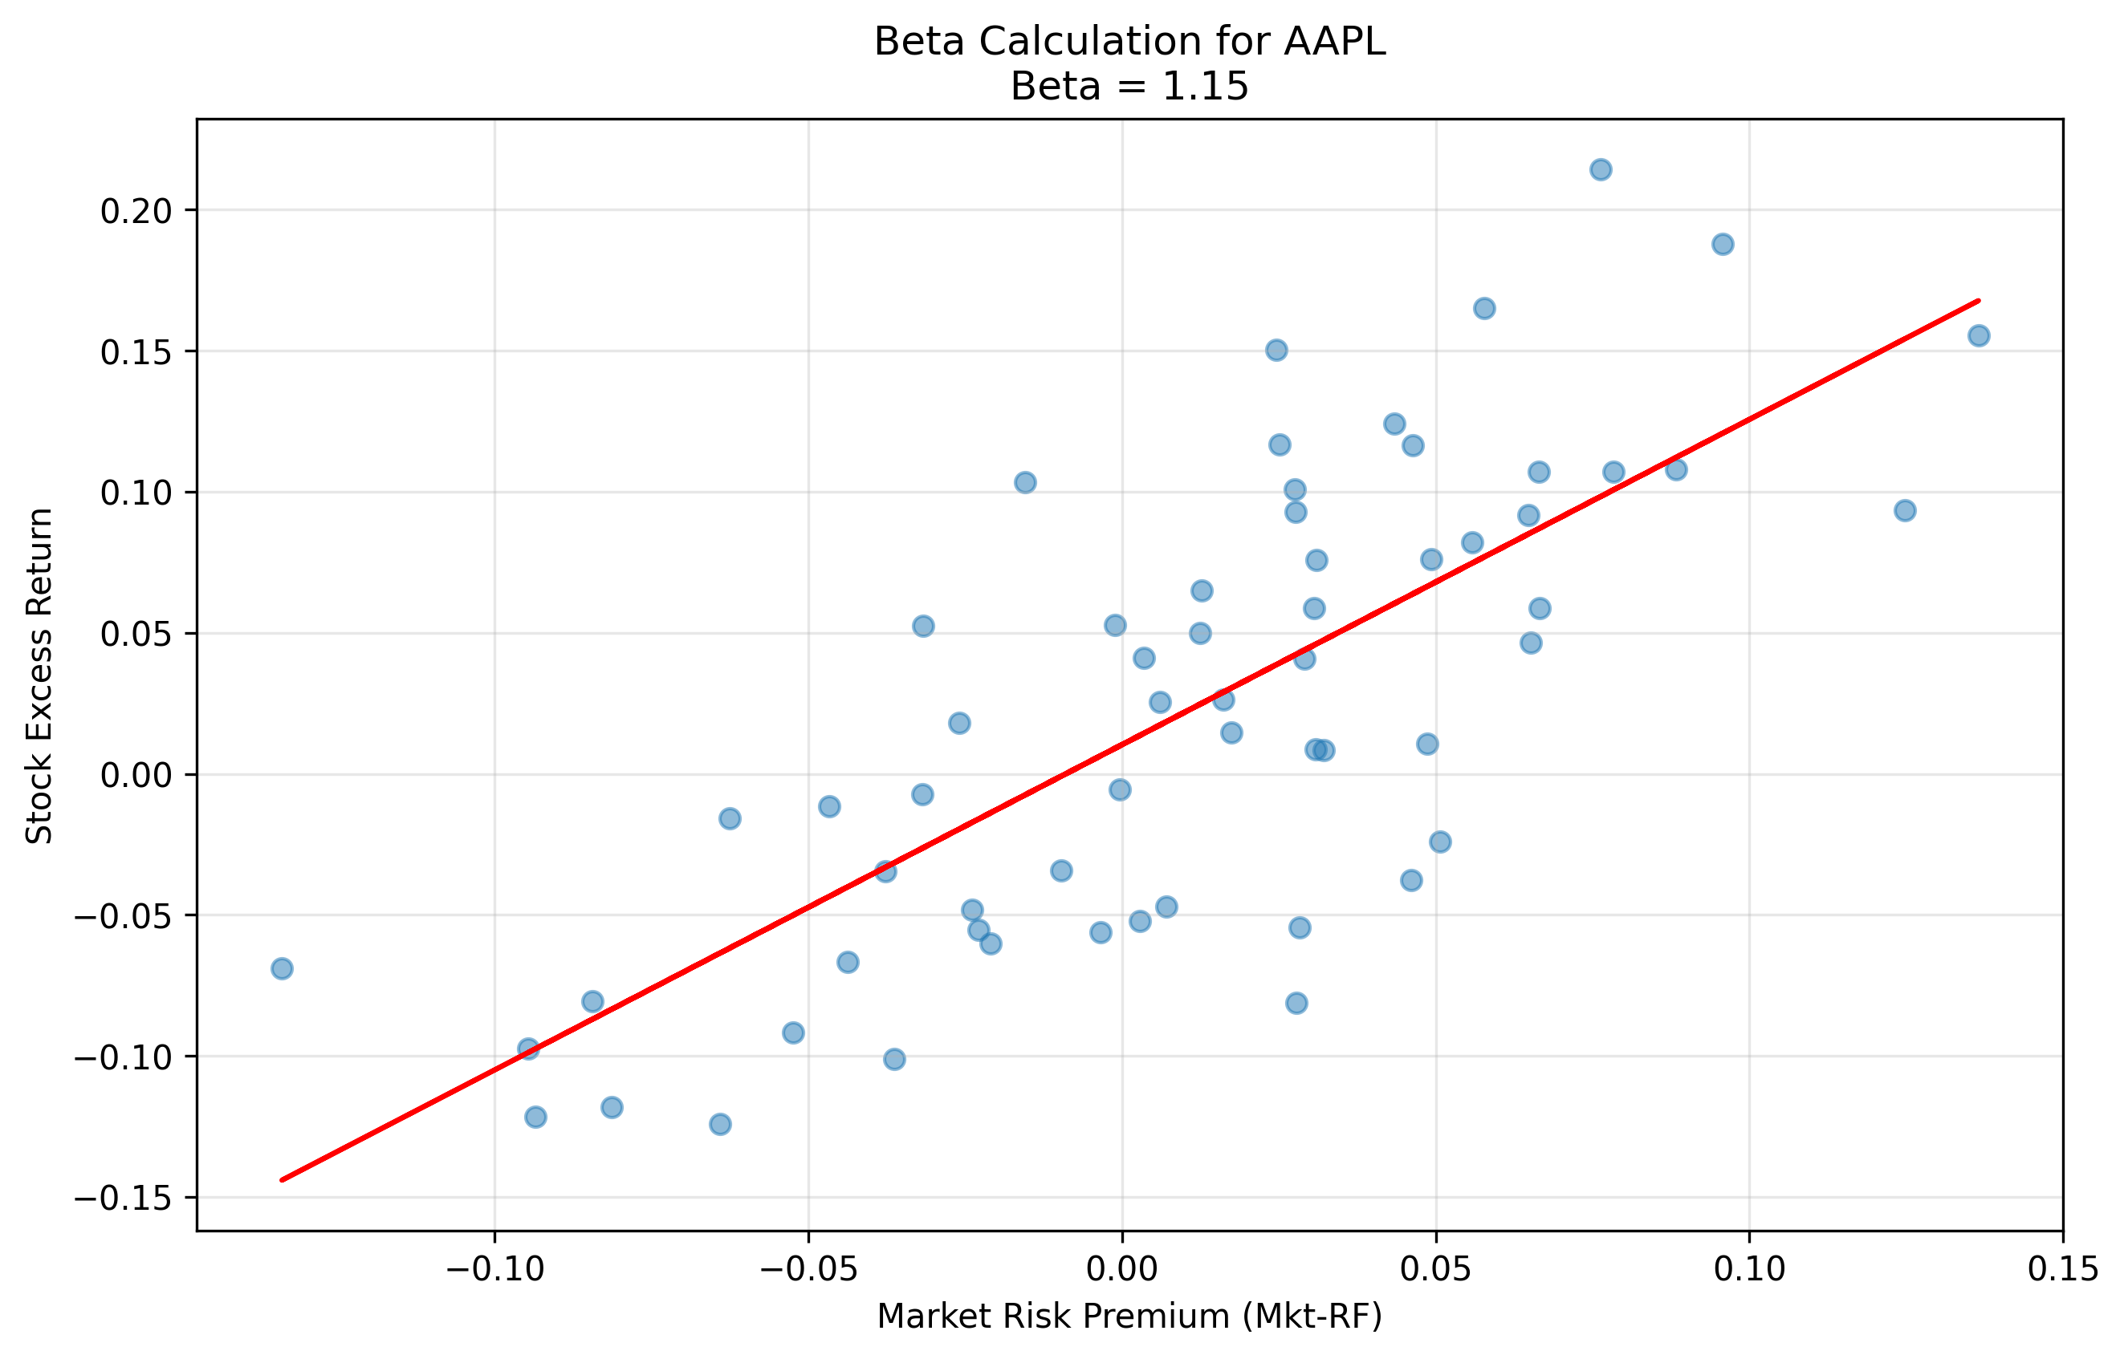
Beta Calculation for AAPL

Slide 3
Cost of Equity Components
Component | Value | Source
Risk-free Rate | 4.20% | 3-month T-bill (FRED)
Beta | 1.15 | Regression using monthly returns
Market Risk Premium | 8.24% | Fama-French factors (1926-present)
Cost of Equity | 13.70% | rf + β × MRP

