Slide 1

MGMT 675
Generative AI for Finance
Course Introduction

Slide 2
From Makers to Checkers
Derek Waldron, JP Morgan Chief Analytics Officer
What we're working towards is that every employee will have their own personalized AI assistant; every process is powered by AI agents, and every client experience has an AI concierge.
You'll still have people at the top who are managing and have relationships with clients, but many, many of the processes underneath are now being done by AI systems.
Workers would shift from being creators of reports or software updates, or 'makers' ... to 'checkers' or managers of AI agents doing that work.

Slide 3
The New Skills Landscape
Brookings Institute, 2025
As AI models begin to handle underwriting, compliance, and asset allocation, the traditional architecture of financial work is undergoing a fundamental shift.
As job descriptions evolve, so does the definition of financial talent. Excel is no longer a differentiator. Python is fast becoming the new Excel.
But technical skills alone will not cut it. The most in demand profiles today are those that speak both AI and finance.

Slide 4
Course Focus
Using AI
Building Agents
Financial Analysis
• Financial analysis
• Generate documents
• Install/use AI tools
• System prompts
• API calls
• Agent logic
• Claude skills
• Cost of Equity
• Mean-variance analysis
• Pro-forma statements
• Discounted cash flow
• Simulation

Slide 5

Chatbots
and Agents

Slide 6
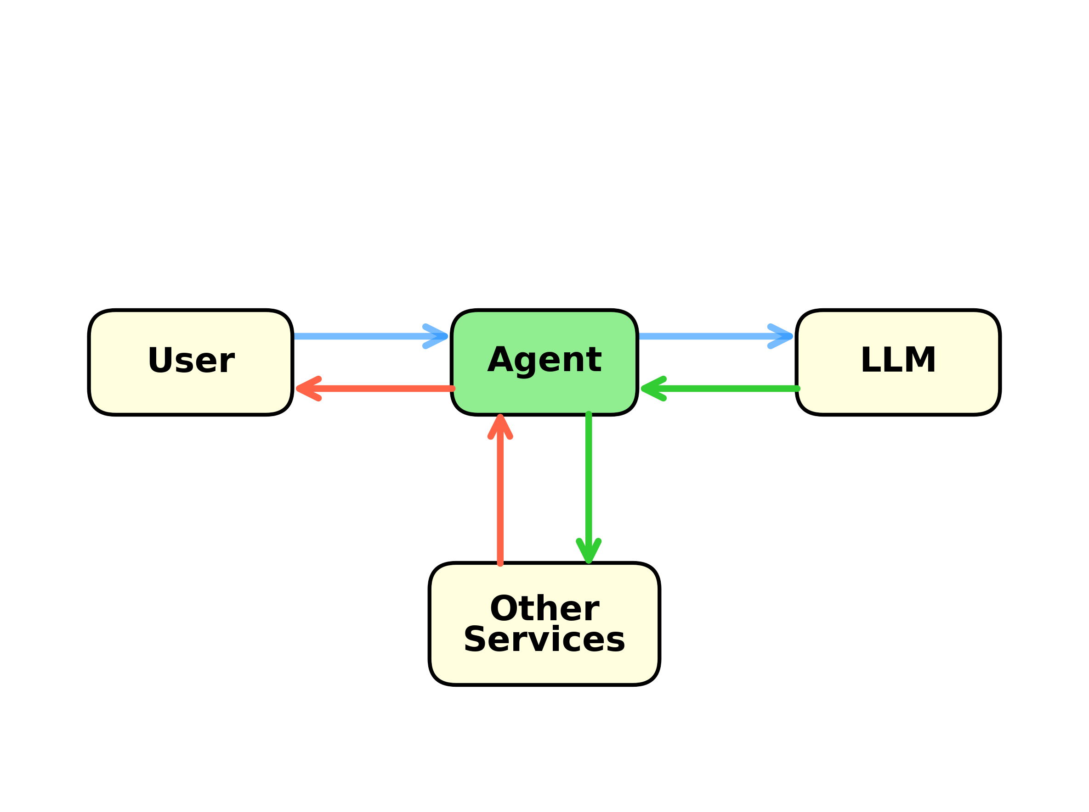
What is an AI Agent?
An AI agent is a chatbot equipped with tools to perform actions beyond conversation.
• Code execution (Python, etc.)
• File generation (Excel, Word, PDF)
• Database access
• Web search and API calls
• System commands

Slide 7
Example Database Agent
data-portal.rice-business.org
• Prompt + System Prompt → LLM
• LLM returns SQL code or a question for the user
• Agent sends SQL code to database or question to the user
• Eventually, SQL code goes to database
• Database returns data or error message
• Error message goes to LLM
• Eventually data goes to user

Slide 8
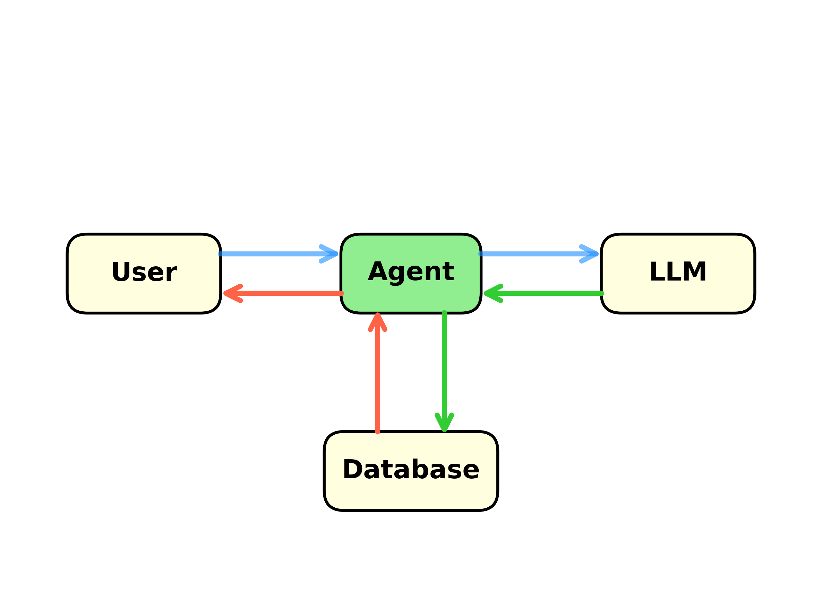
How do We Build It?
• System prompt provides info to LLM and tells it what we want
• Agent logic is hard-coded as "if ... then ..." (not AI)

Slide 9
Applied Finance Spreadsheets → AI Agents
What can we build?

Slide 10

Where all Computing is Probably Headed
Graphical UI
Point & click
Chat Interface
AI agent does everything
Agents will change the way people use computers.

Slide 11
Course Outline
1. Using AI + Python for financial analysis
2. Installing and using AI and related tools
3. Building chatbots and agents for finance

