Slide 1

MGMT 675
Generative AI for Finance
Google Colab

Slide 2
What is Google Colab?
• A free tool from Google for running code in your browser
• No software installation required
• Works on any computer with internet access
• All your work saves automatically to Google Drive

Slide 3
What You Need
Just two things:
1. A Google account (Gmail works)
2. A web browser (Chrome recommended)
That's it!

Slide 4
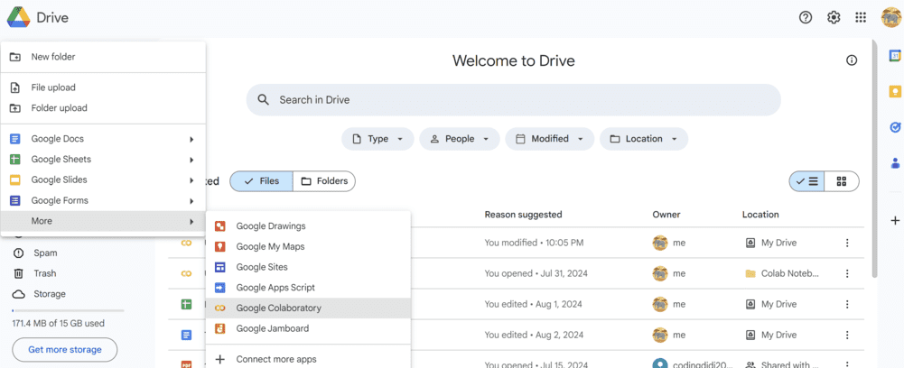
Accessing Colab: From Google Drive
Click New → More → Google Colaboratory

Slide 5
Accessing Colab: Direct
Go directly to:
colab.research.google.com

Slide 6
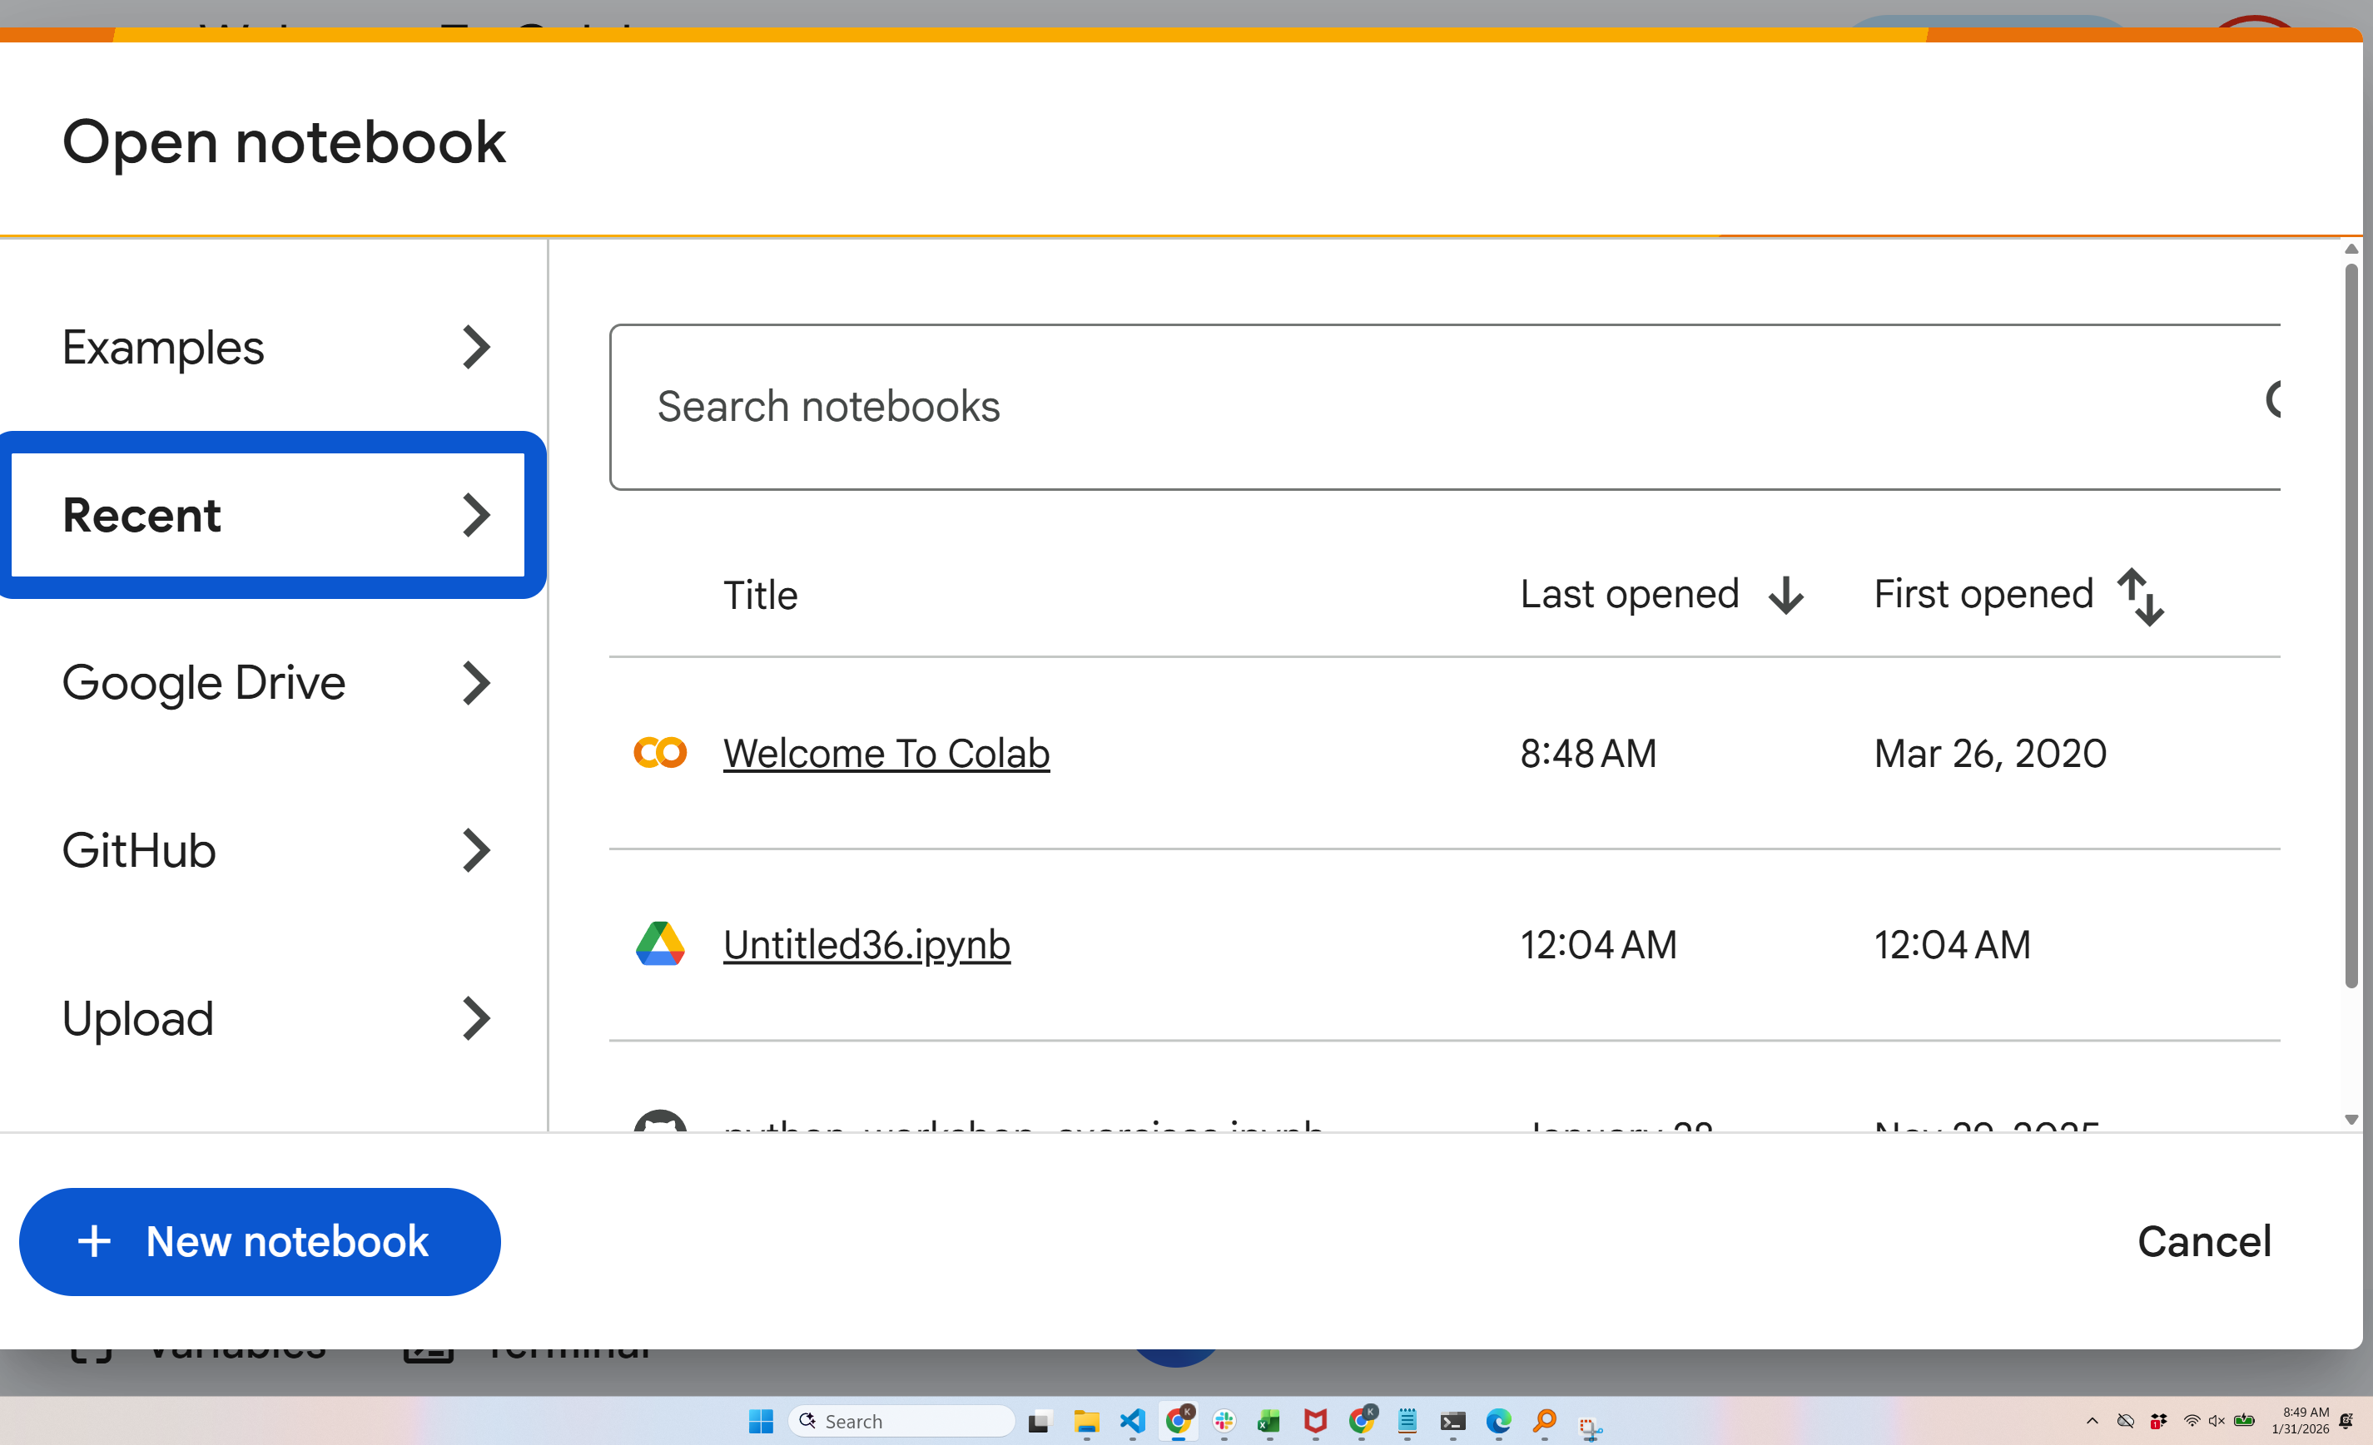
The Open Notebook Dialog

Slide 7
Opening Notebooks
• Examples: Google's tutorial notebooks
• Recent: Your recently opened notebooks
• Google Drive: Notebooks saved in your Drive
• GitHub: Open notebooks from GitHub repos
• Upload: Upload a .ipynb file
Click + New notebook to start a fresh notebook

Slide 8
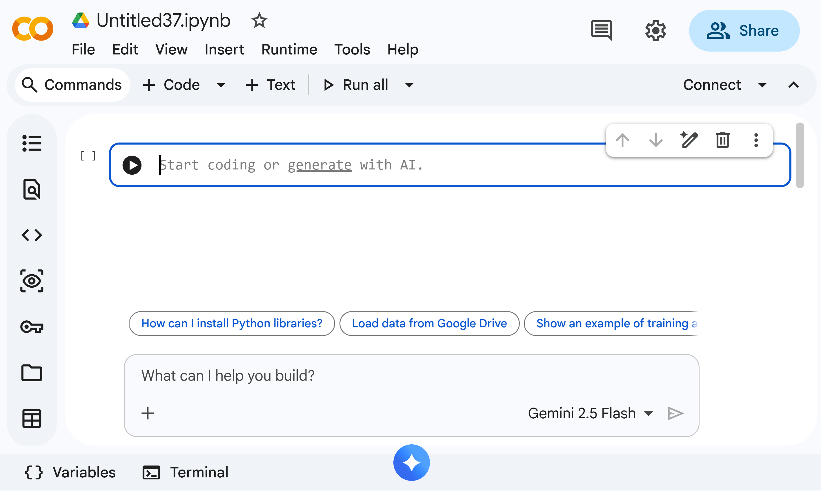
The Colab Interface: Notebook + Gemini

Slide 9
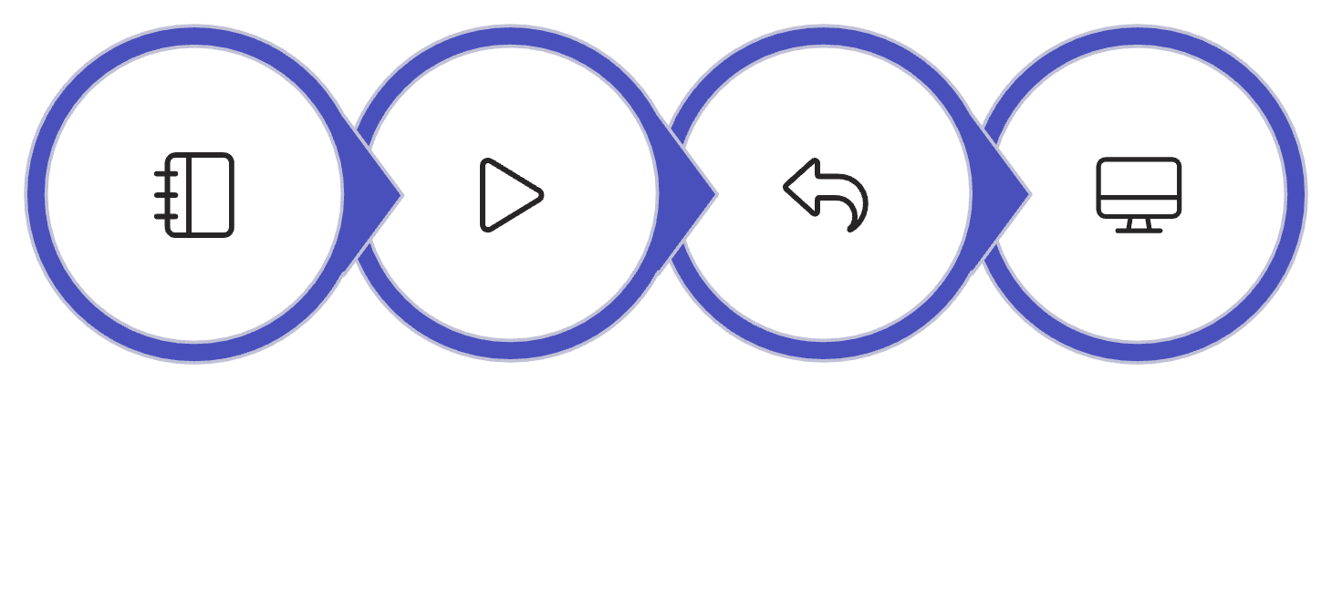

How Notebooks Work: The Runtime Connection
Think of a notebook (called a Jupyter notebook or Colab notebook) as a conversation between you and a computer. Here's the workflow:
Your notebook transmits code to a runtime environment (called a kernel)
The runtime processes and executes your code
Results flow back to the notebook interface
The notebook renders outputs, visualizations, and any error messages
Send Code
Execute
Return Output
Display Results

Slide 10
Navigating a Notebook
• + Code: Add a new code cell
• + Text: Add a text/markdown cell
• Connect: Connect to Google's servers
• Files (folder icon): View and upload files

Slide 11
What is a Cell?
A cell is a box where you write code or text.
Two types:
• Code cells: Run Python code
• Text cells: Write notes and explanations
You can have as many cells as you need.

Slide 12
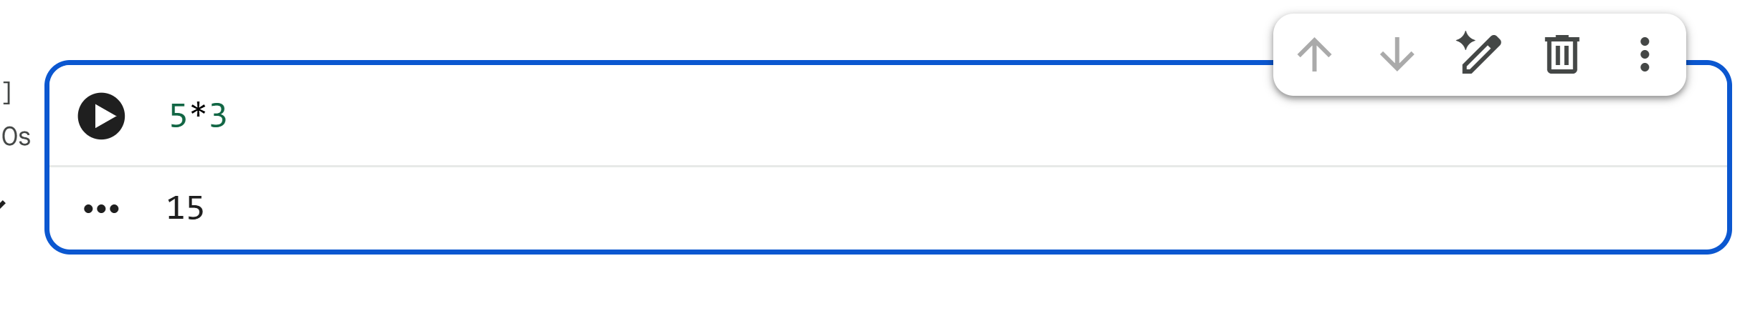
Your First Code: Simple Math
Type 5*3 and press Shift + Enter → Result: 15

Slide 13
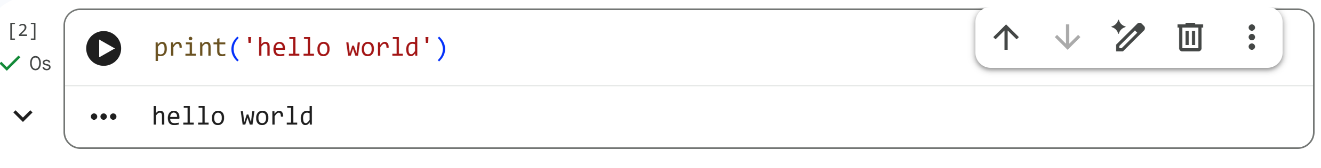
Your First Code: Hello World
Type print('hello world') and press Shift + Enter

Slide 14
Running Code: Three Ways
1. Click the play button (▶) on the left of the cell
2. Press Shift + Enter (runs and moves to next cell)
3. Press Ctrl + Enter (runs and stays in cell)
Tip: Shift + Enter is the most common method

Slide 15
Understanding the Play Button
Before running:
• Circle with play icon (▶) - Cell is ready
While running:
• Spinning circle - Code is executing
After running:
• Checkmark (✓) - Output appears below

Slide 16
Cell Numbers
Notice the [1] or [2] next to cells?
• Shows the order cells were run
• Empty [ ] means not yet run
• [*] means currently running
Important: Can run cells in any order but top to bottom avoids confusion.

Slide 17
Adding New Cells
From the toolbar:
• Click + Code for a code cell
• Click + Text for a text cell
Using keyboard:
• Ctrl + M, B → Add cell below
• Ctrl + M, A → Add cell above

Slide 18
Deleting and Moving Cells
To delete a cell:
• Click the trash icon in the cell toolbar
• Or: Ctrl + M, D
To move a cell:
• Click the up/down arrows in the cell toolbar
• Or drag and drop the cell

Slide 19
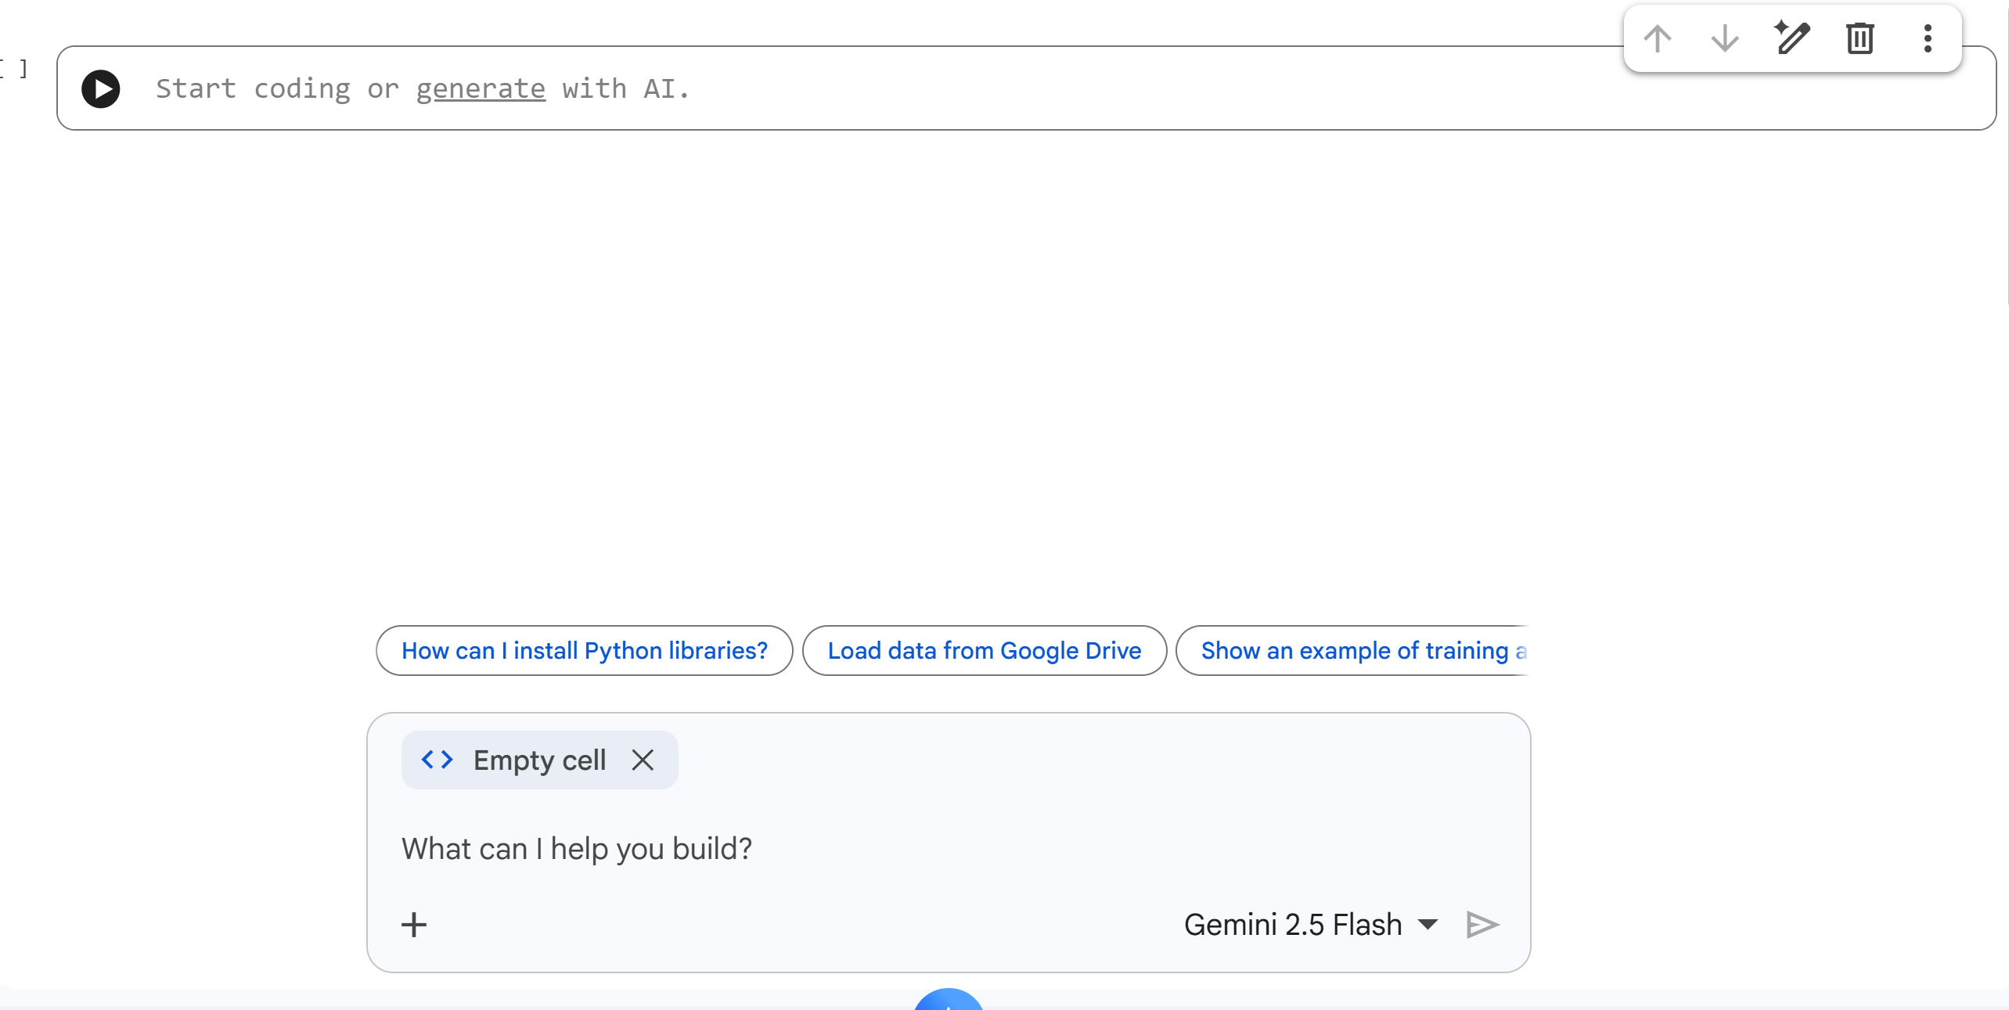
Meet Gemini: Your AI Assistant
Gemini is built into Colab to help you write code

Slide 20
What Gemini Can Do
• Generate code from plain English descriptions
• Explain what existing code does
• Fix errors in your code
• Suggest improvements
• Answer Python questions

Slide 21
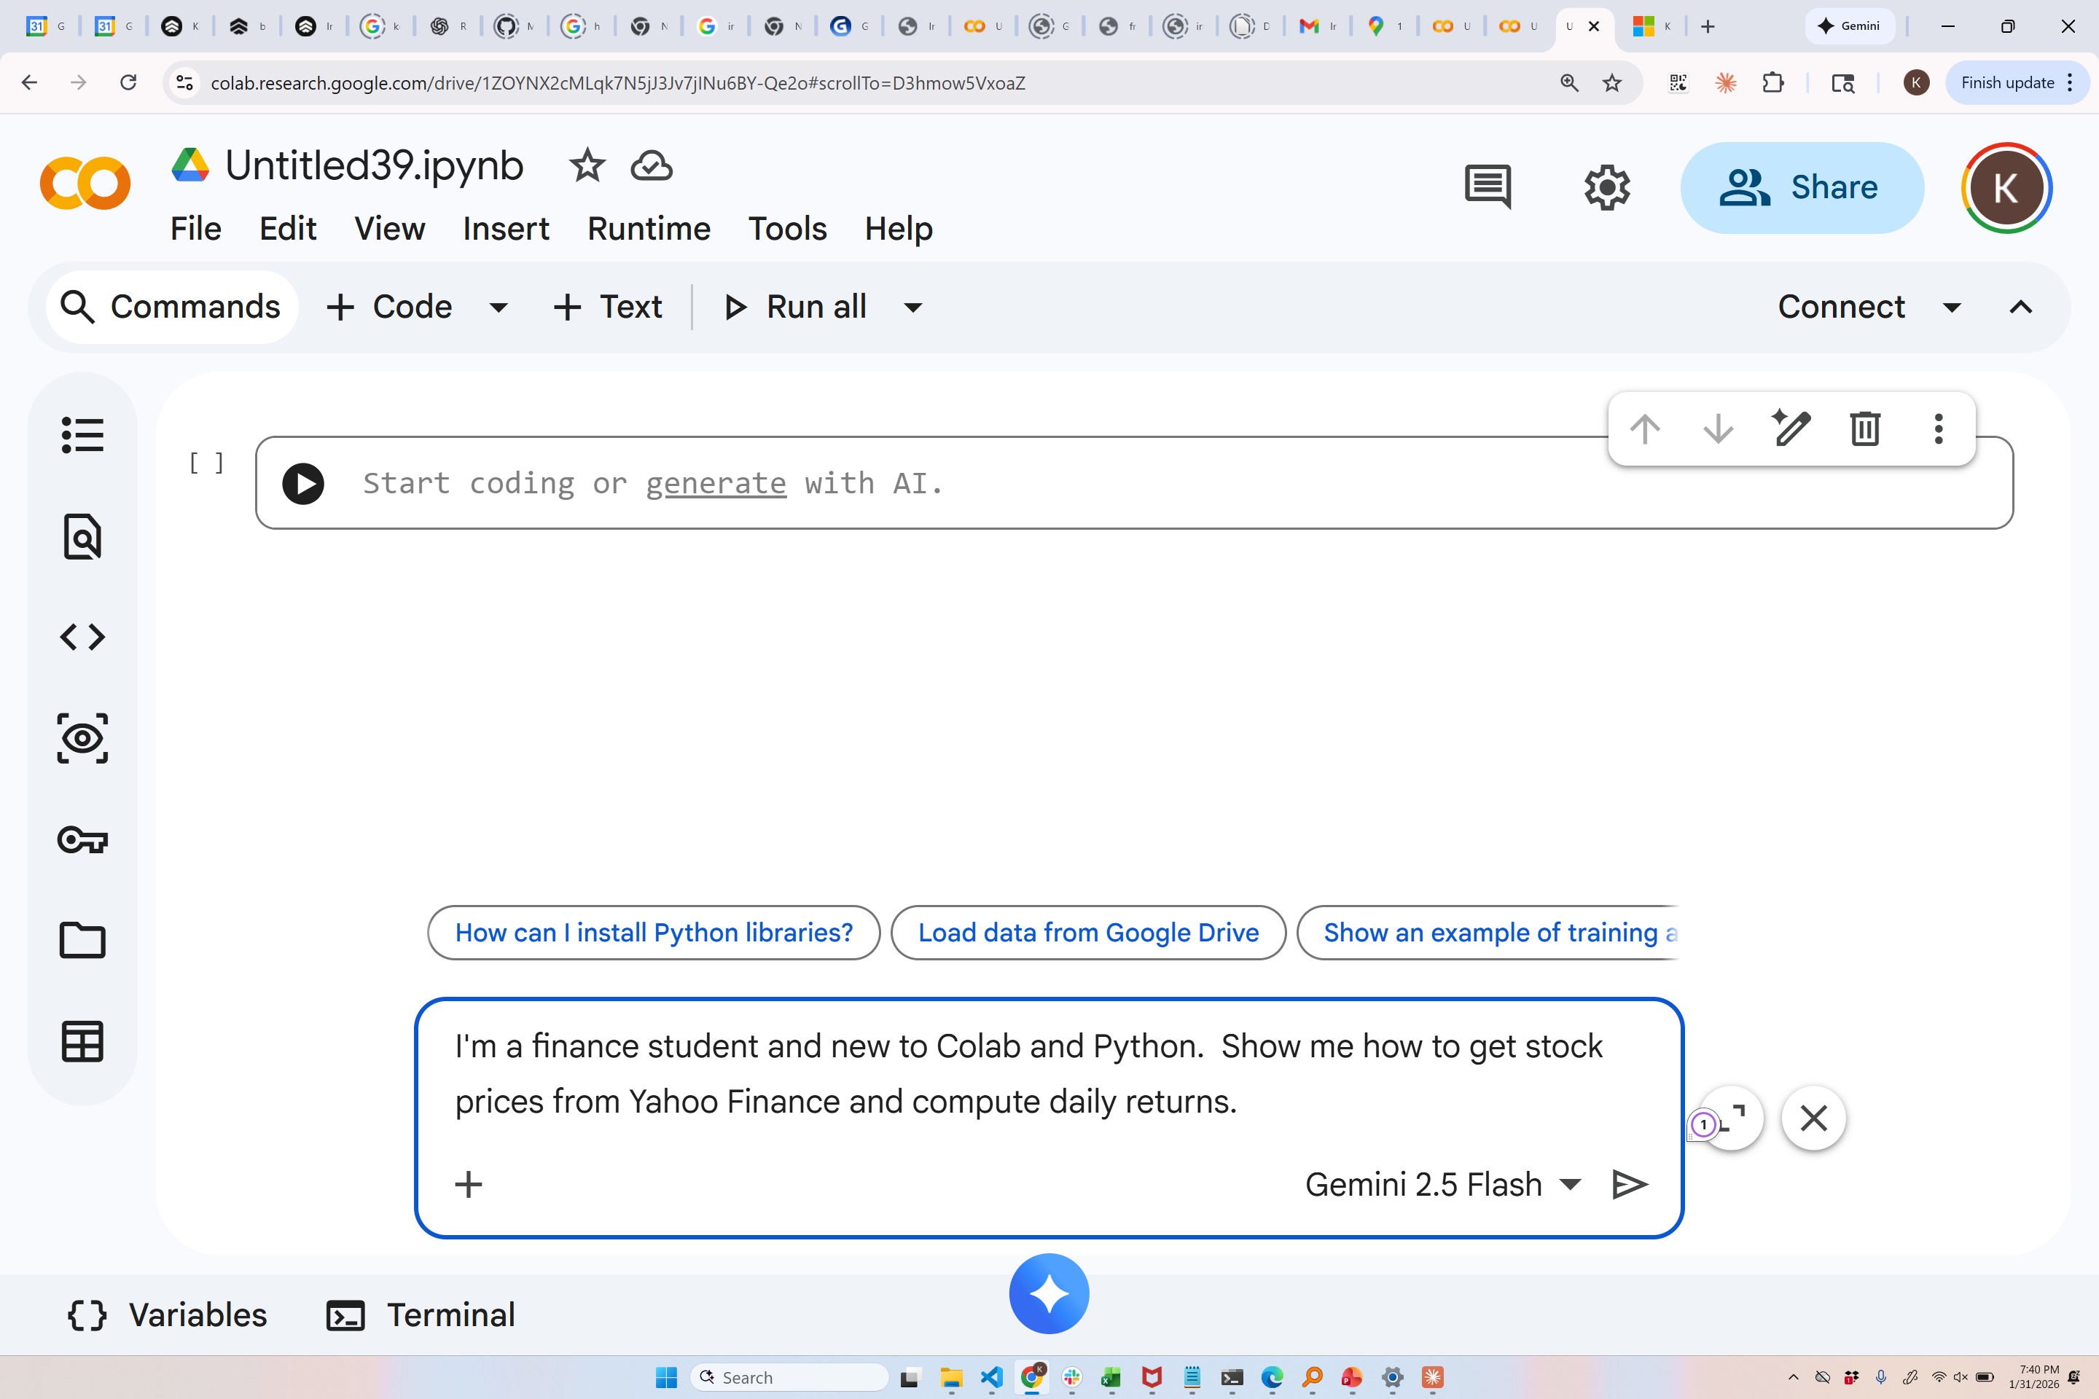

Slide 22
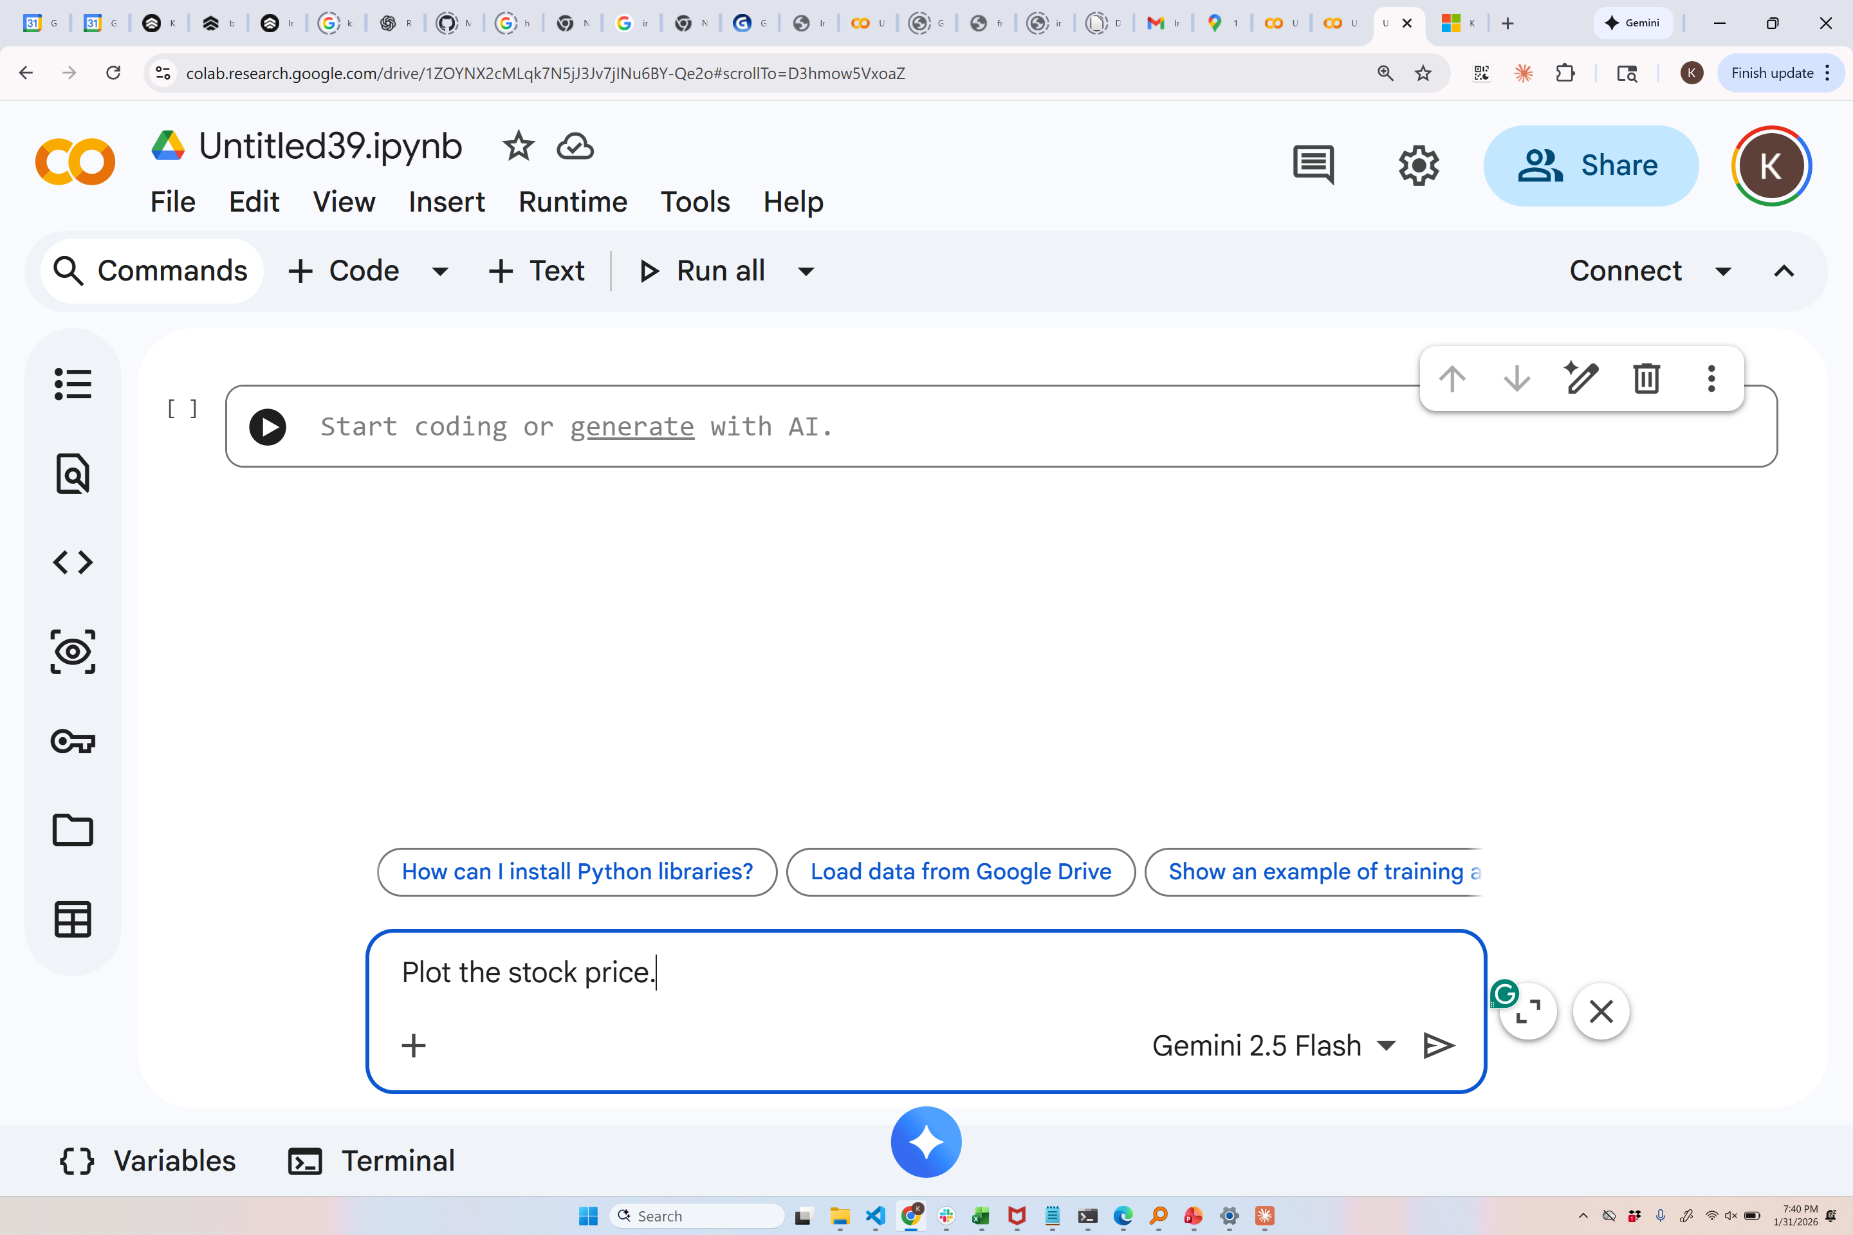

Slide 23


Slide 24
Runtime: What Powers Your Code
When you click Connect, Colab gives you a virtual computer:
• CPU (standard processing)
• RAM (memory)
• Disk space
And optionally: GPU or TPU for machine learning

Slide 25
\
\
Restarting the Runtime
If your code isn't working as expected:
Runtime → Restart runtime
This clears all variables and starts fresh.
Note: You'll need to re-run your cells after restarting

Slide 26
Session Limits
Free Colab limitations:
• Sessions disconnect after ~90 minutes idle
• Maximum ~12 hours continuous use
• Limited GPU/TPU hours per week
Tip: Save your work frequently!

Slide 27
Saving Your Work
Automatic: Colab saves to Google Drive automatically
Manual save: Ctrl + S or File → Save
Download options (File menu):
• Download as .ipynb (Jupyter notebook)
• Download as .py (Python script)

Slide 28
Where Are My Notebooks?
Your notebooks are saved in Google Drive:
My Drive/Colab Notebooks/
You can also:
• Save a copy to GitHub
• Save a copy in Drive with a new name
• Download to your computer

