Slide 1
EARNINGS ANALYSIS · THE GAAP VIEW
Tesla's Earnings Per Share
Twenty quarters of GAAP diluted EPS taken straight from Tesla's SEC filings
Data: SEC EDGAR XBRL company facts · 2021 Q3 – 2026 Q2 · August 2026

Slide 2
AT A GLANCE
The reported peak is not the operating peak
$2.27
$1.07
$0.32
Highest reported quarter
2023 Q4
Best quarter on operations
2022 Q4
Most recent quarter
2026 Q2
Tesla's largest GAAP quarter came from a one-time tax benefit, not from selling cars. Measured against the reported high the decline is 86%; measured against the best quarter Tesla actually operated, it is 70%. Either way the direction is the same.
GAAP diluted EPS as reported to the SEC · Source: SEC EDGAR XBRL company facts

Slide 3
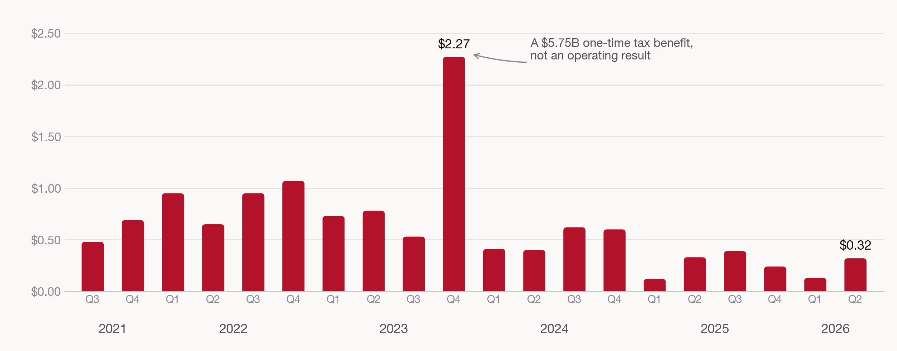
THE SERIES
GAAP diluted EPS, 2021 Q3 – 2026 Q2
Q4 figures derived as fiscal year minus nine months · Source: SEC EDGAR XBRL company facts

Slide 4
THE OUTLIER
What happened in 2023 Q4
The tallest bar in the series is not an operating result. Tesla released the valuation allowance against its deferred tax assets that quarter, booking a large non-cash tax benefit that flowed straight to net income.
Operating income that quarter was $2.06B — right in line with the quarters on either side. Net income was nearly four times larger. Nothing about the underlying business changed; an accounting judgment about future taxable income did.
This is exactly the kind of item adjusted EPS is meant to strip out, and it is why the adjusted series shows $0.71 for the same quarter.
2023 Q4 in four lines
Operating income | $2.06B
Income tax benefit | −$5.75B
Net income | $7.93B
GAAP diluted EPS | $2.27
The tax line is a benefit, not an expense — it added to net income.
Derived from FY2023 less the nine months ended 30 September 2023 · Source: SEC EDGAR

Slide 5
READING THE CHART
Setting the outlier aside, three regimes
1 · Peak profitability
2 · Compression
3 · The floor
2021 Q3 – 2022 Q4
EPS ran from $0.48 to $1.07 while quarterly operating margin held between 15% and 19%. Full-year 2022 margin of 16.8% is the high-water mark of the period.
2023 – 2024
Price cuts pulled margin down every year: 9.2% in 2023, 7.2% in 2024. Apart from the tax quarter, EPS sat between $0.40 and $0.78.
2025 – 2026
EPS between $0.12 and $0.39. Full-year 2025 operating margin of 4.6% is roughly a quarter of the 2022 level, and 2026 Q2 came in at 1.4% — the lowest of the twenty.
Margins are operating income ÷ revenue, computed from filed figures · Source: SEC EDGAR

Slide 6
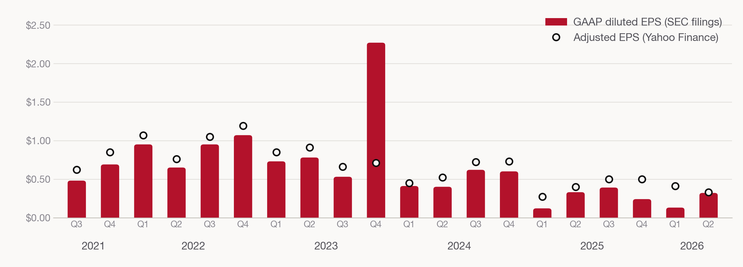
WHY THIS MATTERS
The source you pick changes the story
Adjusted EPS runs above GAAP in 19 of 20 quarters, by $0.11 on average. The one quarter it runs below is 2023 Q4, where GAAP captured the tax benefit and the adjusted figure excluded it. Adjusted gives a smoother read on operations; GAAP is what the company actually reported.
GAAP from SEC EDGAR; adjusted from Yahoo Finance's earnings history

Slide 7
WHY EPS FELL
Revenue grew 76%. Operating income fell 33%.
Fiscal year | Revenue | Operating income | Operating margin | Diluted EPS
2021 | $53.8B | $6.5B | 12.1% | $1.63
2022 | $81.5B | $13.7B | 16.8% | $3.62
2023 | $96.8B | $8.9B | 9.2% | $4.30
2024 | $97.7B | $7.1B | 7.2% | $2.04
2025 | $94.8B | $4.4B | 4.6% | $1.08
Revenue grew 76% from 2021 to 2025 while operating income fell 33%. The 2023 line shows the outlier plainly: EPS of $4.30, the highest of any year, on operating income well below 2022's.
All figures as filed with the SEC · Source: SEC EDGAR XBRL company facts

Slide 8
METHOD AND CAVEATS
Four things EDGAR makes you decide
Restatements are visible
Not only splits
The 2021 Q3 10-Q reported $1.44; after the 2022 3-for-1 split the same quarter reads $0.48. We keep the latest filed value, putting all twenty quarters on one share basis.
2024 Q1 was filed at $0.34, then appears as $0.41 in the 2025 Q1 comparative. Taking the latest filing captures genuine restatements too, not just split arithmetic.
Q4 has to be derived
Tags change over time
No 10-Q covers Q4, so it is fiscal year minus nine months. Cross-checked two ways — net income ÷ implied shares versus FY EPS less 9M EPS — agreeing within $0.01.
Tesla reports revenue under two different XBRL tags across this window, so the series has to be stitched from both. GAAP is authoritative but it is not turnkey.
Full pull is reproducible in edgar_pull.py · CIK 0001318605

Slide 9
THE TAKEAWAY
On the company's own filed numbers, Tesla's quarterly earnings have fallen by roughly 70% from their operating peak — and the single best quarter in the series was a tax entry, not a car business.
Data
SEC EDGAR XBRL company facts, CIK 0001318605, retrieved 6 August 2026.
Twenty quarters, 2021 Q3 – 2026 Q2. Saved as data/tsla_quarterly_eps_edgar.csv.

