Slide 1
Prepared August 2026
HOUSING AFFORDABILITY
Mortgage Rates, Home Prices, and the Cost of Buying, 1990–2024
A quarterly analysis using FRED data on 30-year mortgage rates (MORTGAGE30US),
median home sale price (MSPUS), and real median household income (MEHOINUSA672N)

Slide 2
How the Affordability Ratio Is Computed
Three FRED series, resampled to a common quarterly frequency
1
Resample to quarterly
Weekly mortgage rates (MORTGAGE30US) are averaged within each quarter. Home price (MSPUS) is already quarterly. Real median household income (MEHOINUSA672N) is annual and is linearly interpolated to quarterly values.
2
Price a monthly mortgage payment
Assume a 20% down payment and a 30-year fixed loan on the quarter's median home price. The standard amortization formula gives the monthly principal-and-interest payment on the remaining 80% financed.
3
Express as % of income
Divide the monthly payment by one-twelfth of that quarter's median household income. The result is the affordability ratio — the share of a typical household's monthly income a median home purchase would require.
Monthly Payment = 0.8 × Price × r(1+r)³⁶⁰ ⁄ [(1+r)³⁶⁰ − 1] where r = annual rate ÷ 12

Slide 3
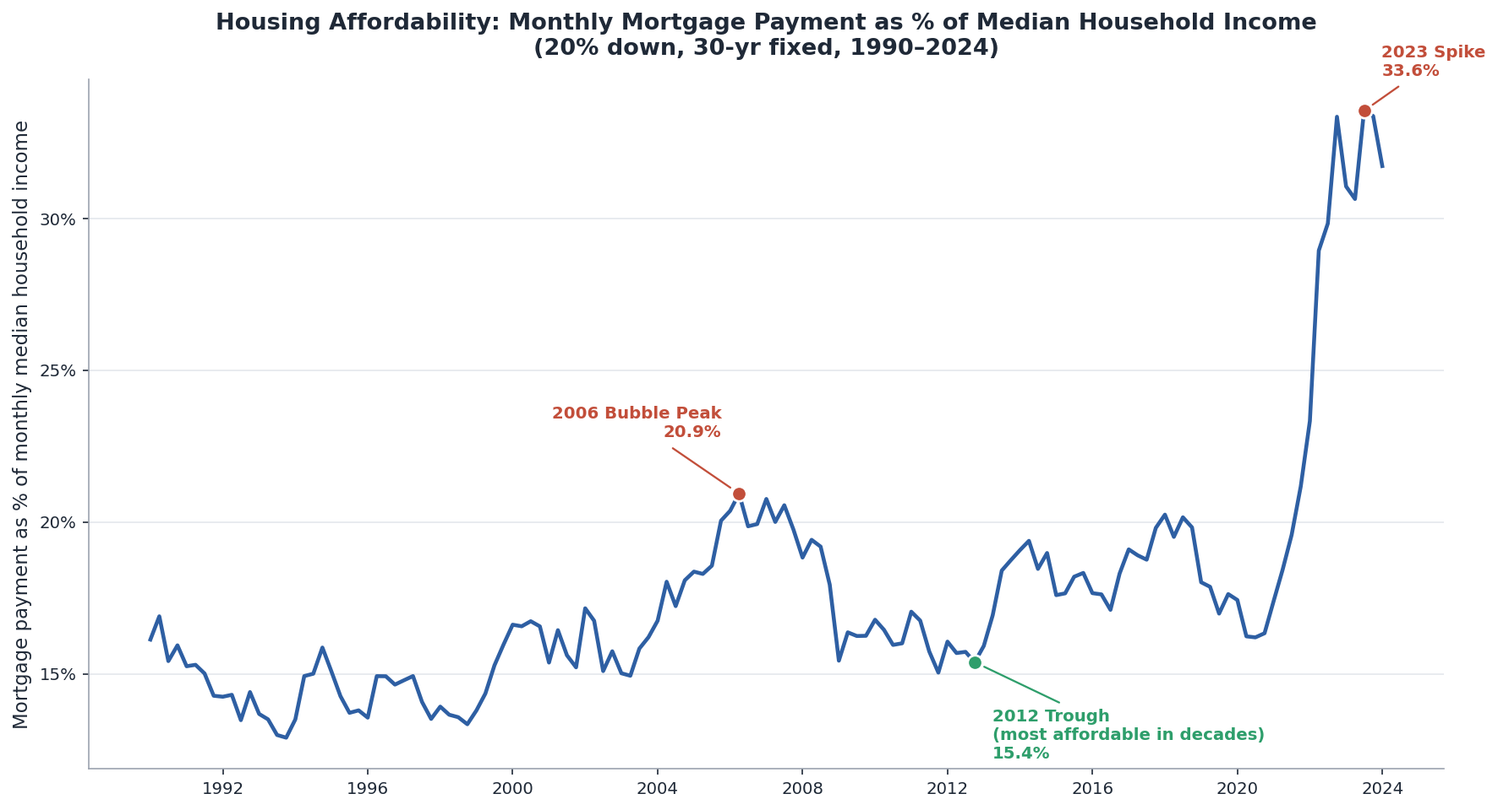
Affordability Has Whipsawed Since the Housing Bubble
Monthly mortgage payment as a % of median household income, quarterly, 1990–2024

Slide 4
What Would It Take to Afford the 2024 Median Home?
Monthly principal & interest payment by mortgage rate and home price (20% down, 30-yr fixed)
Home prices shown are ±20% around the 2024 median sale price of $418,975
Rate \ Price | -20% $335K | -10% $377K | 2024 Median $419K | +10% $461K | +20% $503K
5.0% | $1,439 | $1,619 | $1,799 | $1,979 | $2,159
6.0% | $1,608 | $1,809 | $2,010 | $2,211 | $2,411
7.0% | $1,784 | $2,007 | $2,230 | $2,453 | $2,676
8.0% | $1,968 | $2,213 | $2,459 | $2,705 | $2,951
9.0% | $2,158 | $2,427 | $2,697 | $2,967 | $3,236
At today's ~6.7% rate, a median home carries roughly a $2,300/mo payment — about a third of typical monthly household income.

Slide 5
Conclusions
20.9%
15.4%
33.6%
2006 bubble peak
2012 trough
2023 spike
Rising prices outran income even at moderate ~6.6% rates
Post-crash prices + near-record-low rates made homes
the most affordable in decades
Rates above 7% collided with still-elevated prices —
the least affordable quarter on record since 1990
Affordability is driven jointly by rates and prices, not either alone. The 2012 trough combined falling prices with falling rates; the 2023 spike combined still-high prices with rapidly rising rates. By early 2024, the ratio (~31.7%) remained near its historic high, roughly double the 2012 low — underscoring how far affordability has deteriorated since the post-crash trough.

