Slide 1

Tesla's Earnings Per Share
GAAP
Twenty quarters, straight from SEC filings

Slide 2
The reported peak is not the operating peak
$2.27
$1.07
$0.32
Highest reported quarter — 2023 Q4
Best quarter on operations — 2022 Q4
Most recent quarter — 2026 Q2

Slide 3
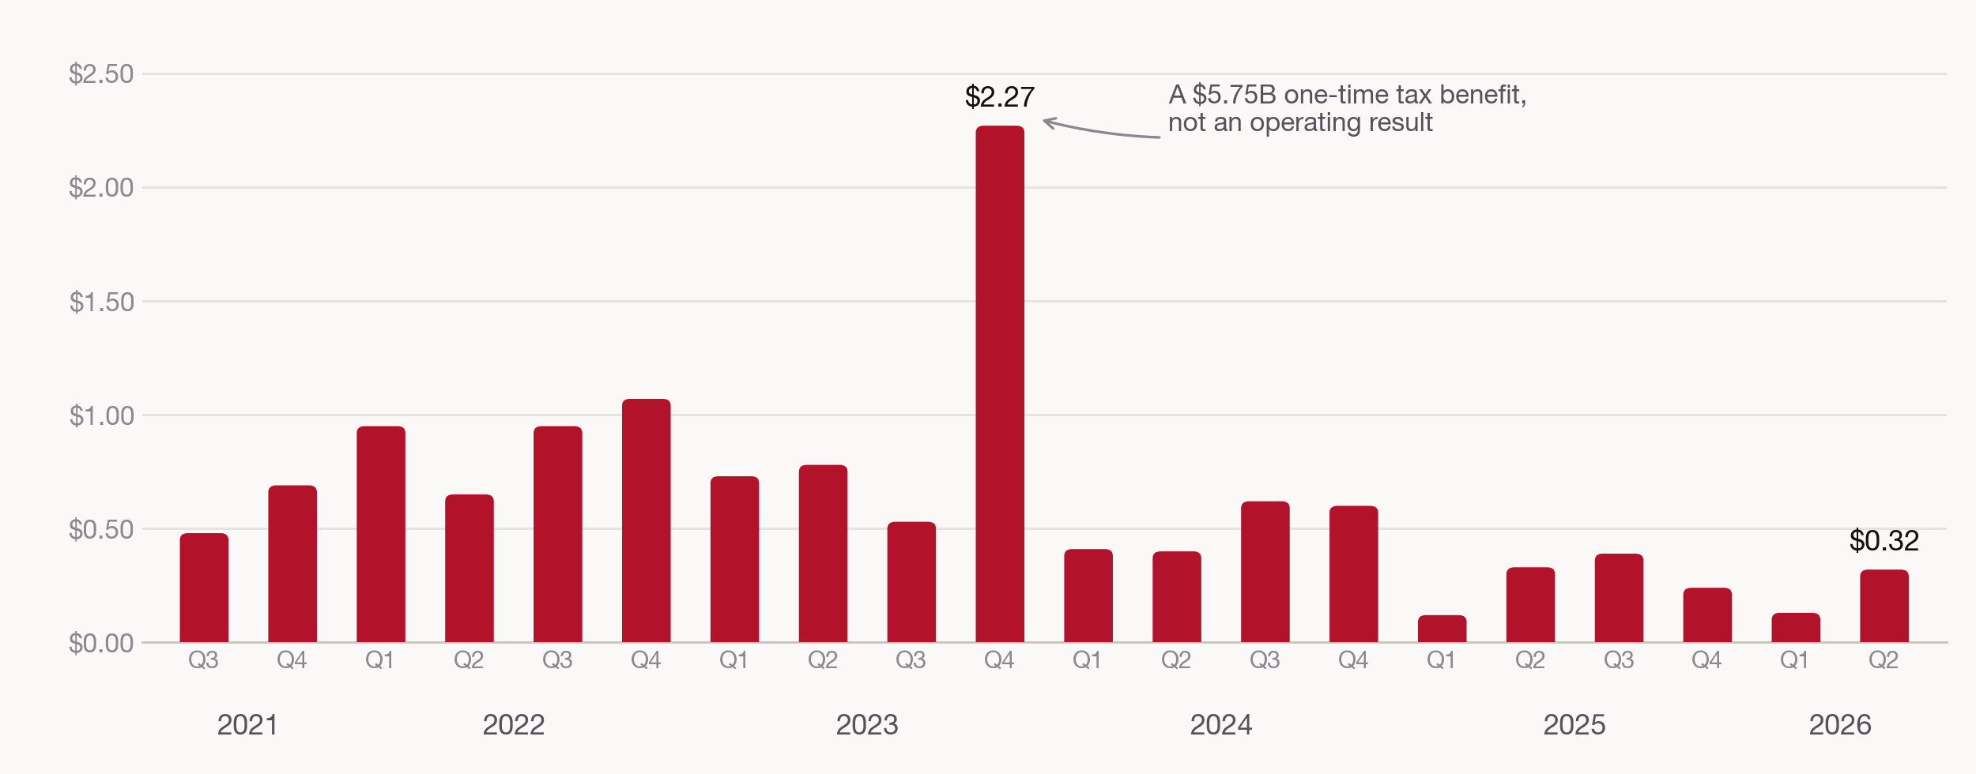
GAAP diluted EPS, 2021 Q3 – 2026 Q2

Slide 4
What happened in 2023 Q4
The tallest bar in the series is not an operating result. Tesla released the valuation allowance against its deferred tax assets that quarter, booking a large non-cash tax benefit that flowed straight to net income.
Operating income that quarter was $2.06B — in line with the quarters on either side. Net income was nearly four times larger. Nothing about the underlying business changed; an accounting judgment did.
2023 Q4
Operating income | $2.06B
Income tax benefit | −$5.75B
Net income | $7.93B
GAAP diluted EPS | $2.27

Slide 5
Setting the outlier aside, three regimes
Peak profitability
Compression
The floor
2021 Q3 – 2022 Q4. EPS $0.48 to $1.07; operating margin 15–19%.
2023 – 2024. Price cuts pulled margin to 9.2% then 7.2%.
2025 – 2026. EPS $0.12 to $0.39; 2026 Q2 margin of 1.4%.

Slide 6
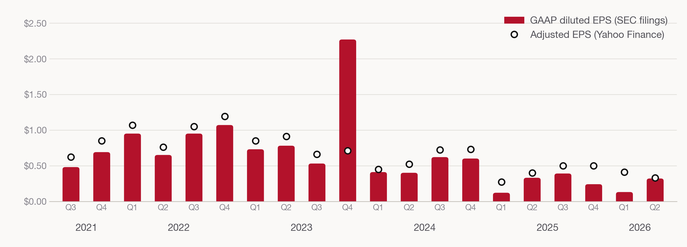
The source you pick changes the story

Slide 7
Revenue grew 76%. Operating income fell 33%.
Fiscal year | Revenue | Operating income | Operating margin | Diluted EPS
2021 | $53.8B | $6.5B | 12.1% | $1.63
2022 | $81.5B | $13.7B | 16.8% | $3.62
2023 | $96.8B | $8.9B | 9.2% | $4.30
2024 | $97.7B | $7.1B | 7.2% | $2.04
2025 | $94.8B | $4.4B | 4.6% | $1.08

Slide 8

Four things EDGAR makes you decide
01.
Restatements are visible in the filed history
02.
Splits are not the only source of revisions
03.
Q4 has to be derived from the fiscal year
04.
XBRL tags change across the window

Slide 9
The takeaway
On the company's own filed numbers, quarterly earnings have fallen by roughly 70% from their operating peak.
SEC EDGAR XBRL company facts · CIK 0001318605

