Slide 1
Utilizing invariant sites for population genetic inference with convolutional neural networks
Kerry Cobb

Slide 2
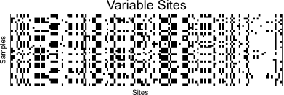
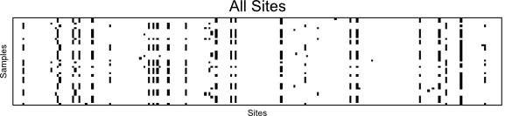
Convolutional Neural Networks

Slide 3
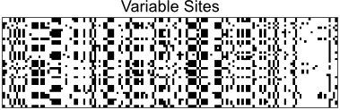
Convolutional Neural Networks
L. Flagel et al. 2019

Slide 4
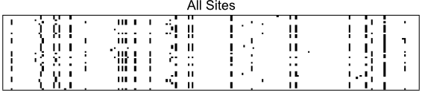
Convolutional Neural Networks

Slide 5
Convolutional Neural Networks
Positions
[ 11, 22, 24, 30, 39, 71, 82, 96, 101, 105, 120, 129… ]

Slide 6
Convolutional Neural Networks

Slide 7
Estimating Theta
Datasets simulated with msprime
6000 datasets with 100,000 bp & 20 diploid individuals
Datasets subsampled to yield additional 20,000 bp dataset
Each dataset used for training and testing a CNN with:
Only variable sites
Variable sites + a vector of positions
All sites
CNN analysis done with Keras & TensorFlow

Slide 8
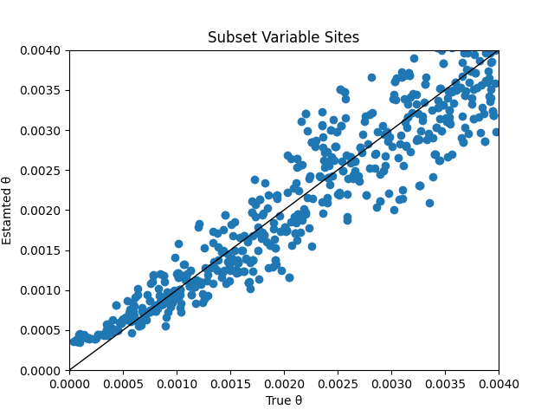
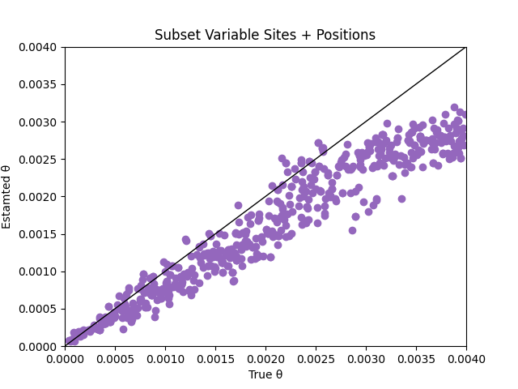
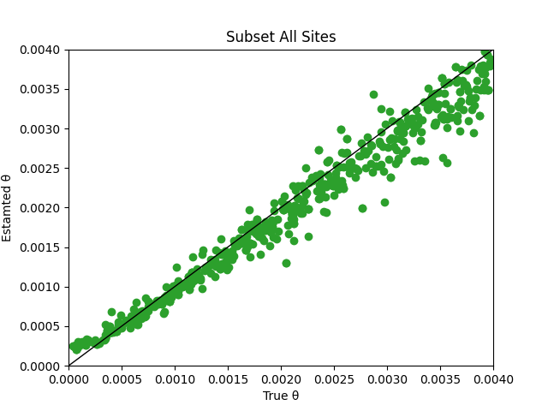
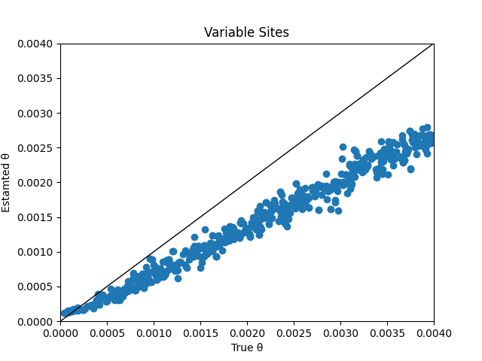
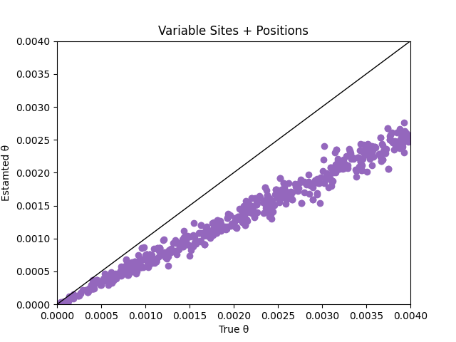
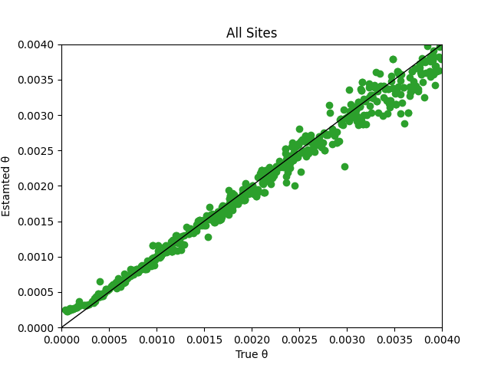
20,000 bp
100,000 bp

Slide 9
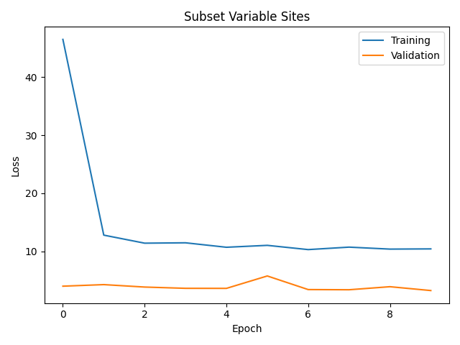
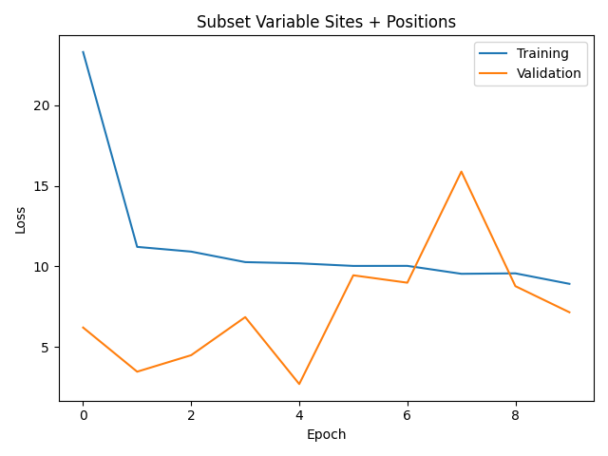
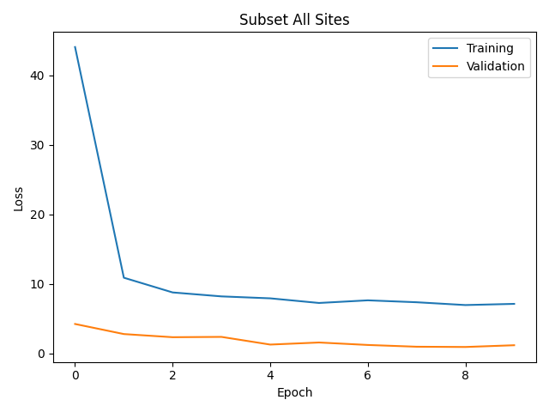
20,000 BP
20,000 bp

Slide 10
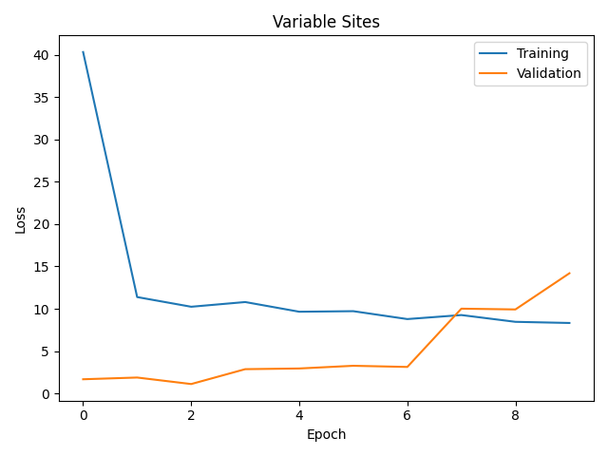
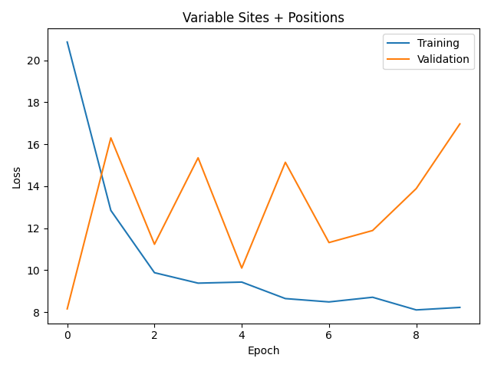
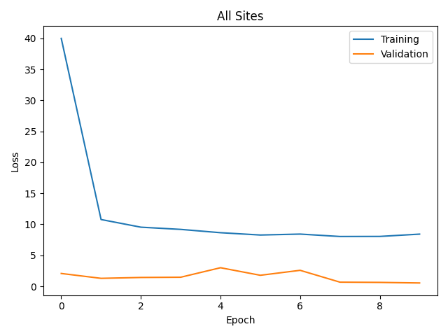
100,000 bp

Slide 11
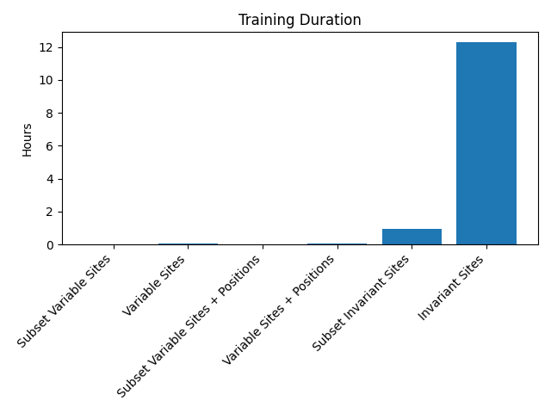

Slide 12
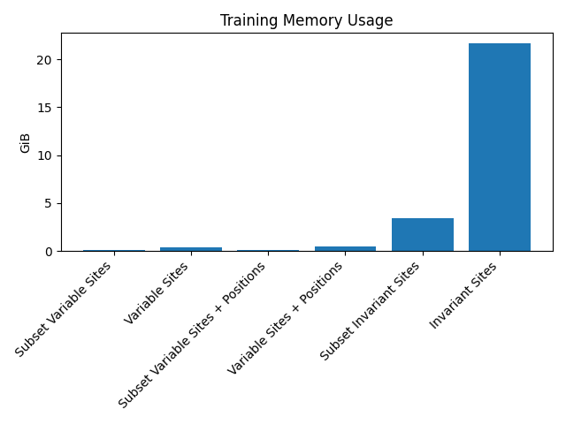

Slide 13
Acknowledgments
Analyses run on the Hopper Cluster at Auburn University
Feedback provided by members of the Phyletica Lab at Auburn University
Reach me at cobbkerry@gmail.com

