Slide 1
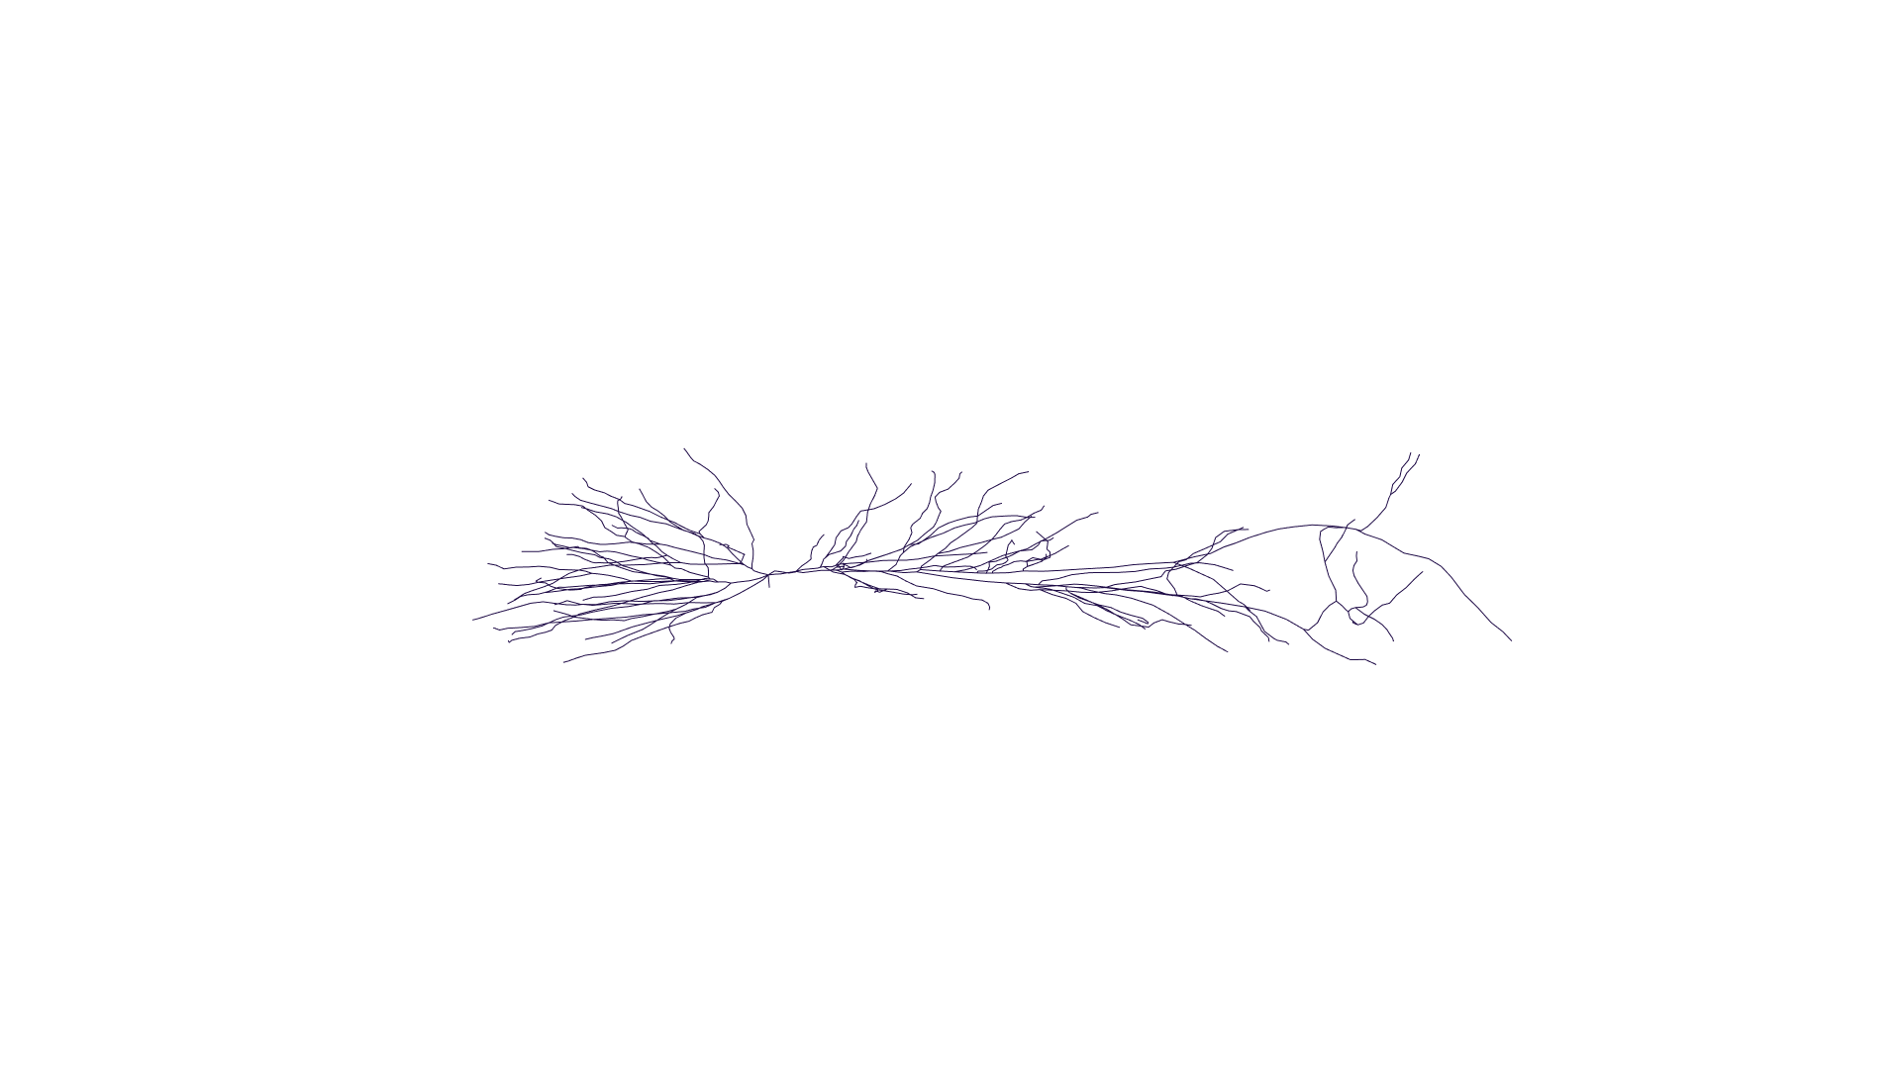


A
EF parallel to the somato-dendritic axis
EF perpendicular to the somato-dendritic axis
$$\vec{E}$$
$$\vec{E}$$

Slide 2
EF parallel to the somato-dendritic axis
EF perpendicular to the somato-dendritic axis
$$\vec{E}$$
$$\vec{E}$$

Slide 3


$$\vec{E}$$
$$\vec{E}$$

Slide 4
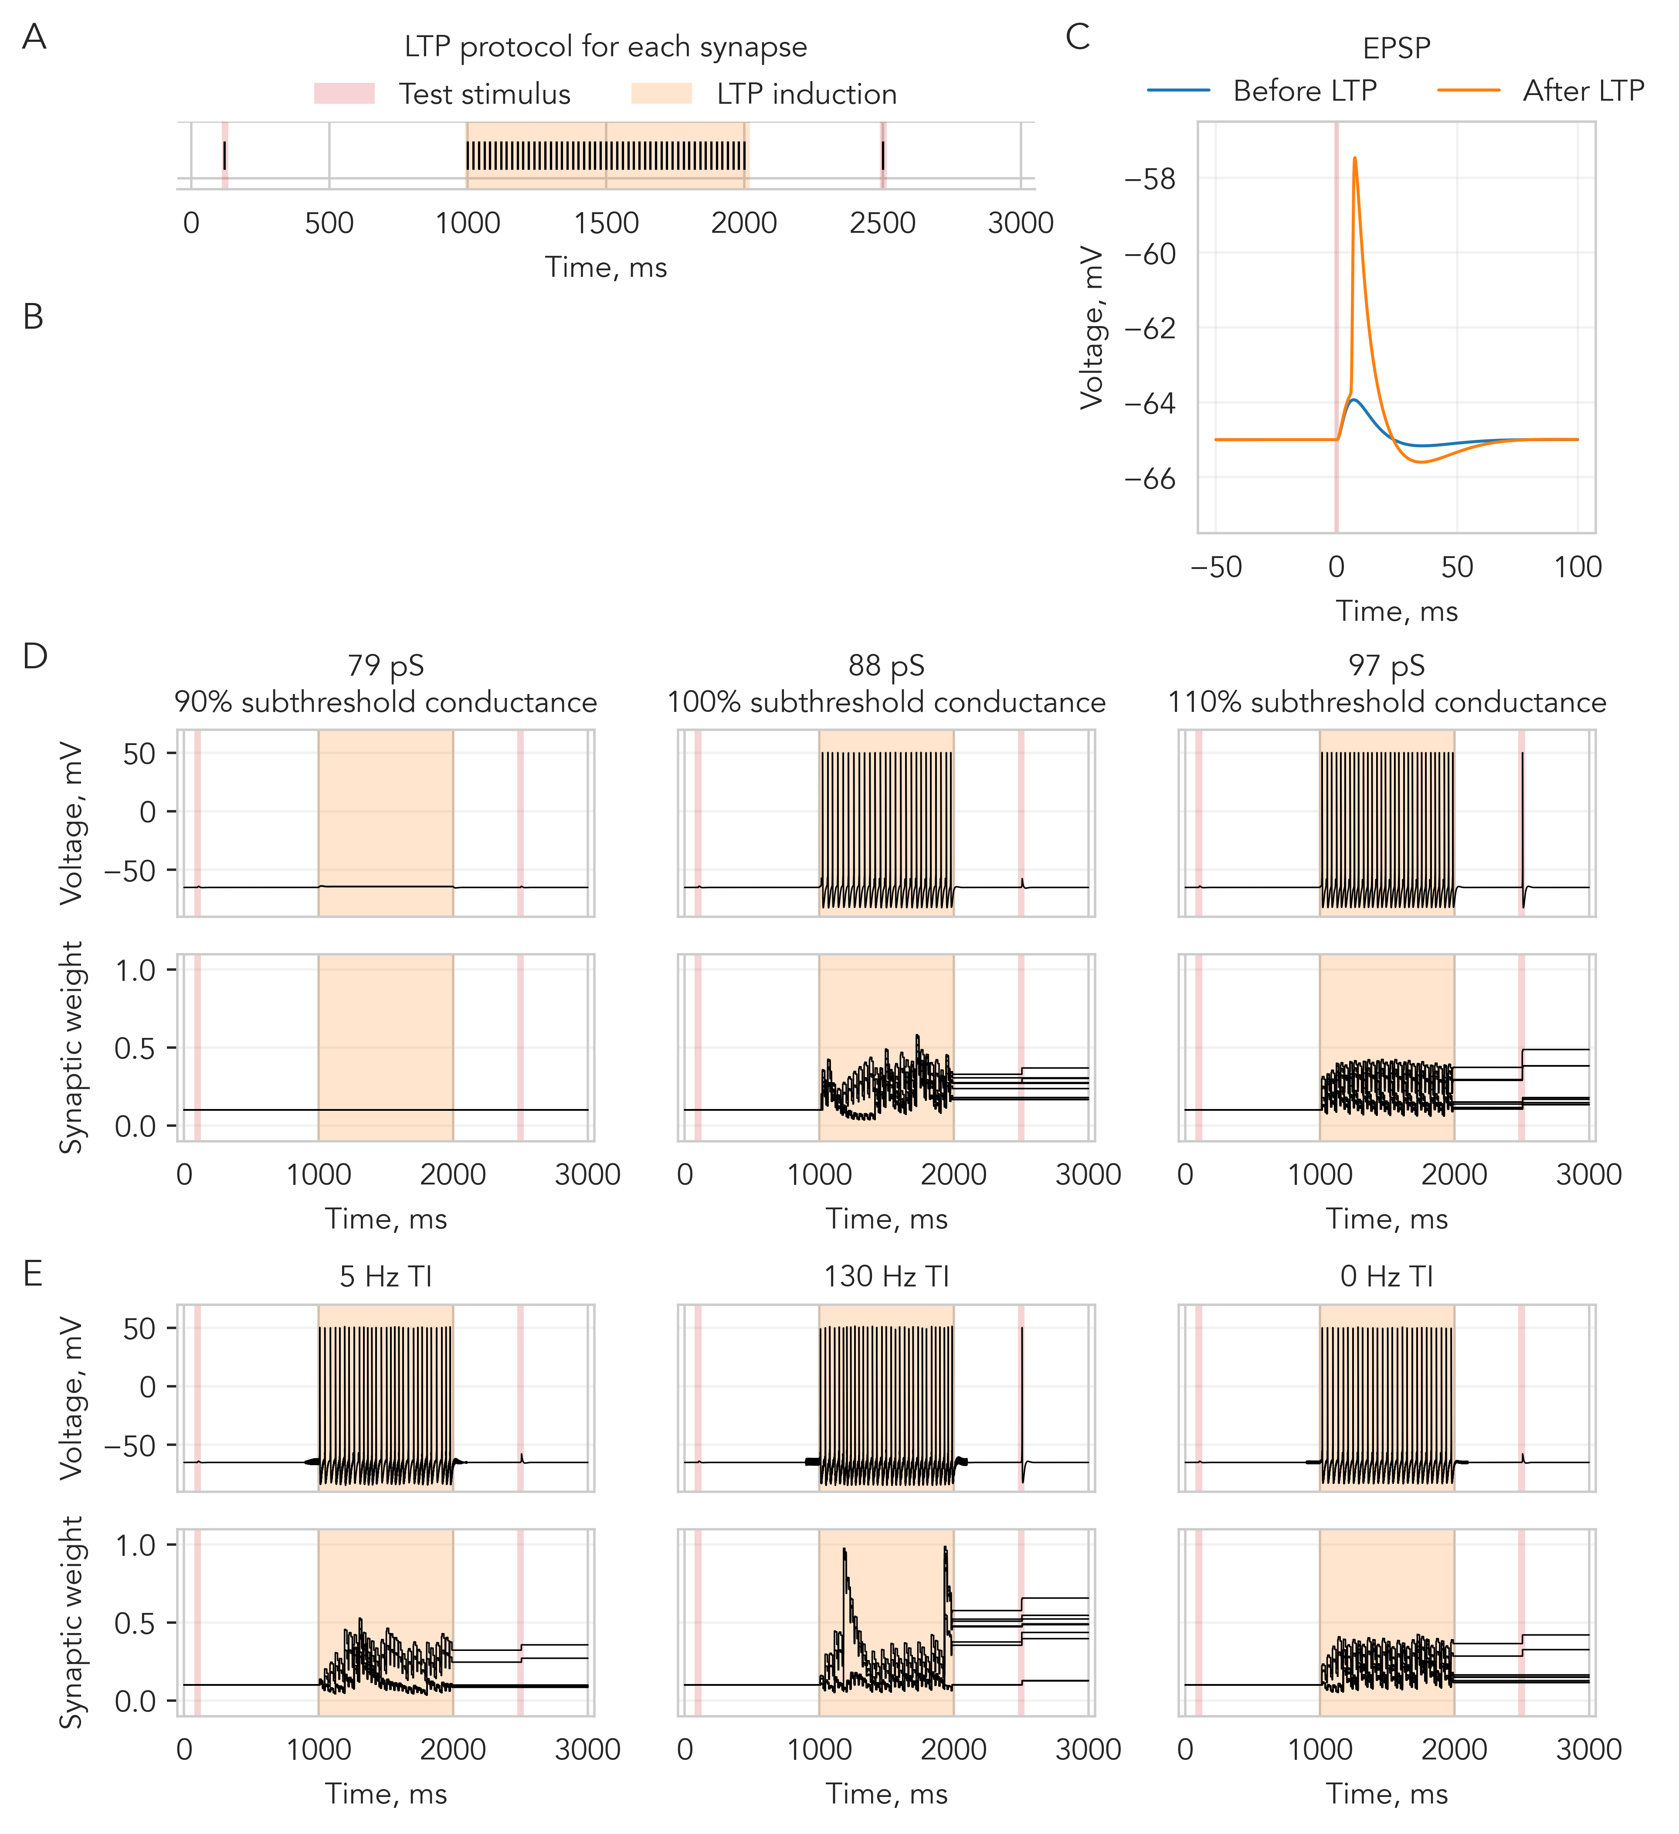
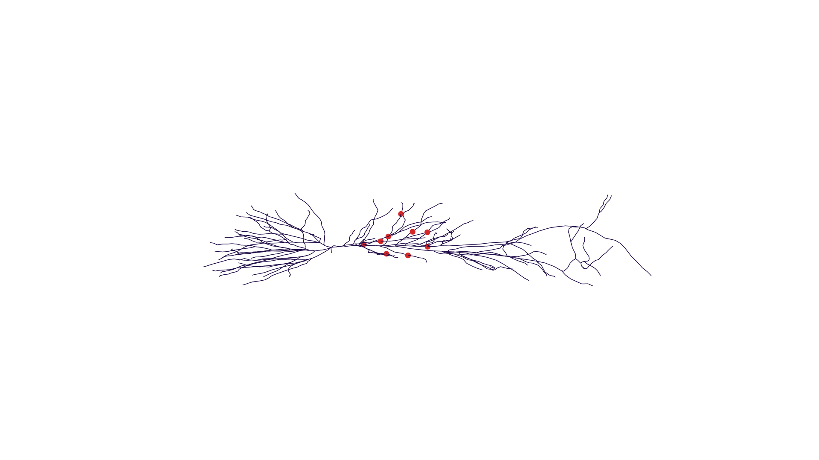

Slide 5
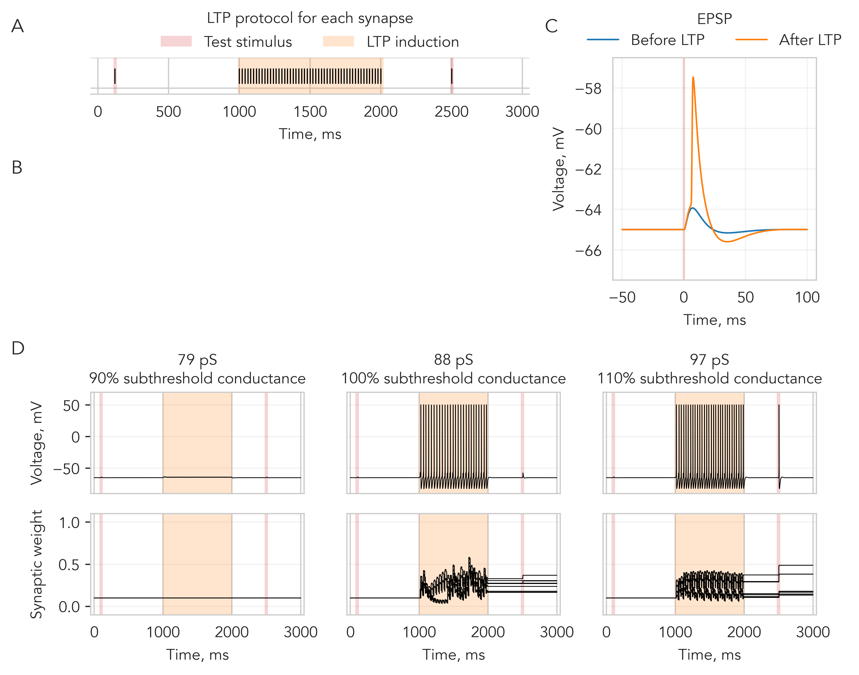

Slide 6
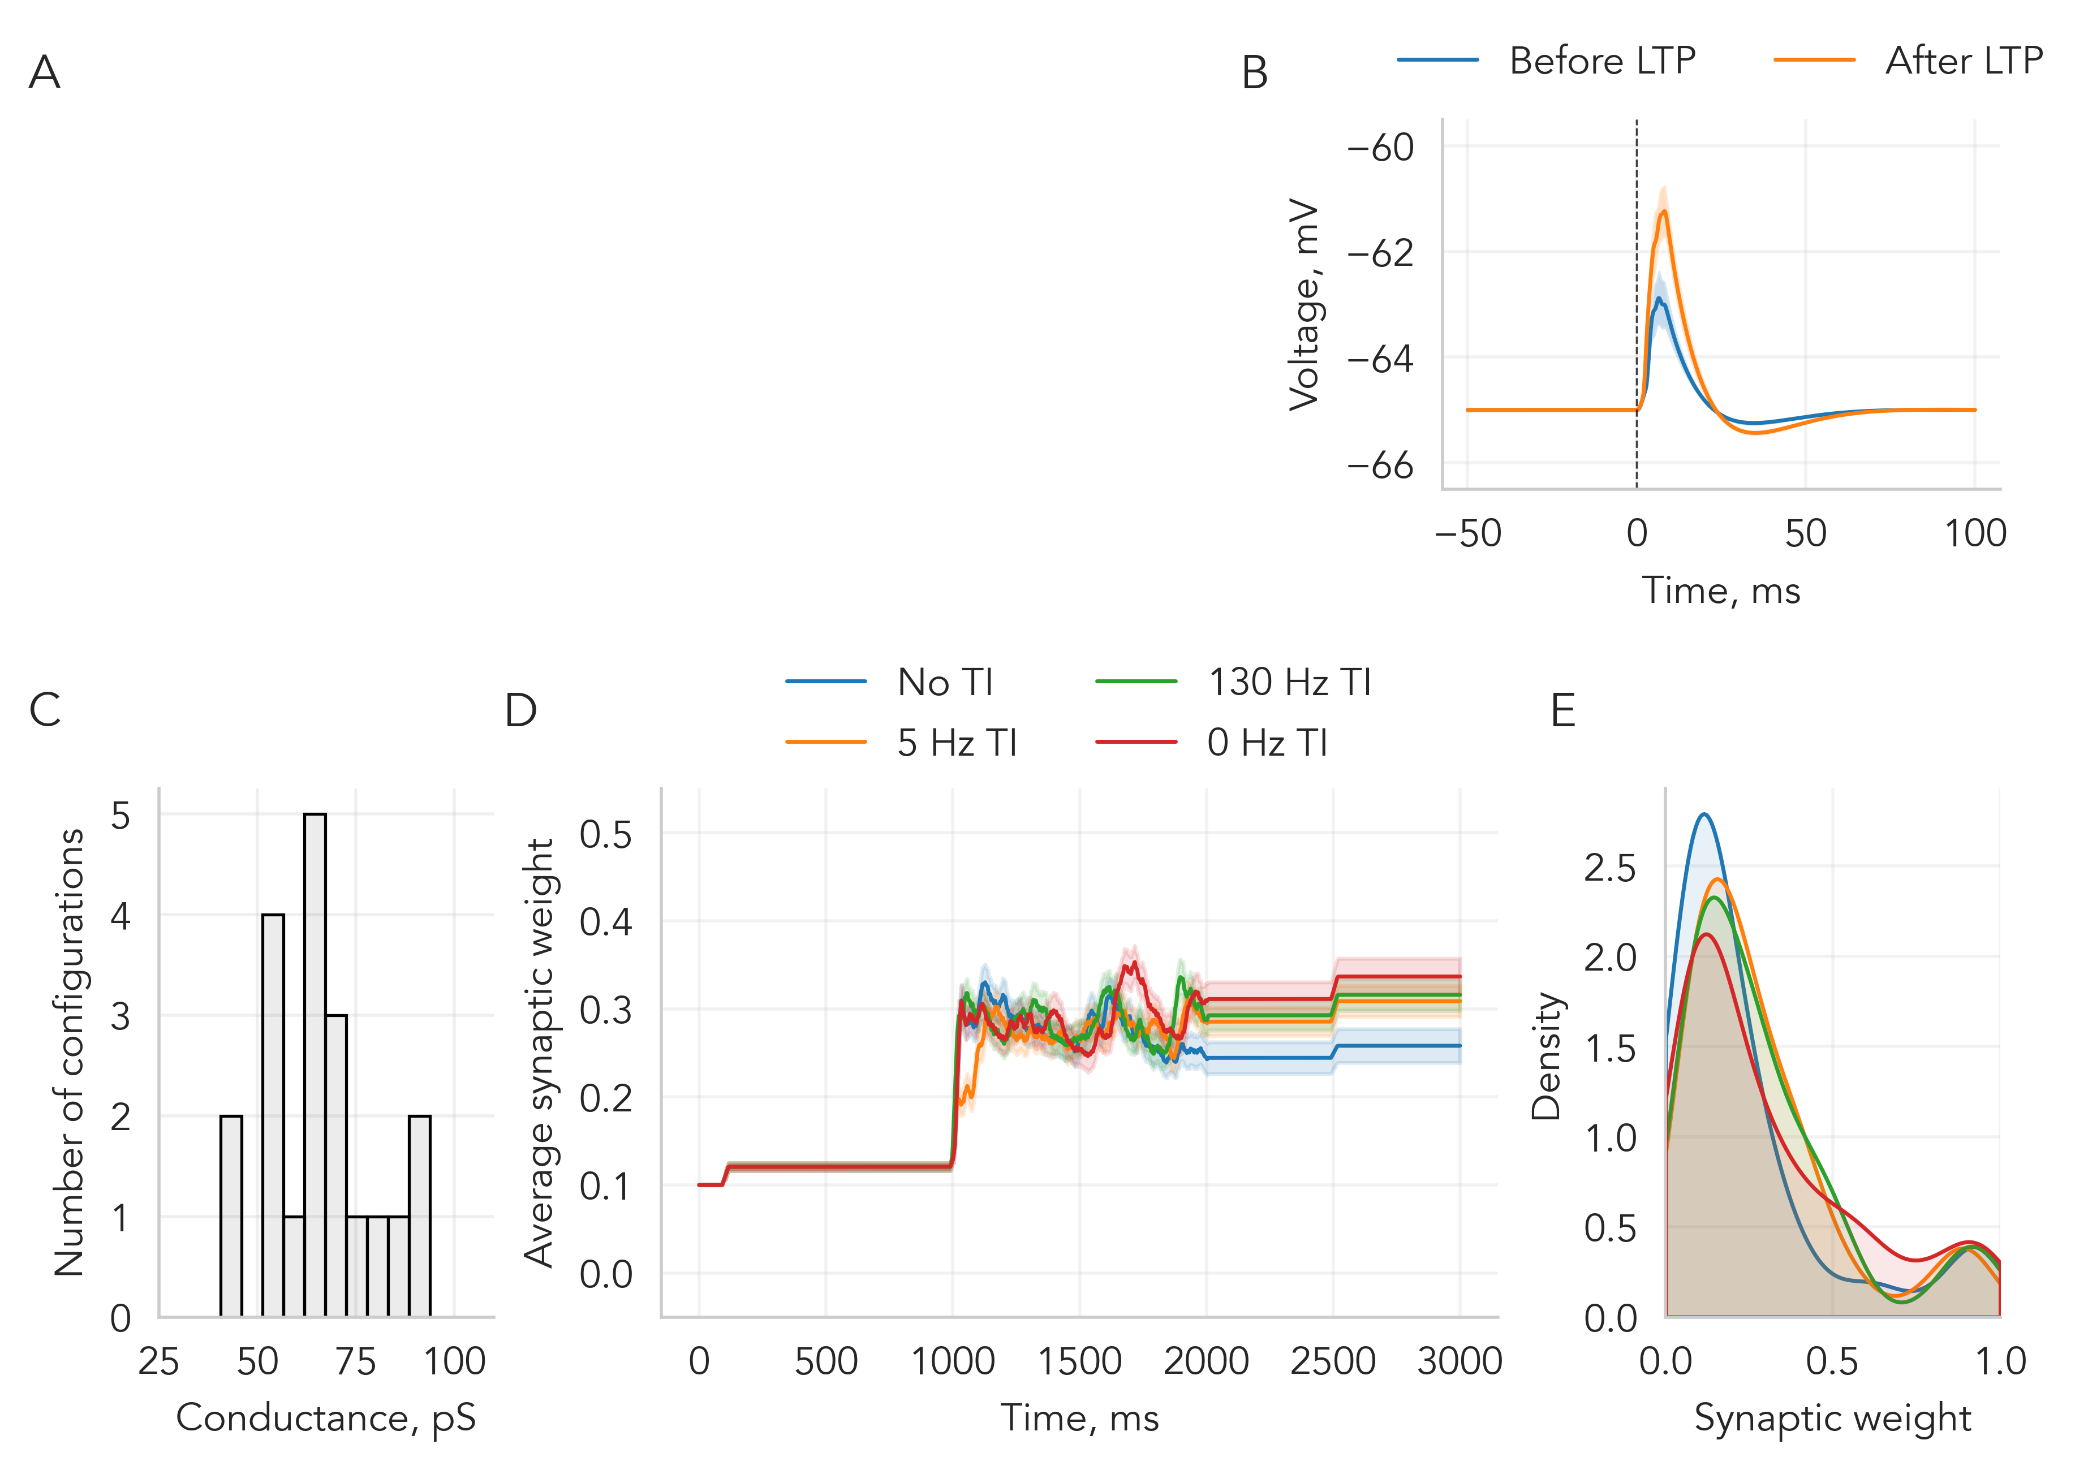
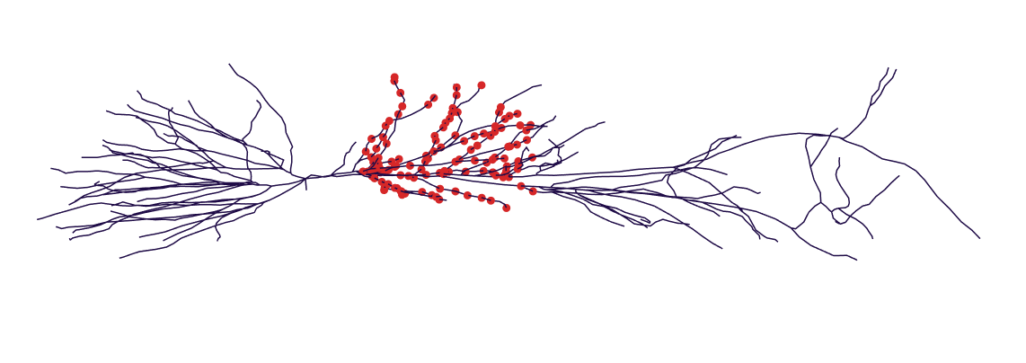

Slide 7
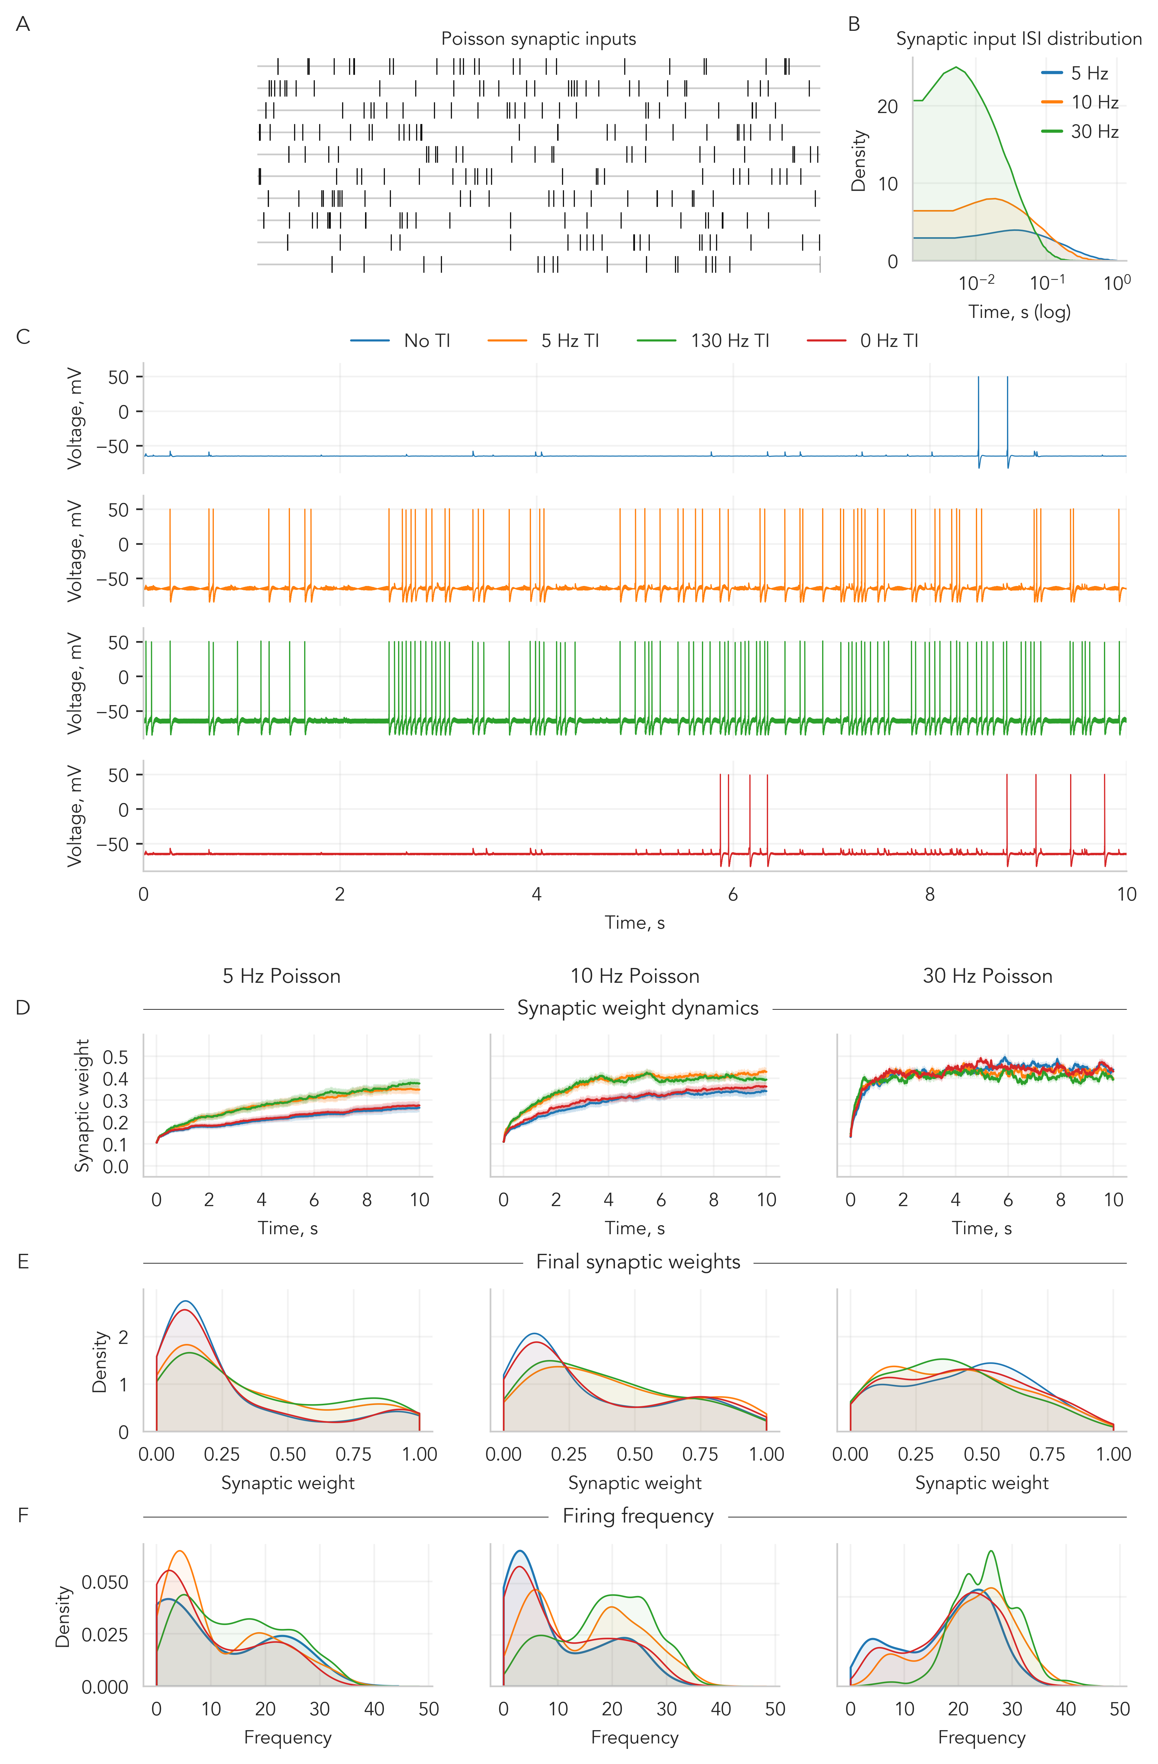

Slide 8
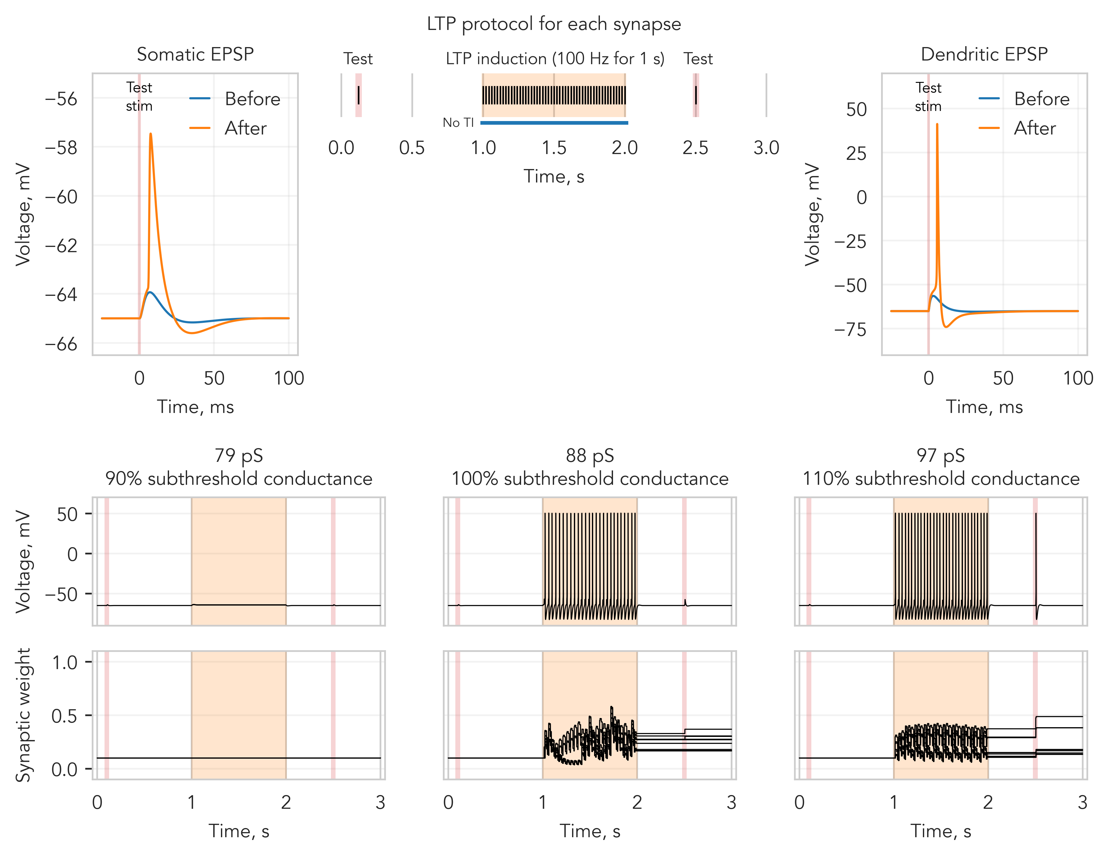

Slide 9
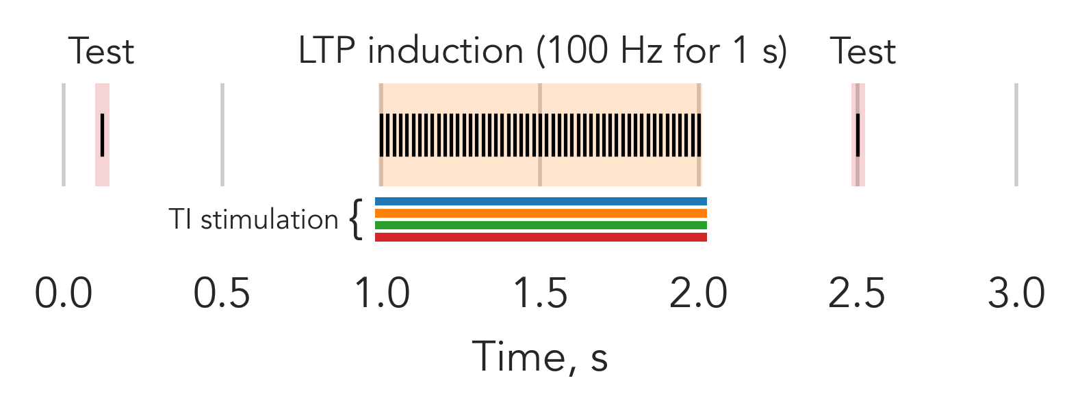
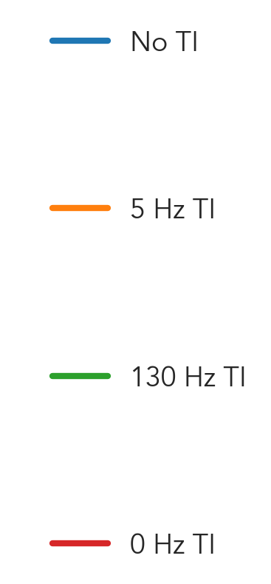

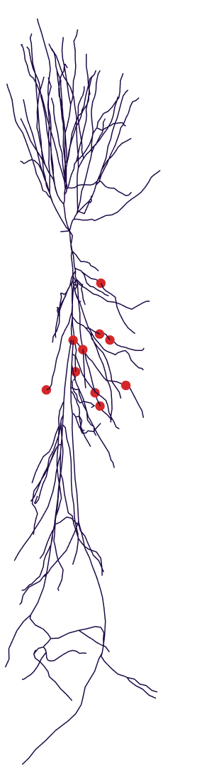
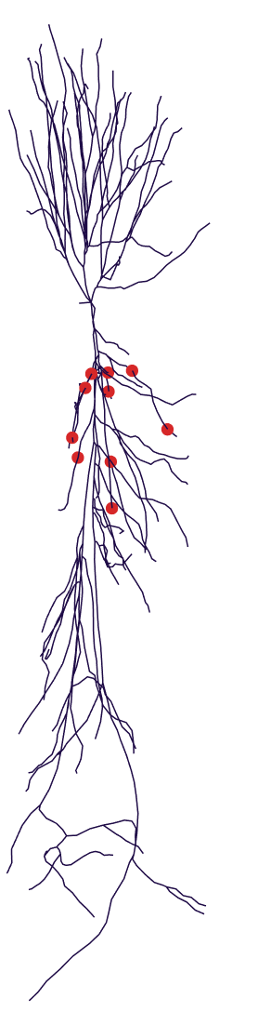
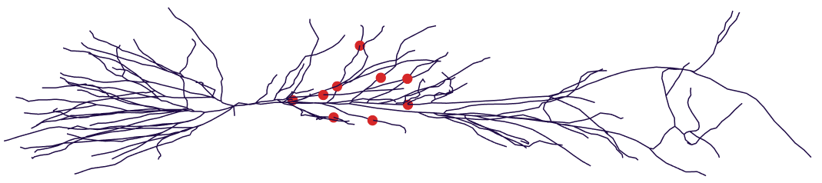
LTP protocol for each synapse
LTP protocol was applied under different synaptic configurations
Applied TI stimulation during the LTP induction
1000 Hz
+
1005 Hz
1000 Hz
+
1130 Hz
× 20 neurons
(with 10 synapses each)
1000 Hz
+
1000 Hz

Slide 10
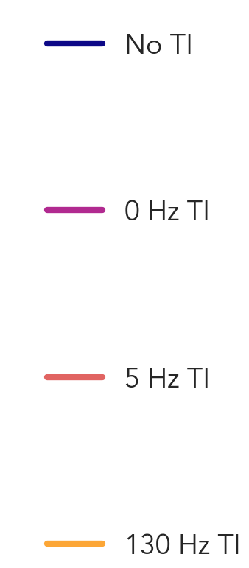
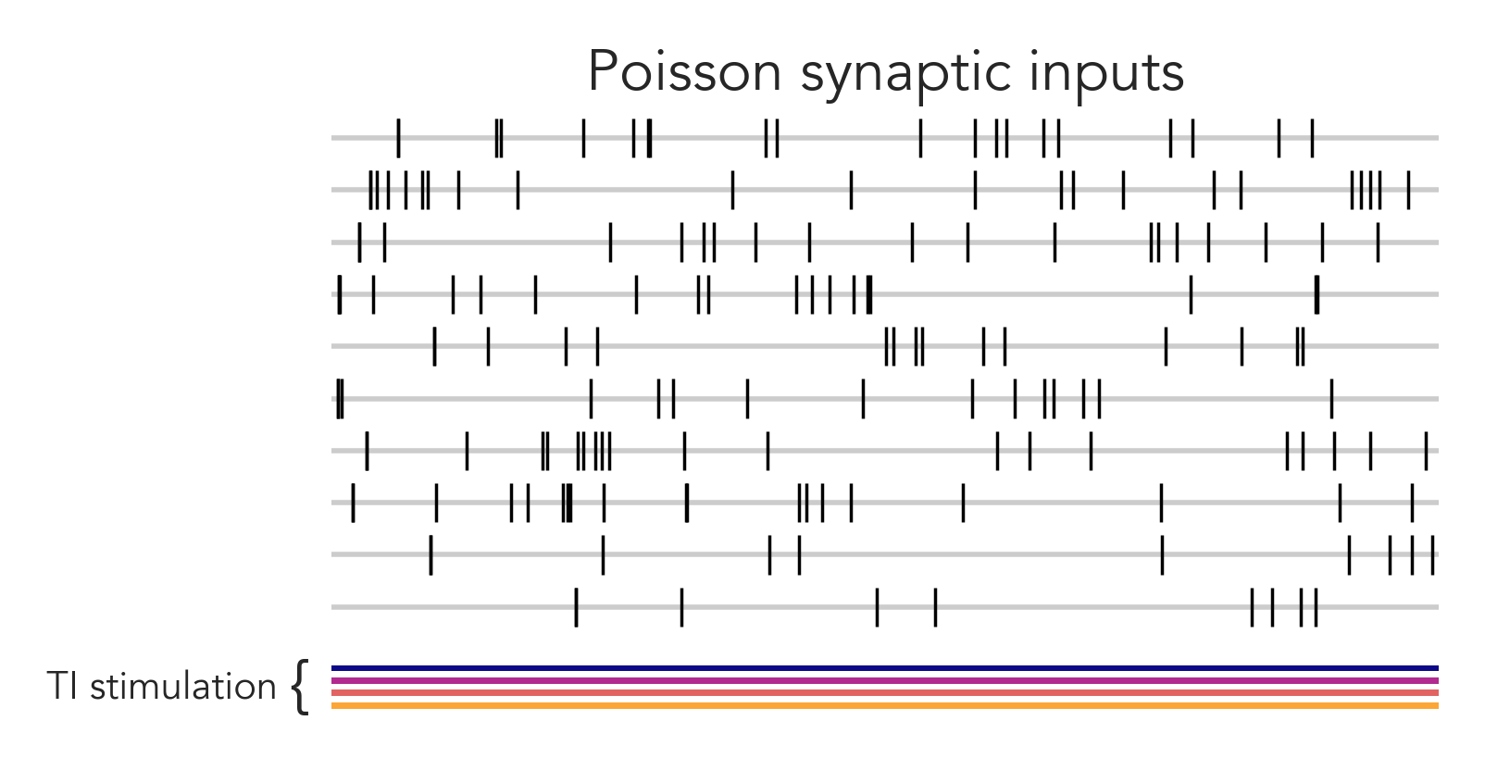
Synapses received Poisson-distributed inputs at 1-30 Hz frequencies
Simulations were performed across multiple synaptic configurations
Applied TI stimulation
1000 Hz
+
1000 Hz
1000 Hz
+
1005 Hz
× 20 neurons
(with 10 synapses each)
1000 Hz
+
1130 Hz

Slide 11
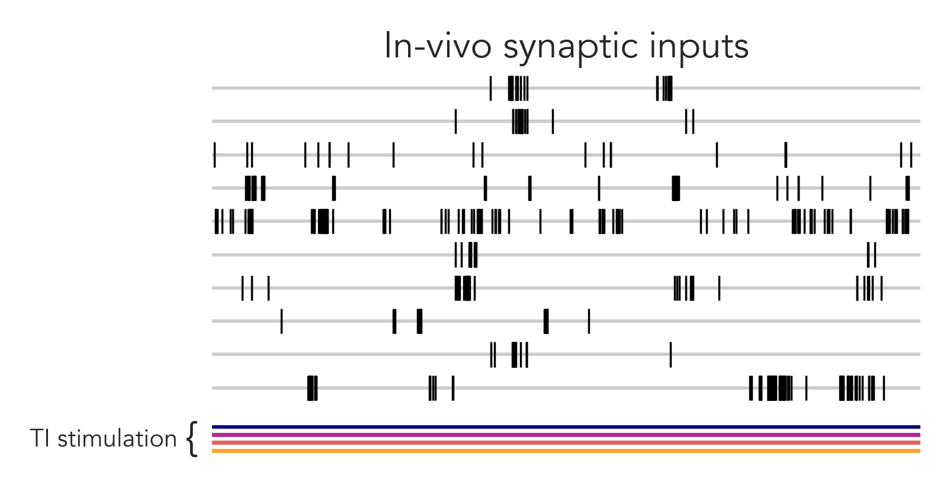
Synapses received in-vivo inputs
Simulations were performed across multiple synaptic configurations
Applied TI stimulation
1000 Hz
+
1000 Hz
1000 Hz
+
1005 Hz
× 20 neurons
(with 10 synapses each)
1000 Hz
+
1130 Hz

Slide 12
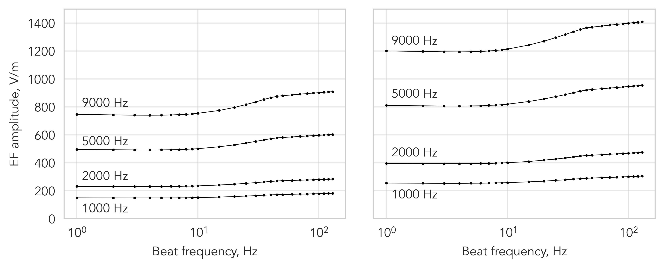
EF parallel to the somato-dendritic axis
EF perpendicular to the somato-dendritic axis
$$\vec{E}$$
$$\vec{E}$$

Slide 13
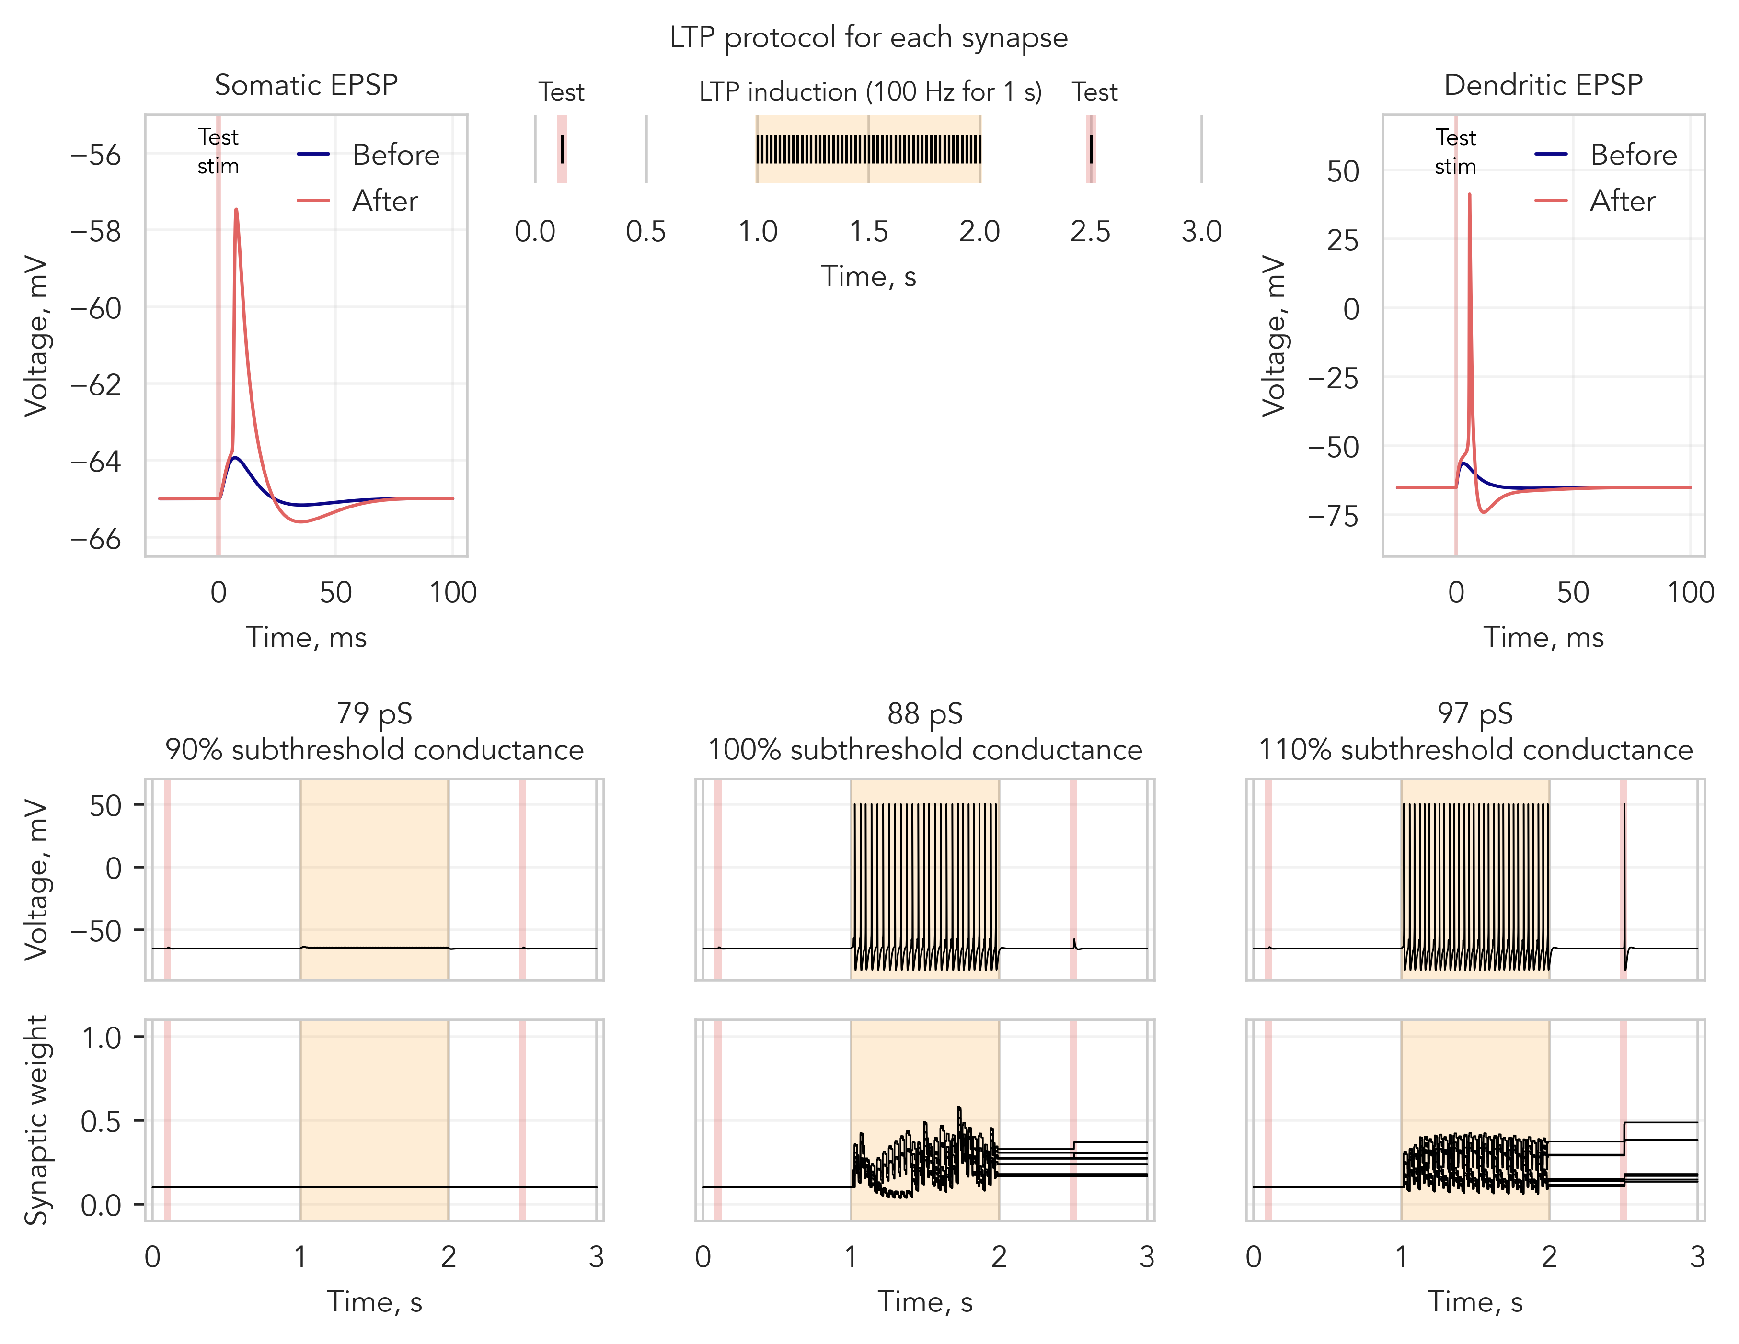

Slide 14
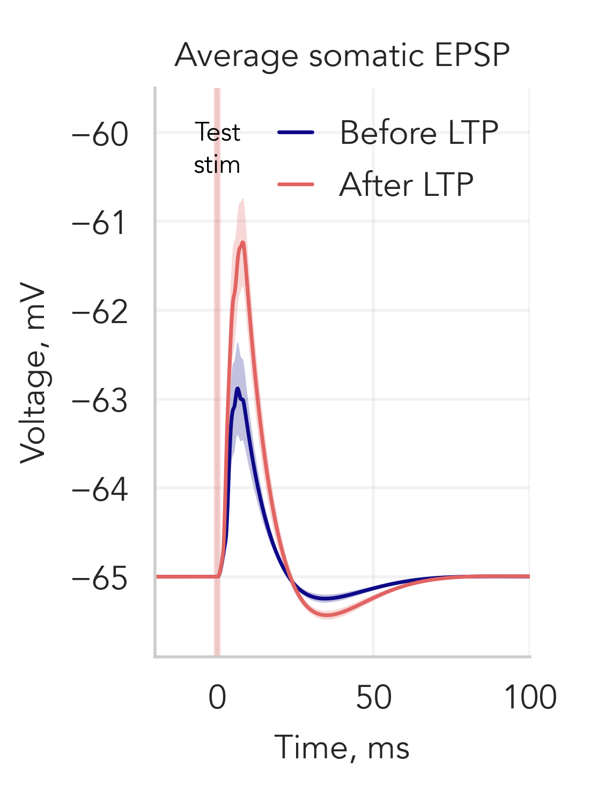
LTP protocol for each synapse
LTP protocol was applied under different synaptic configurations
× 20 neurons
(with 10 synapses each)

