Slide 1
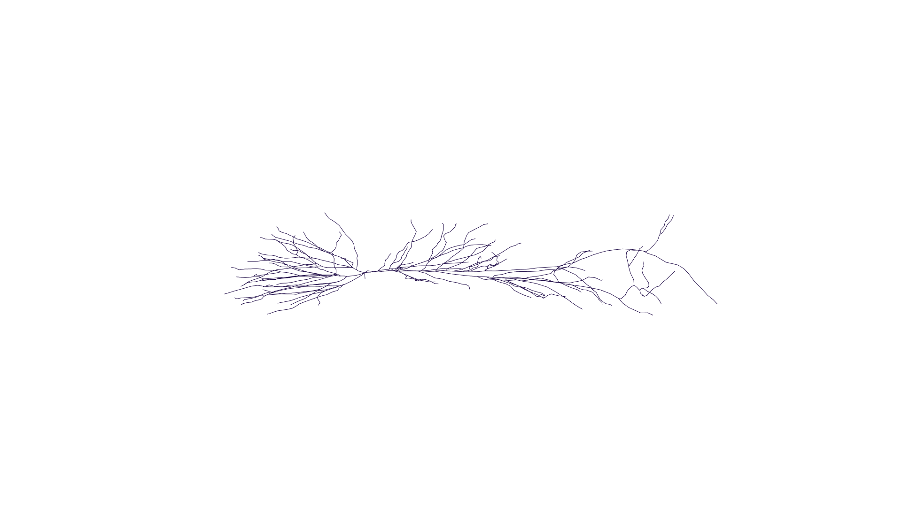
soma
axon
basal dendrites
apical dendrites

Slide 2
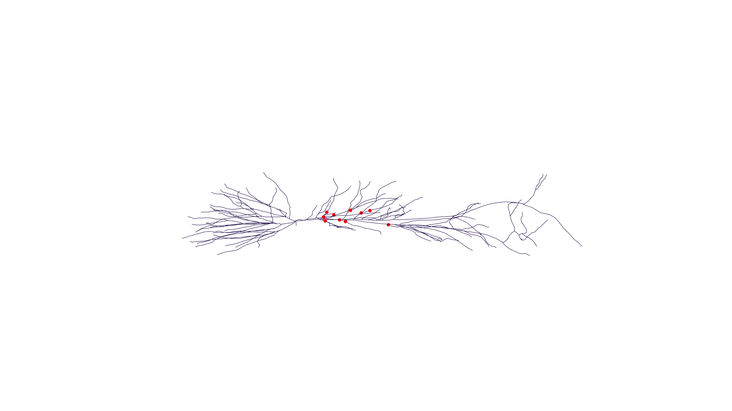
soma
axon
basal dendrites
apical dendrites

