Slide 1

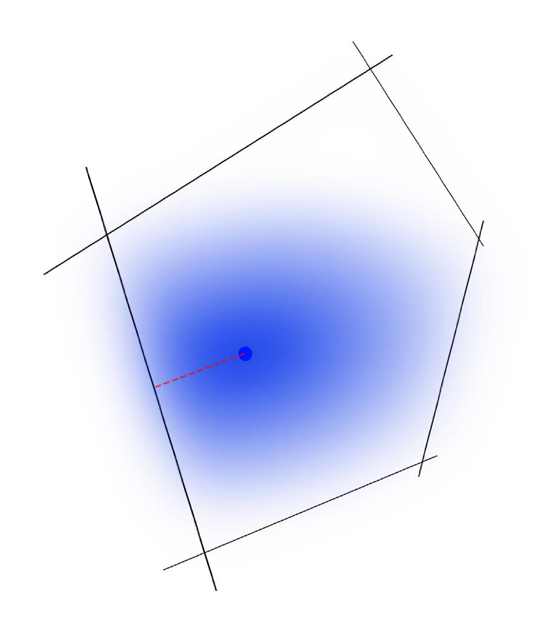
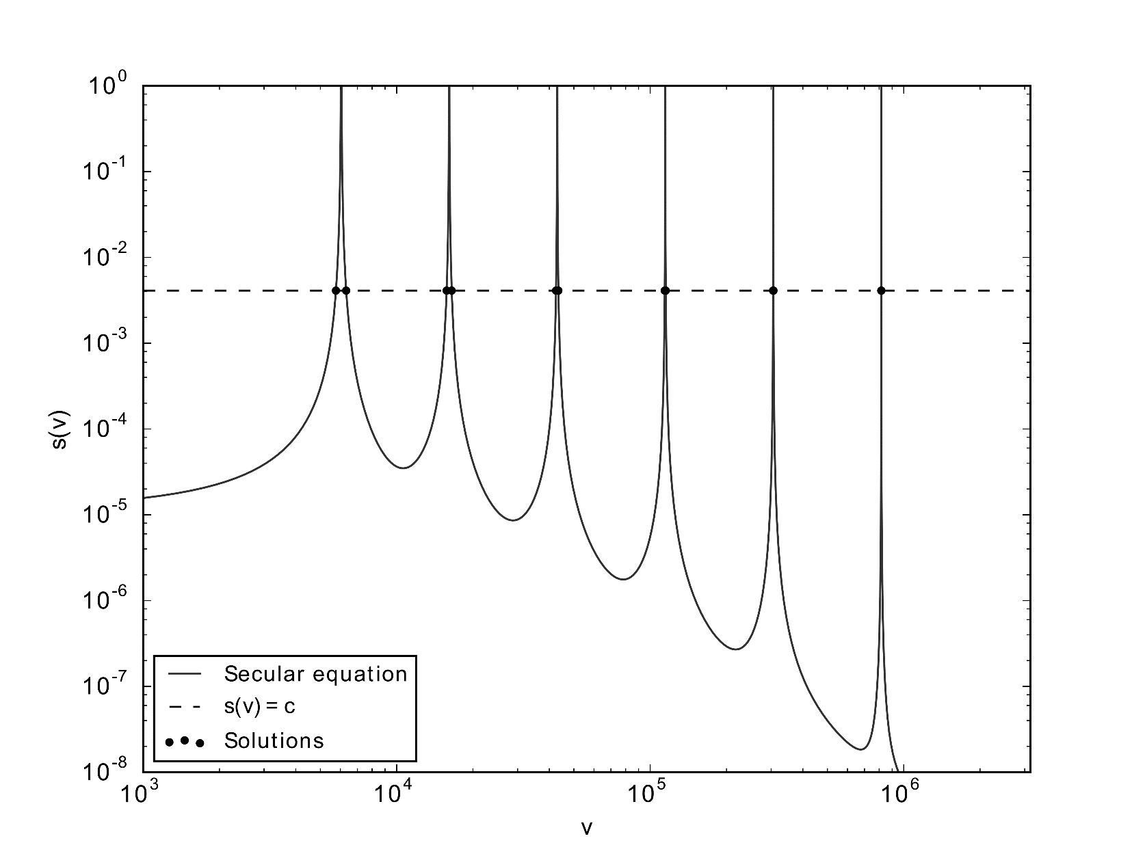
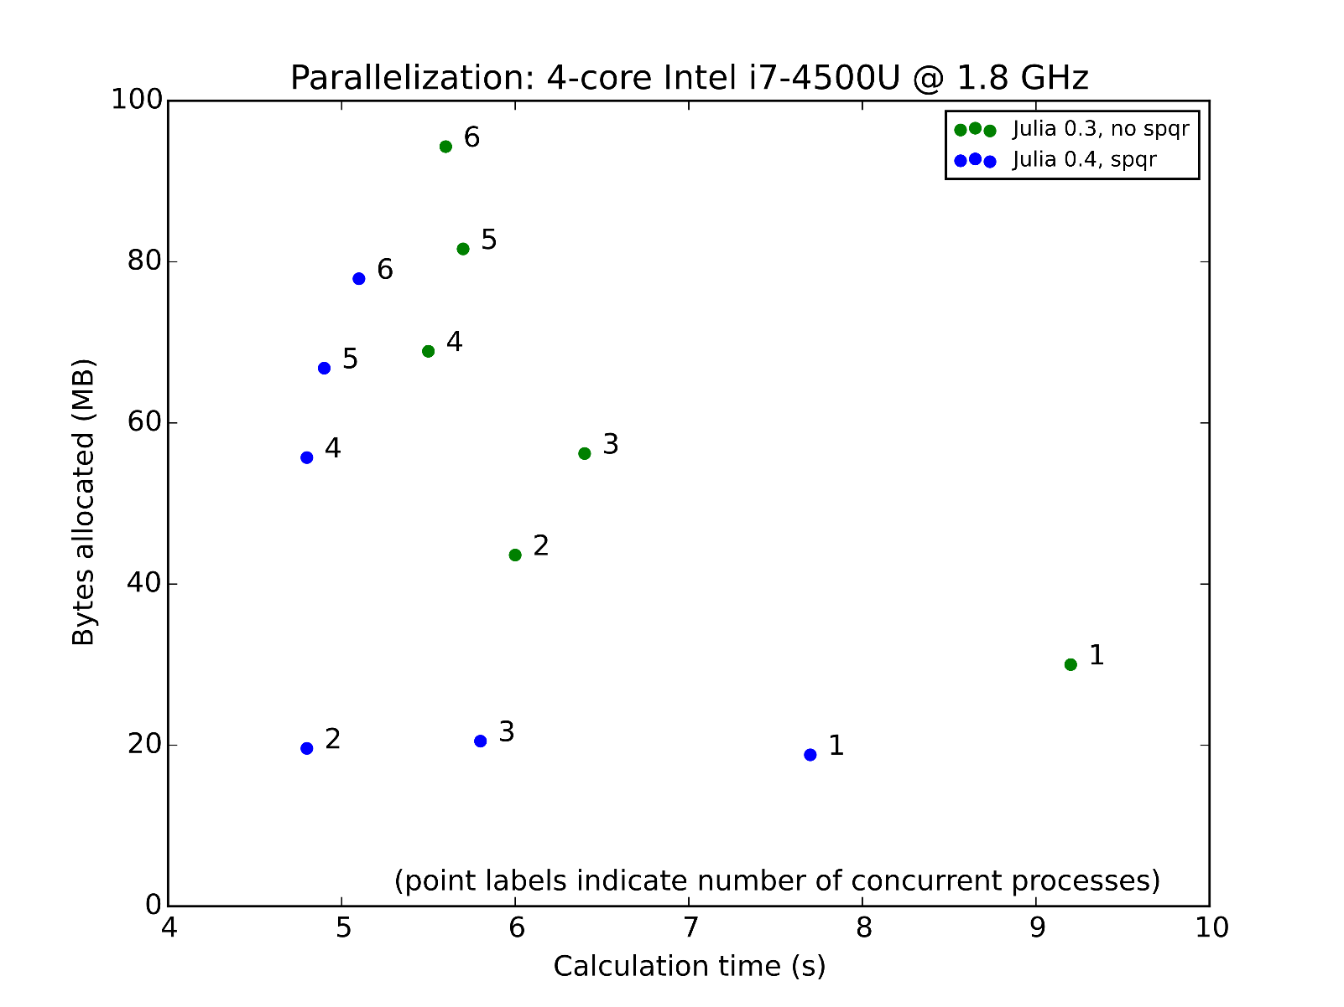
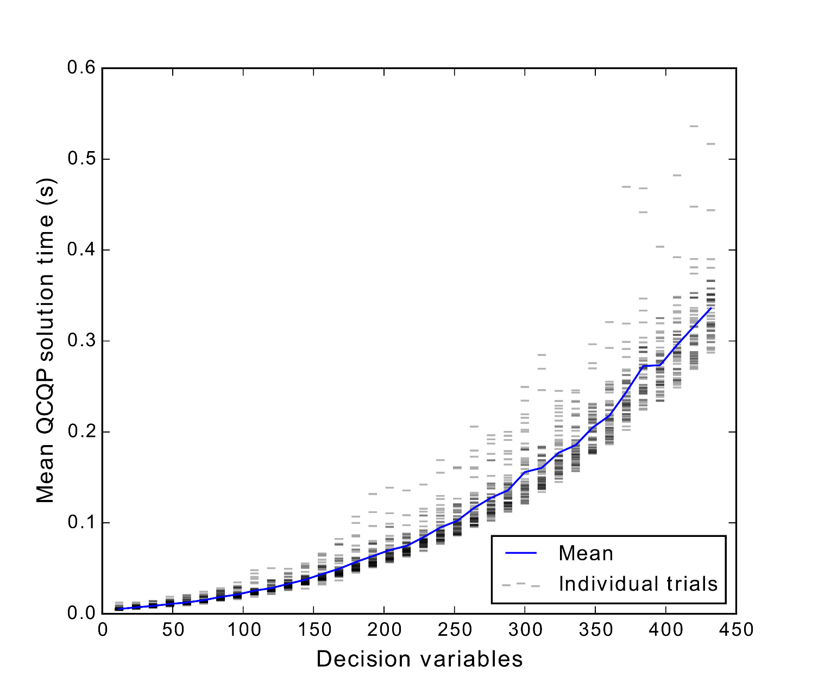
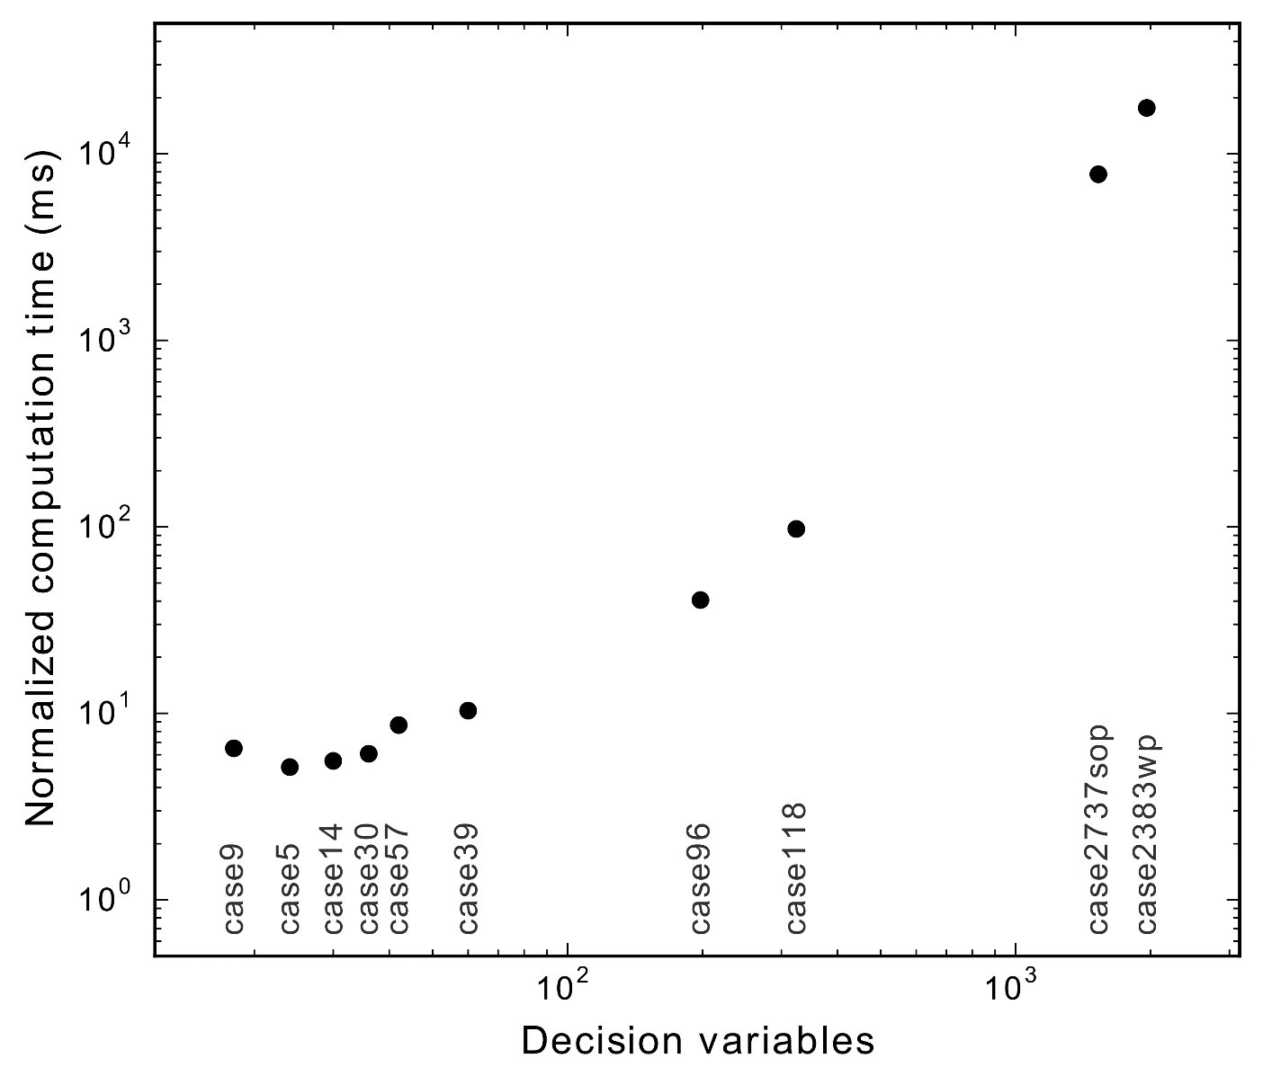
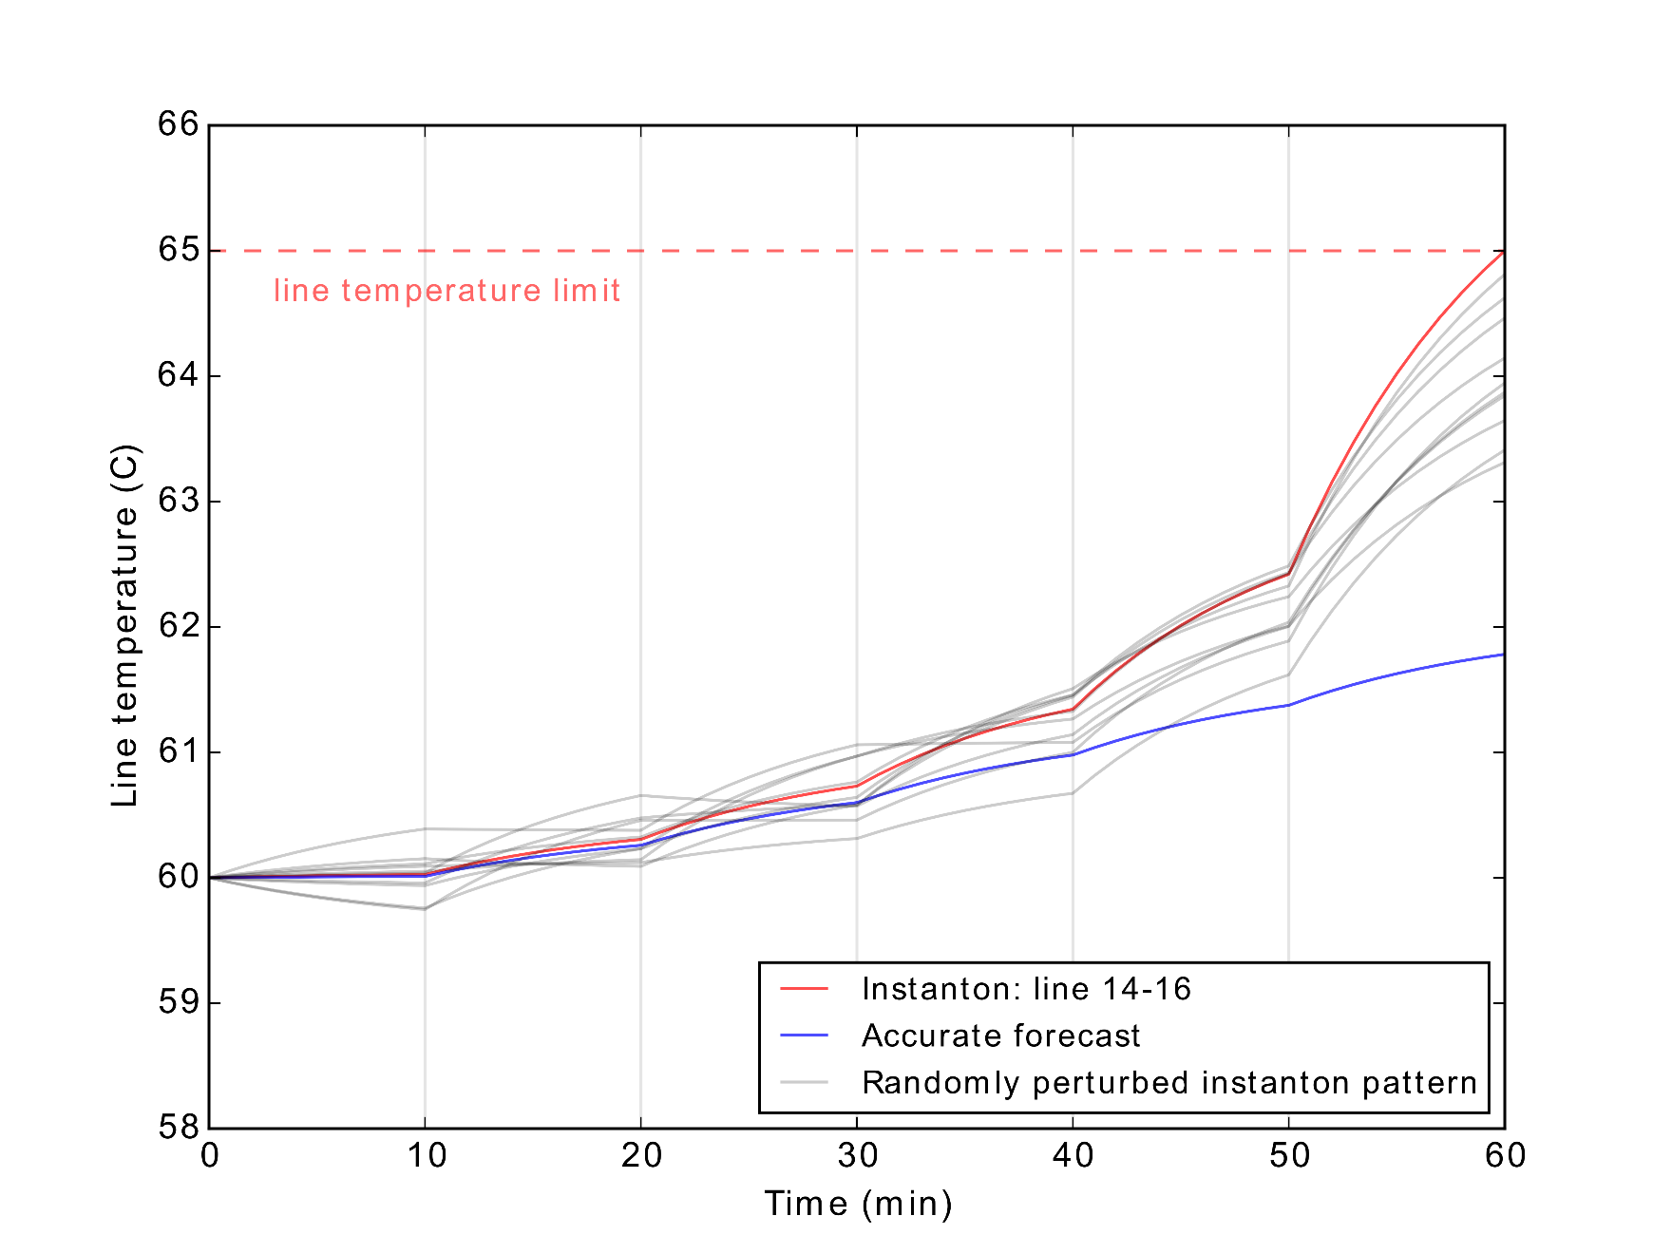

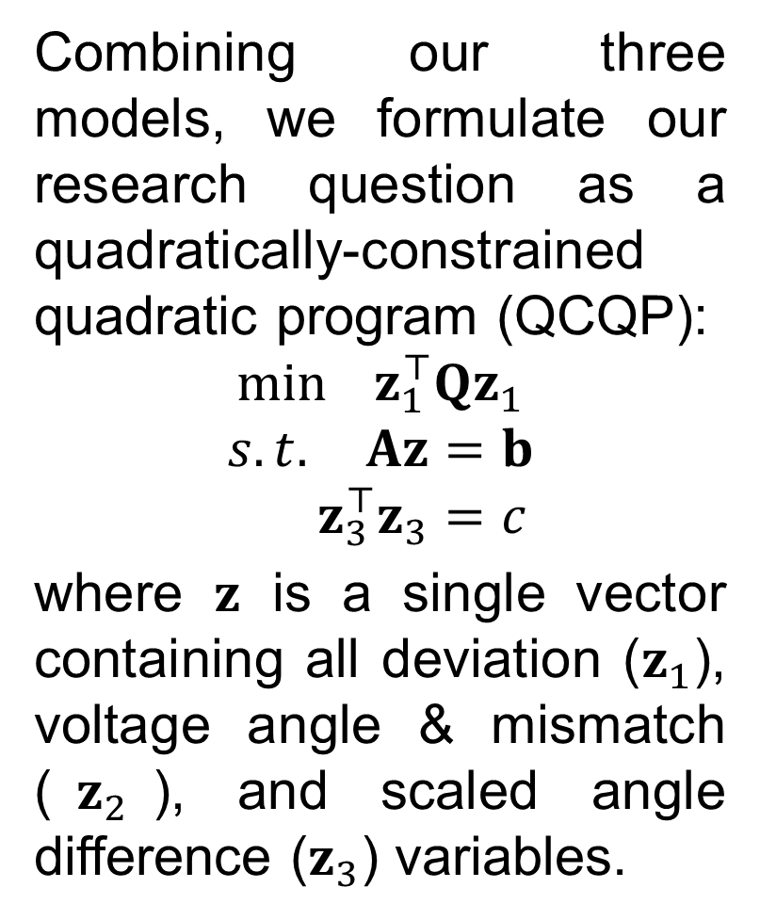
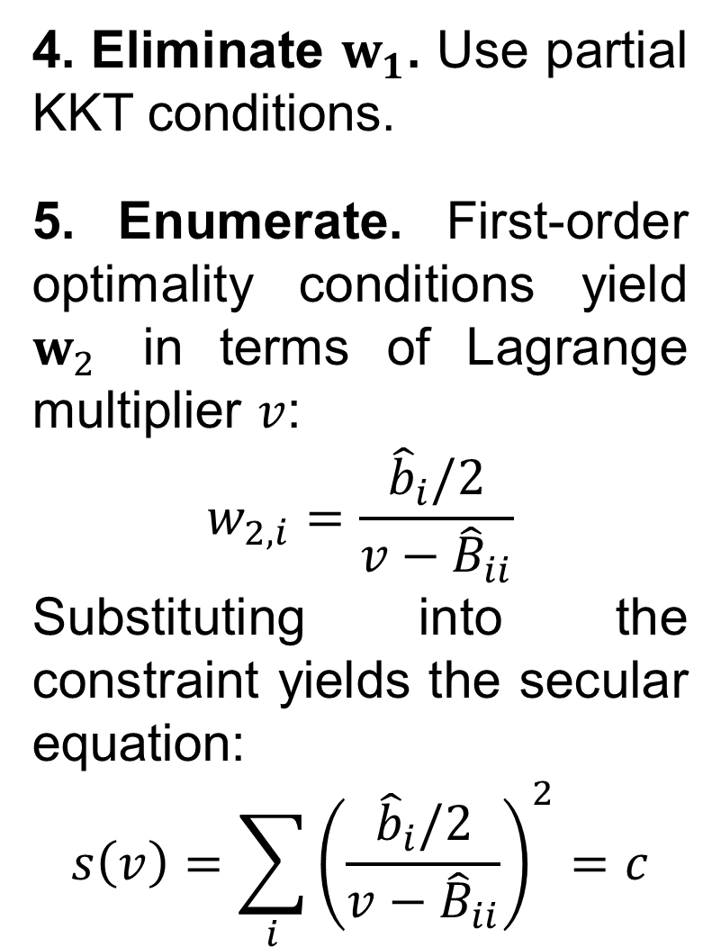
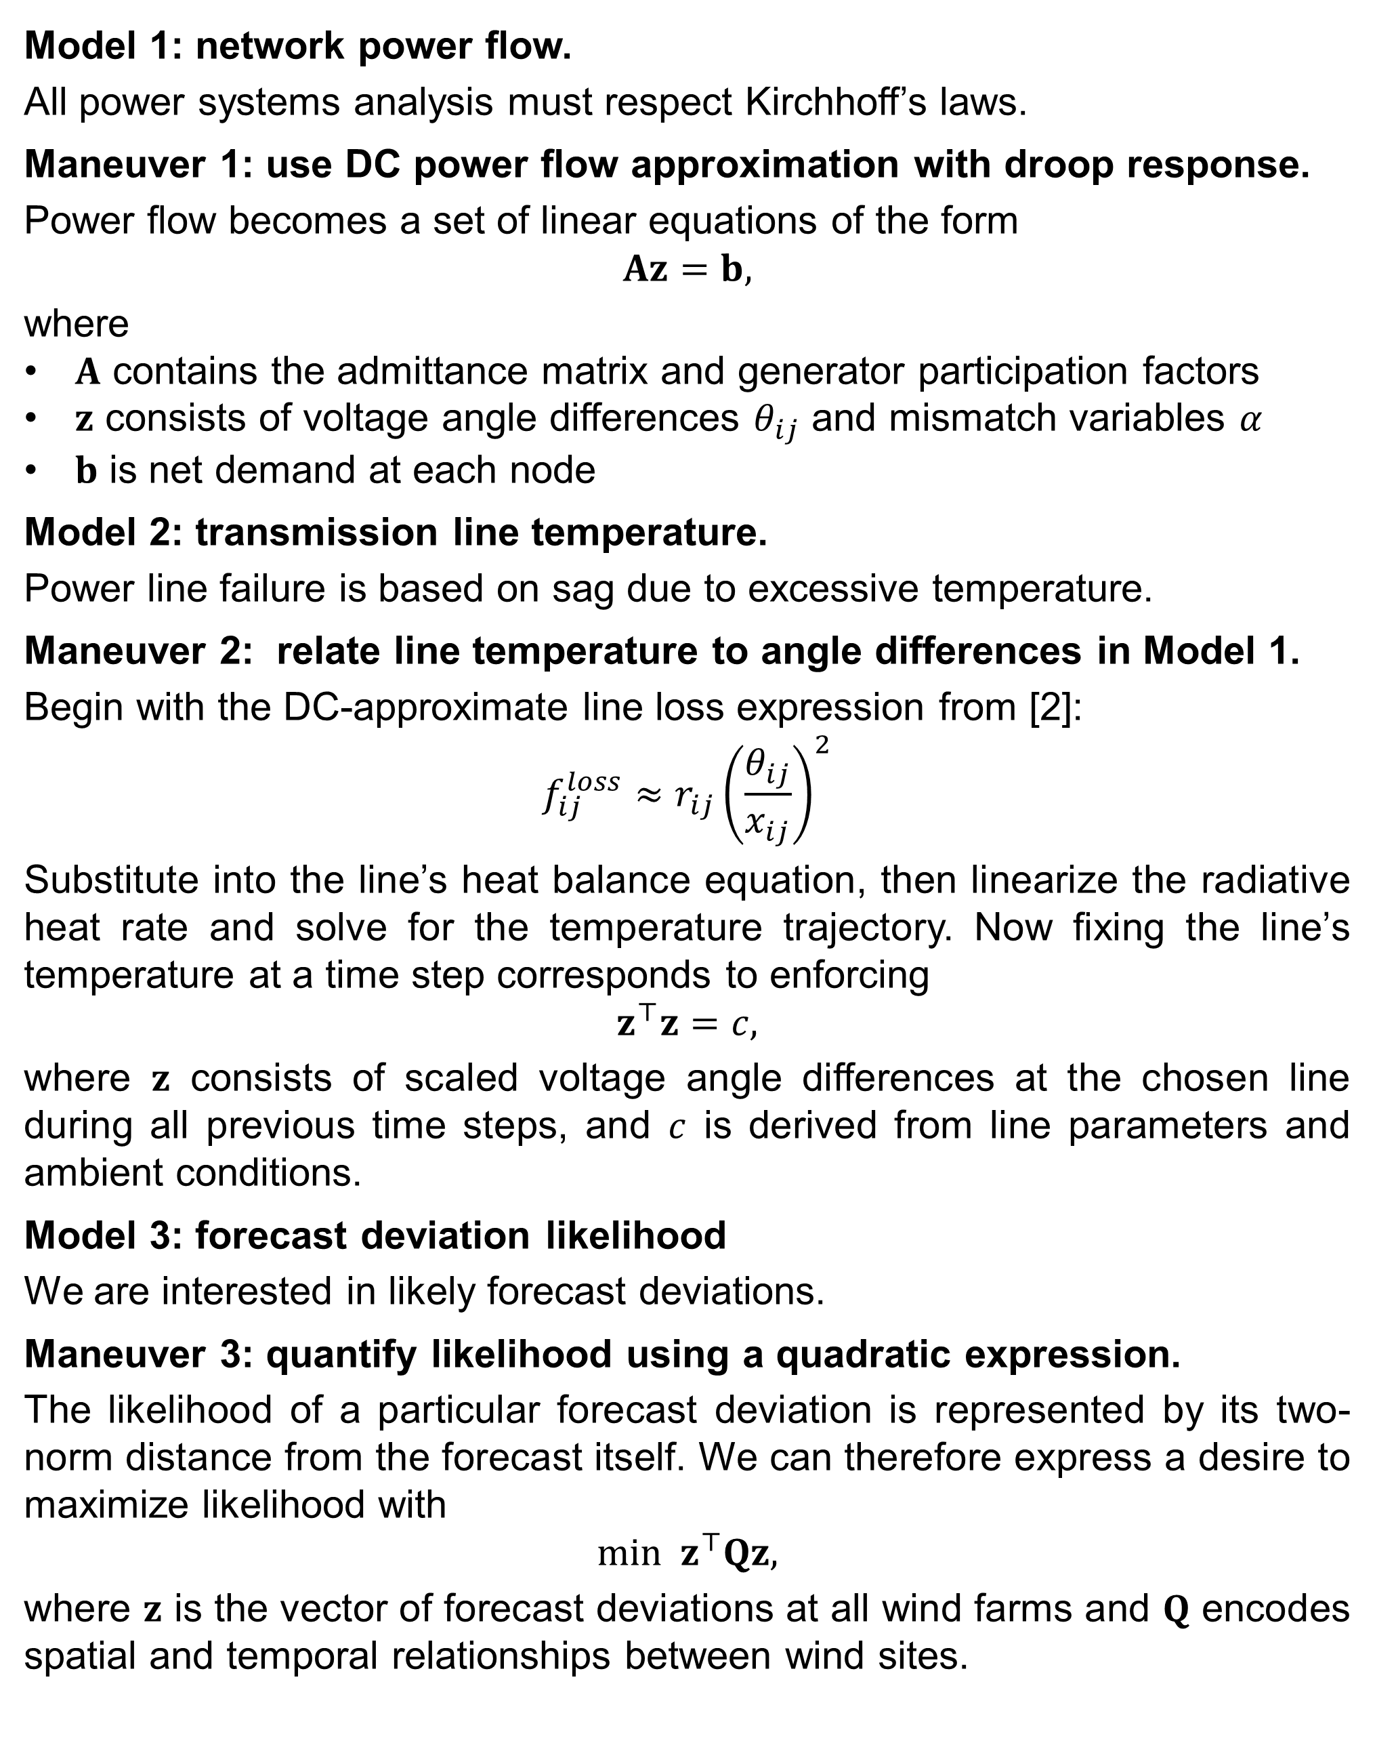
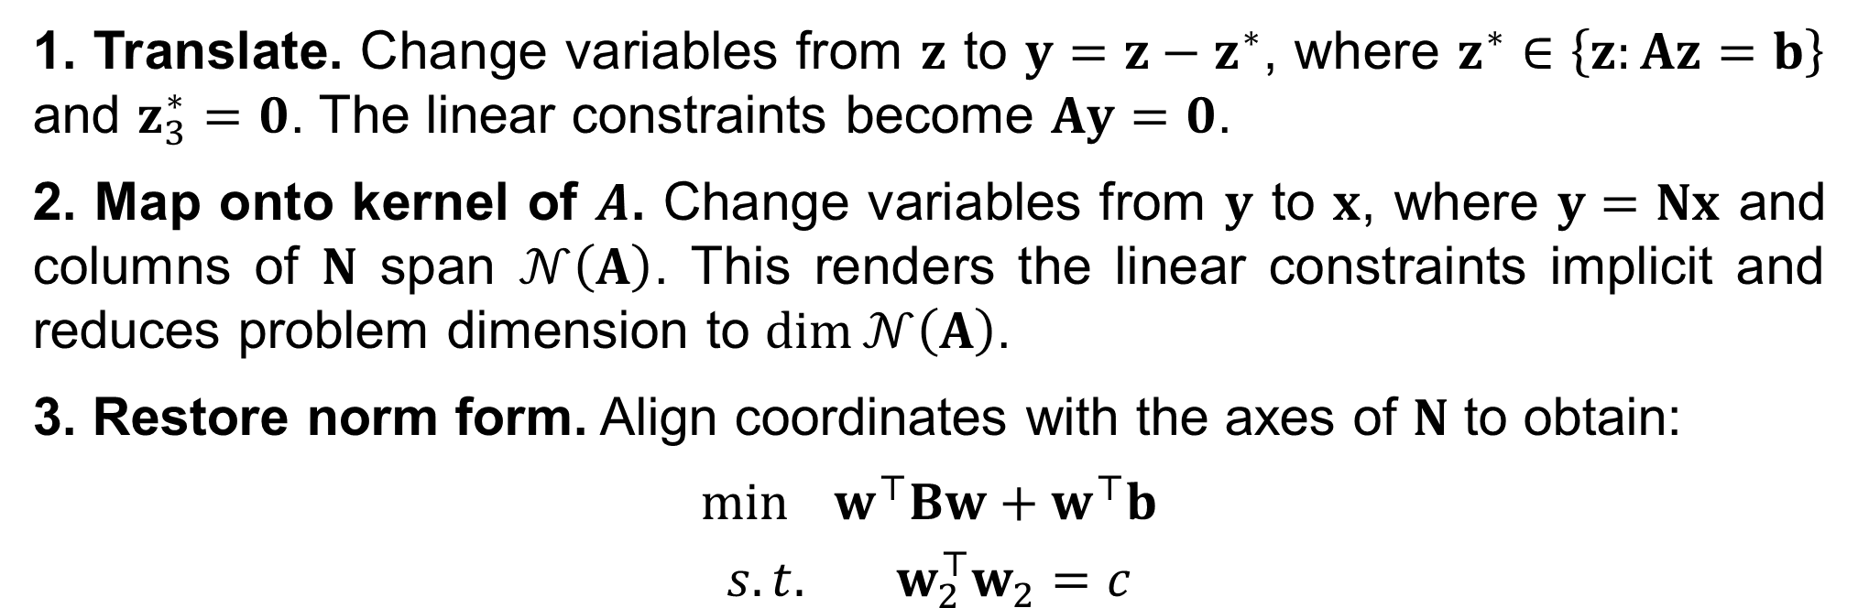
Temporal Instanton Analysis:
Identifying Vulnerability in Transmission Networks
Jonas Kersulis¹, Dr. Ian Hiskens¹
¹Electrical Engineering & Computer Science, University of Michigan, Ann Arbor, MI.
Introduction
QCQP Solution
Power transmission networks increasingly rely on wind generation. Could lines fail when wind deviates from its forecast?
Temporal instanton analysis addresses this question by identifying sag-inducing wind patterns and ranking them by likelihood.
Here we present the model, a mathematical problem formulation and its solution, and various implementation details that help the method scale to large networks.
1. Translate. Change variables from $z$ to $y=z−z^{∗}$, where $z^{∗}∈\left\{z:Az=b\right\}$ and $z_{3}^{∗}=0$. The linear constraints become $Ay=0$.
2. Map onto kernel of $A$. Change variables from $y$ to $x$, where $y=Nx$ and columns of $N$ span $𝒩\left(A\right)$. This renders the linear constraints implicit and reduces problem dimension to $\dim{𝒩\left(A\right)}$.
3. Restore norm form. Align coordinates with the axes of $N$ to obtain:
$$\min{ w^{⊤}Bw+w^{⊤}b}$$
$$s.t. w_{2}^{⊤}w_{2}=c$$
Figure 1: How far is the forecast from the edge of feasible operation?
4. Eliminate $w_{1}$. Use partial KKT conditions.
5. Enumerate. First-order optimality conditions yield $w_{2}$ in terms of Lagrange multiplier $v$:
$$w_{2,i}=\frac{{\hat{b}}_{i}/2}{v−{\hat{B}}_{ii}}$$
Substituting into the constraint yields the secular equation:
$$s\left(v\right)={\sum_{i}{\left(\frac{{\hat{b}}_{i}/2}{v−{\hat{B}}_{ii}}\right)}}^{2}=c$$
Three Models, Three Maneuvers
Model 1: network power flow.
All power systems analysis must respect Kirchhoff’s laws.
Maneuver 1: use DC power flow approximation with droop response.
Power flow becomes a set of linear equations of the form
$$Az=b,$$
where
$A$ contains the admittance matrix and generator participation factors
$z$ consists of voltage angle differences $θ_{ij}$ and mismatch variables $α$
$b$ is net demand at each node
Model 2: transmission line temperature.
Power line failure is based on sag due to excessive temperature.
Maneuver 2: relate line temperature to angle differences in Model 1.
Begin with the DC-approximate line loss expression from [2]:
$$f_{ij}^{loss}≈r_{ij}{\left(\frac{θ_{ij}}{x_{ij}}\right)}^{2}$$
Substitute into the line’s heat balance equation, then linearize the radiative heat rate and solve for the temperature trajectory. Now fixing the line’s temperature at a time step corresponds to enforcing
$$z^{⊤}z=c,$$
where $z$ consists of scaled voltage angle differences at the chosen line during all previous time steps, and $c$ is derived from line parameters and ambient conditions.
Model 3: forecast deviation likelihood
We are interested in likely forecast deviations.
Maneuver 3: quantify likelihood using a quadratic expression.
The likelihood of a particular forecast deviation is represented by its two-norm distance from the forecast itself. We can therefore express a desire to maximize likelihood with
$$min z^{⊤}Qz,$$
where $z$ is the vector of forecast deviations at all wind farms and $Q$ encodes spatial and temporal relationships between wind sites.
Figure 2: A secular equation taken from RTS-96 analysis with six time steps.
Implementation Details
Sparsity-preserving methods dramatically reduce requirements.
Temporal instanton analysis is trivially parallelizable.
Figure 3: QCQP solution algorithm scaling.
Right: Storage and processing requirements for various numbers of worker processes, with and without sparse QR factorization. Bottom Left: RTS-96 analysis with 2-72 wind farms. Each dash represents a different (random) wind farm placement. Bottom Right: various Matpower networks. In each case the number of wind farms was fixed to the number of generators, with overall penetration fixed to 70%. Wind sites were chosen randomly. “Normalized computation time” is the mean of ten QCQP solutions.
One Optimization Problem
Combining our three models, we formulate our research question as a quadratically-constrained quadratic program (QCQP):
$$\min{ z_{1}^{⊤}Qz_{1}}$$
$$s.t. Az=b$$
$${ z}_{3}^{⊤}z_{3}=c$$
where $z$ is a single vector containing all deviation ($z_{1}$), voltage angle & mismatch ($z_{2}$), and scaled angle difference ($z_{3}$) variables.
Acknowledgements
The authors thank Dr. M. Chertkov and Dr. S. Backhaus of Los Alamos National Laboratory (LANL) for discussions and notes, and Dr. D. Bienstock for his assistance in the solution of trust region subproblems. This work was supported by the LANL Grid Science Program, subcontract 270958.
References
[1] J. Kersulis, I. Hiskens, M. Chertkov, S. Backhaus, and D. Bienstock, “Temp- erature-based instanton analysis: Identifying vulnerability in transmission networks,” in IEEE PowerTech 2015 Eindhoven, Jun. 2015, pp. 1–6.
[2] M. Almassalkhi and I. Hiskens, “Model-predictive cascade mitigation in electric power systems with storage and renewables – part I: Theory and implementa- tion,” IEEE Transactions on Power Systems, vol. PP, no. 99, pp. 1–11, 2014.
Figure 4: The instanton wind pattern is unique to each line.

