Slide 1


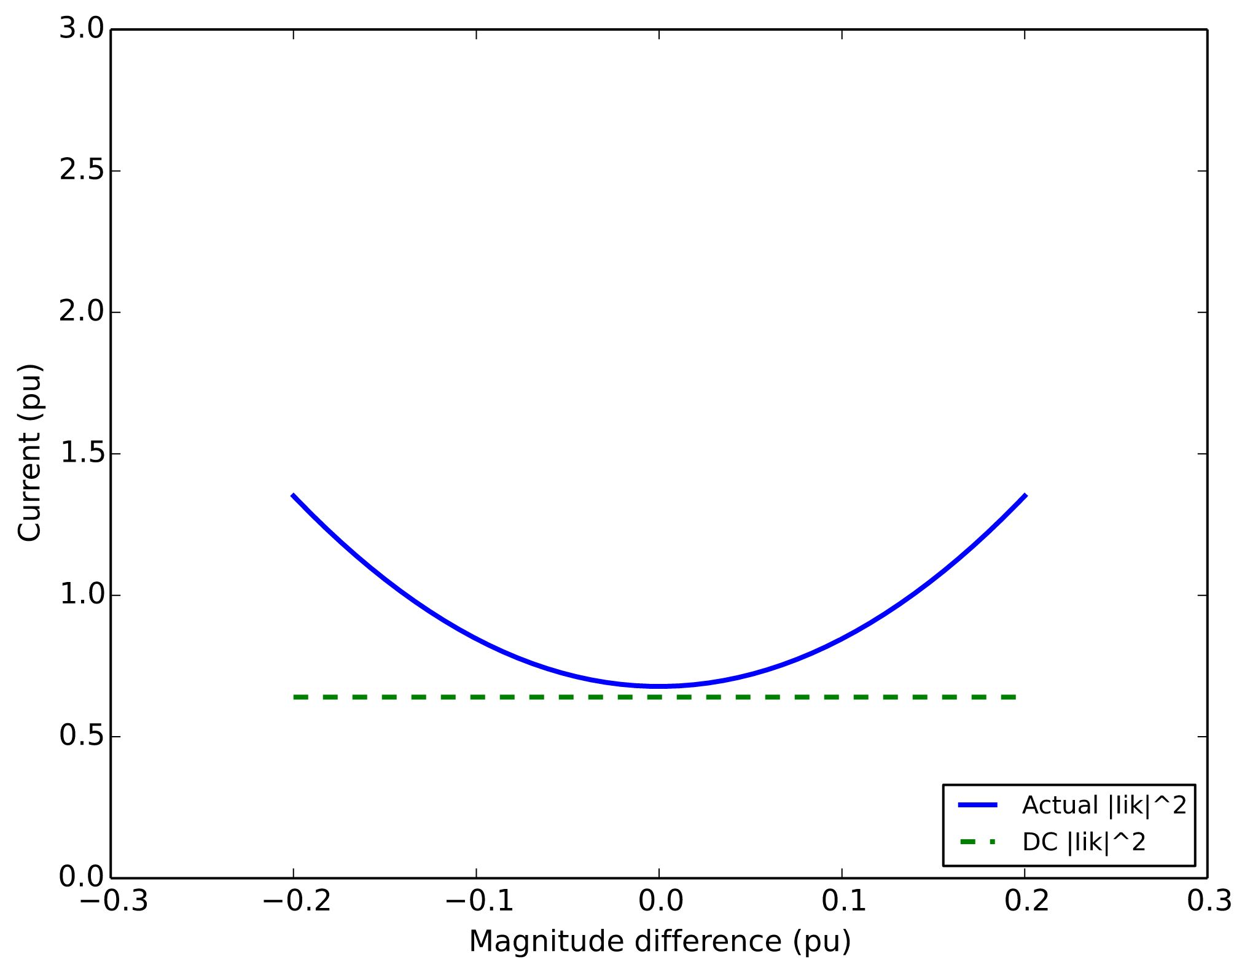
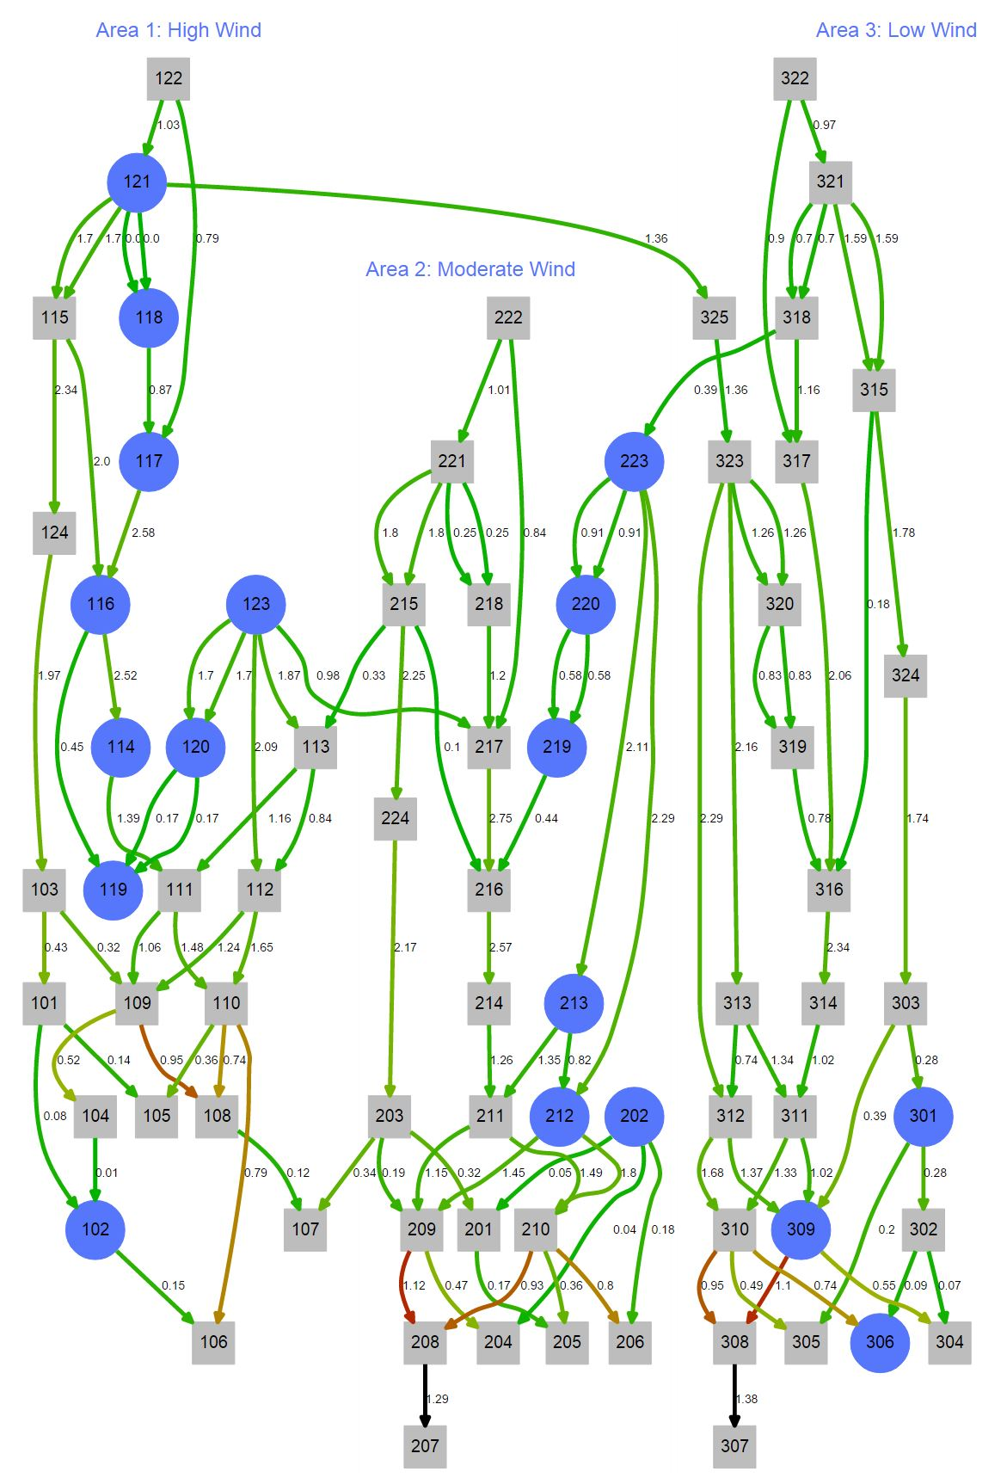
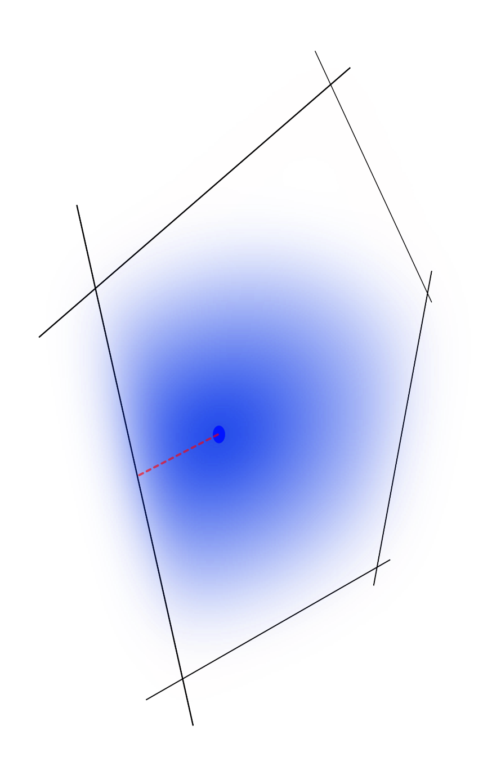
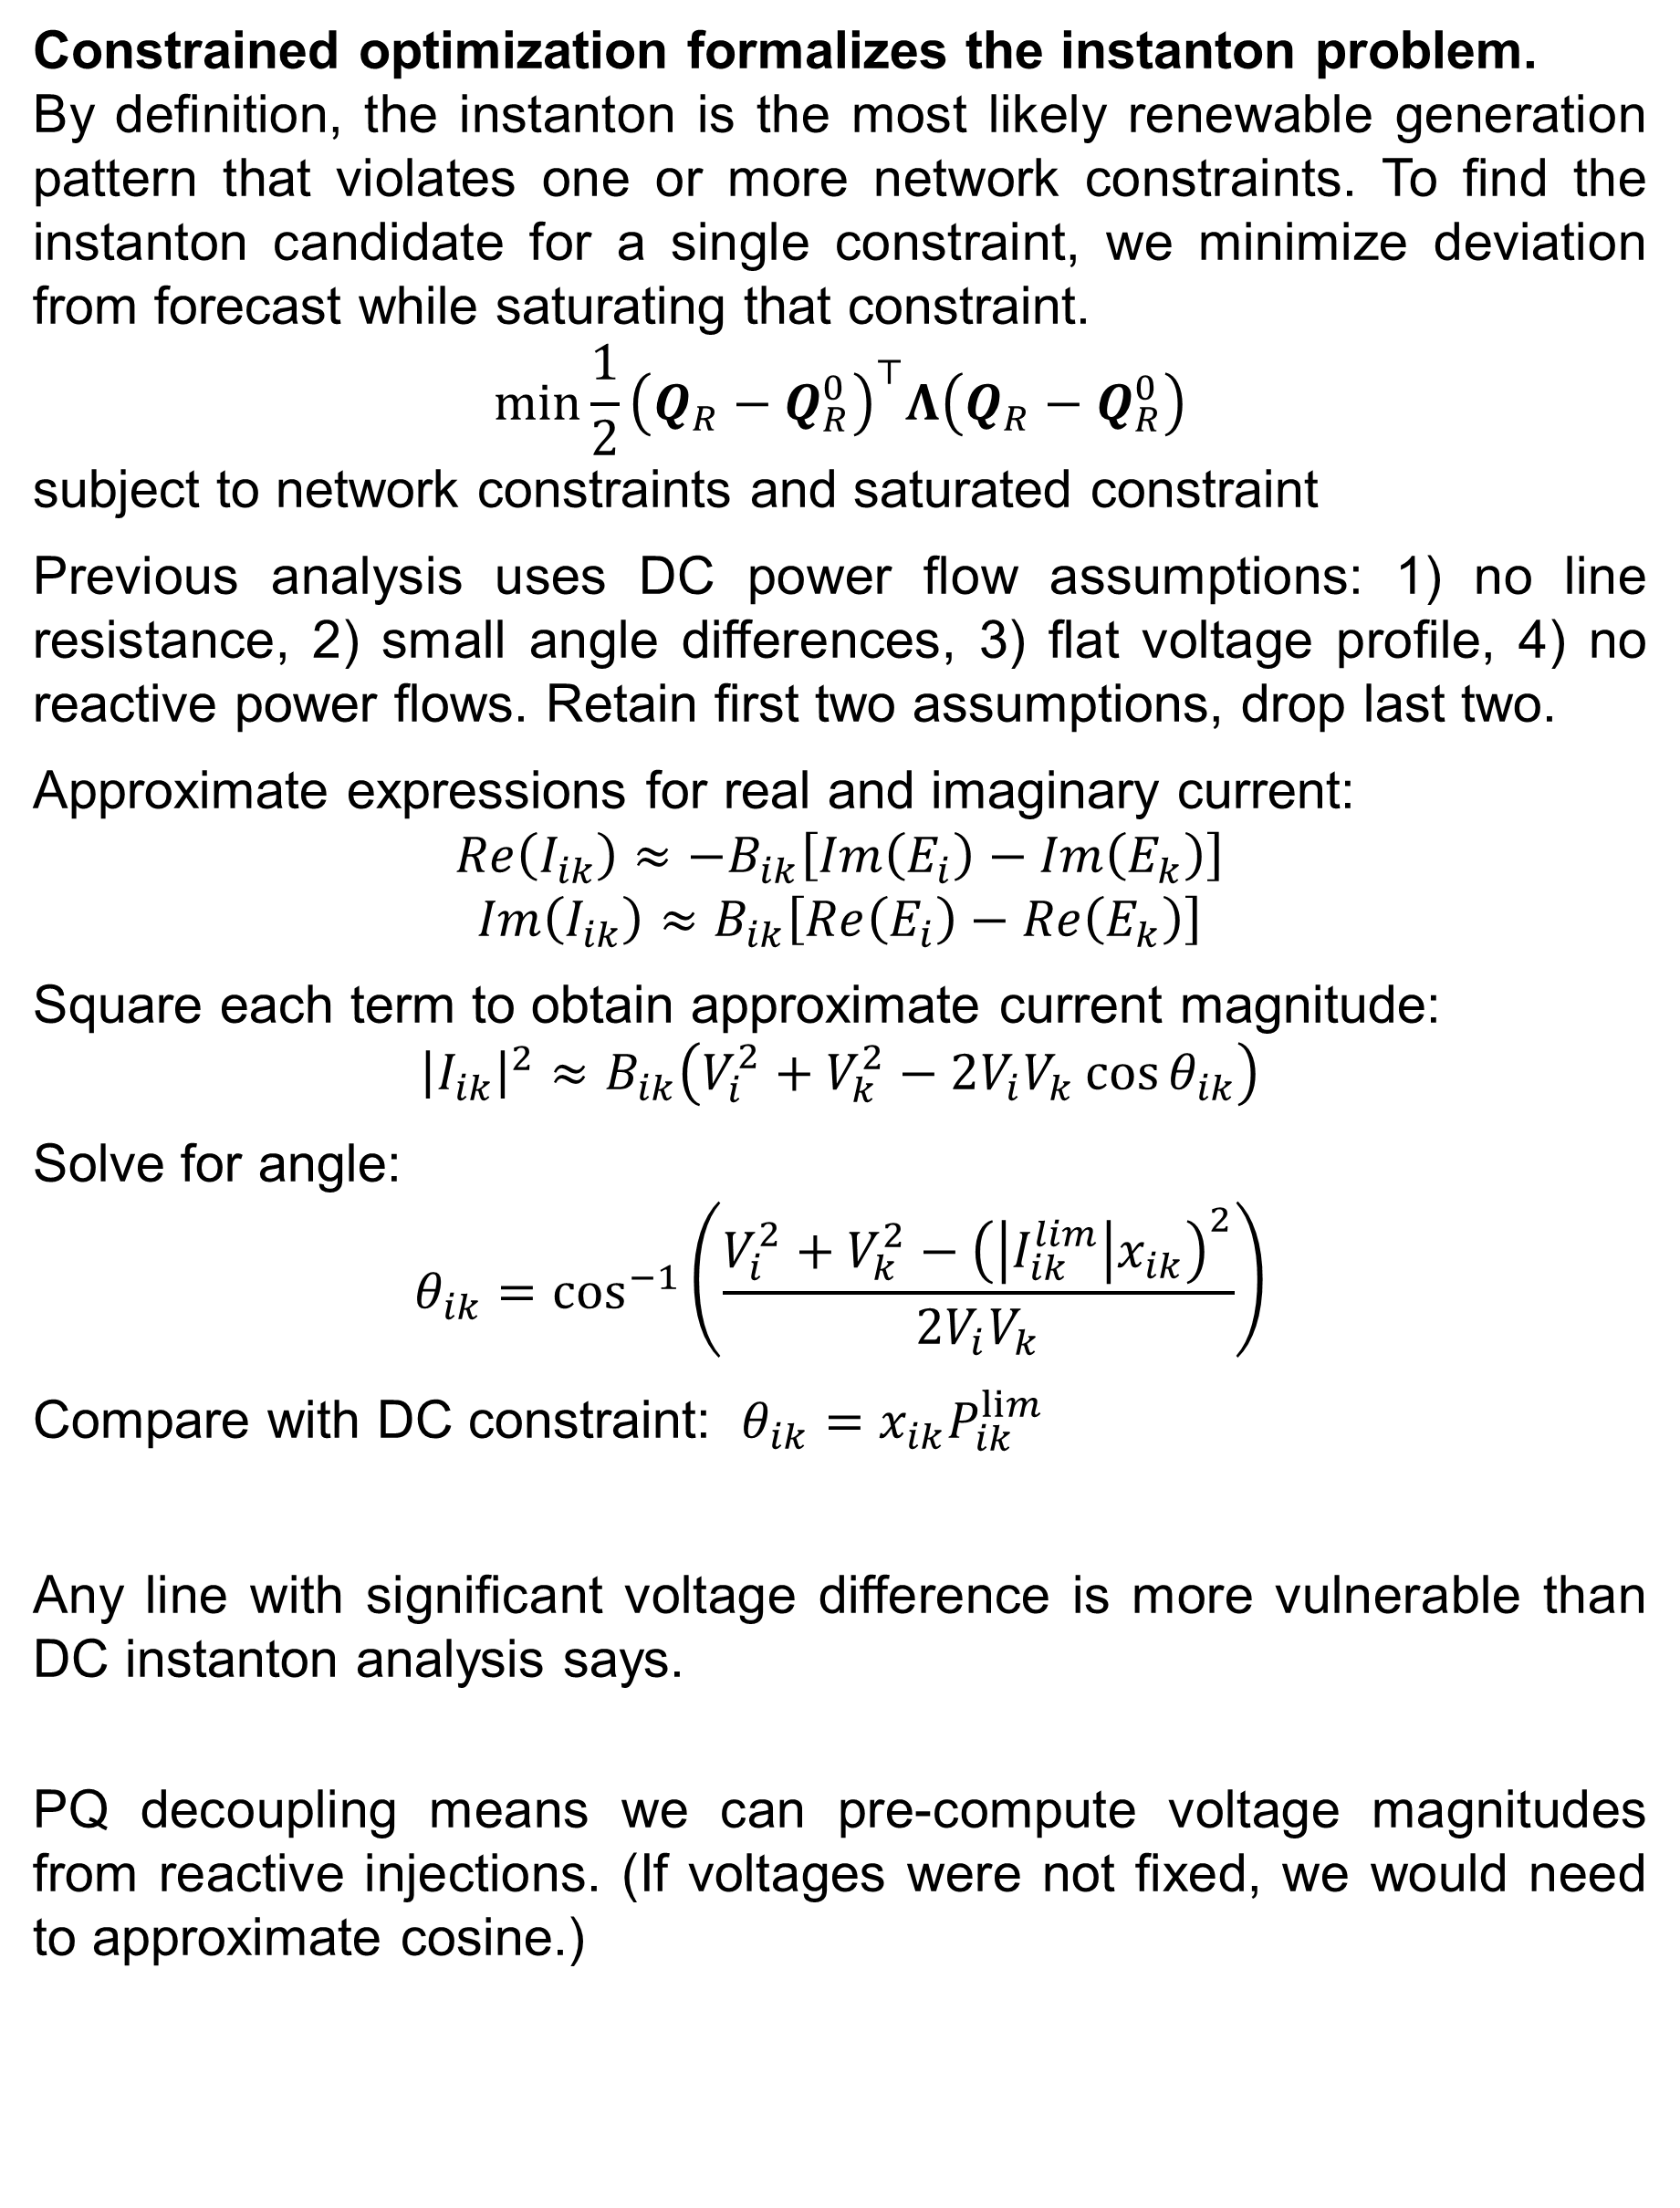
Approximate-Current Instanton Analysis:
Detecting Vulnerability in the Power Grid
Jonas Kersulis¹, Dr. Michael Chertkov², Dr. Scott Backhaus², Dr. Ian Hiskens¹
1. University of Michigan Electrical Engineering: Systems., 2. Los Alamos National Lab Center for Nonlinear Studies
Introduction
New Method: Current Constraint
Acknowledgements
Renewable fluctuations add vulnerability to the power grid.
As renewable generation fluctuates about its forecast, power flows and voltage magnitudes throughout the grid undergo complicated shifts. Most variations are harmless, but even a seemingly benign perturbation can violate network constraints.
The instanton is the most likely generation pattern that violates a constraint.
Of all possible generation patterns, some violate network constraints. Of these, the most likely to occur is the instanton.
The nonlinear AC instanton problem has no guaranteed solution.
The accuracy of the AC instanton formulation has a price: the problem is non-convex and may not have a solution. This is unacceptable in a real-time environment.
The linear DC instanton problem has questionable accuracy.
When the DC power flow approximation is applied to the instanton problem, an analytic solution may be found by matrix inversion. Because the instanton lies on a network constraint, however, DC assumptions (like flat voltage profile) are suspect.
Accommodating non-flat voltage profiles improves instanton accuracy.
The new method maintains convexity while accommodating non-flat voltage profiles and reactive power injections.
Convexified network constraints form a tractable polytope.
Network constraints form a high-order polytope. Because this object may be expressed in terms of renewable generation, our optimization scheme can minimize over each face separately to obtain a ranked list of extreme events.
Dr. Hiskens, my adviser
Dr. Chertkov for hosting me at LANL this past summer
Dr. Backhaus for discussions and decisions
Dr. Bent for implementation discussions
Miles Lubin for introducing me to Julia/JuMP
Yury Dvorkin for stimulating discussions
Funding from Department of Energy Grid Science Initiative
Comparison of improved current model with DC model
Constrained optimization formalizes the instanton problem.
By definition, the instanton is the most likely renewable generation pattern that violates one or more network constraints. To find the instanton candidate for a single constraint, we minimize deviation from forecast while saturating that constraint.
$$min\frac{1}{2}{\left(Q_{R}−Q_{R}^{0}\right)}^{⊤}Λ\left(Q_{R}−Q_{R}^{0}\right)$$
subject to network constraints and saturated constraint
Previous analysis uses DC power flow assumptions: 1) no line resistance, 2) small angle differences, 3) flat voltage profile, 4) no reactive power flows. Retain first two assumptions, drop last two.
Approximate expressions for real and imaginary current:
$$Re\left(I_{ik}\right)≈−B_{ik}\left[Im\left(E_{i}\right)−Im\left(E_{k}\right)\right]$$
$$Im\left(I_{ik}\right)≈B_{ik}\left[Re\left(E_{i}\right)−Re\left(E_{k}\right)\right]$$
Square each term to obtain approximate current magnitude:
$${\left|I_{ik}\right|}^{2}≈B_{ik}\left(V_{i}^{2}+V_{k}^{2}−2V_{i}V_{k}\cos{θ_{ik}}\right)$$
Solve for angle:
$$θ_{ik}=\cos^{−1}\left(\frac{V_{i}^{2}+V_{k}^{2}−{\left(\left|I_{ik}^{lim}\right|x_{ik}\right)}^{2}}{2V_{i}V_{k}}\right)$$
Compare with DC constraint: $θ_{ik}=x_{ik}P_{ik}^{lim}$
Any line with significant voltage difference is more vulnerable than DC instanton analysis says.
PQ decoupling means we can pre-compute voltage magnitudes from reactive injections. (If voltages were not fixed, we would need to approximate cosine.)
Objectives
To use approximate AC methods to develop an instanton-finding tool with
a) greater accuracy than DC instanton method,
b) guaranteed convergence,
c) rapid solution time (sub-exponential in network size), and
d) insightful output (ranked list of extreme events, reconfiguration assistance)
To characterize differences between DC and approximate AC instanton methods
To understand differences between DC and approximate AC power flow methods
Implementation on IEEE RTS-96 Network
References
[1] Baghsorkhi, S.S., and I.A. Hiskens. “Analysis Tools for Assessing the Impact of Wind Power on Weak Grids,” 1–8, 2012.
[2] Coffrin, Carleton, and Pascal Van Hentenryck. “A Linear-Programming Approximation of AC Power Flows,” unpublished.
[3] Coffrin, Carleton, P. Van Hentenryck, and R. Bent. “Approximating Line Losses and Apparent Power in AC Power Flow Linearizations.” In 2012 IEEE Power and Energy Society General Meeting, 1–8, 2012.
Two-dimensional depiction of instanton search. Starting from the forecast (dot), the dashed line shows the most likely shift in generation that would violate a constraint (solid line).

