Slide 1


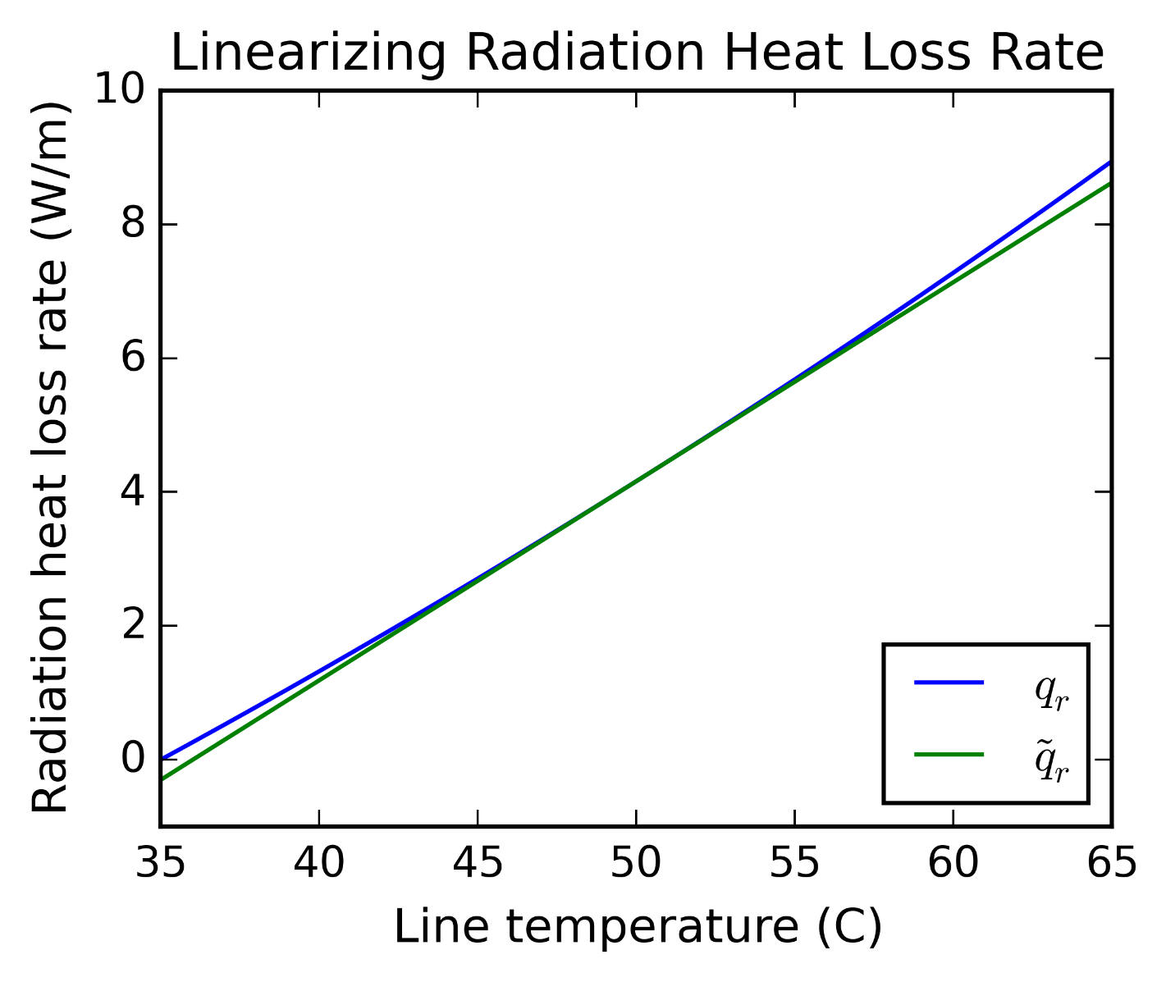
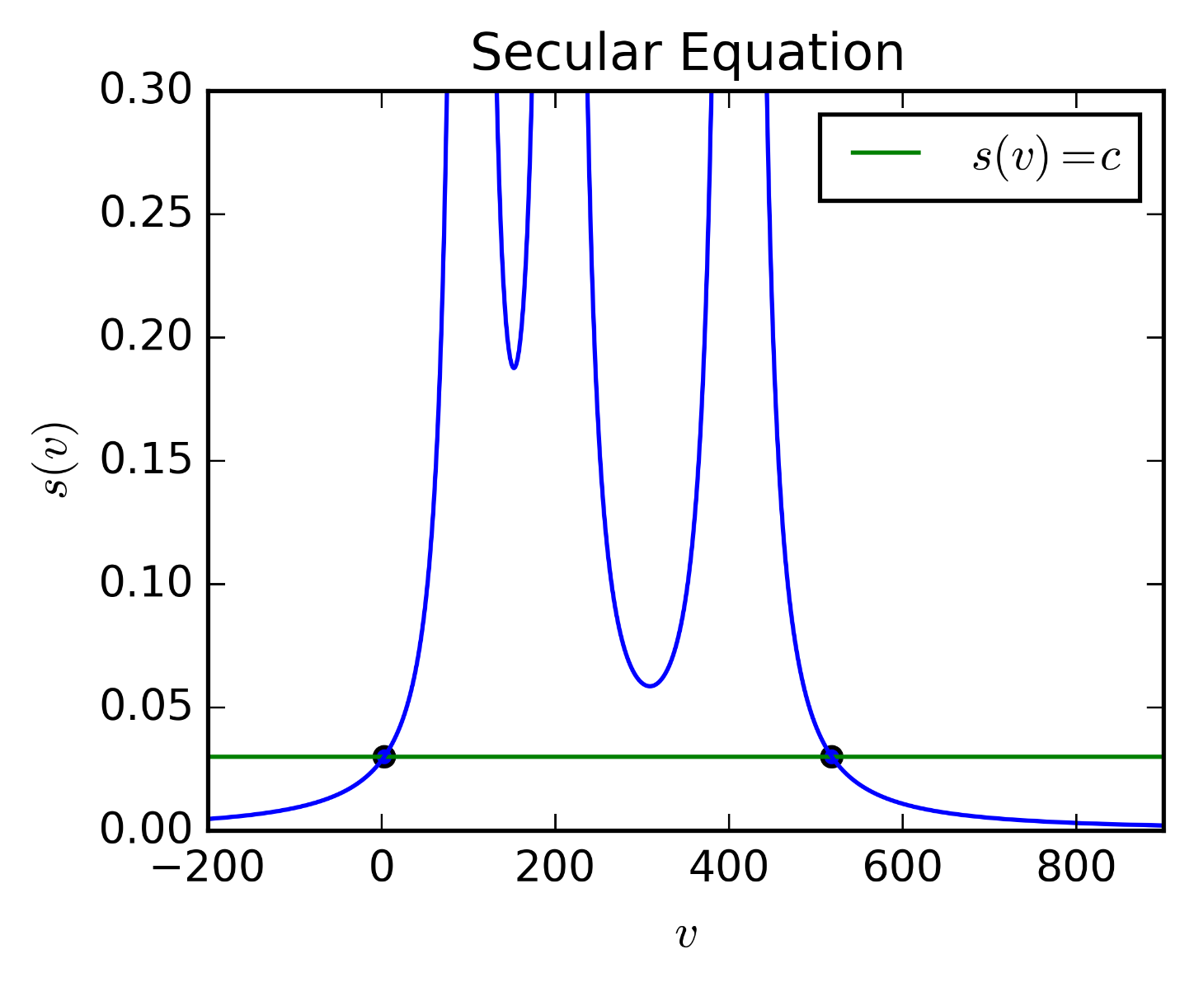
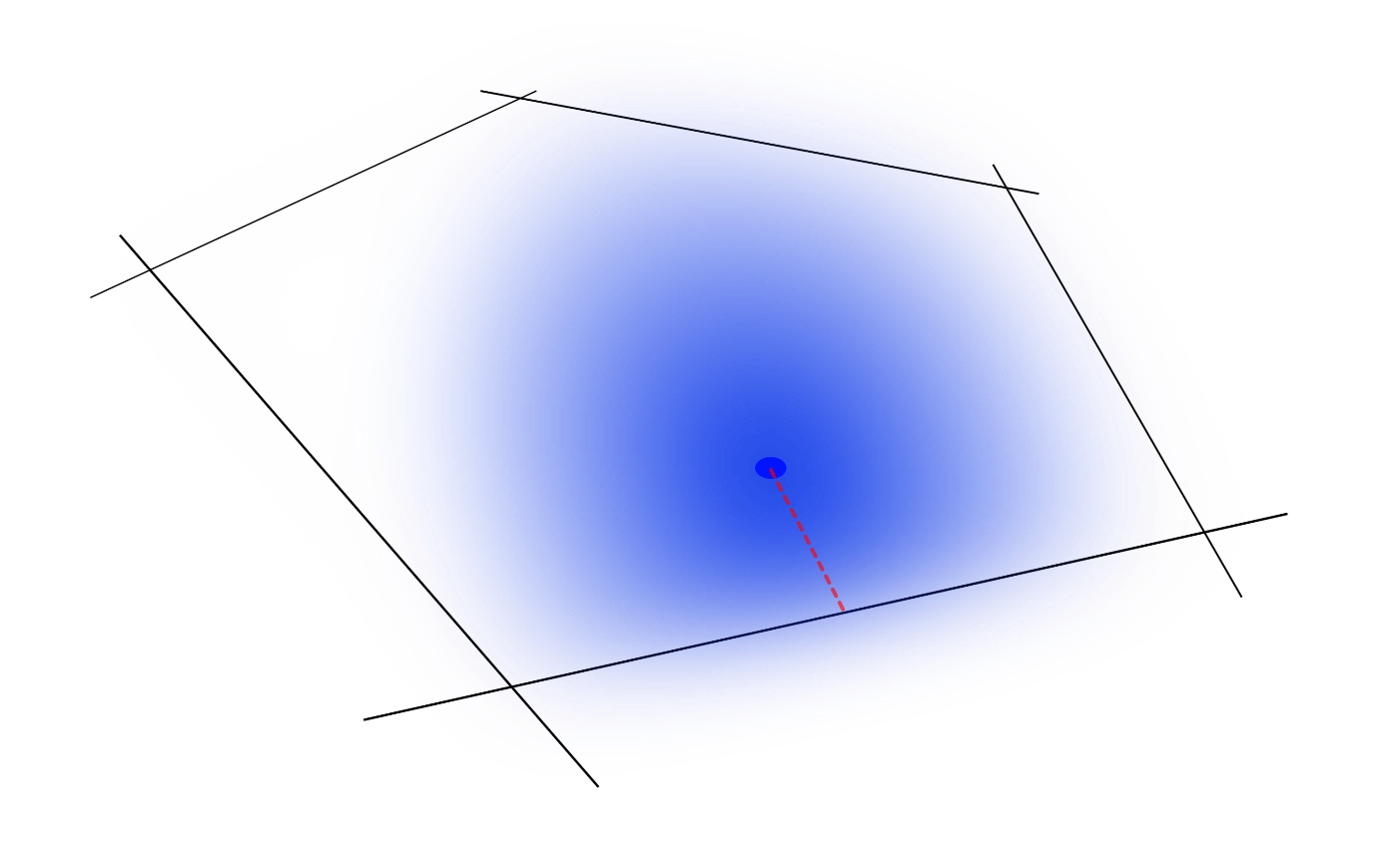
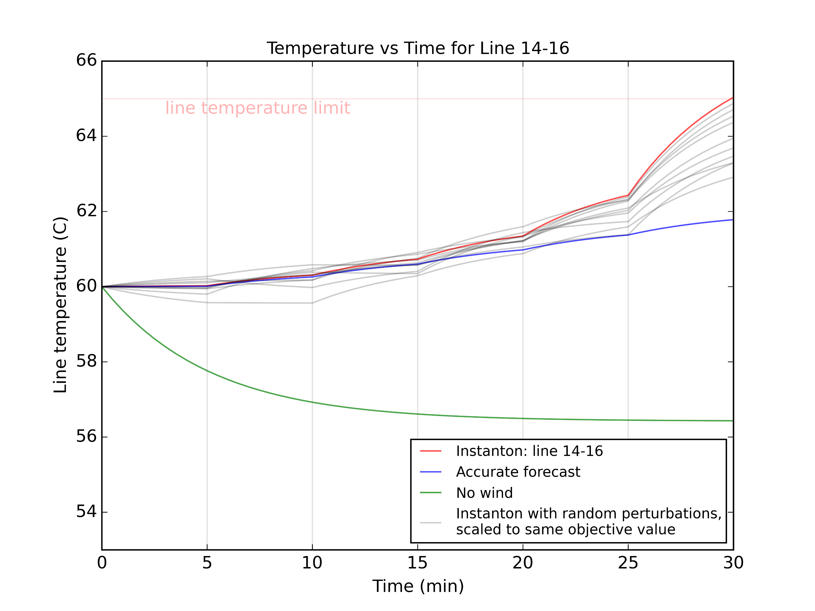
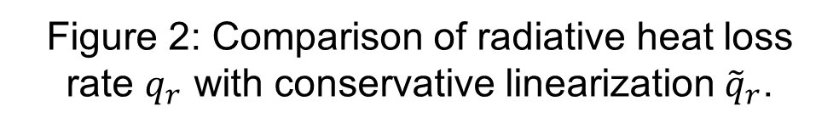
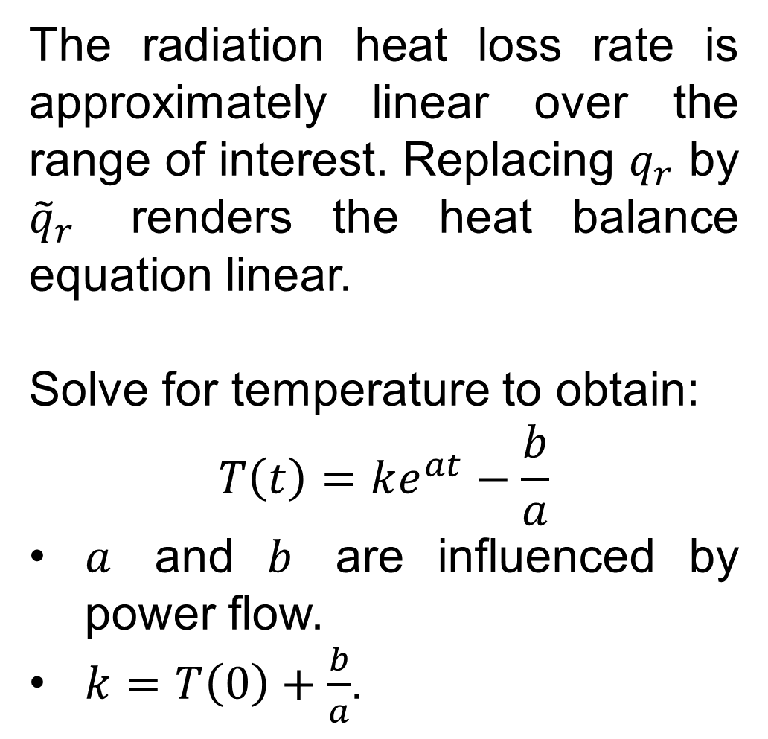
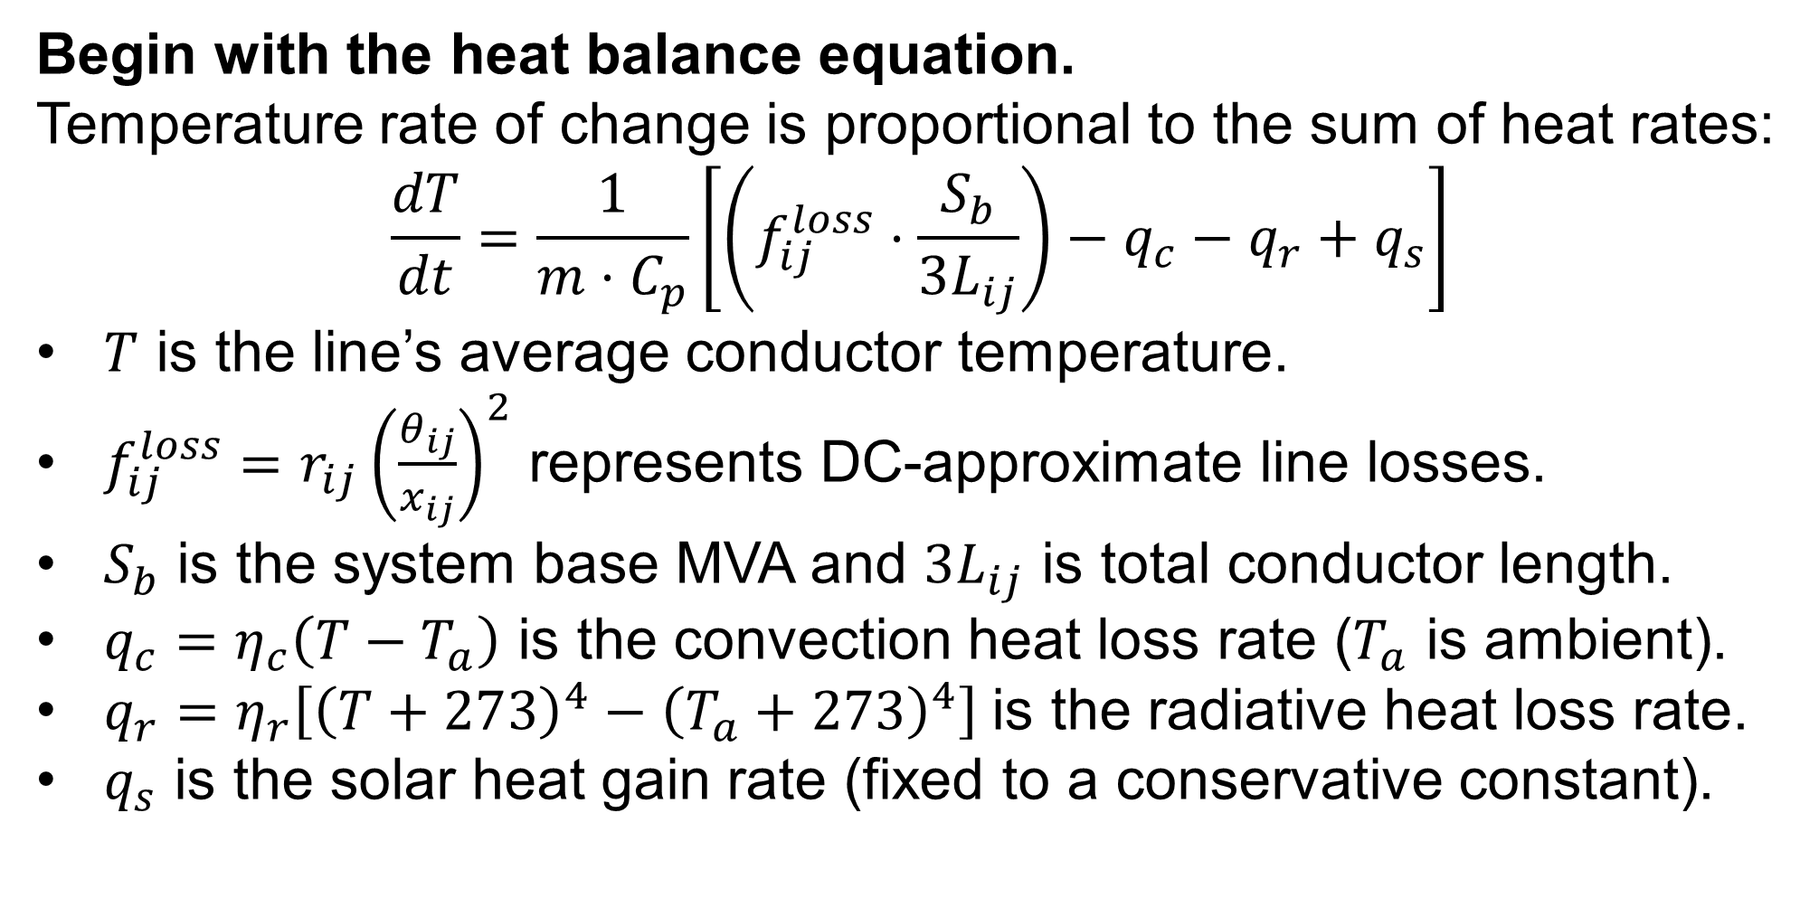
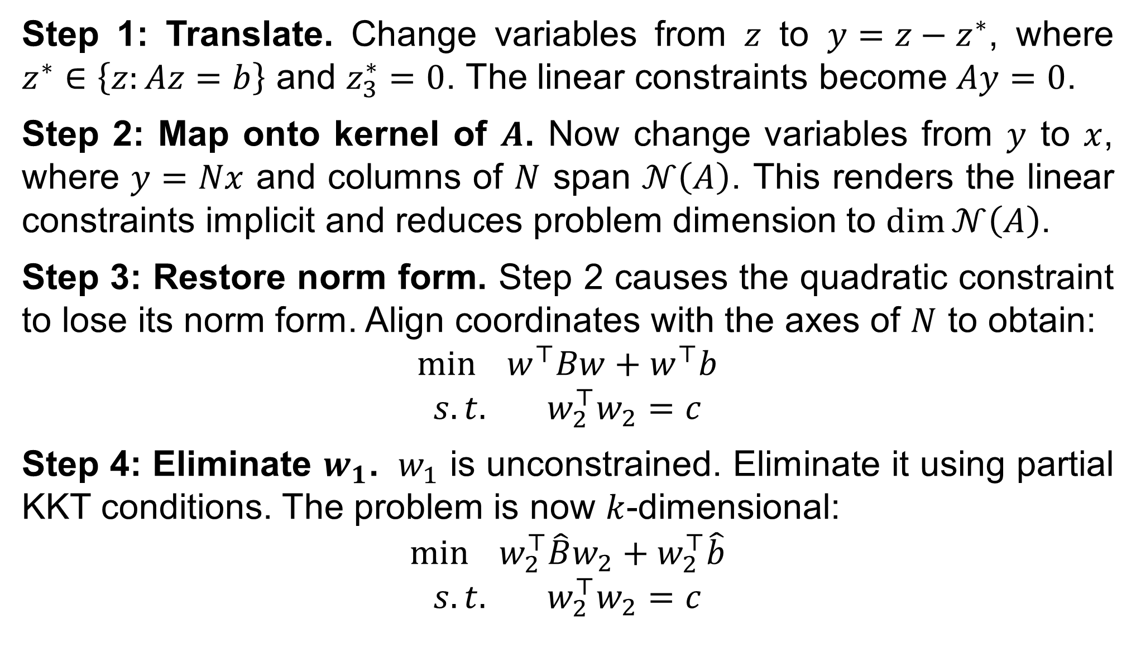
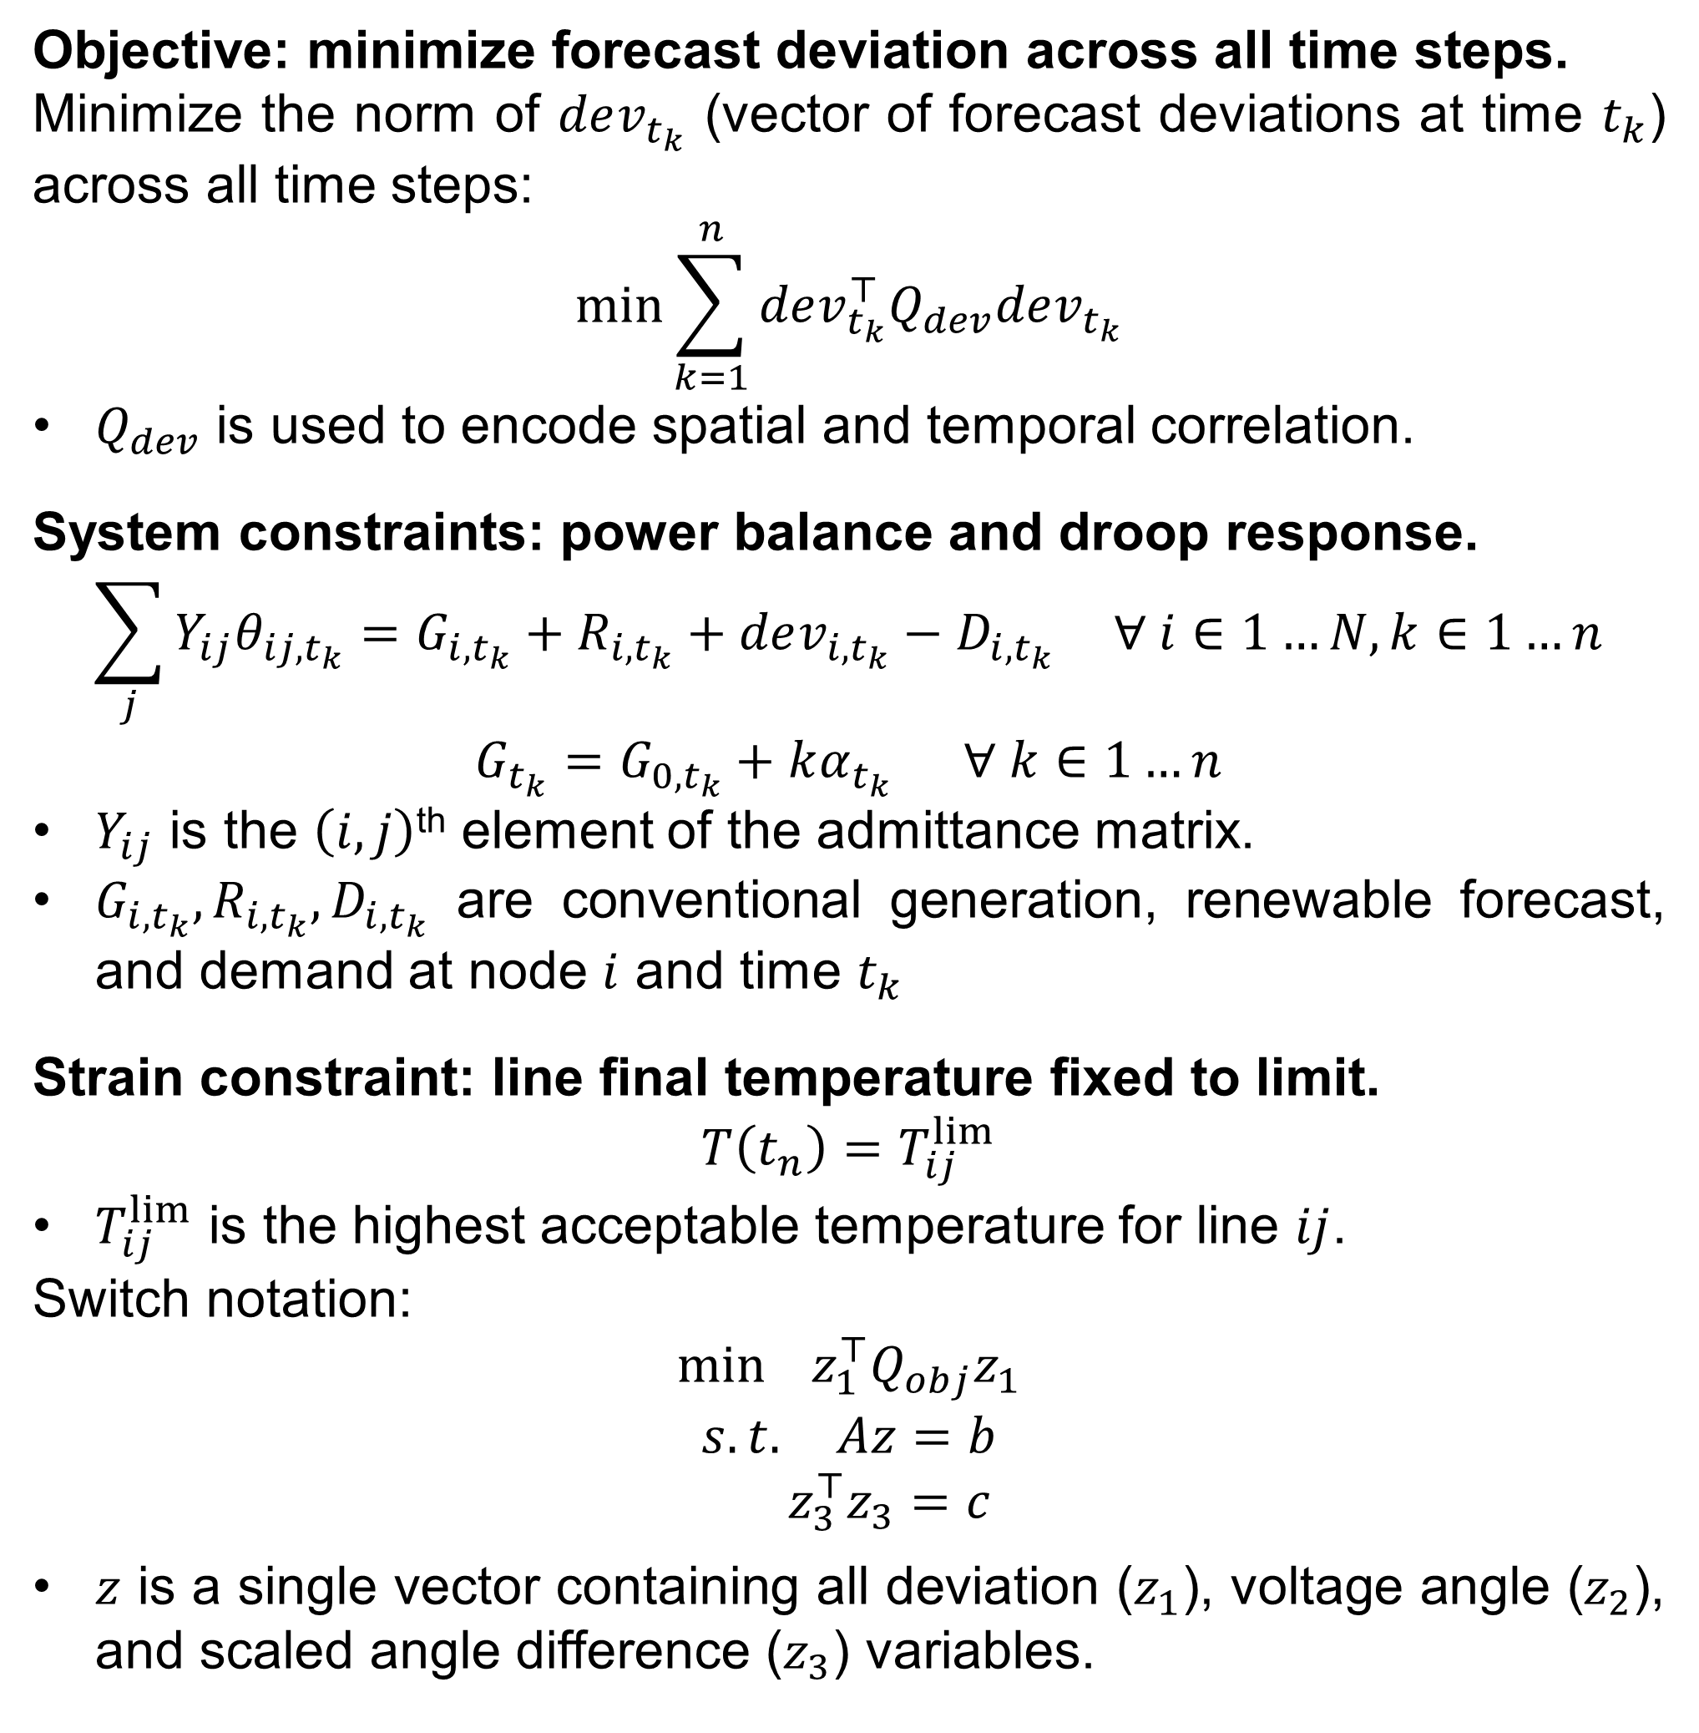
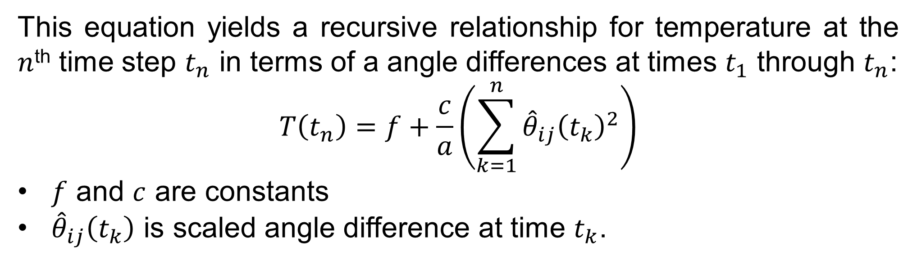
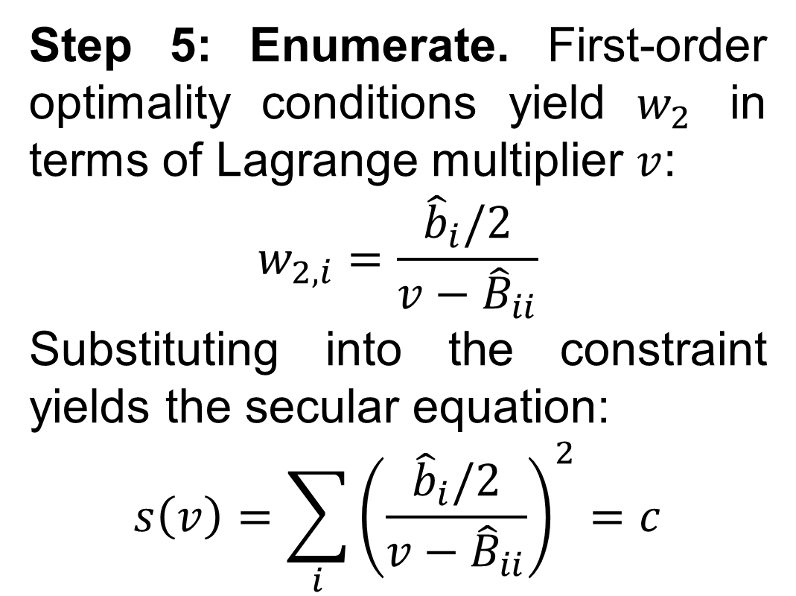
Temperature-based Instanton Analysis:
Identifying Vulnerability in Transmission Networks
Jonas Kersulis¹, Dr. Ian Hiskens¹, Dr. Michael Chertkov², Dr. Scott Backhaus², Dr. Daniel Bienstock³
University of Michigan Electrical Engineering: Systems, 2. Los Alamos National Lab Center for Nonlinear Studies, 3. Columbia University Industrial Engineering & Operations Research
Introduction
Linearize the heat balance equation and solve for temperature.
QCQP Solution Method
Renewable fluctuations add vulnerability to the power grid.
Most variations are harmless, but even seemingly benign shifts may compound across a network to cause excessive line flows.
Instanton analysis finds all troublesome generation patterns.
Instanton analysis identifies the set of troublesome generation patterns, and instanton refers to the most likely pattern in this set.
Previous instanton analysis has considered one instant in time.
Prior work has provided new insight into grid vulnerability, but transmission line failure is a temporal phenomenon. By modeling temperature across multiple time steps, we can identify generation patterns that could realistically cause line sag and failure.
Our temporal instanton problem has a straightforward solution.
Line temperature may be approximated in terms of squared voltage angle differences. Temporal instanton candidate patterns may therefore be expressed as solutions to a quadratically-constrained quadratic program (QCQP). The QCQP is solved by applying trust region methods; no solver is required.
The radiation heat loss rate is approximately linear over the range of interest. Replacing $q_{r}$ by ${\tilde{q}}_{r}$ renders the heat balance equation linear.
Solve for temperature to obtain:
$$T\left(t\right)=ke^{at}−\frac{b}{a}$$
$a$ and $b$ are influenced by power flow.
$k=T\left(0\right)+\frac{b}{a}$.
Step 1: Translate. Change variables from $z$ to $y=z−z^{∗}$, where $z^{∗}∈\left\{z:Az=b\right\}$ and $z_{3}^{∗}=0$. The linear constraints become $Ay=0$.
Step 2: Map onto kernel of $A$. Now change variables from $y$ to $x$, where $y=Nx$ and columns of $N$ span $𝒩\left(A\right)$. This renders the linear constraints implicit and reduces problem dimension to $\dim{𝒩\left(A\right)}$.
Step 3: Restore norm form. Step 2 causes the quadratic constraint to lose its norm form. Align coordinates with the axes of $N$ to obtain:
$$\min{ w^{⊤}Bw+w^{⊤}b}$$
$$s.t. w_{2}^{⊤}w_{2}=c$$
Step 4: Eliminate $w_{1}$. $w_{1}$ is unconstrained. Eliminate it using partial KKT conditions. The problem is now $k$-dimensional:
$$\min{ w_{2}^{⊤}\hat{B}w_{2}+w_{2}^{⊤}\hat{b}}$$
$$s.t. w_{2}^{⊤}w_{2}=c$$
Figure 2: Comparison of radiative heat loss rate $q_{r}$ with conservative linearization ${\tilde{q}}_{r}$.
This equation yields a recursive relationship for temperature at the $n$^{th} time step $t_{n}$ in terms of a angle differences at times $t_{1}$ through $t_{n}$:
$$T\left(t_{n}\right)=f+\frac{c}{a}\left(\sum_{k=1}^{n}{{\hat{θ}}_{ij}{\left(t_{k}\right)}^{2}}\right)$$
$f$ and $c$ are constants
${\hat{θ}}_{ij}\left(t_{k}\right)$ is scaled angle difference at time $t_{k}$.
Step 5: Enumerate. First-order optimality conditions yield $w_{2}$ in terms of Lagrange multiplier $v$:
$$w_{2,i}=\frac{{\hat{b}}_{i}/2}{v−{\hat{B}}_{ii}}$$
Substituting into the constraint yields the secular equation:
$$s\left(v\right)={\sum_{i}{\left(\frac{{\hat{b}}_{i}/2}{v−{\hat{B}}_{ii}}\right)}}^{2}=c$$
Objectives
Temporal Instanton QCQP
Develop a line temperature model that is second-order in voltage angle difference.
Incorporate into a QCQP that minimizes forecast deviation while constraining a line’s final temperature to its limit.
Develop a solution method that does not rely on a solver.
Demonstrate on a variant of the IEEE RTS-96 network.
Objective: minimize forecast deviation across all time steps.
Minimize the norm of $dev_{t_{k}}$ (vector of forecast deviations at time $t_{k}$) across all time steps:
$$\min{\sum_{k=1}^{n}{dev_{t_{k}}^{⊤}Q_{dev}dev_{t_{k}}}}$$
$Q_{dev}$ is used to encode spatial and temporal correlation.
System constraints: power balance and droop response.
$$\sum_{j}{Y_{ij}θ_{ij,t_{k}}=G_{i,t_{k}}+R_{i,t_{k}}+dev_{i,t_{k}}−D_{i,t_{k}} ∀ i∈1…N, k∈1…n}$$
$$G_{t_{k}}=G_{0,t_{k}}+kα_{t_{k}} ∀ k∈1…n$$
$Y_{ij}$ is the $\left(i,j\right)$^{th} element of the admittance matrix.
$G_{i,t_{k}},R_{i,t_{k}},D_{i,t_{k}}$ are conventional generation, renewable forecast, and demand at node $i$ and time $t_{k}$
Strain constraint: line final temperature fixed to limit.
$$T\left(t_{n}\right)=T_{ij}^{lim}$$
$T_{ij}^{lim}$ is the highest acceptable temperature for line $ij$.
Switch notation:
$$\min{ z_{1}^{⊤}Q_{obj}z_{1}}$$
$$s.t. Az=b$$
$${ z}_{3}^{⊤}z_{3}=c$$
$z$ is a single vector containing all deviation ($z_{1}$), voltage angle ($z_{2}$), and scaled angle difference ($z_{3}$) variables.
Figure 3: Secular equation
forecast
Results: IEEE RTS-96 Network
constraint
Consider the RTS-96 network with added wind generation. Suppose conventional generation and demand are steady, but the wind forecast steadily increases over thirty minutes. Power flow data is available every five minutes. Figure 4 illustrates the instanton by comparing temperature trajectories.
Figure 1: Two-dimensional depiction of instanton search. The dashed line represents the smallest generation shift that would violate a constraint.
Line Temperature Model
Begin with the heat balance equation.
Temperature rate of change is proportional to the sum of heat rates:
$$\frac{dT}{dt}=\frac{1}{m⋅C_{p}}\left[\left(f_{ij}^{loss}⋅\frac{S_{b}}{3L_{ij}}\right)−q_{c}−q_{r}+q_{s}\right]$$
$T$ is the line’s average conductor temperature.
$f_{ij}^{loss}=r_{ij}{\left(\frac{θ_{ij}}{x_{ij}}\right)}^{2}$ represents DC-approximate line losses.
$S_{b}$ is the system base MVA and $3L_{ij}$ is total conductor length.
$q_{c}=η_{c}\left(T−T_{a}\right)$ is the convection heat loss rate ($T_{a}$ is ambient).
$q_{r}=η_{r}\left[{\left(T+273\right)}^{4}−{\left(T_{a}+273\right)}^{4}\right]$is the radiative heat loss rate.
$q_{s}$ is the solar heat gain rate (fixed to a conservative constant).
The authors acknowledge the support of the Los Alamos National Laboratory Grid Science Program, subcontract 270958.
Figure 4: Results for IEEE RTS-96 Network

