Slide 1
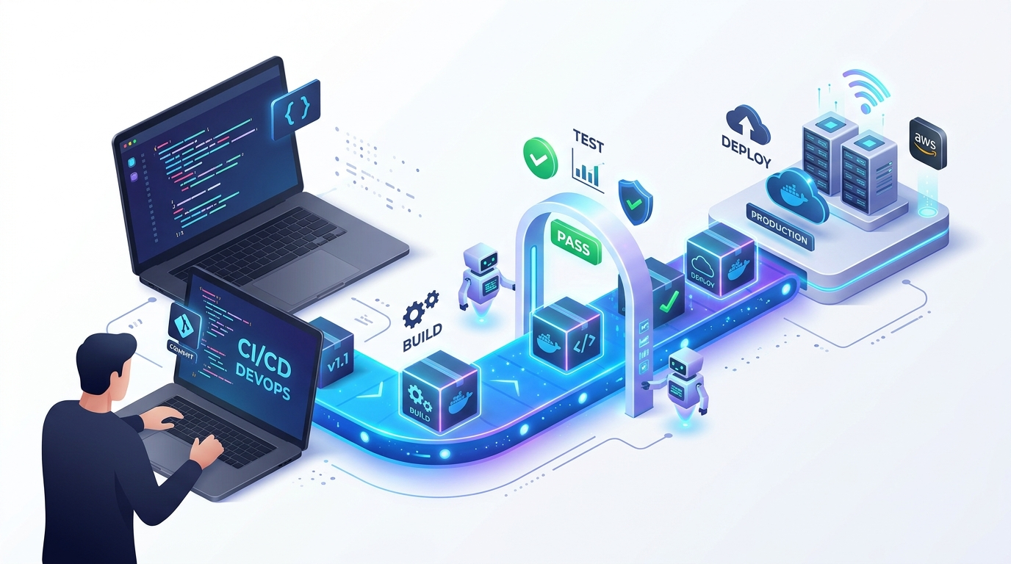
CI/CD: From Manual Software Delivery to Full Automation
A Complete 20-Slide Masterclass on Continuous Integration, Delivery, and GitHub Actions
COURSE CREATOR & INSTRUCTOR
KERTHIK
Project Manager at TNQ
Worked as DevOps Engineer at SentinelFox
Building OrivianLabs (DevOps & Cloud Systems Fellowship)
Engineering leader focused on production cloud architectures, zero-downtime pipelines, and developer productivity.
DevOps CI/CD Conveyor: Git Commit -> Test -> Docker -> AWS
CI/CD Masterclass • Presented by Kerthik (Project Manager at TNQ) • Food Delivery Analogy

Slide 2
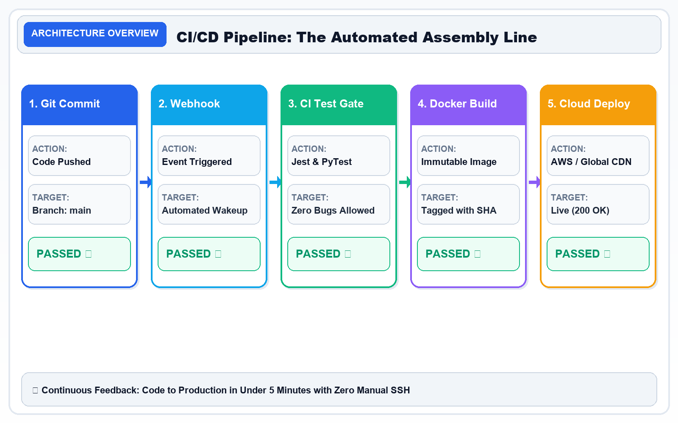
SLIDE 01 / 20 • FOUNDATIONS
Slide 1 — CI/CD: From Manual Work to Automated Software Delivery
Introduction to Continuous Integration and Continuous Delivery/Deployment
CORE CURRICULUM & PRINCIPLES
• Continuous Integration (CI): Developers merge code changes into the shared branch multiple times a day. Every commit triggers automated builds and tests, catching defects in < 10 minutes.
• Continuous Delivery (CDel): The application is continuously packaged and deployed to staging environments. Release to production is kept ready as a 1-click human business decision.
• Continuous Deployment (CDep): Every passing commit is automatically deployed directly to production cloud servers with zero human intervention.
• Business Impact: According to DORA (DevOps Research & Assessment), elite CI/CD teams deploy 208x more frequently and recover from downtime 2,604x faster.
Architecture Diagram: CI/CD Pipeline Flow: Code Commit ➔ Webhook Trigger ➔ Automated Tests ➔ Docker Package ➔ Live Cloud Deploy (200 OK).
KEY TAKEAWAY: CI/CD turns software delivery into a repeatable, automated process.

Slide 3
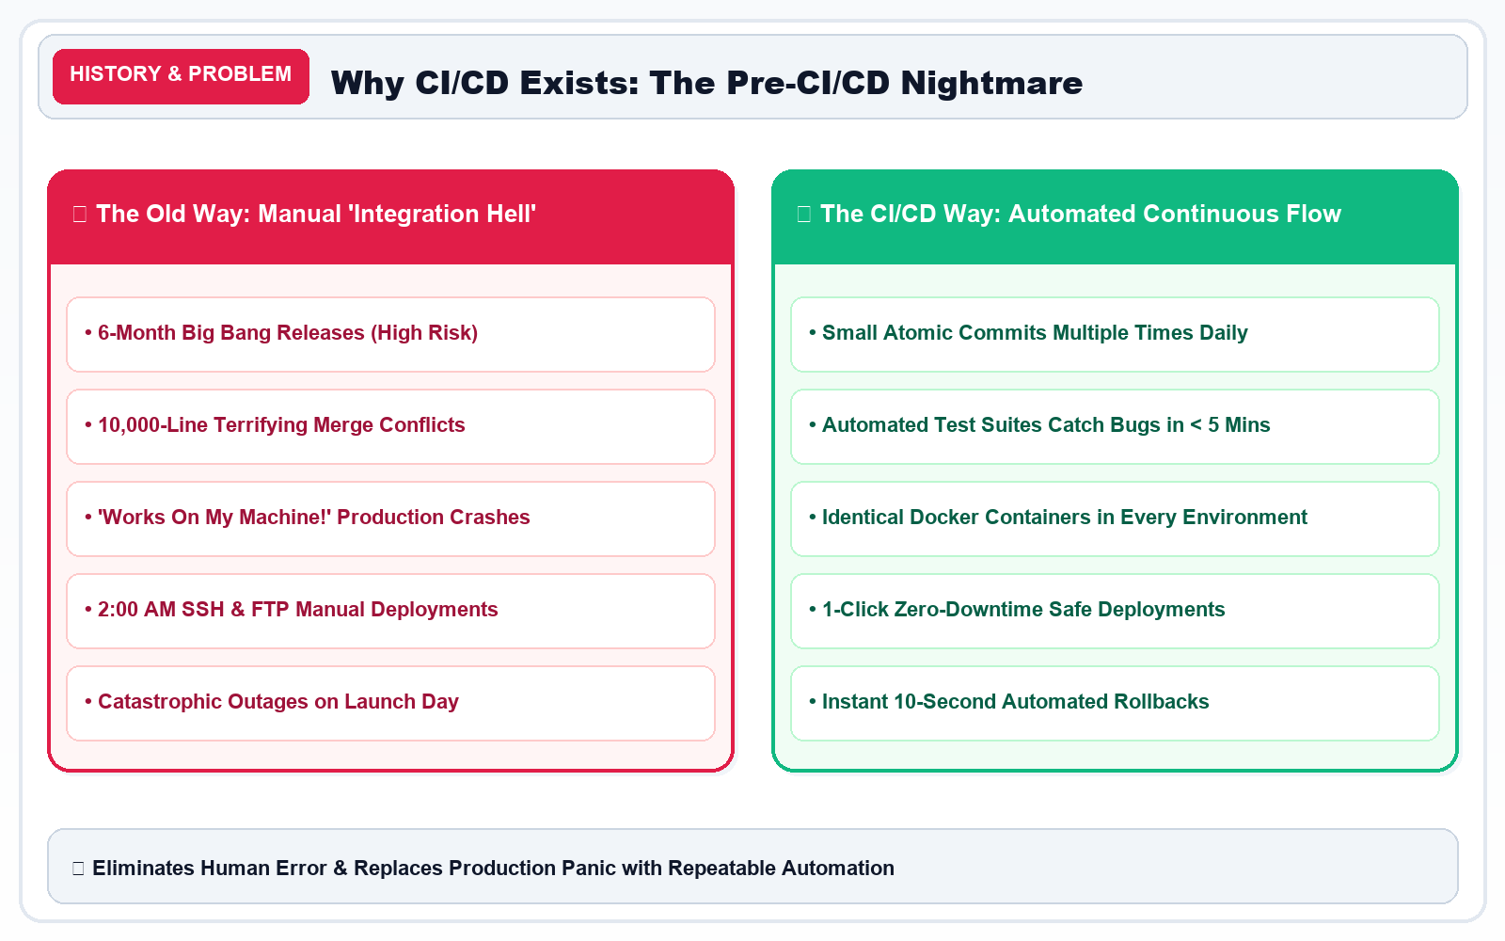
SLIDE 02 / 20 • THE PROBLEM
Slide 2 — Traditional Software Development: The Manual Era
What Happens Before CI/CD? The High-Risk Manual Delivery Process
CORE CURRICULUM & PRINCIPLES
• The 6-Month 'Big Bang' Release: Teams wrote code in isolated branches for months. Merging resulted in 'Integration Hell' with thousands of conflicting code lines.
• The 'Works on My Machine' Trap: A feature worked on the developer's MacBook, but immediately crashed on Linux production servers due to missing packages or different OS libraries.
• Late-Night Production Panic: Releases were scheduled at 2:00 AM on weekends. Engineers manually ran SSH commands and SQL scripts, leading to multi-hour downtime.
Architecture Diagram: Manual Delivery 'Integration Hell' vs. Automated CI/CD Continuous Flow Comparison.
KEY TAKEAWAY: Manual delivery can work for small hobby projects, but becomes unmanageable as applications and teams scale.

Slide 4
SLIDE 03 / 20 • HISTORY & ORIGINS
Slide 3 — The History and Evolution of CI/CD
Who Introduced CI/CD? A Decades-Long Evolution of Engineering Practices
CORE CURRICULUM & PRINCIPLES
* 1990s — Continuous Integration Emerges: Kent Beck established Continuous Integration as a core practice of Extreme Programming (XP), mandating daily code merges.
* 2000 — CI Documented & Codified: Martin Fowler and Matthew Foemmel published seminal papers describing practical automated build-and-test workflows.
* 2001+ — First Automated CI Tools: ThoughtWorks engineers created CruiseControl, the first open-source daemon automating scheduled builds and test runs.
* 2010s — Continuous Delivery Book: Jez Humble and David Farley published 'Continuous Delivery', extending automation from code compilation to cloud production releases.
* Modern — Cloud-Native CI/CD Mainstream: Jenkins, GitLab CI, and GitHub Actions bring native, serverless workflow automation to millions of developers worldwide.
FOOD-ORDERING ANALOGY
Restaurant Modernization Analogy
Initially, a diner used paper slips and shoutouts. Over time, restaurants introduced digital point-of-sale systems, kitchen display screens, automated order tracking, and drone delivery.
KEY TAKEAWAY: CI/CD is an evolution of collaborative engineering practices, not an invention attributable to one individual.

Slide 5
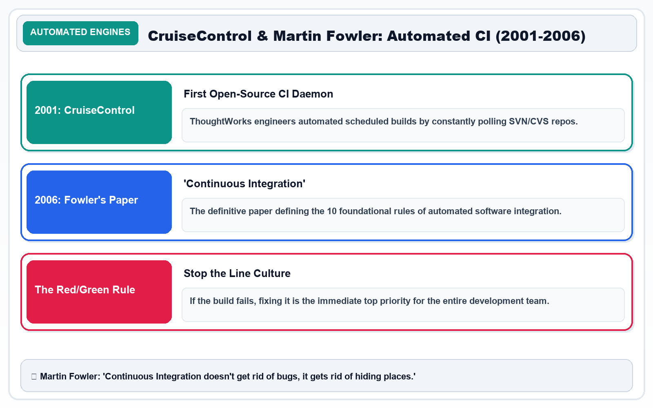
SLIDE 04 / 20 • TRANSFORMATION
Slide 4 — From Manual Releases to Automated Delivery
What Changed After CI/CD? The Paradigm Shift in Velocity & Reliability
CORE CURRICULUM & PRINCIPLES
• Build Phase: Automated clean build triggered on code push
• Testing: Instant automated test suites run on every commit
• Deployment: Automated zero-downtime pipeline deployment
• Bug Detection: Detected within minutes; build fails immediately
• Team Stress: Routine, predictable, non-event daytime releases
Architecture Diagram: Before vs. After Transformation: Shifting from 6-month manual release panic to automated daily non-event deployments.
KEY TAKEAWAY: CI/CD reduces repetitive manual friction, allowing teams to ship higher-quality software with complete confidence.

Slide 6
SLIDE 05 / 20 • CORE CONCEPTS
Slide 5 — Understanding CI, Continuous Delivery, and Continuous Deployment
What Is CI/CD? Dissecting the Three Core Stages of the Pipeline
CORE CURRICULUM & PRINCIPLES
• Continuous Integration (CI): Developers regularly merge code into a shared repository. Every commit automatically triggers clean builds, linters, and unit test suites to detect regressions early.
• Continuous Delivery (CD): After passing all automated checks and staging dry-runs, the software artifact is packaged and ready to deploy. Release to production requires a 1-click human approval.
• Continuous Deployment (CD): Every qualifying change that passes all automated test gates is deployed directly to production cloud servers with zero human intervention.
KEY TAKEAWAY: CI validates changes; Continuous Delivery prepares software for release; Continuous Deployment puts it into production automatically.

Slide 7
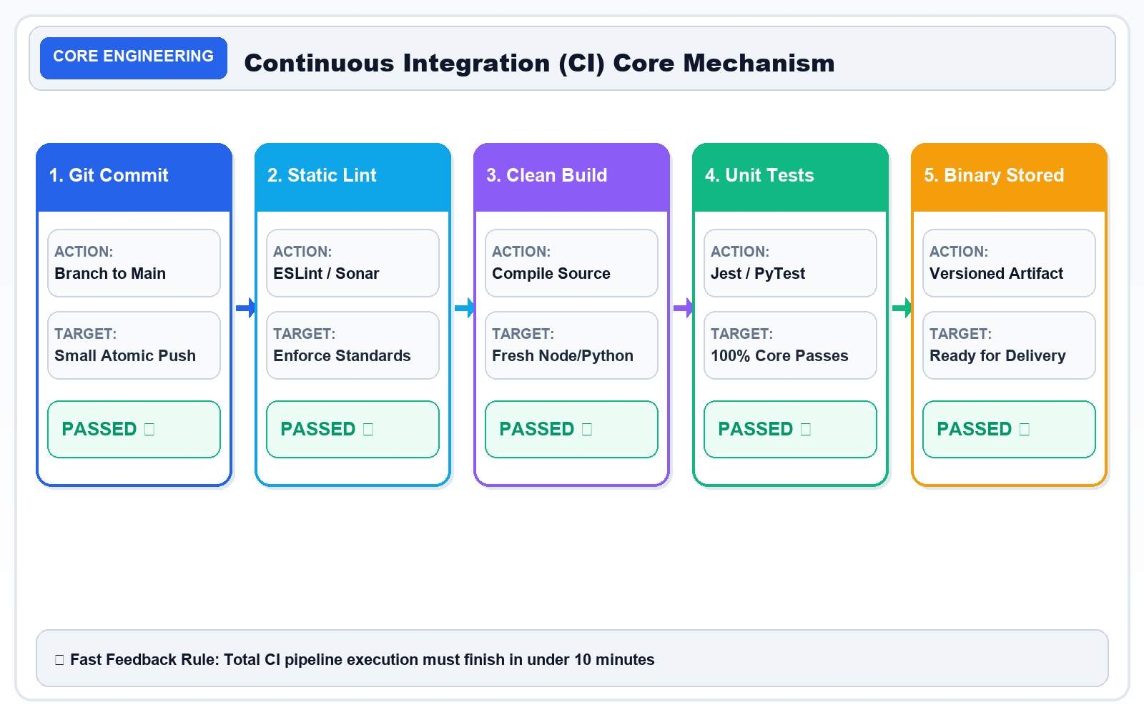
SLIDE 06 / 20 • VERSION CONTROL
Slide 6 — Git: Tracking Every Change in the Code
What Is Git? The Distributed Foundation of Version Control
CORE CURRICULUM & PRINCIPLES
• Git is a distributed version control system that records changes to files over time.
• It enables multiple software engineers to work concurrently on the same codebase without overwriting each other's work.
• Every developer has a full, cryptographic copy of the repository history locally on their machine.
Architecture Diagram: Git Version Control: Cryptographic snapshot commits, lightweight branching, and mainline collaboration.
KEY TAKEAWAY: Git manages code history and team collaboration. It is the necessary starting point for CI/CD.

Slide 8
SLIDE 07 / 20 • PLATFORMS
Slide 7 — GitHub: A Central Place for Code and Collaboration
What Is GitHub? The Cloud Collaboration Platform for Modern Teams
CORE CURRICULUM & PRINCIPLES
• GitHub is a cloud-based hosting platform for Git repositories, serving over 100 million developers globally.
• It provides the centralized remote hub where distributed teams store code, discuss features, and automate workflows.
FOOD-ORDERING ANALOGY
Restaurant Management Hub
If Git is the chef's personal notebook recording recipe steps, GitHub is the shared digital kitchen portal where recipes are stored, team members propose changes, and managers approve menus.
KEY TAKEAWAY: Git manages versions locally; GitHub hosts repositories centrally and connects code directly to automation engines.

Slide 9
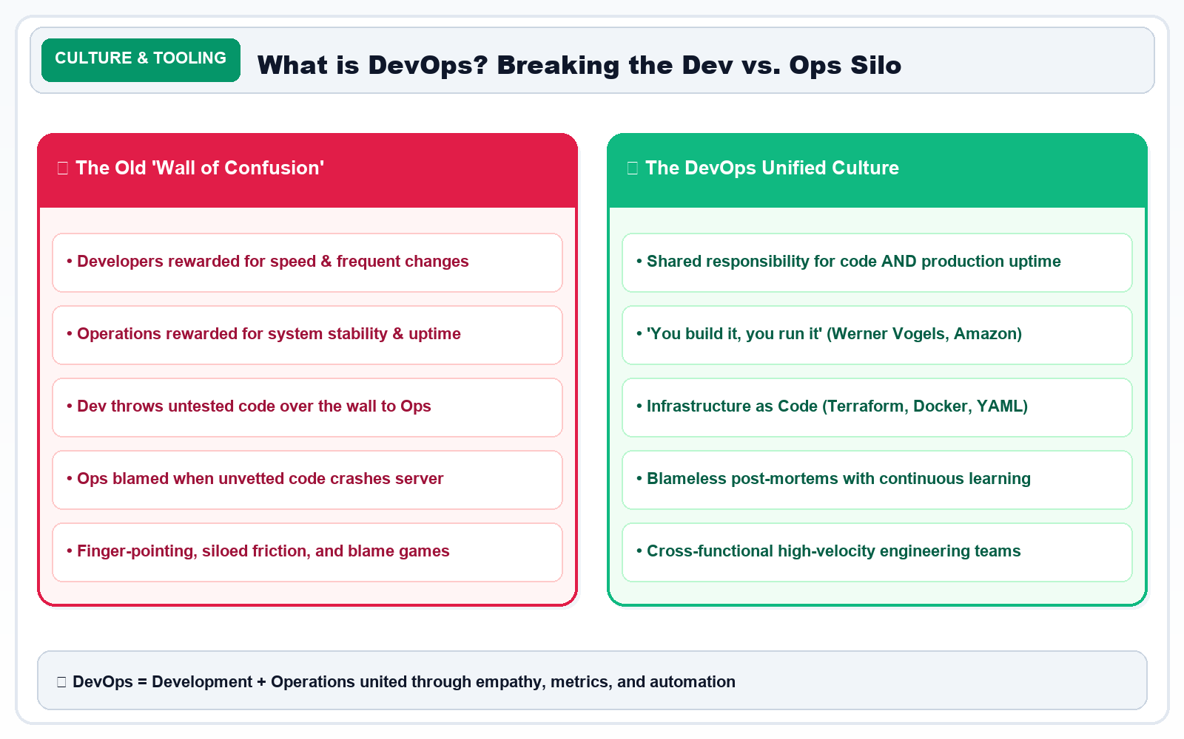
SLIDE 08 / 20 • ECOSYSTEM
Slide 8 — CI/CD Tool Ecosystem: Specialized Tools for Every Stage
What Tools Are Used for CI/CD? Combining Specialized Tools into One Pipeline
CORE CURRICULUM & PRINCIPLES
Architecture Diagram: CI/CD Tool Ecosystem: Specialized tools coordinated across Version Control, CI, Docker, AWS, and Monitoring.
KEY TAKEAWAY: CI/CD is a coordinated process combining specialized tools across the entire software delivery lifecycle.

Slide 10
SLIDE 09 / 20 • GITHUB ACTIONS
Slide 9 — Why Choose GitHub Actions for Our CI/CD Project?
The Practical Advantage of Native, Serverless Repository Automation
CORE CURRICULUM & PRINCIPLES
FOOD-ORDERING ANALOGY
The All-in-One Restaurant Platform
Instead of leasing extra real estate and hiring technicians to maintain custom kitchen machinery, you use a modern kitchen facility with built-in power, appliances, and automated stations ready on demand.
KEY TAKEAWAY: GitHub Actions is the ideal platform because it eliminates infrastructure overhead by bringing code, review, and automation together.

Slide 11
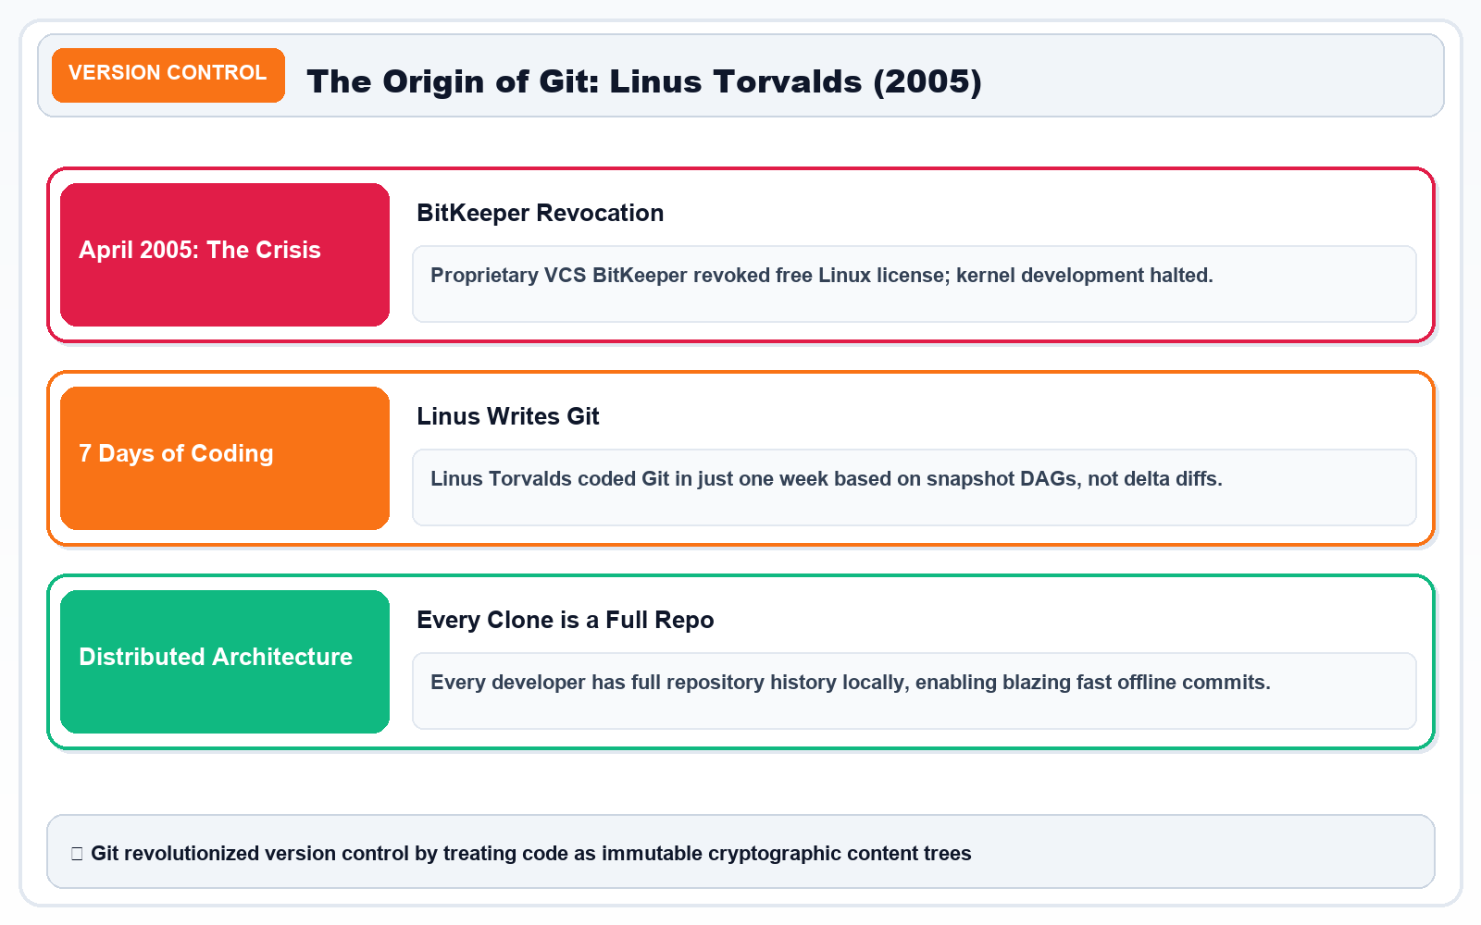
SLIDE 10 / 20 • GITHUB ACTIONS
Slide 10 — GitHub Actions: The Automation Engine
What Is GitHub Actions? The Core Architecture & Key Components
CORE CURRICULUM & PRINCIPLES
• GitHub Actions is an event-driven automation platform built directly into GitHub.
• Workflows are declared in YAML files stored inside the `.github/workflows/` directory of the repository.
• When a developer pushes code, GitHub automatically detects the event, spins up a fresh runner, executes jobs, and reports results.
Architecture Diagram: GitHub Actions Architecture: Event Triggers ➔ Ephemeral Runner VMs ➔ Parallel Jobs ➔ Sequential Step Execution.
KEY TAKEAWAY: GitHub Actions executes the automation rules you define in YAML using ephemeral, secure cloud runners.

Slide 12
SLIDE 11 / 20 • EXECUTION LIFECYCLE
Slide 11 — How Does GitHub Actions Work? From Code Push to Execution
Step-by-Step Lifecycle: What Happens When a Developer Commits Code
CORE CURRICULUM & PRINCIPLES
FOOD-ORDERING ANALOGY
Order Ticket to Cooking Pipeline ‍
The moment an order arrives on the tablet, a kitchen ticket prints, station lights illuminate, cooks wash hands, ingredients are assembled, and food is prepared according to strict timers.
KEY TAKEAWAY: A trigger starts the workflow; the runner executes its jobs and steps in an isolated, clean sandbox.

Slide 13
SLIDE 12 / 20 • WORKFLOW SYNTAX
Slide 12 — Understanding the GitHub Actions Workflow File
Our First CI/CD Workflow: Deconstructing the YAML Syntax Line by Line
CORE CURRICULUM & PRINCIPLES
FOOD-ORDERING ANALOGY
Kitchen Standard Operating Procedure (SOP)
The laminated kitchen SOP sheet lists instructions step by step: 1) Wash hands, 2) Set grill to 350°F, 3) Cook patty for 3 minutes, 4) Check internal temperature with thermometer.
KEY TAKEAWAY: YAML configuration files are human-readable blueprints that tell cloud runners exactly how to build and verify your software.

Slide 14
SLIDE 13 / 20 • CI PIPELINE
Slide 13 — What Happens When We Push Code? The Complete CI Pipeline
Tracing a Real Code Change: Rapid Feedback Loops & Defect Prevention
CORE CURRICULUM & PRINCIPLES
FOOD-ORDERING ANALOGY
Sous-Chef Quality Inspection
The sous-chef tastes the soup before it leaves the kitchen. If too salty, it is rejected right at the pot — preventing an unhappy customer and negative review.
KEY TAKEAWAY: CI gives developers rapid feedback within minutes, stopping broken code before it progresses toward production.

Slide 15
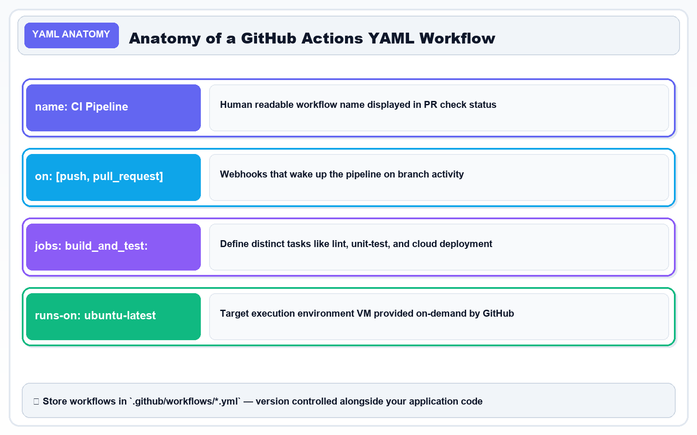
SLIDE 14 / 20 • PIPELINE STAGES
Slide 14 — The Four Major Stages of Delivery: Build, Test, Package, Deploy
The Universal Pipeline Progression from Source Code to Production
CORE CURRICULUM & PRINCIPLES
Architecture Diagram: The 4 Major Delivery Stages: 1. Build (Cook) ➔ 2. Test (Inspect) ➔ 3. Package (Bento Box) ➔ 4. Deploy (Deliver).
KEY TAKEAWAY: A reliable CI/CD pipeline enforces progressive trust: Build ➔ Test ➔ Package ➔ Deploy.

Slide 16
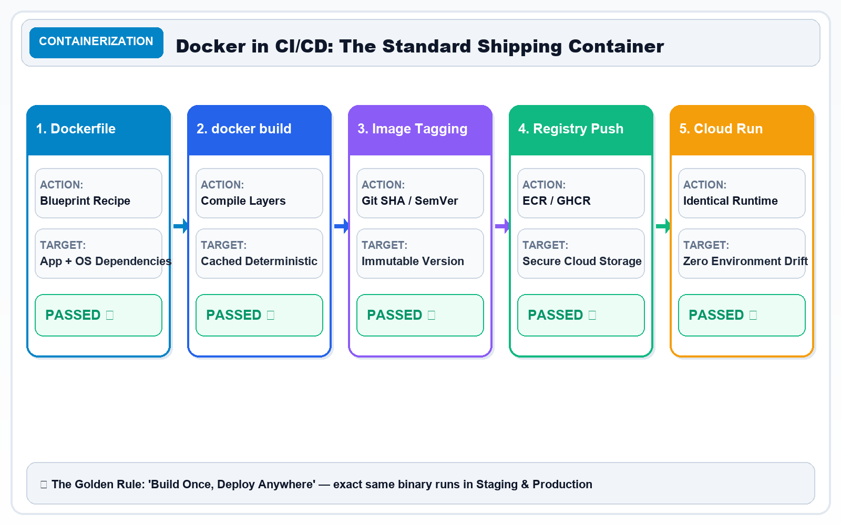
SLIDE 15 / 20 • CONTAINERIZATION
Slide 15 — Docker and Container Images: Packaging Our Application
Curing 'Works on My Machine' by Standardizing the Packaging Layer
CORE CURRICULUM & PRINCIPLES
• Docker packages an application, its runtime dependencies, libraries, and system tools into an immutable container image.
• This eliminates the infamous 'Works on my machine' bug: if a container runs on your laptop, it runs identically on staging and production.
Architecture Diagram: Docker Containerization: Packaging code, libraries, and OS into standardized immutable images.
KEY TAKEAWAY: Docker creates immutable, portable packages; cloud platforms provide the infrastructure to run them.

Slide 17
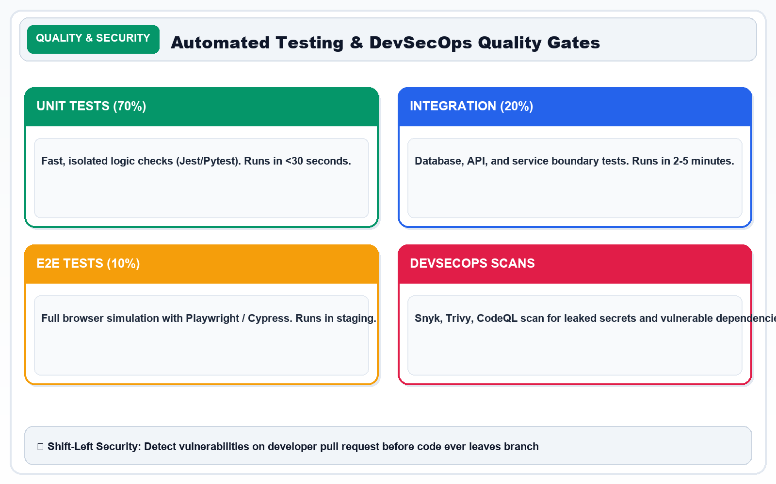
SLIDE 16 / 20 • CLOUD DEPLOYMENT
Slide 16 — Deploying to AWS: From GitHub Actions to the Cloud
Publishing Container Images to Amazon ECR and Running on Amazon ECS
CORE CURRICULUM & PRINCIPLES
Architecture Diagram: AWS Cloud Deployment: GitHub Actions OIDC ➔ Amazon ECR Registry ➔ Amazon ECS High-Availability Clusters.
KEY TAKEAWAY: GitHub Actions automates the deployment process; cloud providers supply the scalable hosting infrastructure.

Slide 18
SLIDE 17 / 20 • SECURITY & GOVERNANCE
Slide 17 — Security and Approval in CI/CD: Automate Safely, Not Just Quickly
DevSecOps: Principle of Least Privilege, Secret Protection, and Release Gates
CORE CURRICULUM & PRINCIPLES
FOOD-ORDERING ANALOGY
Kitchen Health & Hygiene Protocols ️
A restaurant automates order cooking, but still locks cash registers, requires hairnets, tests food temperatures, and restricts kitchen entry to authorized personnel.
KEY TAKEAWAY: Automate safely, not just quickly. Security checks and approval gates protect production from catastrophic leaks.

Slide 19
SLIDE 18 / 20 • RESILIENCE & SRE
Slide 18 — Failure Handling, Monitoring, and Rollback
What Happens When a Pipeline Fails? Embracing Failure Systematically
CORE CURRICULUM & PRINCIPLES
FOOD-ORDERING ANALOGY
Kitchen Quality Incident Response
If food burns on the grill, it stays in the kitchen. If a rider drops a package, the system alerts the team, logs the refund, and dispatches a fresh meal immediately.
KEY TAKEAWAY: A reliable pipeline detects failures instantly, stops unsafe rollouts, and supports rapid recovery.

Slide 20
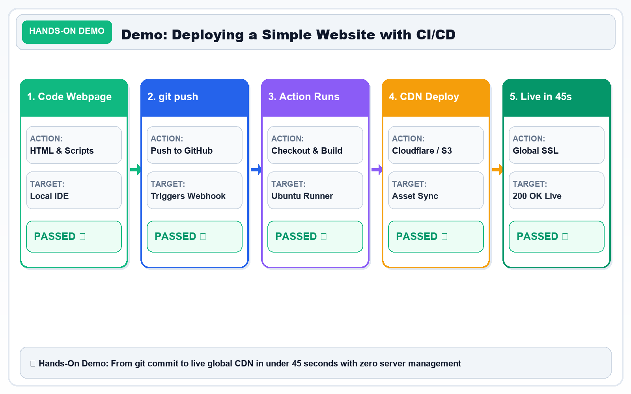
SLIDE 19 / 20 • HANDS-ON ARCHITECTURE
Slide 19 — Real-World Project: Automated Food Ordering Application
Build Your First End-to-End CI/CD Pipeline on GitHub Actions, Docker & AWS
CORE CURRICULUM & PRINCIPLES
Architecture Diagram: End-to-End Real-World Project: Automated Food Ordering App pipeline running on GitHub Actions and AWS.
KEY TAKEAWAY: This end-to-end project combines code, CI/CD, containers, cloud infrastructure, and monitoring into a complete production system.

Slide 21
SLIDE 20 / 20 • MASTERY & SUMMARY
Slide 20 — From Beginner to CI/CD Practitioner: One Code Push, Automated Delivery
Final Summary & Next Steps: Mastering the Continuous Delivery Mindset
CORE CURRICULUM & PRINCIPLES
KEY TAKEAWAY: Mastering CI/CD transforms you into a high-impact engineer capable of delivering reliable software at scale.

