Slide 1
ENTERPRISE OPERATIONAL WORKFLOW & RECONCILIATION PLATFORM
IssueTrace: User Guide & System Walkthrough
An end-to-end visual manual for back-office settlement analysts, investigation technicians, squad leads, and compliance authorities. Designed for automated multi-source reconciliation, zero-hardcoded schema mappings, forensic transaction tracking, and strict Maker-Checker dual authorization.
Automated Ingestion
Ingest multi-format files (Excel, CSV, XML), SFTP schedules, and direct partner intake queues.
Visual DAG Pipelines
Assemble modular validation rules visually with instant pre-flight topology checks.
2-Level Investigation
Forensic transaction trajectory tracing paired with deep cross-system database lookup.
Maker-Checker Dual Control
Enforce strict anti-self-approval on all financial resolutions and discrepancy overrides.

Slide 2
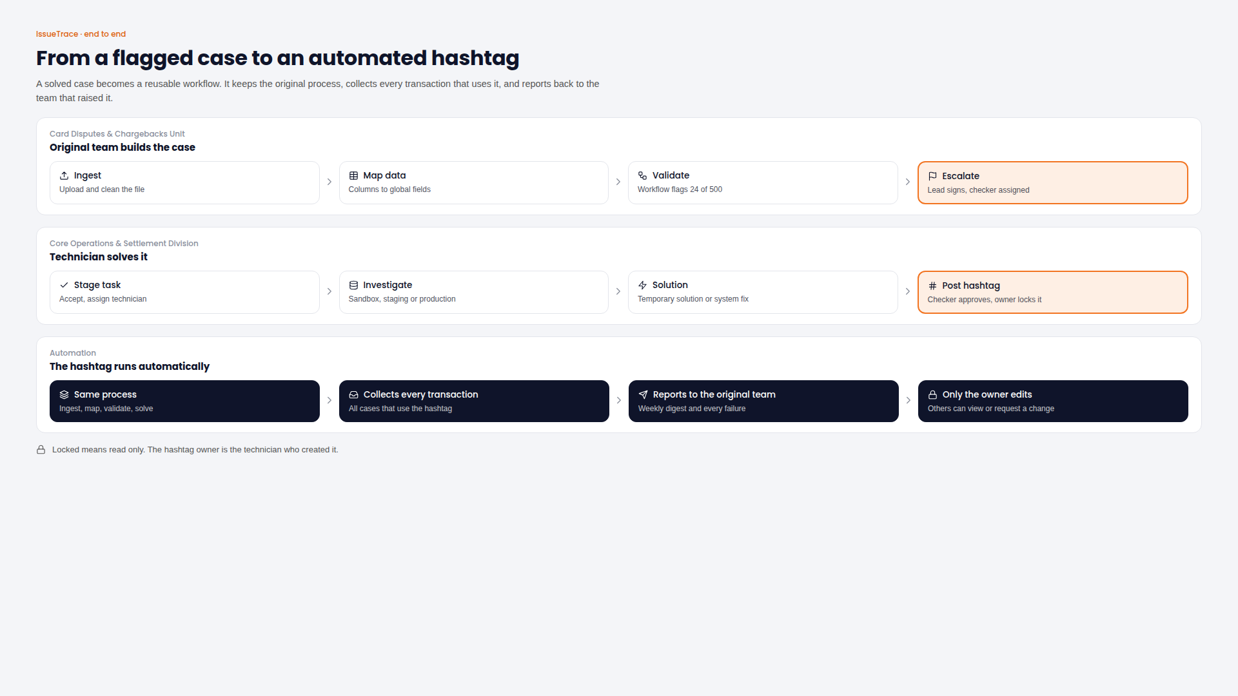
ARCHITECTURE & FLOW
End-to-End Operational Lifecycle & Flow Architecture
Complete journey from raw feed staging to permanent reconciliation and sign-off
IssueTrace orchestrates financial settlement through five deterministic stages, eliminating manual data handling and isolating data discrepancies.
• Stage 1: Multi-Channel Ingress
Extracts settlement data from SFTP, batch Excel/CSV, webhooks, or email intake queues into staging.
• Stage 2: Schema Normalization
Maps external columns to canonical directory fields and normalizes status values via dictionaries.
• Stage 3: DAG Pipeline Validation
Executes multi-step rule checks (existence, matching amounts, duplicate detection) in isolated unlogged mirrors.
• Stage 4: Discrepancy Investigation
Flags mismatched records into technician queues for forensic root-cause analysis and compare-and-resolve.
• Stage 5: Maker-Checker Governance
Routes proposed overrides through dual authorization before committing final resolutions.
💡 USER ACTION GUIDE: Follow this lifecycle sequentially when onboarding new settlement partners or troubleshooting transaction discrepancies.

Slide 3
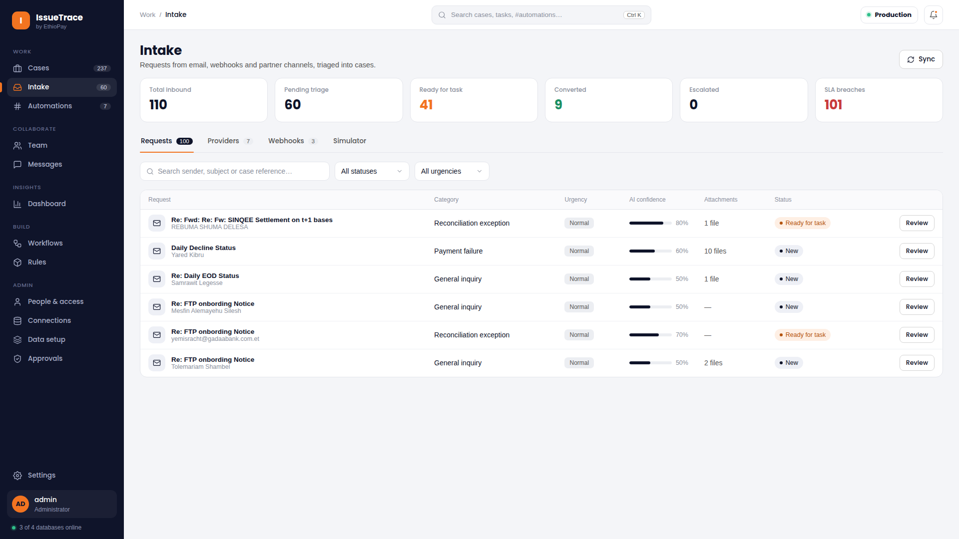
REQUEST MANAGEMENT
Intake Cockpit: External Request Ingress & Triage
Centralized inbox capturing inbound requests across email, webhooks, and partner channels
The Intake Cockpit captures external settlement requests, dispute notices, and batch files, applying automated AI triage before task creation.
• Multi-Channel Consolidation
Unifies inbound messages from Microsoft 365, Zoho Mail, SFTP notifications, and banking webhooks.
• Interactive Paginated Queue
Docked pagination controls (7 items per page default) with fast keyword search and status filters.
• 1-Click Task Conversion
Operators can review raw payloads, inspect file attachments, and convert staged requests directly into operational cases.
💡 USER ACTION GUIDE: Filter by 'Ready for task' and sort by Urgency = 'Critical' at the start of your shift to triage urgent settlement exceptions first.

Slide 4
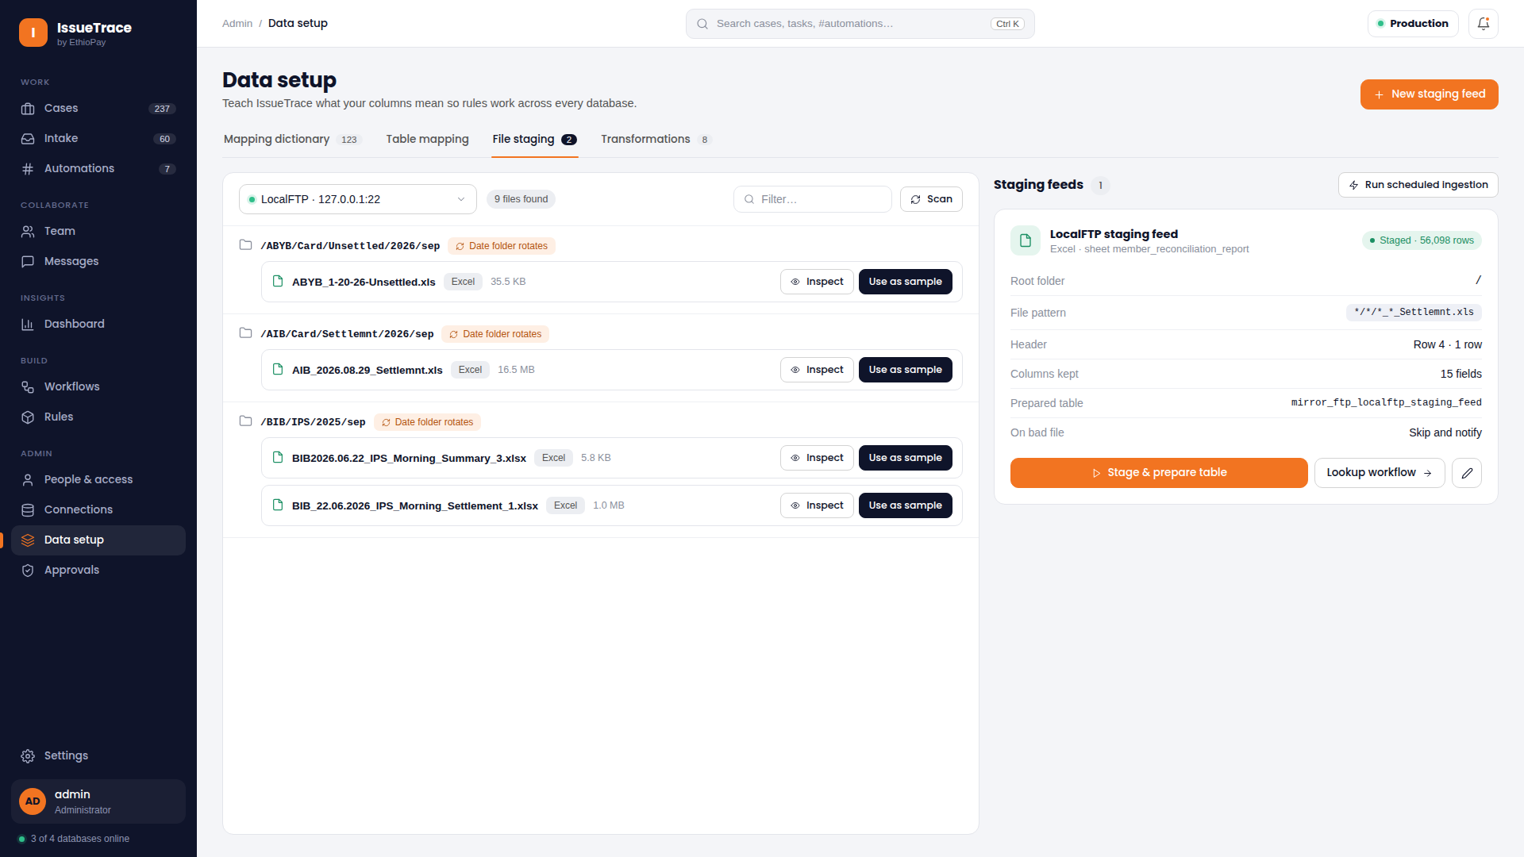
DATA INGESTION
Remote SFTP File Staging & Ingestion Automation
Scheduled extraction, rotating date navigation, and multi-format sheet parsing
Automates the retrieval and ingestion of banking settlement files from remote SFTP servers, eliminating manual file downloads.
• Dynamic Rotating Date Folders
Auto-discovers calendar subfolders (e.g., /2026/sep/...) using dynamic wildcard matching.
• Multi-Format Spreadsheet Parsing
Seamlessly parses multi-sheet Excel (.xlsx, .xls), CSV, XML, and fixed-width text files.
• Header & Offset Detection
Accommodates merged report titles, banner metadata, and variable starting header rows effortlessly.
• Unlogged Mirror Tables
Loads raw data directly into typed PostgreSQL unlogged mirror tables for ultra-fast processing.
💡 USER ACTION GUIDE: Configure automated polling schedules on the SFTP configuration card so morning clearing files are staged before your squad arrives.

Slide 5
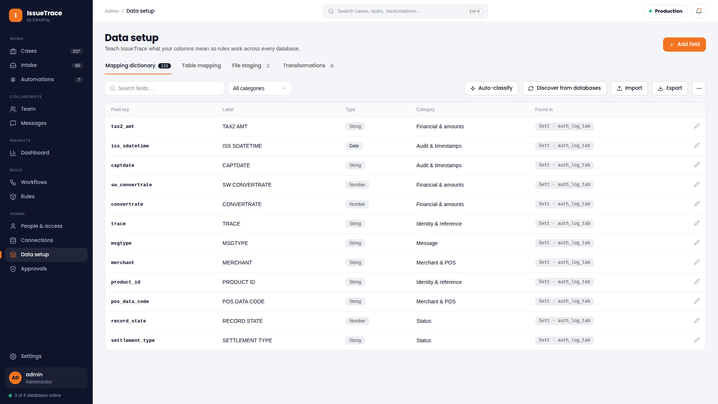
DATA SETUP
Global Data Directory & Physical Column Mapping
Agnostic dictionary architecture decoupling database schemas from workflow rules
The Global Standard Directory provides a canonical dictionary layer that shields business rules from physical column naming differences.
• Zero Hardcoded Field Names
Physical database columns (e.g., `TXN_AMT`, `AMOUNT_CENTS`) map dynamically to canonical keys (`amount`).
• Cross-System Portability
Workflows referencing canonical keys run seamlessly across diverse bank core databases without rewriting SQL.
• Visual Mapping Workbench
Interactive drag-and-drop or dropdown column mapping with immediate validation of data types.
• Database Scoping & Isolation
Maintains distinct column configurations per external connection, preventing schema collisions.
💡 USER ACTION GUIDE: Always map required reconciliation columns (Transaction ID, Amount, Timestamp, Status) before activating a new database connection.

Slide 6
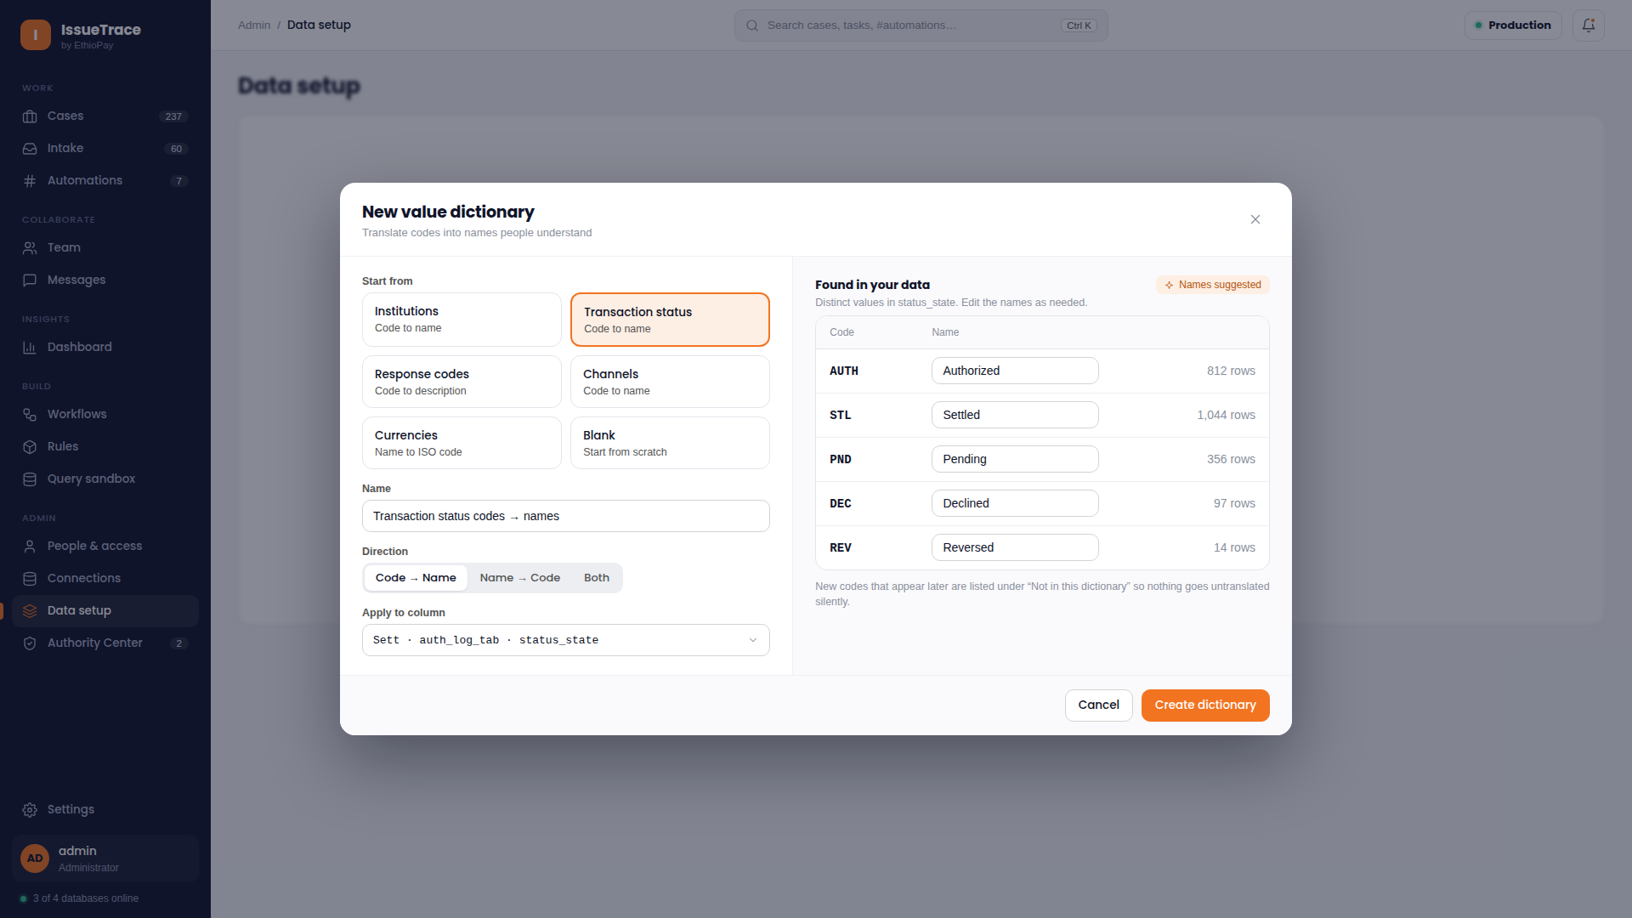
DATA HARMONIZATION
Value Dictionary Workbench & Code Harmonization
Standardizing heterogeneous response codes into uniform operational statuses
Normalizes disparate status codes from payment switches, core banking engines, and partner networks into standardized business statuses.
• Canonical Term Normalization
Translates diverse codes (`00`, `APPR`, `APPROVED`, `PAID`) into a single canonical `SUCCESS` status.
• Failure & Decline Mapping
Maps switch decline codes (`51` = Insufficient Funds, `54` = Expired Card) to uniform investigation categories.
• Multi-Dictionary Support
Create specialized dictionary profiles for Card Networks, ACH Clearing, and Core Banking feeds.
• Instant Rule Integration
Validation boxes utilize dictionary lookups directly, simplifying rule definitions.
💡 USER ACTION GUIDE: Define default fallback values in your value dictionaries to capture unrecognized codes as 'UNKNOWN_EXCEPTION' for review.

Slide 7
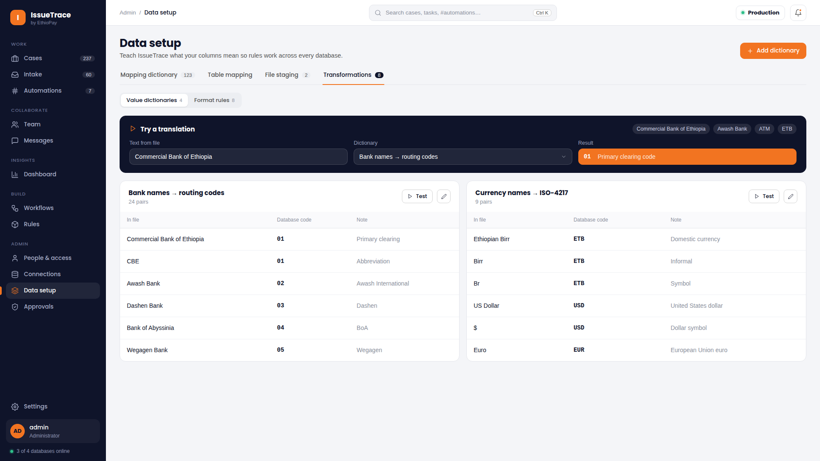
DATA PREPARATION
Data Transformations & Calculated Expression Studio
On-the-fly arithmetic scaling, string formatting, and SQL expression transformations
Allows operators to apply mathematical, string, and temporal transformations to raw input data before reconciliation rules execute.
• Currency & Scale Conversions
Converts integer minor currency units (cents, cents-to-dollars) into decimal representations.
• String Cleansing & Trimming
Strips special characters, trailing spaces, and standardizes account formatting for clean matching.
• Dynamic SQL Expression Builder
Craft custom expressions (e.g., `CASE WHEN type = 'CR' THEN amount * -1 ELSE amount END`).
• Pre-Execution Preview
Tests transformation formulas against sample records to verify calculation accuracy before saving.
💡 USER ACTION GUIDE: Apply amount scaling transformations in the preparation step to ensure input currencies align exactly with core banking ledgers.

Slide 8
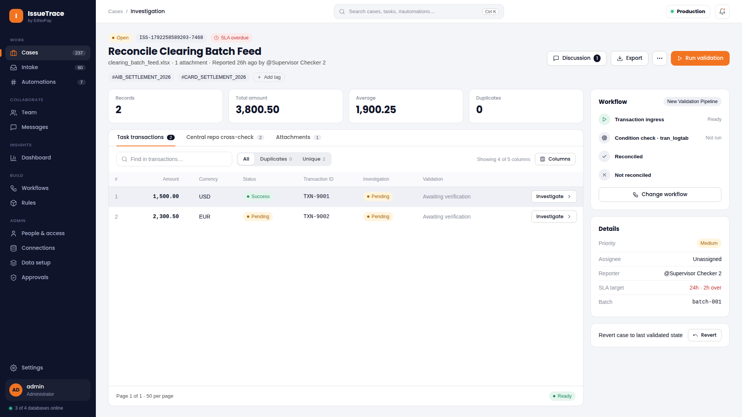
DAILY OPERATIONS
Operations Workspace & High-Throughput Case Grid
Mission control for settlement analysts to track, filter, and inspect transaction batches
The primary working environment for analysts, providing real-time transaction ingestion, status indicators, and batch action controls.
• Real-Time Discrepancy Queue
Ingests batch records and displays validation badges, error classifications, and match states.
• Customizable Column Visibility
Toggle financial, account, fee, and timestamp columns with persistent user preference storage.
• Multi-Dimensional Filtering
Filter instantly by status (New, Processing, Discrepancy), currency, partner institution, or date range.
• One-Click Batch Execution
Trigger validation runs, force re-runs on staged items, revert tasks, or export audit CSV reports with a single click.
💡 USER ACTION GUIDE: Customize your visible columns to keep Transaction ID, Amount, Status, and Error Verdict in view for quick scanning.

Slide 9
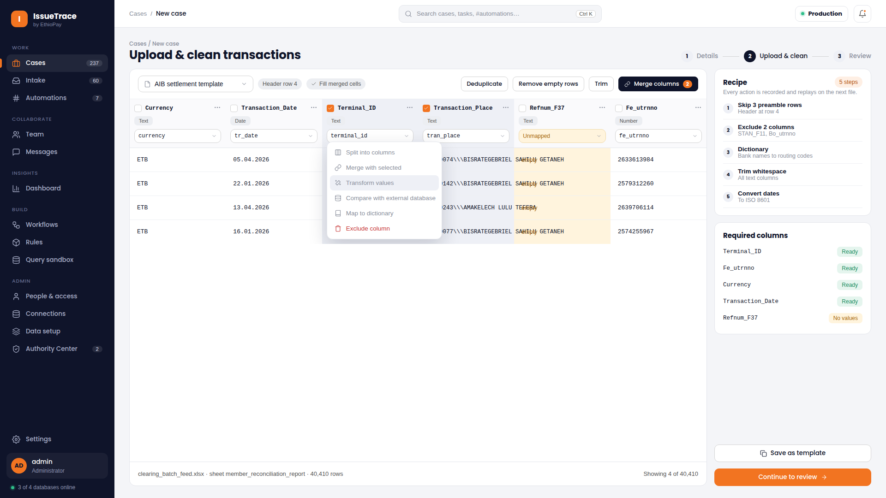
CASE CREATION
Staging New Cases & Pipeline Assignment
Uploading raw settlement batches, attaching validation pipelines, and initiating runs
Provides an intuitive modal interface to upload new reconciliation files, assign execution pipelines, and configure batch metadata.
• Drag-and-Drop Batch Upload
Drop raw Excel, CSV, or TXT settlement files directly into the upload dropzone.
• Pipeline & Workflow Binding
Select from available visual DAG workflows (e.g., Daily Settlement, Card Interchange Reconciliation).
• Database Scope Selection
Explicitly choose the target database connection and core ledger table to reconcile against.
• Execution Policy Configuration
Set batch priorities (Urgent, Standard) and choose whether to auto-run validation immediately.
💡 USER ACTION GUIDE: Verify the target database connection before submitting the staging modal to ensure reconciliation matches the correct core ledger.

Slide 10
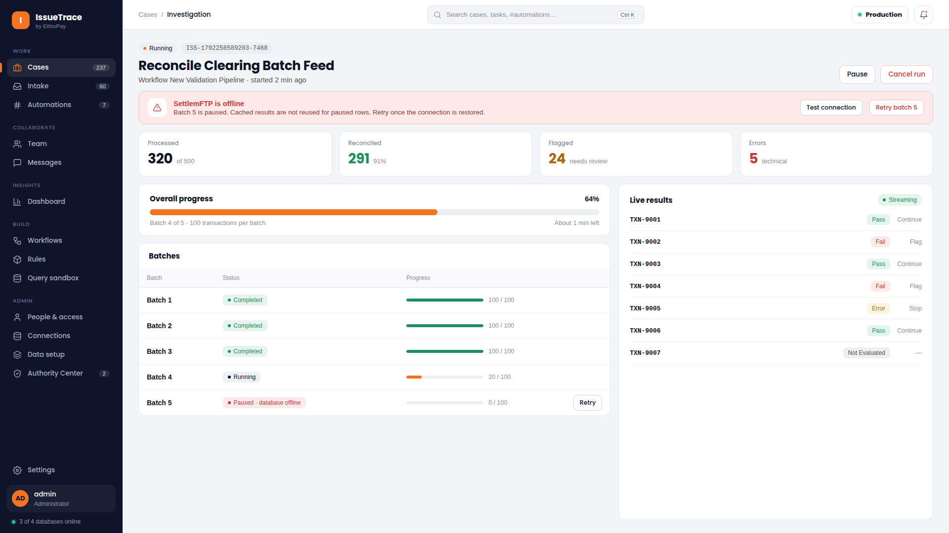
EXECUTION ENGINE
Real-Time Pipeline Execution & Progress Monitoring
Live telemetry, stage progress milestones, and non-blocking asynchronous processing
Tracks active validation execution in real time with visual progress milestones, stage transitions, and execution telemetry.
• Non-Blocking Background Processing
Executes multi-thousand transaction batches asynchronously without freezing the user interface.
• Stage-by-Stage Milestone Bars
Displays progress across Ingestion, Rule Evaluation, Mirror Reconciliation, and Output Reporting.
• Live Counter Telemetry
Monitors processed records, passing transactions, detected discrepancies, and syntax errors in real time.
• Safe Task Cancellation
Operators can pause or terminate running batches if an incorrect file was uploaded.
💡 USER ACTION GUIDE: You can navigate freely across other workspaces while a batch executes; progress will continue and notify you upon completion.

Slide 11
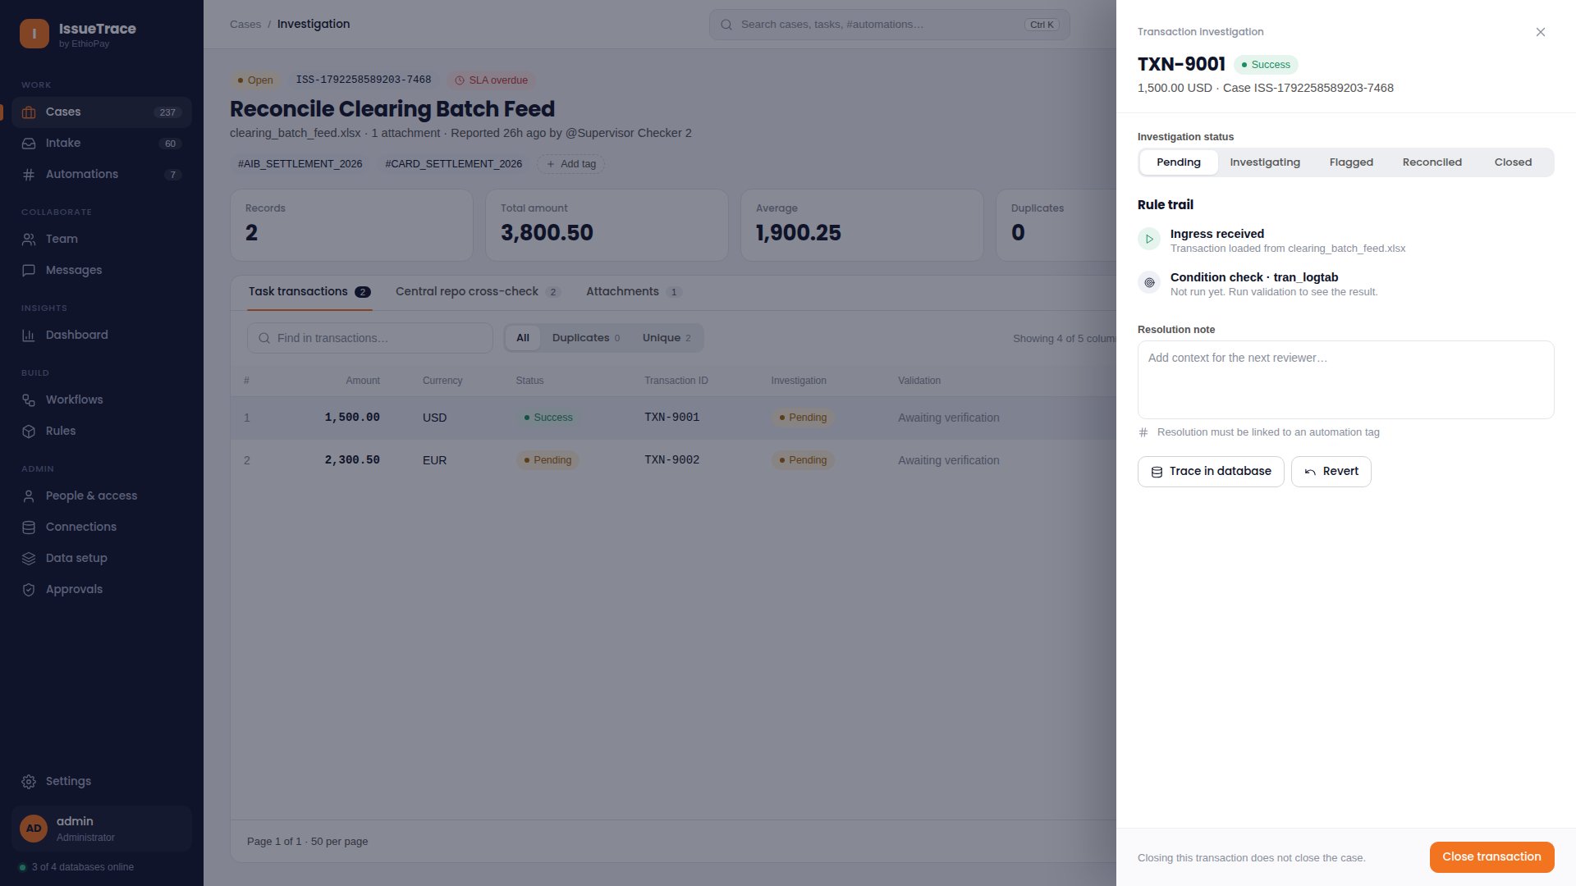
FORENSIC INVESTIGATION
Transaction Forensics & Sequential Rule Trajectory
Row-level deep inspection detailing input data, mirror records, and rule evaluation verdicts
Opening any transaction launches the forensic drawer, revealing the exact sequence of rules evaluated and their outcomes.
• Sequential Trajectory Audit
Traces step-by-step verdicts (PASS, FAIL, ERROR) mapped directly to pipeline actions (CONTINUE, STOP, FLAG).
• Source vs. Mirror Payload Inspection
Compare raw ingested fields side-by-side with database mirror records down to the microsecond.
• Execution Latency & Metadata
Inspect execution duration, evaluated SQL criteria, and parameter values for each validation step.
• Direct Action Triggers
Launch deep compare-and-resolve, initiate team discussions, or stage resolution proposals directly from the drawer.
💡 USER ACTION GUIDE: Click on any failed step in the trajectory list to view the exact SQL criteria and parameter bounds evaluated by the engine.

Slide 12
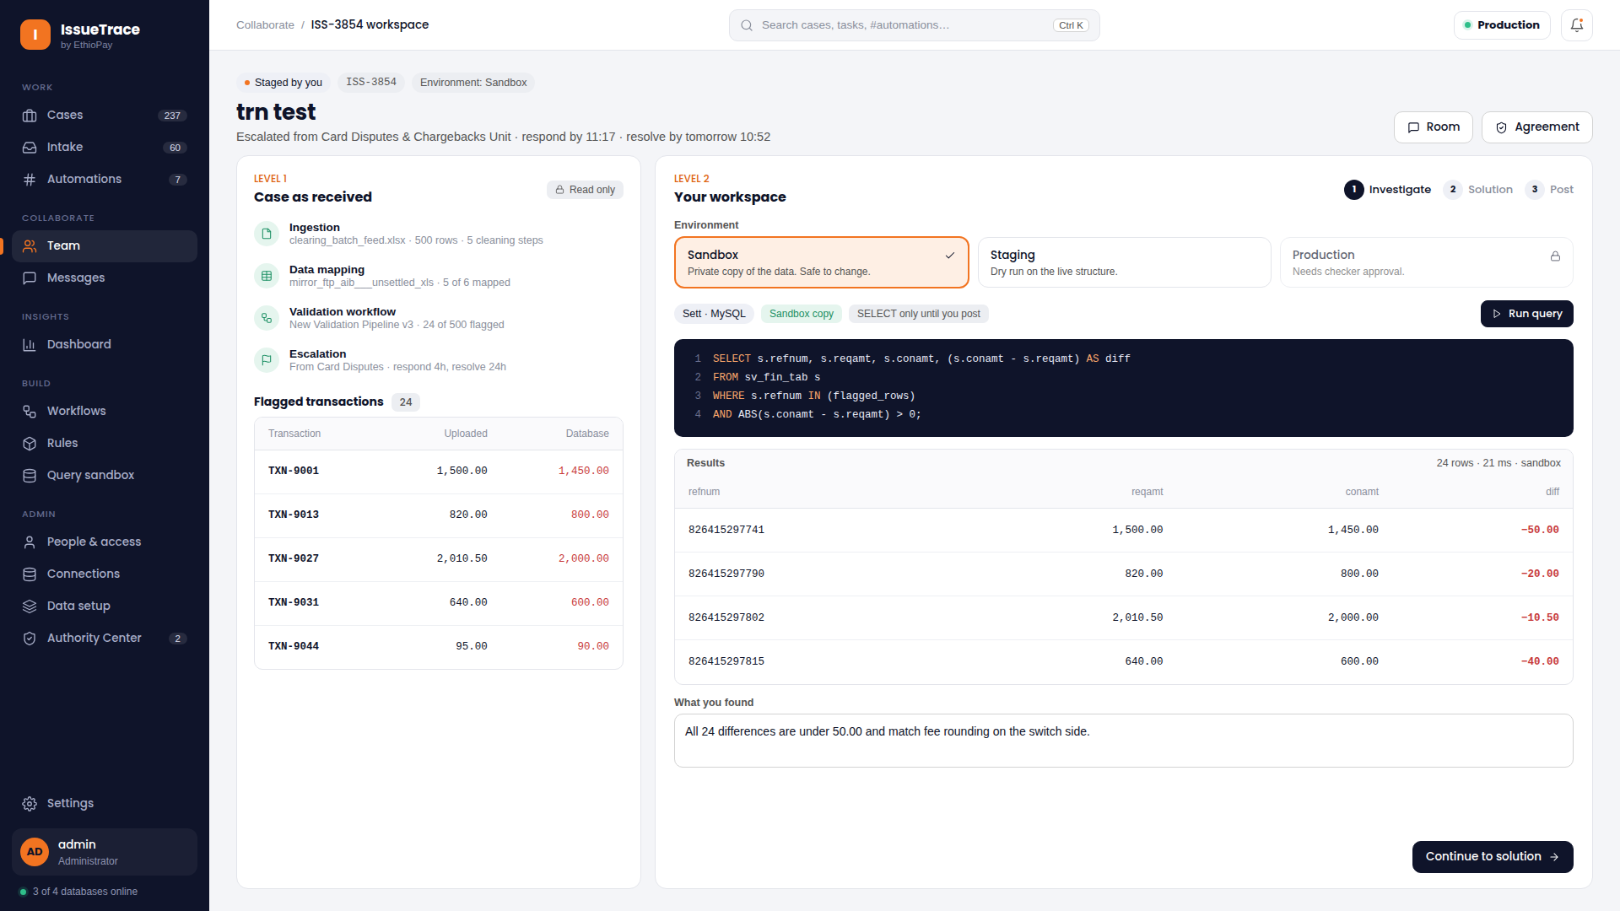
ADVANCED ANALYSIS
Two-Level Discrepancy Investigation Workflow
Hierarchical forensic analysis: batch coordinate checks vs. deep core ledger lookups
Separates investigation into Level 1 (batch coordinate validation) and Level 2 (deep core banking ledger reconciliation).
• Level 1: Batch Coordinate Audit
Validates row coordinate integrity, batch sum totals, file headers, and internal transaction references.
• Level 2: Deep Core Banking Lookup
Executes batched tuple queries against external core banking ledgers to detect missing settlements.
• Clear Investigation Statuses
Tracks investigation progress: Uninvestigated, In Progress, Discrepancy Confirmed, Resolved.
• Root Cause Categorization
Classify root causes: Timing Difference, Network Dropout, Fee Miscalculation, or Legitimate Fraud.
💡 USER ACTION GUIDE: Complete Level 1 checks first; if internal coordinates match, escalate to Level 2 deep lookup to identify external ledger mismatches.

Slide 13
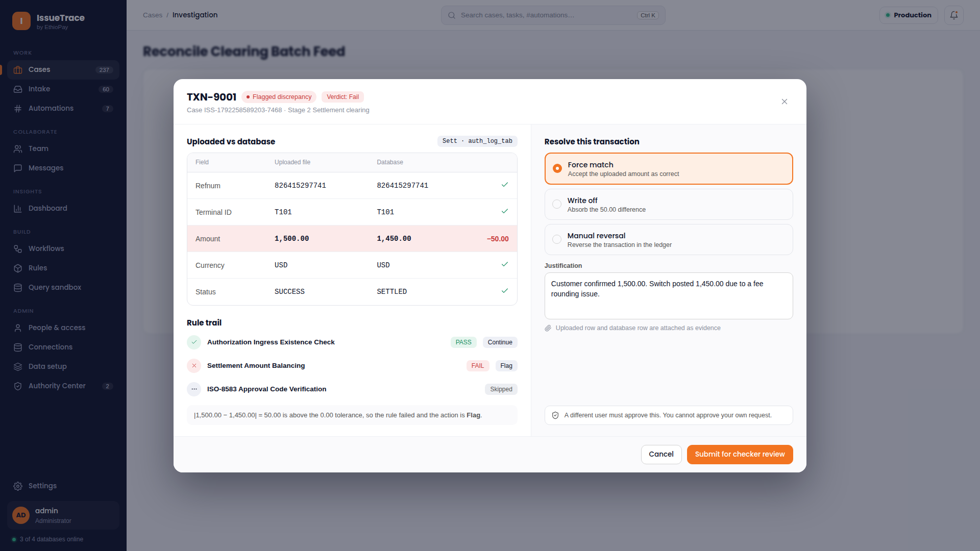
DISCREPANCY RESOLUTION
Compare & Resolve: Side-by-Side Discrepancy Reconciliation
Visual field-level comparison, discrepancy highlighting, and resolution proposal staging
The Compare & Resolve workbench gives technicians a visual diff between the source record and core ledger, enabling manual resolution proposals.
• Field-by-Field Visual Diff
Highlights mismatched fields in bold amber/red (e.g., Ingested $1,500.00 vs. Core Ledger $1,450.00).
• Automated Resolution Options
Select from standardized operational resolutions: Force Match, Write-Off, Manual Reversal, or Reject.
• Mandatory Justification Notes
Technicians must provide detailed rationale and operational notes before submitting a proposal.
• Snapshot Locking
Locks transaction state in `PENDING_CHECKER_REVIEW` with an immutable evidence snapshot for auditability.
💡 USER ACTION GUIDE: Always attach the core banking reference number in the resolution notes to assist the Checker during dual-control review.

Slide 14
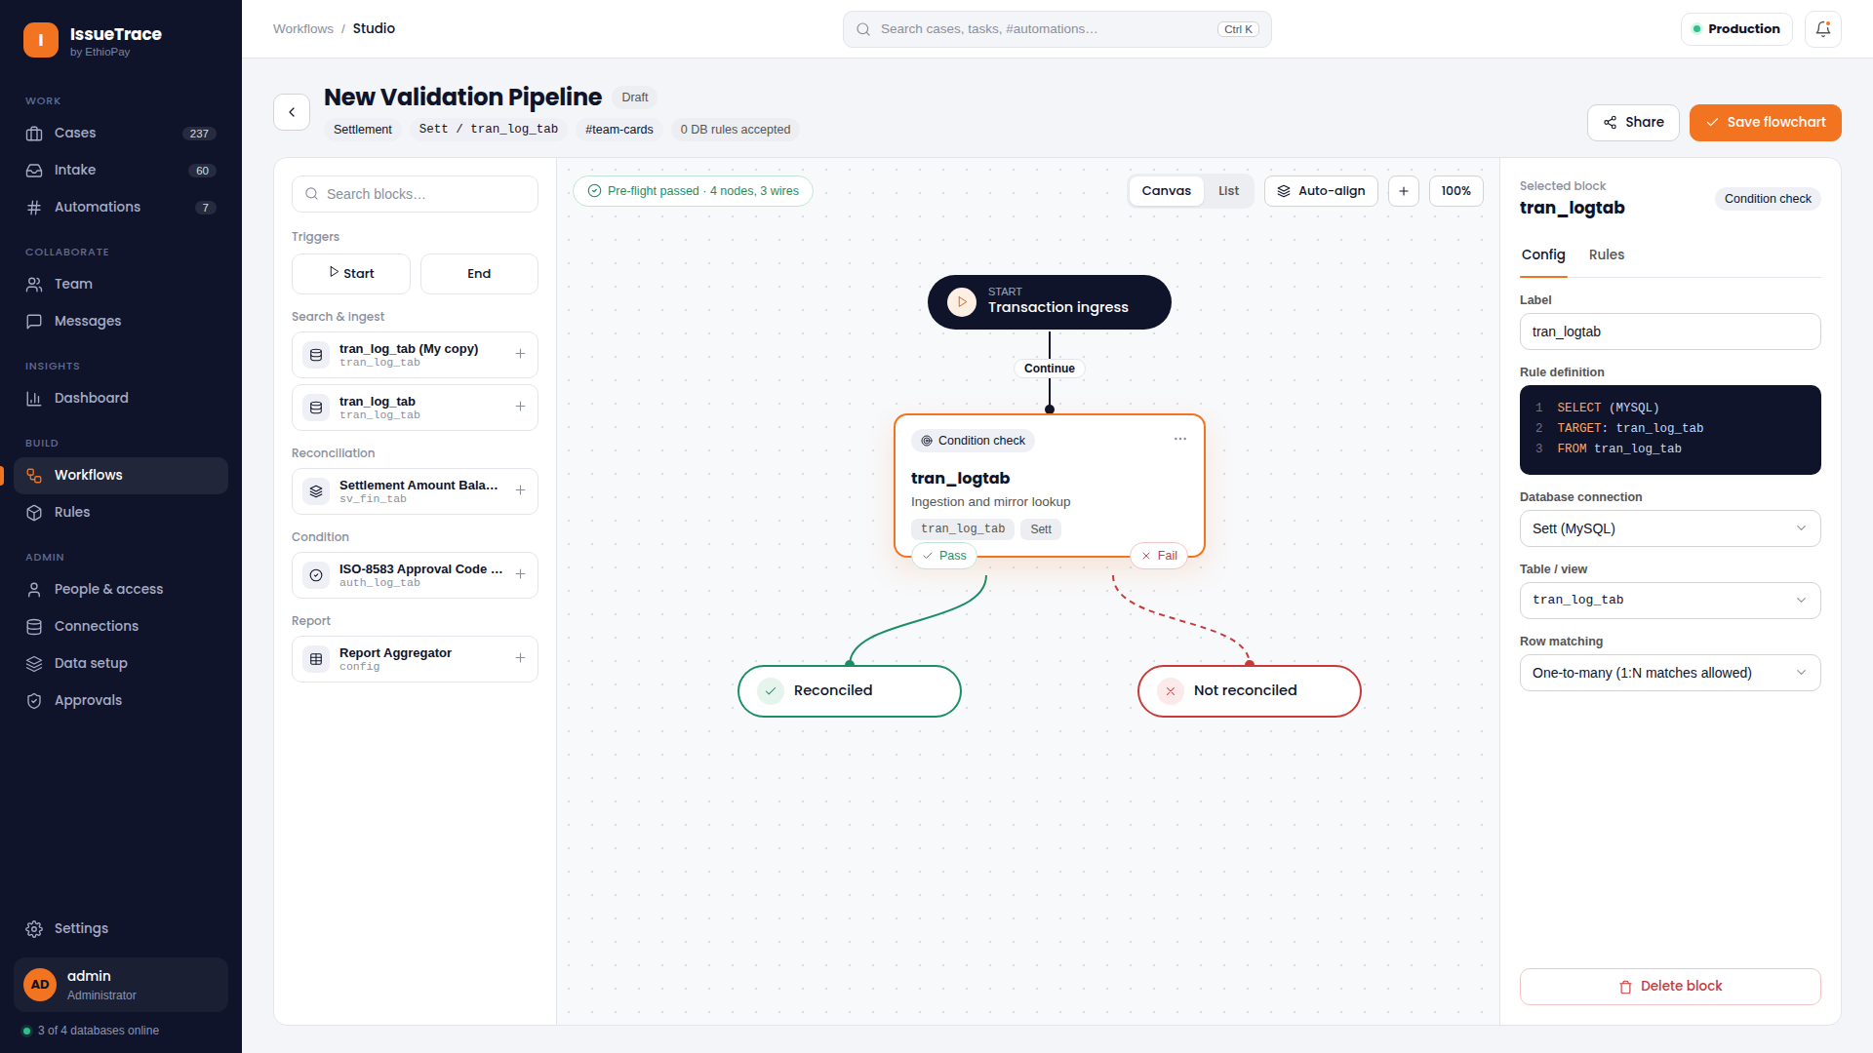
PIPELINE ENGINEERING
Workflow Studio: Visual Flowchart DAG Pipeline Builder
No-code visual canvas to design, wire, and persist multi-stage reconciliation pipelines
Workflow Studio allows administrators and engineers to construct sophisticated reconciliation pipelines visually without writing code.
• Interactive Flowchart Canvas
Drag and drop Start, End, and modular validation nodes; connect ports with visual SVG bezier curves.
• Instant Pre-Flight Topology Validator
Validates graph topology continuously, alerting on disconnected nodes, orphan branches, or infinite loops.
• Database & Stage Scoping
Assign target databases and cardinality policies (Single Row, Multi-Row Aggregate) per stage.
• PostgreSQL Relational Persistence
Stores pipeline definitions directly in PostgreSQL tables for reproducible, version-controlled execution.
💡 USER ACTION GUIDE: Click 'Validate Graph' in the canvas toolbar before saving to ensure all nodes and branch conditions are wired properly.

Slide 15
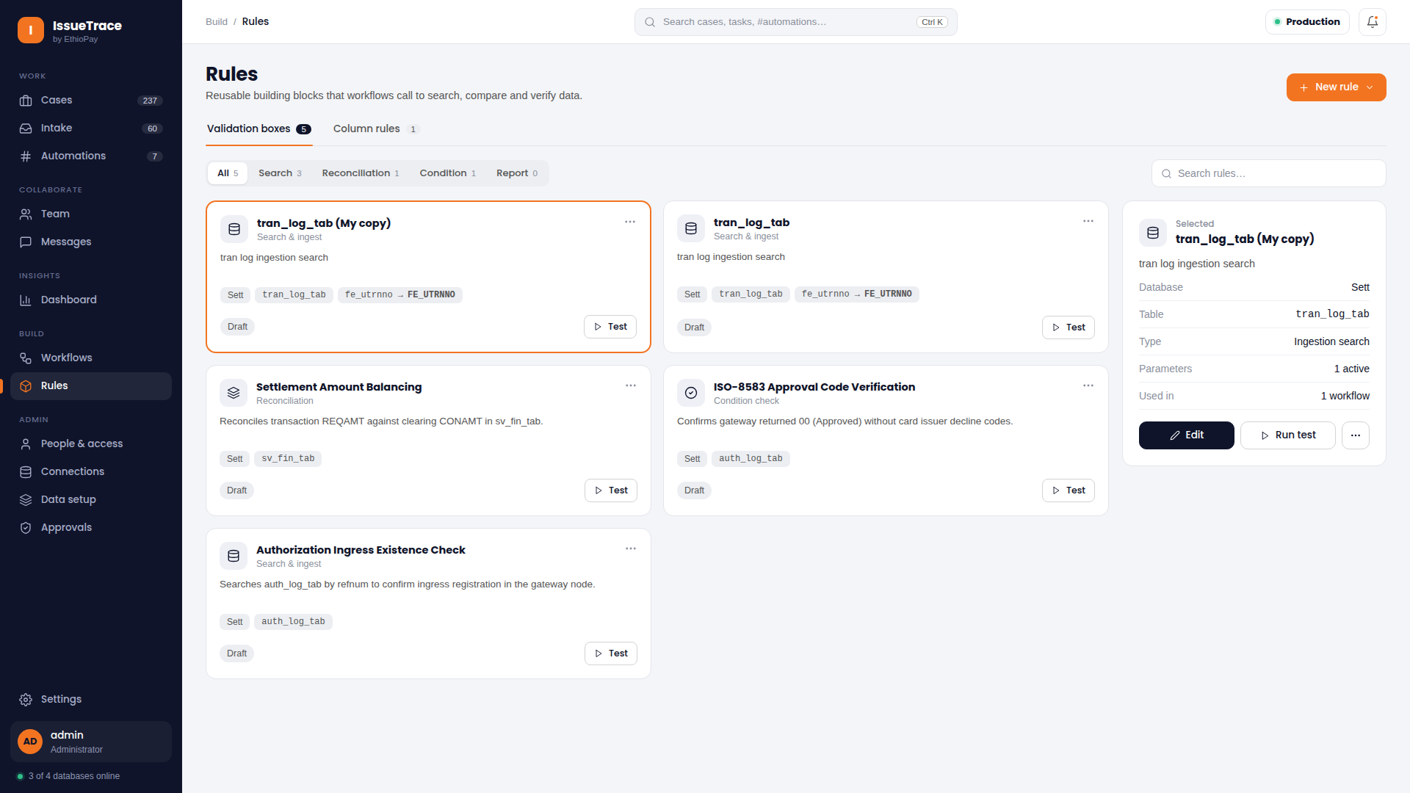
RULE ARCHITECTURE
Modular Validation Rules Library & Sandbox
Reusable validation building blocks with built-in interactive unit testing
A centralized repository of tested validation building blocks that can be dragged into any workflow canvas across the organization.
• Four Canonical Box Types
Strictly structured into Ingestion Search, Condition Check, Reconciliation, and Report Output blocks.
• Standardized Rule Templates
Pre-built templates for ISO Decline Codes, Existence Checks, Amount Thresholds, and Date Consistency.
• Interactive Sandbox Testing
Run dry-run unit tests directly from the library cards against live sample rows before publishing.
• Universal Hashtag Tagging
Tag validation boxes with hashtags (e.g., #card-reconciliation) for instant discovery across squads.
💡 USER ACTION GUIDE: Test any newly configured validation rule in the dry-run sandbox before adding it to an active production pipeline.

Slide 16
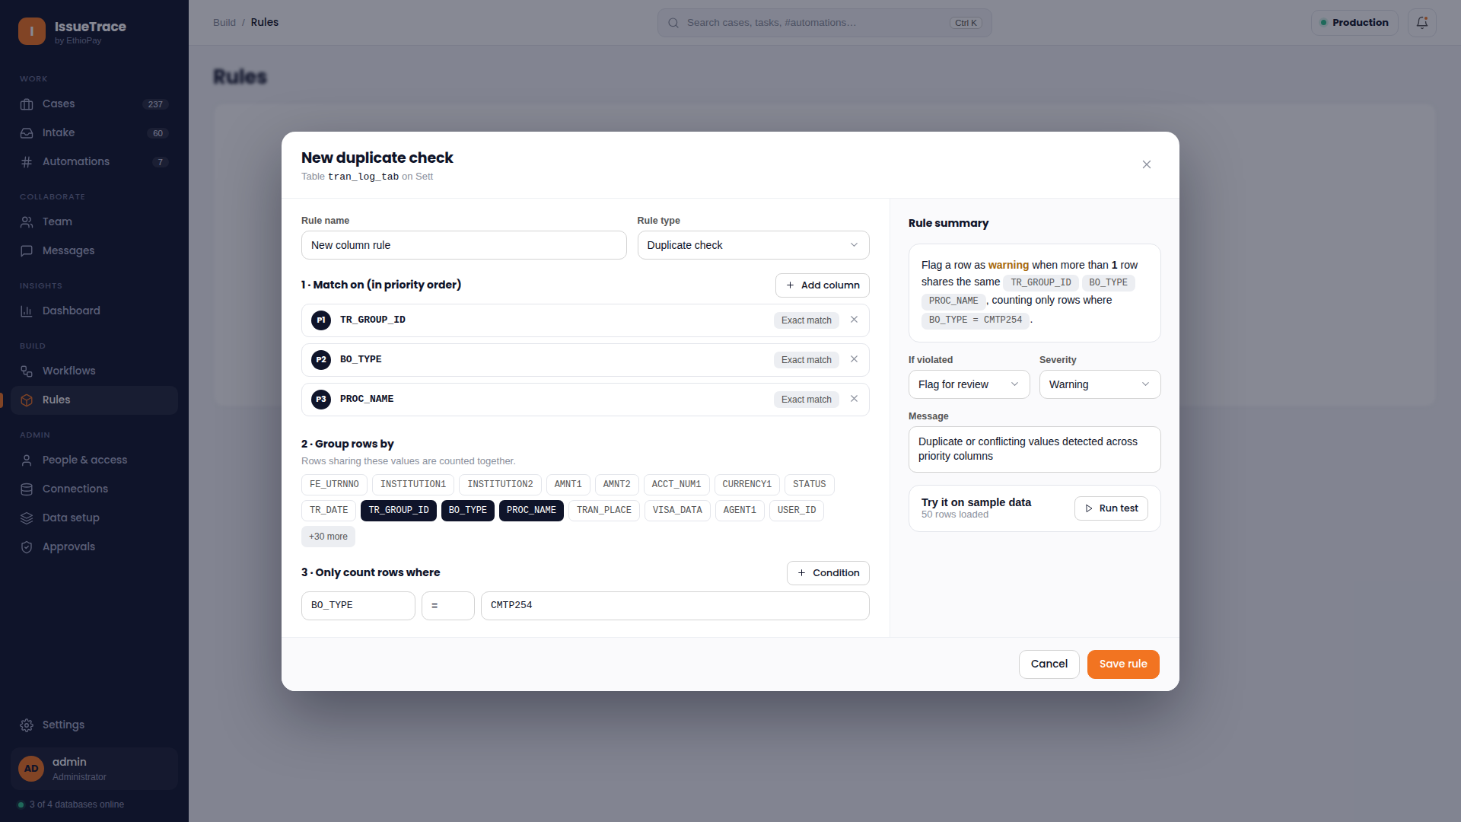
INTEGRITY RULES
Multi-Leg Transaction Rules & Duplicate Elimination
Advanced partition grouping keys and conditional row criteria to eliminate false duplicates
Solves the challenge of complex multi-leg payments by grouping transactions by partition keys and filtering occurrences conditionally.
• Common Partition Grouping Keys
Groups transactions by correlation keys (e.g., `TR_GROUP_ID`, `SESSION_ID`) rather than flat row evaluation.
• Conditional Leg Criteria Builder
Specifies distinct criteria for specific transaction legs (e.g., `BO_TYPE = 'CMTP254'`) using standard operators.
• Filtered Occurrence Counting
Counts only the rows satisfying leg criteria within each partition group and evaluates thresholds (`COUNT = 1`).
• Multi-Leg Integrity Guarantee
Eliminates false-positive duplicate alerts on legitimate multi-leg transfers and currency exchanges.
💡 USER ACTION GUIDE: When configuring duplicate checks on multi-leg transfers, specify the unique transaction group identifier as the partition key.

Slide 17
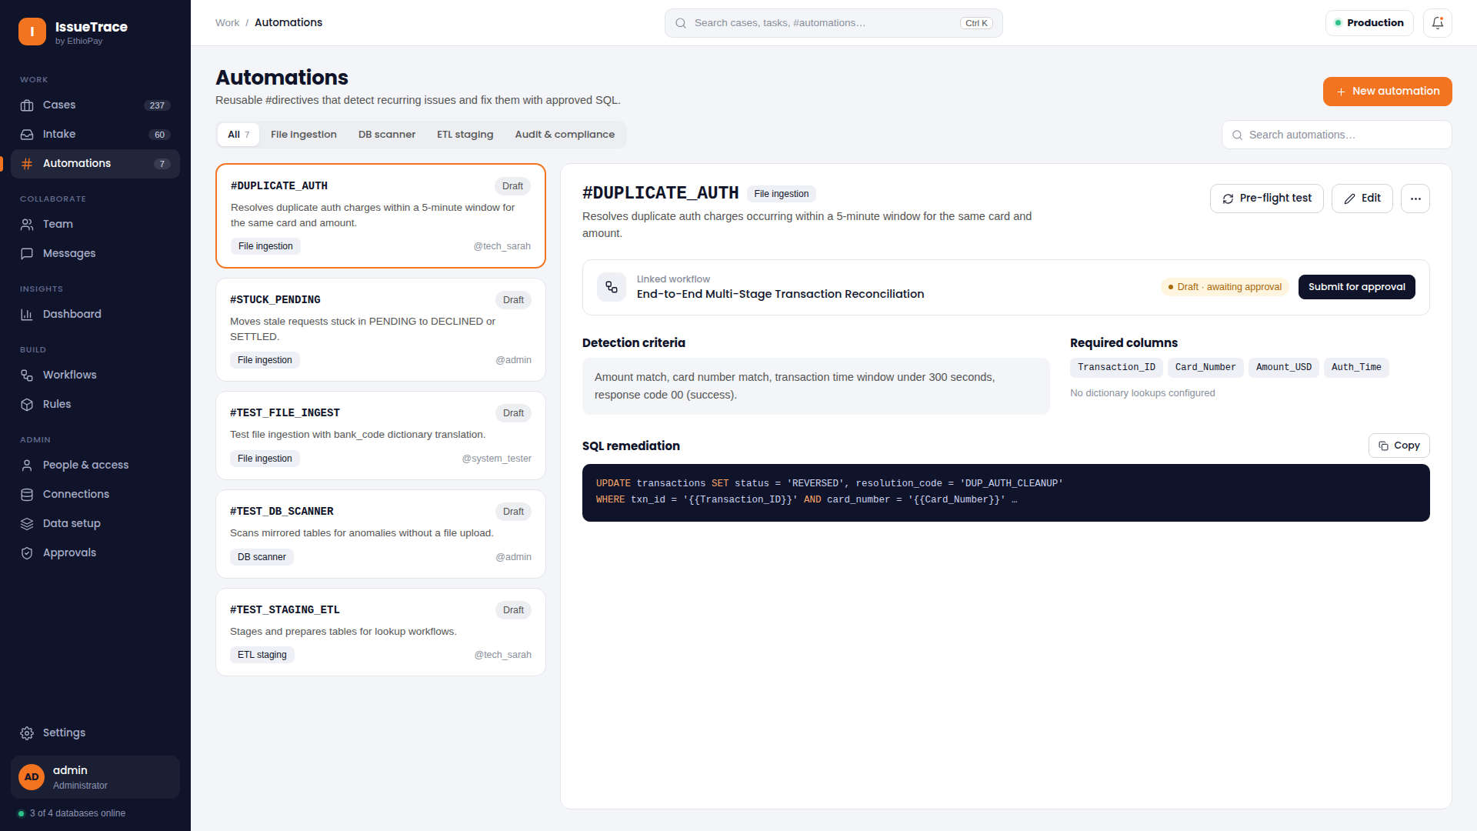
PROCESS AUTOMATION
Automations: Event Triggers & Scheduled Batch Jobs
Configuring cron schedules, event triggers, automated notifications, and auto-triage
Automates recurring operational tasks, file polling, and reconciliation runs with configurable cron expressions and event listeners.
• Flexible Trigger Types
Trigger workflows based on cron schedules (e.g., every morning at 06:00 AM), file arrivals, or webhook events.
• Automated Squad Routing
Auto-assigns newly generated cases to specific squads (Cards, Settlement, Dispute Desk) based on criteria.
• SLA Breach Alerting
Triggers high-priority notifications when aging cases approach SLA expiration thresholds.
• Execution History & Audit Log
Maintains complete run history with success/failure statuses, error traces, and execution durations.
💡 USER ACTION GUIDE: Enable email or Teams notifications on mission-critical automation jobs so squad leads are notified of any polling interruptions.

Slide 18
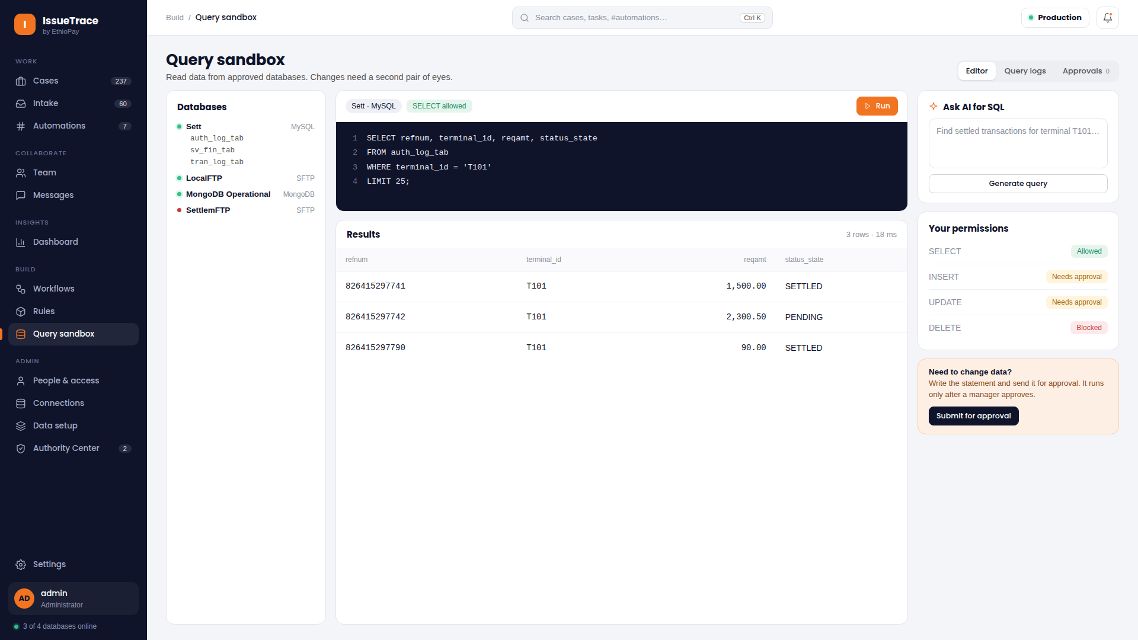
TECHNICAL ANALYSIS
Query Sandbox & Database Explorer
Safe read-only SQL workbench for ad-hoc transaction queries and data schema inspection
Empowers technicians and database administrators to inspect database schemas and run ad-hoc read-only queries safely.
• Safe Read-Only Guardrails
Strictly enforces `SELECT` operations; mutating statements (UPDATE, DELETE, DROP) are blocked automatically.
• Multi-Database Connection Switcher
Query across Core Banking, Switch Archives, and Staged Mirror tables from a single workbench.
• SQL Syntax Highlighting
Modern editor with auto-completion, keyword coloring, line numbering, and query formatting.
• Projected Results & CSV Export
Instant tabular data grid with execution timing, row counts, and one-click export for investigation evidence.
💡 USER ACTION GUIDE: Use the Query Sandbox to verify customer account balances or check historical reference records during deep forensic investigations.

Slide 19
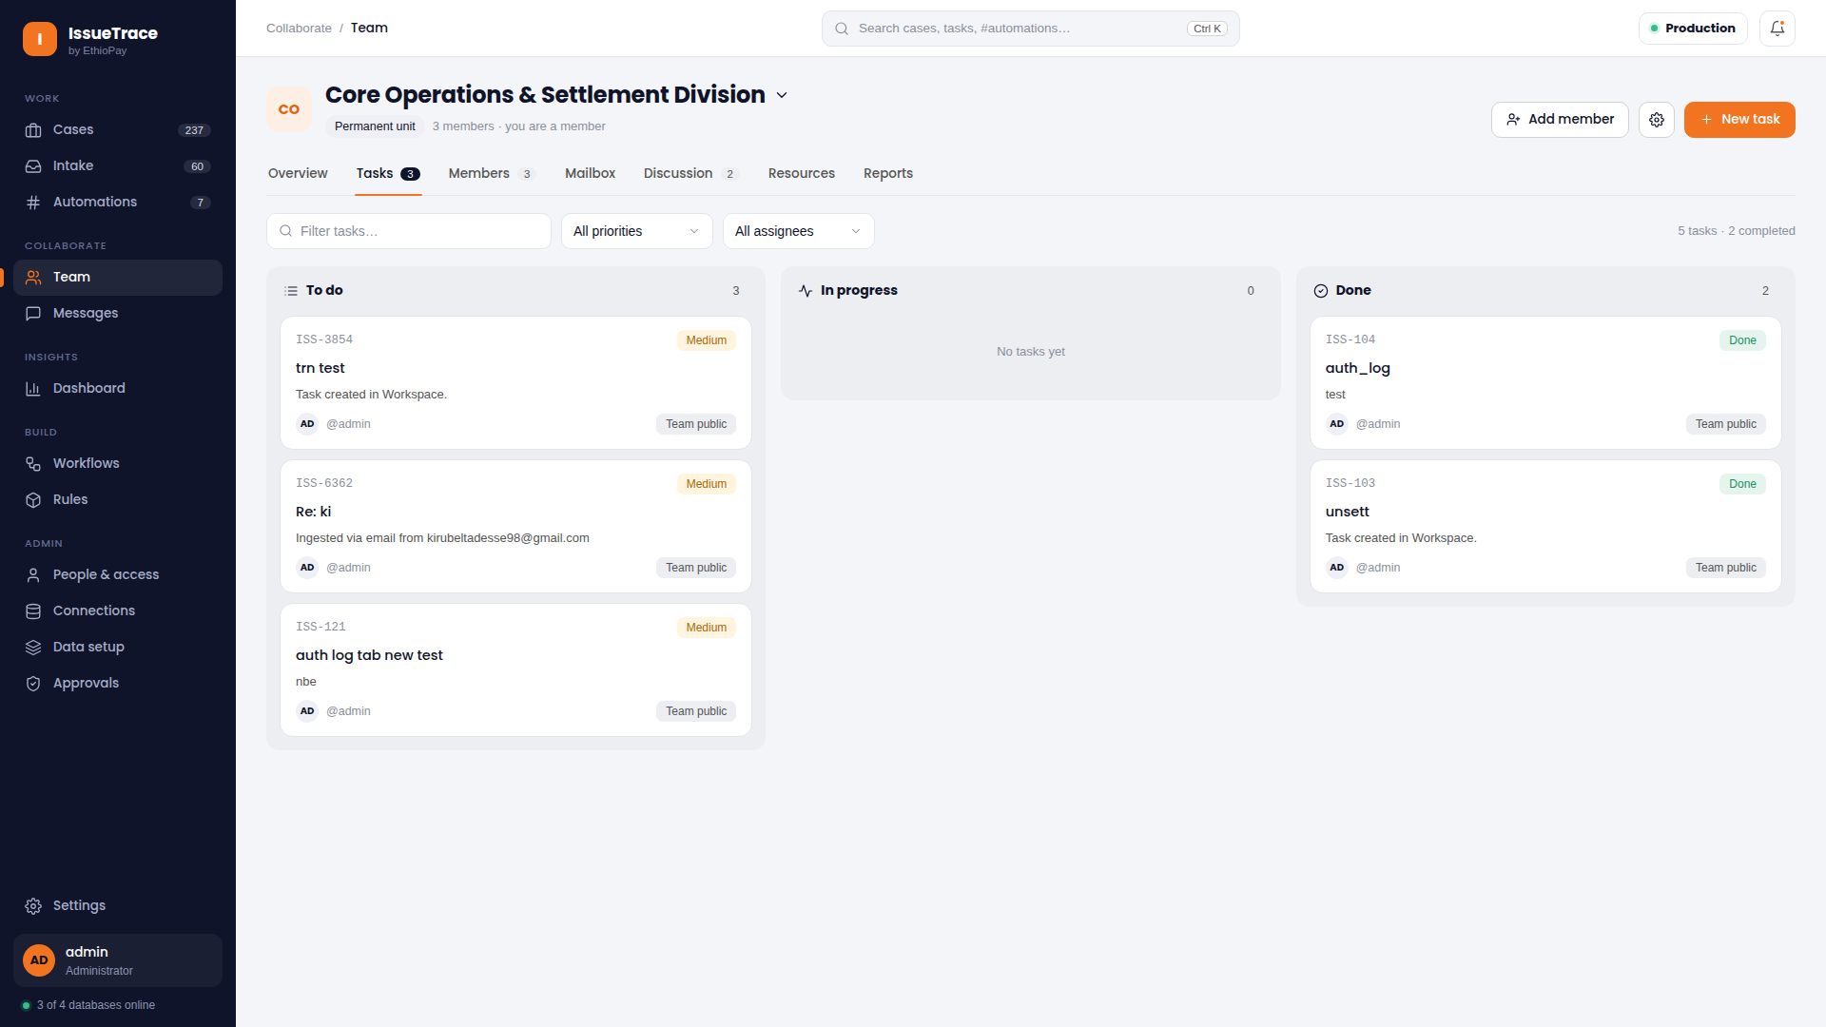
SQUAD COLLABORATION
Team Tasks: Operational Kanban & Task Tracking
Visual workflow board consolidating squad assignments, priorities, and SLA timers
Provides an operational Kanban board tracking cases across Backlog, In Progress, Peer Review, and Completed columns.
• Visual Kanban Columns
Move cases across workflow states with clear priority indicators and assignee avatars.
• Public Team Task Consolidation
Consolidates individual operator tasks into team-visible boards for balanced workload distribution.
• Real-Time SLA Timers
Color-coded countdown badges alert squads to pending SLA breaches before deadlines are missed.
• 1-Click Workspace Navigation
Clicking any task card immediately navigates directly to that case in the operations workspace.
💡 USER ACTION GUIDE: Review the Team Tasks board during daily standups to redistribute cases from overloaded operators to available squad members.

Slide 20
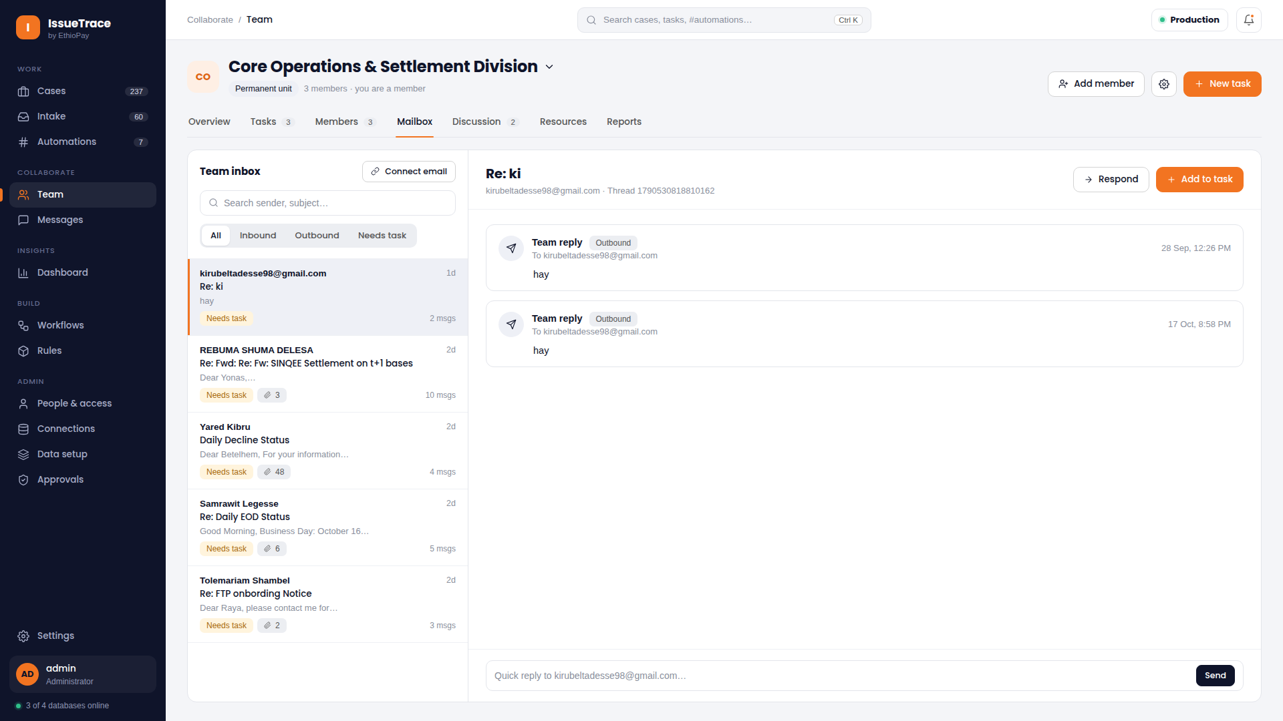
CUSTOMER OPERATIONS
Shared Team Mailbox & Customer Dispute Triage
Unified multi-pane email client connecting directly to team mailboxes via OAuth 2.0
A dedicated dispute desk interface connecting to shared team mailboxes for handling inbound customer chargebacks and partner inquiries.
• Multi-Pane Email Interface
Thread list on the left, full message history and attachment preview pane on the right.
• Centralized OAuth 2.0 Security
Connects securely to Microsoft 365 or Google Workspace without exposing secrets to operators.
• Attachment Ingestion
Extract and preview attached customer proof-of-payment receipts, bank letters, and chargeback claims.
• Direct Case Creation
Convert email threads directly into operational reconciliation cases with full message history attached.
💡 USER ACTION GUIDE: Use the 'Convert to Case' button in the message header to transform a dispute email into an active investigation task.

Slide 21
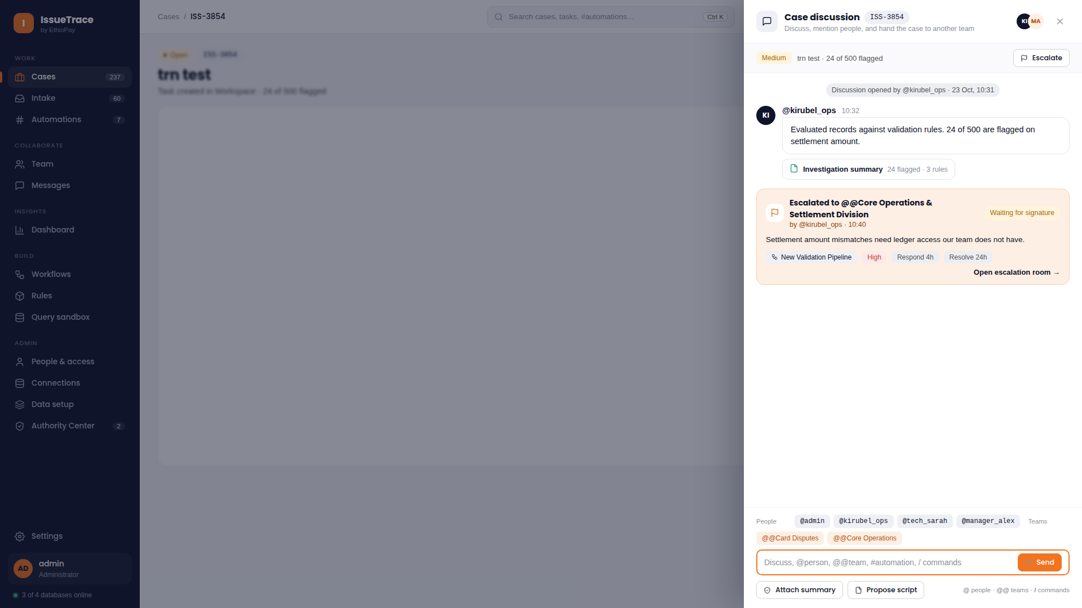
IN-APP CHAT
Contextual Case Discussions & Slash Directives
In-context messaging drawer supporting user mentions, squad tags, hashtags, and slash commands
Each case contains an integrated discussion drawer where operators collaborate in context without leaving the transaction screen.
• Contextual Discussion Drawer
Chat history is permanently bound to the specific case ID for an immutable collaboration record.
• Rich Mention Directives
Use `@username` to mention colleagues, `@@team` to notify entire squads, and `#hashtag` to link related workflows.
• Slash Command Execution
Type `/create-escalate` to open an inter-team room or `/resolve` to initiate a resolution proposal.
• Visual Badge Formatting
Mentions and directives are styled with distinct, colorful pill badges for maximum readability.
💡 USER ACTION GUIDE: Tag the relevant squad using '@@team-cards' or '@@team-core-banking' when requesting cross-department transaction verification.

Slide 22
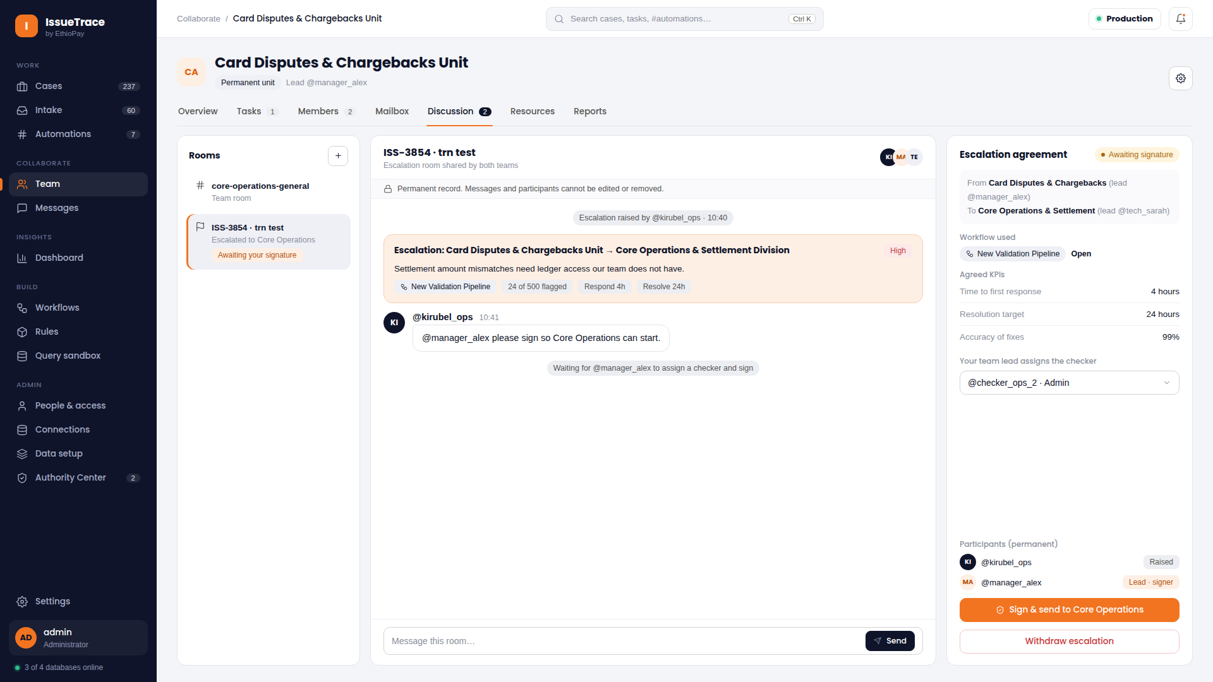
ESCALATION MANAGEMENT
Inter-Team Escalation Rooms & Cross-Squad Collaboration
Dedicated shared rooms bridging operational squads to resolve complex discrepancies
When a discrepancy spans multiple departments (e.g., Settlement ↔ Core Banking), operators spawn dedicated Escalation Rooms.
• Multi-Department Bridge
Creates a shared workspace uniting the escalating squad and receiving squad under a single ticket.
• Frozen Evidence Snapshots
Both teams inspect the exact same immutable snapshot of transaction data and mirror records.
• Real-Time Unified Chat
Full directive autocompletion (`@`, `@@`, `#`, `/`) ensures rapid cross-team communication.
• Clear Squad Ownership
Explicit tracking of which squad currently holds the ball to prevent resolution delays.
💡 USER ACTION GUIDE: Create an escalation room whenever a transaction error originates in an external system outside your squad's direct jurisdiction.

Slide 23
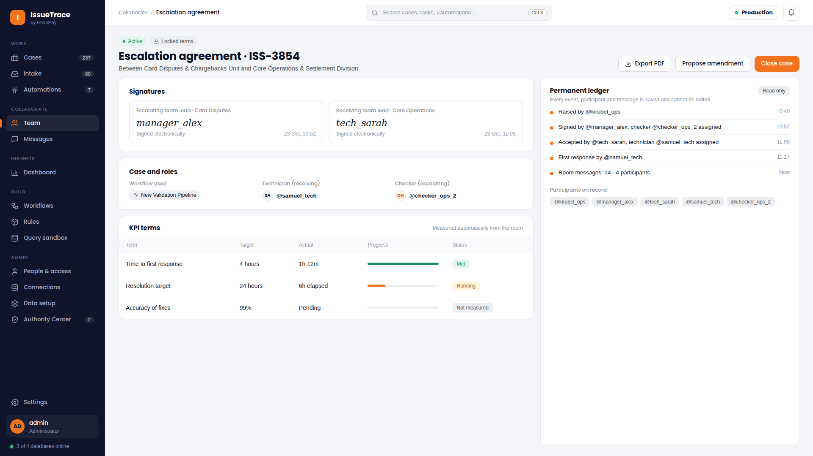
FORMAL SETTLEMENT
Escalation Agreements & Mutual Resolution Commitments
Formalizing resolution terms with dual-team sign-off before closing tickets
To prevent premature case closures, IssueTrace requires formal Escalation Agreements with sign-offs from both squads.
• Formal Agreement Terms
Documents agreed resolution steps (e.g., Ledger Adjustment, Chargeback Reversal, GL Write-Off).
• Dual-Team Authorization
Requires verified approval from authorized leads of both squads before the case can close.
• Immutable Audit Binding
Agreement text, timestamps, and approver identities are cryptographically recorded in the case history.
• Automated Task Unblocking
Once both leads approve, the parent case automatically advances to resolved status.
💡 USER ACTION GUIDE: Ensure the agreement terms clearly specify which team is executing the physical general ledger entry in the core banking system.

Slide 24
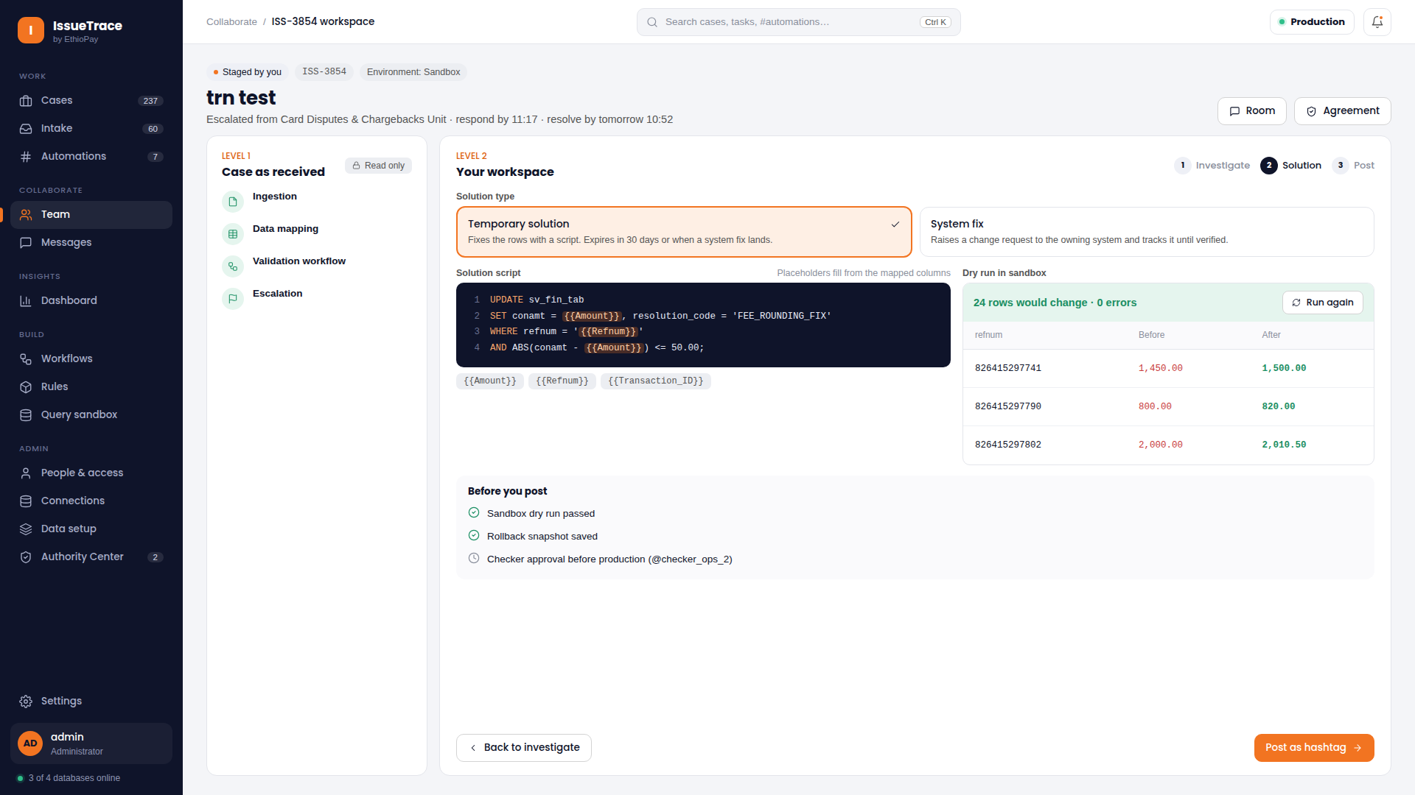
KNOWLEDGE MANAGEMENT
Technician Solution Scripts & Universal Hashtag Knowledge
Publishing and discovering reusable SQL remediation scripts via universal hashtags
Allows experienced technicians to capture SQL remediation scripts and publish them under universal hashtags for squad reuse.
• Remediation Script Repository
Save tested SQL scripts that correct recurring settlement anomalies (e.g., orphaned authorization records).
• Universal Hashtag Binding
Tag scripts with hashtags (e.g., `#AIB_SETTLEMENT_2026`) linking workflows, DAG nodes, and discussions.
• Squad Knowledge Sharing
Junior analysts can discover and review vetted solutions authored by senior technicians.
• Attribution & Governance
Every script retains author attribution, revision timestamps, and safety execution notes.
💡 USER ACTION GUIDE: Search the universal hashtag bar before troubleshooting an unfamiliar error to see if a verified solution script already exists.

Slide 25
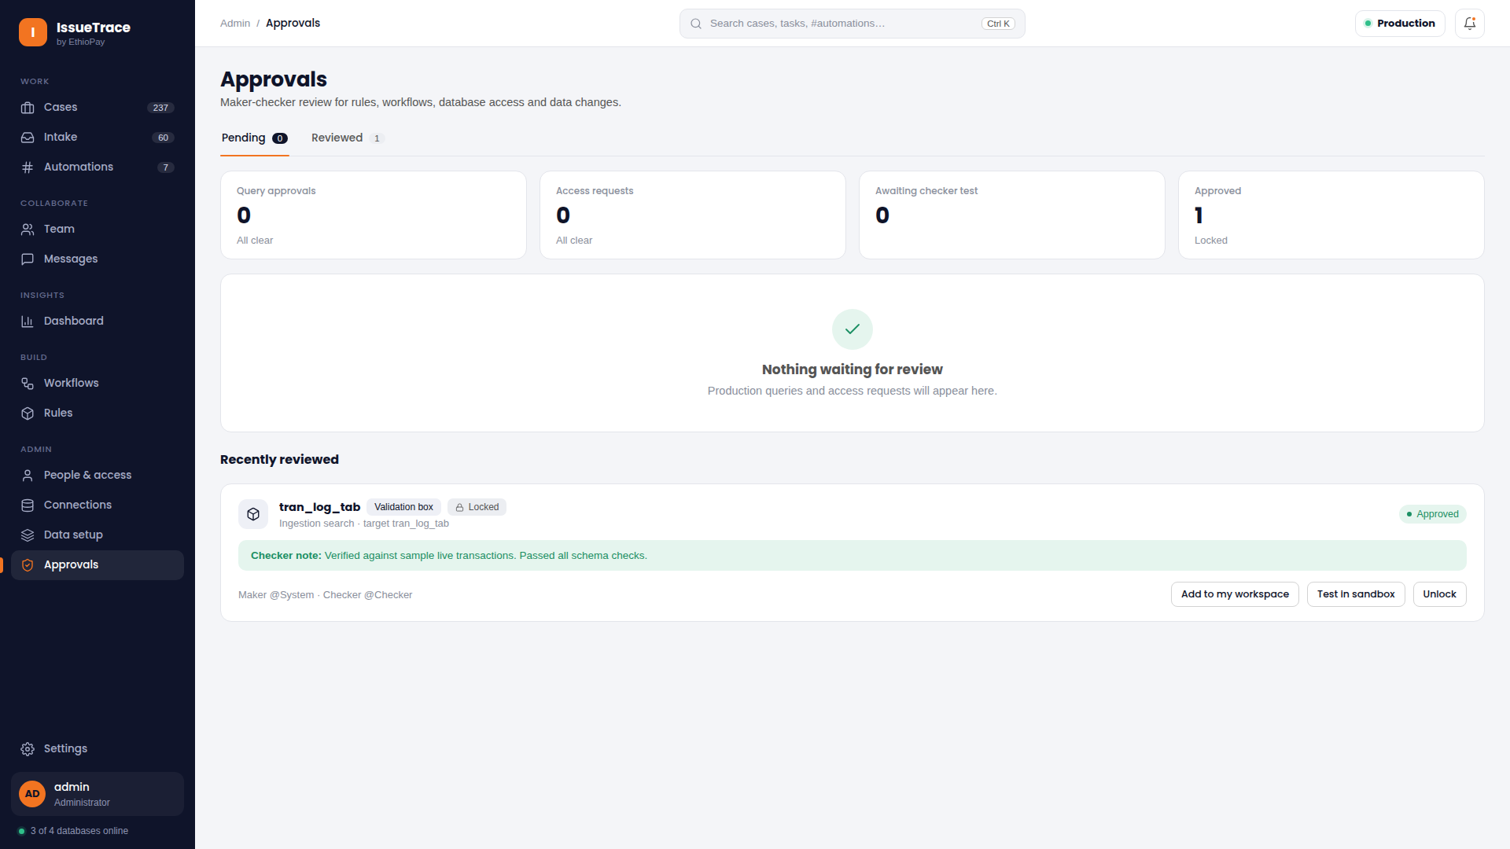
GOVERNANCE & COMPLIANCE
Maker-Checker Dual Authorization & Authority Center
Strict Four-Eyes Principle enforcing anti-self-approval on all financial overrides
The Authority Center enforces banking-grade governance, requiring two distinct operators to authorize any financial adjustment.
• Strict Anti-Self-Approval
The maker who proposes an override cannot approve it (`makerId !== checkerId`); enforced at the API layer.
• Pending Review Queue
Supervisors review proposed overrides (Force Match, Write-Off, Manual Reversal) with evidence snapshots.
• Frozen Evidence Snapshots
Approvers inspect the exact transaction state, source values, and audit logs recorded when proposed.
• Complete Audit Trail
All approval and rejection decisions are permanently logged with timestamps, comments, and operator credentials.
💡 USER ACTION GUIDE: Supervisors should review the Approvals Inbox multiple times daily to prevent pending transaction batches from aging.

Slide 26
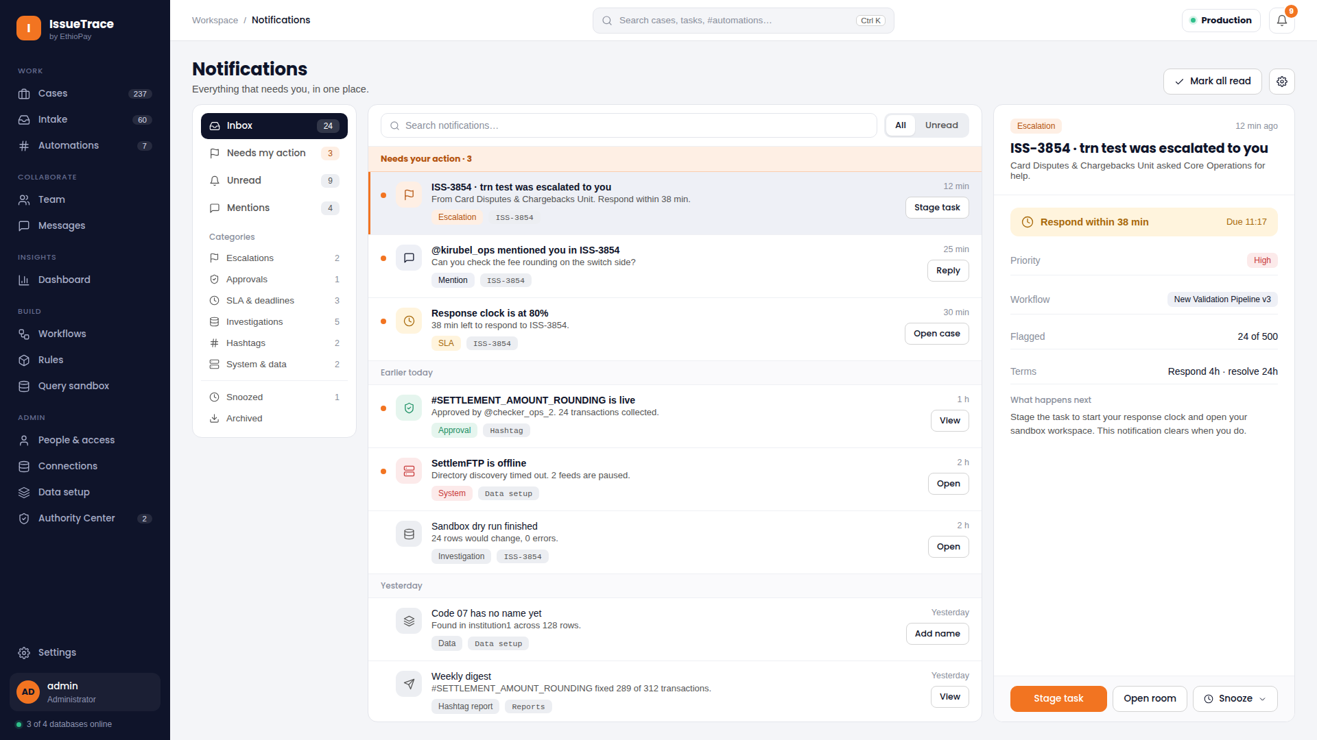
NOTIFICATION SYSTEM
Notification Center & Multi-Channel Alert Matrix
Real-time alert popover, dedicated full-page inbox, and granular preference controls
A comprehensive notification system ensuring operators and leads never miss urgent SLA breaches, mentions, or approvals.
• Top-Bar Popover & Full Center
Quickly review notifications via the header bell popover or dive into the full tabbed notification center.
• Filtered Categorization
Organized tabs: All Notifications, Unread, Mentions, SLA Alerts, and System Announcements.
• Granular Channel Preferences
Customize delivery channels (In-App, Email, Push) independently for each notification category.
• Immediate Deep Linking
Clicking any notification navigates directly to the relevant case, discussion thread, or approval review.
💡 USER ACTION GUIDE: Set SLA breach alerts to both In-App and Email in your Notification Preferences to guarantee rapid response times.

Slide 27
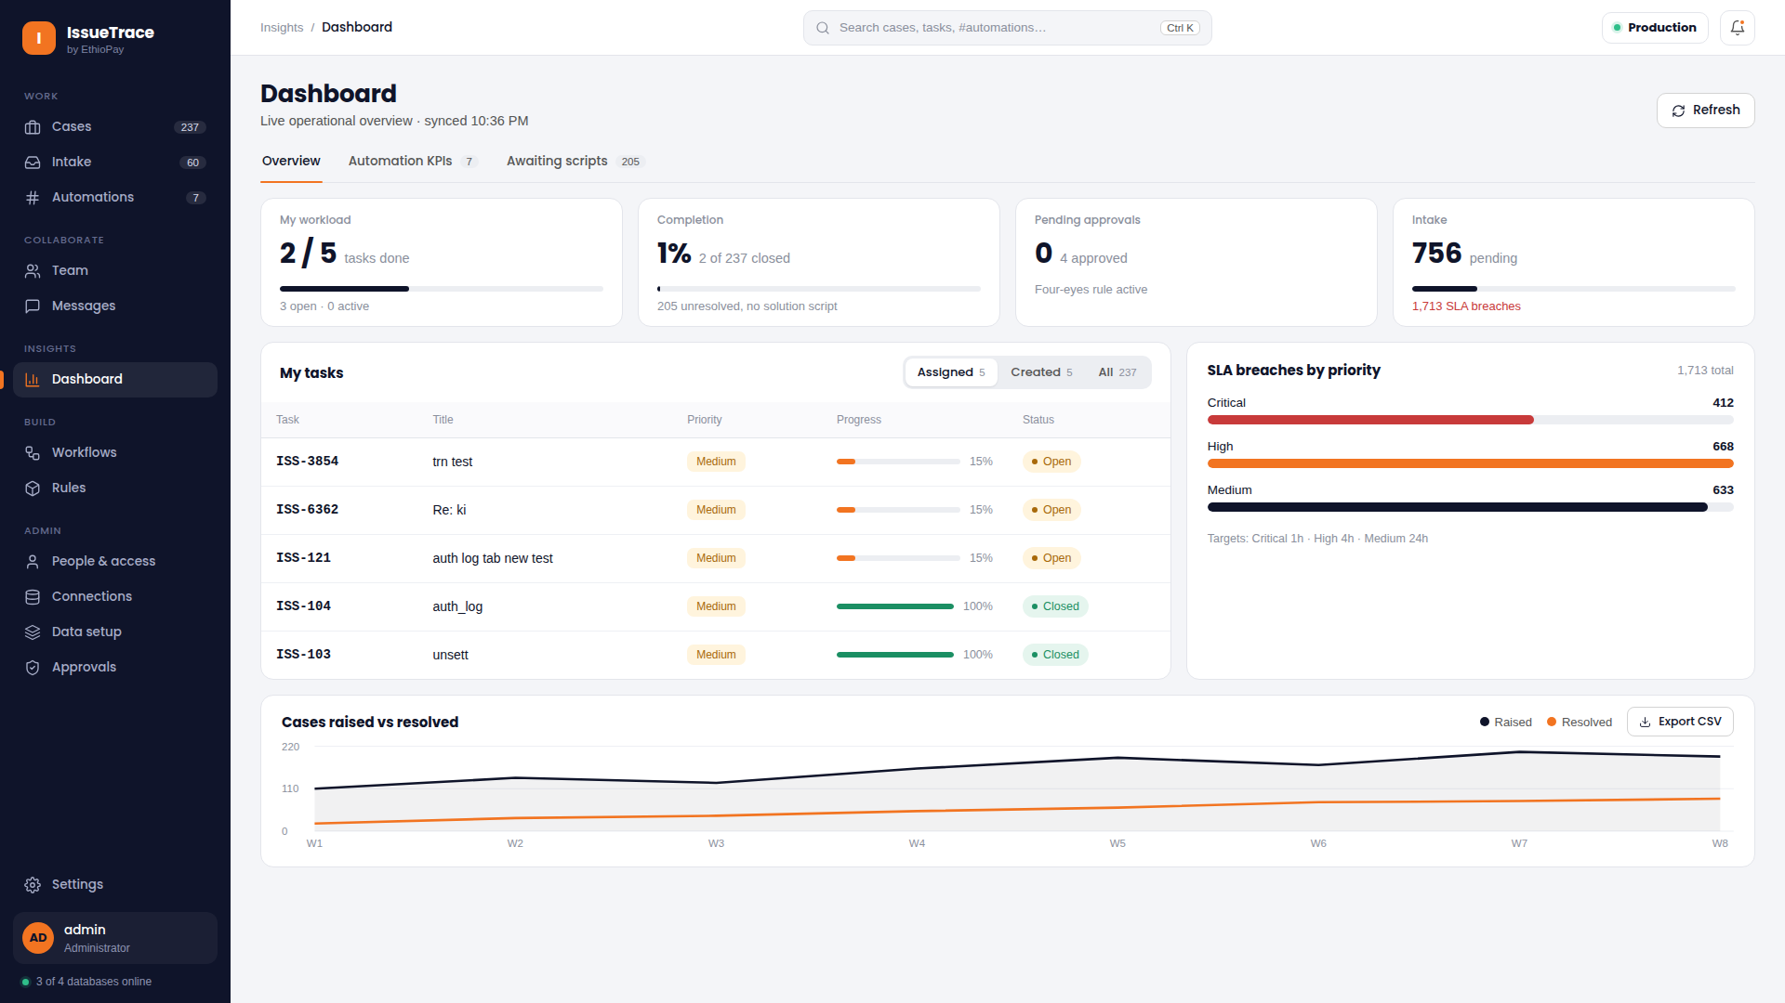
EXECUTIVE REPORTING
Managerial Dashboard & Executive SLA Analytics
High-level operational metrics, team throughput velocity, and reconciliation trends
Provides executives and operations heads with a centralized view of daily settlement volume, resolution velocity, and SLA adherence.
• Executive KPI Summary
Real-time metrics: Total Inbound Volume, Open Discrepancies, Resolved Transactions, and SLA Compliance Rate.
• Weekly Throughput Trends
Visual charts comparing incoming transaction volume against completed squad resolutions over time.
• SLA Risk Monitoring
Identifies aging cases at risk of breach, allowing management to reassign resources proactively.
• Regulatory CSV Export
Generate consolidated audit reports with a single click for financial regulators and internal compliance.
💡 USER ACTION GUIDE: Export the monthly summary report on the 1st of each month for executive leadership reviews and compliance filings.

Slide 28
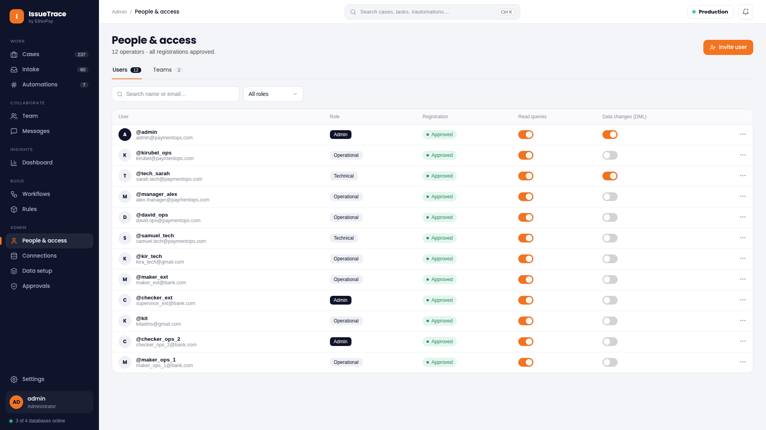
SYSTEM ADMINISTRATION
Enterprise Administration, RBAC & Connection Security
Granular role privileges, team connection isolation, and centralized OAuth 2.0 management
Ensures multi-tenant security and compliance through strict role-based access control, team isolation, and credential masking.
• Granular Role Permissions
Assign distinct roles (Admin, Operations Analyst, Technician, Checker, Read-Only Auditor).
• Team Connection Isolation
Database connections and mirror tables created within a squad are strictly isolated to authorized members.
• Centralized OAuth 2.0 Management
Enterprise credentials (Client ID, Secrets) are maintained centrally at Admin level with masked secrets.
• Audit Logging & Health
Live connectivity monitoring across database endpoints with real-time socket health and execution logging.
💡 USER ACTION GUIDE: Assign the 'Checker' role only to team leads and senior supervisors authorized to approve manual financial write-offs.

Slide 29
OPERATIONAL SUMMARY
Daily User Workflow & Reconciliation Best Practices
Standard operating procedure for back-office teams
1. Intake & Staging
Review Intake queue for external requests; verify morning SFTP file staging completed successfully.
2. Pipeline Validation
Execute visual DAG workflows against staged settlement files; monitor progress milestones in real time.
3. Discrepancy Review
Filter Operations Workspace for failed transactions; inspect row-level trajectory forensics in the drawer.
4. Compare & Resolve
Open two-level investigation; visually diff against core banking ledger; propose structured resolution.
5. Squad Collaboration
Use in-case chat (`@user`, `@@team`, `/create-escalate`) or escalation rooms for cross-team alignment.
6. Checker Sign-Off
Checker supervisor reviews proposed override in Authority Center; approves to commit final settlement.

