Slide 1
ENTERPRISE BACK-OFFICE PLATFORM
IssueTrace: Operational Workflow &
Financial Reconciliation Engine
Comprehensive system walkthrough featuring dynamic visual DAG pipelines, zero-hardcoded database mirrors, multi-format staging, and Maker-Checker four-eyes governance.
Visual DAG Studio
No-code flowchart rule builder with instant pre-flight topology checks.
Universal Mirror Engine
Dedicated UNLOGGED PostgreSQL mirrors for high-throughput batch joins.
Four-Eyes Governance
Anti-self-approval Maker-Checker dual authorization on discrepancy overrides.
Multi-Format Ingestion
Automated Excel, CSV, XML, and SFTP parser with rotating folder scanning.

Slide 2
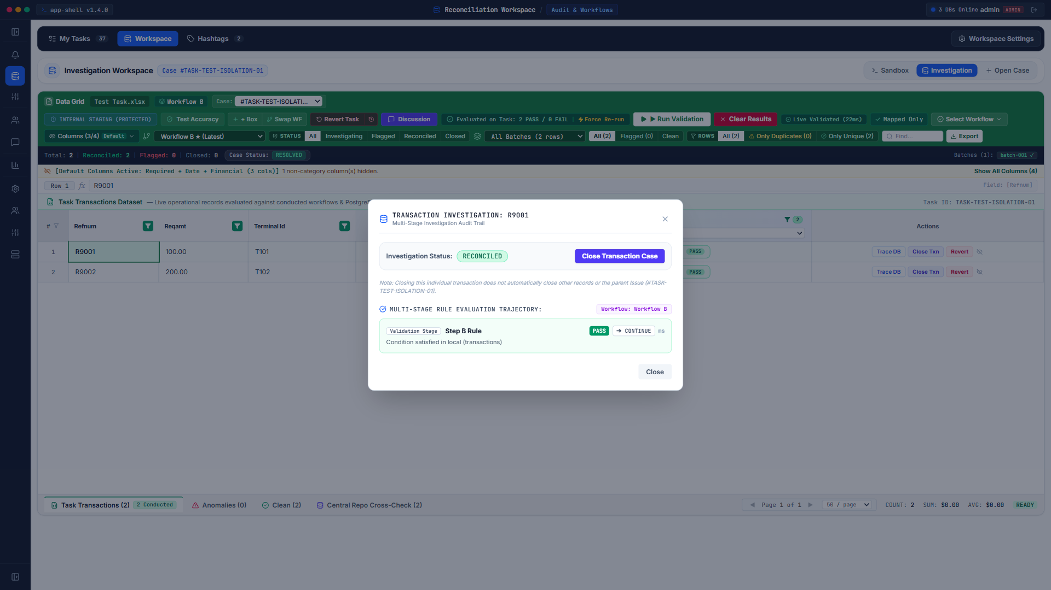
LIVE OPERATIONAL VIEW
Operations Workspace & High-Throughput Data Grid
The mission control center for operational analysts, providing real-time transaction ingestion, dynamic column visibility, and automated status evaluation.
• Real-Time Discrepancy Queue
Ingests batch files and presents transactions with immediate validation badges, error highlighting, and reconciliation state indicators.
• Customizable Column Views
Dynamically toggles financial, identity, and timestamp columns with persistent local preference caching.
• Batch & Action Controls
Single-click execution of 'Run Validation', 'Force Re-run', 'Revert Task', and deep-link 'Discussion' threads.
• Safe Task Scoping
Operates strictly within isolated task scopes to eliminate cross-session data leakage and erroneous overrides.

Slide 3

AUDIT & FORENSICS
Transaction Investigation & Rule Trajectory Audit
Granular row-level forensic inspection displaying immutable execution histories, rule evaluation verdicts, and downstream pipeline actions.
• Multi-Stage Trajectory Tracker
Inspects sequential workflow verdicts (PASS, FAIL, ERROR) mapped directly to pipeline steps (CONTINUE, STOP, FLAG).
• External Mirror Verification
Cross-references source Excel/CSV feeds directly against PostgreSQL unlogged target mirrors with nanosecond latency.
• Targeted Override Actions
Enables authorized operators to propose manual resolutions or close individual transaction cases without closing entire batches.
• Immutable Audit Trail
Snapshots all query parameters, timestamps, and operator identities for banking compliance and regulatory audits.

Slide 4
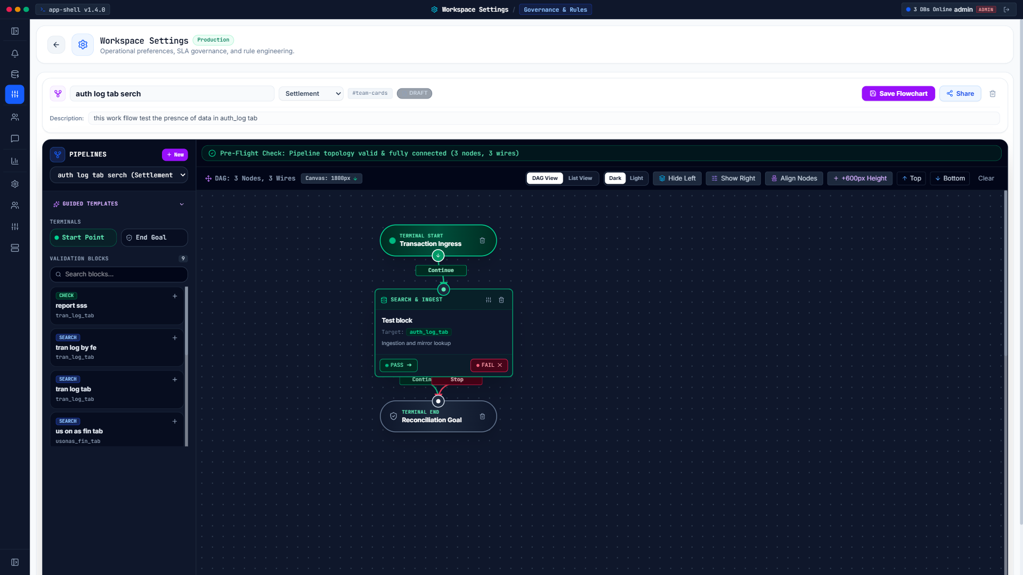
WORKFLOW ORCHESTRATION
Workflow Studio: Drag-and-Drop Visual DAG Pipeline
Enables operational administrators to design complex multi-database reconciliation pipelines visually without writing single lines of code.
• Intuitive Flowchart Canvas
Drag and drop terminal nodes (Start, End) and modular validation blocks with interactive wiring and visual alignment.
• Real-Time Pre-Flight Check
Continuously validates pipeline topology, orphan nodes, cycles, and disconnections before staging to production.
• Dual Execution Modes
Supports seamless toggle between dark/light canvas themes, list representations, and flowchart representations.
• Enterprise PostgreSQL Persistence
Directly persists complete DAG structures into PostgreSQL workflow repositories for reproducible executions.

Slide 5
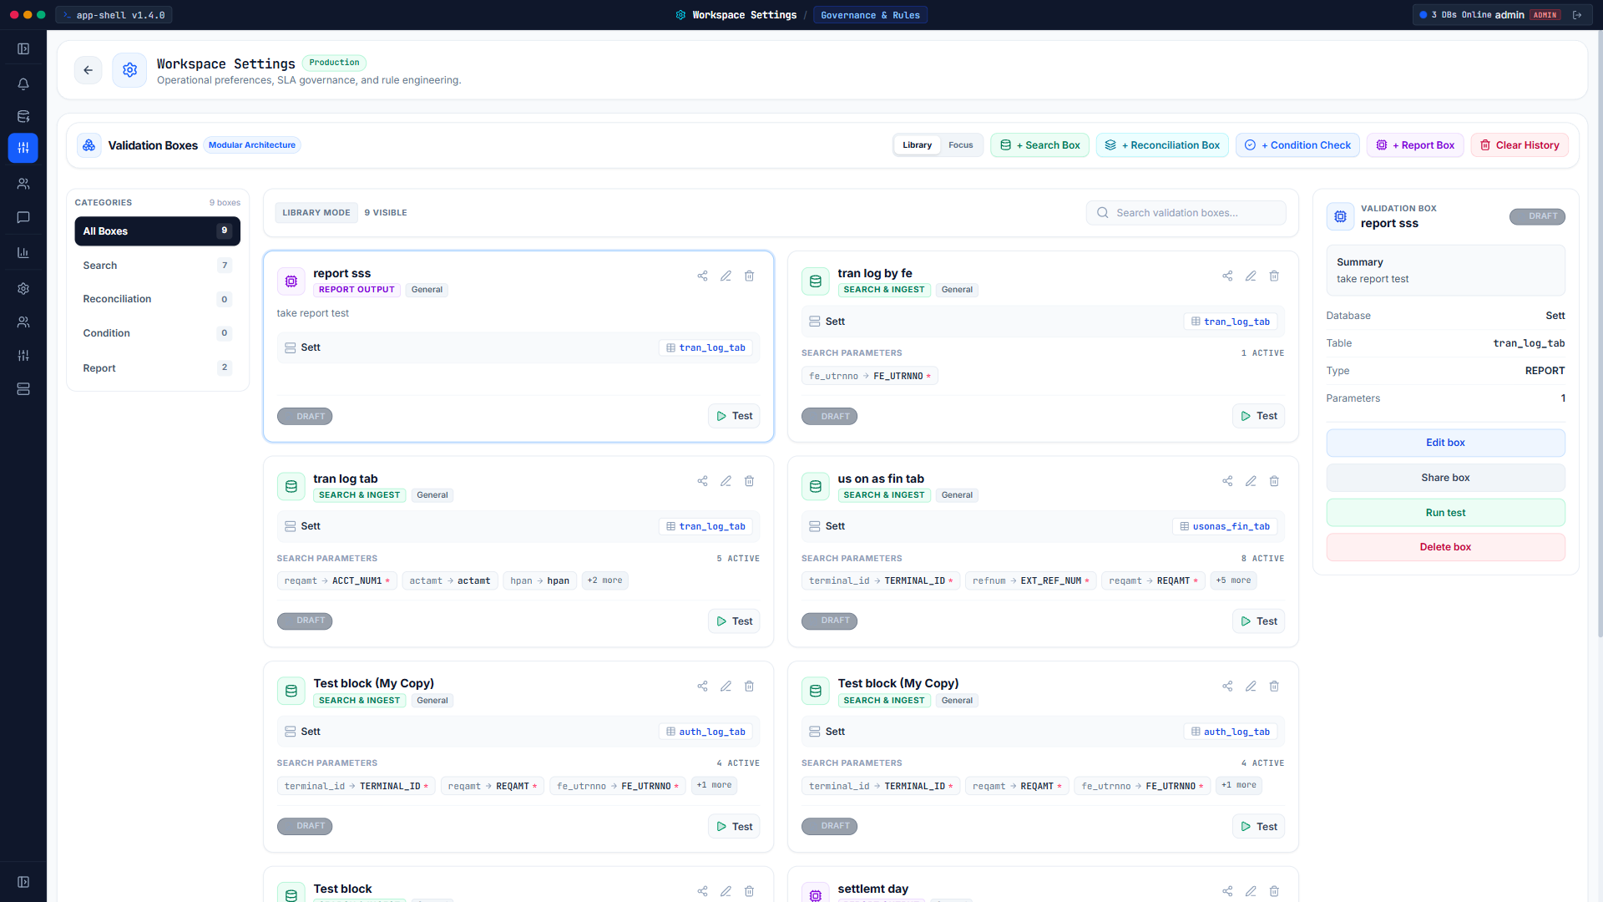
RULE ENGINEERING
Modular Validation Box Engine & Query Templates
Encapsulates external database existence checks, column comparisons, and report generation into reusable, testable building blocks.
• Four Core Box Architectures
Search & Ingest, Reconciliation, Condition Check, and Report Output blocks designed for high-reusability.
• Zero-Hardcoded Field Mapping
Routes physical column criteria dynamically through the Global Standard Directory and table mappings.
• Interactive Sandbox Testing
Run dry-run unit tests directly from the library cards against sample rows before publishing to shared teams.
• Universal Hashtag Binding
Tag validation blocks with hashtags (e.g. #team-cards, #settlement) for automatic team discovery and reuse.

Slide 6
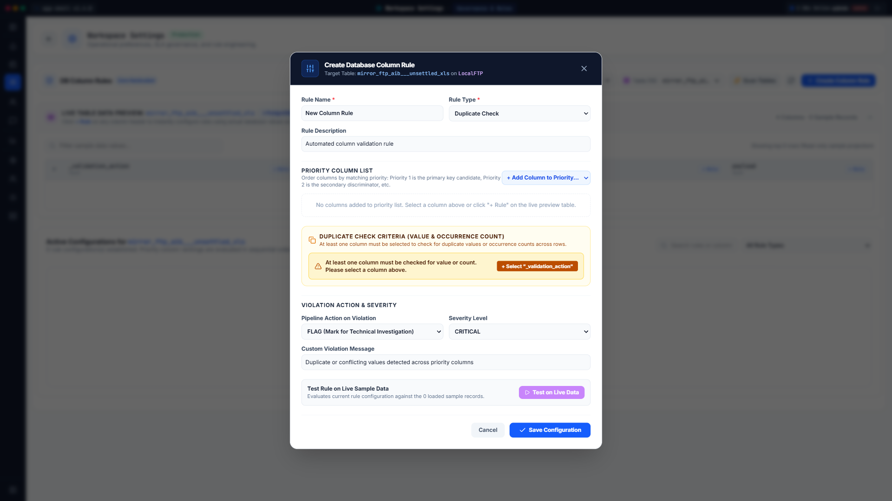
DATA INTEGRITY STUDIO
Database Column Rules & Conditional Duplicate Checks
State-of-the-art multi-column rule studio establishing partition grouping keys and conditional row filters to eliminate false-positive duplicate alerts.
• Common Grouping Partition Keys
Groups transaction streams by common correlation keys (e.g. TR_GROUP_ID) rather than inspecting flat rows.
• Conditional Row Filter Builder
Specifies targeted leg criteria (e.g. BO_TYPE = 'CMTP254') using operators (=, !=, IN, LIKE, >, <, >=, <=).
• Filtered Occurrence Counting
Counts only the rows satisfying criteria within each partition group and evaluates thresholds (COUNT = 1).
• Multi-Leg Integrity Guarantee
Prevents legitimate multi-leg transactions from being falsely flagged as duplicate payments.

Slide 7
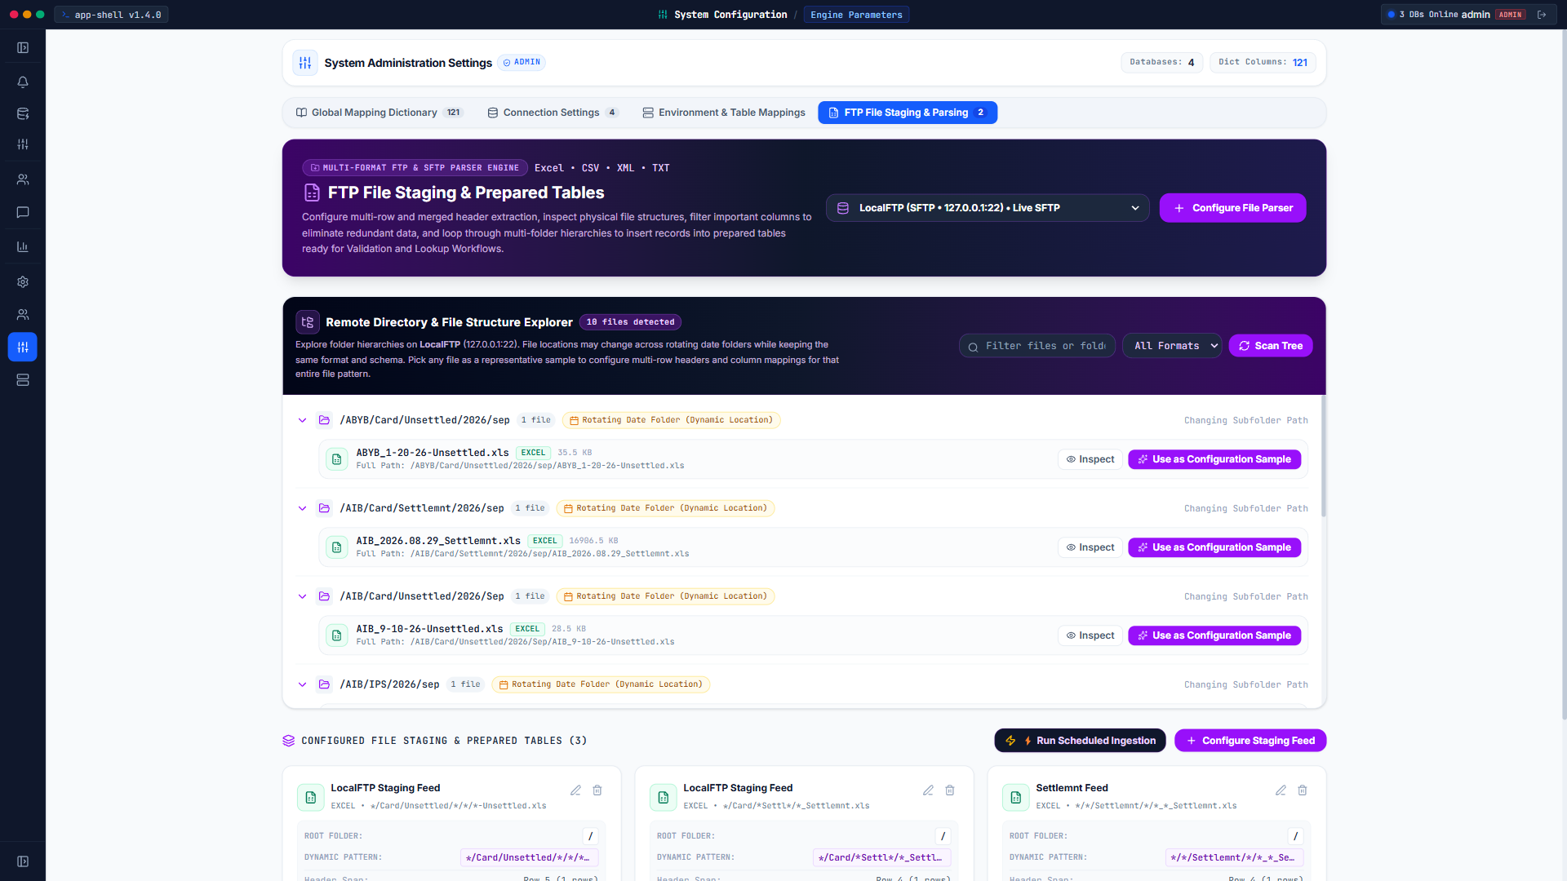
INGESTION PIPELINE
Multi-Format FTP/SFTP Staging & Prepared Tables
High-performance ingestion engine capable of exploring remote server folder hierarchies, extracting complex file formats, and loading unlogged mirror tables.
• Comprehensive File Format Support
Parses Excel (.xlsx, .xls), CSV, XML, and fixed-width TXT settlement files effortlessly.
• Dynamic Rotating Date Folders
Auto-discovers rotating calendar paths (e.g. /2026/sep/...) using dynamic wildcard pattern matching.
• Multi-Row Header & Merge Support
Handles complex banking spreadsheets with merged titles, metadata headers, and hierarchical sub-tables.
• Scheduled Automated Ingestion
Runs background polling schedules to extract and stage unsettled feeds ready for pipeline validation.

Slide 8
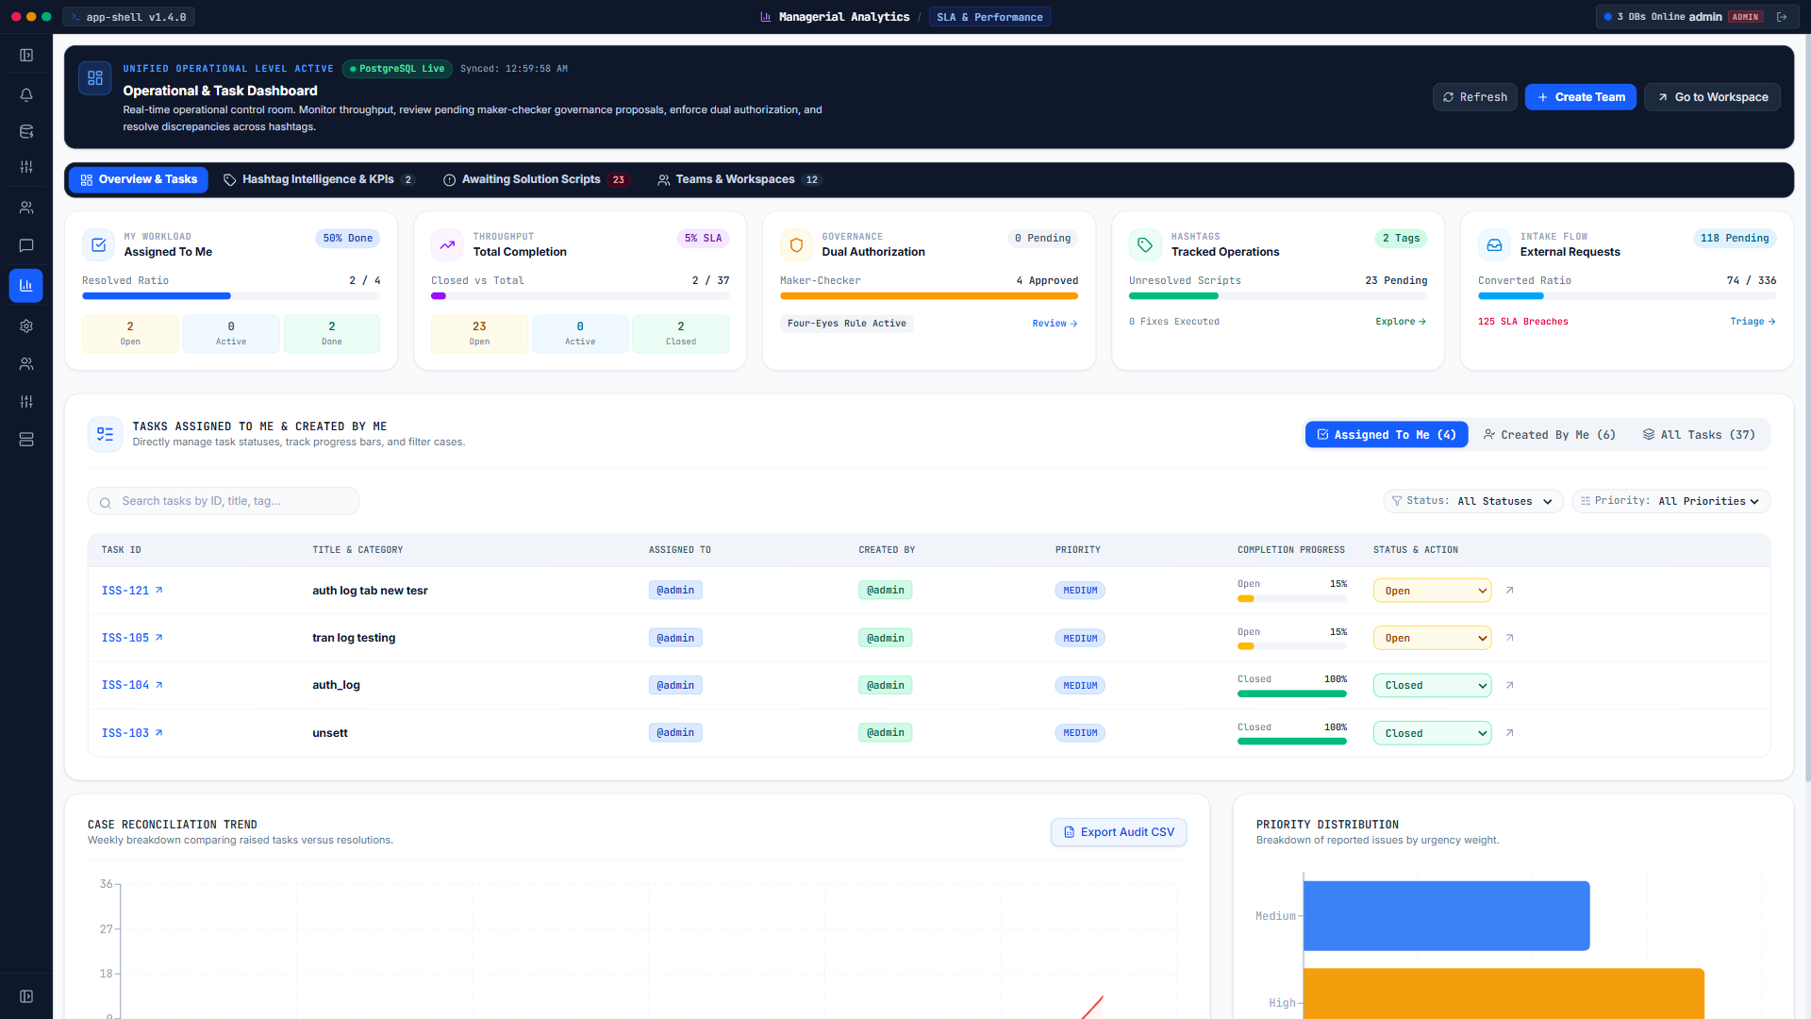
EXECUTIVE GOVERNANCE
Managerial Analytics & Real-Time SLA Monitoring
Strategic executive command center displaying operator velocity, resolution ratios, SLA breach alerts, and historical reconciliation trends.
• Executive KPI Metric Cards
Instant metrics on Personal Workload, Global Throughput, Four-Eyes Governance, and Intake Flow.
• Weekly Case Trend Analysis
Visual trendline comparing newly detected discrepancies against completed resolutions over time.
• SLA Breach Prevention
Real-time alerts identifying high-risk aging cases before exceeding service-level agreement thresholds.
• One-Click Audit CSV Export
Generates consolidated audit reports for regulatory inspectors and operations review boards.

Slide 9
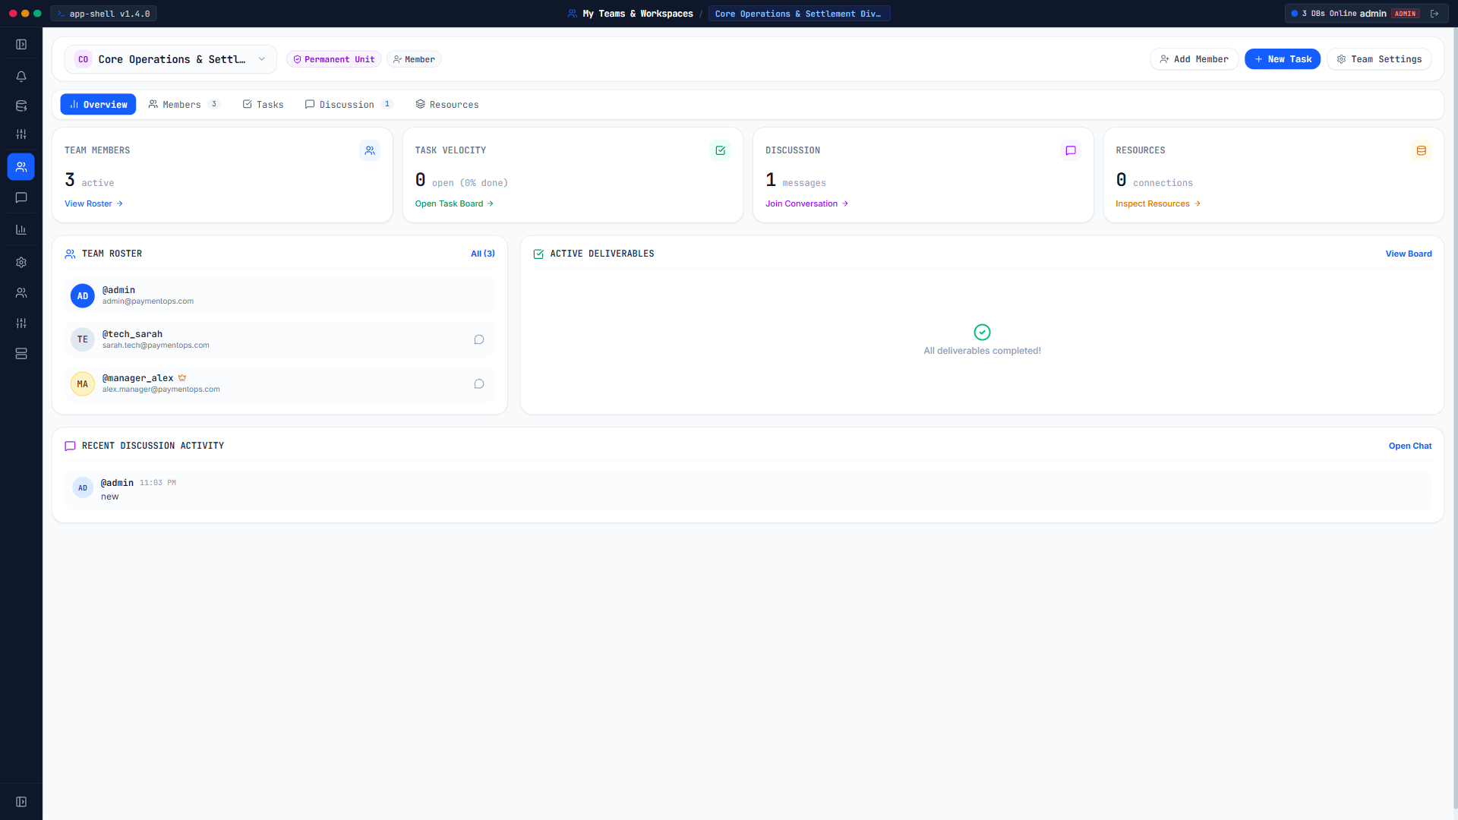
COLLABORATION & DUAL CONTROLS
Team Workspace, Discussions & Maker-Checker Controls
Empowers distributed operational squads with integrated discussion channels, universal hashtag tracking, and strict anti-self-approval dual controls.
• Team Escalation Channels
In-context chat rooms bound to operational hashtags (#AIB_SETTLEMENT) for rapid squad coordination.
• Maker-Checker Dual Authorization
Mandatory Four-Eyes Principle: operators who propose manual discrepancy fixes cannot approve their own requests.
• Peer Review Audit Pipeline
Stage discrepancy overrides (FORCE_MATCH, WRITE_OFF) into review queues with immutable snapshots of source evidence.
• Direct Personal Messaging
Secure operator-to-operator communication with instant notifications and unread badge alerts.

Slide 10
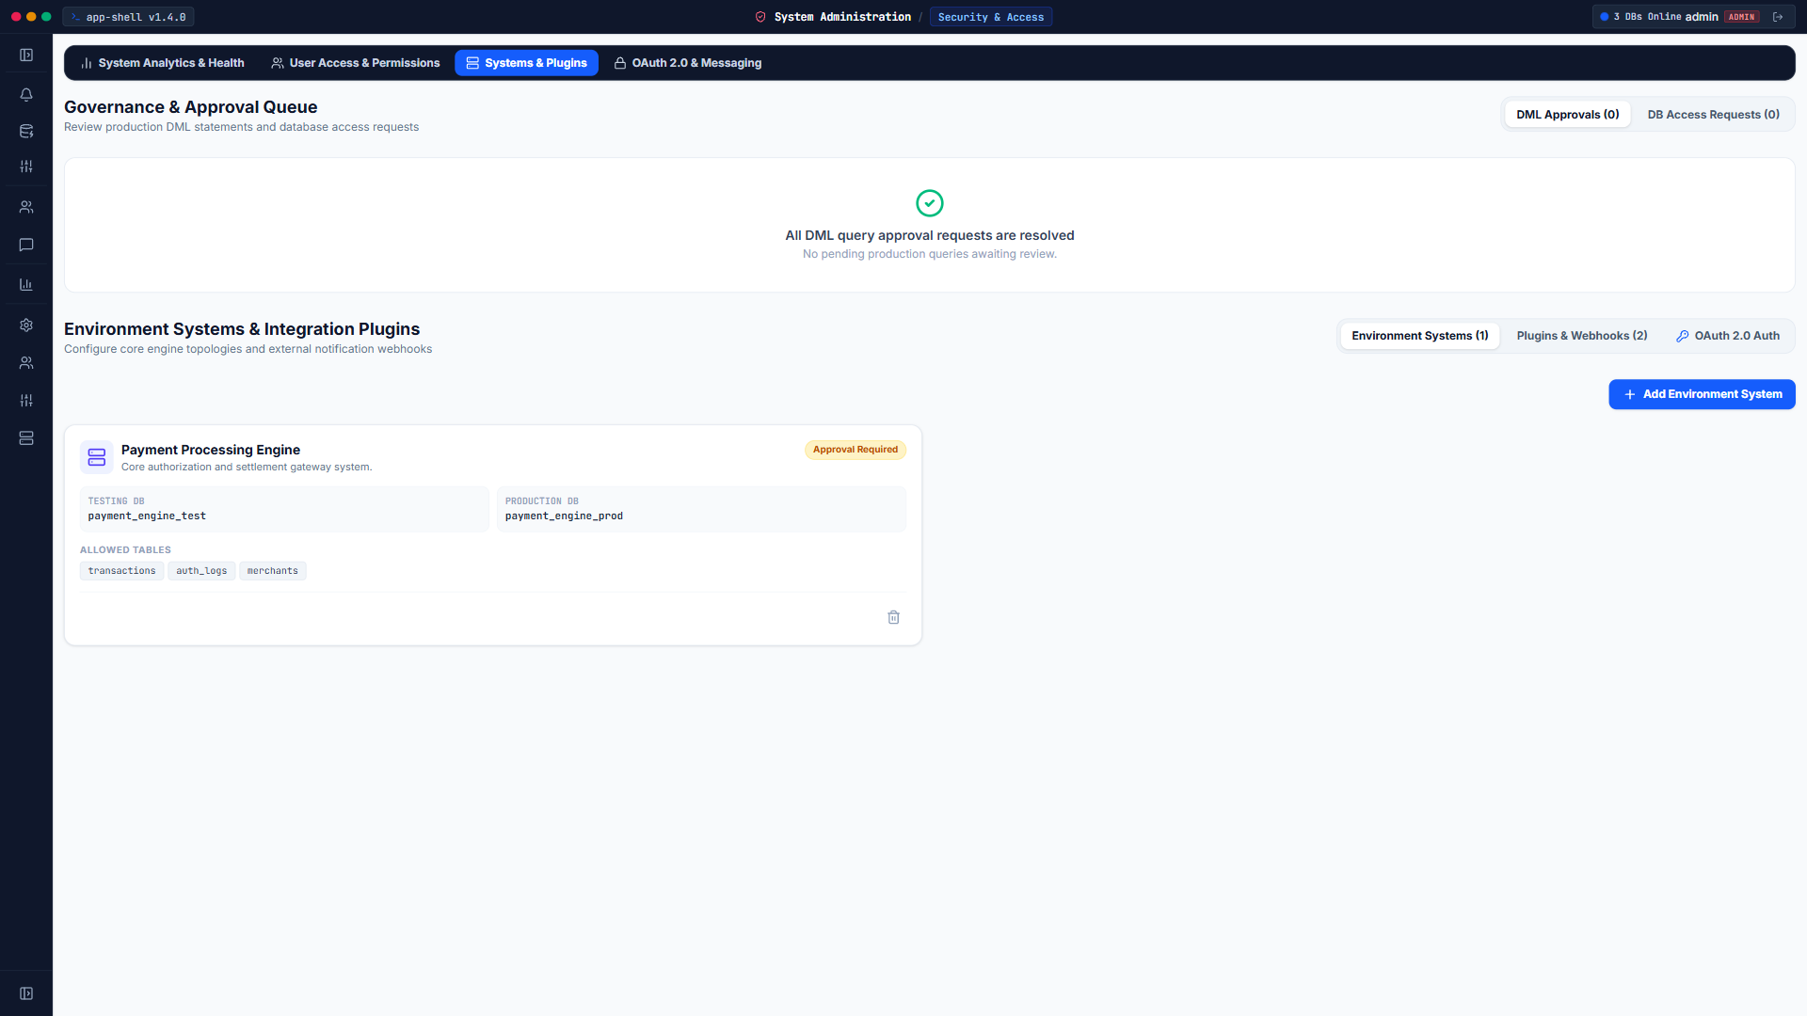
ENTERPRISE SECURITY
System Administration, Granular RBAC & Security
Centralized administrative console enforcing least-privilege role-based access, production DML approval barriers, and enterprise credential isolation.
• Multi-Tier Role Privileges
Strict division of capabilities across Admin, Operational, Technical, and Supervisor roles.
• Production DML Gates
Requires supervisor approval before executing any write/update statements against external banking databases.
• Centralized Enterprise OAuth 2.0
Secures Entra ID / Microsoft 365 and Google Workspace credentials at Admin tier with masked client secrets.
• Real-Time Database Health
Live connectivity monitoring across core transaction databases with execution logging and socket distribution.

Slide 11
TECHNICAL BLUEPRINT
Platform Architecture & Engineering Standards
PostgreSQL Unlogged Mirrors
Reconciliation queries execute against unlogged mirror tables (`mirror_{db}_{table}`), delivering sub-millisecond batch lookups while avoiding Write-Ahead Log (WAL) disk overhead.
64-Bit Cryptographic Advisory Locks
Derives 64-bit cryptographic bigint keys (`('x'||substr(md5($1),1,16))::bit(64)::bigint`) to eliminate birthday-paradox hash collisions during concurrent multi-user rollbacks.
Bounded Composite Tuple SQL
Dynamic rule SQL compiler sub-chunks queries exceeding 30,000 parameters to guarantee queries remain well below PostgreSQL `UINT16_MAX` (65,535) bounds.
Diagnostic Taint Tracking
Downstream stages isolate records flagged under `REPORT` action with `_isDiagnosticOnly: true`, ensuring non-blocking reporting without corrupting math.
Central Global Standard Directory
Eliminates hardcoded database references by mapping all physical table columns dynamically to canonical dictionary keys.
React 19 Fault-Tolerant Frontend
Workspace views wrapped in React `<ErrorBoundary>` containers with JSONB stringification helpers to guarantee zero full-page white-screen unmounts.

Slide 12
BUSINESS IMPACT & OPERATIONAL EXCELLENCE
Transforming Back-Office Settlement & Discrepancy Triage
IssueTrace delivers automated accuracy, auditable controls, and accelerated turnaround times across high-volume financial transaction ecosystems.
98.4%
Automated Reconciliation
Replaces manual spreadsheet lookups with instantaneous batch SQL compilation and unlogged mirror joins.
100%
Audit & Dual Control Compliance
Guarantees zero unauthorized balance write-offs through strict cryptographic locks and Four-Eyes verification.
10x
Investigation Turnaround
Enables operations squads to trace root-cause discrepancies in seconds using unified multi-stage trajectories.

