Slide 1
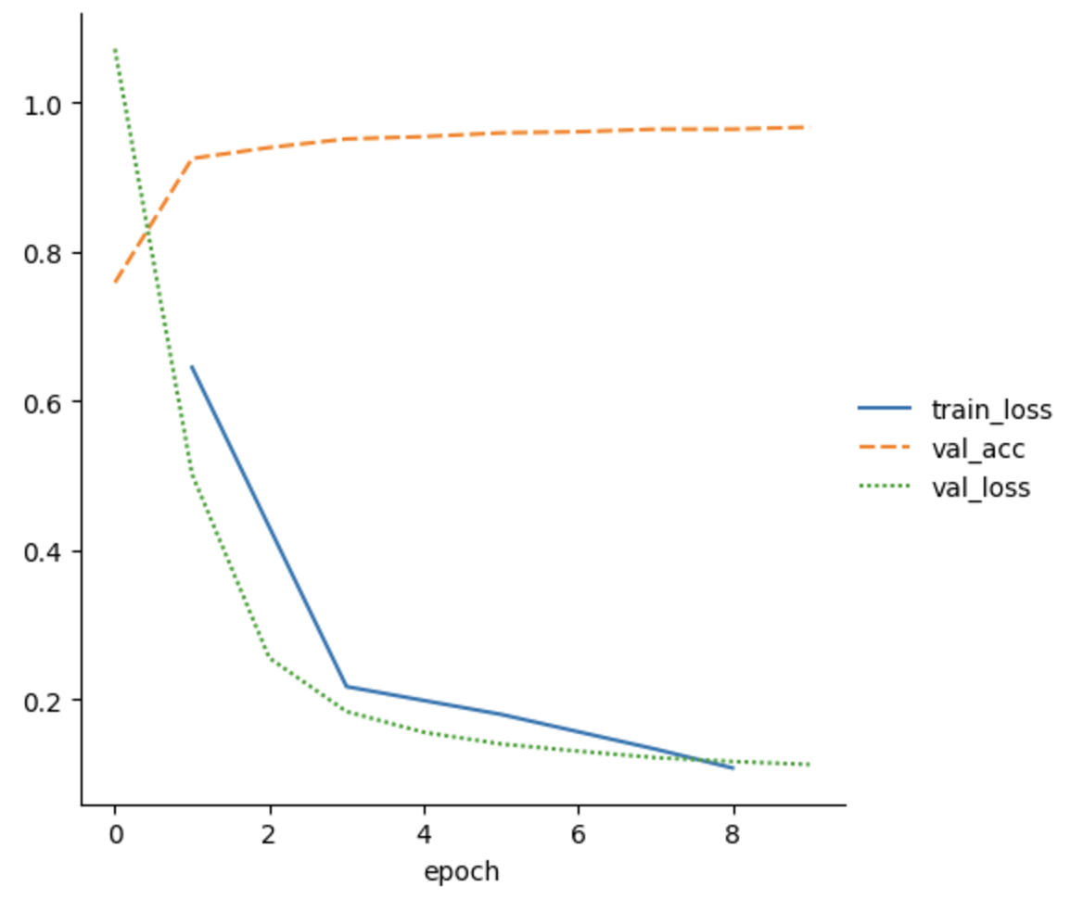
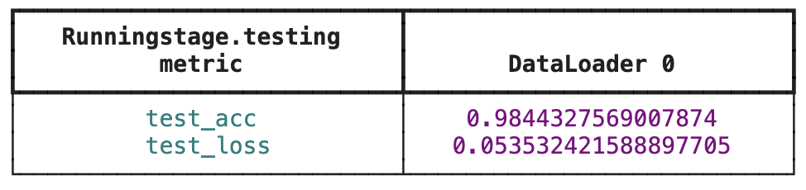
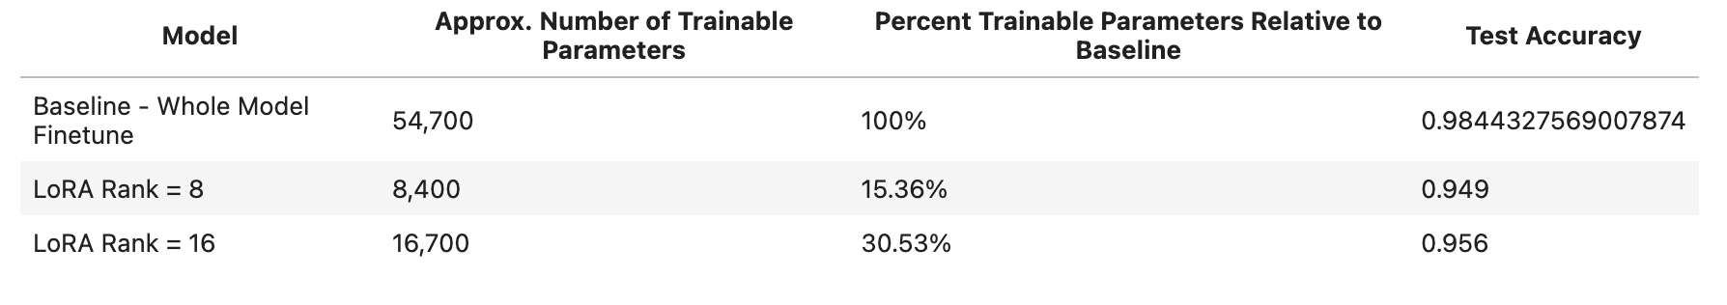
Problem Set
Pre-train a MLP for image classification
Only use 5/10 classes as training set
Fully fine-tuning the model using the remaining training examples
Use LoRA to fine-tune the model
Compare difference

Slide 2
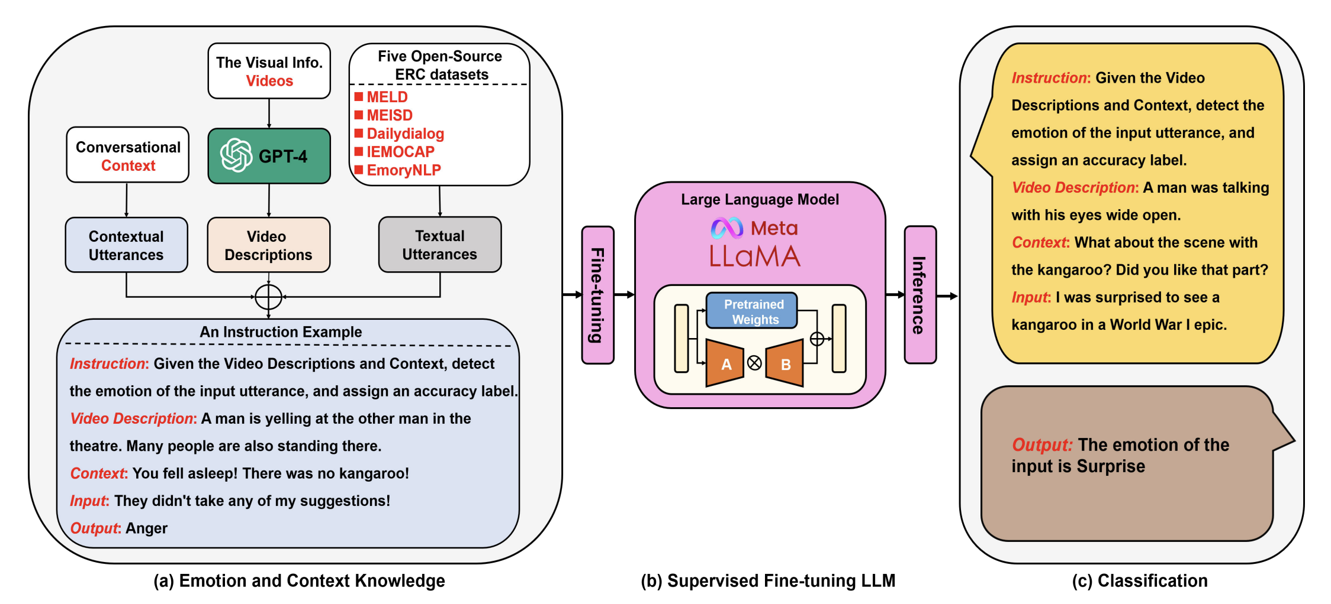
Other Application -- NLP
Emotion recognition
Text classification
Role recognition
Program repair
Text-to-SQL

Slide 3
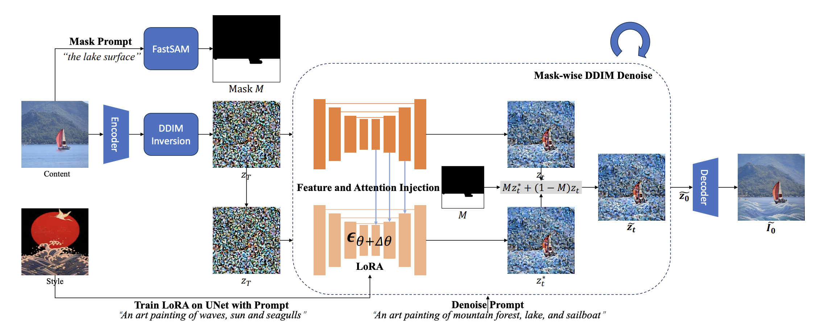
Other Application -- CV
Image generation
Image style transfer
Text-to-image generation
Image segmentation

