Slide 1
SAMPAGUITA RESIDENCE HALL
GENERAL ASSEMBLY
PLAN OF ACTIVITIES
First Semester, A.Y. 2026-2027

Slide 2
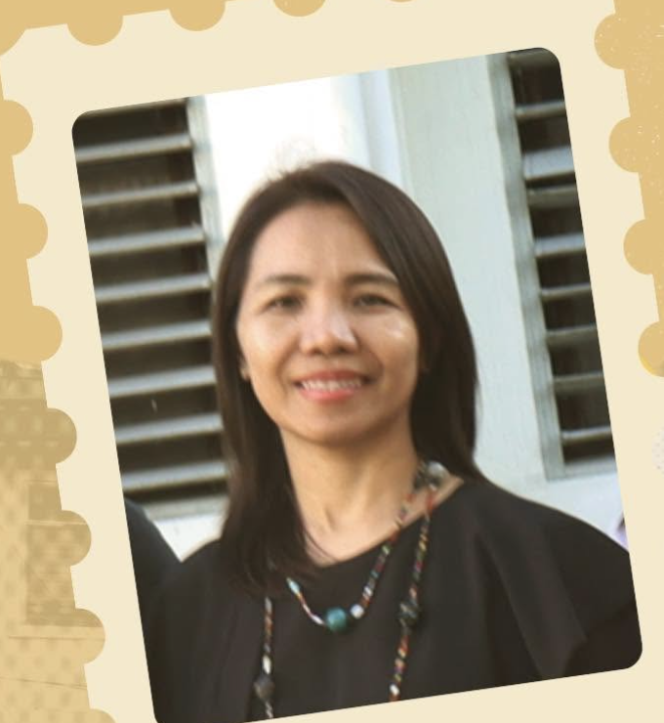


ADMINISTRATION
DORM MANAGERS & HOUSEPARENT
DORM MANAGER
Ma'am Len
OIC / DORM MANAGER
Ma'am Zay
HOUSEPARENT
Ma'am Gen

Slide 3
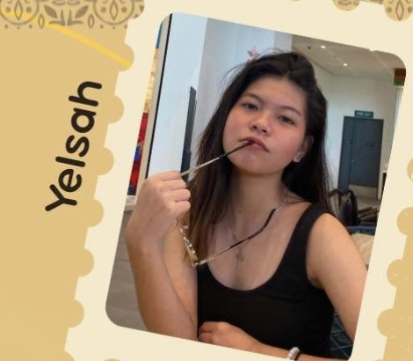
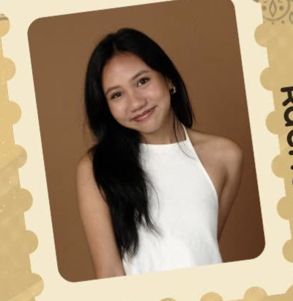
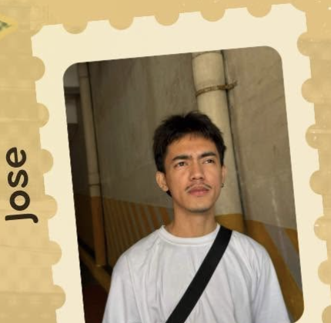
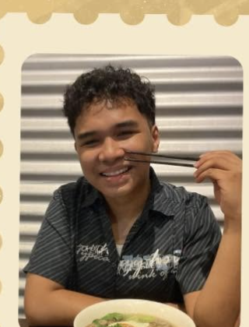
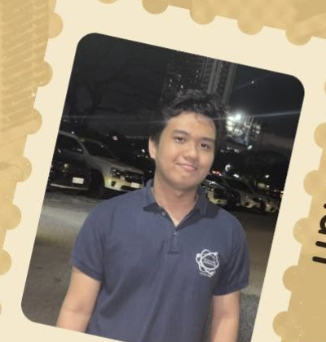
YOUR SA TEAM
STUDENT ASSISTANTS
SA
Yelsah
SA
Rachel
SA
Jose
SA
Ash (GA1 Head)
SA
Matt

Slide 4
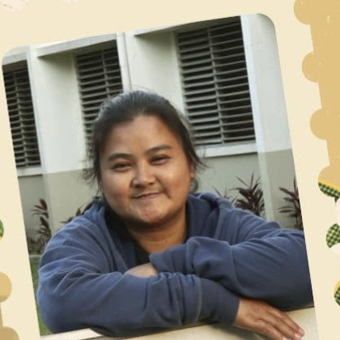
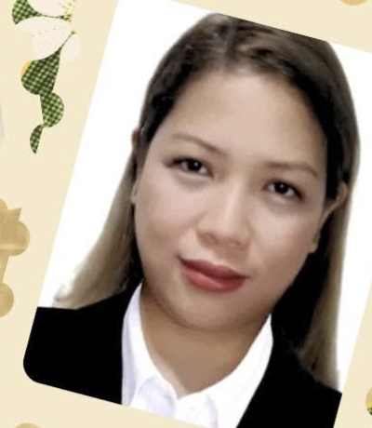
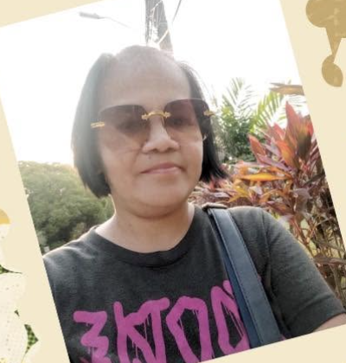
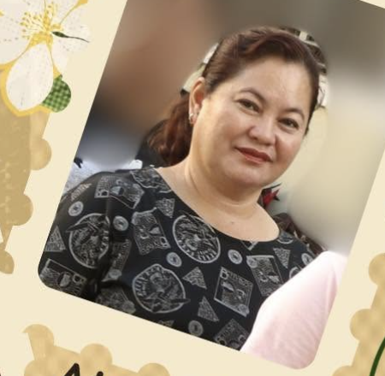

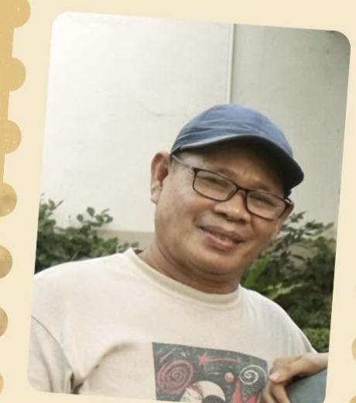
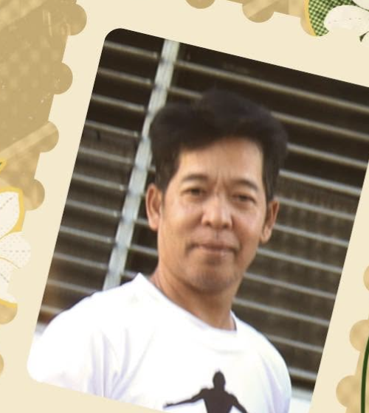
SUPPORT TEAM
OFFICE & MAINTENANCE STAFF
Ate Rhea
Ate December
Ate Feny
Ate Tere
Kuya Bagyo
Kuya Dani
Kuya Emong

Slide 5
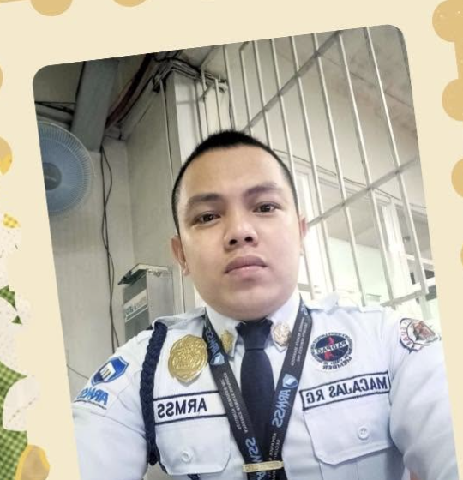
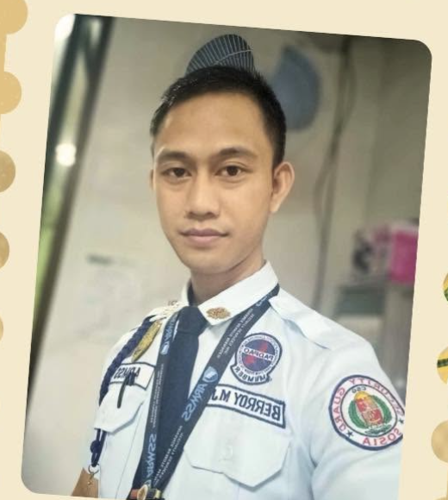
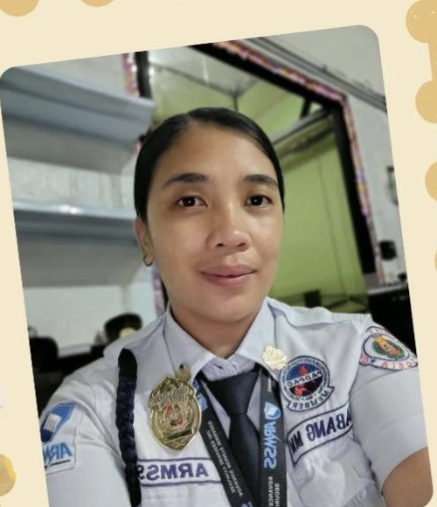
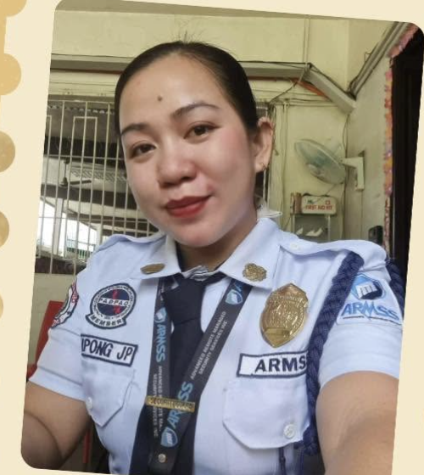
PROTECTORS
SECURITY PERSONNEL
SECURITY GUARD
Kuya Nard
SECURITY GUARD
Kuya Julius
SECURITY GUARD
Ate Jen
SECURITY GUARD
Ate Joh

Slide 6
OVERVIEW
PLAN OF ACTIVITIES OVERVIEW
01 GA1 / AKWE
Date: Aug 31 - Sep 4
Tag: SPIDER-MAN THEME
02 HALLOWEEN WEEK
Date: Oct 19 - Oct 23
Tag: HORROR THEME
03 GA2 / YEAR-END
Date: End of Semester
Tag: CELEBRATION
04 ADDITIONAL EVENTS
Date: Semester-Long
Tag: SPECIAL PROJECTS

Slide 7
EVENT 01
GA1 / AKWE: DETAILS & DECOR
EVENT METADATA
• Event Head: Ash
• Target Window: August 31 to September 4 (Poll deadline Aug 31; choices Sept 1-3)
• Design Theme: Spider-Man
VENUE DECOR & MATERIALS
• Banderitas: Red, blue, white, and black crepe paper theme.
• Web Designs: White yarn webs across venue (reusable for Halloween).
• Accents & Photo-booth: Spider-Man printouts taped with banderitas + photo setup.

Slide 8
GA1 FEATURE
INTERACTIVE BULLETIN BOARD
BOARD PROMPT:
"If you were to be forgotten by everyone, what will be the first thing that you will do?"
EXECUTION & INCENTIVES
• Materials: Masking tape, bond paper squares, markers.
• Dormer Incentive: Free candies provided!
• Process: Dormers answer the prompt on paper squares as they fall in line for GA registration.

Slide 9
GA1 PROGRAM
PROGRAM & ACQUAINTANCE PARTY
GA PROGRAM FLOW
• Welcoming Remarks
• Special Performer
• Interactive Game (Hero/Spider-Man)
• Presentation Deck Walkthrough
PARTY GAMES & PRIZES
Games:
- Animal Sounds Team Finder
- Balloon Pop
- Charades Relay
- 1-2-3 Go Game
Prizes:
- Candy, Tsitsirya (snacks)
- Dorm Essentials (noodles, panlaba, canned goods)

Slide 10
EVENT 02
HALLOWEEN PARTY WEEK
DATE: October 19 - October 23 | THEME: Horror
SAMPA-SPECIFIC ACTIVITIES:
• Interactive Bulletin Board: Prompt: "What's your horror story?"
• Outdoors Movie Night: Open-air film screening
• Open House & Collaboration: Possible Sampa x Kamia Halloween Night collaboration
• Design-Your-Own-Room / Corridor Contest: Spookiest room decor competition
• Photobooth & Performers: Dedicated photo setup and live entertainment

Slide 11
EVENT 03
GA2 / YEAR-END PARTY
DATE: End of Semester | THEME: Year-End Celebration
PLANNED HIGHLIGHTS:
• Low-Cost Exchange Gift: White Elephant style gift swap
• Bingo Night: Classic dorm bingo with prizes
• Year-End Assembly: Wrap-up celebration & recognition

Slide 12
SPECIAL EVENTS
POSSIBLE ADDITIONAL EVENTS
MENTAL HEALTH WEEK
Theme: Mental Health & The Arts
• Big canvas-style bulletin board
• Chalk Art activity zone
• Coloring pages & creative crafts
GAME NIGHTS
Concept: Corridor Wars
• Tournament Style weekly game nights
• Corridor/Floor competitive format
• Cumulative prize at end of month

Slide 13
DORM GUIDELINES
DAY TO DAY LIVING REMINDERS
ELECTRICAL DECLARATION
Declare all brought electrical items:
• Electric Fans & Desk Lamps
• Laptops, Desktops, Printers
• Cellphones & Tablets
STUDY & COMMON AREAS
• Meals in study area discouraged; light snacks allowed.
• Observe strict cleanliness at all times.
• Be mindful of gadgets & valuable personal belongings.

Slide 14
ACTION ITEMS
NEXT STEPS & POLL DEADLINE
IMMEDIATE ACTION ITEMS:
1. GA1 Date Poll: Deadline August 31 (Choices: Sept 1-3).
2. Material Sourcing: Crepe paper, yarn, tape, and printouts.
3. Prize Procurement: Candy, snacks, and dorm essentials.
OPEN FLOOR FOR QUESTIONS & SUGGESTIONS!

