Slide 1

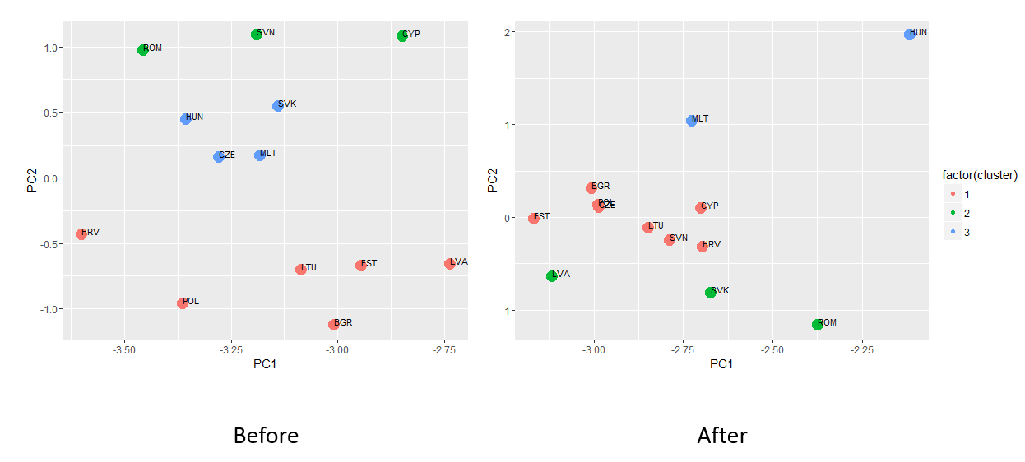
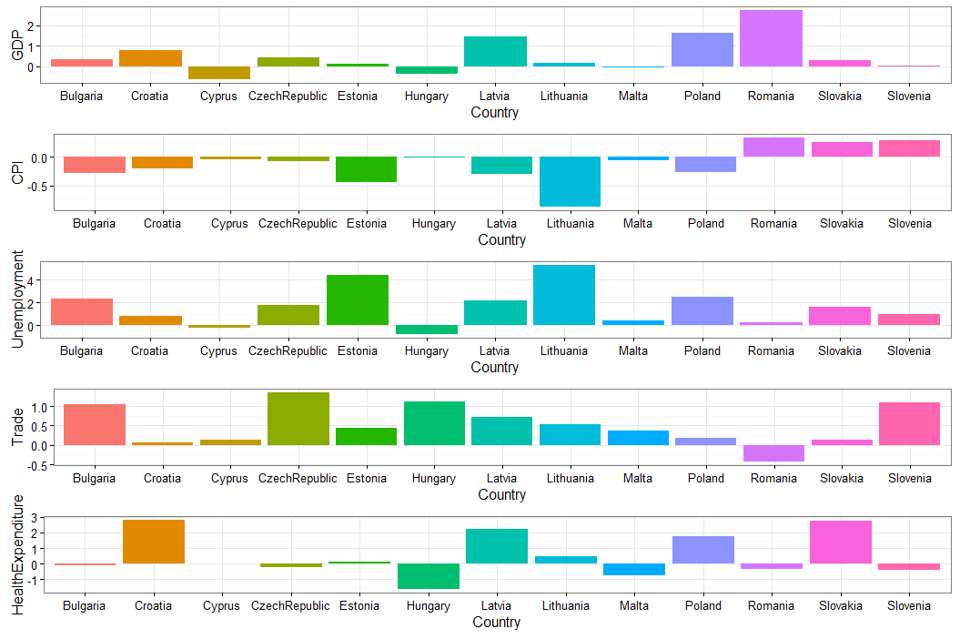
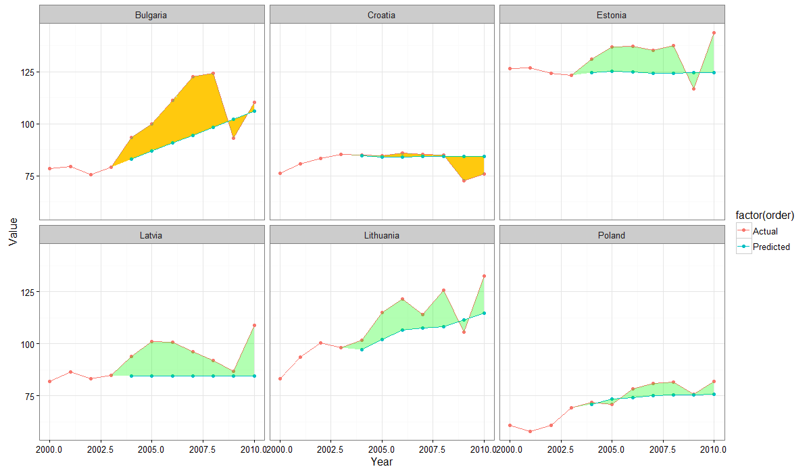
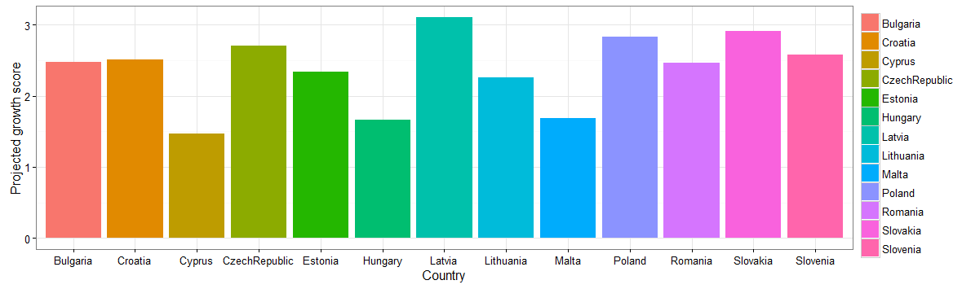
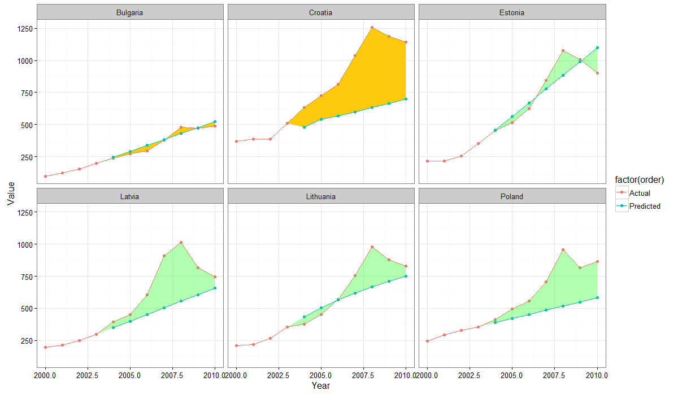


Analysis of Development Indicators of Selected European Union Countries
By Anton Yeschenko (Software Engineering) and Kerwin Jorbina (Software Engineering)
ABSTRACT
METHODS
RESULTS
In 2004, there are 10 countries that ascended into the European Union. In this project, an analysis on the countries will be done to see if there is a tremendous change in the selected development indicators when they joined the group.
Although, there are other factors for growth or decline in these indicators such as the global financial crisis in 2008 and different political influences, this project will assume that part of its growth was due to its inclusion in the union.
To analyze the changes, different methods were performed in the historical data acquired. Specifically, this study used clustering methods and intervention analysis techniques. Furthermore, the same methods will be performed for the data of those regarded as comparable countries (those which joined the EU later on) to see if such growth is really contributed by the European Union.
We used the k-means clustering algorithm to know which cluster a country belong based on the values of its yearly growth of the development indicators. For every indicator, the growth is normalized so that each indicator will have the same weight. The Principal Component Analysis (PCA) is also used to find strong patterns and correlation in the derived data. The output data from this method then is fed to the said clustering method.
To show how indicators will behave, a cutoff point in 2004 was chosen, and the indicators were projected in the following years. Regression and extrapolation methods couldn’t be used in here due to time dependency, thus, an intervention time series analysis, particulary ARIMA (AutoRegressive Integrated Moving Average) model was used instead.
After prediction, the new country growth coefficients were calculated (as the difference between actual and predicted, in 2004-2008). These values are used for “after” clustering.
Lastly, the projected growth scores are calculated, to see which countries grew the most out of expected rate.
This is the cluster of the countries below and after 2004.
BACKGROUND
Projected growth scores for all countries based on selected indicators. The scores are given in such a way that the higher its value, the better it performed.
It is presumptive that joining the European Union will bring benefits to a country such as labor and free movement of the citizens. However, one nation must able to comply with the Copenhagen Criteria which contains rules on the eligibility to join the European Union. Thus, changes are already made in the countries before officially joining the union.
This study on the other hand would like to analyze the contributing effects of officially joining the European Union given the following development indicators:
Gross Domestic Product (GDP)
Consumer Prices Index (CPI)
Unemployment Rate
Trade (% of GDP)
Health expenditure per capita (current US$)
Will the name of being part of the European Union tremendously affect these countries? This is with the assumption that there is no other critical factor that would introduce such change in the growth or decline.
The countries chosen were those that joined the union in 2004. The countries that joined later such as Croatia, Bulgaria and Romania are also included to compare how these 10 countries grow relatively with the change.
RESULTS
Trade in 2000 - 2010 years, predicted versus actual, comparison for similar countries, based on clustering “before”, cluster 1.
The yellow color is used for countries that weren’t part of 2004 EU enlargement
Overall Projected growth scores. Who beat predictions the most?
Health expenditure in 2000 - 2010 years.
OBJECTIVES
The goal of this project is to visualize the growth of the countries that joined the European Union in 2004 and compare it to those who joined later. In here, we would like to answer the following questions:
Did officially joining the EU in 2004 helped the 10 countries?
What country has the most non-trivial growth after 2004 using prediction methods from its historical data from 1995 to 2004?
Which cluster based on the growth of the development indicators does a country belong before 2004?
Which cluster based on the relative growth of the development indicators does a country belong after 2004?
CONCLUSIONS
Upon analysis on the results, it can be said that officially joining the European Union did not have a big impact on the indicators selected as the countries that joined later have almost the same growth as them.
It can also be said in the results that Latvia grew the most based on the scores given from finding the difference of the predicted against the actual growth.
It can be said that the growth before 2004 was more or less based on its geographical position. However, there are a bit of changes in the clusters after 2004 as the countries that were reported to have gained most came from different clusters before.
https://github.com/yesanton/EU_development_indicator_analysis

