Slide 1
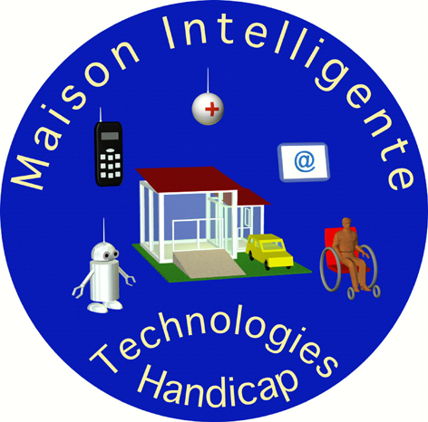
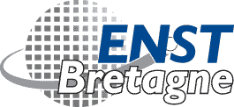
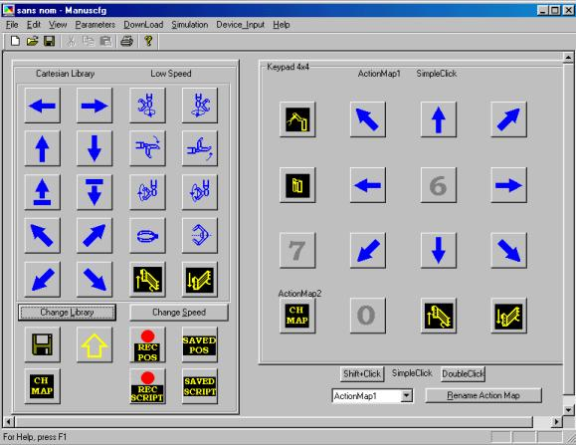
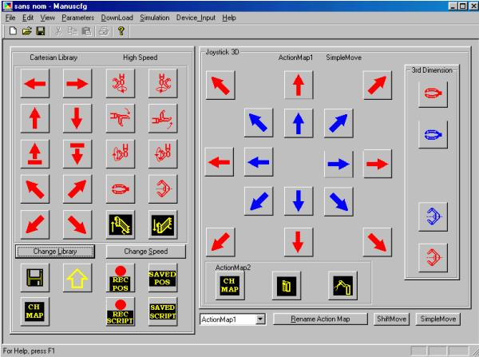

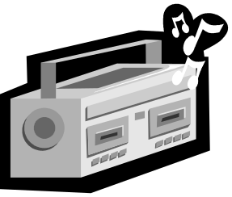
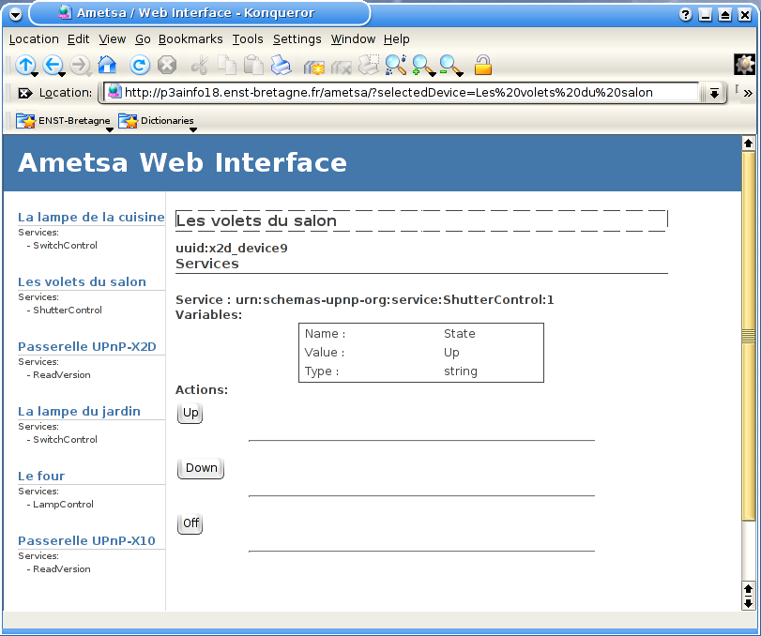
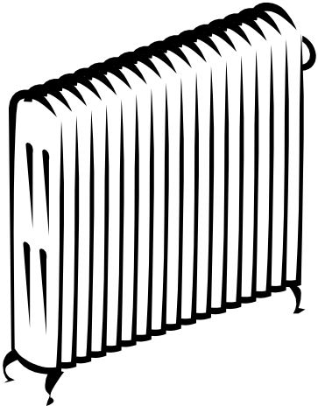



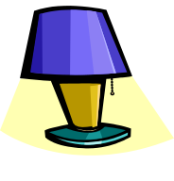
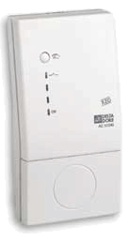
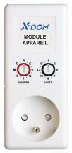
Smart homes & communication
Smart Home project:
Innovated Action financed by GET &
Louis Leprince Ringuet Foundation
S.I.D. / ENST Bretagne Goal
Development of generic tools allowing interconnection of home communication protocols and IP (Internet Protocol).
S.I.D. Project
Goals: “Services Innovants pour personnes Dépendantes” project (S.I.D.) aims at proposing new services to improve integration of impaired people.
Partners: SIADV Laval, C.H.U. Brest
Team:
Partners: ENST Bretagne, Télécom Paris, and INT
Associated partners : AFM, Garches Hospital, SIADV Laval
intra-info/enst-bretagne.fr
André Thépaut | Thibaut Billon
Jean-Yves Floch | Arantza Plazaola
Ronan Keryell | Jerome Poichet
Maria-Teresa Segarra
Jerome Kerdreux
Audio
Feedback
Generic Home Control Platform
Ametsa Core
Remotely-accessible representation
of the UPnP Objects.
Created by the Object Mapper depending
on information from the UPnP Objects Manager.
Java HMI
CORBA Objects
CORBA Protocols
Object Mapper
UPnP-X10
Gateway
Device
Web
Interface
UPnP
Objects
UPnP Objects
Manager
UPnP-X2D
Gateway
Device
Actions
Events
Announce
Discovery
UPnP Protocols
HTTP
UPnP-RC5
Gateway
Device
UPnP Stack
Ametsa UPnP Control Point
Object-oriented representation of current available devices.
Created by the UPnP Objects Manager depending
on information coming from the UPnP stack.
UPnP Technology
Peer-to-Peer local network connectivity of intelligent appliances, wireless devices, and PCs.
Based on Internet standards (HTTP, IP, SOAP, XML).
Functionalities
Device discovery.
Device search.
Events subscription.
Commands/actions sending.
Components
Control Points
Send commands to UPnP devices.
Manage UPnP devices.
Devices
Execute actions on real devices.
Services
Device functionalities.
Accessible by executing actions.
CORBA
Standard architecture for open distributed object computing.
Hides distribution and implementation language heterogeneity.
Ametsa Control Point
Subscribes to all available UPnP devices.
Receives actions from users and sends them to the corresponding devices.
UPnP Stack
Based on the UPnP specifications.
Receives announces from UPnP devices.
Manages subscriptions to UPnP devices.
Sends commands/actions to UPnP devices.
Ametsa Core
Maintains an object-oriented view of current available devices.
Provides infrastructure to allow remote access to UPnP objects.
Communication Protocols
PLC, Radio: X2D, X10
Protocols to control electrical units.
Need special receiver and modem units
Receivers should be configured (unique address).
Modem is connected to a computer serial port.
Infrared: RC5
Standard protocol for infrared data communication.
Mostly used on hi-fi and TV devices.
UPnP Gateways
Built as an UPnP device.
Embed an UPnP device per physical device to be controlled.
Translate UPnP actions into the corresponding protocol.
UPnP
Objects
UPnP Objects
Manager
RS232 Serial Line
X2D/X10 Modems
Actions
Events
Announce
Discovery
Power Line Communication (PLC)
HTTP
X2D Receiver
X10 Receiver
UPnP Stack
ICOST 2003 , September 24 –26, 2003
1st International Conference On Smart homes and health Telematics
" Independent living for persons with disabilities and elderly people "
  Maria-Teresa Segarra, Ronan Keryell, André Thépaut

