Slide 1
Compiler and System Techniques for SoC distributed accelerators
J. Cambonie, S. Guérin, R. Keryell, L. Lagadec
B.Pottier, O. Sentieys, B. Weber, S. Yazdani
Speaker : Bernard Pottier

Slide 2
Framework
An organization of reconfigurable units (RU) in a System on Chips is
  Modular and Scalable
  Flexible, and easy to compose
RU1
RU2
IP2
IP2/3
We are studying:
Balanced coarse/fine grain RU architectures
Local ‘low level’ tools/compilers
System behaviour
HL compiler support (GP intensive computations ?)
IP1
CPU
(ref. SCORE project, UCB)

Slide 3
Author affiliations
Architecture
Low level tools
Architecture synthesis
STMicroelectronics CR&D Berkeley and AST Grenoble
  J.Cambonie
UBO
  L. Lagadec
  B. Pottier
  S.Yazdani
ENST-Bretagne
  S. Guérin
  R. Keryell
  B. Weber
IRISA/R2D2
  O.Sentieys
(+ V.George)

Slide 4
Summary
Architecture
System interface
Physical tools
Compiler interface

Slide 5
I. Architecture

Slide 6
Overview of a Mixed Grain Architecture
network
Interface and node control
Tile organization
  Ram banks
  Address sequencers
  Arithmetic array
Seq
Ram
ALU
X-i
FPGA
mail
Box,
Fine grain eFPGA
Block
Config.
Configuration support
Interface and steering logic
interconnect
Conf.
Mem.
Configuration loader
(8 rows)

Slide 7
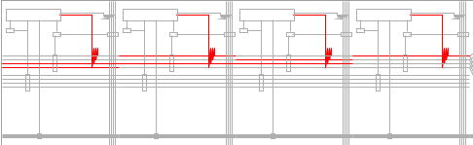
Architecture details:RAM
Ram per tile
  4 x 256 bytes dual ported to CPU address space
  Configurable connection into the tiles:
    2 horizontal and vertical data bus
    1 address bus
    1 control bus
  Direct external R/W access from network transactions

Slide 8
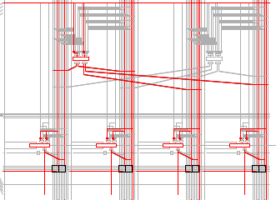
Architecture details: arithmetic
Arithmetic / tile
  4 x 8 Bits cascadable ALU slices
  2 x 16 Bits multipliers
  registered

Slide 9
Architecture details:eFPGA
Embedded FPGA (M2000)
  Equivalent of 15 K Xilinx gates per unit, x 2
Reconfigurable interconnect
  Tile address, control and data bus, one side (#120x8)
  eFPGA 350 signals, other side
Tiles
eFPGA

Slide 10
Architecture details: Configuration
network
Interface and node control
Configuration memory
  1Mbits Dram
2 stage configuration using a configuration manager
  Write specified adresses into the configuration memory
  Load configuration bit ranges to RAM, arithmetic or eFPGA … or save configurations
Seq
Ram
ALU
X-i
FPGA
Block
Config.
Conf.
Mem.
Configuration loaders

Slide 11
Mailbox support (input)
network
Target port
  Demultiplex to internal devices
  Propagate data to devices
  Generate signals from configurable tables
Target port
Control+data
Obj. Id
Op. Code
Data
Command
generation
Signal
generation
(control points)
Target part
(arithmetic,
eFPGA,
ram)

Slide 12
Mailbox support (output)
Initiator port, inversely:
  Monitor signal transitions
  Multiplex from internal devices
  Generate network messages from configurable tables

Slide 13
II. System interface

Slide 14
System Integration
Soc ips
IP1
IP2
IP3
controller
Cross bar bus
Steering logic
rgv
rgv
mailbox
Process 1
Process 2
Fine grain (state machines)
Coarse grain
Configurable logic block

Slide 15
Receiving messages
One word at a time
  Name a target, or group of targets using object-ids
  Send one data word to RAM, eFPGA, arithmetic bank
Packet based
  A start/stop mark enable local automata to process messages of unknown size

Slide 16
Sending messages
Transform low level event into high level messages
  Monitor internal event from fine grain control automata
  Generate messages automatically based on tables
  Act as a hardware to software interface

Slide 17
Process Organization
Local status
At least two options:
Direct mapping of a computation graph flow,
Overlapped input/output and computations, with possibility of on-the-fly reconfiguration
Distributed or centralized application control
network
Interface and node control
Seq
Ram
ALU
X-i
P1
Block
Config.
P1: input DMA
P2
P4
P2: processing
P3: output DMA
P3
P4: pipeline task control+signaling
Conf.
Mem.
Configuration loaders

Slide 18
III. Physical mapping
(process based)
(for LUT based synthesis and physical tools,
refer to our previous Samos2/3 papers)

Slide 19
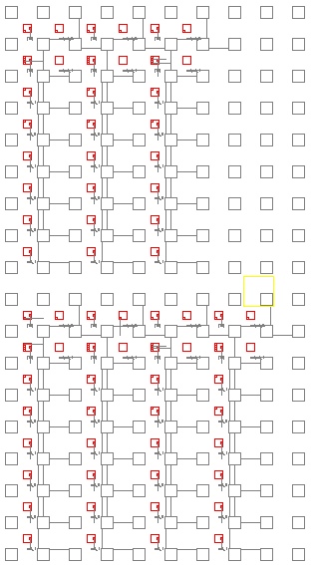
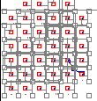

Fine grain tools
Application
architecture
Composing and
physical organization
OO code
Function/FSM
description
Compiler and
Technology synthesizer
Device
modeling
Grammar and
Physical tools

Slide 20
Medium grain tools
Homogeneous with fine grain tools
  Architecture description
  Place and route approach (channels and signals)
Connectivity with eFPGA using X interface
Operation graph
description
Compiler and
Technology synthesizer
Device
modeling
Grammar and
Physical tools

Slide 21
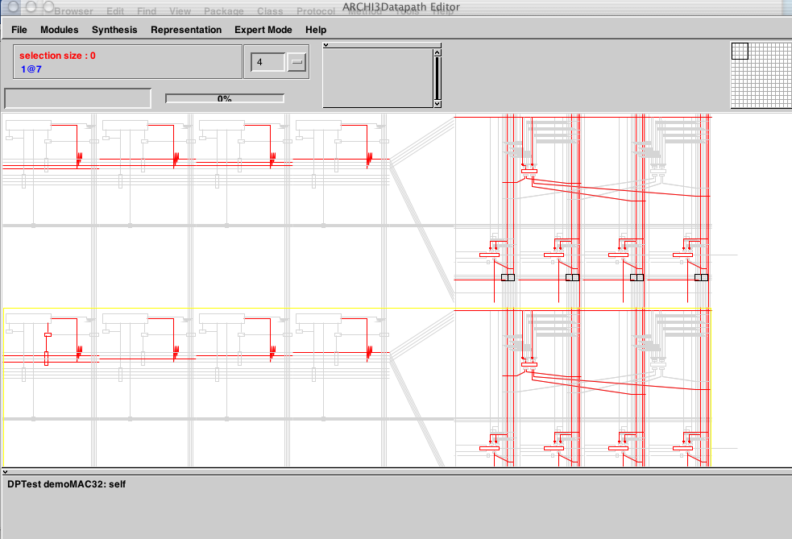
Low level architecture description, macro programming

Slide 22
IV. Compiler interface

Slide 23
Motivation and techniques
Need tools for :
  rapid prototyping
  Input close to algorithmic programming
  Trying to keep expressiveness for the designer
Generating code suitable for the Madeo back-end programming model
Multi-threaded control program
Heterogeneous hardware accelerators, programmable or not.

Slide 24
As an example: PIPS tools
Source-to-source code restructurer (École des Mines de Paris since 1988)
Linear algebra framework: many things represented as integer polyhedra
Precise semantics analysis: predicates on integer variables, various data dependence graph,...
Many different analysis and transformation phases to compile, optimize, restructure,...
Cope with interprocedurality and big programs.
Functions can deal with hardware hierarchy
Supercomputer techniques in a SoC compiler

Slide 25
Compiler flow characteristics
C or Fortran PIPS parser
Optimizations and transformations express needed parallelism
  Fine grain parallelization for SIMD or vector like operators
  Coarse grain parallelization to express task parallelism
Static complexity evaluator estimate the hardware cost
Hardware part is isolated in a new separate function
  Control flow is replaced by finite state machines
  Data-flow is computed according to PIPS polyhedral array region to generate bus movement
Prettyprint the source for Madeo hardware generation
C or Fortran generated for simulation

Slide 26
V. Work status & conclusion
Architecture: being fabricated, (2 units = 14mm2, 0.13µ ST)
Low level tools:
  arithmetic + ram modeled,
  Coarse grain P&R possible under programmer control
  Fine grain : tools working, (but not for M2000)
Compiler interfaces (PIPS & BSS)
  Generates control automata suitable for low level tools
  Operation graph automatic, P&R not implemented
Attractive project, a number of issues!

Slide 27
Thanks.

Slide 28
rssi
Micro controller
- System config
- FIFO sync
- Datapath reconfiguration
- DSP procedures
1
AD
CIC
Shaping
FIFO
Preamble detect
6
CORDIC
Timing estimate
Freq offset estimate
4
FFT+ bit reverse
Channel estimate
Configuration for a 802.11a compatible receiver with turbo decoder and bit loading
2
Equalizer
Tracking phase
+ channel
Soft demapper
2
5
3
Turbo decoder
Depuncturing
STBL bus connection
Soft connection
2
Descramble
(1)Analog interface
(2)Configurable datapath
(3)Block encoder
(4)FFT processor
(5)DeMapper
(6)Cordic processor
DMA
MAC processor

Slide 29
Operation modes: control
External process can:
  Reset the unit
  Write configuration memory
  Load configurations to devices
  Receive and emit messages, including synchronisation
    To and from different threads

