Slide 1
Data Flow
Desktop
www.google.com
Internet Service Provider
www.google.com
Domain Name System Server
(DNS Server)
172.217.163.164
172.217.163.164
172.217.163.164
HTML
172.217.163.164
HTML
Internet
HTML
Google Server
(172.217.163.164)

Slide 2
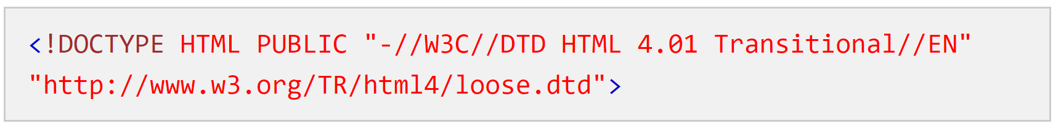
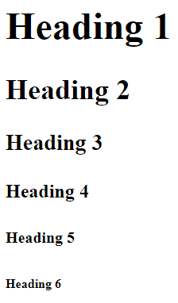
About hello.html
Denotes HTML Version 5
<!doctype html>
<html>
<body>
<h1>Hello World!!</h1>
</body>
</html>
Document Root
Document content that will be shown in the browser
Heading Tag. h1 to h6

Slide 3











World Wide Web & HTML
1991
1952
12 Countries
CERN
Nuclear
Research
Tim Berners Lee
1980s
Hyper Text Markup Language
Version 1.0 released in 1995
HTML is a Specification Document
https://www.w3.org/TR/2018/WD-html53-20181018/
World Wide Web
1993
Version 5.0 released in 2014
As of 2021 HTML5 is the latest version

Slide 4

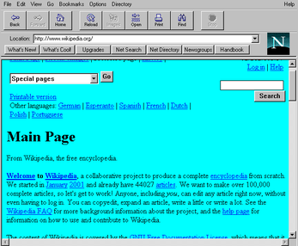
History of JavaScript (1994)
No dynamic behavior after the page was loaded
There was a compelling need to overcome this limitation

Slide 5





History of JavaScript
1995
1996
2000
JScript
2004
ECMAScript 5 - 2009
ECMAScript 6 - 2015
2008

Slide 6



End to End Architecture
JSON
REST API
Desktop
Web Server
Database
REST API
JSON

Slide 7
REST
Simple Standard for data exchange
Less complex than XML based SOAP
Primarily uses JSON for data transfer
REST – REpresentational State Transfer
Can be developed using .NET, Java, Python, etc.

Slide 8

REST API
Internet
Weather Forecast
fn()
Top News
Bank
fn()
Account Balance
Web Server
Funds Transfer
API – Application Programming Interface
Refers to the list of classes and functions available to develop an application

Slide 9

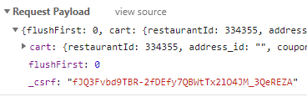

REST API Structure
function
REST API
Method Name
End Point
Input Parameters
Request Payload
Return
Response

Slide 10
JSON
JSON stands for JavaScript Object Notation
JSON is represented as a string
JSON syntax is similar to JavaScript Object definition
Lightweight format for storing and transfer data
Open standard managed by ECMA
Created during early 2000s

Slide 11
End to End Architecture
JSON
REST API
Desktop
Web Server
Database
XMLHttpRequest
fetch
REST API
JSON

Slide 12
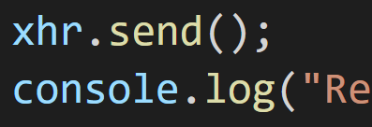
Race Condition
REST API
Web Server

Slide 13
Synchronous
.
.
xhr1.send();
.
.
xhr2.send();
.
.
xhr3.send();
20 seconds
Browser is freezed and no data is displayed in the page of 20 seconds.
This will result in bad user experience

Slide 14
Asynchronous
.
.
xhr1.send();
.
.
xhr2.send();
.
.
xhr3.send();
20 seconds
0.5 second
0.75 second

Slide 15
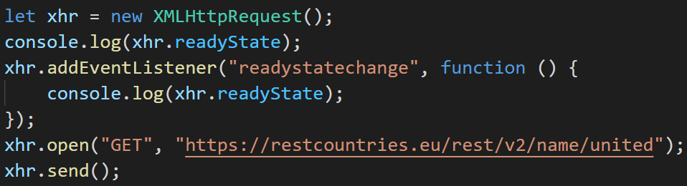
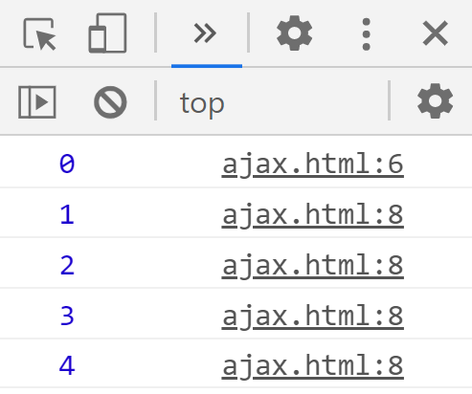
Ready State
Asynchronous
Background Process
Request Sent
Response Data can be read when readyState value is 4
Web Server
headers
received
unsent
opened
loading
done
xhr.readyState =
0
1
2
3
4

