Slide 1
Data Flow
Desktop
www.google.com
Internet Service Provider
www.google.com
Domain Name System Server
(DNS Server)
172.217.163.164
172.217.163.164
172.217.163.164
HTML
172.217.163.164
HTML
Internet
HTML
Google Server
(172.217.163.164)

Slide 2
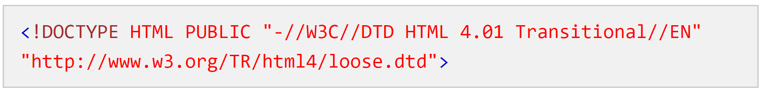
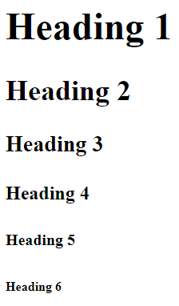
About hello.html
Denotes HTML Version 5
<!doctype html>
<html>
<body>
<h1>Hello World!!</h1>
</body>
</html>
Document Root
Document content that will be shown in the browser
Heading Tag. h1 to h6

Slide 3











World Wide Web & HTML
1991
1952
12 Countries
CERN
Nuclear
Research
Tim Berners Lee
1980s
Hyper Text Markup Language
Version 1.0 released in 1995
HTML is a Specification Document
https://www.w3.org/TR/2018/WD-html53-20181018/
World Wide Web
1993
Version 5.0 released in 2014
As of 2021 HTML5 is the latest version

Slide 4

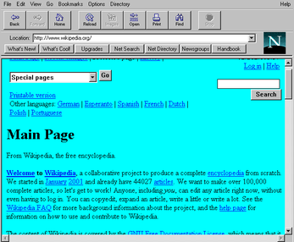
History of JavaScript (1994)
No dynamic behavior after the page was loaded
There was a compelling need to overcome this limitation

Slide 5





History of JavaScript
1995
1996
2000
JScript
2004
ECMAScript 5 - 2009
ECMAScript 6 - 2015
2008

