Slide 1
CONSTRUCTION MANAGEMENT PORTAL
BUILDCORE
One platform for Projects, Procurement, Finance, Clients,
Workforce and Vendors — from head office to the site.
Client Presentation · 2026

Slide 2
WHY BUILDCORE
EVERYTHING YOUR PROJECT NEEDS, CONNECTED
▪ Single source of truth — planning, purchasing, money and manpower share one live database
▪ Role-based portals — Admin, Site Engineer, Accountant, Procurement, Client and Vendor each see exactly what they need
▪ Field-first — one-tap attendance and progress updates from the site, visible at HQ instantly
▪ Financial control — budgets, commitments, invoices and labour costs tracked in ₹ Crores, live
▪ Instant alerts — blocked or delayed work notifies admins the moment it happens
6+
Integrated modules
6
User roles & portals
100%
E2E test pass rate
Live
Real-time site data

Slide 3
PLATFORM AT A GLANCE
SIX MODULES, ONE WORKFLOW
PROJECT PLANNING
Phases, milestones, % progress, site tracking updates, document vault
PROCUREMENT
Vendors, bid packages, POs, subcontracts, change orders, pay applications
VENDOR QUOTATION
Vendor portal bidding, side-by-side quote comparison, one-click award
FINANCE
Invoices & payments, expenses, payroll runs, project P&L, labour cost
CLIENT MANAGEMENT
Client directory, per-client projects, invoices & documents, client portal
WORKFORCE & FIELD OPS
Employee register by trade, daily attendance, wage-based labour costing
Plus: role-based security (JWT), in-app blocked-work alerts, and real file uploads across all modules.

Slide 4
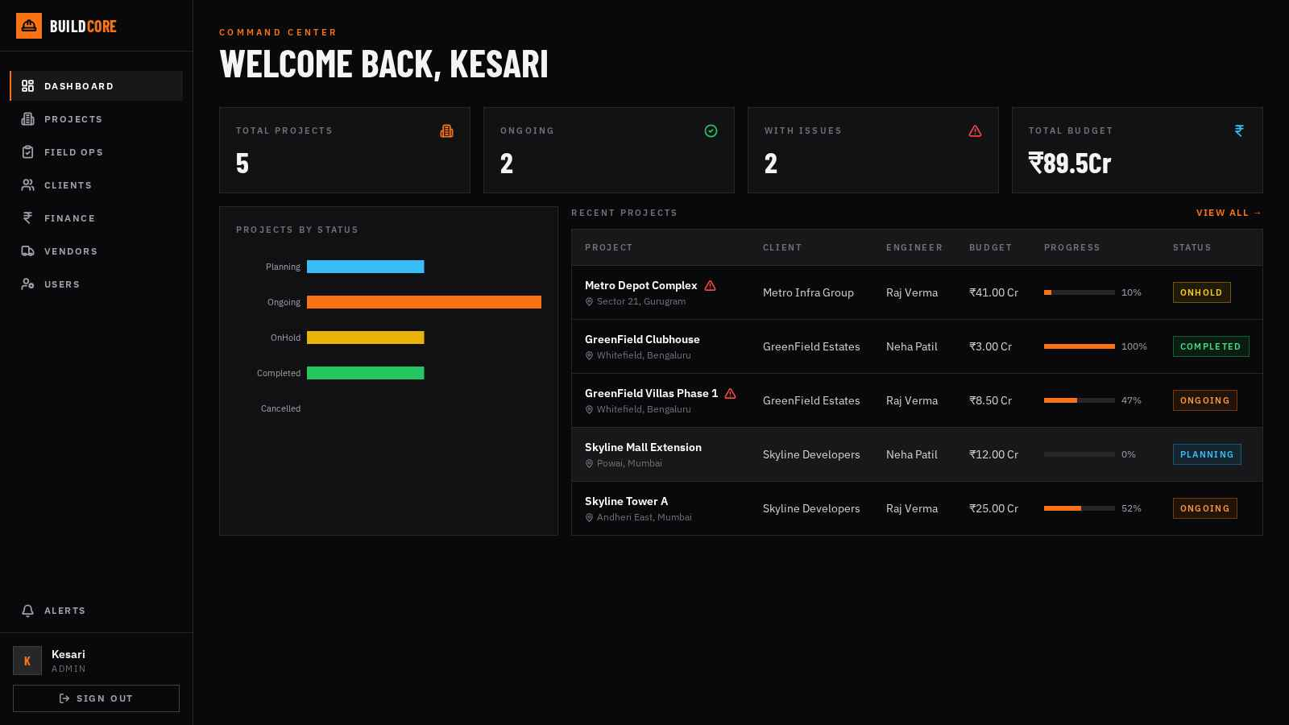
COMMAND CENTER
LIVE PORTFOLIO DASHBOARD
▪ Portfolio KPIs — total projects, ongoing, issues, total budget in Crores
▪ Status breakdown — planning / ongoing / on-hold / completed at a glance
▪ Recent projects — client, engineer, budget, live % progress, status
▪ Issue flags — projects with blocked or delayed work highlighted

Slide 5
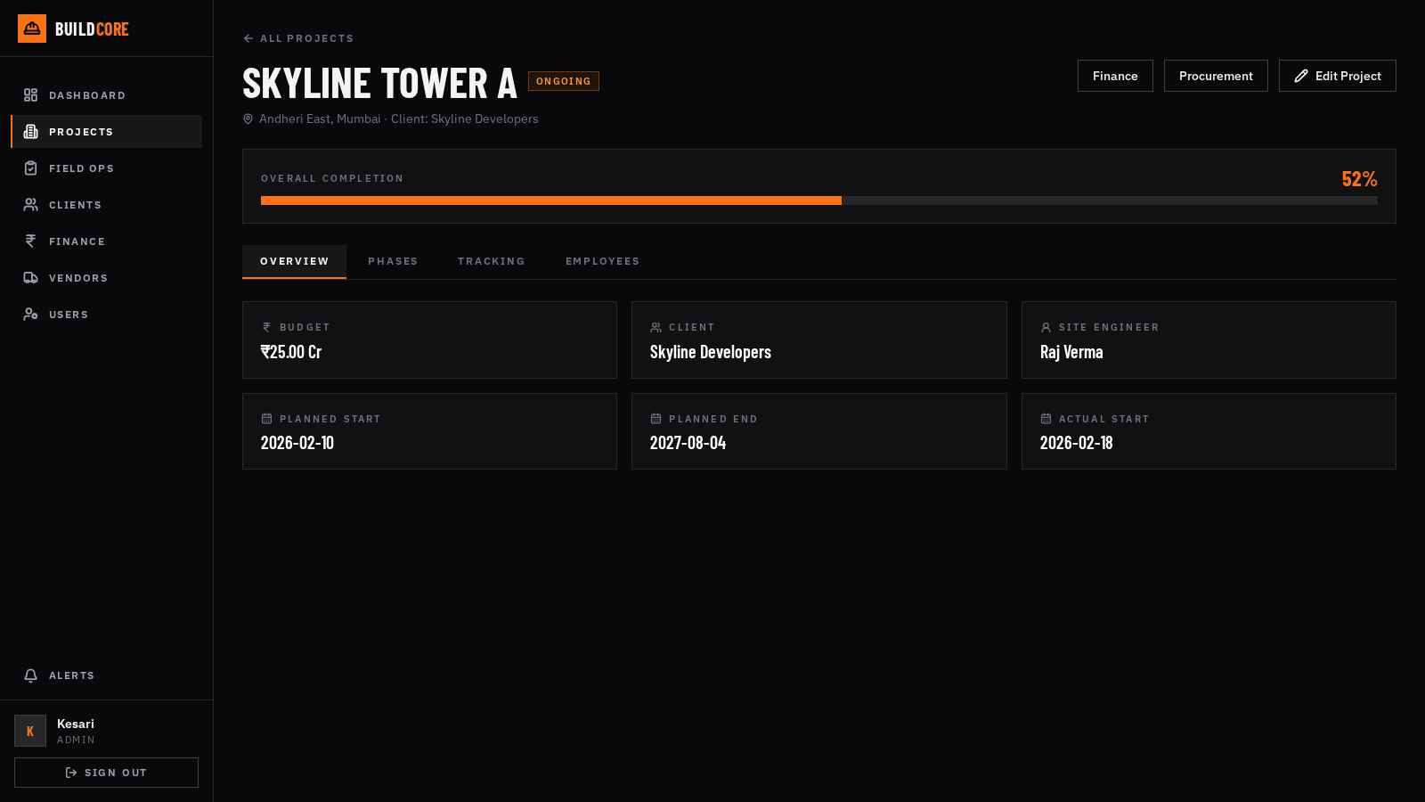
MODULE 01
PROJECT PLANNING & TRACKING
▪ Project master — budget, client, site engineer, planned vs actual dates
▪ Phases & milestones — sequenced stages with weighted % completion
▪ Site tracking — progress updates with photos, flags: on-track / delayed / blocked
▪ Document vault — drawings, permits, contracts — uploaded & versioned
▪ Overall completion — auto-computed from phase progress

Slide 6
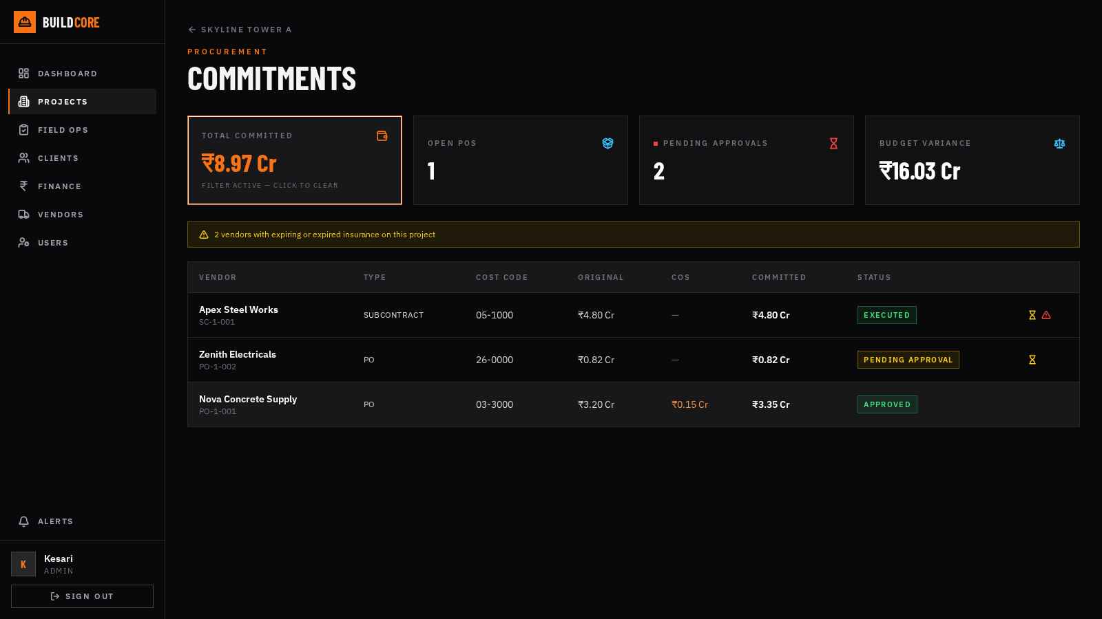
MODULE 02
PROCUREMENT & COMMITMENTS
▪ Commitment register — POs & subcontracts with cost codes, COs, committed value
▪ Approval workflow — insurance-gated approvals; expired vendors blocked
▪ Change orders — approved COs auto-revise committed amounts
▪ Pay applications — retainage, G702/G703 line items, lien waivers
▪ Budget variance — over-budget cost codes flagged in real time

Slide 7
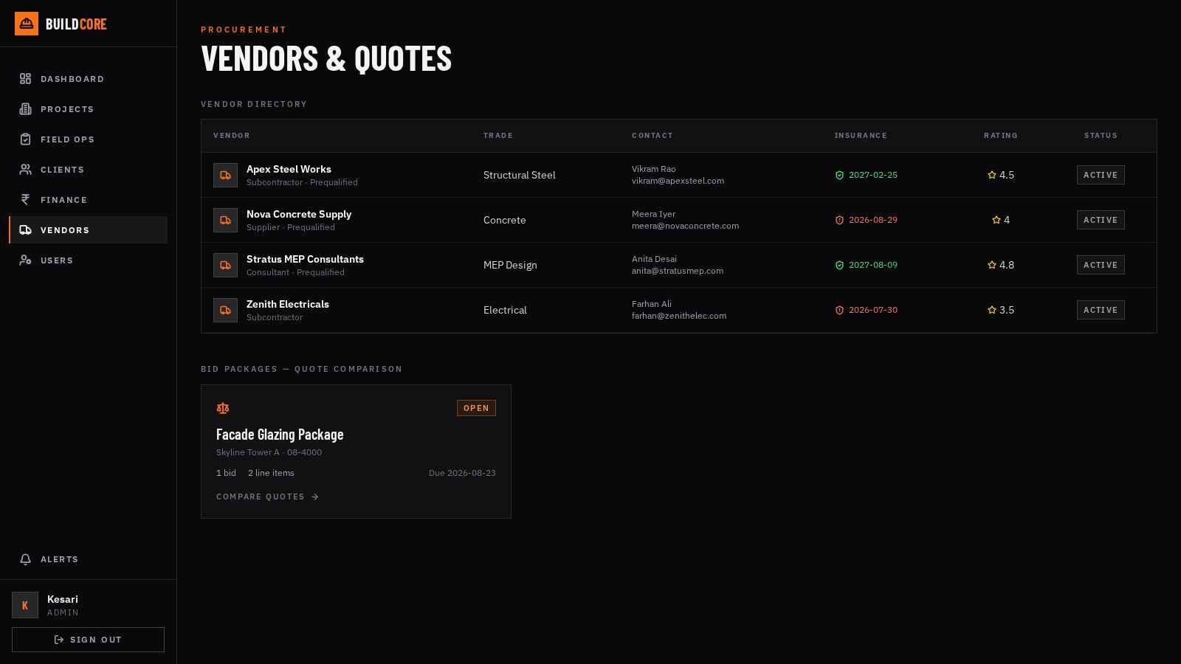
MODULE 03
VENDOR QUOTATION & BIDDING
▪ Vendor directory — trades, ratings, insurance expiry warnings, prequalification
▪ Vendor portal — vendors log in, see invited packages, quote line-by-line
▪ Quote comparison — vendors side-by-side per line item, best price highlighted
▪ One-click award — award as PO or Subcontract — commitment created instantly

Slide 8
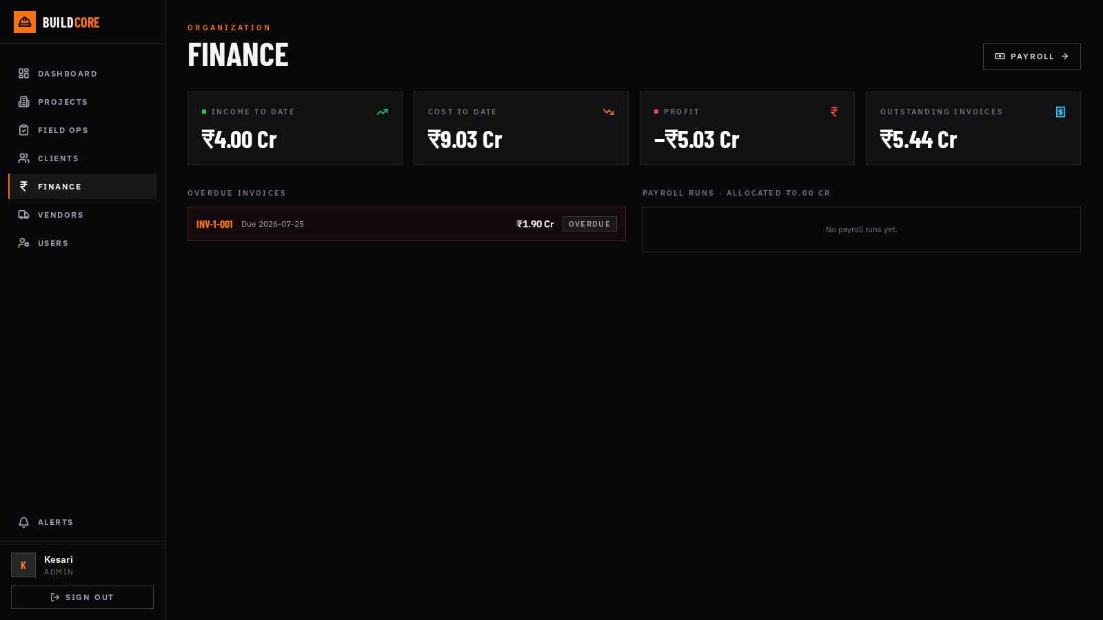
MODULE 04
FINANCE, PAYROLL & LABOUR COST
▪ Org dashboard — income, cost, profit and outstanding invoices — live
▪ Project P&L — invoices, payments received, expense log per project
▪ Payroll runs — salaried staff payroll: create → process → mark paid
▪ Labour cost report — attendance × daily wage, auto-computed per project
▪ Overdue tracking — aging invoices surfaced automatically

Slide 9
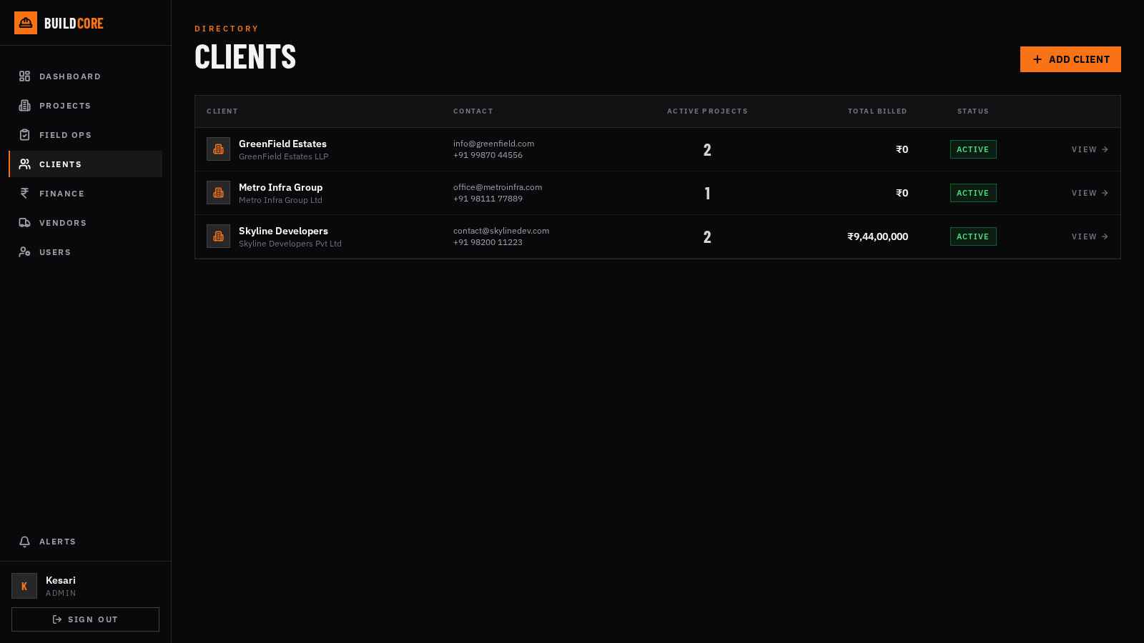
MODULE 05
CLIENT MANAGEMENT & CLIENT PORTAL
▪ Client directory — active projects, total billed, status per client
▪ Client 360° — projects, invoices and shared documents in tabs
▪ Client portal — clients log in to see their projects, progress & documents
▪ Controlled sharing — internal documents stay internal — client-safe by default

Slide 10
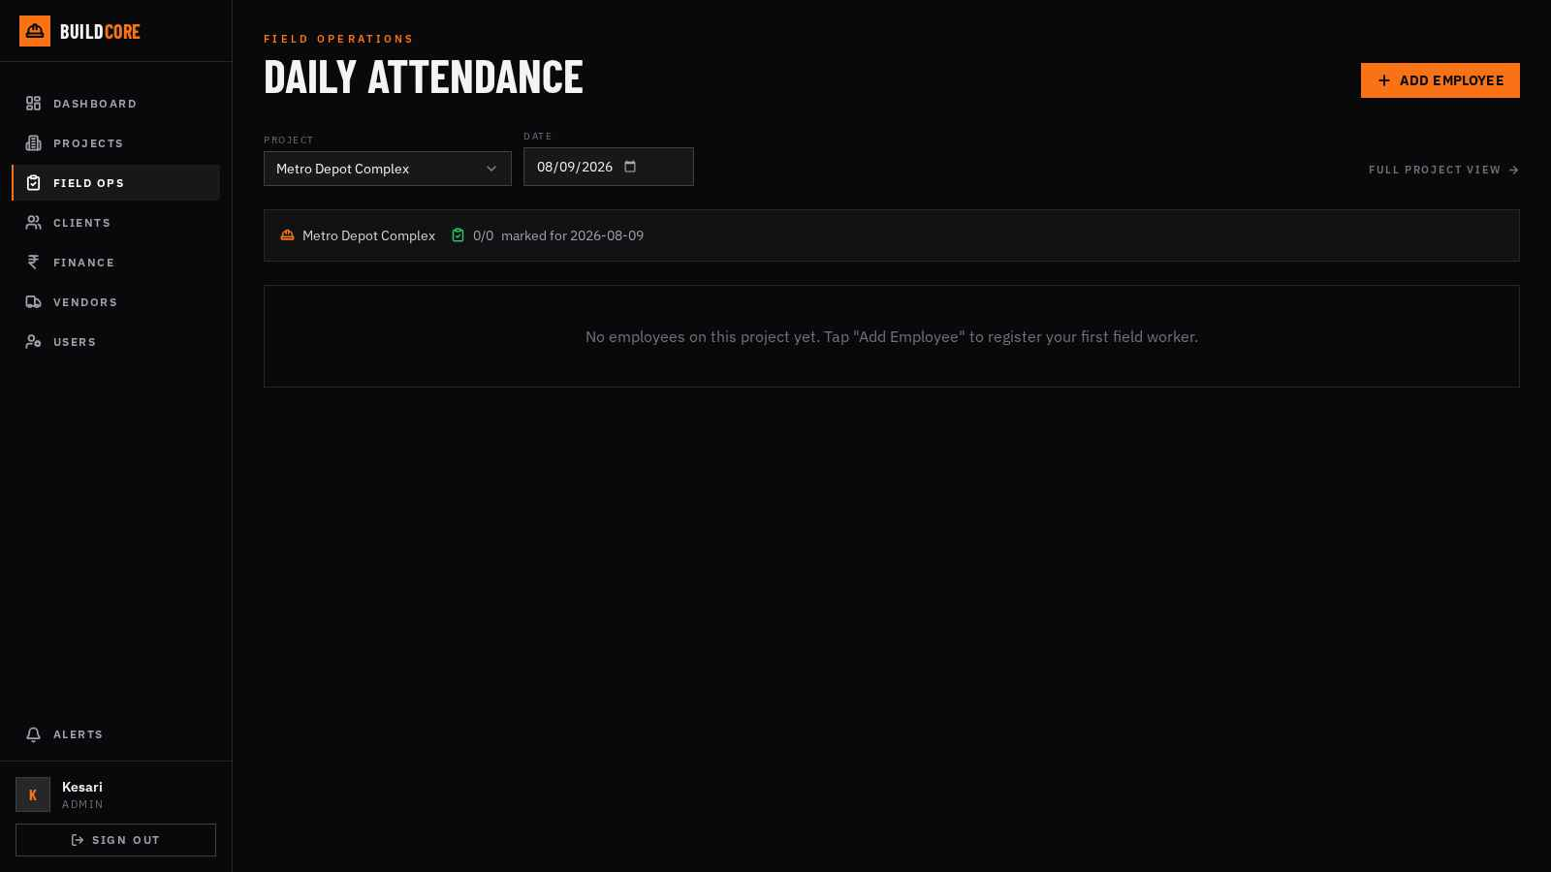
MODULE 06
WORKFORCE, ATTENDANCE & FIELD OPS
▪ Employee register — field workers by managed trade categories (Mason, Electrician…)
▪ One-tap attendance — Present / Half-day / Absent / Leave from the site engineer's phone
▪ 7-day grid — admins review & correct attendance; 3-day backdating guard
▪ Wage control — site engineers add workers; only Admin/Accountant edit wages
▪ Single source of truth — field entries appear at HQ instantly — no syncing

Slide 11
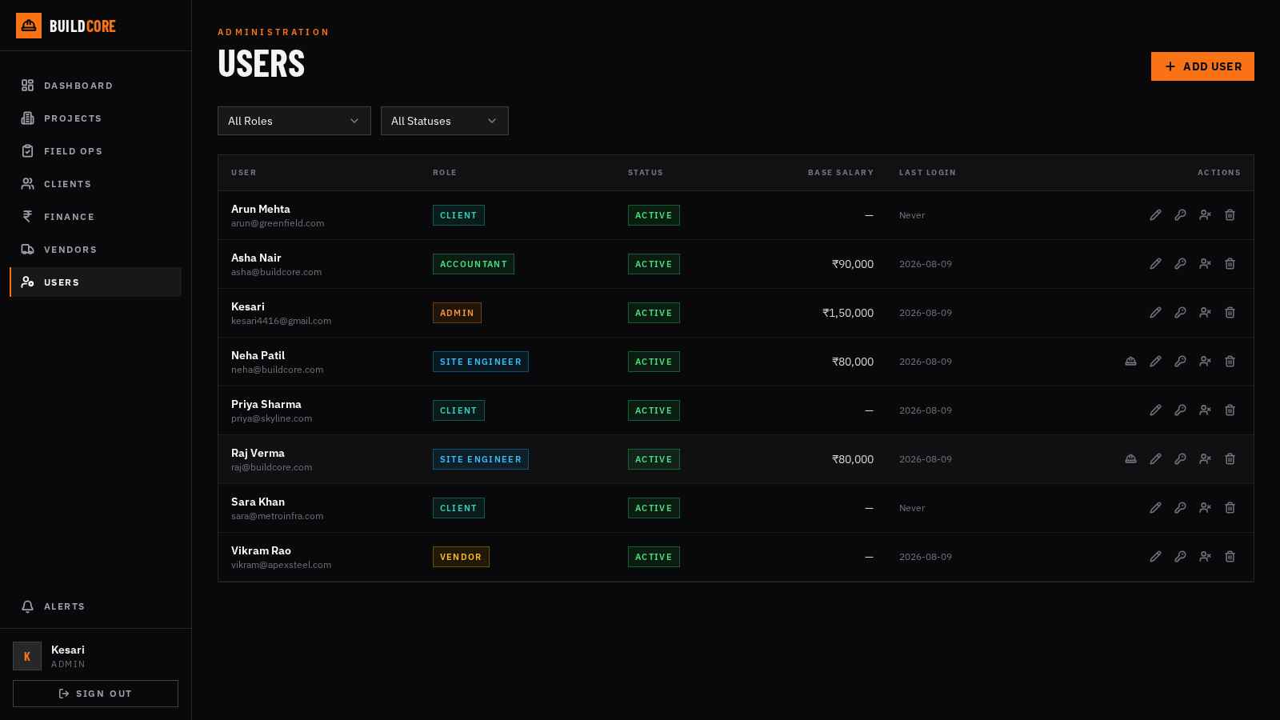
GOVERNANCE
USER MANAGEMENT & SECURITY
▪ Six roles — Admin, Site Engineer, Accountant, Procurement Officer, Client, Vendor
▪ Full lifecycle — invite, disable, reset password, project assignments
▪ Server-enforced access — engineers scoped to assigned projects; portals isolated
▪ JWT authentication — secure sessions; every route permission-checked
▪ Blocked-work alerts — admins & engineers notified in-app the moment work stalls

Slide 12
UNDER THE HOOD
MODERN, PROVEN TECHNOLOGY
FRONTEND
React 19 · Tailwind CSS · responsive, mobile-friendly design
BACKEND
FastAPI (Python) · REST API · JWT security
DATABASE
PostgreSQL — relational integrity for financial data
QUALITY
90+ automated backend tests · 8 rounds of end-to-end QA
Scales from a single site to a full portfolio. Deployable to the cloud with your domain and branding.

Slide 13
NEXT STEPS
LET'S BUILD TOGETHER
▪ Live walkthrough — guided demo with your own project data
▪ Pilot project — onboard one live site in days, not months
▪ Roadmap — attendance-linked payroll, Gantt timelines, PDF invoice exports & more
BUILDCORE — Construction Management Portal

