Slide 1
CRMITDESK EVOLVED
CRMITdesk Evolved
One platform for sales and support — with AI built in from day one.
QUANTIQ SYSTEMS
Notes:
Meet CRMITdesk Evolved. It's a single platform that brings your sales pipeline and your IT help desk together, with AI woven into almost every screen instead of bolted on as an afterthought.

Slide 2

Sales and support shouldn't live in different apps
A separate CRM and a separate help desk mean two logins, two databases, and no shared view of the customer.
Support has no visibility into the deal a customer just signed. Sales has no idea a customer has three open tickets.
Every automation, integration, and report has to be built and maintained twice.
Notes:
Most growing businesses end up running a CRM and a help desk as two completely separate tools. That means two logins, two databases, and no shared view of the customer — support can't see the deal that was just signed, and sales has no idea a customer has three open tickets. Worse, every integration, automation, and report has to be built and maintained twice.

Slide 3

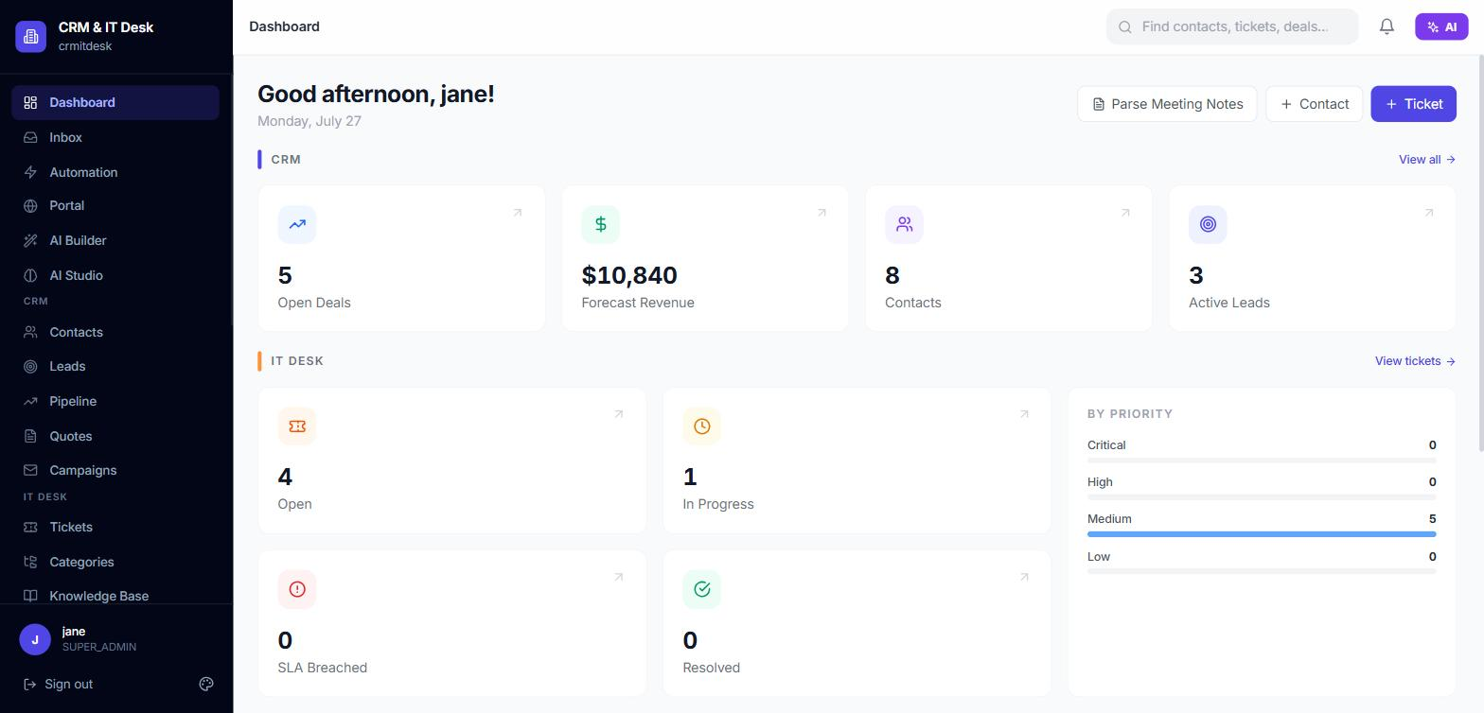
One platform. One shared view of every customer.
CRMITdesk Evolved runs sales and support side by side, on the same contacts, the same organization, the same login.
AI is available across the whole platform, not a separate add-on.
A no-code automation engine connects the two sides without a developer.
Notes:
CRMITdesk Evolved fixes that by running sales and support side by side — same contacts, same organization, same login. On top of that shared foundation, we've layered AI across the whole platform, and a no-code automation engine that connects the two sides without needing a developer.

Slide 4


Three pillars, one platform
All-in-One Platform
AI Built In
No-Code Automation
CRM and IT help desk, unified — plus a self-service portal for your customers.
AI assists on nearly every screen, for both sales and support teams.
Workflows, scheduled reminders, and integrations — no engineering required.
Notes:
Everything we're about to show you falls into three pillars: an all-in-one platform for CRM and IT support, AI built into nearly every screen, and no-code automation that connects it all together.

Slide 5
PILLAR ONE
All-in-One Platform
Sales, support, and self-service — under one roof.
Notes:
Let's start with the first pillar: the all-in-one platform itself.

Slide 6

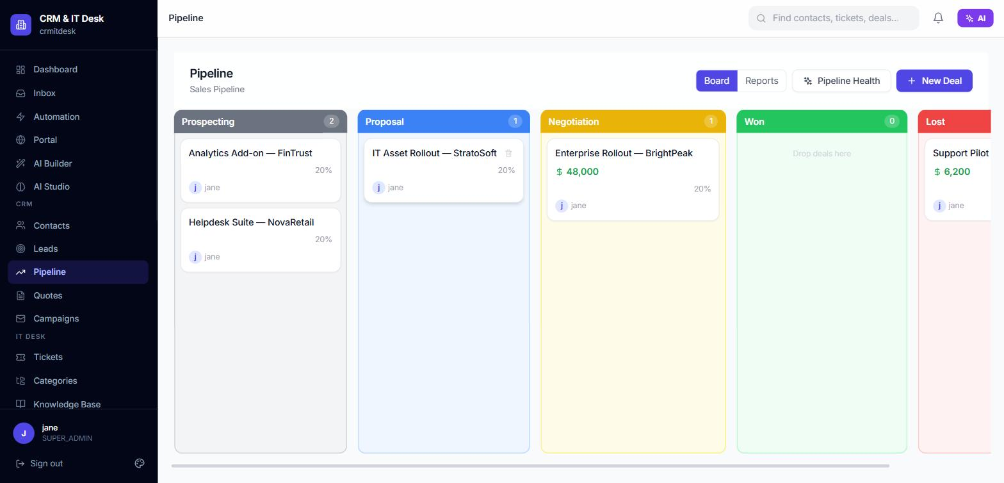
A full sales pipeline, start to finish
Capture leads, qualify them, and convert them into deals with one click.
A drag-and-drop Kanban board moves deals through your pipeline stages.
Build quotes with line items, and run bulk email campaigns to your contact base.
Built-in forecasting shows funnel value, win rate, and a probability-weighted revenue forecast.
Notes:
On the sales side, teams capture leads, qualify them, and convert them into deals in one click. A drag-and-drop board moves deals across your pipeline stages, quotes go out with proper line items, and campaigns reach your whole contact base. Built-in forecasting shows funnel value, win rate, and a probability-weighted revenue forecast — no spreadsheet required.

Slide 7

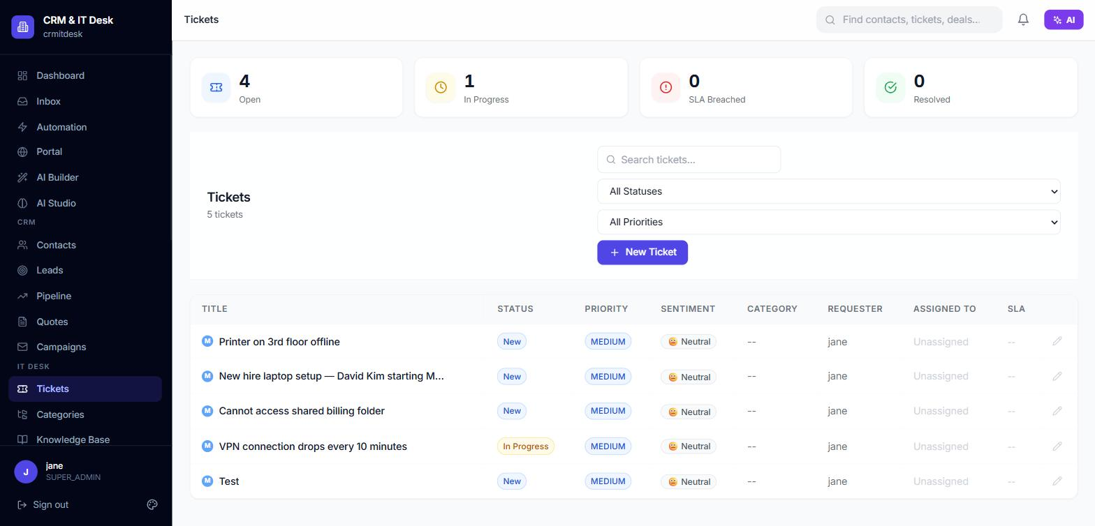
IT support that keeps every SLA visible
Ticketing with categories, priorities, and automatic SLA deadlines.
A knowledge base, IT asset inventory, and ITIL-style change management.
Automatic customer satisfaction surveys after every resolved ticket.
Notes:
On the support side, tickets carry categories and priorities, and SLA deadlines are calculated automatically the moment a ticket is created. A knowledge base, an IT asset inventory, and ITIL-style change management round out the help desk — and every resolved ticket automatically triggers a customer satisfaction survey.

Slide 8

One inbox for email and WhatsApp
Every email and WhatsApp conversation lands in a single shared inbox.
Conversations update live — no refreshing, no missed messages.
Agents can filter by channel and status, and see who's already assigned.
Notes:
Email and WhatsApp conversations both land in one shared inbox, updating live as messages arrive. Agents filter by channel or status and always know who's already handling a conversation — so nothing falls through the cracks between channels.

Slide 9

A branded self-service portal for your customers
Customers log in with a secure, passwordless magic link — no password to remember.
They submit and track their own tickets without emailing or calling in.
Portal styling — logo, color, and welcome text — matches your brand.
Notes:
And your customers get their own lightweight, branded portal. They log in with a secure, passwordless magic link, submit and track their own tickets, and see your logo and colors instead of ours — so it feels like part of your product, not a bolted-on tool.

Slide 10
PILLAR TWO
AI Built In, Not Bolted On
AI shows up where the work happens — for sales and support alike.
Notes:
The second pillar is AI — and this is where CRMITdesk Evolved really stands apart.

Slide 11

AI that helps sales close more, faster
Automatic lead scoring with a plain-language reason for every score.
AI-drafted follow-up emails and multi-touch nurture sequences.
Win-probability and close-date prediction based on your own pipeline history.
Churn-risk and account health signals right on the contact page.
Notes:
For sales, leads are scored automatically with a plain-language reason attached to every score. AI drafts follow-up emails and full nurture sequences, predicts win probability and likely close dates from your own pipeline history, and flags churn risk right on the contact page — so reps spend their time on the deals that matter.

Slide 12

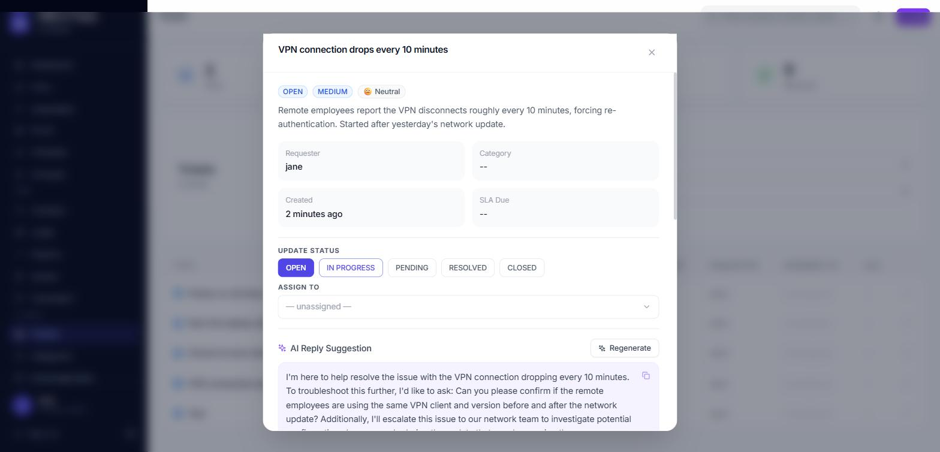
AI that helps support resolve faster
Suggested replies, grounded in your own published knowledge base articles.
Automatic routing suggestions for category and assignee.
Duplicate-ticket detection before a redundant ticket is even submitted.
Sentiment detection and SLA-breach-risk scoring on every open ticket.
Notes:
For support, agents get suggested replies grounded in your own knowledge base, automatic routing suggestions, and duplicate detection that flags a redundant ticket before it's even submitted. Sentiment detection and SLA-risk scoring highlight which open tickets need attention first.

Slide 13

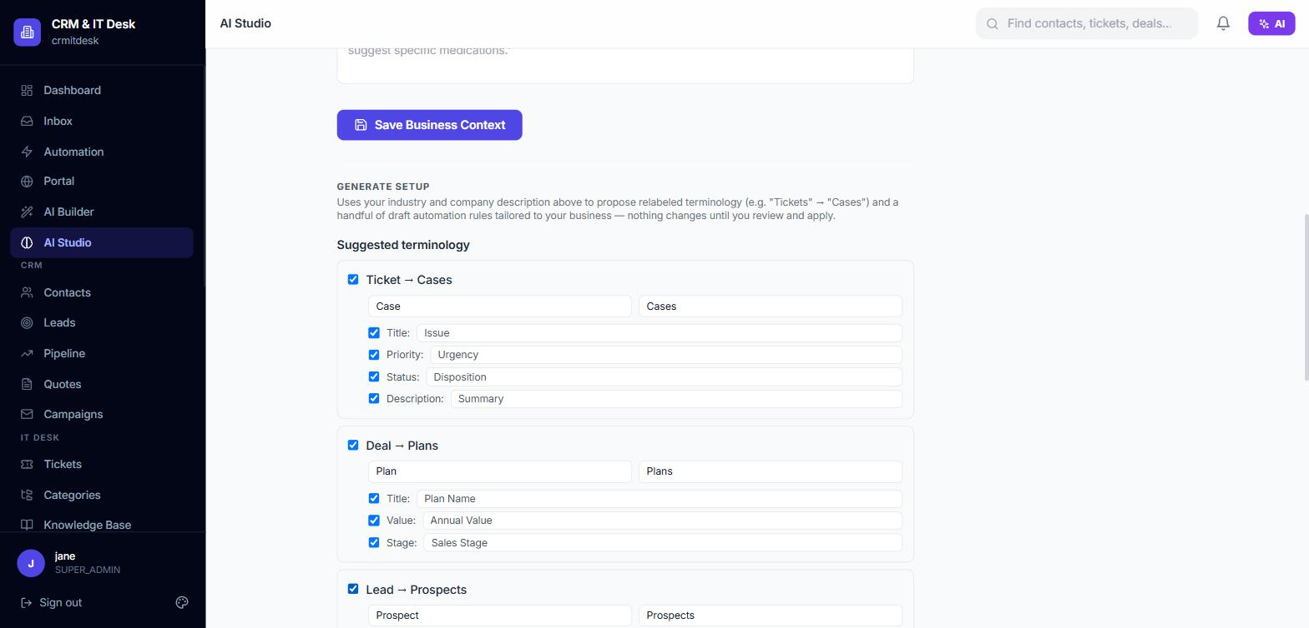
AI Studio — the AI learns your business, not the other way around
Describe your industry once, and AI proposes your own terminology — 'Ticket' becomes 'Case', 'Deal' becomes 'Policy', whatever fits.
It drafts starter automation rules for you to review and approve.
Nothing changes until you review and click Apply — you're always in control.
Notes:
AI Studio is where the platform adapts to you. Describe your industry once, and it proposes your own terminology throughout the app — a ticket can become a 'case', a deal can become a 'policy', whatever fits your business — plus a starter set of automation rules. Nothing is applied until you've reviewed it and clicked Apply, so you're always the one in control.

Slide 14

Ask it anything, right from the toolbar
A natural-language command bar (Ctrl/Cmd+K) turns a typed instruction into a finished record.
Ask the dashboard a plain-English question and get a real answer, grounded in your live data.
Paste raw meeting notes and get structured contacts, leads, and next steps back.
Notes:
And it's not limited to one screen. A natural-language command bar turns a typed instruction into a finished record. You can ask your dashboard a plain-English question and get a real, data-grounded answer back. You can even paste in raw meeting notes and get structured contacts, leads, and next steps out the other side.

Slide 15
PILLAR THREE
Automate the Busywork
No-code rules and reminders that run themselves.
Notes:
The third pillar is automation — turning repetitive manual steps into rules that run themselves.

Slide 16

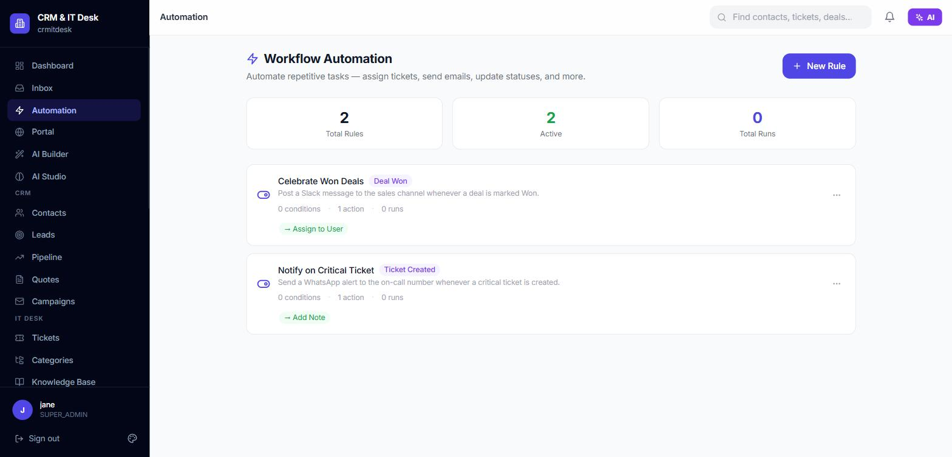
No-code workflows across sales and support
Build if-this-then-that rules for tickets, leads, and deals — no code required.
Trigger actions like assigning, prioritizing, emailing, or messaging on WhatsApp.
Every rule keeps a running execution log, so you can see exactly what fired and when.
Notes:
Managers build if-this-then-that automation rules across tickets, leads, and deals with no code at all — assign, re-prioritize, send an email, or message someone on WhatsApp, automatically, the moment something happens. Every rule keeps a running log so you can see exactly what fired and when.

Slide 17

Scheduled WhatsApp reminders
Schedule a one-off or recurring reminder tied to any ticket or deal.
Send it to the customer, the assignee, or any number you choose.
Runs automatically in the background — set it once and move on.
Notes:
Any staff member can schedule a WhatsApp reminder directly from a ticket or a deal — a one-off nudge or a recurring one — sent to the customer, the assignee, or any number you choose. Set it once, and the platform handles the rest in the background.

Slide 18

Plugs into the tools your team already uses
Slack and Microsoft Teams notifications for new tickets, SLA breaches, and won deals.
Signed, verifiable outgoing webhooks for your own systems.
A scoped, revocable API key for programmatic access.
Notes:
It also connects outward — Slack and Microsoft Teams get notified the moment a ticket comes in, an SLA breaches, or a deal is won. Outgoing webhooks are cryptographically signed so your systems can verify they really came from us, and a scoped API key gives developers programmatic access when they need it.

Slide 19

Enterprise-grade trust, from day one
Every organization's data is fully isolated in its own tenant.
Six-role access control, down to row-level restriction on tickets.
Two-factor authentication, encrypted secrets at rest, and a full audit trail.
Scoped, revocable API keys for every integration.
Notes:
None of this comes at the expense of security. Every organization's data is fully isolated, six-role access control governs who can see and do what, two-factor authentication and encrypted secrets protect your accounts and credentials, and a complete audit trail records every meaningful change.

Slide 20

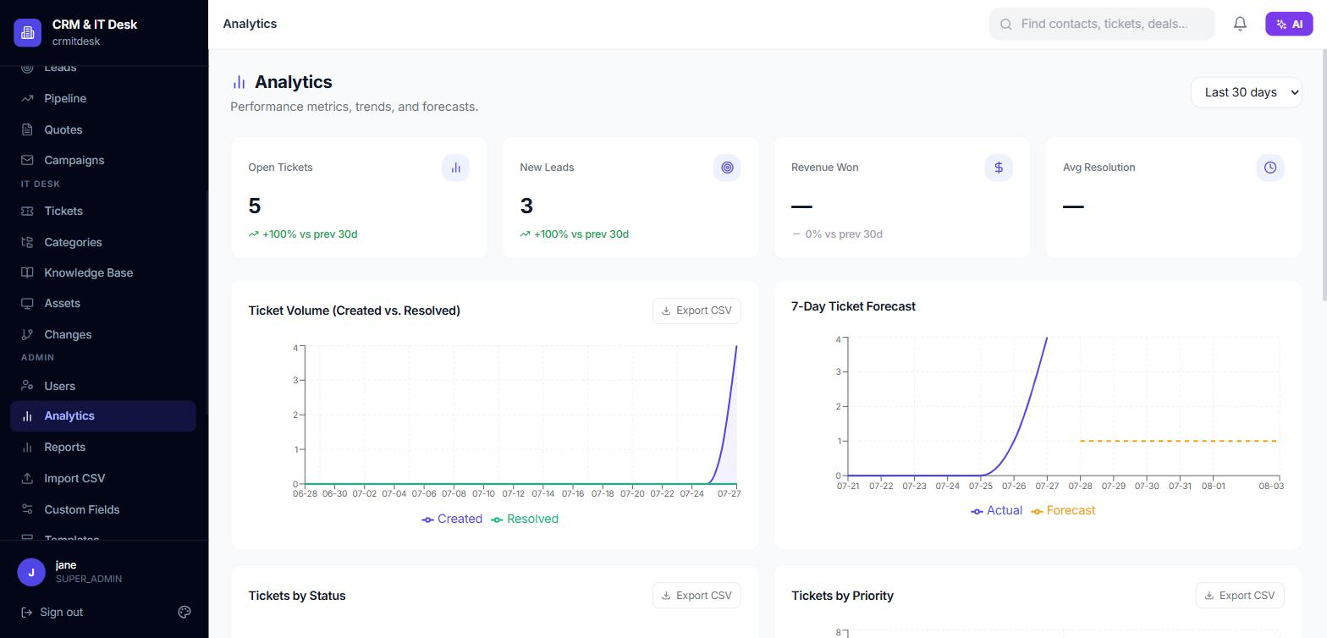
Real answers, not just raw data
Live dashboards for pipeline, ticket volume, and SLA compliance.
A 7-day forecast for ticket volume, and a probability-weighted revenue forecast.
One-click CSV export on every chart.
Notes:
Reporting rounds it out — live dashboards for pipeline, ticket volume, and SLA compliance, a short-term forecast for ticket volume, a probability-weighted revenue forecast, and one-click CSV export whenever you need the raw numbers.

Slide 21

Plans that grow with your team
Free, Pro, and Enterprise plans — every plan runs the full platform: CRM, IT Desk, and AI.
Self-serve billing and plan management, right in the app.
Seat-based pricing that scales as your team grows.
Notes:
And it's simple to get started. Free, Pro, and Enterprise plans all run the full platform — CRM, IT desk, and AI — with self-serve billing and plan management built right into the app, and seat-based pricing that scales as your team grows.

Slide 22
Stop switching tools. Start sharing one view of your customer.
CRMITdesk Evolved — CRM, IT support, and AI, together.
Notes:
Stop switching between tools that don't talk to each other. CRMITdesk Evolved brings your sales team, your support team, and AI together in one place, so every conversation with a customer has the full picture behind it.

Slide 23
See it on your own data
Book a walkthrough and we'll show you CRMITdesk Evolved with your own use case.
support@quantiqsystems.com
CRMITdesk Evolved — by QuantiQ Systems
Notes:
If this looks like something your team needs, reach out to us at support at quantiqsystems dot com, and we'll walk you through CRMITdesk Evolved using a use case from your own business.

