Slide 1

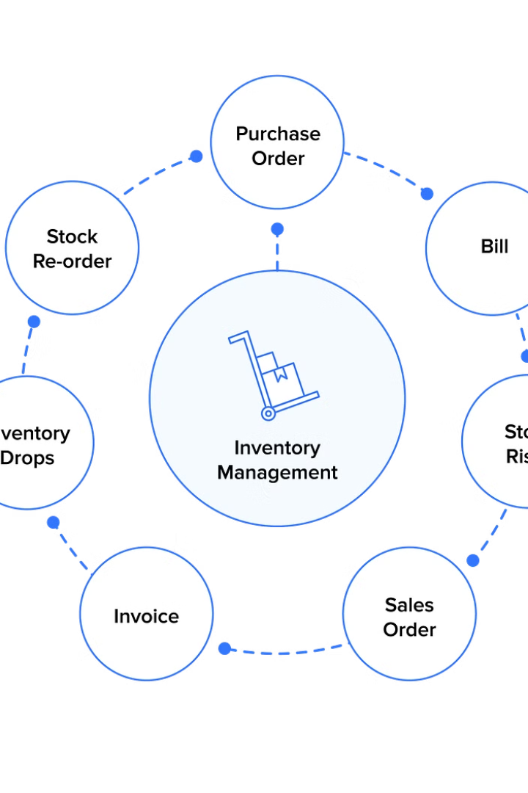
The Strategic Imperative of Inventory Control Management for Unlocking Success of an Organization using RNN
By:
Vandavasi Kesava
192224077
P Ajay Kumar
192224026

Slide 2
Introduction:
Inventory control is an activity of checking a shop’s stock and to maintain the inventory at desired levels, keeping in view the best economic interest of an organization.
Inventory control is a process of ensuring that a business maintains the adequate quantity of stock to meet the forecasted demand with minimum holding cost.
Managing adequate stock is key for managing inventory successfully. Overstocking will lead to cash flow blockage and the additional cost for managing excess stock.
Inventory control helps the business in knowing the shortfall and quantities to be ordered considering the net stock available.

Slide 3
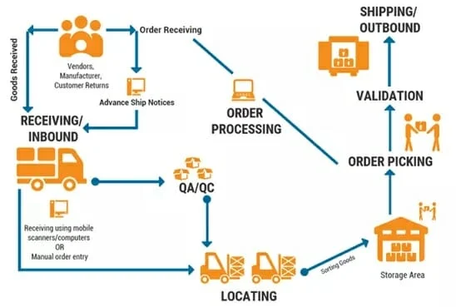
Methodology:
Order receiving
Validation
Order Processing
Receiving orders from suppliers and confirming the details.
Ensuring the accuracy and completeness of received orders.
Processing orders for further action and fulfillment.
Quality Assurance / Quality control procedures
Sorting Goods
Locating
Organizing and categorizing goods based on specific criteria.
Finding and identifying the physical location of items in the inventory.
Implementing procedures to maintain the quality of goods and services.
Storage area
Storing goods in designated areas according to inventory management practices.

Slide 4
Implementation :
Problem definition and scope
1
Defining the problem and its scope is the first step in the implementation process. It involves clearly understanding the issues at hand and determining the boundaries within which the solution will be developed.
2
Data Collection
Collecting relevant data is a crucial part of the implementation process. This involves gathering information and resources that will be used to address the identified problem and develop a solution.
Data Processing
3
Processing the collected data is essential for extracting meaningful insights and preparing it for further analysis. This step involves cleaning, organizing, and transforming the data into a usable format.
4
Model Selection and Development
Choosing the appropriate model and developing it is a critical aspect of the implementation process. This involves selecting the right approach and building a model that aligns with the objectives and requirements.
Evaluation and Integration
5
Evaluating the developed model and integrating it into the existing system is an important step in the implementation process. This involves assessing the performance and compatibility of the model with the intended environment.
6
Maintenance and Iteration
Maintaining and iterating the implemented solution is necessary for continuous improvement and adaptation. This step involves monitoring, updating, and refining the solution based on feedback and changing requirements.

Slide 5
Execution:
Source code:
import pandas as pd
import numpy as np
from sklearn.preprocessing import MinMaxScaler
from tensorflow.keras.models import Sequential
from tensorflow.keras.layers import LSTM, Dense
data = pd.read_excel("/content/drive/MyDrive/cv/innventory.dtst.xlsx")
'inventory_data.csv' is your dataset file
data = data.drop(columns=['product_name'])
data['Order Date'] = pd.to_datetime(data['Order Date'])
data.set_index('Order Date', inplace=True)
data.fillna(method='ffill', inplace=True)
non_numeric_columns = data.select_dtypes(exclude=[np.number]).columns.tolist()

Slide 6
if non_numeric_columns:
data = data.drop(columns=non_numeric_columns)
scaler = MinMaxScaler(feature_range=(0, 1))
scaled_data = scaler.fit_transform(data)
sequence_length = 10 # Choose appropriate sequence length
X, y = [], []
for i in range(len(scaled_data) - sequence_length):
X.append(scaled_data[i:i+sequence_length])
Assuming
y.append(scaled_data[i+sequence_length])
X = np.array(X)
y = np.array(y)
X = np.reshape(X, (X.shape[0], X.shape[1], data.shape[1]))
model = Sequential([
LSTM(units=50, return_sequences=True, input_shape=(X.shape[1], X.shape[2])),
LSTM(units=50, return_sequences=False),

Slide 7

Results:
Tracking stock levels: Businesses can use it to monitor the quantity of each item in stock, ensuring they don't run out of essential products.
Managing orders: Inventory data helps determine if there's enough stock to fulfill incoming orders. It can also prevent overstocking and reduce storage costs.
Optimizing stock management: By analyzing inventory data, businesses can identify patterns in demand and optimize stock levels to minimize stockouts and holding costs.
Making informed decisions: Inventory control systems provide valuable data for making informed decisions about purchasing, production planning, and pricing strategies.

Slide 8
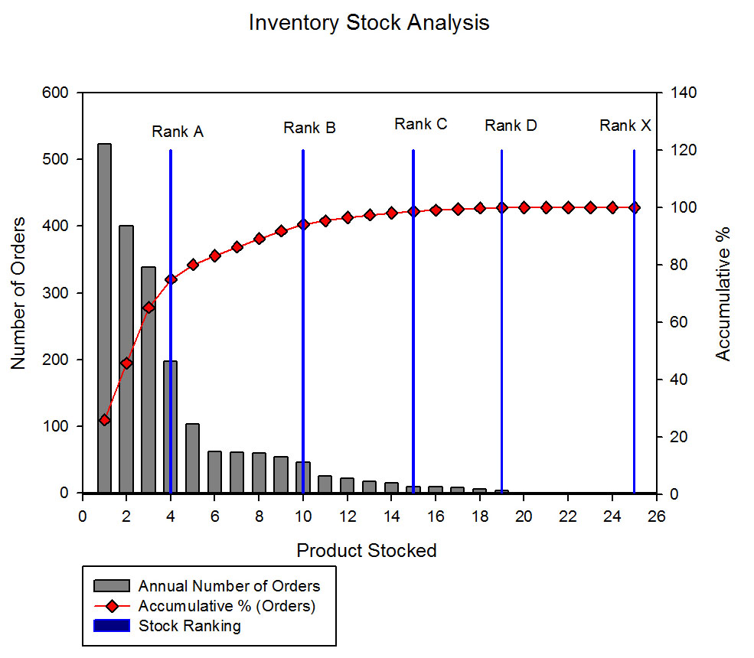
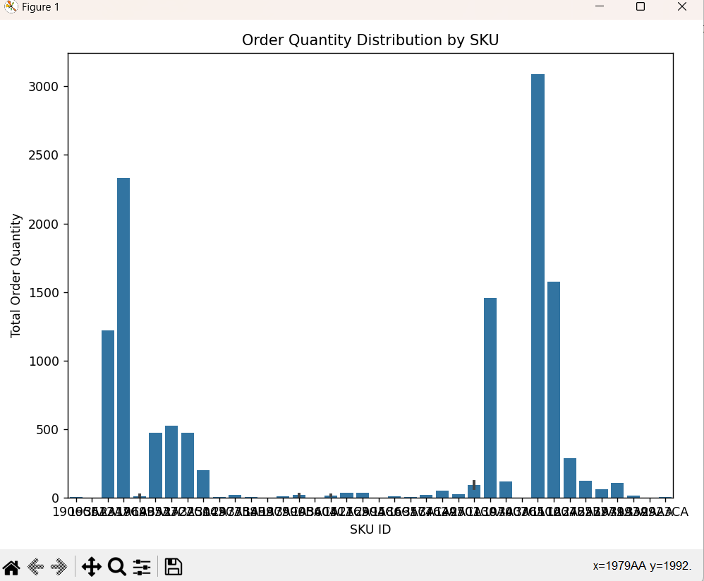

Slide 9
Limitations and Future Scope
Data accuracy: The effectiveness of the system relies on the accuracy of the data entered. Businesses need to ensure proper procedures are in place for recording stock movements and updating information.
Scalability: The provided code might not be suitable for very large inventories. Businesses with extensive stock may need to consider more sophisticated inventory management systems that integrate with databases.
Integration with other systems: For optimal benefits, the inventory control system should ideally integrate with other business systems like sales and accounting software. This can provide a more holistic view of operations and streamline data flow.
Integration with advanced technologies: Explore opportunities to incorporate advanced technologies like artificial intelligence, machine learning, or Internet of Things (IoT) for enhanced inventory control.
Enhanced user interface: Improve the user interface of the inventory management system to make it more intuitive and user-friendly.
Multi-location inventory management: Extend the system's capabilities to handle inventory across multiple locations or warehouses.
Demand forecasting and planning: Incorporate demand forecasting and planning capabilities to optimize inventory levels and minimize stockouts or overstock situations.
Customization and scalability: Provide options for customization and scalability to meet the specific needs and growth of different businesses.

Slide 10
Discussion:
•Effective inventory control management is recognized as one of the areas management of any organization should acquire capability.
•In general the findings that emerged from this study have indicated that organizations stand to gain a lot from effective inventory control management system. Some of this benefit include optimal use of resources, cost reduction, improved profitability, improved sales effectiveness, reduction of waste, transparency and accountability, easy storage and retrieval of stock, high inventory utilization amongst others.
•.However, in order to achieve all these, organizations have to maintain flexible inventory service. Thus, the study found that there is a significant relationship between effective inventory control management system and organizational performance.

Slide 11
Conclusion:
•Effective inventory control management is recognized as one of the areas management of any organization should acquire capability. The ability of any organization to evolve effective inventory control management system will depend on the extent to which it perceives the benefits it stands to gain from such program. In general the findings that emerged from this study have indicated that organizations stand to gain a lot from effective inventory control management system. Some of this benefit include optimal use of resources, cost reduction, improved profitability, improved sales effectiveness, reduction of waste, transparency and accountability, easy storage and retrieval of stock, high inventory utilization amongst others. However, in order to achieve all these, organizations have to maintain flexible inventory service. Thus, the study found that there is a significant relationship between effective inventory control management system and organizational performance.

Slide 12
