Slide 1
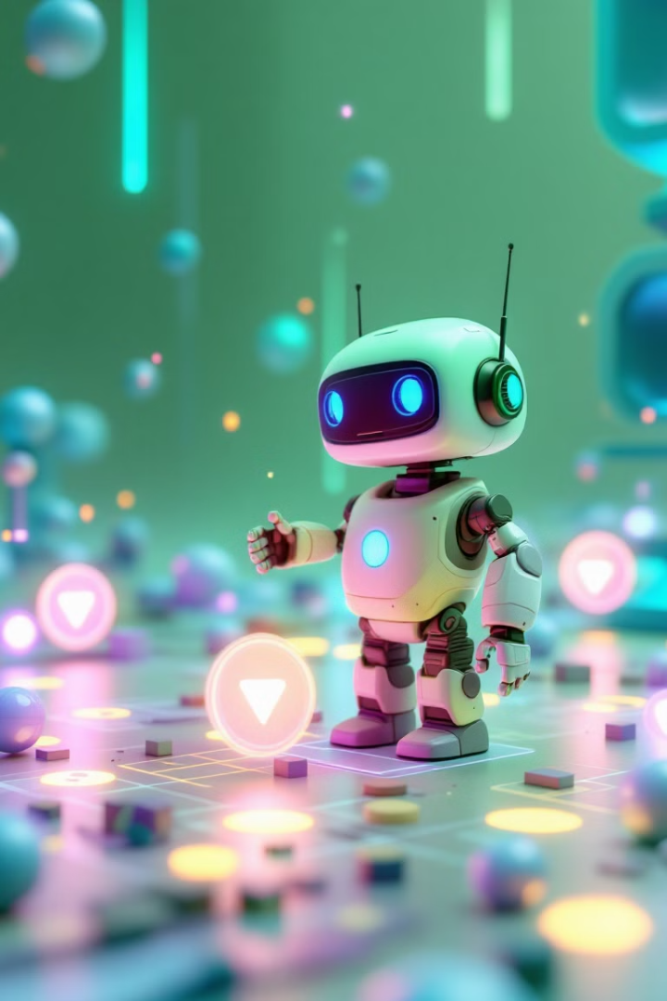
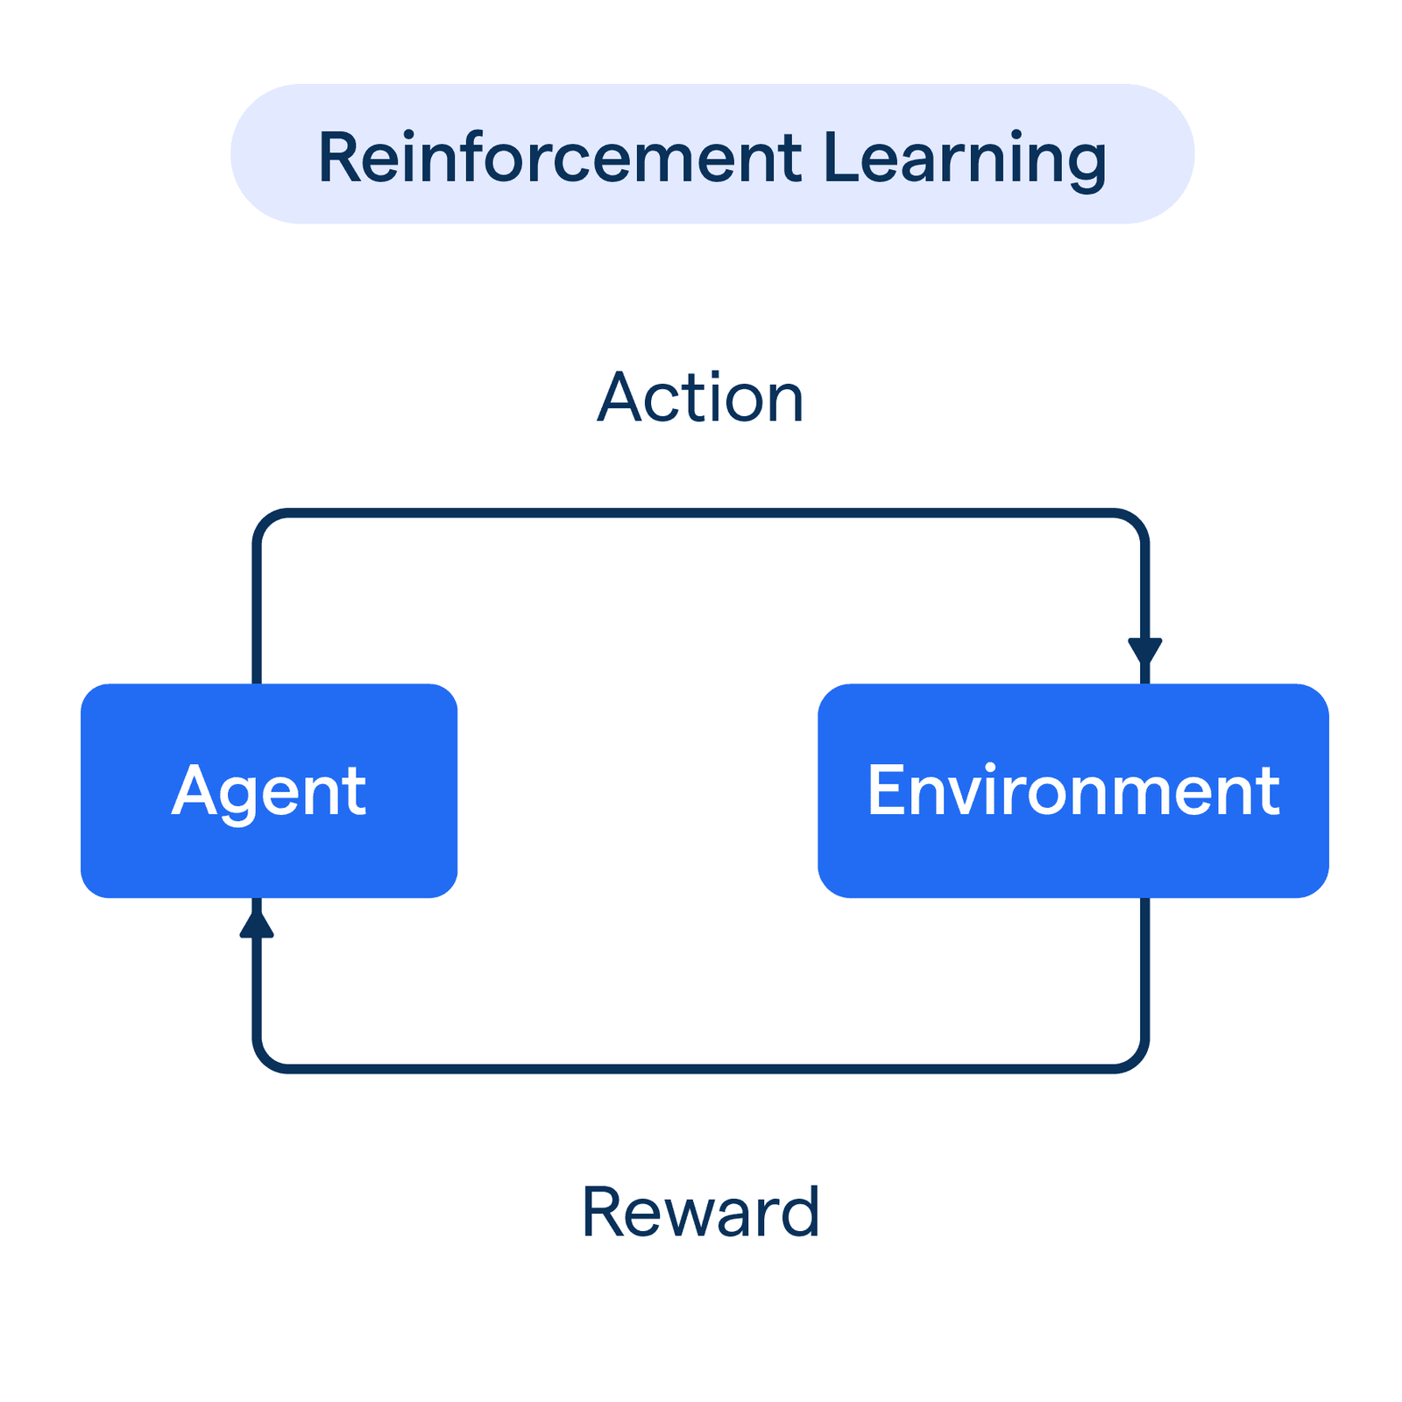
Reinforcement Learning: Teaching Machines to Make Decisions
Reinforcement learning is a machine learning technique where an agent learns to make decisions in an environment to maximize a reward signal, through trial and error and feedback from the environment.

Slide 2




The Core Components of Reinforcement Learning
Agent
Environment
Reward
The decision-maker that learns through interaction with its environment.
Everything the agent interacts with that defines the learning task.
Numerical feedback that guides the agent toward optimal behavior.

Slide 3




The Reinforcement Learning Process
Observe State
1
Choose Action
Agent perceives the environment.
2
Agent selects what to do next.
Update Knowledge
4
Receive Reward
3
Agent improves its strategy.
Environment provides feedback.

Slide 4
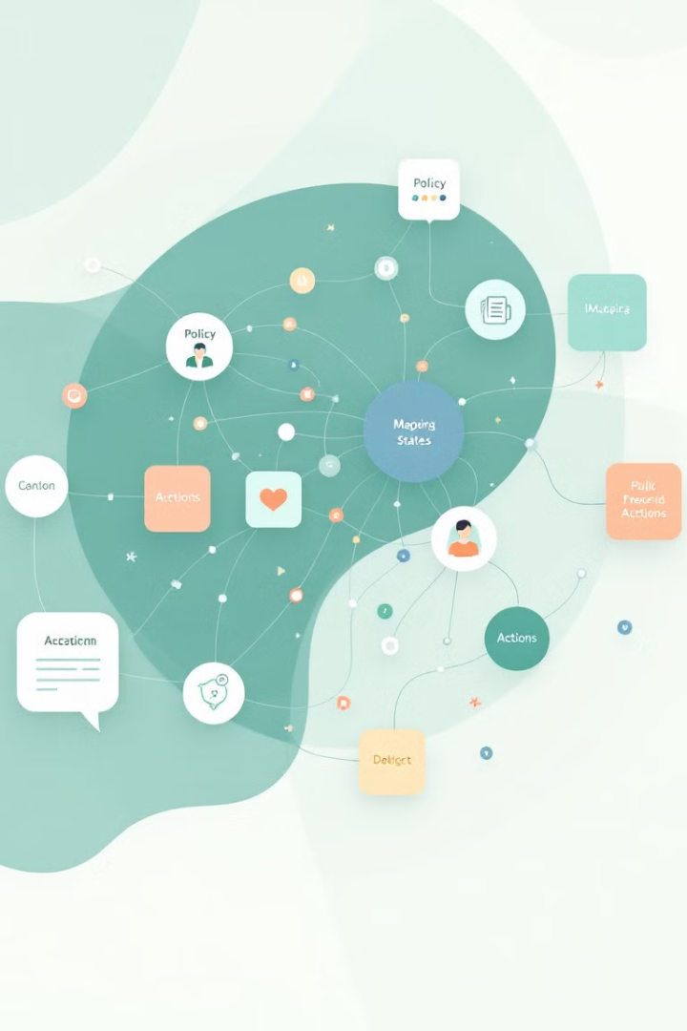
Key Elements of the RL Framework
State (S)
Action (A)
A snapshot of the environment at a specific moment. It provides all relevant information for decision-making.
The set of possible moves an agent can make. These vary depending on the problem space.
Policy (π)
The strategy that guides action selection. It maps states to actions, evolving through learning.

Slide 5

Learning Through Trial and Error
Start with Random Actions
The agent begins with no knowledge of optimal behavior.
Collect Feedback
Each action yields rewards that indicate success or failure.
Update Strategy
The agent adjusts its policy to maximize future rewards.
Improve Over Time
Performance enhances with more experience and learning.

Slide 6

Case Study: Teaching AI to Play Flappy Bird
States
Actions
Rewards
Bird position
Flap wings
+1 for passing pipes
Bird velocity
Do nothing
-10 for crashing
Distance to pipes

Slide 7




Popular Reinforcement Learning Algorithms
Advanced Actor-Critic Methods
1
Combines value and policy optimization
Deep Q-Networks (DQN)
2
Uses neural networks for complex environments
Q-Learning
3
Learns optimal value functions without model
Basic Value Iteration
4
Foundation for tabular solutions

Slide 8
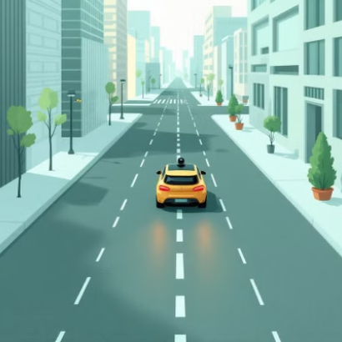
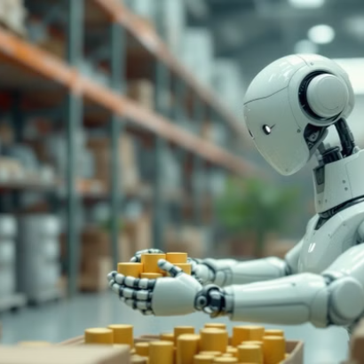


Real-World Applications of Reinforcement Learning
Reinforcement learning powers innovations across industries—from autonomous vehicles to robotic automation, algorithmic trading, and smart energy systems.

