Slide 1
💬
NATURAL LANGUAGE PROCESSING
Day 3 · Disaster Response Coordination

Slide 2
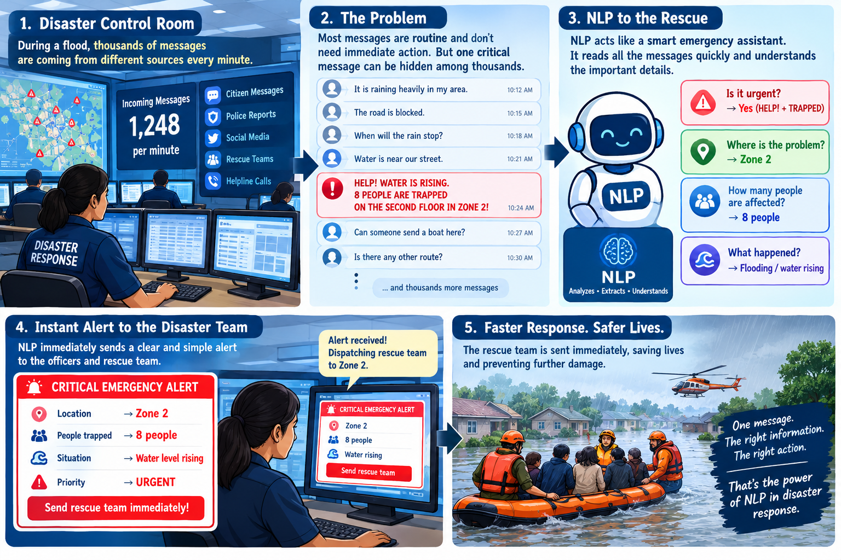

Slide 3
THE REAL PROBLEM
Can a Human Read Thousands of Messages, 24/7?
📨
Thousands of messages
INCOMING MESSAGE FEED
arrive every hour across every channel
💬 Good morning, all quiet here
Multiple channels
💬 Class is cancelled today
📡
SMS, social posts, dispatch logs, helplines
💬 Roads are a bit wet near camp
A constant stream
💬 Where is the relief center?
⏱️
there is no pause button during a disaster
🚨 HELP! 8 people trapped, water rising, Zone 2
Need for instant triage
💬 Can someone confirm the boat schedule?
⚡
seconds matter for the critical few
We need a system that can read language itself and predict what matters. This is where Natural Language Processing enters the story.
5

Slide 4
What Is NLP?
RAW
MESSAGES
→
FIND
PATTERNS
→
NEW
MESSAGE
→
PREDICT
URGENCY
Natural Language Processing means learning patterns from past messages
to make predictions about new ones.
“just checking in, all good here”
LOW RISK
“heard sirens, not sure what's happening”
MODERATE RISK
“HELP water rising cant see street sign”
SEVERE RISK
If a new message uses words similar to the Severe examples, what should the model predict?
Notes:
Walk through the three example rows left to right before asking the closing question.

Slide 5
LIVE DEMO — OUR TRAINED MODEL
New Emergency Message Incoming...
“8 people are trapped in Zone 2. Water is rising rapidly. Send a rescue boat immediately.”
↓
PREDICTED URGENCY: HIGH
7

Slide 6
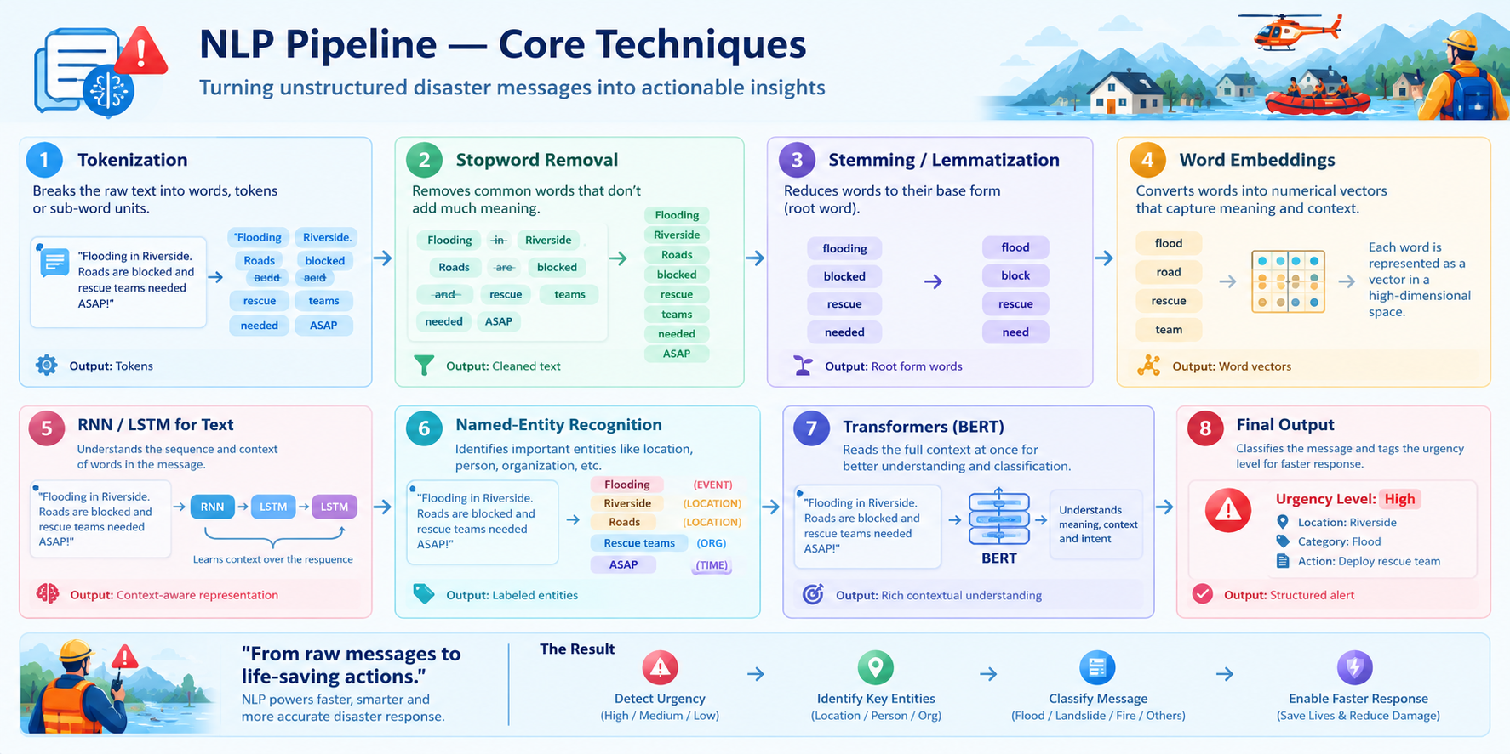

Slide 7
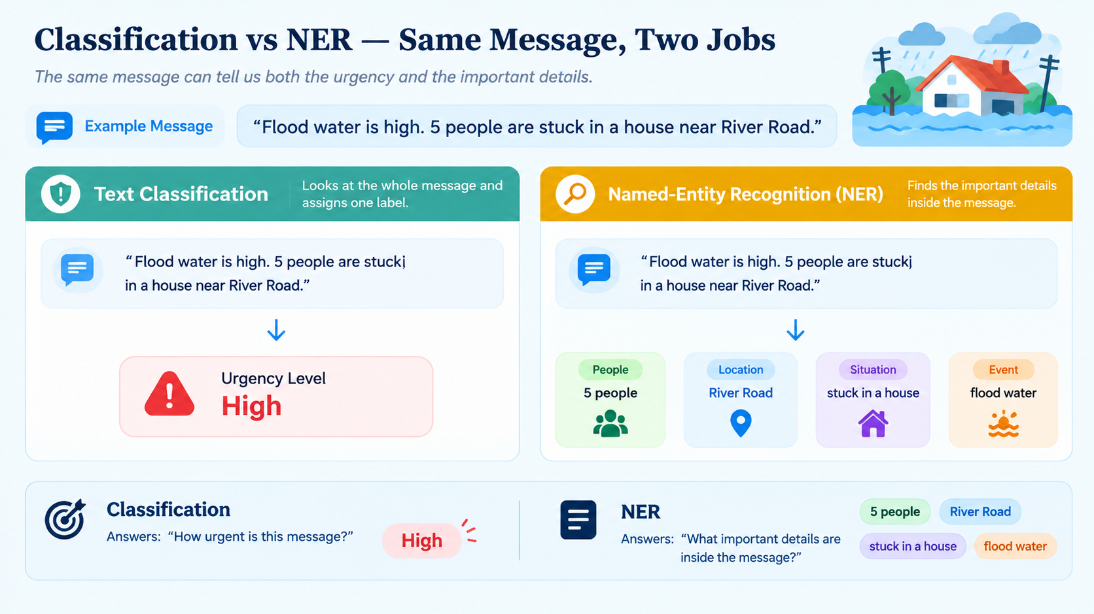
Types of NLP Tasks

Slide 8
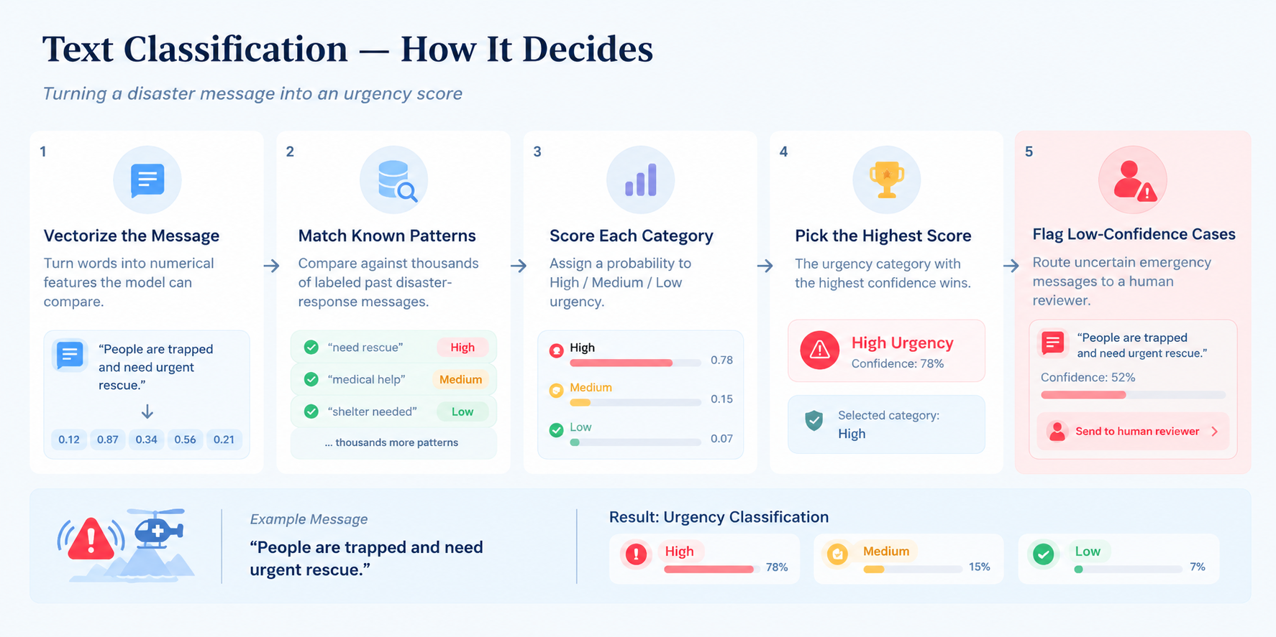

Slide 9
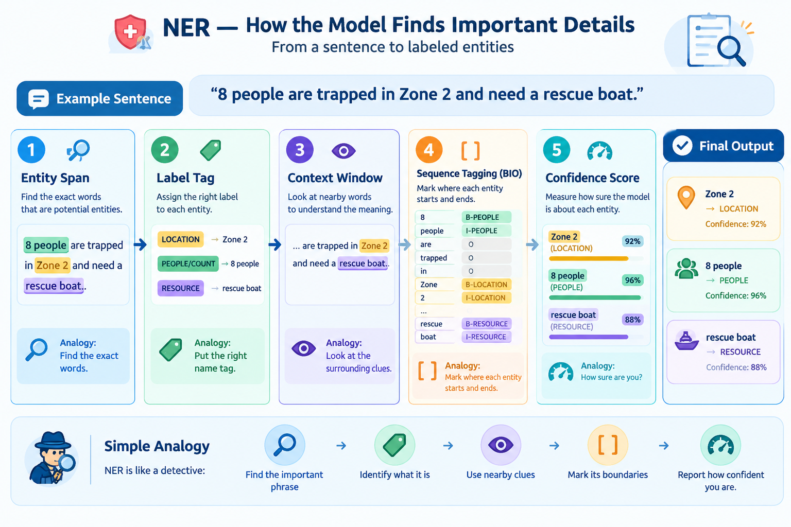
NER — Core Building Blocks

Slide 10
NEW PROBLEM
Can We Train a Model on Messy Text?
Can we directly train an
NLP model using messy text?
“help help oak street water”
(duplicate)
“help help oak street water”
← Duplicate
“wtr risin cnt c strt sgn hlp”
(typos/slang)
NO.
“ ” — no text, blank entry
← Missing
Every NLP system needs someone to clean and annotate the text first.
Notes:
Point at the duplicate row, the typo-laden slang, and the blank entry — let students name the problems before you label them.

Slide 11
MEET THE ROLE
🧹
DATA ENGINEER
Problem: Raw text is messy and comes from many channels — dispatch logs, SOPs, social posts.
Multiple raw text sources
Remove duplicates & noise
Annotate urgency labels
Combine data
ONE CLEAN, ANNOTATED TEXT DATASET
The Data Engineer prepares clean, labeled text for the next stage.
Notes:
Connect back to slide 16's messy text examples — this role fixes exactly what students just flagged.

Slide 12
NEW PROBLEM
Does the Vocabulary Make Sense?
“everything is totally fine, no problem at all!!! HELP”
🔍
EDA ENGINEER
Does this look normal? Or could this be sarcasm, a false alarm, or a mislabeled record?
The EDA Engineer explores vocabulary, finds patterns, and checks suspicious or ambiguous phrasing.
Clean Data
Explore Vocabulary
Find Ambiguity
Verified Signal
Notes:
Let students argue both sides — 'sarcasm' vs 'real emergency' — before naming the role.

Slide 13
MEET THE ROLE
Now our data is clean and verified. What should we do next?
🧠
NLP ENGINEER
Raw Message Text
NLP MODEL
(Classifier + NER)
Urgency: Low/Mod/Severe
→
→
Vocabulary Signals
Entities: Location, Resource, Headcount
The NLP Engineer trains the pipeline using past data so it can read a new message.
Notes:
This is the slide where 'training' finally gets a face — the NLP Engineer, not magic.

Slide 14
CAN WE TRUST IT?
The pipeline is 100% correct on training logs. Should we trust it immediately?
TRAINING DATA
Model has already seen it
UNSEEN TEST LOGS
Model has never seen it
NO.
✅
EVALUATION ENGINEER
Tests the pipeline on unseen logs to check whether it really learned the pattern — or only memorized the training data.
Precision / Recall
Overconfidence
How many urgent messages were caught correctly
Model is very confident but wrong
Notes:
Use the analogy: memorizing exam answers vs actually understanding the subject.

Slide 15
INTEGRATION ENGINEER
🚨 Disaster Response Command Center
📱 Emergency Message Input: "8 people are trapped in Zone 2. Water is rising rapidly. Send a rescue boat immediately."
📍 LOCATION
👥 PEOPLE AFFECTED
⚠️ PREDICTED URGENCY
📊 SIMILARITY
Zone 2
8
HIGH
63.44%
🚑 RESOURCE REQUIRED
🤖 AI RECOMMENDED ACTION
rescue boat, boat, water
⚠️ Prioritize rescue operation immediately
This is the real interface built in app.py using Streamlit — wired directly to the same trained model you just saw predict live.

