Slide 1
💬
SMALL LANGUAGE MODEL
Day 4 · Disaster Response Coordination

Slide 2
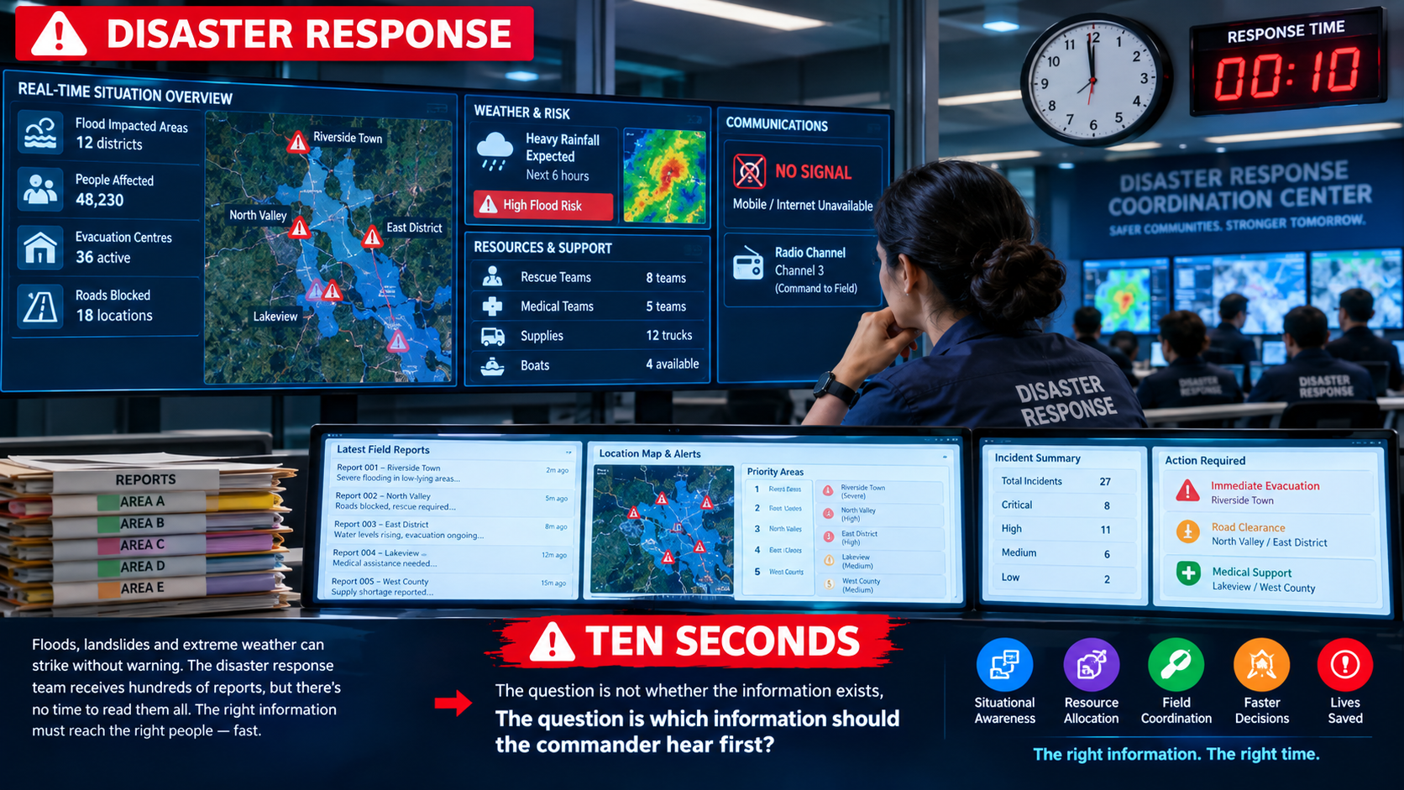

Slide 3
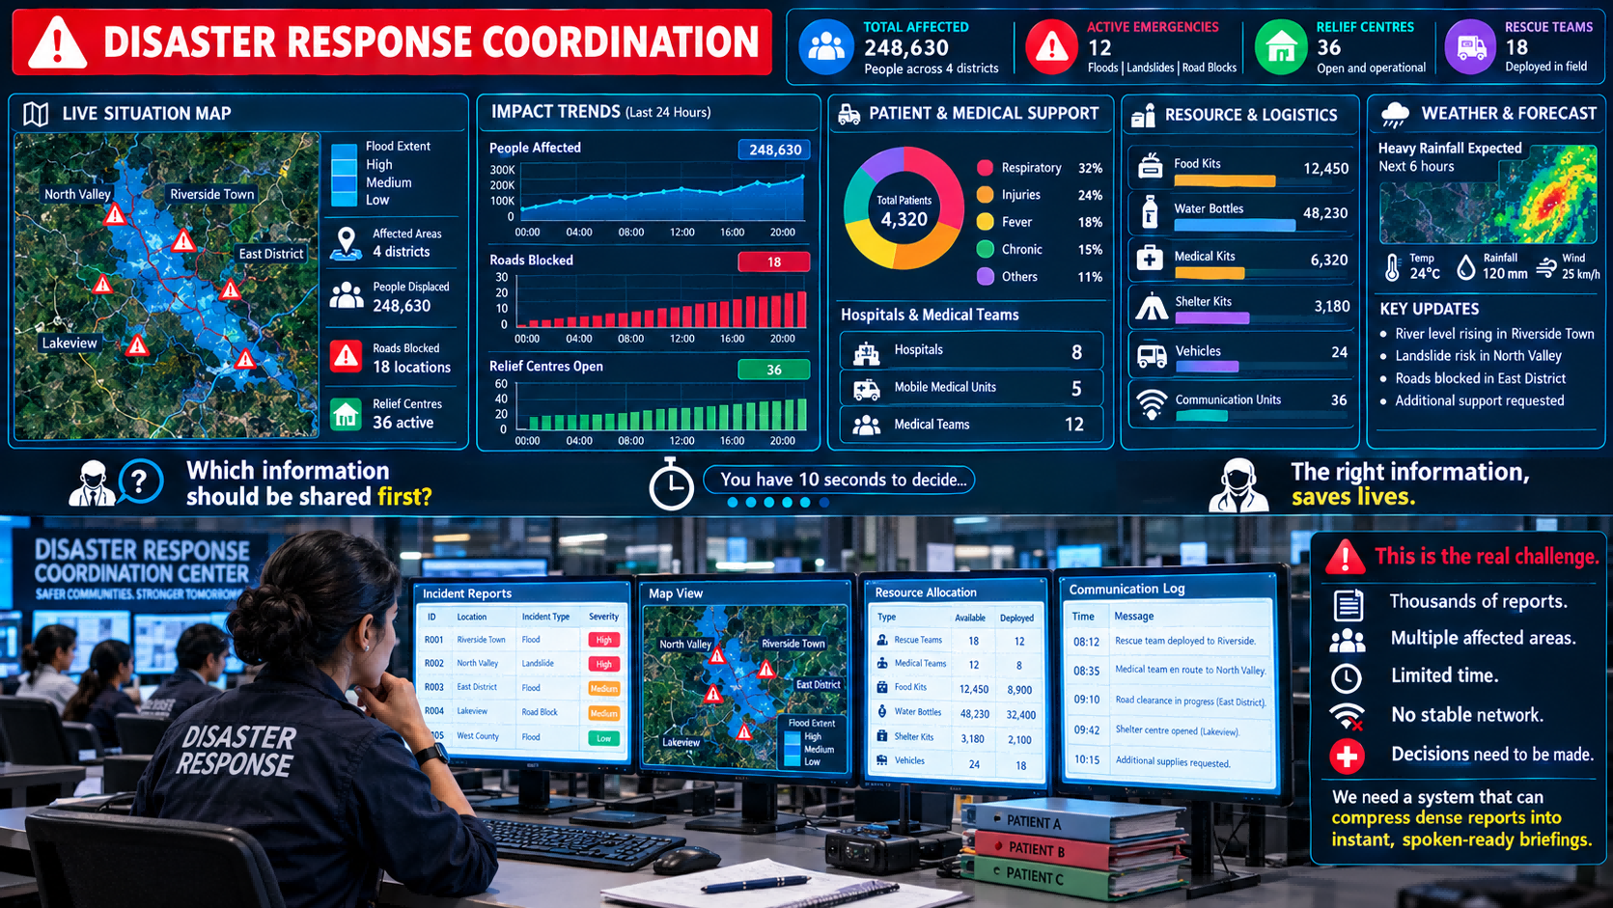

Slide 4
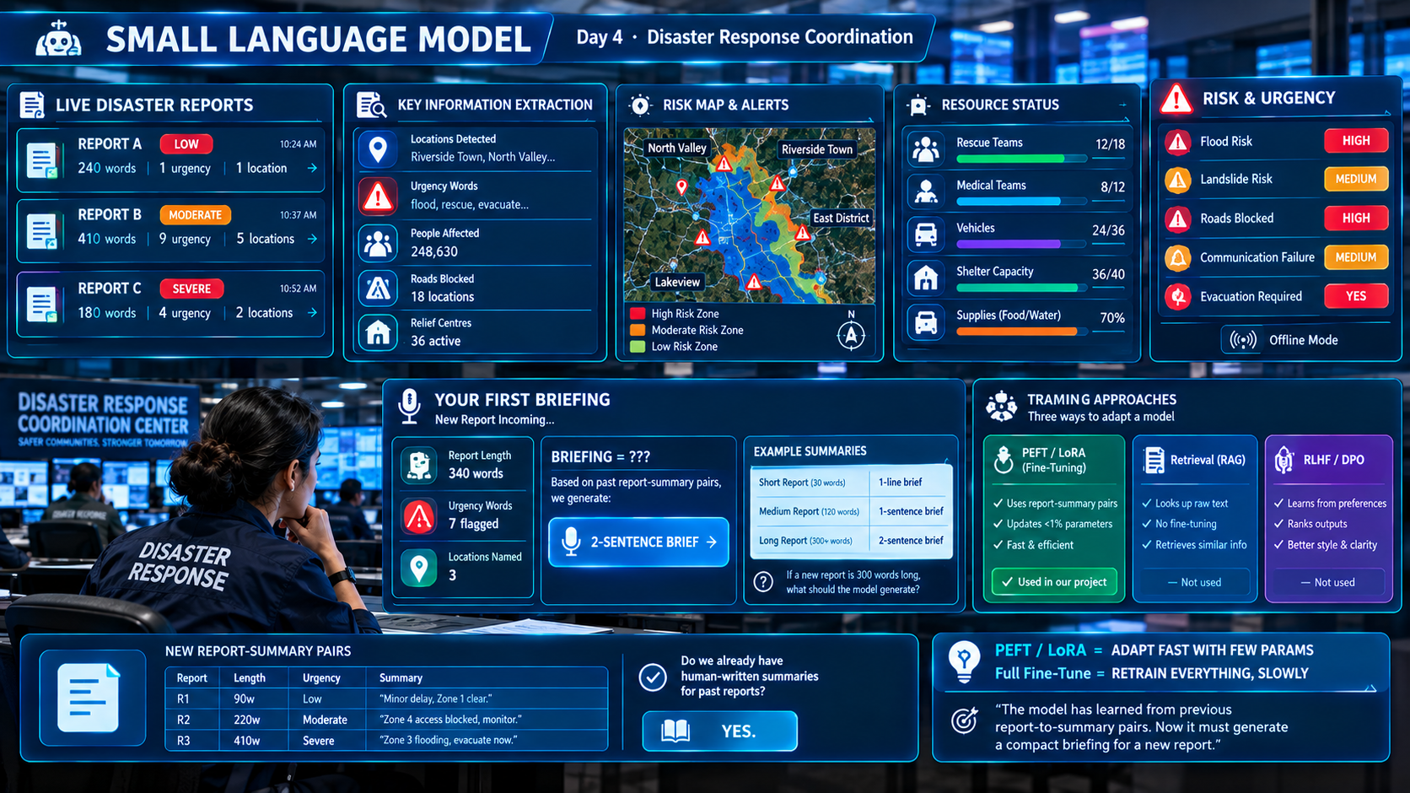

Slide 5
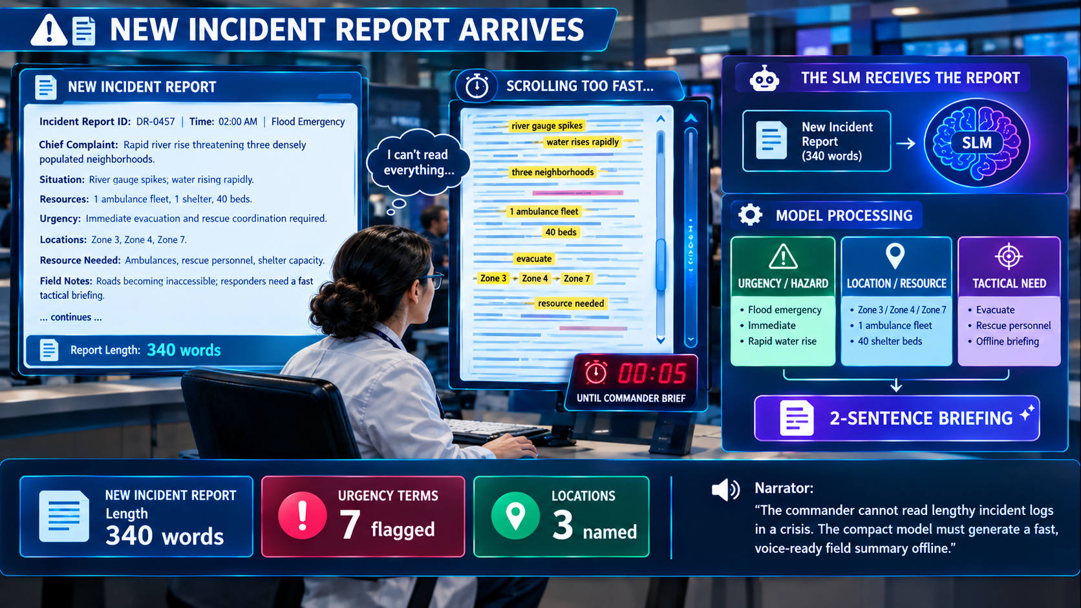

Slide 6
What Is a Small Language Model?
FULL REPORT
(200+ words)
→
EXTRACT
KEY FACTS
→
COMPACT
MODEL
→
GENERATE
BRIEFING
A Small Language Model means compressing a large model's knowledge
into a compact model fine-tuned for one job: fast, offline summaries.
Short report (30 words)
1-LINE BRIEF
Medium report (120 words)
1-SENTENCE BRIEF
Long report (300+ words)
2-SENTENCE BRIEF
If a new report is 300 words long, what should the model generate?
Notes:
Walk through the three example rows left to right before asking the closing question.

Slide 7
NEW PROBLEM
Can We Fine-Tune on Messy Report-Summary Pairs?
Report
length
Urgency
Summary
Can we directly fine-tune an SLM
using messy pairs?
R1
90 words
Low
“Minor Delay.Zone 1 is clear”
R2
220 words
moderate
-
← Duplicate
R3
410 words
severe
“Zone 3 flooding , evacuate now”
NO.
Every SLM system needs someone to prepare the training pairs first.
Notes:
Point at the duplicate row and the missing cell — let students name the problems before you label them.

Slide 8
MEET THE ROLE
🧹
DATA ENGINEER
Problem: Raw report-summary pairs are messy and come from different sources.
Multiple raw pair files
Remove duplicate pairs
Handle missing summaries
Combine into one set
ONE CLEAN FINE-TUNING DATASET
The Data Engineer prepares clean, usable report-summary pairs for the next stage.
Notes:
Connect back to Slide 9's messy table — this role fixes exactly what students just flagged.

Slide 9
NEW PROBLEM
Does the Summary Make Sense?
Report
"Zone 1 minor delay"
Does this summary match the report? Or did the model invent details?
Summary
"Zone 1 catastrophic, all units!"
Match?
No
Flag
Hallucination
🔍
EDA ENGINEER
The EDA Engineer explores the pairs, checks token patterns, and flags summaries that drift from the source.
Clean Pairs
→
Explore Token Patterns
→
Find Hallucinations
→
Verified Pairs
Notes:
Let students argue both sides — 'plausible' vs 'invented' — before naming the role.

Slide 10
MEET THE ROLE
Now our pairs are clean and verified. What should we do next?
⚙️
SLM ENGINEER
Full Report
Short brief
SLM MODEL
(PEFT / LoRA Fine-Tuned)
Length
→
→
1 - sentence brief
Urgency Tags
2-sentence brief
Locations
The SLM Engineer fine-tunes the model using past pairs so it can generate a briefing for a new report.
Notes:
This is the slide where 'fine-tuning' finally gets a face — the SLM Engineer, not magic.

Slide 11
Full Fine-Tuning vs PEFT/LoRA — Same Report Data
The key difference: how many parameters does training actually touch?
🟢 PEFT / LoRA FINE-TUNING
🔵 FULL FINE-TUNING
Report | Length (words) | Adapter % | Summary
R1 | 90 | 0.3% | Low
R2 | 220 | 0.3% | Moderate
R3 | 410 | 0.3% | Severe
R4 | 140 | 0.3% | Low
R5 | 350 | 0.3% | Severe
Report | Length (words) | Params Updated %
R1 | 100 | 100%
R2 | 130 | 100%
R3 | 410 | 100%
R4 | 380 | 100%
R5 | 150 | 100%
FROZEN BASE + TINY ADAPTER → MODEL LEARNS
Learns to compress reports by training less than 1% of parameters.
ALL WEIGHTS RETRAINED → MODEL LEARNS SLOWLY
Every parameter is touched and updated.
NEW REPORT: 320 words | Adapter only
→ Model generates: 2-sentence briefing
COST
Full GPU cluster, hours
RESULT
Same accuracy, far slower
PEFT/LoRA = ADAPT FAST WITH FEW PARAMS | FULL FINE-TUNE = RETRAIN EVERYTHING, SLOWLY

Slide 12
Do We Already Have Report-Summary Pairs?
Report
Length
Urgency
Summary
Do we already have human-written summaries for past reports?
R1
90w
Low
"Minor delay, Zone 1 clear."
R2
220w
Moderate
"Zone 4 access blocked, monitor."
YES.
R3
410w
Severe
"Zone 3 flooding, evacuate now."
📘
PEFT / LoRA FINE-TUNING
We already have past reports and their human-written summaries.
The model learns the mapping from a full report to a compact briefing.
RAG: retrieves similar text, no training
RLHF: learns from ranked preference feedback
Our briefing project uses PEFT/LoRA Fine-Tuning.
Notes:
Keep RAG/RLHF to one line each — they are context, not the lesson.

Slide 13
How Should the Model Condense the Report?
If a report is long, should we just chop it in half? What should we extract first?
Location mentioned?
↓ YES
You just built an extraction-to-briefing pipeline.
Resource needed named?
↓ YES
The model checks a series of key facts — location, resource, urgency — one at a time, before generating a briefing.
Headcount / urgency stated?
↓ YES
🎙️ 2-SENTENCE BRIEFING
For this project, we use INSTRUCTION-TUNED PEFT/LoRA — fast, offline-capable, and easy to deploy on any laptop.
Notes:
Build this pipeline live with the class — ask 'what should we check next?' after each yes.

Slide 14
CAN WE TRUST IT?
The model sounds fluent and confident on training reports. Should we trust it immediately?
NO.
TRAINING DATA
UNSEEN TEST DATA
Model has already seen it
Model has never seen it
✅
EVALUATION ENGINEER
Tests the model on unseen reports to check whether summaries stay accurate — or only sound fluent.
Actual Facts vs Generated Summary
Accuracy
How many key facts are kept
Overconfidence
Model sounds fluent but drops or invents facts
Notes:
Use the analogy: memorizing exam answers vs actually understanding the subject.

Slide 15
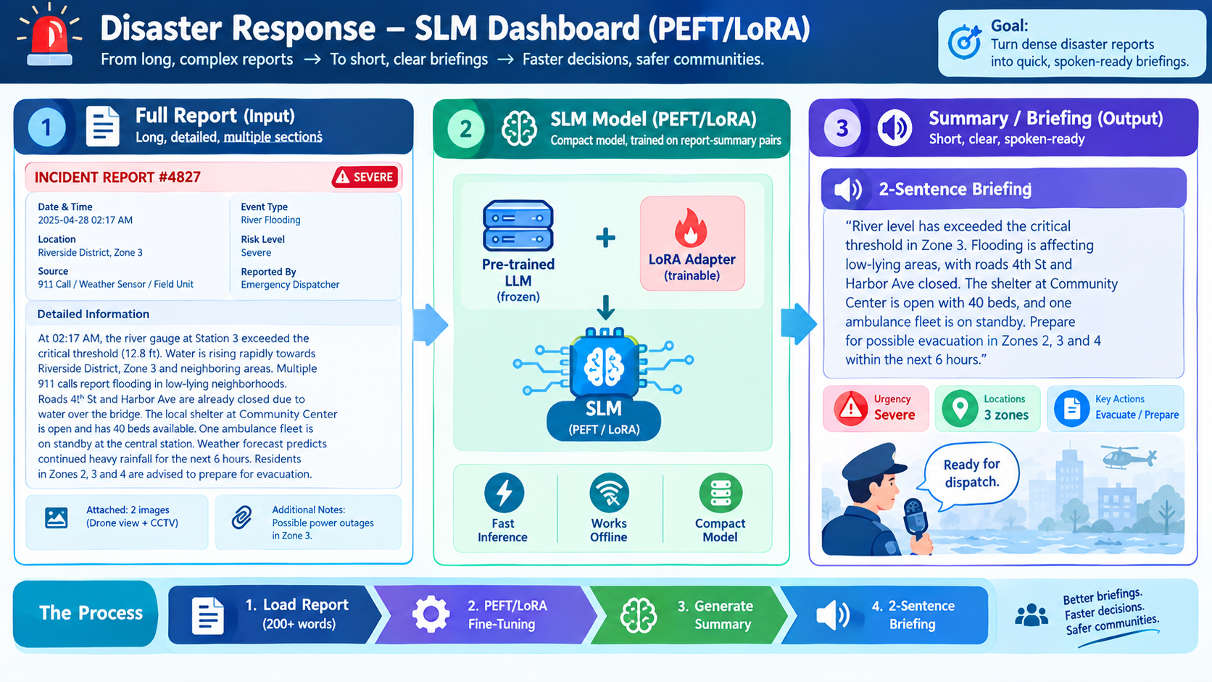
INTEGRATION ENGINEER

