Slide 1
PERCENTAGE

Slide 2
Percentage - 2
Passing marks based problems.
Miscellaneous Percentage problem (Venn diagram, Dry fruits).
Data Sufficiency on related topic.
Voting based problems.
Percentage bifurcation based problems
Population increment or decrement

Slide 3
Percentage
1. A student has to secure minimum 35% marks to pass in an examination. If he gets 200 marks and fails by 10 marks, then the maximum marks are
A] 200 B] 600
C] 500 D] 800
Notes:
Correct Option B
Compulsory
Difficulty level: Easy

Slide 4
Percentage
2. A candidate who scores 30 per cent fails by 5 marks, while another candidate who scores 40 per cent marks gets 10 more than minimum pass marks. The minimum marks required to pass are
A] 50 B] 150
C] 70 D] 100
Notes:
Correct Option A
Compulsory
Difficulty level: Easy

Slide 5
Percentage
3. Radha spends 40% of her salary on food, 20% on house rent, 10% on entertainment and 10% on conveyance. If her savings at the end of a month are 1500, then her salary per month (in ) is
A] Rs. 7500 B] Rs.8000
C] Rs.6000 D] Rs.10000
Notes:
Correct Option A
Compulsory
Difficulty level: Easy

Slide 6
Percentage
4. A person gave 20% of his income to his elder son, 30% of the remaining to the younger son and 10% of the remaining, he donated to a trust. He is left with 10080. His income was :
A] Rs. 50000 B] Rs. 40000
C] Rs. 30000 D] Rs. 20000
Notes:
Correct Option D
Compulsory
Difficulty level: Moderate

Slide 7
Percentage
5. village lost 12% of its goats in a flood and 5% of remainder died from diseases. If the number left now is 8360, what was the original number before the flood?
A] Rs. 10000 B] Rs. 9000
C] Rs. 11000 D] Rs. 12000
Notes:
Correct option: A
Difficulty level: Moderate

Slide 8
Percentage
Voting Concept:
Total Votes
Casted Votes
Uncasted Votes
Valid Votes
Invalid Votes
Votes to Winner
Votes to Loser
Winning Difference

Slide 9
Percentage
6. At an election there were two candidates. A candidate got 37.5% of votes and lost by 6500 number of votes. The total number of valid votes were
A] 13000 B] 13800
C] 16200 D] 26000
Notes:
Correct option: D
Compulsory
Difficulty level: Easy

Slide 10
Percentage
7. In an assembly election, a candidate got 55% of the total valid votes. 2% of the total votes were declared invalid. If the total number of voters is 104000, then the number of valid votes polled in favor of the candidate is: A] 56506 B] 56650
C] 56560 D] 56056
Notes:
Correct Option: D
Difficulty level: Moderate

Slide 11
Percentage
8. 8% of the voters in an election did not cast their votes. In this election, there were only two candidates. The winner by obtaining 48% of the total votes defeated his contestant by 1100 votes. The total number of voters in the election was :
A] 21000 B] 23500
C] 22000 D] 27500
Notes:
Correct Option D
Compulsory
Difficulty level: Moderate

Slide 12
Percentage
9. In an election 10% of the voters on the voters’ list did not cast their votes and 60 voters cast their ballot papers blank. There were only two candidates. The winner was supported by 47% of all the voters in the list and he got 308 votes more than his rival. The number of voters on the list was
A] 3600 B] 6200
C] 4575 D] 6028
Notes:
Correct Option B
Compulsory
Difficulty level: Difficult

Slide 13
Percentage
10. In a certain office, 66% of workers prefer tea and 44% prefer coffee. If each on them prefers tea or coffee and 40 like both, the total number of workers in the office is:
A] 400 B] 220
C] 252 D] 284
Notes:
Correct Option A
Compulsory
Difficulty level: Easy

Slide 14
Percentage
11. In a school of 1000 students, 40% of the students play football and 50% of the students play cricket. If 18% of the students play neither football nor cricket, percentage of students playing both is,
A] 80 B] 800
C] 40 D] 400
Notes:
Correct Option A
Compulsory
Difficulty level: Easy

Slide 15
Percentage
12. In a survey of 500 students of a college, it was found that 49% liked watching football, 53% liked watching hockey and 62% liked watching basketball. Also, 27% liked watching football and hockey both, 29% liked watching basketball and hockey both and 28% liked watching football and basket ball both. 5% liked watching none of these games. How many students like watching all the three games?
A] 75 B] 80
C] 40 D] 40
Notes:
Correct Option A
Difficulty level: Moderate

Slide 16
Percentage
13. Fresh fruit contains 68% of water and dry fruit contains 20% water. How much dry fruit can be obtained from 100 kg of fresh fruits?
A] 52 kg B] 32 kg
C] 50 kg D] 40 kg
Notes:
Correct Option: D
Compulsory
Difficulty level: Moderate

Slide 17
Percentage
14. Fresh grapes contains 80% water while dry grapes contain 10% water. If the weight of dry grapes is 500kg, then what is its total weight when it fresh?
A] 1500 kg B] 1570 kg
C] 2250 kg D] 2040 kg
Notes:
Correct Option: C
Difficulty level: Moderate

Slide 18
Percentage
15. Of the 1000 inhabitants of a town, 60% are males of whom 20% are literate. If, of all the inhabitants, 25% are literate, then what percent of the females of the town are literate?
A] 15 % B] 35.70 %
C] 32.5 % D] 20.40 %
Notes:
Correct Option: C
Compulsory
Difficulty level: Moderate

Slide 19
Percentage
16. The ratio of the number of boys to that of girls in a school is 4 : 1. If 75% of boys and 70% of the girls are scholarship-holders, then the percentage of students who do not get scholarship is
A] 50 % B] 74 %
C] 26 % D] 60 %
Notes:
Correct Option: C
Difficulty level: Difficult

Slide 20
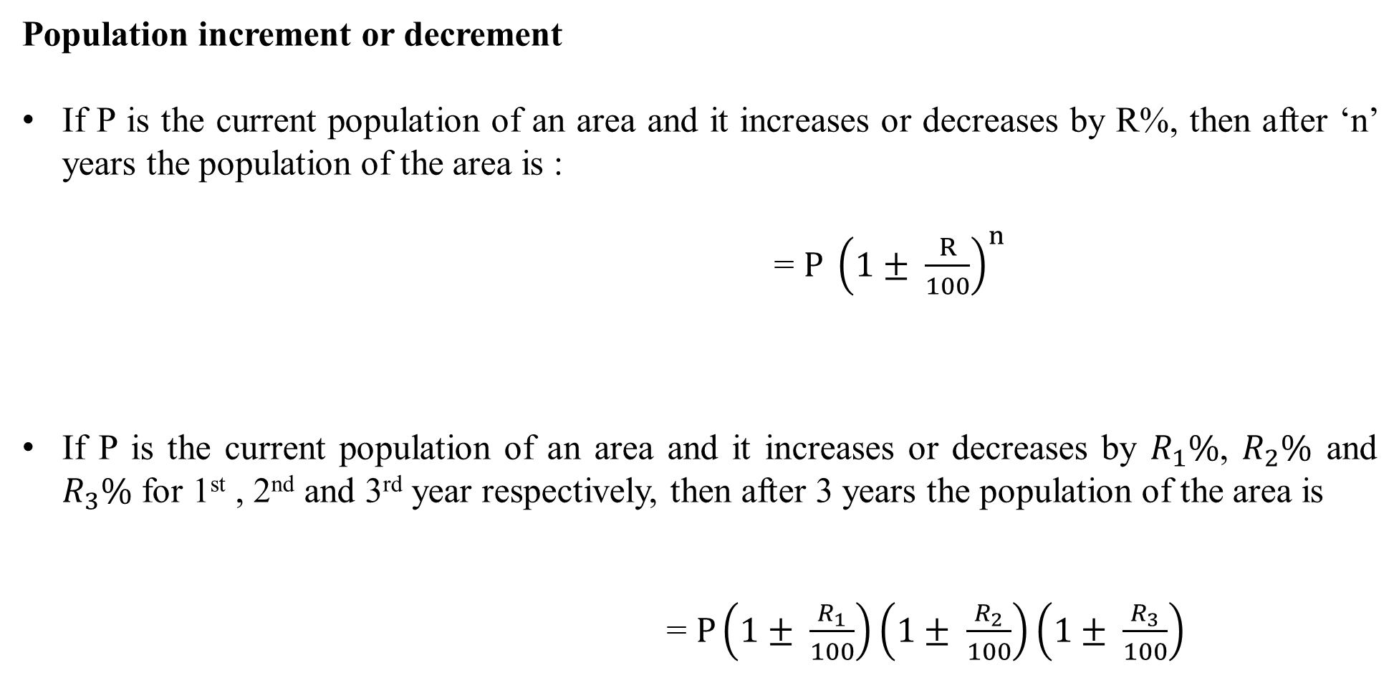
Percentage
Population increment or decrement
If P is the current population of an area and it increases or decreases by R%, then after ‘n’ years the population of the area is :
= $P {\left(1± \frac{R}{100}\right)}^{n}$
If P is the current population of an area and it increases or decreases by $R_{1}\%$, $R_{2}\%$ and $R_{3}\%$ for 1st , 2nd and 3rd year respectively, then after 3years the population of the area is
= $P\left(1± \frac{R_{1}}{100}\right)\left(1± \frac{R_{2}}{100}\right)\left(1± \frac{R_{3}}{100}\right)$

Slide 21
Percentage
17. The present population of a city is 160000. If it increases at the rate of 12.5% per annum, its population after 2 years will be :
A] 205000 B] 250500
C] 202500 D] 200500
Notes:
Correct Option: C
Compulsory
Difficulty level: Easy

Slide 22
Percentage
18. A district has 64000 inhabitants. If the population increases at the rate of 2 (1/2) % per annum, the number of inhabitants at the end of 3 years will be
A] 70000 B] 69200
C] 68921 D] 68911
Notes:
Correct Option: C
Compulsory
Difficulty level: Moderate

Slide 23
Percentage
19. The population of a town increased by 10% and decreased by 10% for next year and similarly 10% increase and decrease for the next 2 years. If the current population is 9801 what was the population of the town 4 years ago?
A] 12100 B] 10000
C] 14000 D] 11000
Notes:
Correct Option: B
Compulsory
Difficulty level: Difficult

Slide 24
Percentage
20. The population of a town was 1,60,000 three years ago, If it increased by 3%, 2.5% and 5% respectively in the last three years, then the present population in
A] 155679 B] 167890
C] 179890 D] 177366
Notes:
Correct Option: D
Compulsory
Difficulty level: Difficult

Slide 25
Percentage
21. A salesman gets 18% commission of the total sales up to Rs. 20000 and gets 2% extra commission for the sales of more than Rs. 20000. His earnings for a certain month is Rs. 18800. Find the total sale of that month.
A] 60000 B] 85700
C] 96000 D] 72000
Notes:
Correct Option: C
Compulsory
Difficulty level: Difficult

Slide 26
Percentage
22. Class B has 50% more students than class A. Number of girls in class A is equal to number of boys in class B. The percentage of girls is the same in both classes. What percentage of the student group are boys?
A] 40 % B] 50 %
C] 33.33 % D] 60 %
Notes:
Correct Option: A
Compulsory
Difficulty level: Difficult

Slide 27
Percentage
23. A two digit number ab is 60% of x. The two-digit number formed by reversing the digits of ab is 60% more than x. Find x.
A] 45 B] 54
C] 63 D] 72
Notes:
Correct Option: A
Compulsory
Difficulty level: Difficult

Slide 28
Percentage
For the following question two statements are given. Use the data of those statements and then determine which of the following statements is necessary to answer the question.
A] Statement I is sufficient to answer the question.
B] Statement II is sufficient to answer the question.
C] Either Statement I or statement II is sufficient to answer the question.
D] Neither Statement I nor statement II is sufficient to answer the question.
E] Both Statements I and II are necessary to answer the question.
24. What is the ratio of two numbers?
Statement I . 40% of x is 20% of 50.
Statement II. 30% of y is 25% of 72.
Notes:
Correct Option E
Compulsory
Difficulty level: Easy

Slide 29
Percentage
For the following question two statements are given. Use the data of those statements and then determine which of the following statements is necessary to answer the question.
A] Statement I is sufficient to answer the question.
B] Statement II is sufficient to answer the question.
C] Either Statement I or statement II is sufficient to answer the question.
D] Neither Statement I nor statement II is sufficient to answer the question.
E] Both Statements I and II are necessary to answer the question.
25. What is the value of 20 percent of x?
Statement I . One- fourth of 20 percent of x is 5.
Statement II. 4x = S, 5y = S and y = 80.
Notes:
Correct Option A
Compulsory
Difficulty level: Easy

Slide 30
Percentage
Directions (Question no. 26 to 27):
For each of the following questions two statements are given. Use the data of those statements and then determine which of the following statements is necessary to answer the question.
A] Statement I is sufficient to answer the question.
B] Statement II is sufficient to answer the question.
C] Either Statement I or statement II is sufficient to answer the question.
D] Neither Statement I nor statement II is sufficient to answer the question.
E] Both Statements I and II are necessary to answer the question.

Slide 31
Percentage
26. What percent of a company's employees are women with a college degree?
Statement I . Of the women employed in the company, 40% do not have a college degree.
Statement II. There are 400 men out of 1000 employees.
Notes:
Correct Option E
Difficulty level: Moderate

Slide 32
Percentage
27. In 2013 there are 300 employees at Company ABC. If the number of employees at Company ABC increased by 200% from 1993 to 2013, by what percent did the number of employees at Company ABC increase from 2003 to 2013?
Statement I . In 2003 there were 160 employees at Company ABC.
Statement II. From 1993 to 2003 the number of employees increased by 60% at Company ABC.
Notes:
Correct Option C
Difficulty level: Difficult

Slide 33
Any Doubts???

