Slide 1
PROFIT AND LOSS
Profit and Loss

Slide 2
PROFIT & LOSS
Basic Terms and Important formula
Relation between CP, SP and MP
Number of articles based questions
Successive discount problems
Concept of Dishonest shopkeeper/ Faulty weight
Data Sufficiency on related topic

Slide 3
Profit and Loss
Basic Terms:
Cost Price(CP) : The price at which an object is Purchased
Selling Price (SP): The price at which the object is Sold.
Profit or Gain: When SP > CP then Profit or Gain will occur.
Loss: When SP < CP then Loss will occur.
Marked Price (List price/ Label Price/Sale Price/MRP): The Price at which a Product is marked is called marked price.
Discount : The concession provided on the marked price is called the discount.
Note: Actual loss% and profit% both are calculated with respect to CP while the discount% is calculated with respect to Marked Price.

Slide 4
Profit and Loss
Important Formula:
Profit or Gain = SP – CP
Loss = CP – SP
Profit % = (Profit / CP ) * 100
Loss % = (Loss / CP) * 100
Discount = MP – SP
Discount % = (D/MP)* 100
When X articles are free with Y articles, then discount% is equals to
D% = [X / (X+Y)]*100

Slide 5
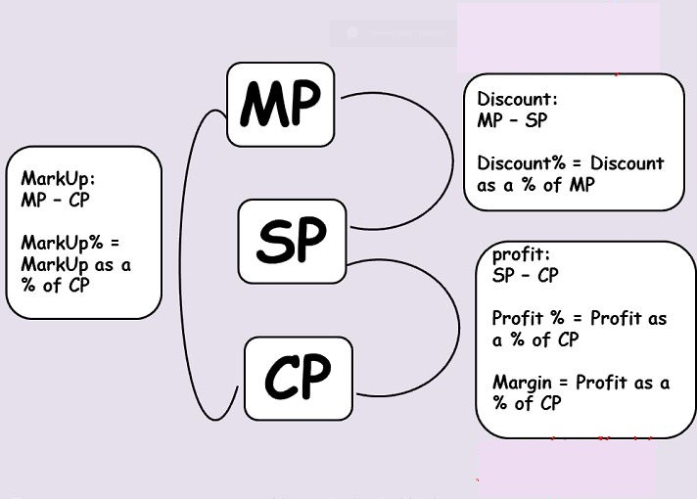
Profit and Loss
Relation among Cost Price, Selling Price and Marked Price:

Slide 6
Profit and Loss
1. A man buys a cycle for 1400 and sells it at a loss of 15%. What is the selling price of the cycle?
A] Rs. 1201 B] Rs. 1190
C] Rs. 1160 D] Rs. 1000
Notes:
Option B
Compulsory
Difficulty level: Easy

Slide 7
Profit and Loss
2. A shopkeeper sells his article at 40% profit on selling price. Find his actual profit%?
A] 25% B] 40%
C] 66 (2/3)% D] 50%
Notes:
Option: C
Compulsory
Difficulty level: Easy

Slide 8
Profit and Loss
3. There is a profit of 20% on the cost price of an article. The % of profit, when calculated on selling price is
A] 16 (2/3)% B] 20%
C] 66 (1/3)% D] 33 (1/3)%
Notes:
Option: A
Difficulty level: Easy

Slide 9
Profit and Loss
4. By selling an article for Rs. 450, I lose 20%. For what price should I sell it to gain 20% ?
A] Rs. 490 B] Rs. 675
C] Rs. 470 D] Rs. 562.5
Notes:
Option B
Compulsory
Difficulty level: Easy

Slide 10
Profit and Loss
5. A shopkeeper sold an article at a loss of 9%. Had he sold it for Rs. 750 more than he would gain 6%. Find the cost price?
A] Rs. 5000 B] Rs. 4200
C] Rs. 4600 D] Rs. 4800
Notes:
Option: A
Compulsory
Difficulty level: Easy

Slide 11
Profit and Loss
6. If the profit on selling an article for Rs. 425 is the same as the loss on selling it for Rs. 355, then the cost price of the article is
A] Rs. 410 B] Rs. 380
C] Rs. 400 D] Rs. 390
Notes:
Option D
Compulsory
Difficulty level: Easy

Slide 12
Profit and Loss
7. The profit (in Rs.) after selling an article for Rs. 524 is the twice as the loss (in Rs.) after selling it for Rs. 452. The cost price of the article is:
A] Rs. 460 B] Rs. 476
C] Rs. 470 D] Rs. 500
Notes:
Option B
Compulsory
Difficulty level: Easy

Slide 13
Profit and Loss
8. The selling price of 5 articles is the same as the cost price of 3 articles. The gain or loss percent is :
A] 20 %gain B] 25 % gain
C] 33.33 % loss D] 40 % loss
Notes:
option: D
Compulsory
Difficulty level: Moderate

Slide 14
Profit and Loss
9. A cloth merchant on selling 33 metres of cloth obtains a profit equal to the selling price of 11 metres of cloth. The profit percent is
A] 50 % B] 22 %
C] 11 % D] 40 %
Notes:
Option: A
Compulsory
Difficulty level: Moderate

Slide 15
Profit and Loss
10. A bookseller procures 50 books for Rs. 2000 and sells them at a profit equal to the selling price of 10 books. What is the selling price of one dozen books, if the price of each book is same?
A] Rs. 1500 B] Rs.1200
C] Rs. 1000 D] Rs. 600
Notes:
Option D
Difficulty level: Moderate

Slide 16
Profit and Loss
11. A person buys some pencils at 5 for a rupee and sells them at 3 for a rupee. His gain per cent will be :
A] 30 % B] 50 %
C] 66 (2/3)% D] 40 %
Notes:
Option: C
Compulsory
Difficulty level: Moderate

Slide 17
Profit and Loss
12. A man buys a certain number of oranges at 20 for Rs. 60 and an equal number at 30 for Rs. 60. He mixes them and sells them at 25 for Rs. 60. What is gain or loss percent ?
A] Gain of 4% B] Neither gain nor loss
C] Loss of 4% D] Loss of 5%
Notes:
option: C
Compulsory
Difficulty level: Moderate

Slide 18
Profit and Loss
13. A person bought some articles at the rate of 5 per rupee and the same number at the rate of 4 per rupee. He mixed both the types and sold at the rate of 9 for 2 rupees. In this business he suffered a loss of Rs. 3. The total number of articles bought by him was
A] 1090 B] 540
C] 545 D] 1080
Notes:
Option: D
Compulsory
Difficulty level: Difficult

Slide 19
Profit and Loss
14. A fruit-seller buys some oranges and by selling 40% of them he realises the cost price of all the oranges. As the oranges being to grow over-ripe, he reduces the price and sells 80% of the remaining oranges at half the previous rate of profit. The rest of the oranges being rotten are thrown away. The overall percentage of profit is
A] 80 B] 94
C] 84 D] 96
Notes:
Option: C
Compulsory
Difficulty level: Difficult

Slide 20
Profit and Loss
15. A man sells an article at a profit of 25%. If he had bought it at 20% less and sold for Rs. 10.50 less, he would have gained 30%. Find the original cost price of the article?
A] Rs. 72 B] Rs. 96
C] Rs. 62 D] Rs. 50
Notes:
Option: D
Compulsory
Difficulty level: Difficult

Slide 21
Profit and Loss
Based on same SP:
Case 1:Equal % profit & loss on the same cost price of 2 articles: If the cost price of two items are Rs. X each, and one is sold at a loss of p % and the other at a profit of p %, then the two transactions have resulted in no profit or no loss.
Case 2 :Equal % profit & loss on the same selling price of 2 articles: If two items are sold at Rs. X each, one at a loss of p % and the other at a gain of p %, then the two transactions have resulted in an overall loss of (p²/100) %. This is the loss in percentage.

Slide 22
Profit and Loss
16. Ram sells two TVs at the same price. On one, he gains 10% and on the other he loses 10%. The total gain or loss in the transaction is
A] 1% gain B] 1% loss
C] No loss or gain D] 2% loss
Notes:
Option B
Compulsory
Difficulty level: Easy

Slide 23
Profit and Loss
17. A shopkeeper sold two watches for Rs. 1008 each. On one, he gained 12% and on other he lost 28%. Find the overall profit or loss percent?
A] 12.34 % Loss B] 12.34 % Gain
C] 22.33 % Gain D] 33.38 % loss
Notes:
Option: A
Compulsory
Difficulty level: Moderate

Slide 24
Profit and Loss
18. The profit percent of A and B are same on selling the article at Rs. 1800 each. But A calculate his profit on SP and B calculate his profit on CP which is equal to 20%. Find the total cost price of A and B.
A] Rs. 1648 B] Rs. 3111
C] Rs. 2940 D] Rs. 2678
Notes:
Option C
Compulsory
Difficulty level: Moderate

Slide 25
Profit and Loss
19. A man purchased sugar worth Rs. 364. He sold 4/7th at a loss of 10% and the remaining at a gain of 4%. On the whole, he gets:
A] 5% gain B] 4% loss
C] 8% gain D] 7% loss
Notes:
Option B
Compulsory
Difficulty level: Moderate

Slide 26
Profit and Loss
21.Two- third of a consignment was sold at a profit of 5% and the remainder at a loss of 2%. If the total profit was Rs. 400, the value of the consignment (in Rs.) was:
A] 15660 B] 4000
C] 15000 D] 25000
Notes:
Option C
Difficulty level: Moderate

Slide 27
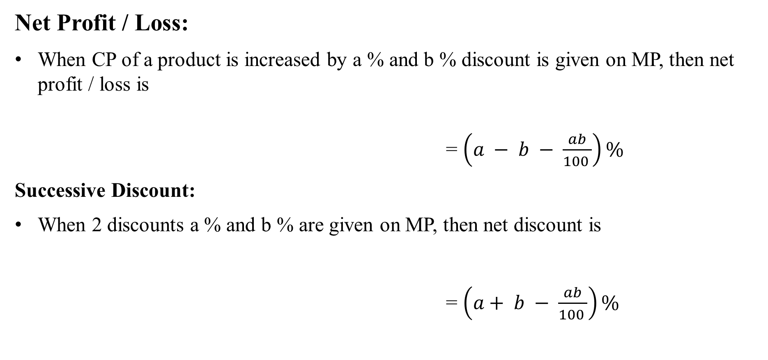
Profit and Loss
Net Profit / Loss:
When CP of a product is increased by a % and b % discount is given on MP, then net profit / loss is
= $\left(a − b − \frac{ab}{100 }\right)\%$
Successive Discount:
When 2 discounts a % and b % are given on MP, then net discount is
= $\left(a+ b − \frac{ab}{100 }\right)\%$

Slide 28
Profit and Loss
22. Successive discounts of 10% and 20% are equivalent to a single discount of :
A] 28% B] 12%
C] 30% D] 15%
Notes:
Option A
Compulsory
Difficulty level: Easy

Slide 29
Profit and Loss
23. A single discount equivalent to discount series 20%, 20% and 10% is
A] 50% B] 48.4%
C] 40.4% D] 42.4%
Notes:
Option D
Compulsory
Difficulty level: Moderate

Slide 30
Profit and Loss
24. Applied to a bill for 1,00,000 the difference between a discount of 40% and two successive discounts of 36% and 4% is :
A] Nil B] 1440
C] 2500 D] 4000
Notes:
Option B
Compulsory
Difficulty level: Moderate

Slide 31
Profit and Loss
25. The marked price of a watch is 800. A shopkeeper gives two successive discounts and sells the watch at 612. If the first discount is 10%, the second discount is :
A] 10% B] 12%
C] 15% D] 20%
Notes:
Option C
Difficulty level: Moderate

Slide 32
Profit and Loss
26. A shopkeeper bought a table marked at Rs. 200 at two successive discount of 10% and 15% respectively. He spent Rs. 7 on transport and sold the table for Rs. 208, What will be his profit%?
A] 22.5% B] 45%
C] 25% D] 30%
Notes:
Option D
Difficulty level: Moderate

Slide 33
Profit and Loss
27. A trader marks his goods at 20% above the cost price. He allows his customers a discount of 8% on marked price. Find out his profit per cent. profit%?
A] 12% B] 10.4%
C] 8.6% D] 8.2%
Notes:
Option B
Compulsory
Difficulty level: Moderate

Slide 34
Profit and Loss
28. A trader marked the selling price of an article at 10% above the cost price. At the time of selling, he allows certain discount and suffers a loss of 1%. He allowed the discount of
A] 11% B] 10%
C] 9% D] 10.5%
Notes:
Option B
Difficulty level: Moderate

Slide 35
Profit and Loss
29. How much percent above the cost price should a shopkeeper mark his goods so as to earn a profit of 32% after allowing a discount of 12% on the marked price ?
A] 50% B] 40%
C] 60% D] 45%
Notes:
Option A
Compulsory
Difficulty level: Moderate

Slide 36
Profit and Loss
30. A merchant purchases a wrist watch for Rs. 450 and fixes its list price in such a way that after allowing a discount of 10%, he earns a profit of 20%. Find the list price of the watch.
A] Rs. 600 B] Rs. 850
C] Rs. 766.67 D] Rs. 875
Notes:
Option A
Difficulty level: Moderate

Slide 37
Profit and Loss
31. The marked price of a laptop is Rs. 12000. In a clearance sale it is sold at a discount of 15%, incurring a loss of 4%. What is the cost price of the laptop?
A] Rs. 10200 B] Rs. 10625
C] Rs. 11200 D] Rs. 10275
Notes:
Option B
Compulsory
Difficulty level: Moderate

Slide 38
Profit and Loss
32. A dishonest dealer professes to sell his goods at cost price but uses a weight of 960gm for a kg weight. Find his gain percent?
A]. 4(1/6)% B]. 4(6/7)%
C]. 4(2/3)% D]. 4.5%
Notes:
option: A
Compulsory
Difficulty level: Moderate

Slide 39
Profit and Loss
33. A shopkeeper sells his sweets at 10% loss. If he weights 800gm instead of 1000gms. Find his profit%?
A]. 12.5% B]. 15%
C]. 10% D]. 20%
Notes:
option: A
Compulsory
Difficulty level: Moderate

Slide 40
Profit and Loss
34. A shopkeeper marks his goods at 20% above cost price and gives 10% discount to customer. At the time of selling the goods, he uses 900gms instead of 1000gms. Find his profit%?
A]. 10% B]. 37.5%
C]. 20% D]. 40%
Notes:
option: c
Difficulty level: Moderate

Slide 41
Profit and Loss
35. A shopkeeper gives 3 articles free on the every purchase of 7 articles and also allows a discount of 14(2/7)% to his customers and still earns 25% profit. Find by how much percent he should mark his goods above its cost price?
A] 50% B] 25%
C] 25% D] None
Notes:
Option D (108.33% )
Compulsory
Difficulty level: Difficult

Slide 42
Profit and Loss
36. A shopkeeper sold sarees at Rs. 266 each after giving 5% discount on labelled price. Had he not given the discount, he would have earned a profit of 12% on the cost price. What was the cost of each saree?
A]. Rs. 230 B]. Rs. 200
C]. Rs. 250 D]. Rs. 255
Notes:
option: C
Compulsory

Slide 43
Profit and Loss
37. On selling a product, what is the profit % earned?
Statement I. The profit earned on selling the product was Rs 45.
Statement II. Had the product been sold for Rs 555, the profit would have been Rs 50.
A. Only I is necessary
B. Only II is necessary
C. Either I or II is necessary
D. Both I and II are necessary
E. None of these
Notes:
Option B
Compulsory
Difficulty level: Moderate

Slide 44
Profit and Loss
38. By selling a product with 20% profit, how much profit was earned?
Statement I. The difference between cost and selling price is Rs. 40.
Statement II. The selling price is 120 percent of the cost price.
A. I alone sufficient while II alone not sufficient to answer
B. II alone sufficient while I alone not sufficient to answer
C. Either I or II alone sufficient to answer
D. Both I and II are not sufficient to answer
E. Both I and II are necessary to answer
Notes:
Option A
Compulsory
Difficulty level: Moderate

Slide 45
Any Doubts???

