Slide 1


COVER LETTER GENERATOR
Presented By Bethireddy Kesava Nagendra Reddy

Slide 2

Writing Cover Letters is Hard!
Time-consuming and repetitive.
Difficult to Well Fit effectively for each job.
Ensuring professional tone and quality.
Many job seekers skip them, missing an opportunity.

Slide 3
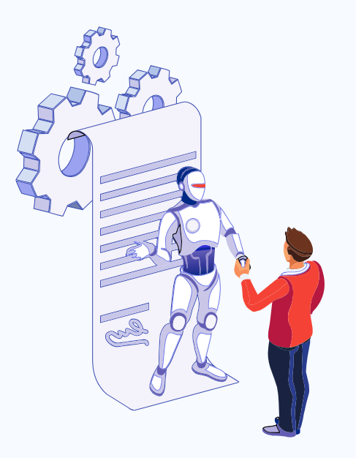
Introducing the AI-Powered Solution
Brief description: A web application that leverages Artificial Intelligence to help users quickly generate personalized and professional cover letters Well Fitted to specific job descriptions.
Value Proposition: Saves time, improves quality, increases confidence, and helps users stand out.

Slide 4
How It Works
Input: User pastes the job description.
Personalize: User adds key details (relevant skills, experience snippets, company name)
OR Upload the Resume.
Generate: AI processes the inputs and creates a draft cover letter.
Download/Copy: User gets the final cover letter ready to use.
ASK AI: User can Modify the text according to there requirements.

Slide 5



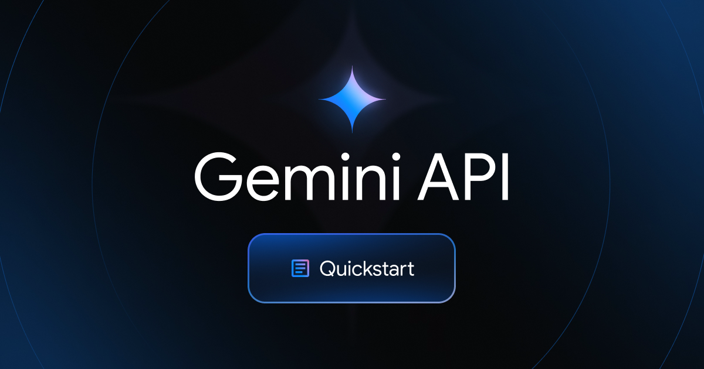

Technology Behind the Magic
Frontend: (e.g., HTML/CSS/JavaScript) - What the user sees
Backend: (e.g., Python/Flask) - The server-side logic
AI Model/API: (e.g., Google AI Studio 2.0) - The core AI engine

Slide 6
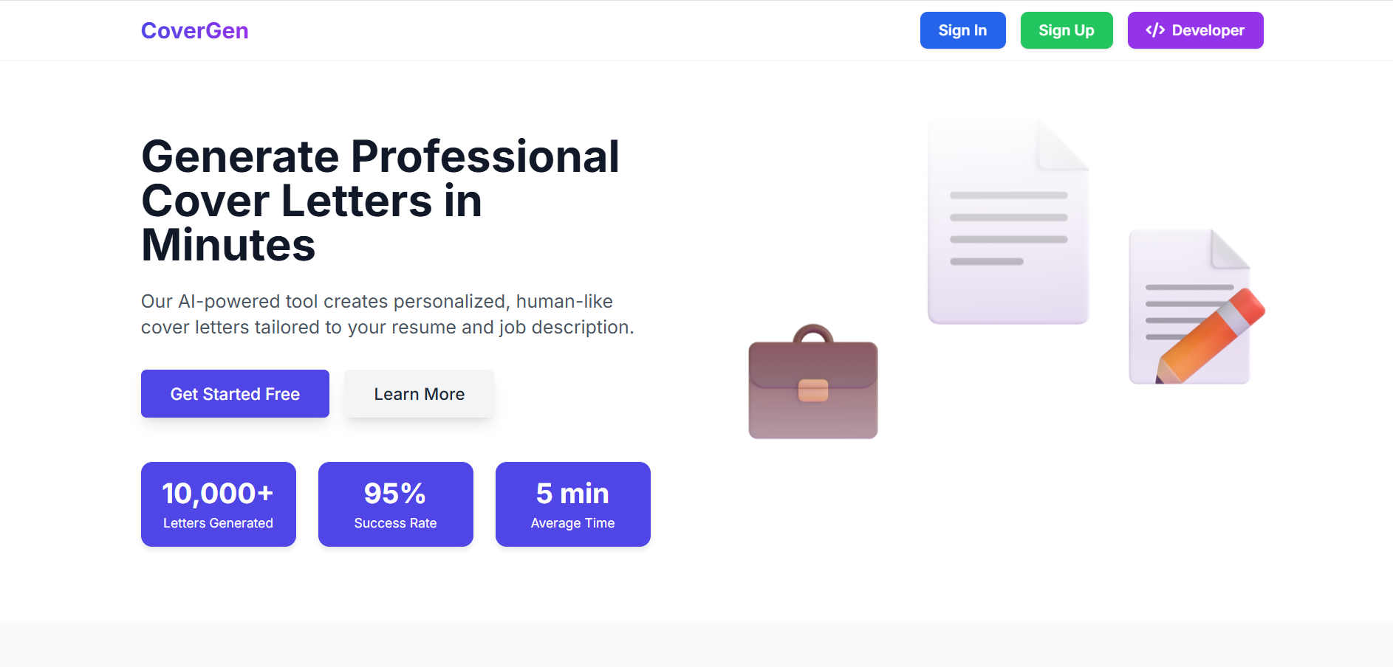
Website View

Slide 7
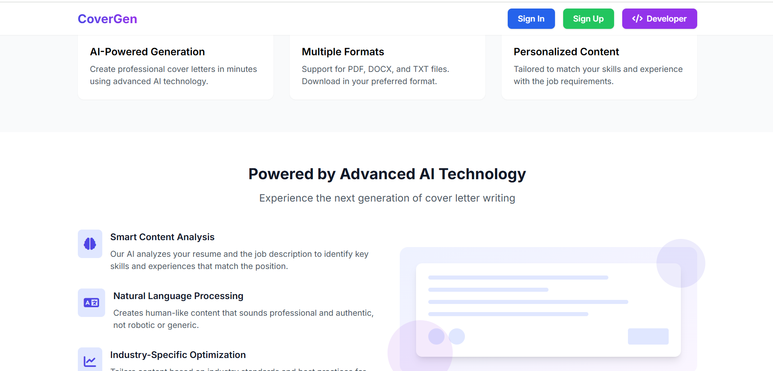

Slide 8
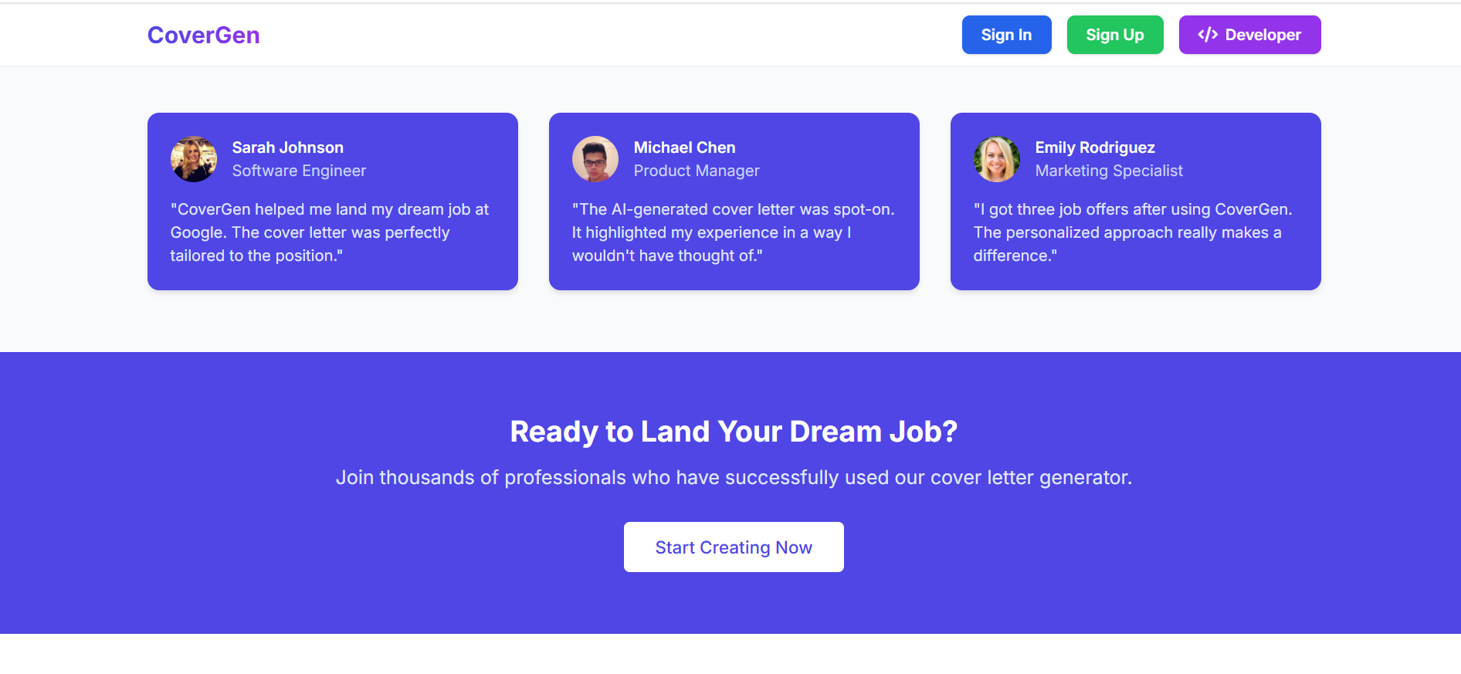

Slide 9
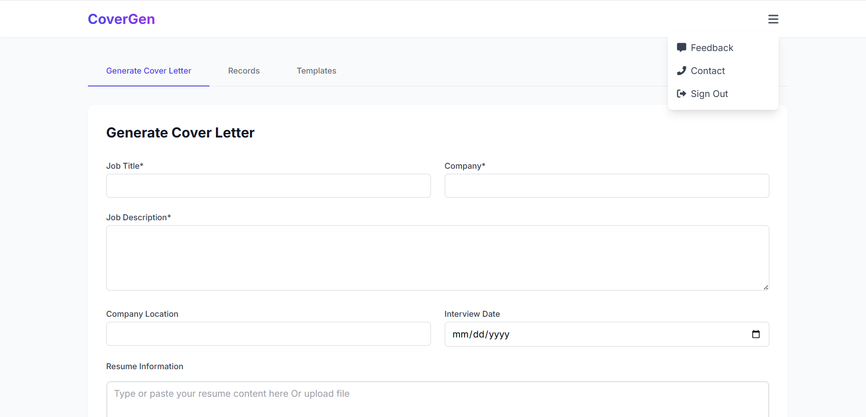

Slide 10
