Slide 1
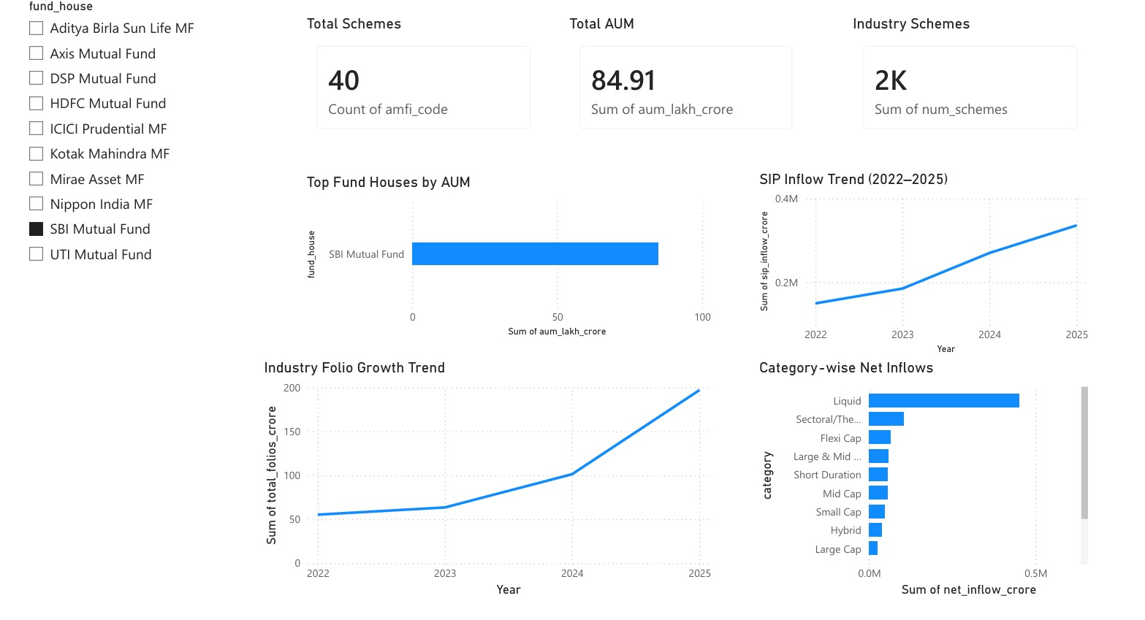
Bluestock Mutual Fund Analytics
Capstone Project
Kesavan S
Python | SQLite | Power BI 2026

Slide 2
Problem Statement & Objectives
Problem Statement: Investors often struggle to evaluate mutual fund performance, risk exposure, and portfolio diversification due to large and complex financial datasets.
Objectives:
Build ETL pipeline
Perform EDA
Analyze fund performance
Calculate risk metrics
Study investor behavior
Create fund recommendation system
Build Power BI dashboard

Slide 3
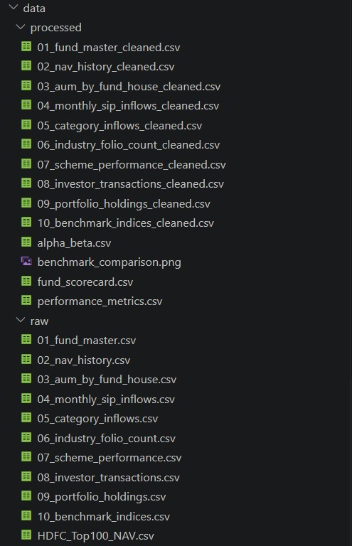
Data Sources
Datasets Used:
Fund Master
NAV History
AUM Data
SIP Inflows
Category Inflows
Investor Transactions
Portfolio Holdings
Benchmark Indices
Dataset Statistics:
NAV Records: 46,000+
Schemes: 40
Transactions: 32,778
Portfolio Holdings: 322

Slide 4
Project Architecture
ETL Workflow:
Raw Data
↓
Data Extraction
↓
Data Cleaning
↓
Data Transformation
↓
SQLite Database
↓
Analytics Layer
↓
Power BI Dashboard

Slide 5
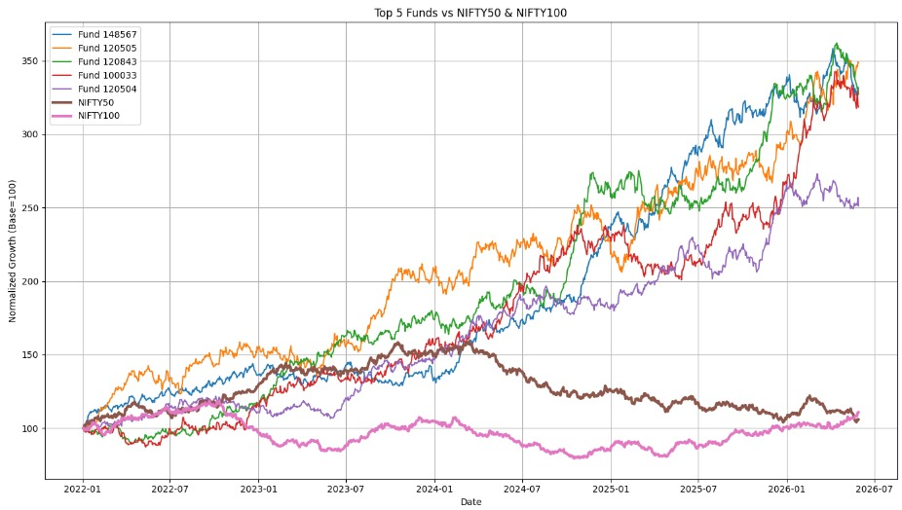
EDA Highlights
NAV & Benchmark Analysis:
Historical NAV trend analysis
Benchmark comparison
Category-wise performance comparison
Findings:
Small-cap funds showed higher volatility
Large-cap funds showed stable growth
Several funds outperformed benchmarks

Slide 6
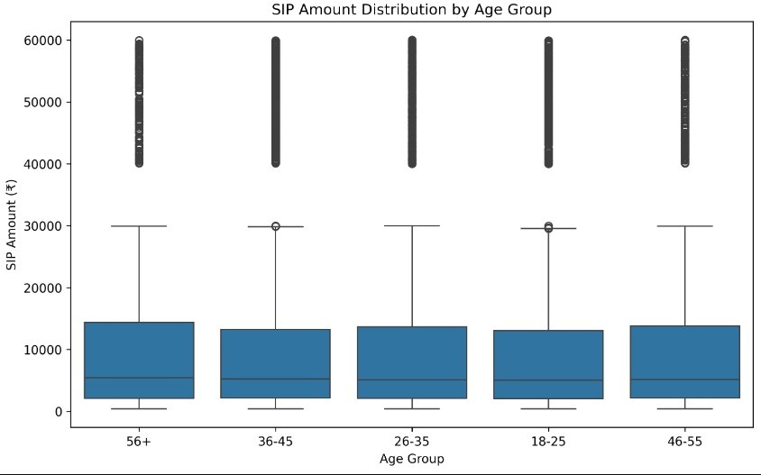
EDA Highlights
Investor Analysis:
Age Group Analysis
SIP Behavior Analysis
Transaction Pattern Analysis
Findings:
26–55 age group dominated investments
SIP is the most popular investment mode
Tier-1 cities contributed major investments

Slide 7
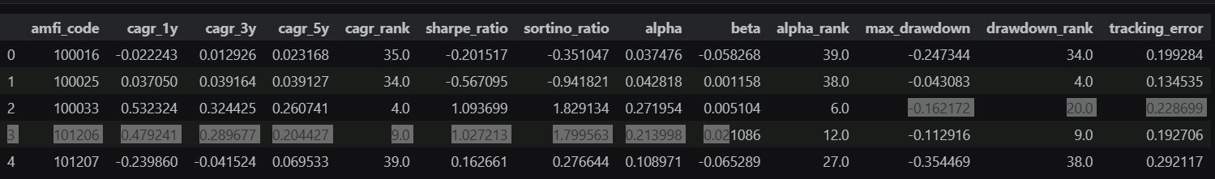
Performance Metrics
Performance Analytics
Metrics Calculated:
CAGR
Sharpe Ratio
Sortino Ratio
Alpha
Beta
Findings:
Several funds delivered strong risk-adjusted returns
Positive Alpha indicated benchmark outperformance

Slide 8
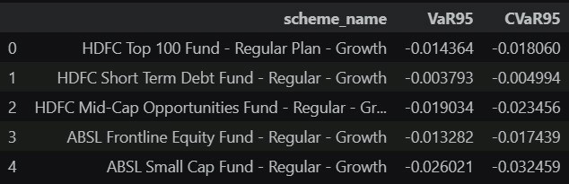
Performance Metrics
Advanced Risk Analytics:
Historical VaR (95%)
Conditional VaR (95%)
Rolling 90-Day Sharpe Ratio
Findings:
Small-cap funds showed highest downside risk
Risk-adjusted returns varied across market periods

Slide 9
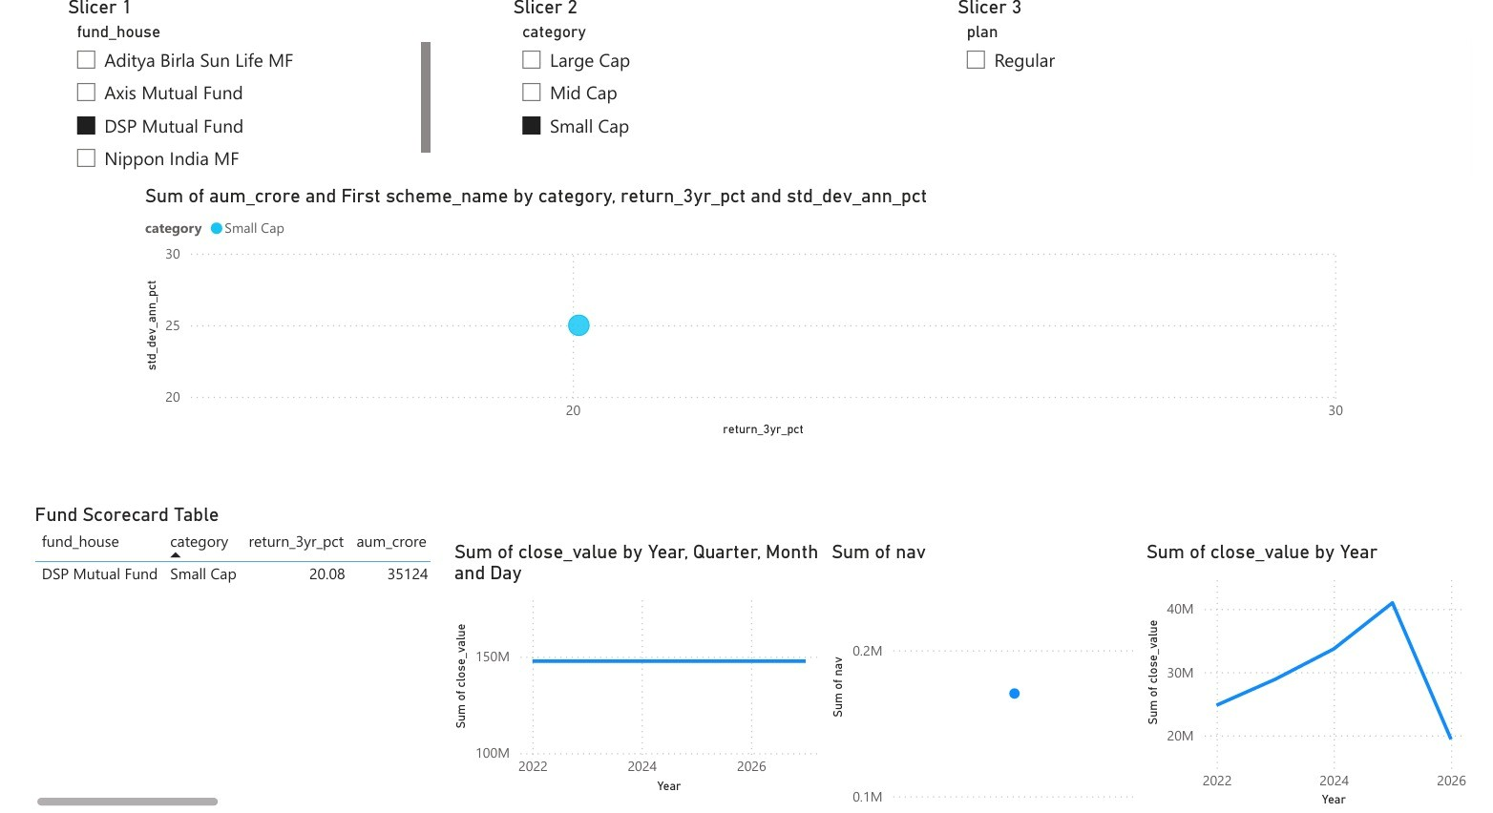

Dashboard Screenshot
Power BI Dashboard Overview
Features:
KPI Monitoring
Fund Performance Tracking
Interactive Filters
Category Analysis

Slide 10
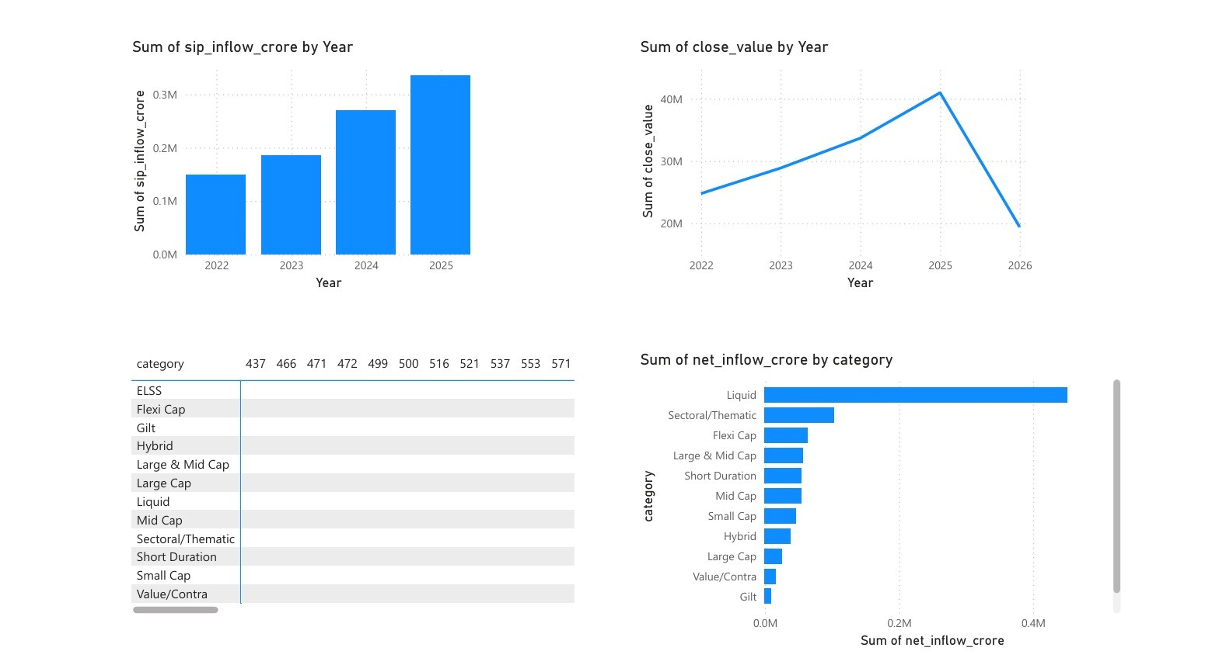
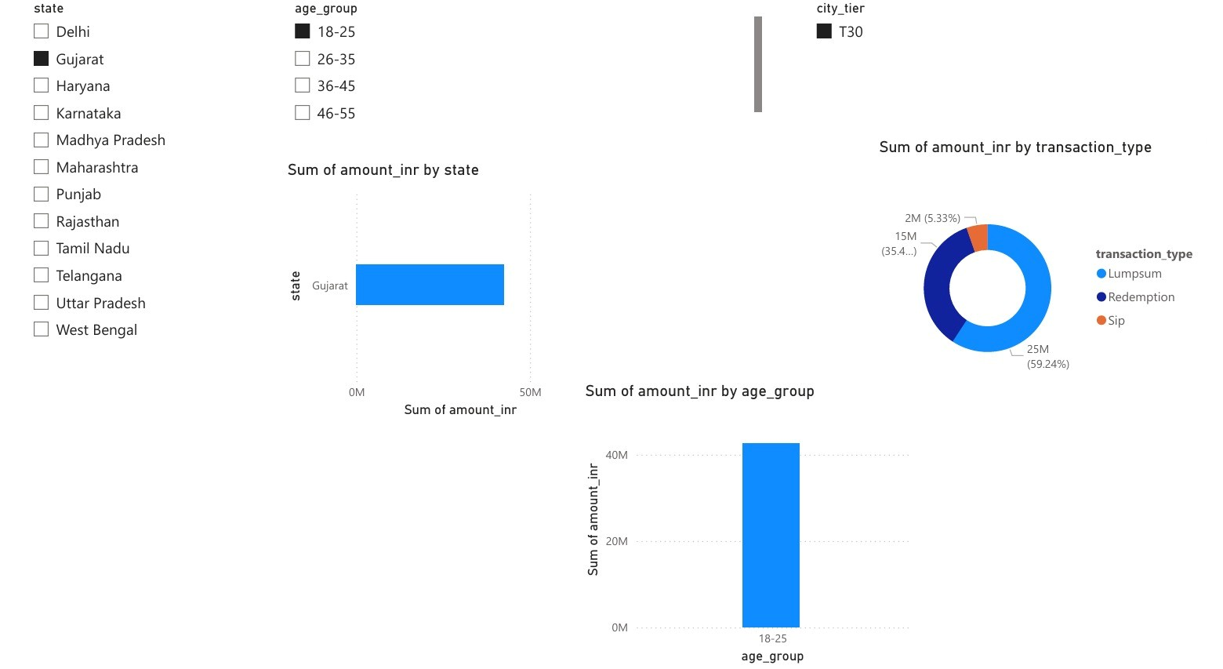
Dashboard Screenshot
Investor & Portfolio Dashboards
Features:
Investor Demographics
SIP Analysis
Portfolio Holdings
HHI Concentration Analysis

Slide 11
Key Findings & Recommendations
Key Findings:
Strong-performing funds identified
Small-cap funds carried higher risk
SIP investors demonstrated strong continuity
Diversification reduced concentration risk
Recommendations:
Use risk-adjusted metrics for fund selection
Maintain diversified portfolios
Continue SIP investments regularly
Monitor portfolio concentration

Slide 12
Conclusion & Thank You
The project successfully integrated:
ETL Pipeline
Performance Analytics
Risk Modeling
Investor Analytics
Power BI Visualization
Future Enhancements
Real-time market APIs
Machine Learning fund recommendations
Portfolio optimization
Web deployment

