Slide 1
Problem Statement
Develop a 2D Occupancy Grid Map of a Room using Overhead Cameras

Slide 2
Unique Idea Brief (Solution)
1. Image Stitching: Develop an algorithm to stitch images from the cameras to create a comprehensive 2D view of the room.
2. Object Detection: Implement object detection to identify and classify objects within the room.
3. Semantic Labeling: Add semantic labels (“table," "chair," "other AMR") to the occupancy grid map to provide contextual information for the AMRs.
4. Occupancy Grid Map: Convert the stitched image into a 2D occupancy grid map, accurately representing the positions of the static objects.
5. Navigation: Validate that the dynamically updated occupancy grid map with semantic labels is reliable for AMR navigation and path-planning in the dynamic environment.

Slide 3
Features Offered
Image acquisition from 4 RGB cameras
Stitching Images into a composite 2D map
Objects detection works on both static and dynamic environment
Developing a occupancy grid map
Accuracy and latency benchmarking.

Slide 4
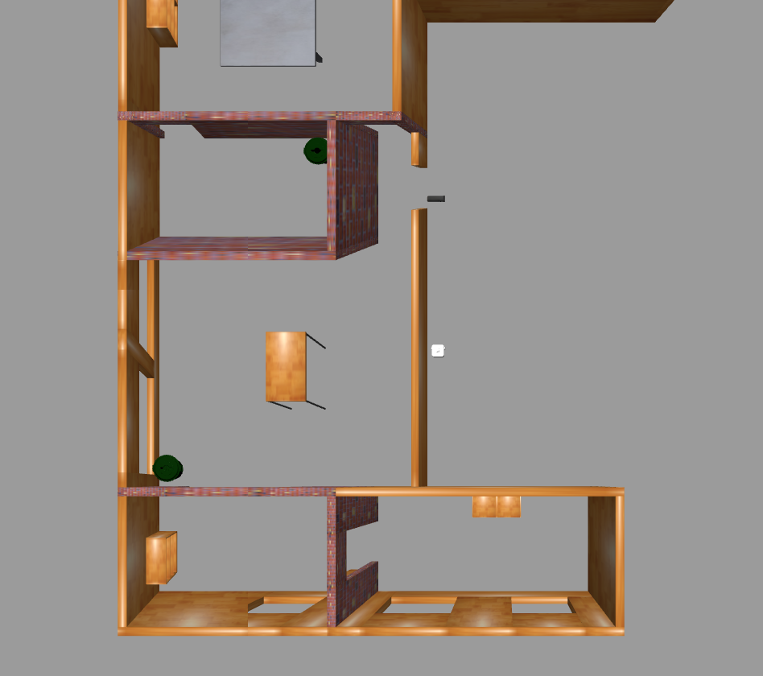
Process flow
Gazebo simulation:
Setup environment and cameras
Image Acquisition:
Capture Images from ROS2 topics
Image Stitching:
Align and combine Images
Object Detection:
Detect objects presented in the environment
Benchmarking:
Compare against simulation and measure latency

Slide 5
Technologies Used
ROS2: Middleware for robot software
Gazebo: Simulation environment
Python: Programming language for scripts
Opencv: Library for image processing
Raspberry Pi: For real-time processing

Slide 6
Conclusion
In conclusion, developing a 2D Occupancy Grid Map using overhead cameras was a highly educational and unique project. What made this project special was the integration of advanced techniques like camera calibration, image stitching, and real-time object detection with YOLOv5 to create accurate and functional room representations. The project not only enhanced my technical expertise but also honed practical skills in problem-solving, collaboration, and time management. Additionally, it deepened my understanding of spatial awareness and the application of machine learning in computer vision. This comprehensive learning experience provided a solid foundation for future endeavors in robotics and automation, setting this project apart as a significant milestone in my development.
Notes:
In Slide Show mode, select the arrows to visit links.

