Slide 1
HRdodos
Kesaven, Phavish, Johan

Slide 2


Components of employee engagement
Motivate
Empower
Respect
Challenge
Vision
Strategy
Employees contribution
Employee Engagement
Company Culture
Motivation & Trust relationship
Management
of execution
Company Strategy
Develop teams
Motivation
Strong relationships
Expectations
Accountability
Clear communication

Slide 3



Digital Channels : MySDWorx
Web
Mobile
Conversational
MySDWorx
Employers
Employees
SD Worx

Slide 4
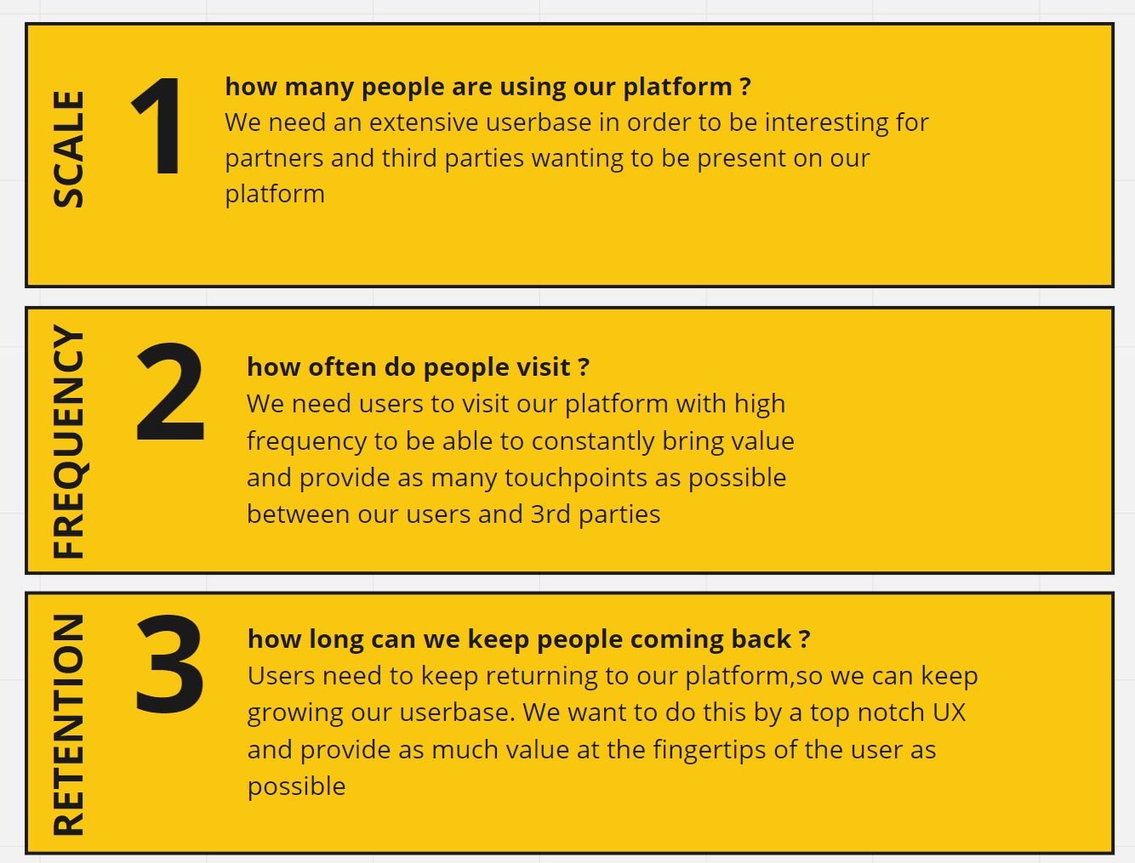
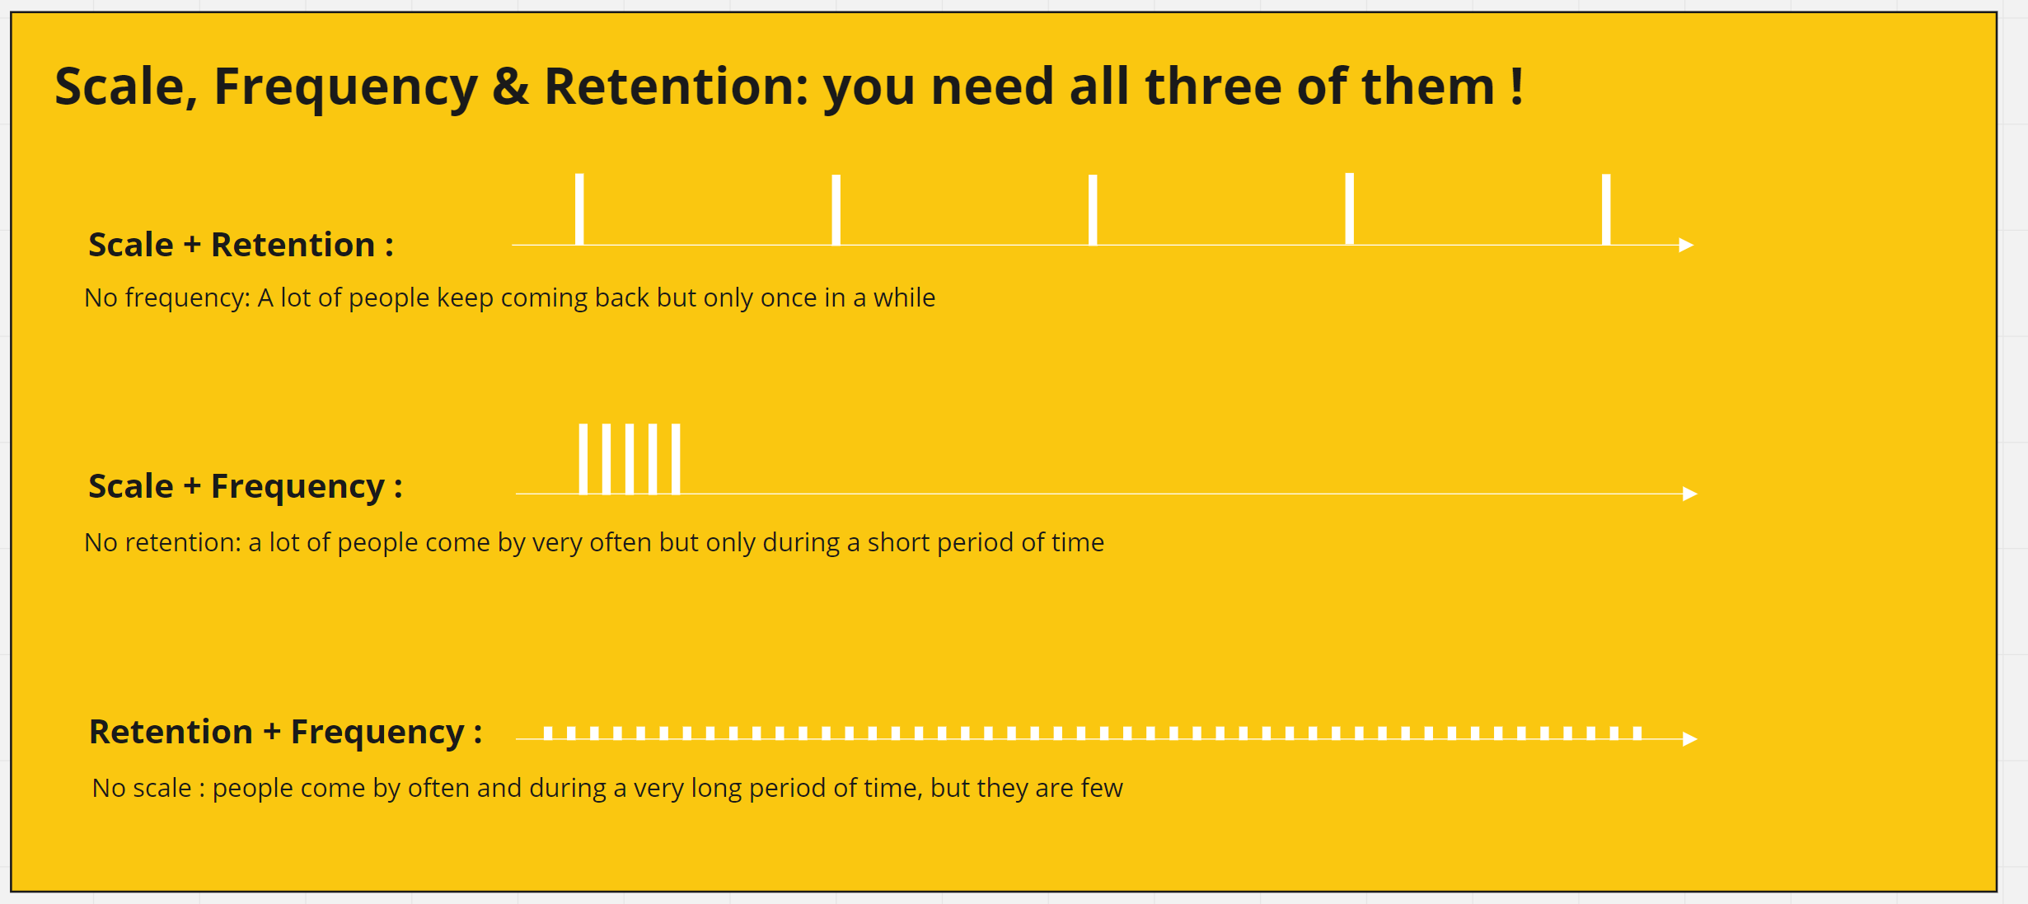
Scale, Frequency & Retention

Slide 5
Daily huddle moment by teams of customers
Team appraisals
How do you feel today
Smileys exchange through the system
Capture traffic
Feedback on colleagues / the Boss Bruce
Send feedback in general in the same way on topics
Team goal
Monthly production cycles
Change targets or criteria
LMA dashboard – KPI tracking – feedback of the team on how we are doing
Pulling model
Splash screen at startup / push notification to respond at 9, just before huddle
Active pulling in and reminding EE to get involved

Slide 6
Career path
Next steps in a career
Visible path
How are you doing on competences needed for a next step
Feedback from colleagues and management [360]

Slide 7
Topic
Response of EE
Mobile messaging / push
How are you feeling today?
How are we doing on team goal1?

Slide 8
Daily standup moment with our customers
We capture all communication
Assess interaction between EE
Use data analyze the intra and inter team relationships
Aggregate up
Assessing where the customer might need help
Direct group feedback
Outliers get visible
Optional reveal all scores from team members

Slide 9
Bot layer
Cards => direct line
Frontends
Web app [input & team result]
Mobile app [input & team result]
Bot direct line
Backend
Get Q for user
Save results

