Slide 1
ECE 1901- TECHNICAL ANSWERS TO REAL WORLD PROBLEM REVIEW 1
COVID 19 PREDICTION SYSTEM BASED ON SYMPTOMS
TEAM MEMBERS:
U SAI PRANEETH - 19BEC0005
RAVI YASWANTH SAI-19BEC0168
GAGAN KARTHIK K - 19BEC0344
KESAV NAGENDRA -19BEC0378
KATTA JAYA KRISHNA - 19BEC0382
SATYA SAI SUJAN N- 19BEC0641

Slide 2
PROBLEM STATEMENT
Due to covid outbreak, health crisis has occurred.
There are many people who fear COVID for small symptoms and others who neglect to test them due to negligence.
Also, the limited facilities hinder in testing a huge amount of people at a time.

Slide 3
ABSTRACT
Anyone can get sick with COVID-19 and become seriously ill or die at any age.
COVID-19 testing began to rise all over the world during this pandemic and there is reduce of proper medical resources all over the world
In this project we are trying to make a machine learning model which will predict weather you have a chance to test COVID-19 positive or not.

Slide 4
OBJECTIVE
Objective is to predict whether you have a chance to test COVID-19 positive or not.
We are trying to use the prediction model and are using all the symptoms which will cause covid-19.
Using existing real time data, we are going to create a data set and build a prediction model for covid -19.
With this model we can easily predict weather you have a chance of getting covid or not using the training data set.
As this is a prediction model the results can’t be 100% sure but it will give you a basic idea whether you are in risky position or not.
Our Main goal is to reduce the anxiety of the patient and better understanding of symptoms due to COVID-19.

Slide 5
WORK FLOW
DATA COLLECTION
DATA PREPERATION
MAKING A MACHINE LEARNING MODEL
TRAINING THE MODEL
SELECTING THE BEST MODEL
PREDICTION OF OUTPUTS
DEPLOYING THE MODEL

Slide 6
WORK DIVISION
GAGAN KARTHIK AND SATYA SAI SUJAN N: CONVERSION OF THE DATA SET INTO A MACHINE LANGUAGE COMPATIBLE DATA
KESAV NAGENDRA AND JAYA KRISHNA: WORKING ON THE MACHINE LANGUAGE CODE
U SAI PRANEETH, RAVI YASWANTH SAI: CODE AND IMPLEMENTATION

Slide 7
Tools used
Python
Jupyter notebook
IBM Watson Studio
IBM Machine learning

Slide 8
LITERATURE SURVEY
 | SERIAL NO. | JOURNAL NAME | JOURNAL AND YEAR | DESCRIPTION
 | 1 | Evaluation and management of adverse reactions to the COVID-19 vaccines | OceanSide Publications, Inc JAN 2022 | This paper mainly discusses about the negative reactions due to vaccination. In the development of vaccines directed against the severe acute respiratory syndrome coronavirus virus have revealed a need for a better understanding of the evaluation and management
 | 2 | COVID-19 Prediction Applying Supervised Machine Learning Algorithms with Comparative Analysis Using WEKA | MDPI JOURNALS MARCH 2021 | This study aimed to build a COVID-19 presence predictor model by applying five supervised machine learning algorithms, including J48 Decision Tree, Random Forest, K-Nearest Neighbors, Naïve Bayes and Support Vector Machine.
 | 3 | A prediction model based on machine learning for diagnosing the early COVID-19 patients | MEDRIX JOURNALS MARCH 2020 | Analyzing complex medical datasets based on machine learning provides health care workers excellent opportunities for developing a simple and efficient COVID-19 diagnostic system.
 | 4 | Machine learning based prediction of COVID-19 diagnosis based on symptoms | NATURE JOURNAL JANUARY 2021 | In this paper, they propose a machine learning model that predicts a positive COVID infection in a RT-PCR test by asking eight basic questions.

Slide 9
LITERATURE SURVEY
 | 5 | Loss of Smell and Taste Can Accurately Predict COVID-19 Infection: A Machine-Learning Approach. | JOURNAL OF CLINICAL MEDICINE, 2021 | This study concludes that smell and taste disorders are accurate predictors, with ML algorithms constituting helpful tools for COVID-19 diagnostic prediction.
 | 6 | The role of machine learning algorithms for diagnosing diseases | JASTT, 2021 | In this work, many previous studies were reviewed that used machine learning algorithms for detecting various diseases in the last three years. A comparison is provided concerning these algorithms, assessment processes, and the obtained results.
 | 7 | Signs and symptoms to determine if a patient presenting in primary care or hospital outpatient settings has COVID‐19 | Cochrane Library,2021 | This paper assesses the diagnostic accuracy of signs and symptoms to determine if a person presenting in primary care or to hospital outpatient settings, such as the emergency department or dedicated COVID‐19 clinics, has COVID‐19.

Slide 10
LITERATURE SURVEY
 | 8 | Machine Learning Algorithms for Predicting SARS-CoV-2 (COVID-19) – A Comparative Analysis | IEEE, 2021 | This paper aims at determining which Classification method performs a high accuracy rate for the collected data samples of COVID-19 positive cases. The author proposed a machine learning system that uses CT scan slices to detect cases of lung infection using a series of methods. According to this paper , support vector machine (SVM) gave highest accuracy.
 | 9 | Machine Learning to Predict COVID-19 and ICU Requirement | IEEE , 2020 | This paper focuses on the application of machine learning algorithms to manage novel coronavirus disease . For this, different ML classifiers are used for two cases, one for the prediction of COVID-19 patients, and another for the prediction of the intensive care unit requirement. Highest accuracy is achieved using stacking ensemble with random forest (RF), XGBoost (XGB) and logistic regression (LR)
 | 10 | A Comparative Study of Machine Learning Models for COVID-19 prediction in India | IEEE, 2020 | This paper shows the ability of ML models to estimate the forthcoming COVID-19 affected patients . In this paper five ML models are used to forecast the threatening variables of COVID-19 . According to this paper poly LR and poly LASSO gave the best results .

Slide 11
Research paper
Zoabi, Y., Deri-Rozov, S. & Shomron, N. Machine learning-based prediction of COVID-19 diagnosis based on symptoms. npj Digit. Med. 4, 3 (2021). https://doi.org/10.1038/s41746-020-00372-6
https://www.nature.com/articles/s41746-020-00372-6#citeas

Slide 12
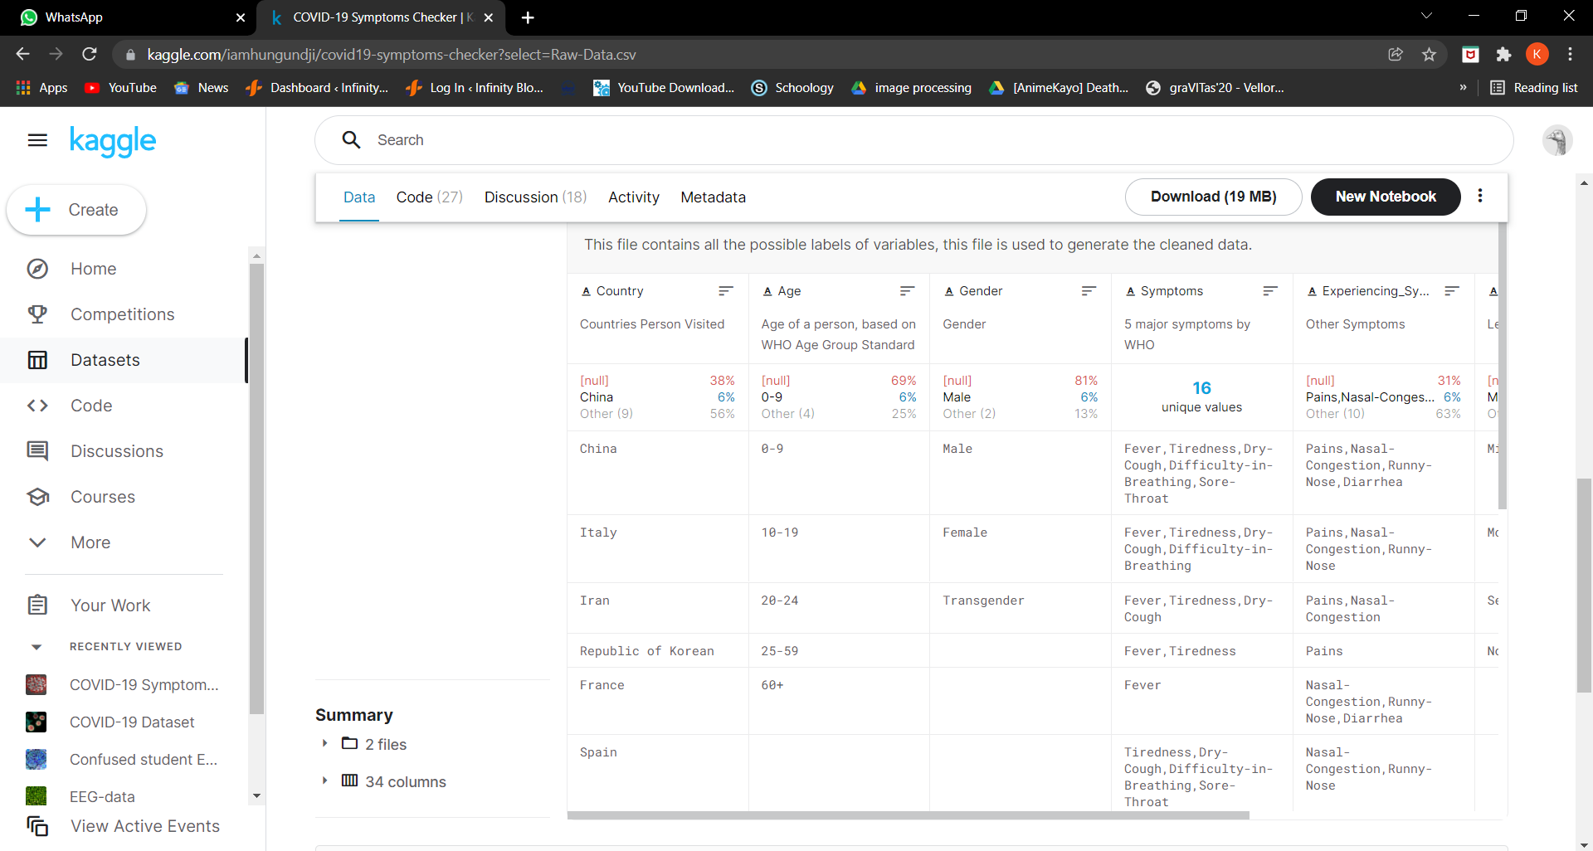
Reference for real time data
https://www.kaggle.com/iamhungundji/covid19-symptoms-checker?select=Raw-Data.csv

