Slide 1
Google Play Review Analysis
FOUNDATIONS OF DATA ANALYTICS
CSE3505
REVIEW-2

Slide 2
GROUP MEMBERS
KESAV SANTHOSH 20BCE1105
PARTH TIWARI 20BCE1653

Slide 3
INTRODUCTION
It’s hard to analyze the positive reviews and negative reviews on an app given by the user on Play Store and therefore it is hard for a user on play store to find out whether the app is good or bad by checking the reviews. We are performing analysis to find out how various factors such as category , amount, number of reviews are affecting rating of an app.

Slide 4
PROJECT MODULES
Google play store apps and reviews
Data cleaning
Correcting data types
Exploring app categories
Distribution of app ratings
Size and price of an app

Slide 5
PROJECT MODULES
Relation between app category and app price
Filter out junk apps
Measures of rating for each category
Popularity of paid apps vs free apps
Sentiment analysis of user reviews
Conclusion

Slide 6
DATA ANALYTICS LIFE CYCLE
Discovery
Model Planning
Communicate Results
1
3
5
2
4
6
Data Preparation
Model Building
Operationalize

Slide 7
PROJECT IMPLEMENTATION
Implementation of half of the modules of the project.

Slide 8
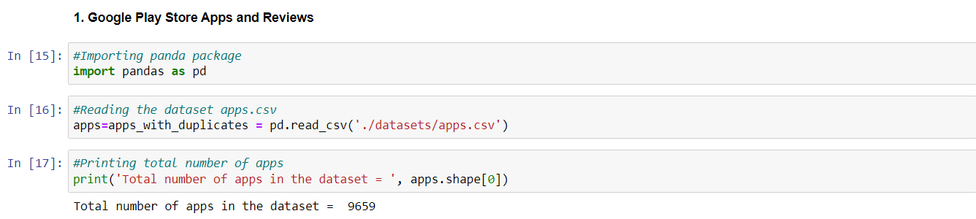
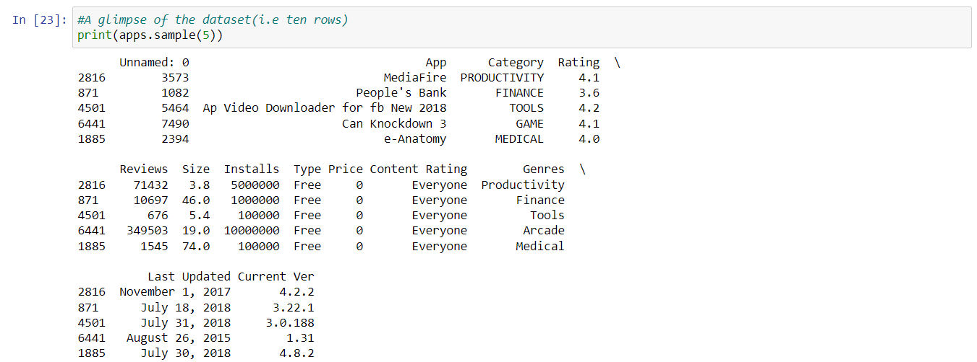
1.GOOGLE PLAY STORE APPS AND REVIEWS

Slide 9
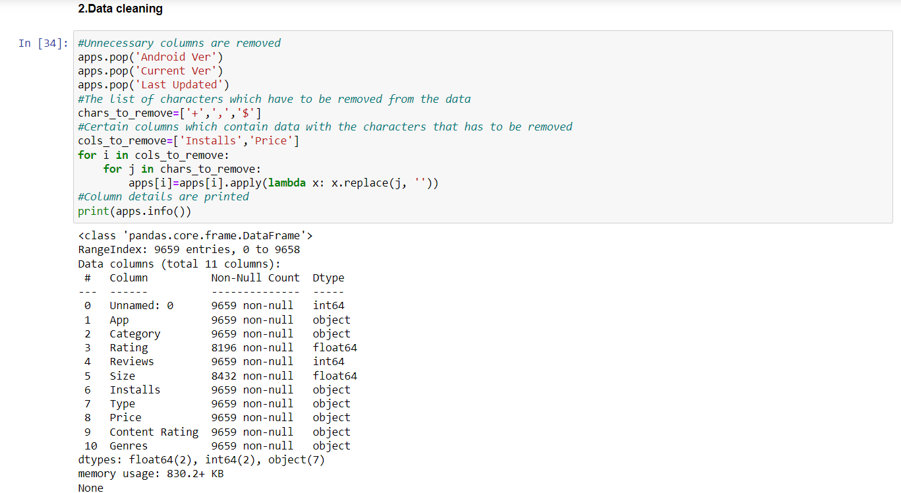
2.DATA CLEANING

Slide 10
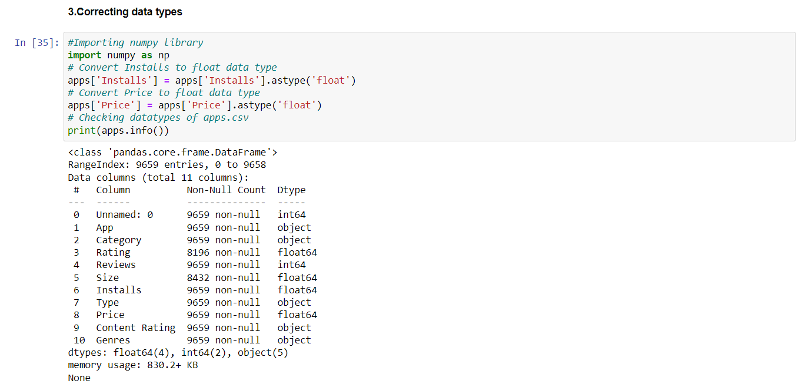
3.Correcting Datatypes

Slide 11
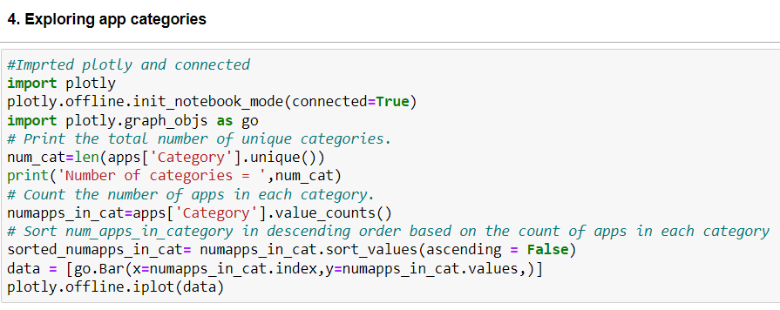
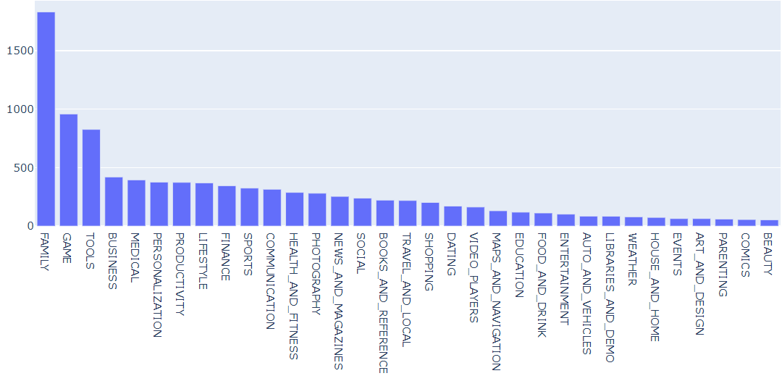
4.EXPLORING APP CATEGORIES

Slide 12
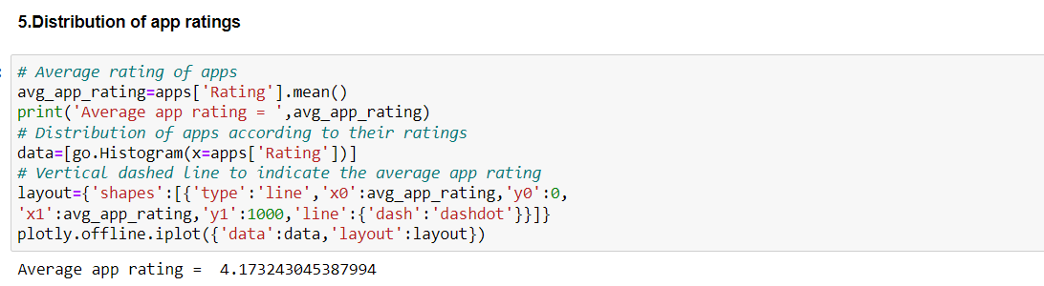
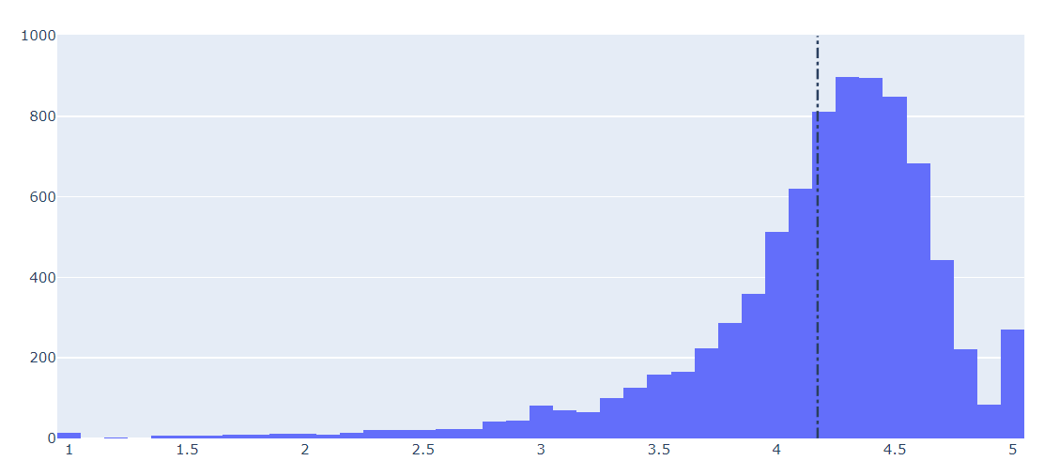
5.DISTRIBUTION OF APP RATINGS

Slide 13
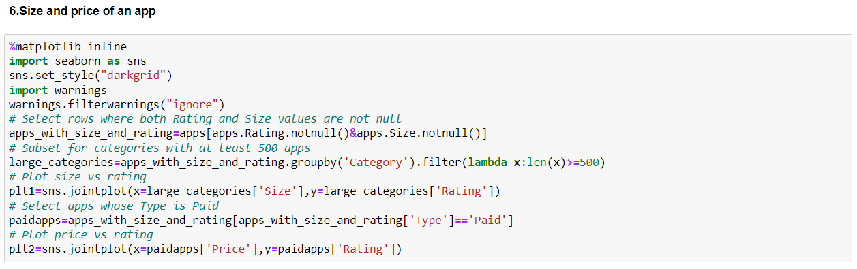
6.SIZE AND PRICE OF AN APP

Slide 14
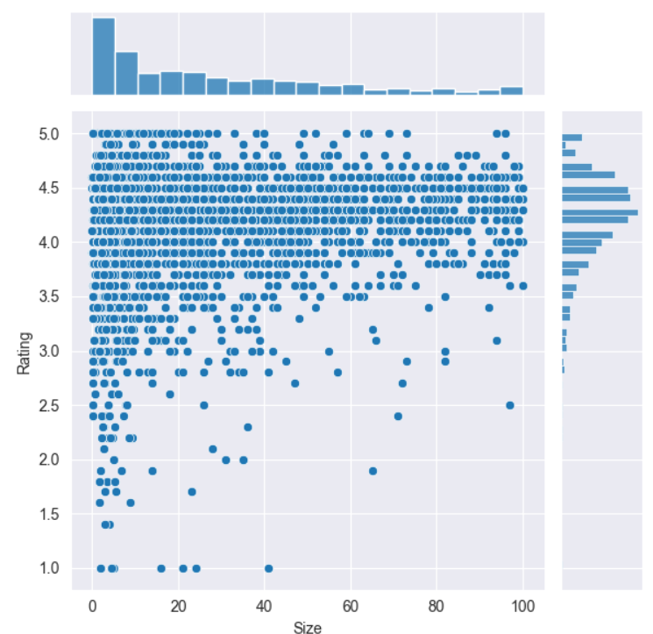
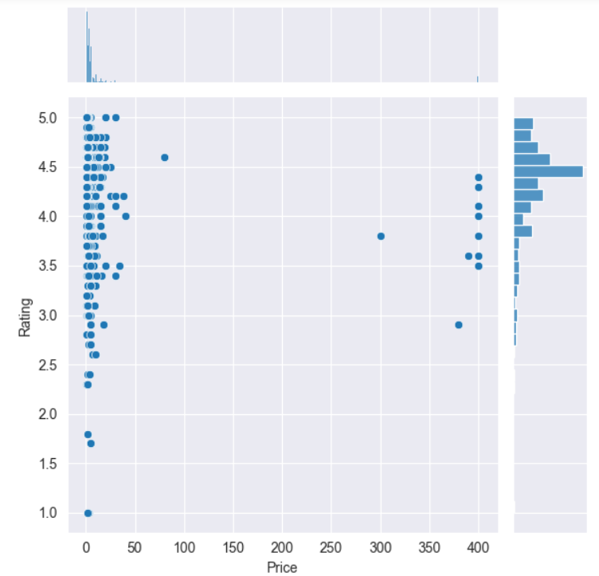
6. SIZE AND PRICE OF AN APP

Slide 15
MODEL DESIGN
Organized data and elements of our project

Slide 16
MODEL DESIGN
Distribution of App
Ratings
The distribution of the app ratings with number of users rated is plotted and using it the average rating an app recieves on playstore is found out. Using the analysis, it is found out that more people opt to vote more close to the average.The extremes ratings are very less rated.The number of people who have rated increases as we go more closer to the average.
Size and Price of an App
The distribution of app ratings are plotted with respect to the size of an app only which comes under category with more than 500 apps.The distribution of app ratings are also plotted with respect to the price of an app for paid apps.
Measures of rating for each category
The relation between the number of apps in the category and average rating of the category is to be found out using linear regression,Using the linear regression equation,the expected average rating is calculated and is verified with an existing app category with the same number of app ratings.
Relation between app category and app price
The app pricing trend across categories is to be plotted for each category.The lower limit for the price of the paid apps to be 200.Certain app categories to be selected to narrow down among many categories.

Slide 17
PERFORMANCE METRICS
Metric to judge our performance

Slide 18
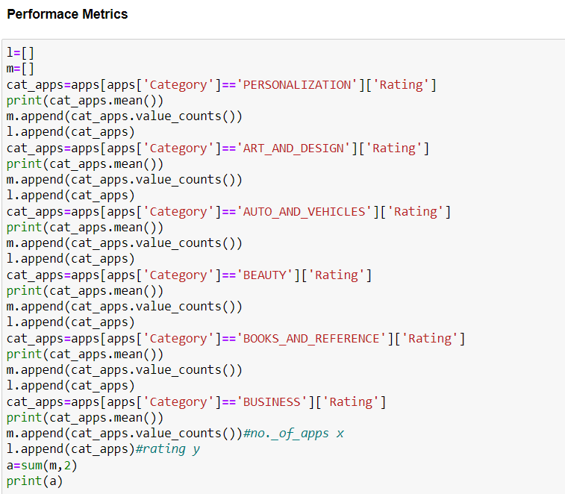
PERFORMANCE METRICS
The average rating is calculated for list of some categories and using linear regression between the number of apps in the category and the average rating, the rating is calculated and is checked with the actual average rating of that category.
So, accuracy could be found out using the equation,
accuracy = metrics.accuracy_score(y_test, preds) accuracy

Slide 19
Gantt chart
 | Week 1 |  |  |  |  |  |  | Week 2
November | 1 | 2 | 3 | 4 | 5 | 6 | 7 | 8 | 9 | 10 | 11 | 12 | 13
Module planning and model design
Review 2 PPT |  |  |  |  |  | ◆
50% implementation
Rest of the project |  |  |  |  |  |  |  |  |  |  | ◆
Model Building |  |  |  |  |  |  |  |  | ◆
Review 3

Slide 20
CONCLUSION
The sample 5 rows of the dataset is printed ,the data is cleaned and incorrect datatypes are updated in preprocessing ,App categories are explored and the distribution of apps with the number of ratings is plotted using bar graph. The effect of size and price on app rating is checked and plotted .The variation in the rating for change in size and price of an app is analyzed.

Slide 21
REFERENCES
https://www.kaggle.com/datasets/utshabkumarghosh/android-app-market-on-google-play?resource=download
https://www.dataquest.io/blog/jupyter-notebook-tutorial/
https://365datascience.com/tutorials/python-tutorials/jupyter-notebook-tutorial/

Slide 22
THANK YOU
REMAINING PART OF THE PROJECT IN REVIEW 3

