Slide 1
Google Play Review Analysis
FOUNDATIONS OF DATA ANALYTICS
CSE3505
REVIEW-3

Slide 2
GROUP MEMBERS
KESAV SANTHOSH 20BCE1105
PARTH TIWARI 20BCE1653

Slide 3
PROJECT MODULES
Google play store apps and reviews
Data cleaning
Correcting data types
Exploring app categories
Distribution of app ratings
Size and price of an app

Slide 4
PROJECT MODULES
Relation between app category and app price
Filter out junk apps
Popularity of paid apps vs free apps
Sentiment analysis of user reviews
Remove Null Values From User Review
Draw Histogram To Understand User Sentiment Distribution
Few Positive, Neutral and Negative Review

Slide 5
DATA ANALYTICS LIFE CYCLE
Discovery
Model Planning
Communicate Results
1
3
5
2
4
6
Data Preparation
Model Building
Operationalize

Slide 6
PROJECT IMPLEMENTATION
Implementation of half of the modules of the project.

Slide 7
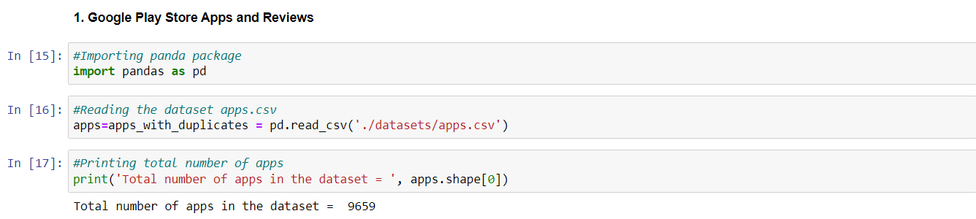
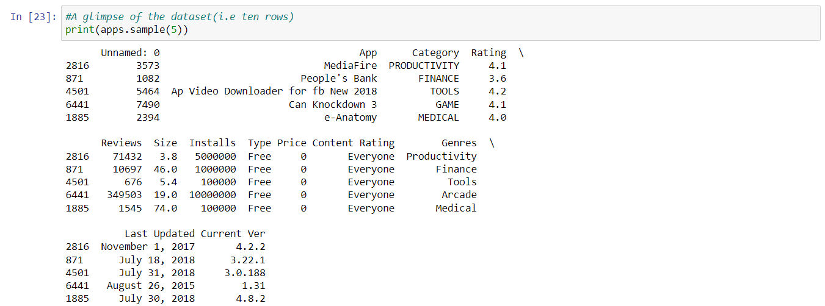
1.GOOGLE PLAY STORE APPS AND REVIEWS

Slide 8
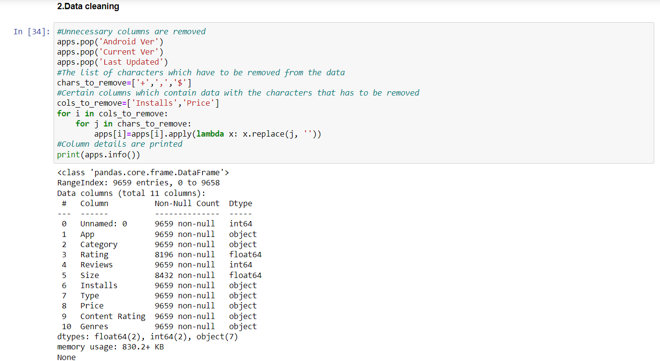
2.DATA CLEANING

Slide 9
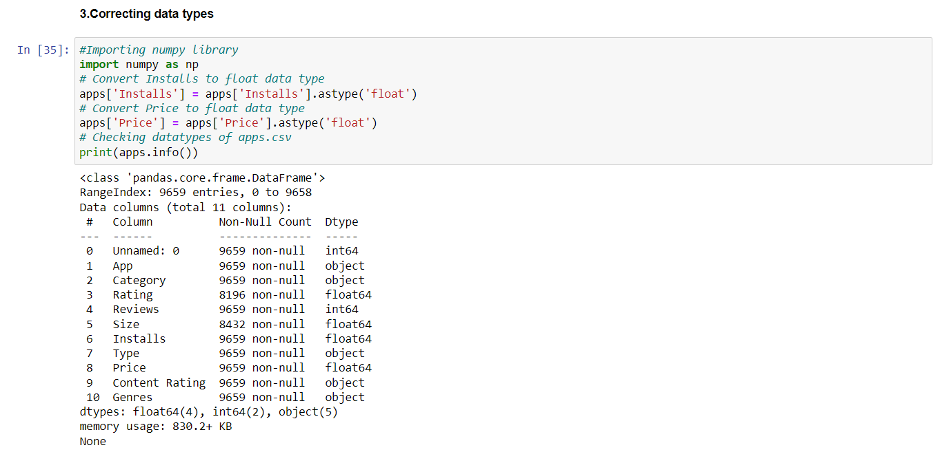
3.Correcting Datatypes

Slide 10
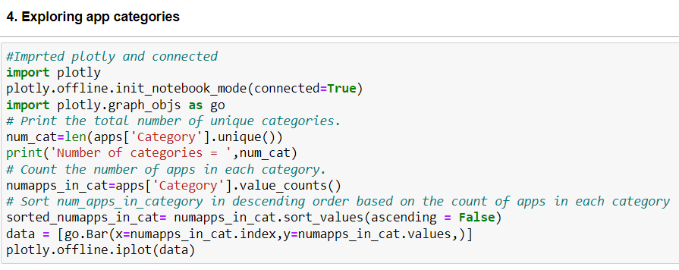
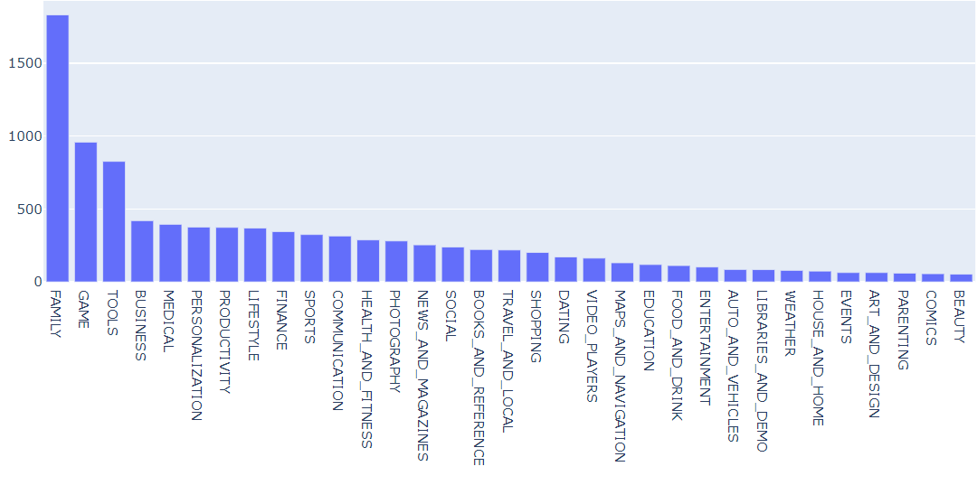
4.EXPLORING APP CATEGORIES

Slide 11
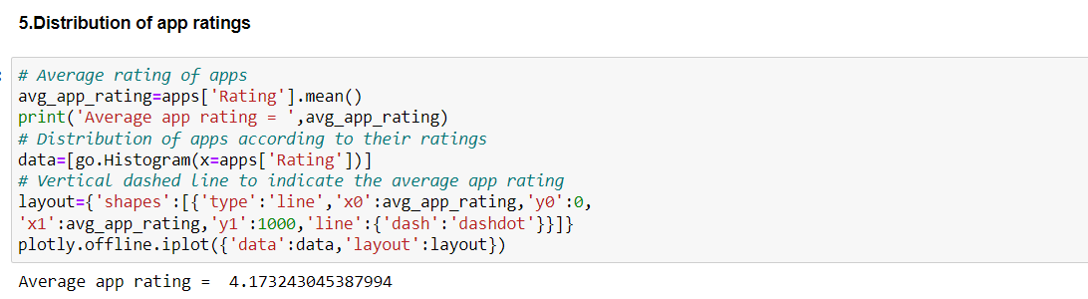
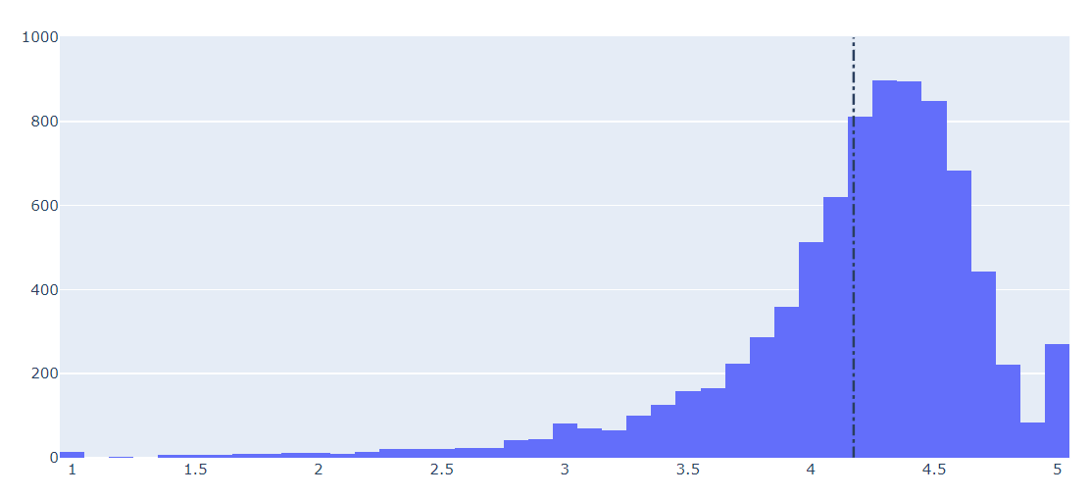
5.DISTRIBUTION OF APP RATINGS

Slide 12
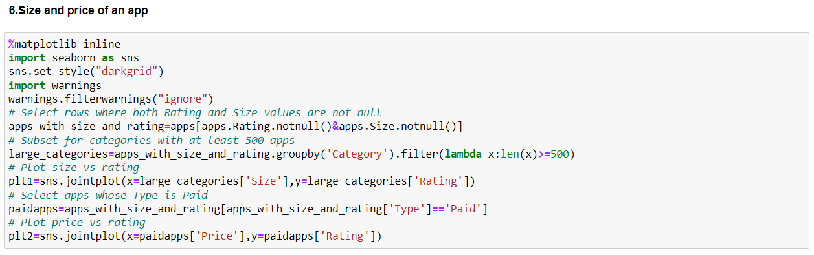
6.SIZE AND PRICE OF AN APP

Slide 13
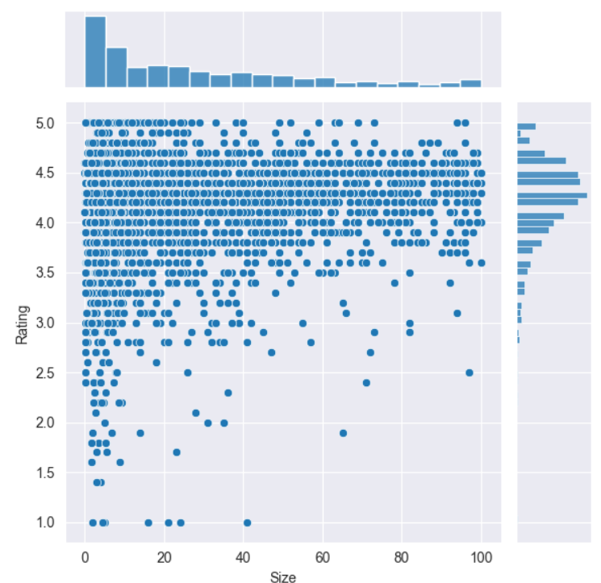
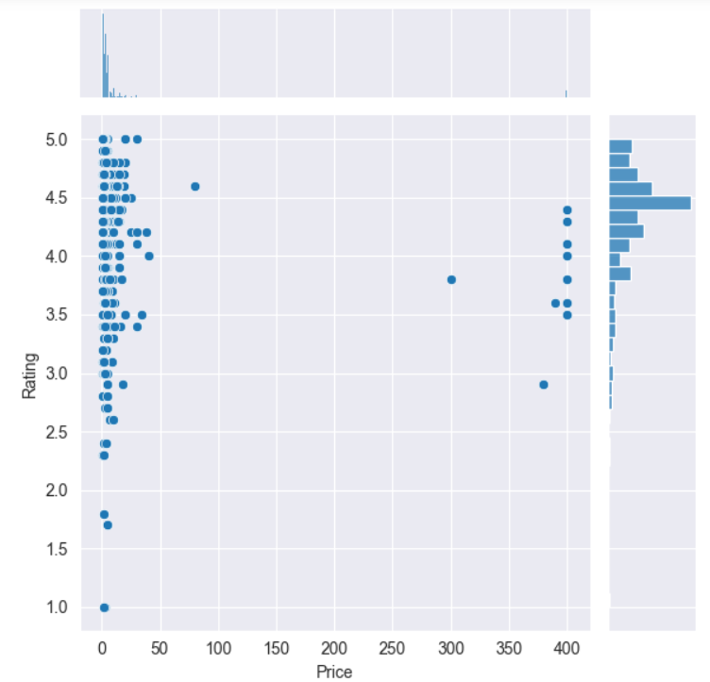
6. SIZE AND PRICE OF AN APP

Slide 14
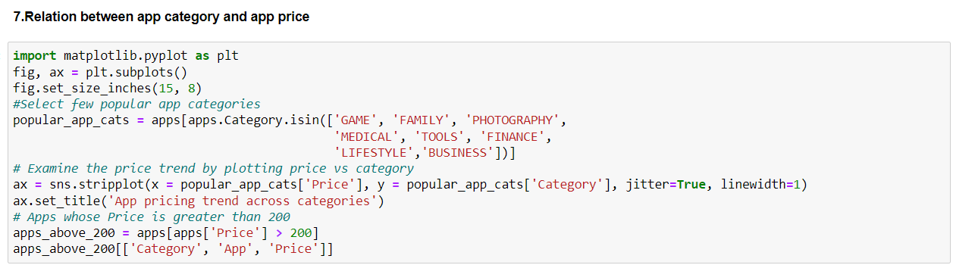
7. Relation between app category and app price

Slide 15
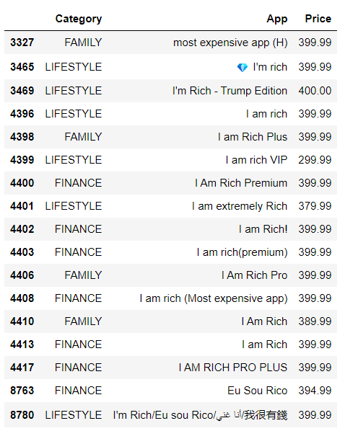
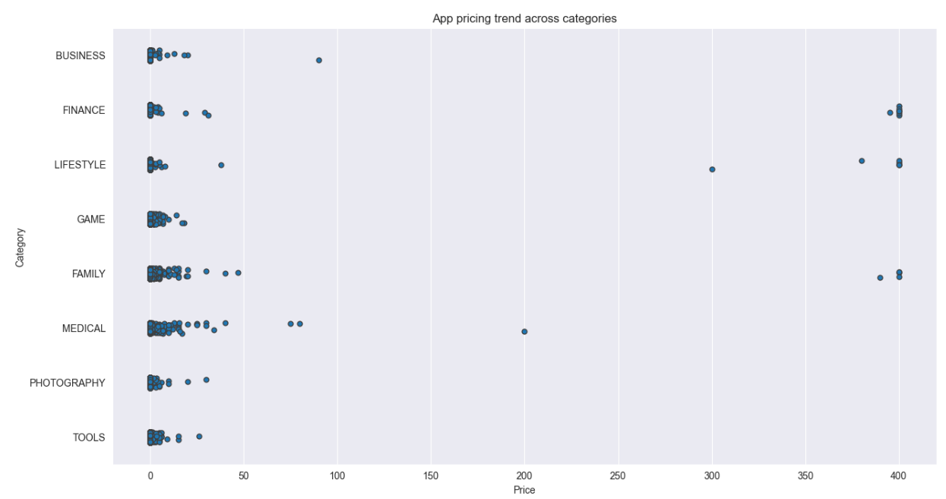
7. Relation between app category and app price

Slide 16
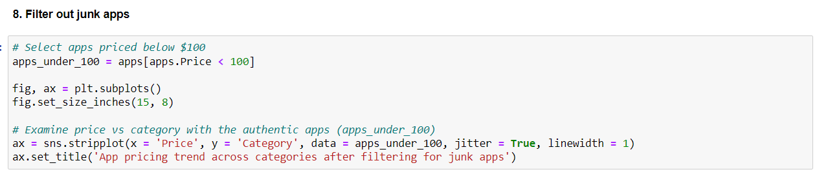
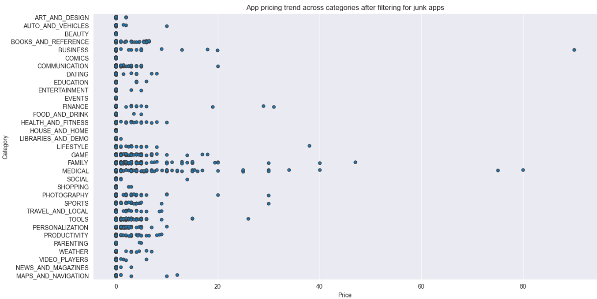
8. Filter out junk apps

Slide 17
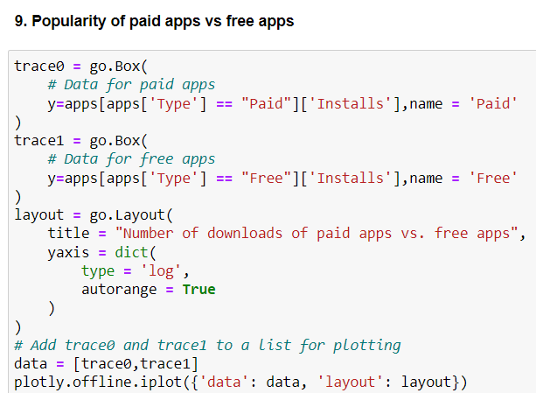
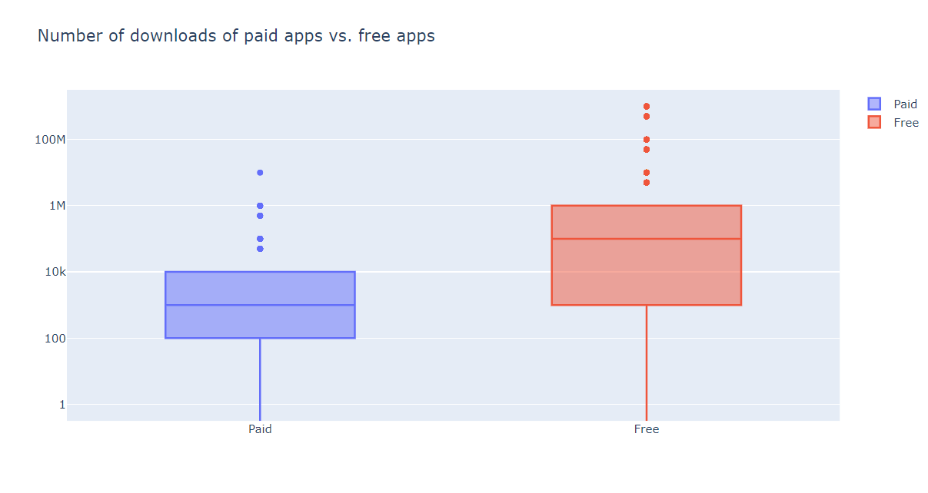
9. Popularity of paid apps vs free apps

Slide 18
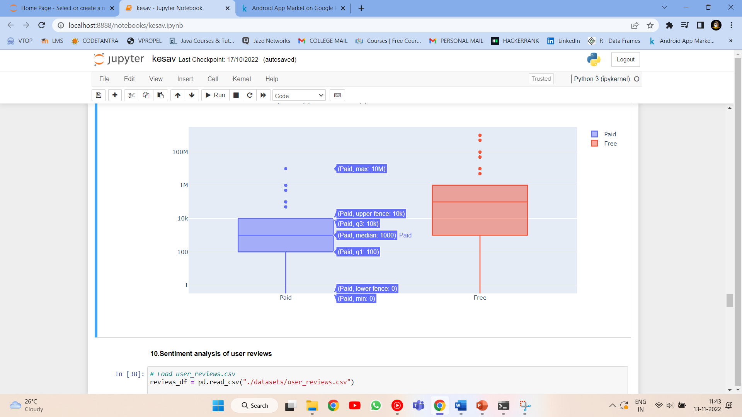
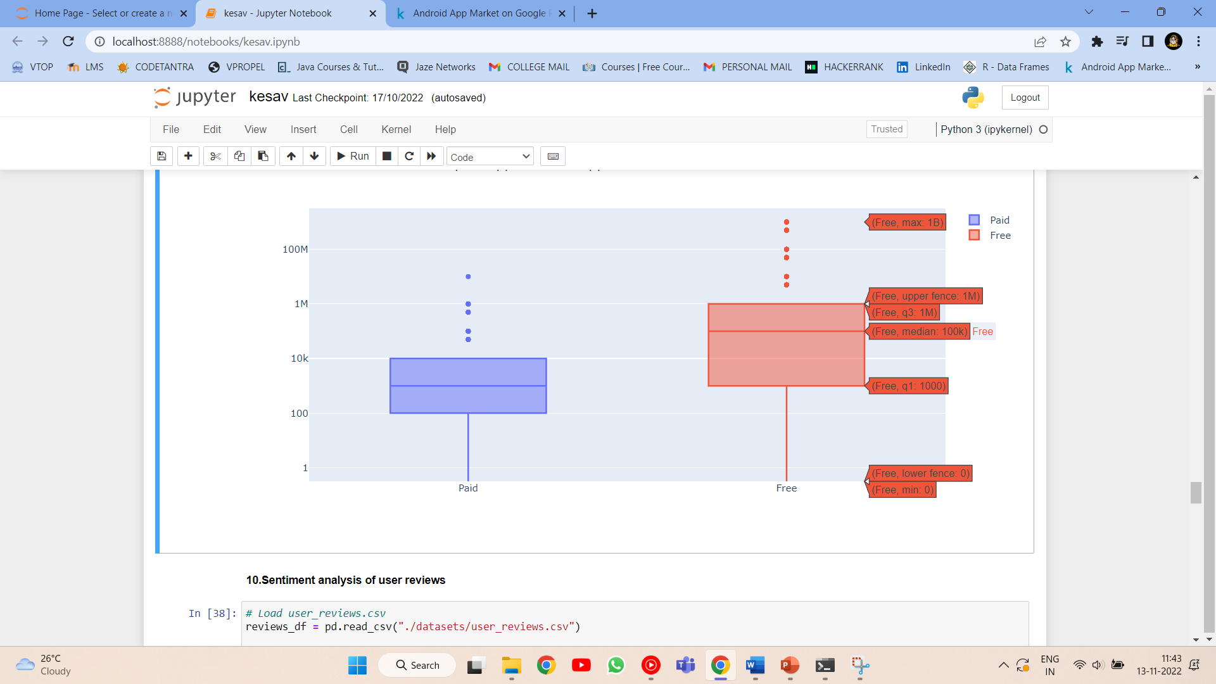
9. Popularity of paid apps vs free apps

Slide 19
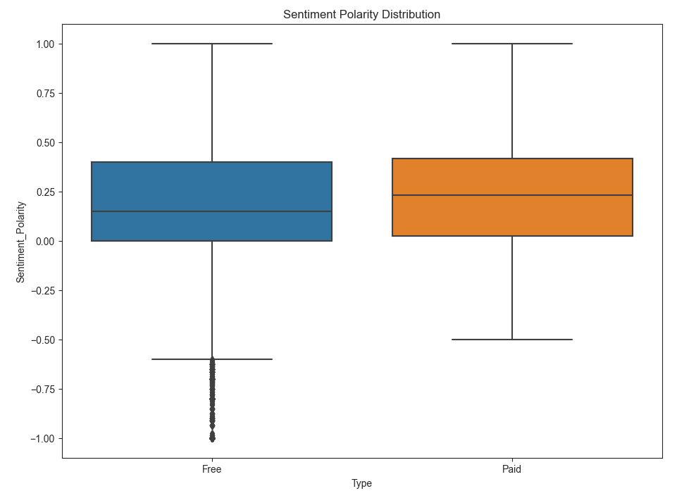
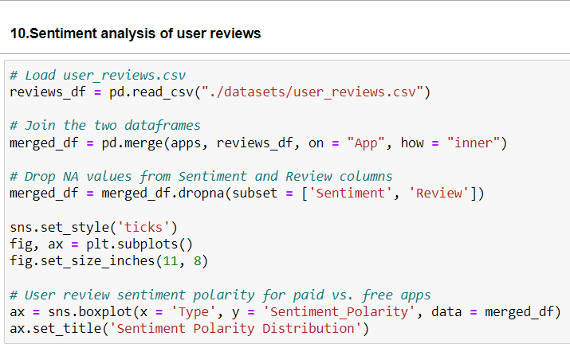
10. Sentiment analysis of user reviews

Slide 20
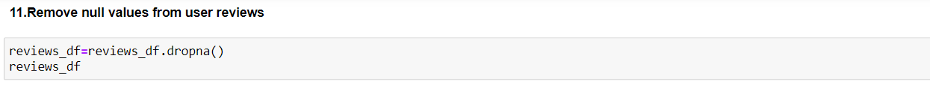
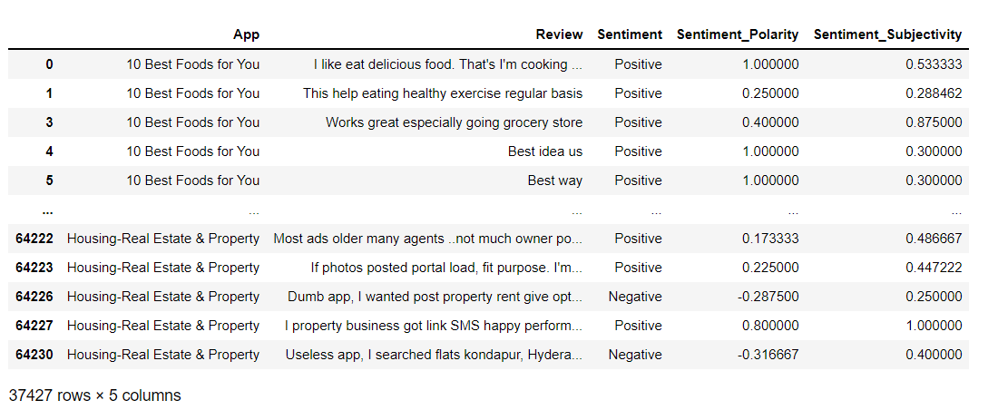
11. Remove null values from user reviews

Slide 21
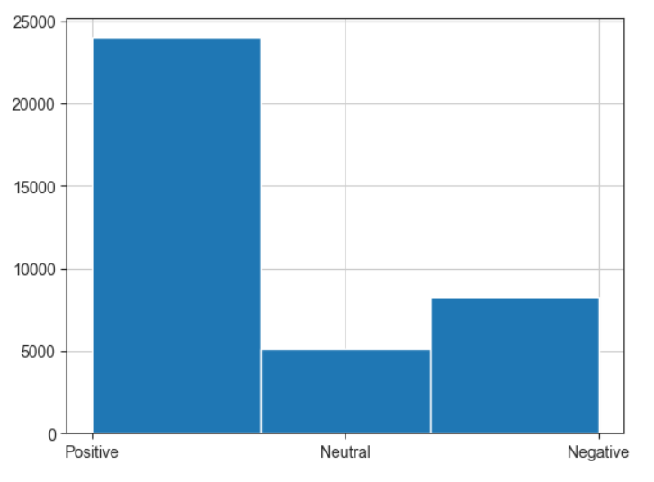
12. Draw histogram to understand user sentiment distribution

Slide 22
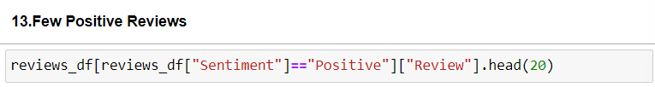
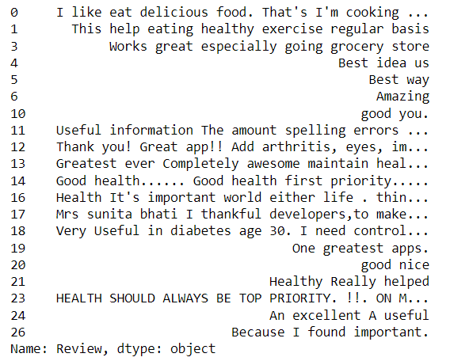
13. Few positive, neutral and negative reviews

Slide 23

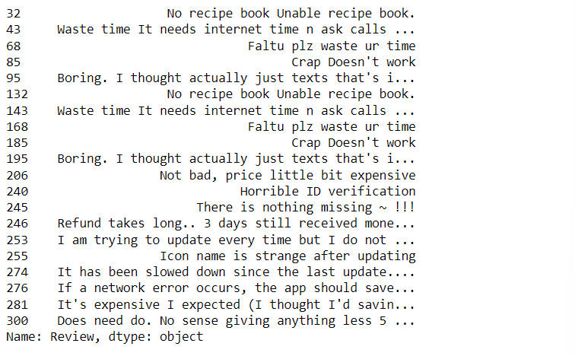
13. Few positive, neutral and negative reviews

Slide 24

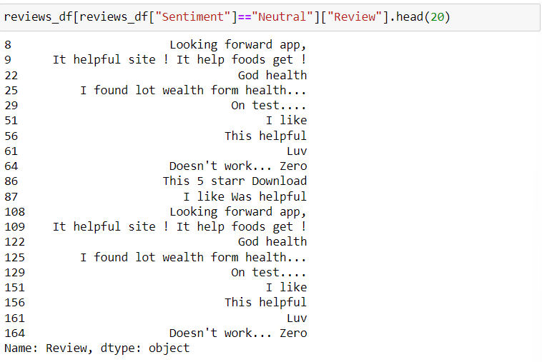
13. Few positive, neutral and negative reviews

Slide 25
MODEL DESIGN
Organized data and elements of our project

Slide 26
MODEL DESIGN
Distribution of App
Ratings
The distribution of the app ratings with number of users rated is plotted and using it the average rating an app recieves on playstore is found out. Using the analysis, it is found out that more people opt to vote more close to the average.The extremes ratings are very less rated.The number of people who have rated increases as we go more closer to the average.
Size and Price of an App
The distribution of app ratings are plotted with respect to the size of an app only which comes under category with more than 500 apps.The distribution of app ratings are also plotted with respect to the price of an app for paid apps.
Measures of rating for each category
The relation between the number of apps in the category and average rating of the category is to be found out using linear regression,Using the linear regression equation,the expected average rating is calculated and is verified with an existing app category with the same number of app ratings.
Relation between app category and app price
The app pricing trend across categories is to be plotted for each category.The lower limit for the price of the paid apps to be 200.Certain app categories to be selected to narrow down among many categories.

Slide 27
PERFORMANCE METRICS
Metric to judge our performance

Slide 28
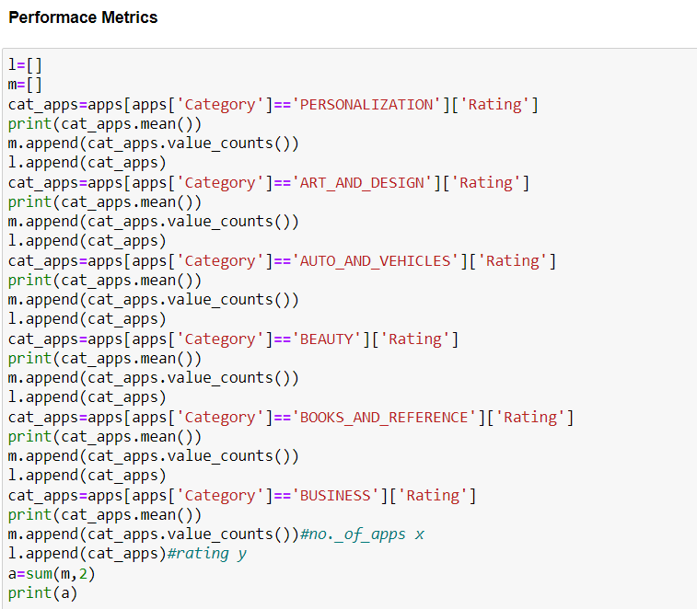
PERFORMANCE METRICS
The average rating is calculated for list of some categories and using linear regression between the number of apps in the category and the average rating, the rating is calculated and is checked with the actual average rating of that category.
So, accuracy could be found out using the equation,
accuracy = metrics.accuracy_score(y_test, preds) accuracy

Slide 29
CONCLUSION
In this project, we analysed the app features such as size, price, ratings, reviews and category of apps found on Play Store. Our project aimed at finding out the factors which result in finding out whether the app is good or bad. We studied about the distribution of app reviews into positive, negative and neutral that is sentimental analysis of user reviews. At first, we performed data cleaning. Then we compared the popularity of paid and free apps and found out that free apps are more downloaded than free apps. We plotted the variation of ratings with the size and price. The distribution of app ratings with number of apps with the particular rating is plotted using histogram. Number of apps in each category is plotted using histogram.

Slide 30
Objective:
The objective of our project is to analyze thousands of apps available on Google Play Store across various categories and analyze the reviews written by various users for all apps. Also find out the sentiment polarity of each review such as positive, negative or neutral.
Project Submission site:
We have submitted our project report and power point document in LMS moodle.
Contribution of work:
Kesav Santhosh: Completed the first half modules, review 1 report, review 1 PPT and final project report.
Parth Tiwari: Completed the second half modules and review 2 and review 3 PPTs.
Percentage Satisfaction of our work:
We got 92% satisfaction from our work as we were unable to completely perform sentimental analysis in our project. From our 13 modules we got predicted outcome for our 12 modules.
Publicity of our work:
We have published our work on GitHub and here it’s link-
Link: https://github.com/kesavsanthosh3/FDA-PROJECT/

Slide 31
THANK YOU

